Slide 1
Sprint 1 presentation
E-commerce Project
Presented By :- Dnyanesh Deore

Slide 2
Contents
1. Flow Diagram
2. Features
3. Tables

Slide 3
BACK END
FRONT END
Web Api
Angular App
Get
DB
Post
Introduction to Building ASP.Net Core and Angular Web Application
Introduction to Building ASP .Net Core and Angular Web Application

Slide 4
Connection
Create a Web Api in . Net
Create Database in Sql Server
Create web app in Angular
Feature
User can see the Home Page
User can register and login
User can see the Product in After Login
He can purchase the product through Login page
He Buy Click and then add the Card to the payment
Admin Section
Admin can login and Add Categories
Can see all orders placed by the customer and customer details
Admin can Add products

Slide 5
Tables
1. User Details Table
ID | UserName | Password | IsAdmin
1 | abhi@gmail.com | 12345 | Null
2
2. Product Details Table
Id | Product name | Product description | Cat ID | Product Image | Productmrp | Product final | Product quantity
1 | Mobile | Vivo | 1 |  | 1500 | 15000 | 2
3. Product Category Table
ID | CategoryName

Slide 6
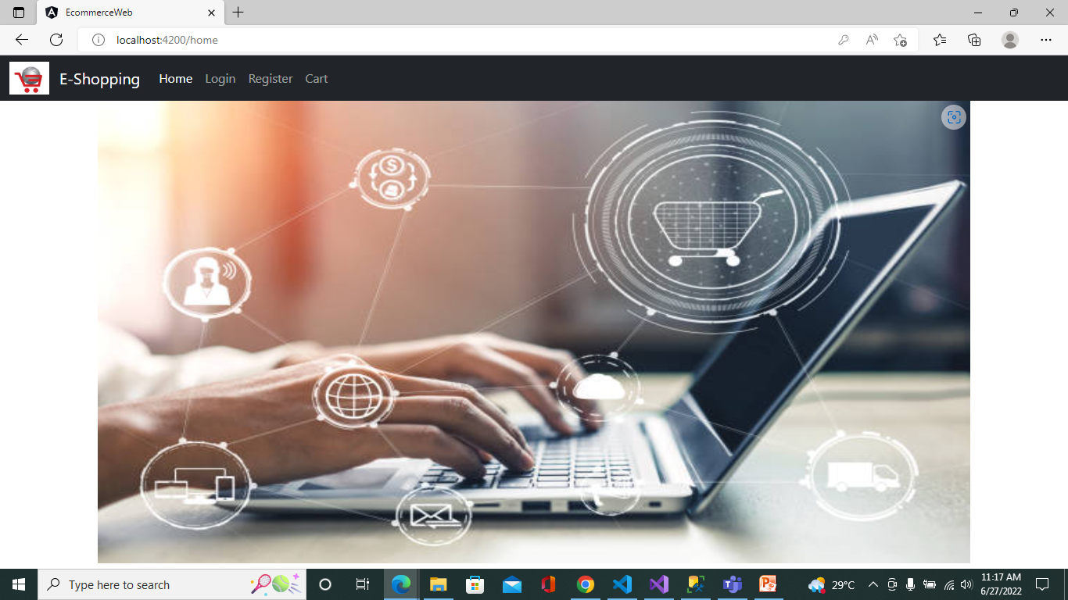

Slide 7
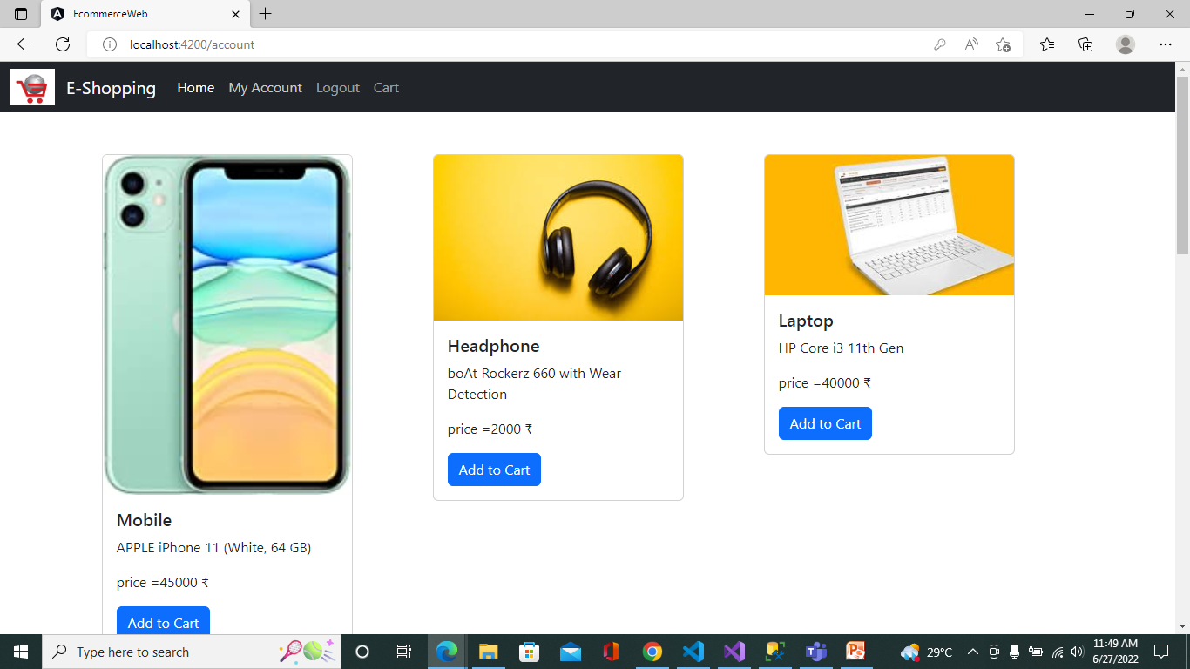

Slide 8
git repository
https://github.com/dnyaneshd1999/Ecommerce_project.git

Slide 9
Thank You

