Slide 1

Core Java Revision
Week-1

Slide 2
Prerequisite of Spring Boot
Java Fundamentals
Variables
Control Statements
Data Types
Type Casting
Methods
Etc.
Object Oriented Programming
Class and Object
Constructor
Overloading – CompileTime Polymorphism
Inheritance
Overriding - RunTime Polymorphism
Interfaces
Encapsulation

Slide 3
Prerequisite of Spring Boot
Packages
String Handling
Exception Handling
Collection Framework
List, Set, Map
Sorting Logics
Comparable and Comparator
Equality Logics
Annotations
Java 8 Features
Java Database Connectivity[JDBC]
Programming Skills
IDE Eclipse/IntelliJ/Netbeans

Slide 4
Core Java Revision -1
Object Oriented Programming
OOP is a programming paradigm that organizes code around "objects,”.
Here are some key concepts of OOP:
Objects: Instances of a class that represent real-world entities or concepts. Object can have properties(attributes) and behaviors(method).
Classes: Blueprints for creating objects. They define the properties (data) and behavior (methods) that objects of that class will have.
Encapsulation: Bundling data and methods together within an object, protecting data from unauthorized access.
Inheritance: Creating new classes (subclasses) that inherit properties and behaviors from existing classes (superclasses).
Polymorphism: The ability of objects of different classes to respond differently to the same message.

Slide 5
Core Java Revision -1
Object Oriented Programming
OOP is a programming paradigm that organizes code around "objects,”.
Here are some key concepts of OOP:
Objects: Instances of a class that represent real-world entities or concepts. Object can have properties(attributes) and behaviors(method).
Classes: Blueprints for creating objects. They define the properties (data) and behavior (methods) that objects of that class will have.
Encapsulation: Bundling data and methods together within an object, protecting data from unauthorized access.
Inheritance: Creating new classes (subclasses) that inherit properties and behaviors from existing classes (superclasses).
Polymorphism: The ability of objects of different classes to respond differently to the same message.

Slide 6
Core Java Revision -1
Constructor
The main purpose of a constructor is to initialize the object's state.
When you use new, memory is allocated for the object, and the constructor is invoked to perform any necessary setup for that object.
The constructor name must be identical to the class name.
No return type: Unlike methods, constructors don't have a return type (not even void).
Implicit call: Constructors are called implicitly when you use new. You don't explicitly call them like methods.
this keyword
Call current class constructor
Refer current invoking object(use to call object data member and methods)

Slide 7
Core Java Revision -1
Overloading
Constructor Overloading
Defining more than one constructor in same class is called constructor overloading.
Argument must be different.
Method Overloading
Defining more than one method with same name and different argument is called method overloading

Slide 8
Core Java Revision -1
Inheritance
Acquiring properties and methods of one class by another class.
A class (subclass) can inherit attributes and methods from another class (superclass or parent class).
Core Reusability
Maintainability
Overriding
When child class is not satisfied with parent methods then child class can redefine the method body .

Slide 9
Encapsulation
Binding a data member and member methods in single unit class name.

Slide 10
Abstraction
Showing Features and Hiding Implementations.
Abstract Classes and Interfaces are use to achieve abstraction in java.

Slide 11
Collection Framework
Group of object represented as Single Unit is a Collection.
java.util package provides all the classes and interfaces to work with group of objects(Collection)
Collection(Root Interface) is a interface that resent group of objects as single unit.
Collection Framework:
Interfaces and Its implementation
Algorithms

Slide 12
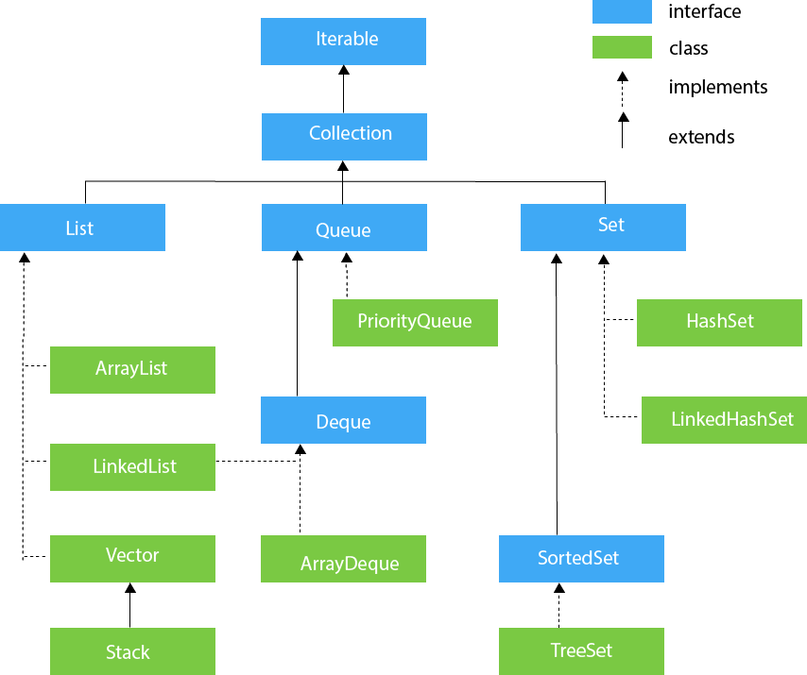
Collection Framework

Slide 13
Commonly used operation
Add element
Get element
Traverse Elements
Using Iterator
Using ListIterator
Using Enumeration
forEach
Copy elements for other collection

Slide 14
Sorting Logic
Comparable
Present in java.lang
Have to override compareTo method
Single sorting logic
Comparator
Present in java.io
Have to override compre method
Multiple sorting logic

Slide 15
Collection Map API
Map is used to represent collection of key value pair.

Slide 16
Common operations
Add key-value pair
Get value of key
Traverse the key-value pair
Remove key value
Getting only keys
How to get all the keyes

Slide 17
Important Java 8 Features

Slide 18
Lambda Expression
Lambda Expression
Short block of code which takes parameters and return value
Lambda is use to implement Functional Interface.
Syntax:
parameter -> expression
(parameter1, parameter2) -> expression
(parameter1, parameter2) -> { code block }
Parameters type : automatically refer
Return Type : refer
We can pass as parameter and we can return from any method.

Slide 19
Stream API
The Stream API offers a declarative way to process collections of elements.
It provides a chainable set of operations for filtering, mapping, and reducing data.
java.util.stream package provides all the important classes and methods for stream api
Create Stream: Stream Interface

Slide 20
Optional Class
The Optional class introduced in Java 8 is a powerful tool for handling null references more safely and effectively.

Slide 21
Stream Operations
filter(Predicate): Filters elements based on a condition.
map(Function): Transforms each element using a function.
flatMap(Function): Flattens a Stream of Streams into a single Stream.
sorted(): Sorts the elements in the Stream.
count(): Counts the number of elements in the Stream.
forEach(Consumer): Performs an action on each element.
collect(Collector): Collects the results of the Stream operations into a specific data structure.
reduce()

Slide 22
Method references static method ref not-static method ref constructor ref

