Slide 1
BIKE SHOWROOM
MANAGEMENT SYSTEM
Full-Stack Web Application
React.js • Node.js • Express • MongoDB
JWT Authentication • REST APIs • Nodemailer
Group Members:-
Shivam Thite
Aditya Patil
Dnyaneshwar Nakkawar
Project Guide:- Prof.RiteshKumar Sir
Project Presentation

Slide 2
1. Project Overview
Bike Showroom
What is the Bike Showroom System?
A full-stack web application for managing and presenting motorcycle showroom information online.
Provides customers with a modern interface to register, log in, browse bikes, and contact the showroom.
Provides authenticated management features for maintaining bike inventory.
Stores user and bike information persistently in MongoDB.
Customer Experience
Browse bikes, view details, and access showroom information.
Secure Access
Registration, login, JWT tokens and protected routes.
Inventory
Add, update and delete bike records through APIs.
2

Slide 3
2. Objectives
Project Goals
Main Objectives
Digital showroom
User authentication
Create an online platform to showcase available motorcycles.
Provide secure registration and login for users.
Inventory management
Protected operations
Maintain centralized bike records in MongoDB.
Restrict management actions to authenticated users.
Scalable design
Keep the architecture ready for future sales and dealership features.
3

Slide 4
3. Key Features
Functionalities
System Features
1
User registration and login
2
JWT-based authentication
3
Protected routes for authorized users
4
Bike listing and detail retrieval
5
Add, update and delete bike records
6
MongoDB inventory storage
7
Responsive React + Bootstrap UI
8
Welcome email during registration
9
Home and Contact pages
4

Slide 5
4. Technology Stack
Tools & Technologies
Technologies Used
Frontend
Backend
Database
React.js
React Router
Bootstrap + CSS
Node.js
Express.js
REST APIs
MongoDB
Mongoose ODM
Security
Email
Integration
JWT
bcryptjs
Protected routes
Nodemailer
Registration welcome email
CORS
Frontend ↔ Backend communication
5

Slide 6
5. System Architecture & Workflow
Application Flow
How the Application Works
User / Browser
React Frontend
Router + UI
Express Backend
REST APIs
MongoDB
Users + Bikes
1. User interacts with the React interface.
2. React sends requests to Express REST APIs.
3. Backend validates authentication and business rules.
4. Mongoose reads/writes user and bike data in MongoDB.
5. API response is returned to the frontend and displayed to the user.
6

Slide 7
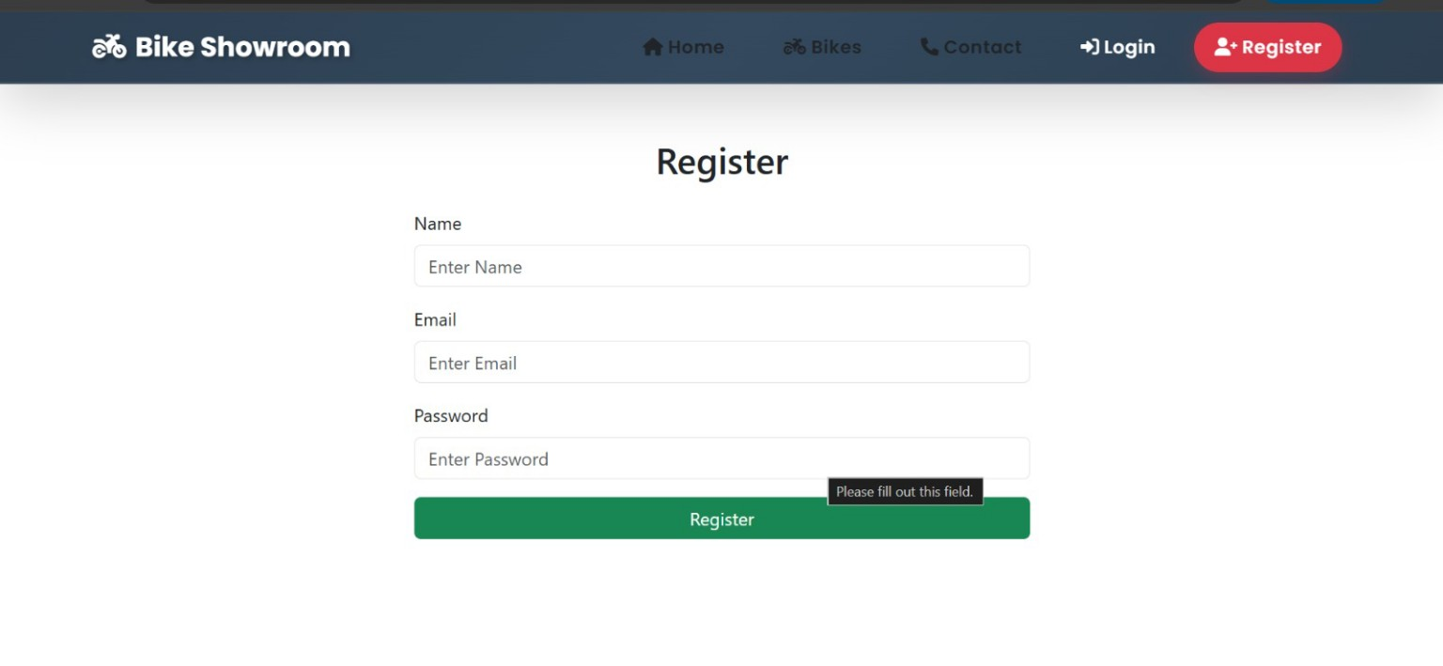
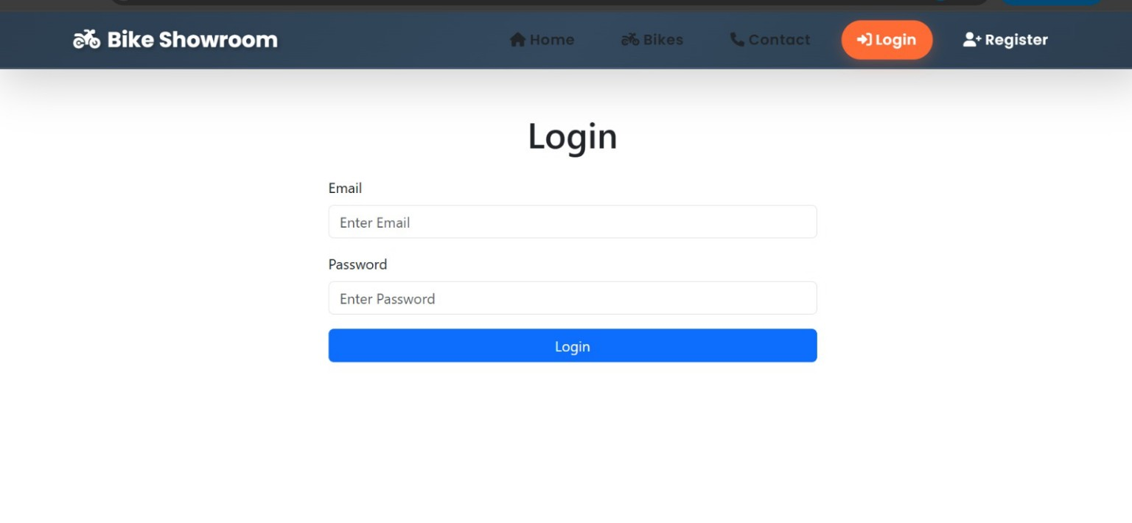
6. User Authentication
Registration & Login
Registration and Login
Registration page with name, email and password
Login page for existing users
7

Slide 8
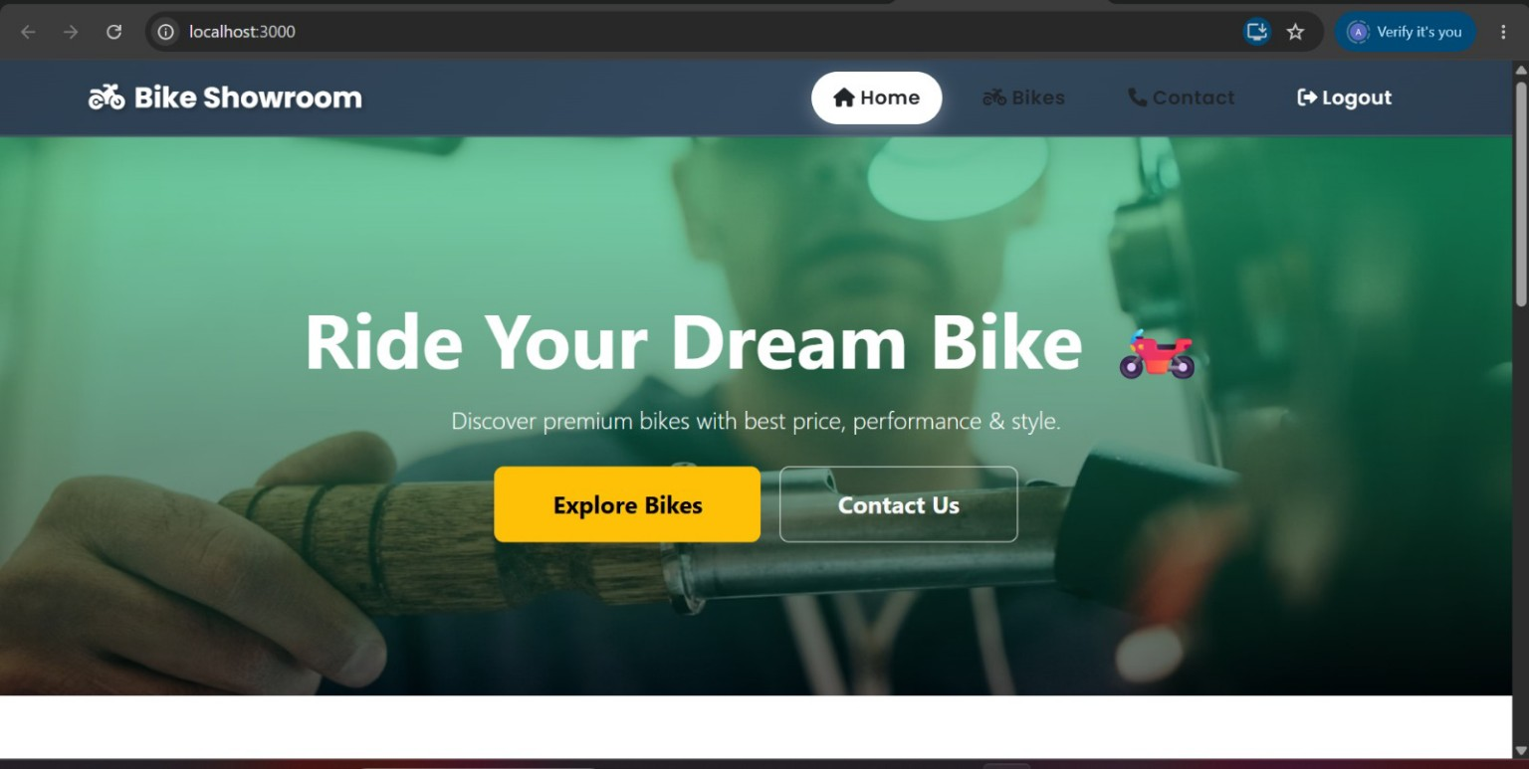
7. Home Page
User Interface
Home Page – Showroom Landing Screen
Hero section with Explore Bikes and Contact Us actions
8

Slide 9
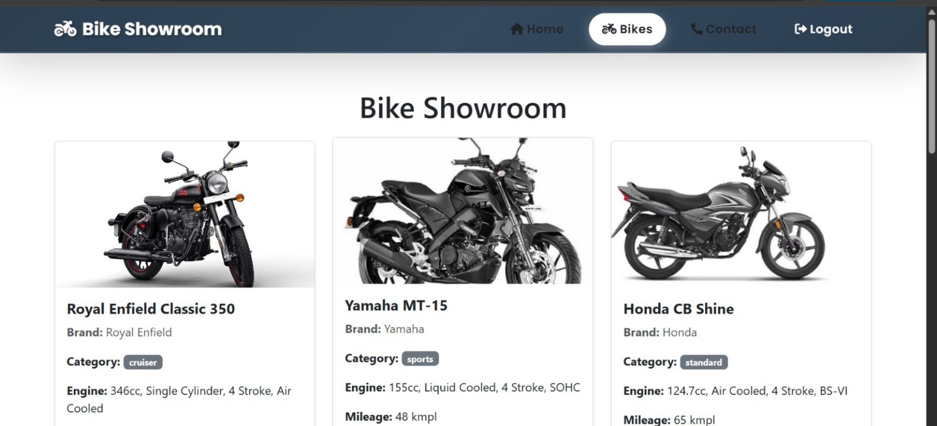
8. Bike Listing
Inventory Display
Bike Showroom – Inventory Listing
Bike cards display brand, category, engine and mileage information
9

Slide 10
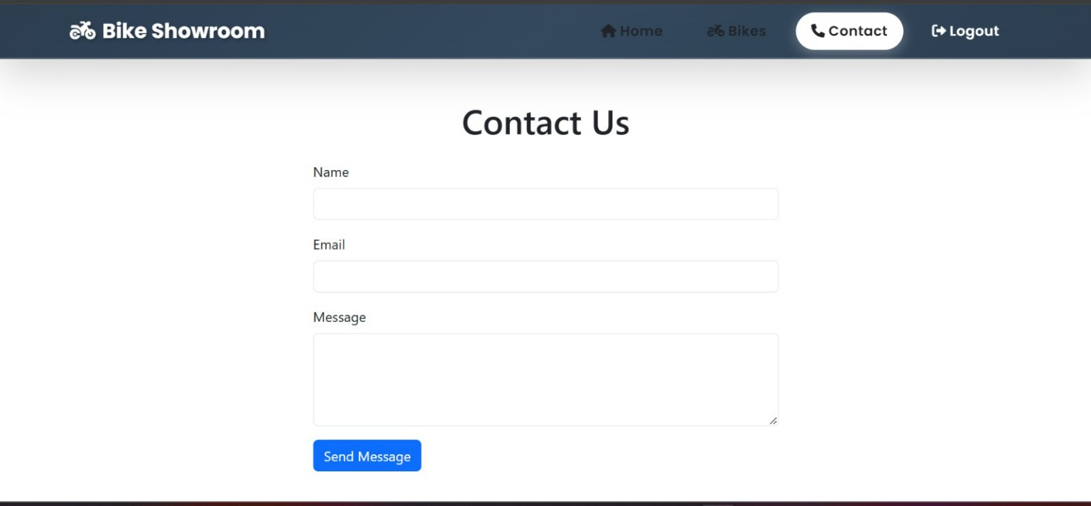
9. Contact Page
Customer Communication
Contact Us Page
Customer contact form with Name, Email and Message
10

Slide 11
10. Security & Data Management
Backend
Authentication, APIs and Database
JWT Authentication
Password Security
MongoDB + Mongoose
After successful login, the backend issues a token. Protected routes use the token to authorize access.
bcryptjs is used to hash passwords instead of storing them as plain text.
User and bike records are stored in MongoDB and accessed through Mongoose models.
REST API Operations
Email Integration
APIs support registration, login, bike retrieval and inventory operations such as add, update and delete.
Nodemailer can send a welcome email after successful registration.
11

Slide 12
11. Conclusion & Future Scope
Project Summary
Conclusion
The Bike Showroom Management System demonstrates a complete full-stack web application.
It combines a responsive React frontend with a Node.js/Express backend and MongoDB database.
Authentication and protected routes provide controlled access to management functions.
The project provides a strong base for expanding into a complete online bike dealership platform.
Future Enhancements
• Online bike booking / test-drive requests
• Search, filter and sorting
• Admin dashboard and sales reports
• Payment gateway integration
• Customer reviews and notifications
Thank You
12

