Slide 1
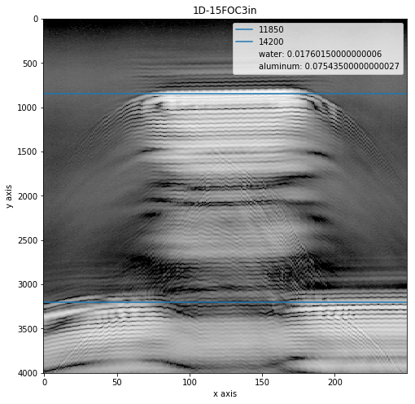
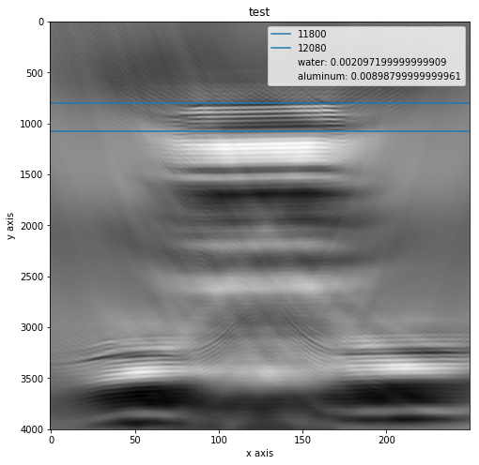
1.5 Focused Transducer, 3 in depth

Slide 2
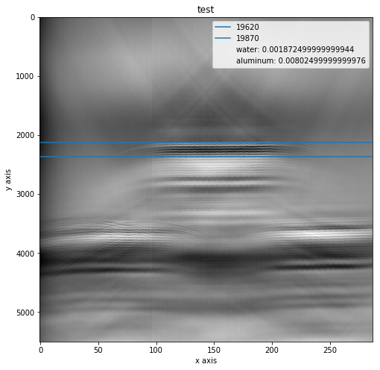
1.5 Focused Transducer, 5 in depth

Slide 3
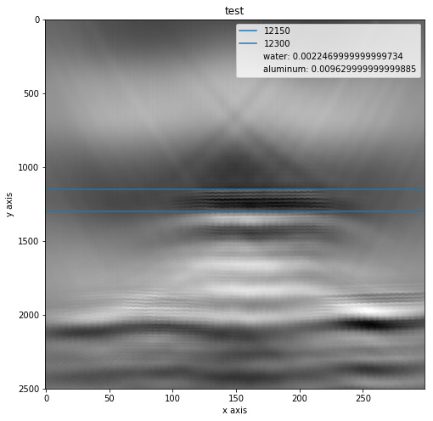
1.5 Focused Transducer, 7 in depth

