Slide 1
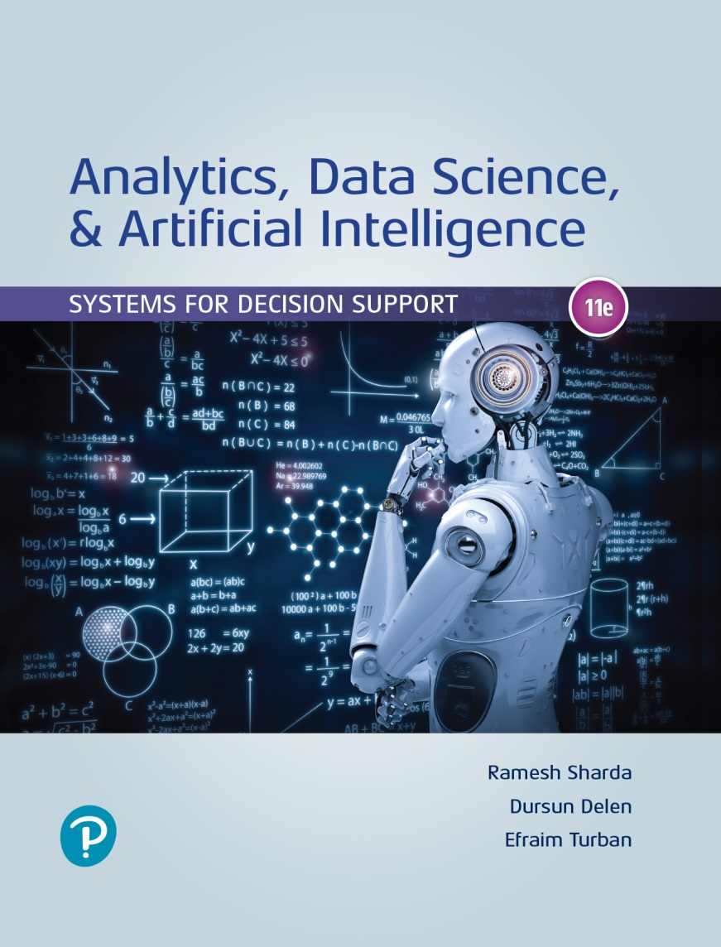
Analytics, Data Science and A I: Systems for Decision Support
Eleventh Edition
Chapter 2
Artificial Intelligence Concepts, Drivers, Major Technologies, and Business Applications
Slide in this Presentation Contain Hyperlinks. JAWS users should be able to get a list of links by using INSERT+F7
Copyright © 2020, 2015, 2011 Pearson Education, Inc. All Rights Reserved
Notes:
If this PowerPoint presentation contains mathematical equations, you may need to check that your computer has the following installed:
1) Math Type Plugin
2) Math Player (free versions available)
3) NVDA Reader (free versions available)

Slide 2
Learning Objectives (1 of 2)
2.1 Understand the concepts of artificial intelligence (A I).
2.2 Become familiar with the drivers, capabilities, and benefits of A I.
2.3 Describe human and machine intelligence.
2.4 Describe the major A I technologies and some derivatives.
2.5 Discuss the manner in which A I supports decision making.
Notes:
Slide 2 is list of textbook LO numbers and statements

Slide 3
Learning Objectives (2 of 2)
2.6 Describe A I applications in accounting.
2.7 Describe A I applications in banking and financial services.
2.8 Describe A I in human resource management.
2.9 Describe A I in marketing.
2.10 Describe A I in production-operation management.
Notes:
Slide 2 is a list of textbook LO numbers and statements

Slide 4
Opening Vignette (1 of 3)
I N R I X Solves Transportation Problems
http://www.inrix.com
The problem…
The solution…
The results…

Slide 5
Opening Vignette (2 of 3)
I N R I X Solves Transportation Problems
Questions for the Opening Vignette:
Explain why traffic may be down while congestion is up (see the London case at inrix.com/uk-highways-agency/).
How does this case relate to decision support?
Identify the A I elements in this system.
Identify developments related to A I by viewing the company’s press releases from the most recent four months at inrix.com/press-releases. Write a report.

Slide 6
Opening Vignette (3 of 3)
I N R I X Solves Transportation Problems
Questions for the opening vignette (cont.):
According to Gitlin (2016), I N R I X’s new mobile traffic app is a threat to Waze. Explain why.
Go to sitezeus.com/data/inrix and describe the relationship between I N R I X and Zeus. View the 2:07 min. video at sitezeus.com/data/inrix/. Why is the system in the video called a “decision helper”?

Slide 7
Introduction to Artificial Intelligence
Definitions for artificial intelligence (A I)
Many definitions of A I
Relationship between A I and logic
plato.stanford.edu/entries/logic-ai
Major characteristics of A I machines
Smarter computers/machines
Major elements of A I …

Slide 8
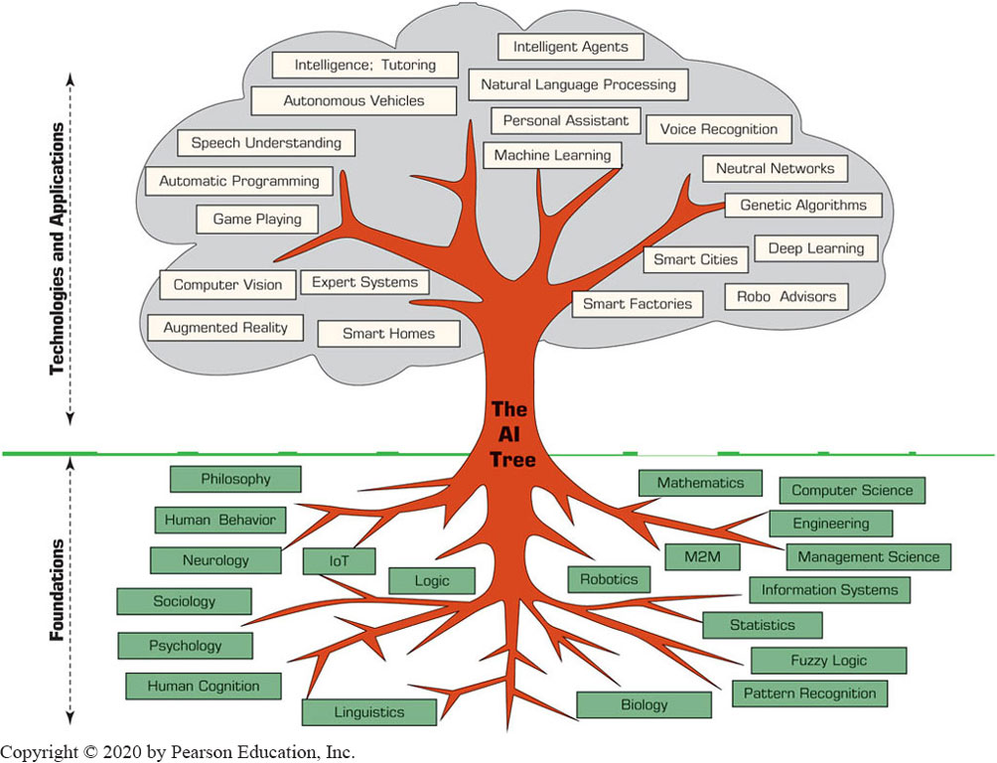
The Functionalities and Applications of A I

Slide 9
Artificial Intelligence (A I) (1 of 8)
Many application of A I exists
Example: Pitney Bowes Is Getting Smarter with A I
Major goals of A I
Perceive and properly react to changes in the environment that influence specific business processes and operations.
Introduce creativity in business processes and decision making.

Slide 10
Artificial Intelligence (A I) (2 of 8)
Drivers of A I
Interest in smart machines and artificial brains
The low cost of A I applications
The desire of large tech companies
The pressure on management to increase productivity
The availability of quality data
The increasing functionalities and reduced cost of computers in general
The development of new information technologies, particularly the cloud computing

Slide 11
Artificial Intelligence (A I) (3 of 8)
Benefits of A I
A I has the ability to complete certain tasks much faster
The consistency of the work
A I machines do not make arbitrary mistakes
A I systems allow for continuous improvement projects
A I can be used for predictive analysis via its capability of pattern recognition
A I can manage delays and blockages in business processes
A I machines do not stop to rest or sleep
Many more…

Slide 12
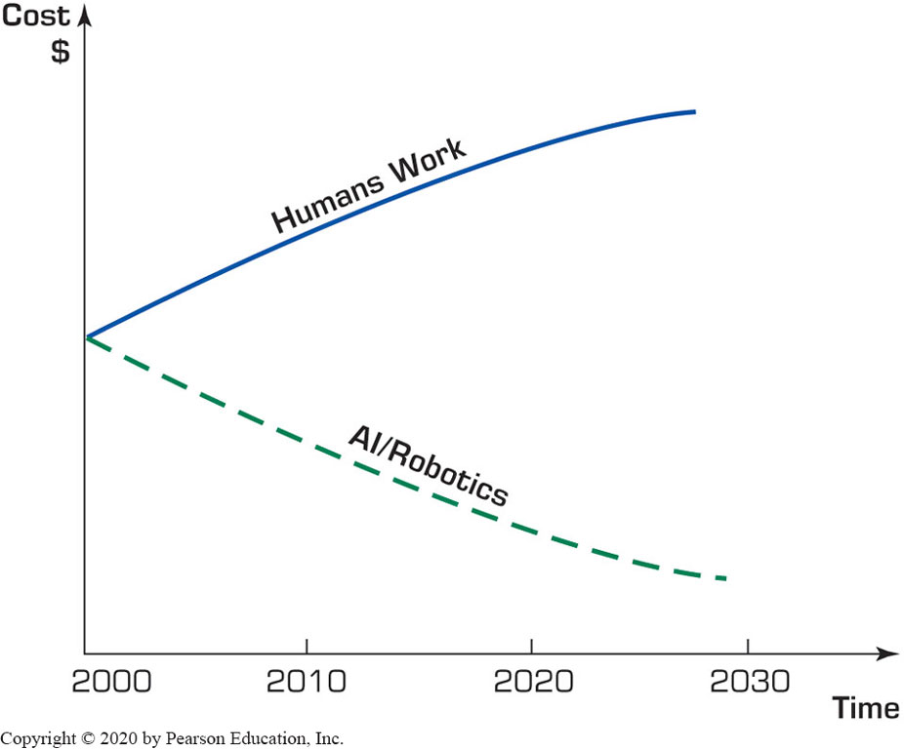
Artificial Intelligence (A I) (4 of 8)
Figure 2.2 Cost of Human Work versus the Cost of A I Work.

Slide 13
Artificial Intelligence (A I) (5 of 8)
Examples of A I Benefits
I S D A uses A I to eliminate tedious activities
A I revolutionizing business recruitment
A I is redefining management
Help blind people experience the world around them
Identify overlooked borrowers
Predict customer expectation
Startup A I companies are emerging in large numbers
Most impactful: customer experience and enjoyment.

Slide 14
Artificial Intelligence (A I) (6 of 8)
Some limitations of A I Machines
Lack human touch and feel
Lack attention to non-task surroundings
Can lead people to rely on A I machines too much
Can be programmed to create destruction
Can cause many people to lose their jobs
Can start to think by themselves, causing significant damage
Hypothetically … no evidence of that!
These limitations are diminishing over time

Slide 15
Artificial Intelligence (A I) (7 of 8)
What A I can and cannot do?
Three flavors of A I decisions
Assisted intelligence
Autonomous intelligence
Augmented intelligence
Artificial brain
A people made machine “as intelligent, creative, and self-aware as humans”
To date, no one has created such a machine

Slide 16
Artificial Intelligence (A I) (8 of 8)
Technology Insight – Augmented Intelligence
Combining the performance of people and machines [combining ≈ augmenting]
Augmented machines extend human abilities
Examples
Cybercrime fighting
E-commerce decisions
High-frequency stock market trading

Slide 17
Human and Computer Intelligence (1 of 4)
What is intelligence?
Types of intelligence:
Linguistic and verbal, logical, spatial, body/movement, musical, interpersonal, intrapersonal, naturalist
Intelligence is not a simple concept!
Content of intelligence
Reasoning, learning, logic, problem-solving, perception, and linguistic ability

Slide 18
Human and Computer Intelligence (2 of 4)
Capabilities of intelligence
Learning or understanding from experience
Making sense out of ambiguous, incomplete, or even contradictory messages and information
Responding quickly and successfully to a new situation (i.e., using the most correct responses)
Understanding and inferring in a rational way, solving problems, and directing conduct effectively
Applying knowledge to manipulate environments
Recognizing and judging the relative importance of different elements in a situation

Slide 19
Human and Computer Intelligence (3 of 4)
How intelligent is A I?
Comparing human intelligence with A I
Table 2.1 Artificial Intelligence versus Human Intelligence.
Area | AI | Human
Execution | Very fast | Can be slow
Emotions | Not yet | Can be positive or negative
Computation speed | Very fast | Slow, may have trouble
Imagination | Only what is programmed for | Can expand existing knowledge
Answers to questions | What is in the program | Can be innovative
Flexibility | Rigid | Large, flexible
Many more, in the book…

Slide 20
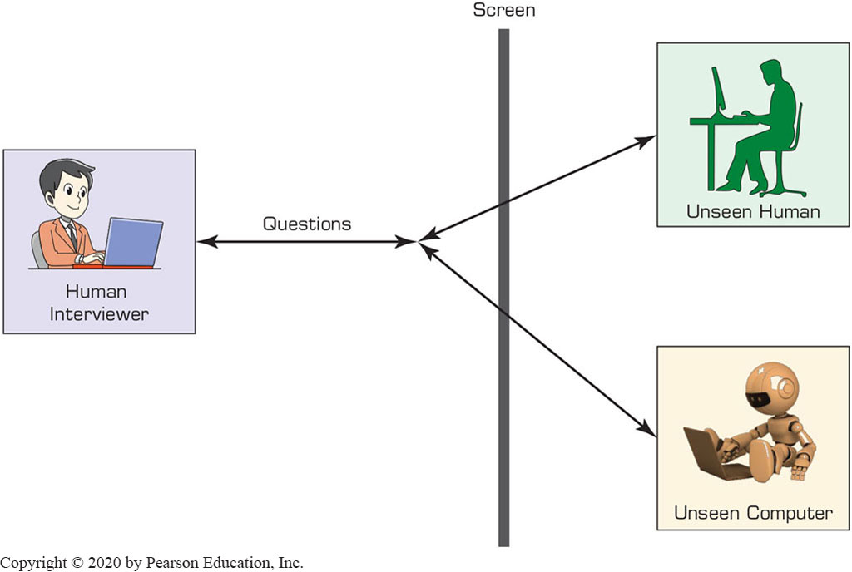
Human and Computer Intelligence (4 of 4)
Measuring A I: The Turing Test

Slide 21
Application Case 2.1
How Smart Can a Vacuum Cleaner Be?
Questions for Discussion:
How did the Korean researchers determine the performance of the vacuum cleaners?
If you own (or have seen) the Roomba, how intelligent do you think it is?
What capability can be generated by the deep learning feature? (You need to do some research.)
Find recent information about L G’s Roboking. Specifically, what are the newest improvements to the product?

Slide 22
Major A I Technologies & Drivers (1 of 3)
Intelligent agents
Intelligent? Autonomous? Mobile? …
Machine learning
“Human learning embedded into machines”
Deep learning
A part of machine learning (see Chapter 6)
Computer vision (machine vision)
Video analytics

Slide 23
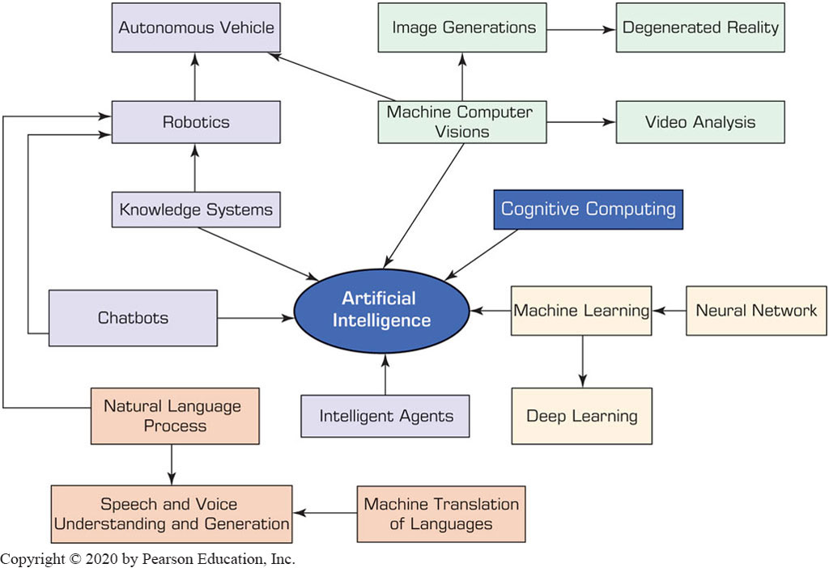
Major A I Technologies

Slide 24
Application Case 2.2
How Machine Learning Is Improving Work in Business
Questions for Discussion:
Discuss the benefits of combining machine learning with other A I technologies.
How can machine learning improve marketing?
Discuss the opportunities of improving human resource management.
Discuss the benefits for customer service.

Slide 25
Major A I Technologies & Drivers (2 of 3)
Robotic systems
Industrial robots [for manufacturing]
Service robots
Example: Walmart is using robots to properly stock shelves
Use of robots (or bots) in eComemrce
Many are being used at Amazon.com
Online shopping robots (shopbots)
SoftBank – a cellphone store in Tokyo entirely staffed by robots

Slide 26
Major A I Technologies & Drivers (3 of 3)
Natural language processing
Natural language understanding
Natural language generation
Speech (voice) understanding
An interesting application cs.cmu.edu/~./listen
Machine translation of human languages
Balel fish (babelfish.com)
Google translator (translate.google.com)
Example: Sogou’s travel translator

Slide 27
Knowledge and Expert Systems (1 of 2)
Knowledge sourced intelligent systems
Knowledge acquisition
Identifying experts
Knowledge representation
Reasoning from knowledge
Chatbots
Emerging A I technologies
Effective computing
Biometric analysis

Slide 28
Knowledge and Expert Systems (2 of 2)
Cognitive computing
Knowledge derived from cognitive science
Self learning algorithms
I B M Watson
More on this is covered in Chapter 6
Augmented reality
Augmentation: integration of digital information within the user environment in real time
Real + virtual combined
Virtual reality

Slide 29
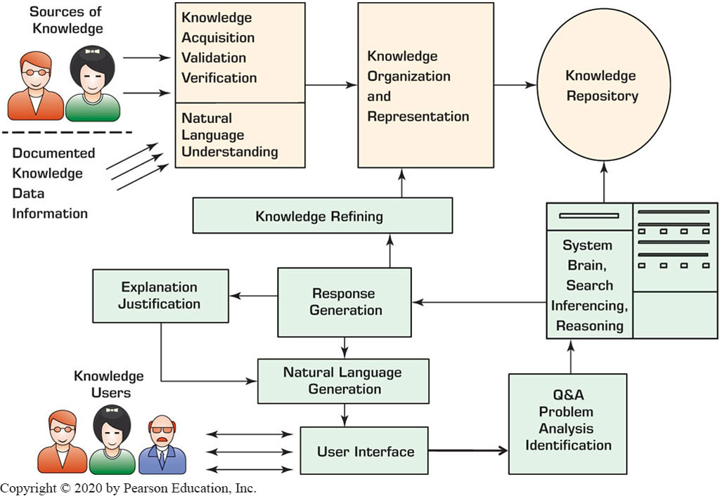
Automated Decision Making Process

Slide 30
A I Support for Decision Making
Jeff Bezos, the C E O of Amazon.com, said in May 2017 that A I is in a golden age …
A I can …
Solve complex problems that people have not been able to solve.
Make much faster decisions.
Find relevant information, even in large data sources, very fast.
Make complex calculations rapidly.
Conduct complex comparisons and evaluations in real time.
Watch “A I Will Be Making Decisions for You” at https://www.youtube.com/watch?v=Dr9jeRy9whQ

Slide 31
Using A I in Decision Making
Issues & factors:
The nature of the decision [routine vs non-routine]
The method of support / technologies used
Expert systems, recommender systems
Deep learning, pattern recognition, biometrics recognition
Cos-benefit and risk analysis
Using business rules
A I algorithms
Speed

Slide 32
A I Support for Decision-Making Process
As it relates to Simon’s decision making process (see Chapter 1 for the background information)
A I support in problem identification
A I support in generating or finding alternative solutions
A I support in selecting a solution
A I support in implementing the solution
A I can (and should) play a role in each and every step in the decision making process

Slide 33
Application Case 2.3
How Companies Solve Real-World Problems Using Google’s Machine-Learning Tools
Questions for Discussion:
Why use machine learning for predictions?
Why use machine learning for detections?
What specific decisions were supported in the five cases?

Slide 34
Intelligent & Automated Decision Support
Automated decision making (since 1970s)
Common examples:
Small loan approvals
Initial screening of job applicants
Simple restocking
Prices of products and services (when and how to change them)
Product recommendation (e.g., at Amazon.com)
Example: Supporting Nurses Diagnosis Decisions
An experiment conducted in a Taiwanese hospital (in 2015)
87% agreement between A I and human experts

Slide 35
Technology Insight 2.2
Schrage’s Models for Using A I to Make Decisions
The autonomous advisor
The autonomous outsource
People-machine collaboration
Complete machine autonomy
Implementing these four models require appropriate management leadership and collaboration with data scientists.

Slide 36
A I Applications in Accounting
A I in big accounting firms (see application case 2.4)
A I in small accounting firms
Solve complex billing problems (especially in healthcare)
Claim processing and reimbursement
Real estate contracts, risk analysis …
A I provides cheaper and better data-driven support
Generates needed insights from data analysis
Frees time of accountants for more complex tasks
Machine learning is often used for prediction
A I will improve and automate accounting tasks but at the same time will take away some accounting jobs.

Slide 37
Application Case 2.4
How E Y, Deloitte, and P w C Are Using A I
Questions for Discussion:
What are the characteristics of the tasks for which A I is used?
Why do the big accounting firms use different implementation strategies?

Slide 38
A I Applications in Financial Services (1 of 2)
Diverse use of A I, in banking and insurance.
Examples of A I use in general financial services:
Extreme personalization (e.g., chatbots, personal assistants, etc.)
Shifting customer behavior both online and in branches
Facilitating trust in digital identity, revolutionizing payments
Sharing economic activities (e.g., person-to-person loans)
Offering financial services 24/7 and globally
Banking can also uses A I for …
Face recognition (safer online banking), help customer with smart investment decisions, prevent money laundering, …
Insurance – mostly in issuing policies and handling claims

Slide 39
A I Applications in Financial Services (2 of 2)
Application of A I uses in Banking
Employee surveillance (A I machines, e.g., I B M Watson).
Tax preparation/filing (H&R block uses I B M Watson).
Automated customer service; answering customer inquiries in real-time.
See Rainbird Co. ar rainbirf.ai as a company that provides such services (using I B M Watson).
Automated online support for paying bills and account inquiries using Amazon Alexa (e.g., Capital One).
Fraud detection and anti–money-laundering activities; also improving customer experience (Bank Danamon).
Victual banking assistant, Olivia at H S B C, learn from experience and helps customer better.

Slide 40
Application Case 2.5
U S Bank Customer Recognition and Services
Questions for Discussion:
What are Einstein’s advantages to U S Bank?
What are its advantages to customers?
What are the benefits of voice communication?

Slide 41
A I in Human Resource Management (1 of 2)
Recruitment – talent acquisition
See Application Case 2.6 for an example
Training – A I facilitates training
Performance assessment (evaluation)
Retention –eliminating attrition
Predicting attrition way ahead of time to eliminate loss of talent
Using chatbots for supporting H R M
See olivia.paradox.ai.

Slide 42
A I in Human Resource Management (2 of 2)
Introducing A I to H R M operations:
Experiment with a variety of chatbots
Develop a team approach involving other functional areas
Properly plan a technology roadmap for both the short and long term, including shared vision with other functional areas
Identify new job roles and modifications in existing job roles in the transformed environment
Train and educate the H R M team to understand A I and gain expertise in it.

Slide 43
Application Case 2.6
How Alexander Mann Solutions (A M S) Is Using A I to Support the Recruiting Process
Questions for Discussion:
What types of decisions are supported?
Comment on the human–machine collaboration.
What are the benefits to recruiters? To applicants?
Which tasks in the recruiting process are fully automated?
What are the benefits of such automation?

Slide 44
A I in Marketing, Advertising, & C R M (1 of 2)
One of the richest area for A I applications:
Product and personal recommendations
Smart search engines
Fraud and data breaches detection
Social semantics
Web site design
Producer pricing
Predictive customer service
… many more in the book …

Slide 45
A I in Marketing, Advertising, & C R M (2 of 2)
Improving customer experience and C R M
Use N L P for generating user documentation. This capability also improves the customer–machine dialogue.
Use visual categorization to organize images (for example, see I B M’s Visual Recognition and Clarifai)
Provide personalized and segmented services by analyzing customer data. This includes
A I in C R M Example: Salesforce’s A I Einstein

Slide 46
Application Case 2.7
Kraft Foods Uses A I for Marketing and C R M
Questions for Discussion:
Identify all A I technologies used in the Food Assistant.
List the benefits to the customers.
List the benefits to Kraft Foods.
How is advertising done?
What role is “behavioral pattern recognition” playing?
Compare Kraft’s Food Assistant to Amazon.com and Netflix recommendation systems.

Slide 47
A I in Production-Operation Management
A I in manufacturing
Automation for compliance and cost reduction
React quicker and more effectively (agility)
Implementation model
Streamlining processes, smart outsourcing, work automation, improving customer experience
Intelligent factories
Logistic and transportation
Example: D H L supply-chain

Slide 48

Copyright
This work is protected by United States copyright laws and is provided solely for the use of instructors in teaching their courses and assessing student learning. Dissemination or sale of any part of this work (including on the World Wide Web) will destroy the integrity of the work and is not permitted. The work and materials from it should never be made available to students except by instructors using the accompanying text in their classes. All recipients of this work are expected to abide by these restrictions and to honor the intended pedagogical purposes and the needs of other instructors who rely on these materials.

