Slide 1

Analytics, Data Science and A I: Systems for Decision Support
Eleventh Edition
Chapter 5
Machine-Learning Techniques for Predictive Analytics
Slide in this Presentation Contain Hyperlinks. JAWS users should be able to get a list of links by using INSERT+F77
Copyright © 2020, 2015, 2011 Pearson Education, Inc. All Rights Reserved
Notes:
If this PowerPoint presentation contains mathematical equations, you may need to check that your computer has the following installed:
1) Math Type Plugin
2) Math Player (free versions available)
3) NVDA Reader (free versions available)

Slide 2
Learning Objectives (1 of 2)
5.1 Understand the basic concepts and definitions of artificial neural networks (A N N)
5.2 Learn the different types of A N N architectures
5.3 Understand the concept and structure of support vector machines (S V M)
5.4 Learn the advantages and disadvantages of S V M compared to A N N
5.5 Understand the concept and formulation of k-nearest neighbor (k N N) algorithm
Notes:
Slide 2 is list of textbook LO numbers and statements

Slide 3
Learning Objectives (2 of 2)
5.6 Learn the advantages and disadvantages of k N N compared to A N N and S V M
5.7 Understand the basic principles of Bayesian learning and Naïve Bayes algorithm
5.8 Learn the basics of Bayesian Belief Networks and how they are used in predictive analytics
5.9 Understand different types of ensemble models and their pros and cons in predictive analytics
Notes:
Slide 2 is list of textbook LO numbers and statements

Slide 4
Opening Vignette (1 of 4)
Predictive Modeling Helps Better Understand and Manage Complex Medical Procedures
Situation
Problem
Solution
Results
Answer & discuss the case questions.

Slide 5
Opening Vignette (2 of 4)
Discussion Questions for the Opening Vignette:
Why is it important to study medical procedures? What is the value in predicting outcomes?
What factors do you think are the most important in better understanding and managing healthcare?
What would be the impact of predictive modeling on healthcare and medicine? Can predictive modeling replace medical or managerial personnel?
What were the outcomes of the study? Who can use these results? How can they be implemented?
Search the Internet to locate two additional cases in managing complex medical procedures.

Slide 6
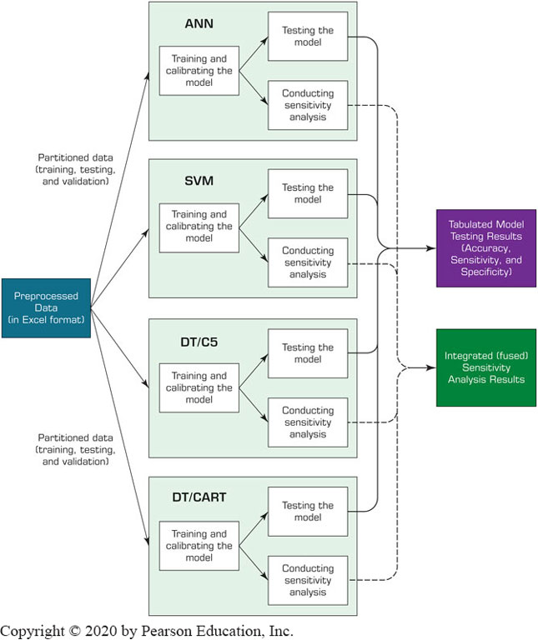
Opening Vignette (3 of 4)
A Process Map for Training and Testing Four Predictive Models

Slide 7
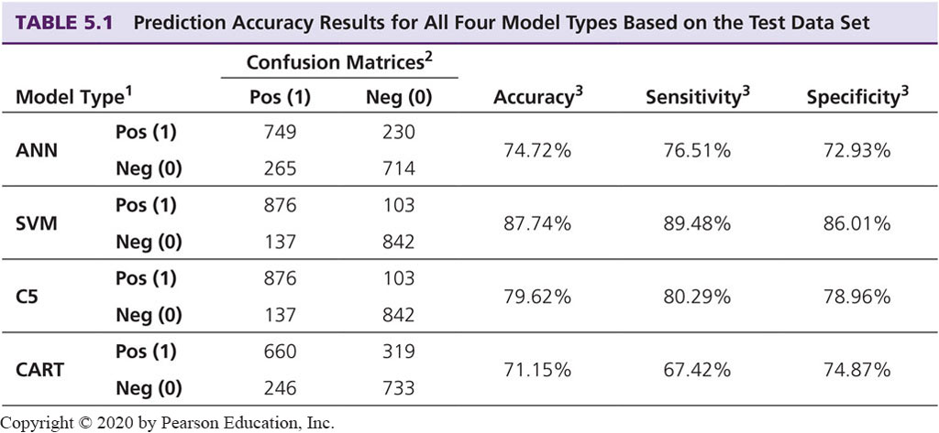
Opening Vignette (4 of 4)
The Comparison of the Four Models
¹Acronyms for model types: artificial neural networks (A N N), support vector machines (S V M), popular decision tree algorithm (C5), classification and regression trees (C A R T).
²Prediction results for the test data samples are shown in a confusion matrix where the rows represent the actuals and columns represent the predicted cases.
³Accuracy, sensitivity, and specificity are the three performance measures that were used in comparing the four prediction models.

Slide 8
Neural Network Concepts
Neural networks (N N): a human brain metaphor for information processing
Neural computing
Artificial neural network (A N N)
Many uses for A N N for
pattern recognition, forecasting, prediction, and classification
Many application areas
finance, marketing, manufacturing, operations, information systems, and so on

Slide 9
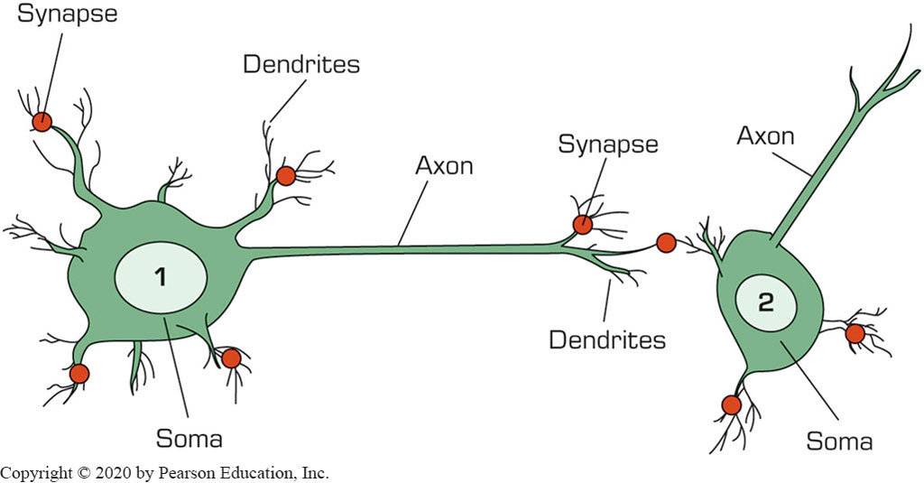
Biological Neural Networks
Two interconnected brain cells (neurons)

Slide 10
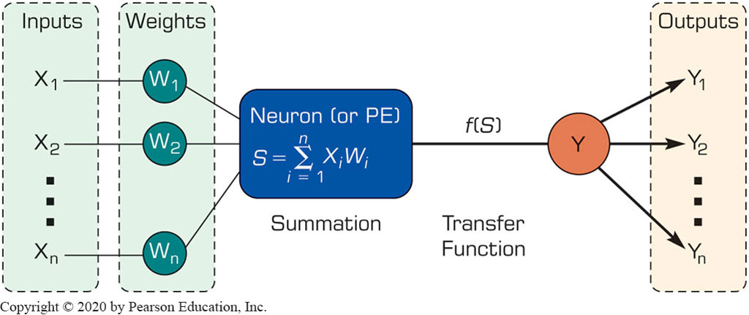
Processing Information in A N N
A single neuron (processing element – P E) with inputs and outputs

Slide 11
Biology Analogy
Biological | Artificial
Soma | Node
Dendrites | Input
Axon | Output
Synapse | Weight
Slow | Fast
Many neurons (10⁹) | Few neurons (a dozen to hundreds of thousands)

Slide 12
Elements of A N N
Processing element (P E)
Network architecture
Hidden layers
Parallel processing
Network information processing
Inputs
Outputs
Connection weights
Summation function

Slide 13
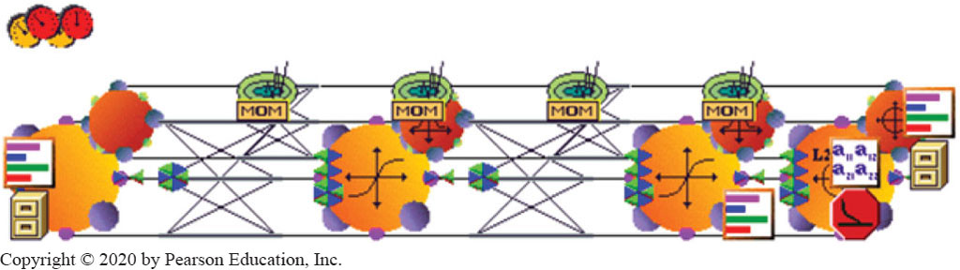
Application Case 5.1
Neural Networks Are Helping to Save Lives in the Mining Industry
Questions for Discussion:
How did neural networks help save lives in the mining industry?
What were the challenges, the proposed solution, and the obtained results?

Slide 14
Neural Network Architectures
Architecture of a neural network is driven by the task it is intended to address
Classification, regression, clustering, general optimization, association
Feedforward, multi-layered perceptron with backpropagation learning algorithm
Most popular architecture:
This A N N architecture will be covered in Chapter 6
Other A N N Architectures – Recurrent, self-organizing feature maps, hopfield networks, …

Slide 15
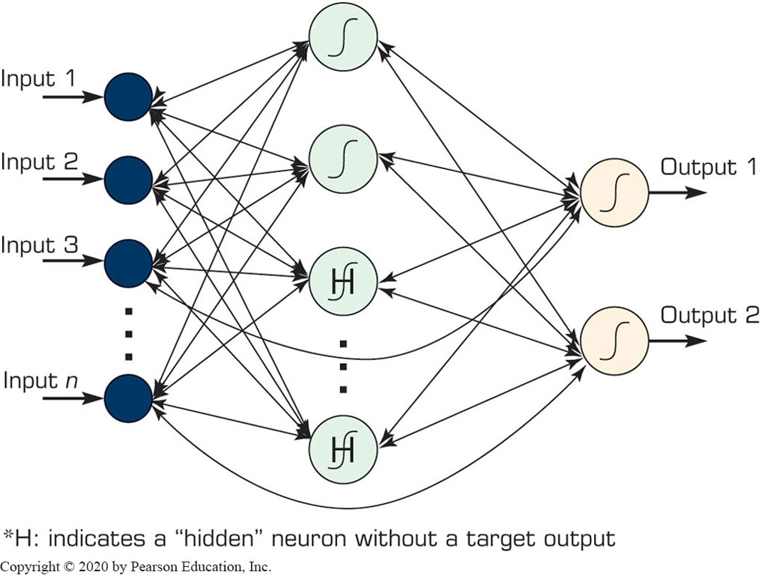
Neural Network Architectures Recurrent Neural Networks

Slide 16
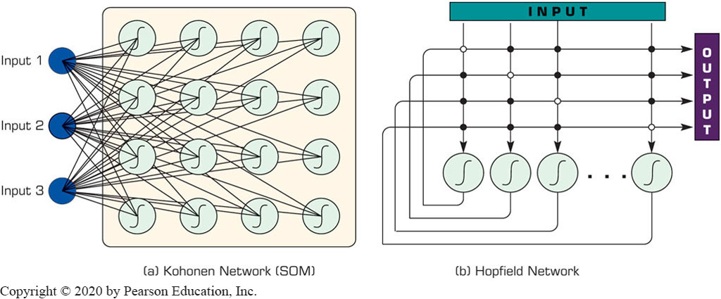
Other Popular A N N Paradigms Self Organizing Maps (S O M)
First introduced by the Finnish Professor Teuvo Kohonen
Applies to clustering type problems

Slide 17
Other Popular A N N Paradigms Hopfield Networks
First introduced by John Hopfield
Highly interconnected neurons
Applies to solving complex computational problems (e.g., optimization problems)

Slide 18
Application Case 5.2
Predictive Modeling Is Powering the Power Generators
Questions for Discussion:
What are the key environmental concerns in the electric power industry?
What are the main application areas for predictive modeling in the electric power industry?
How was predictive modeling used to address a variety of problems in the electric power industry?

Slide 19
Support Vector Machines (S V M) (1 of 4)
S V M are among the most popular machine-learning techniques.
S V M belong to the family of generalized linear models… (capable of representing non-linear relationships in a linear fashion)
S V M achieve a classification or regression decision based on the value of the linear combination of input features.
Because of their architectural similarities, S V M are also closely associated with A N N.

Slide 20
Support Vector Machines (S V M) (2 of 4)
Goal of S V M: to generate mathematical functions that map input variables to desired outputs for classification or regression type prediction problems.
First, S V M uses nonlinear kernel functions to transform non-linear relationships among the variables into linearly separable feature spaces.
Then, the maximum-margin hyperplanes are constructed to optimally separate different classes from each other based on the training dataset.
S V M has solid mathematical foundation!

Slide 21
Support Vector Machines (S V M) (3 of 4)
A hyperplane is a geometric concept used to describe the separation surface between different classes of things.
In S V M, two parallel hyperplanes are constructed on each side of the separation space with the aim of maximizing the distance between them.
A kernel function in S V M uses the kernel trick (a method for using a linear classifier algorithm to solve a nonlinear problem)
The most commonly used kernel function is the radial basis function (R B F).

Slide 22
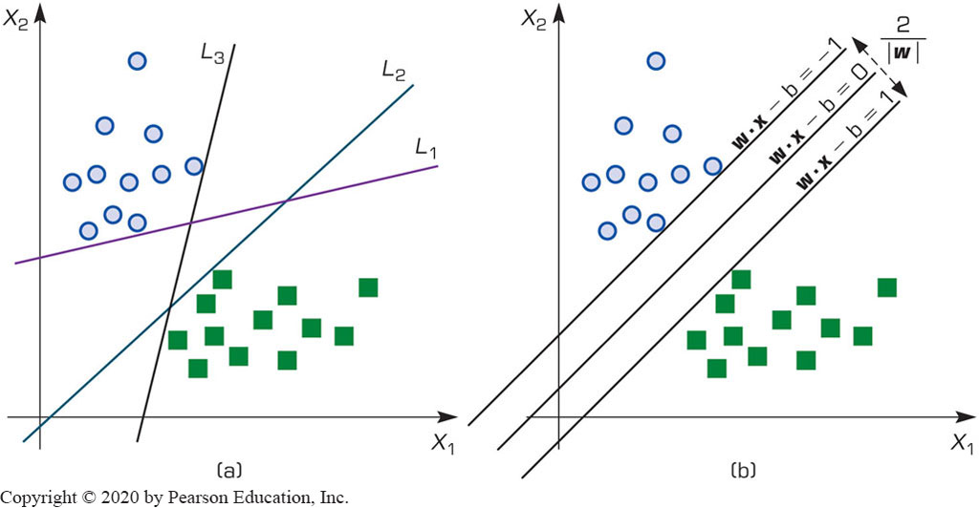
Support Vector Machines (S V M) (4 of 4)
Many linear classifiers (hyperplanes) may separate the data

Slide 23
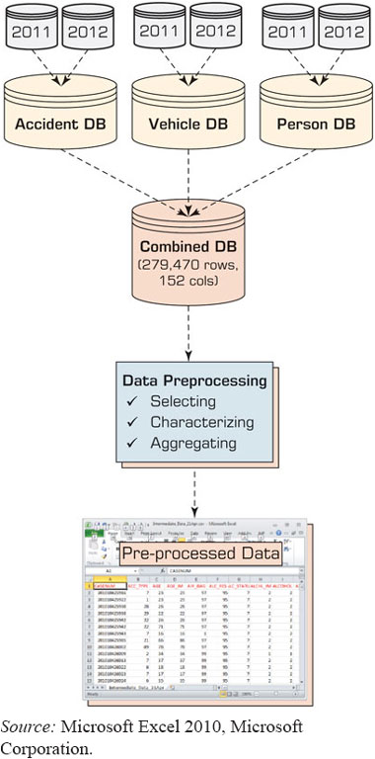
Application Case 5.3 (1 of 4)
Identifying Injury Severity Risk Factors in Vehicle Crashes with Predictive Analytics
Figure 5.7 Data Acquisition/Merging/Preparation Process.
Problem
Method
Results
Conclutions
Source: Microsoft Excel 2010, Microsoft Corporation.

Slide 24
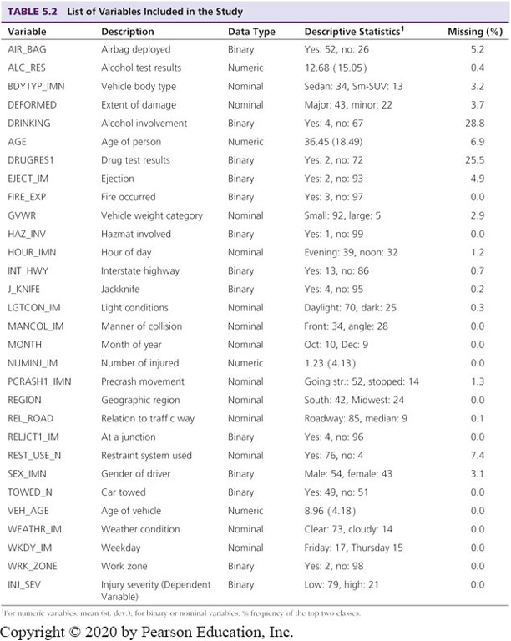
Application Case 5.3 (2 of 4)
Identifying Injury Severity Risk Factors in Vehicle Crashes with Predictive Analytics
Key success factors:
Data acquisition
Data Preparation
¹For numeric variables: mean (st. dev.); for binary or nominal variables: % frequency of the top two classes.

Slide 25
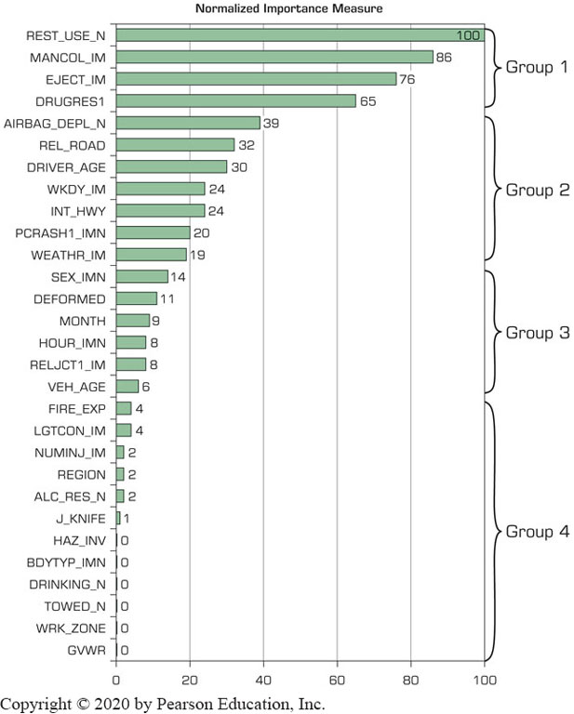
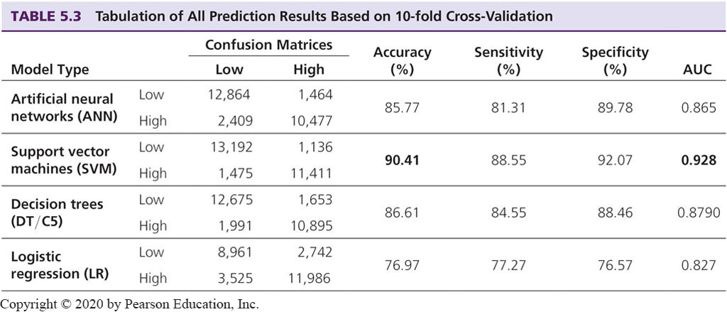
Application Case 5.3 (3 of 4)
Identifying Injury Severity Risk Factors in Vehicle Crashes with Predictive Analytics
Accuracy
Variable importance

Slide 26
Application Case 5.3 (4 of 4)
Identifying Injury Severity Risk Factors in Vehicle Crashes with Predictive Analytics
Questions for Discussion:
What are the key environmental concerns in the electric power industry?
What are the main application areas for predictive modeling in the electric power industry?
How was predictive modeling used to address a variety of problems in the electric power industry?

Slide 27
How Does a S V M Works?
Following a machine-learning process, a S V M learns from the historic cases.
The Process of Building S V M
1. Preprocess the data
Scrub and transform the data.
2. Develop the model.
Select the kernel type (R B F is often a natural choice).
Determine the kernel parameters for the selected kernel type.
If the results are satisfactory, finalize the model, otherwise change the kernel type and/or kernel parameters to achieve the desired accuracy level.
3. Extract and deploy the model.

Slide 28
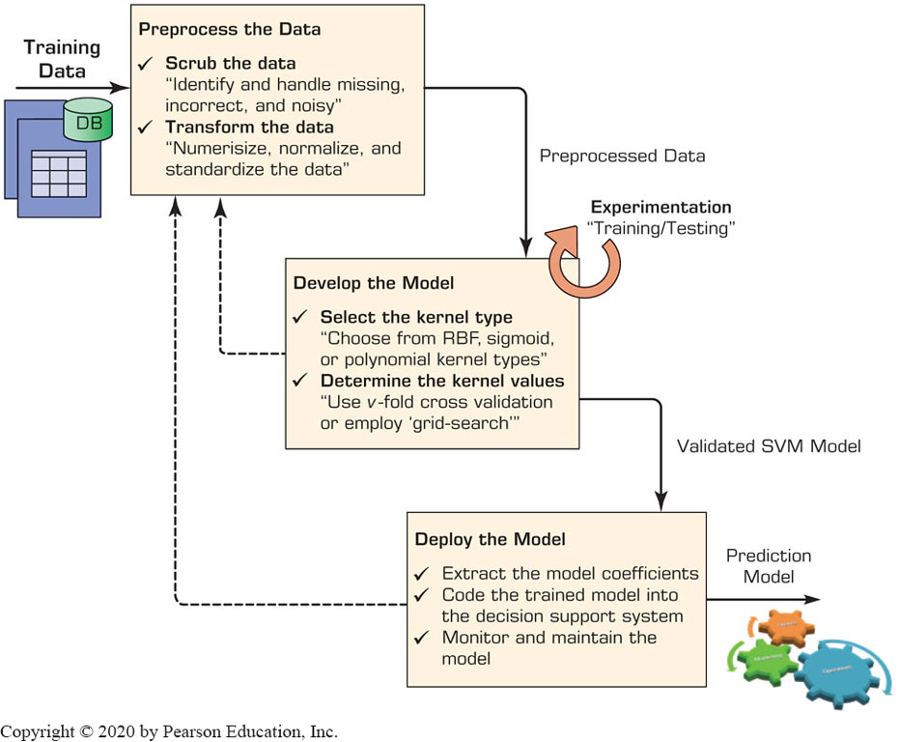
The Process of Building a S V M

Slide 29
S V M Applications
S V M are the most widely used kernel-learning algorithms for wide range of classification and regression problems
S V M represent the state-of-the-art by virtue of their excellent generalization performance, superior prediction power, ease of use, and rigorous theoretical foundation
Most comparative studies show its superiority in both regression and classification type prediction problems.
S V M versus A N N?

Slide 30
k-Nearest Neighbor Method (k-N N) (1 of 2)
A N N s and S V M s → time-demanding, computationally intensive iterative derivations
k-N N a simplistic and logical prediction method, that produces very competitive results
k-N N is a prediction method for classification as well as regression types (similar to A N N & S V M)
k-N N is a type of instance-based learning (or lazy learning) – most of the work takes place at the time of prediction (not at modeling)
k : the number of neighbors used in the model

Slide 31
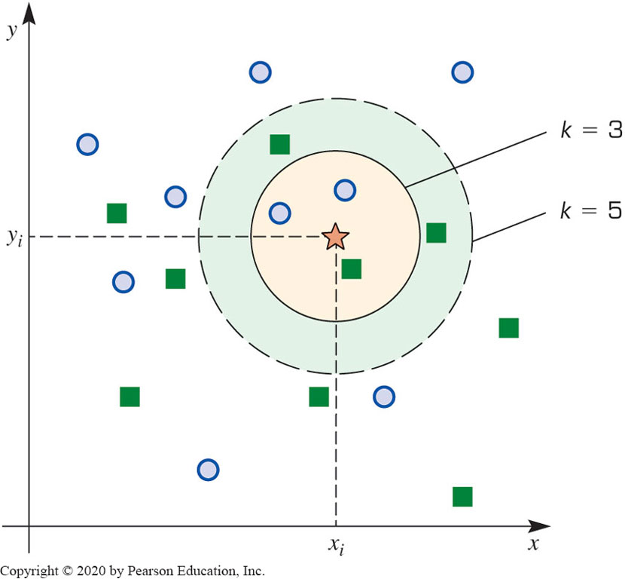
k-Nearest Neighbor Method (k-N N) (2 of 2)
The answer to “which class a data point belongs to?” depends on the value of k

Slide 32
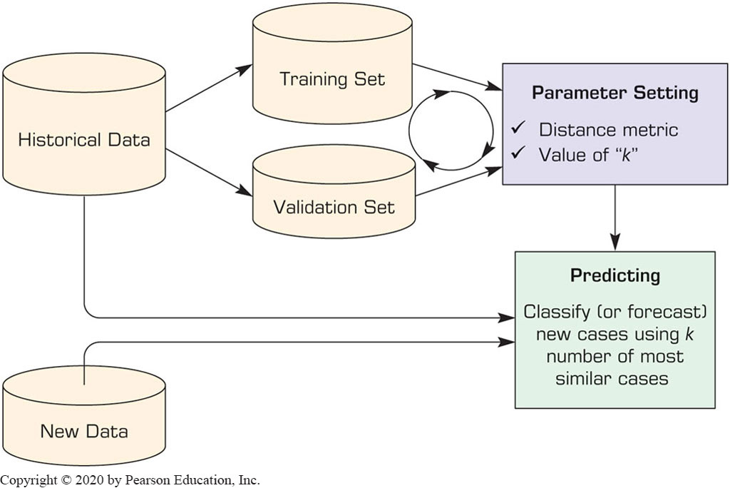
The Process of k-N N Method

Slide 33
k-N N Model Parameter (1 of 2)
Similarity Measure: The Distance Metric
Numeric versus nominal values?

Slide 34
k-N N Model Parameter (2 of 2)
Number of Neighbors (the value of k)
The best value depends on the data
Larger values reduces the effect of noise but also make boundaries between classes less distinct
An “optimal” value can be found heuristically
Cross Validation is often used to determine the best value for k and the distance measure

Slide 35
Application Case 5.4
Efficient Image Recognition and Categorization with k N N
Questions for Discussion:
Why is image recognition/classification a worthy but difficult problem?
How can k N N be effectively used for image recognition/classification applications?

Slide 36
Naïve Bayes Method for Classification (1 of 2)
Naïve Bayes is a simple probability-based classification method
Naïve - assumption of independence among the input variables
Can use both numeric and nominal input variables
Numeric variables need to be discretized
Can be used for both regression and classification
Naïve based models can be developed very efficiently and effectively
Using maximum likelihood method

Slide 37
Bayes Theorem
Developed by Thomas Bayes (1701–1761)
Determines the conditional probabilities
Given that X and Y are two events:
Go trough the simple example in the book (p. 279)

Slide 38
Naïve Bayes Method for Classification (2 of 2)
Process of Developing a Naïve Bayes Classifier
Training Phase
Obtain and pre-process the data
Discretize the numeric variables
Calculate the prior probabilities of all class labels
Calculate the likelihood for all predictor variables/values
Testing Phase
Using the outputs of Steps 3 and 4 above, classify the new samples
See the numerical example in the book…

Slide 39
Application Case 5.5 (1 of 2)
Predicting Disease Progress in Crohn’s Disease Patients: A Comparison of Analytics Methods
Questions for Discussion:
What is Crohn’s disease and why is it important?
Based on the findings of this Application Case, what can you tell about the use of analytics in chronic disease management?
What other methods and data sets might be used to better predict the outcomes of this chronic disease?

Slide 40
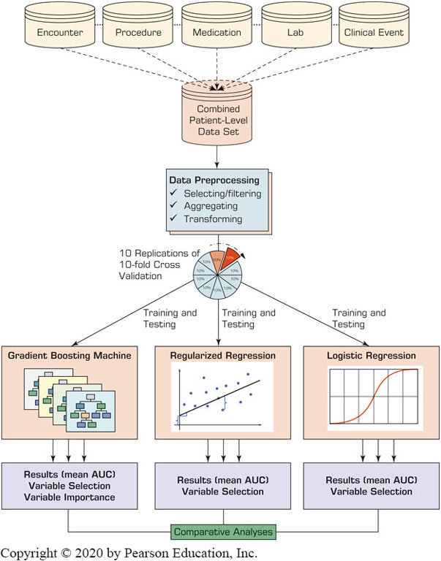
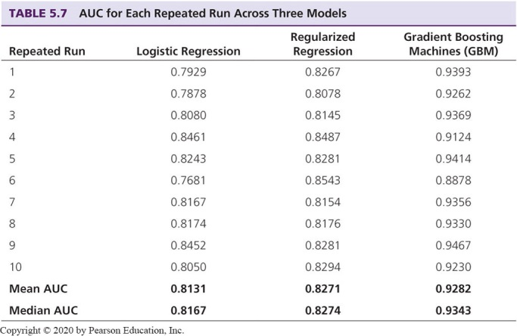
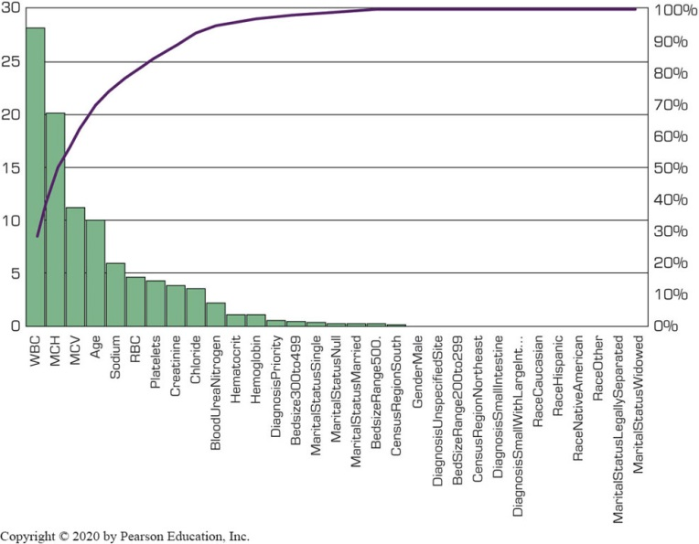
Application Case 5.5 (2 of 2)
Predicting Disease Progress in Crohn’s Disease Patients: A Comparison of Analytics Methods
Prediction Accuracy
Methodology
Variable Importance

Slide 41
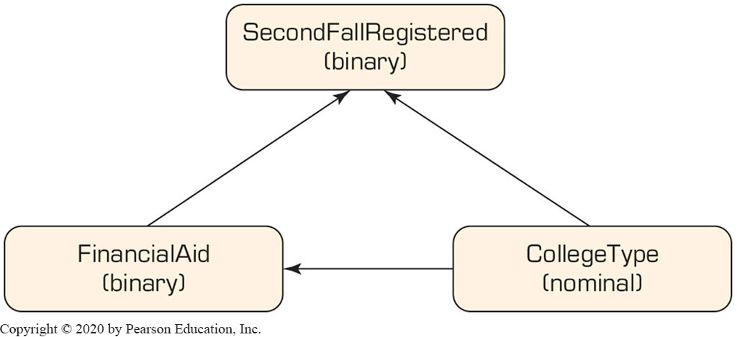
Bayesian Networks (1 of 5)
A tool for representing dependency structure in a graphical, explicit, and intuitive way
A directed acyclic graph whose nodes correspond to the variables and arcs that signify conditional dependencies between variables and their possible values
Direction of the arc matter
A partial causality link in student retention

Slide 42
Bayesian Networks (2 of 5)
How can B N be constructed?
Manually
By an engineer with the help of a domain expert
Time demanding, expensive (for large networks)
Experts may not even be available
Automatically
Analytically …
By learning/inducing the structure of the network from the historical data
Availability high-quality historical data is imperative

Slide 43
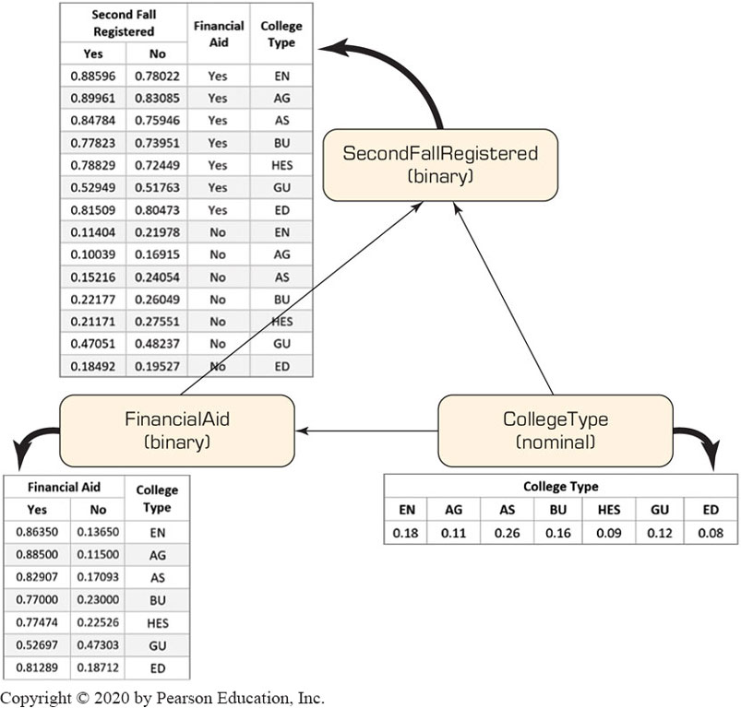
Bayesian Networks (3 of 5)
How can B N be constructed?
Analytically

Slide 44
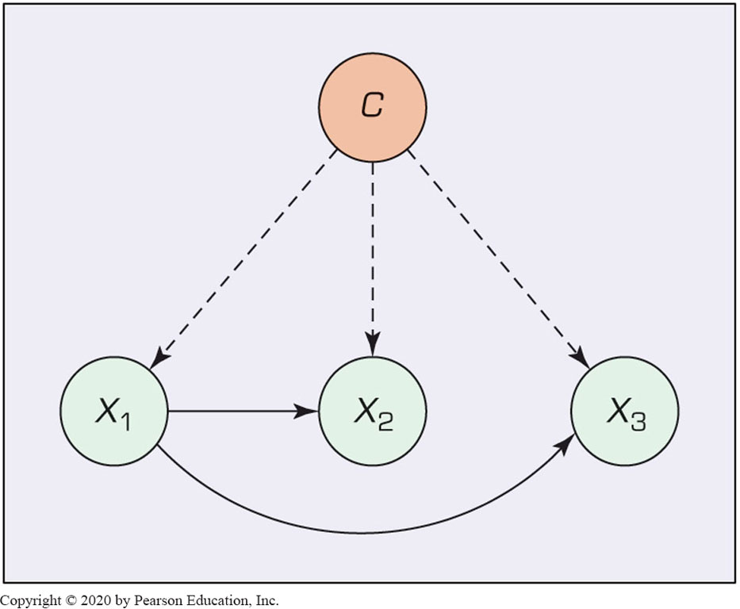
Bayesian Networks (4 of 5)
How can B N be constructed?
Tree Augmented Naïve Bayes Network Structure
Compute information function
Build the undirected graph
Build a spanning tree
Convert the undirected graph into a directed one
Construct a T A N model
Tree Augmented Naïve (T A N) Bayes Network Structure

Slide 45
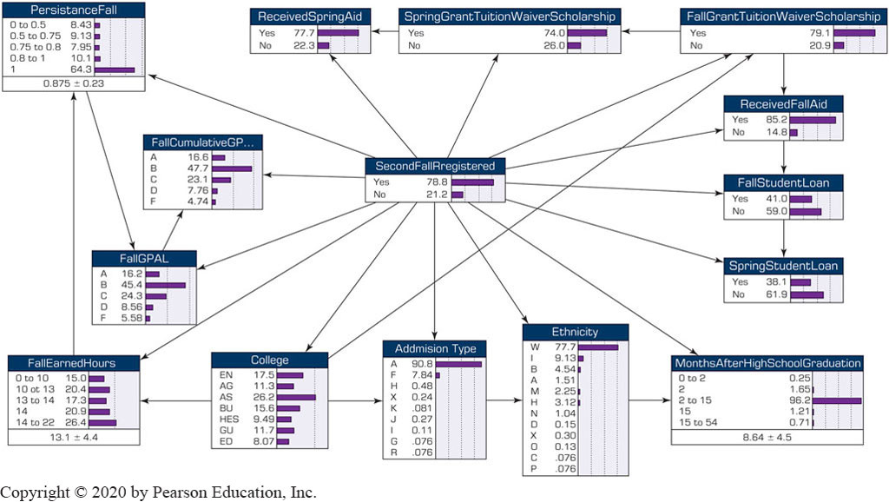
Bayesian Networks (5 of 5)
EXAMPLE: Bayesian Belief Network for Predicting Freshmen Student Attrition

Slide 46
Ensemble Modeling (1 of 3)
Ensemble – combination of models (or model outcomes) for better results
Why do we need to use ensembles:
Better accuracy
More stable/robust/consistent/reliable outcomes
Reality: ensembles wins competitions!
Netflix $1M Prise completion
Many recent competitions at Kaggle.com
The Wisdom of Crowds

Slide 47
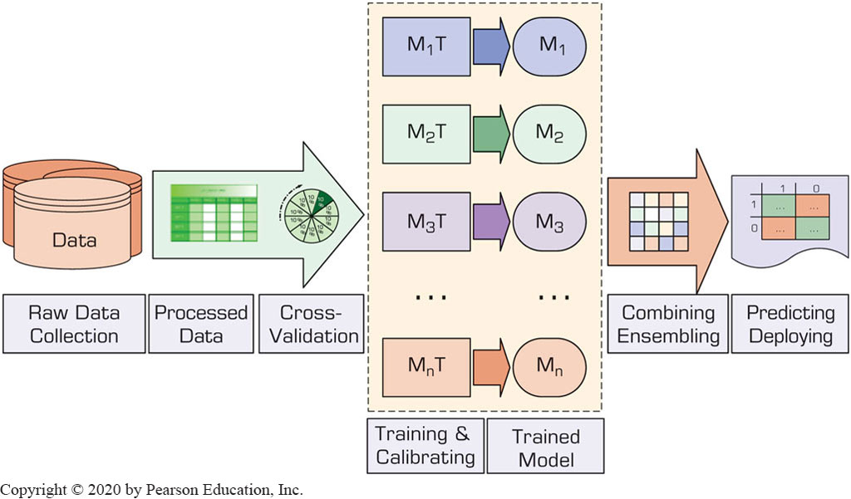
Ensemble Modeling (2 of 3)
Figure 5.19 Graphical Depiction of Model Ensembles for Prediction Modeling.

Slide 48
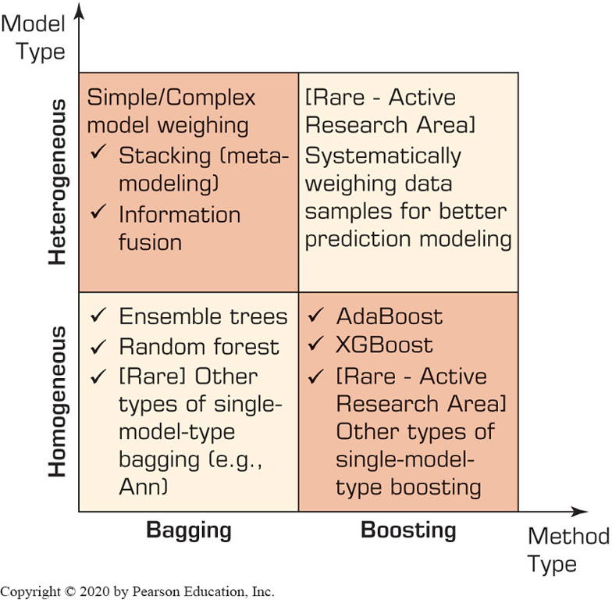
Types of Ensemble Modeling (1 of 4)
Figure 5.20 Simple Taxonomy for Model Ensembles.

Slide 49
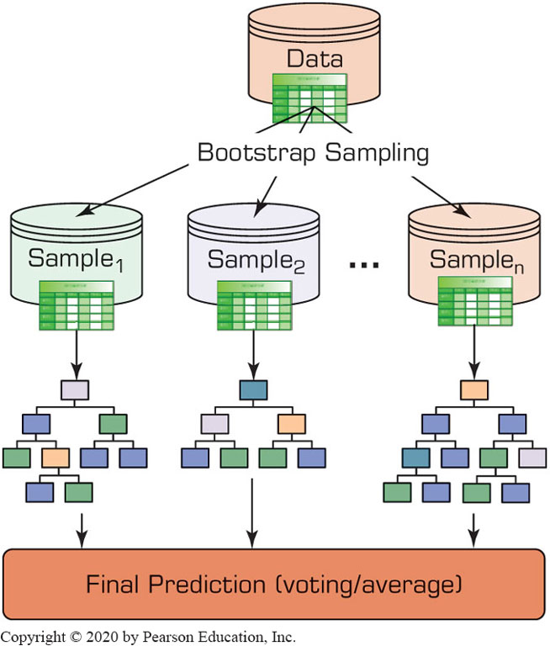
Types of Ensemble Modeling (2 of 4)
Figure 5.20 Bagging-Type Decision Tree Ensembles.

Slide 50
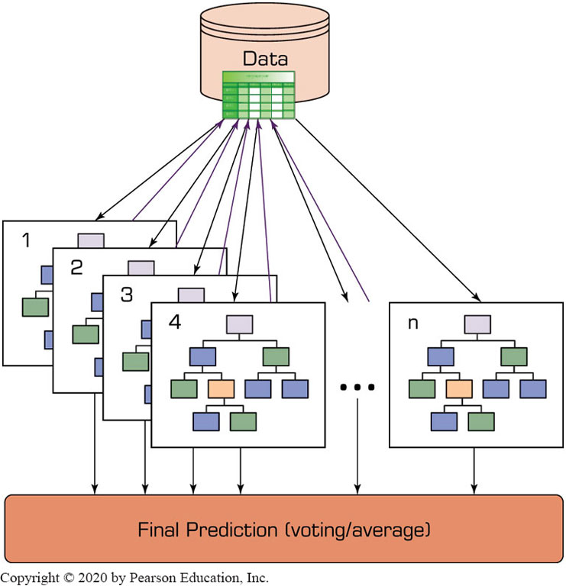
Types of Ensemble Modeling (3 of 4)
Figure 5.20 Boosting-Type Decision Tree Ensembles.

Slide 51
Ensemble Modeling (3 of 3)
Variants of Bagging & Boosting (Decision Trees)
Decision Trees Ensembles
Random Forest
Stochastic Gradient Boosting
Stacking
Stack generation or super learners
Information Fusion
Any number of any models
Simple/weighted combining

Slide 52
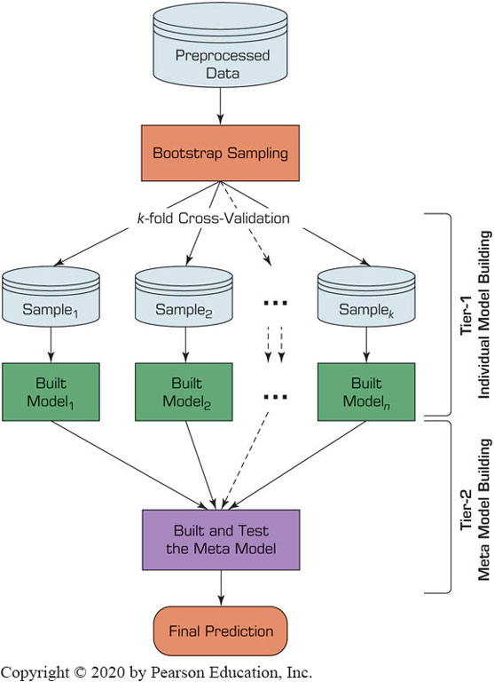
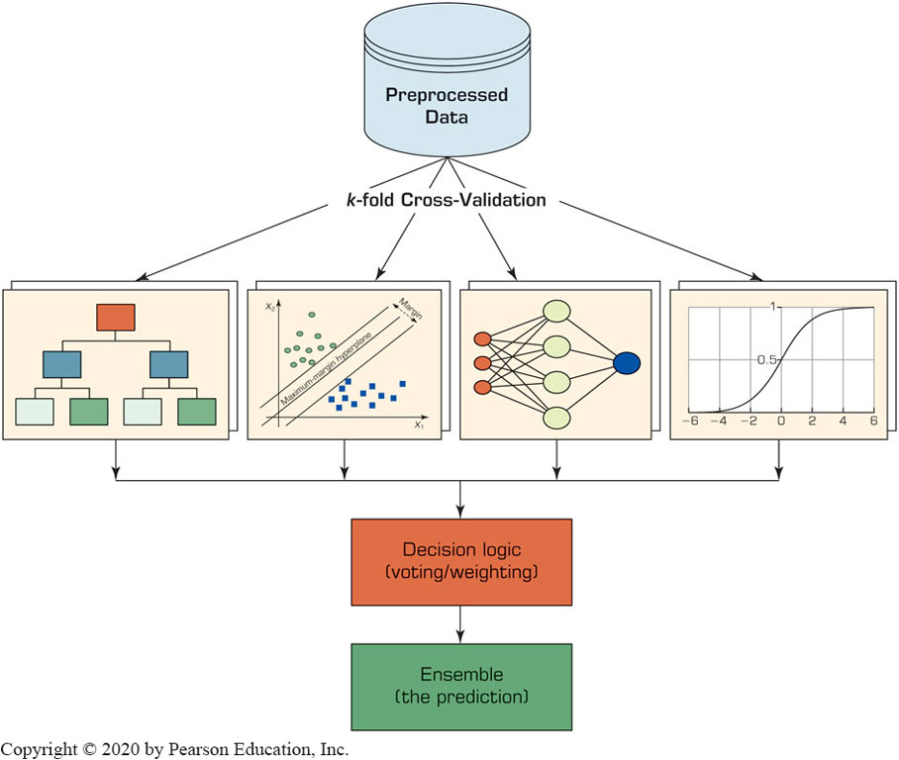
Types of Ensemble Modeling (4 of 4)
STACKING
INFORMATION FUSION

Slide 53
Ensembles – Pros and Cons
Table 5.9 Brief List of Pros and Cons of Model Ensembles Compared to Individual Models.
PROS (Advantages) | Description
Accuracy | Model ensembles usually result in more accurate models than individual models.
Robustness | Model ensembles tend to be more robust against outliers and noise in the data set than individual models.
Reliability (stable) | Because of the variance reduction, model ensembles tend to produce more stable, reliable, and believable results than individual models.
Coverage | Model ensembles tend to have a better coverage of the hidden complex patterns in the data set than individual models.
CONS (Shortcomings) | Description
Complexity | Model ensembles are much more complex than individual models.
Computationally expensive | Compared to individual models, ensembles require more time and computational power to build.
Lack of transparency (explainability) | Because of their complexity, it is more difficult to understand the inner structure of model ensembles (how they do what they do) than individual models.
Harder to deploy | Model ensembles are much more difficult to deploy in an analytics-based Managerial decision-support system than single models.

Slide 54
Application Case 5.6 (1 of 3)
To Imprison or Not to Imprison: A Predictive Analytics-Based D S S for Drug Courts
Questions for Discussion:
What are drug courts and what do they do for the society?
What are the commonalities and differences between traditional (theoretical) and modern (machine-learning) base methods in studying drug courts?
Can you think of other social situations and systems for which predictive analytics can be used?

Slide 55
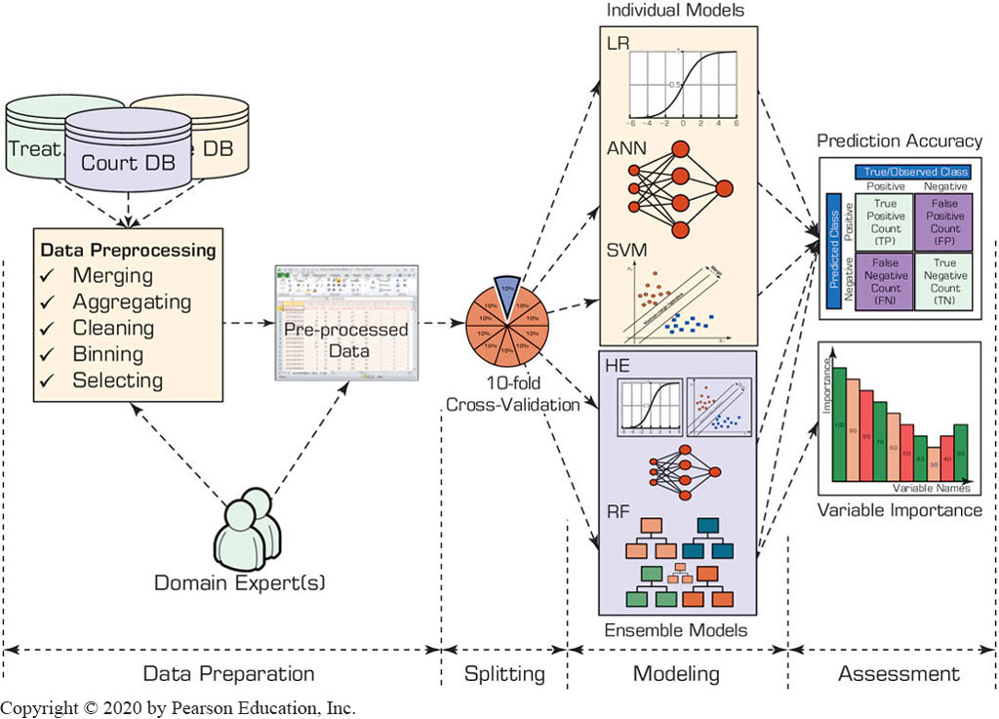
Application Case 5.6 (2 of 3)
To Imprison or Not to Imprison: A Predictive Analytics-Based D S S for Drug Courts
Methodology

Slide 56
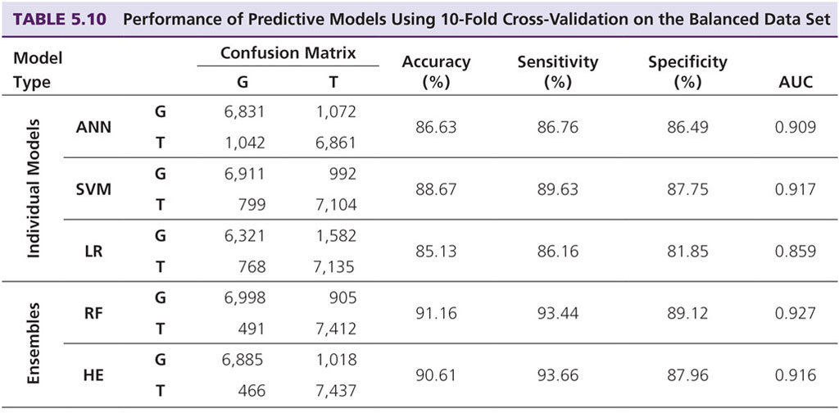
Application Case 5.6 (3 of 3)
To Imprison or Not to Imprison: A Predictive Analytics-Based D S S for Drug Courts
Prediction Accuracy
A N N: artificial neural networks; D T: decision trees; L R: logistic regression; R F: random forest; H E: heterogeneous ensemble; A U C: area under the curve; G: graduated; T: terminated

Slide 57
End of Chapter 5
Questions / Comments

Slide 58

Copyright
This work is protected by United States copyright laws and is provided solely for the use of instructors in teaching their courses and assessing student learning. Dissemination or sale of any part of this work (including on the World Wide Web) will destroy the integrity of the work and is not permitted. The work and materials from it should never be made available to students except by instructors using the accompanying text in their classes. All recipients of this work are expected to abide by these restrictions and to honor the intended pedagogical purposes and the needs of other instructors who rely on these materials.

