Slide 1

Analytics, Data Science and A I: Systems for Decision Support
Eleventh Edition
Chapter 7
Text Mining, Sentiment Analysis, and Social Analytics
Copyright © 2020, 2015, 2011 Pearson Education, Inc. All Rights Reserved
Notes:
If this PowerPoint presentation contains mathematical equations, you may need to check that your computer has the following installed:
1) Math Type Plugin
2) Math Player (free versions available)
3) NVDA Reader (free versions available)

Slide 2
Learning Objectives (1 of 2)
7.1 Describe text mining and understand the need for text mining
7.2 Differentiate among text analytics, text mining and data mining
7.3 Understand the different application areas for text mining
7.4 Know the process of carrying out a text mining project
7.5 Appreciate the different methods to introduce structure to text-based data 7.6 Describe sentiment analysis
Notes:
Slide 2 is list of textbook LO numbers and statements

Slide 3
Learning Objectives (2 of 2)
7.7 Develop familiarity with popular applications of sentiment analysis
7.8 Learn the common methods for sentiment analysis
7.9 Become familiar with speech analytics as it relates to sentiment analysis
7.10 Learn three facets of Web analytics—content, structure, and usage mining
7.11 Know social analytics including social media and social network analyses
Notes:
Slide 2 is list of textbook LO numbers and statements

Slide 4

Opening Vignette (1 of 3)
Amadori Group Converts Consumer Sentiments into Near-Real-Time Sales
Background
Problem
Solution
Results

Slide 5



Opening Vignette (2 of 3)
Amadori Group Converts Consumer Sentiments into Near-Real-Time Sales
Blank | Instrumented | The interactive digital platform supports rapid, accurate data collection from business partners and customers.
Blank | Interconnected | The digital platform also provides an integrated view of the company’s end-to-end processes from production plan to marketing and sales.
Blank | Intelligent | Content management, data collection, and predictive analytics applications monitor and analyze social media relevant to the Amadori brand, helping the company anticipate issues and better align products and marketing promotions with customers’ needs and desires.

Slide 6
Opening Vignette (3 of 3)
Amadori Group Converts Consumer Sentiments into Near-Real-Time Sales
Discussion Questions for the Opening Vignette:
According to the vignette and based on your opinion, what are the challenges that the food industry is facing today?
How can analytics help businesses in the food industry to survive and thrive in this competitive marketplace?
What were and still are the main objectives for Amadori to embark into analytics? What were the results?
Can you think of other businesses in the food industry that utilize analytics to become more competitive?

Slide 7
Text Analytics and Text Mining (1 of 2)
Text Analytics versus Text Mining
Text Analytics =
Information Retrieval +
Information Extraction +
Data Mining +
Web Mining
or simply
Text Analytics = Information Retrieval + Text Mining

Slide 8
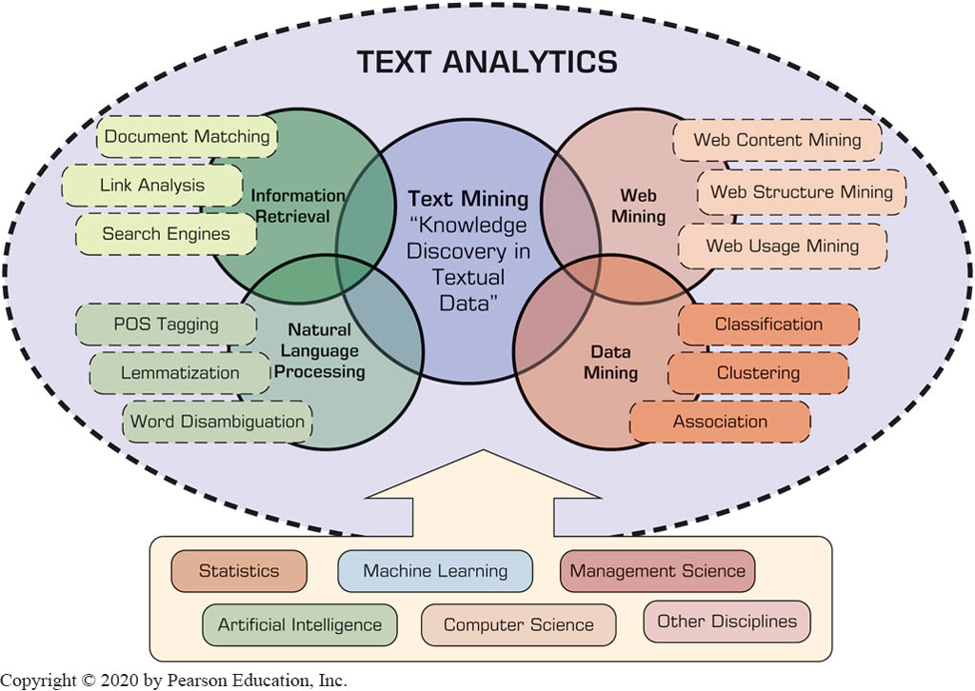
Text Analytics and Text Mining (2 of 2)
Figure 7.2 Text Analytics, Related Application Areas, and Enabling Disciplines.

Slide 9
Text Mining Concepts (1 of 2)
85-90 percent of all corporate data is in some kind of unstructured form (e.g., text)
Unstructured corporate data is doubling in size every 18 months
Tapping into these information sources is not an option, but a need to stay competitive
Answer: text mining
A semi-automated process of extracting knowledge from unstructured data sources
a.k.a. text data mining or knowledge discovery in textual databases

Slide 10
Data Mining versus Text Mining
Both seek for novel and useful patterns
Both are semi-automated processes
Difference is the nature of the data:
Structured versus unstructured data
Structured data: in databases
Unstructured data: Word documents, P D F files, text excerpts, X M L files, and so on
To perform text mining – first, impose structure to the data, then mine the structured data.

Slide 11
Text Mining Concepts (2 of 2)
Benefits of text mining are obvious especially in text-rich data environments
e.g., law (court orders), academic research (research articles), finance (quarterly reports), medicine (discharge summaries), biology (molecular interactions), technology (patent files), marketing (customer comments), etc.
Electronic communization records (e.g., Email)
Spam filtering
Email prioritization and categorization
Automatic response generation

Slide 12
Text Mining Application Area
Information extraction
Topic tracking
Summarization
Categorization
Clustering
Concept linking
Question answering

Slide 13
Text Mining Terminology (1 of 2)
Unstructured or semistructured data
Corpus (and corpora)
Terms
Concepts
Stemming
Stop words (and include words)
Synonyms (and polysemes)
Tokenizing

Slide 14
Text Mining Terminology (2 of 2)
Term dictionary
Word frequency
Part-of-speech tagging
Morphology
Term-by-document matrix
Occurrence matrix
Singular value decomposition
Latent semantic indexing

Slide 15
Application Case 7.1
Netflix: Using Big Data to Drive Big Engagement: Unlocking the Power of Analytics to Drive Content and Consumer Insight
Questions for Discussion
What does Netflix do? How did they evolve into this current business model?
In the case of Netflix, what was it meant to be data-driven and customer-focused?
How did Netflix use Teradata technologies in its analytics endeavors?

Slide 16
Natural Language Processing (N L P) (1 of 4)
Structuring a collection of text
Old approach: bag-of-words
New approach: natural language processing
N L P is …
a very important concept in text mining
a subfield of artificial intelligence and computational linguistics
the studies of "understanding" the natural human language
Syntax- versus semantics-based text mining

Slide 17
Natural Language Processing (N L P) (2 of 4)
What is “Understanding” ?
Human understands, what about computers?
Natural language is vague, context driven
True understanding requires extensive knowledge of a topic
Can/will computers ever understand natural language the same/accurate way we do?

Slide 18
Natural Language Processing (N L P) (3 of 4)
Challenges in N L P
Part-of-speech tagging
Text segmentation
Word sense disambiguation
Syntax ambiguity
Imperfect or irregular input
Speech acts
Dream of A I community
to have algorithms that are capable of automatically reading and obtaining knowledge from text

Slide 19
Natural Language Processing (N L P) (4 of 4)
WordNet
A laboriously hand-coded database of English words, their definitions, sets of synonyms, and various semantic relations between synonym sets.
A major resource for N L P.
Need automation to be completed.
Sentiment Analysis
A technique used to detect favorable and unfavorable opinions toward specific products and services
SentiWordNet

Slide 20
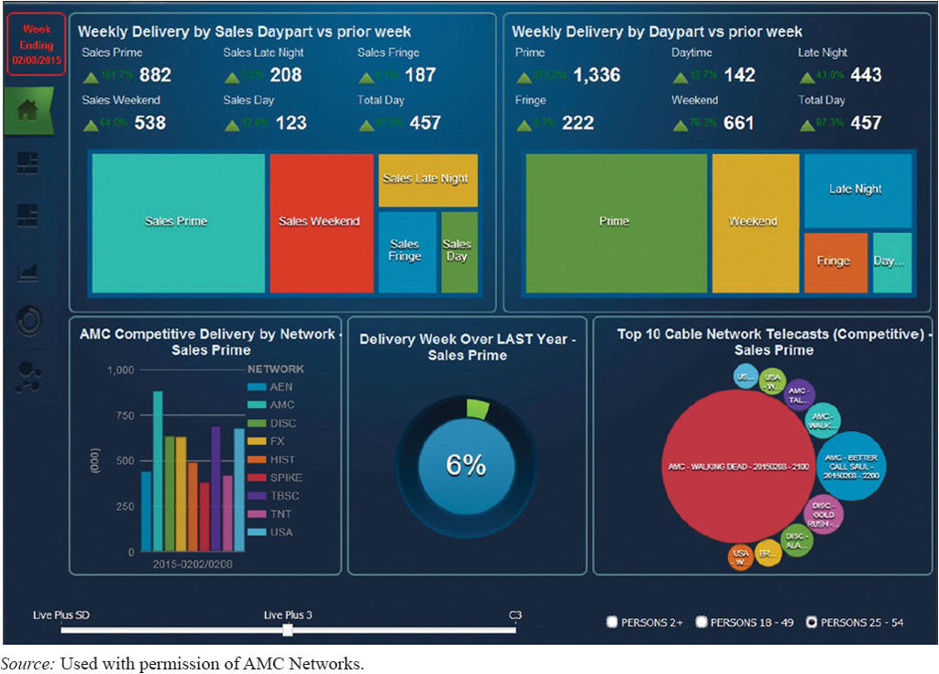
Application Case 7.2 (1 of 2)
A M C Networks Is Using Analytics to Capture New Viewers, Predict Ratings, and Add Value for Advertisers in a Multichannel World
Web-Based Dashboard Used by A M C Networks.
Source: Used with permission of A M C Networks.

Slide 21
Application Case 7.2 (2 of 2)
A M C Networks Is Using Analytics to Capture New Viewers, Predict Ratings, and Add Value for Advertisers in a Multichannel World
Questions for Discussion:
What are the common challenges broadcasting companies are facing nowadays? How can analytics help to alleviate these challenges?
How did A M C leverage analytics to enhance their business performance?
What were the types of text analytics and text mini solutions developed by A M C networks? Can you think of other potential uses of text mining applications in the broadcasting industry?

Slide 22
N L P Task Categories
Question answering
Automatic summarization
Natural language generation & understanding
Machine translation
Foreign language reading & writing
Speech recognition
Text proofing, optical character recognition
Optical character recognition

Slide 23
Text Mining Applications (1 of 2)
Marketing applications
Enables better C R M
Security applications
E C H E L O N, O A S I S
Deception detection (…example coming up)
Medicine and biology
Literature-based gene identification (…)
Academic applications
Research stream analysis

Slide 24
Application Case 7.3 (1 of 4)
Mining for Lies
Deception detection
A difficult problem
If detection is limited to only text, then the problem is even more difficult
The study
Analyzed text based testimonies of person of interests at military bases
Used only text-based features (cues)

Slide 25
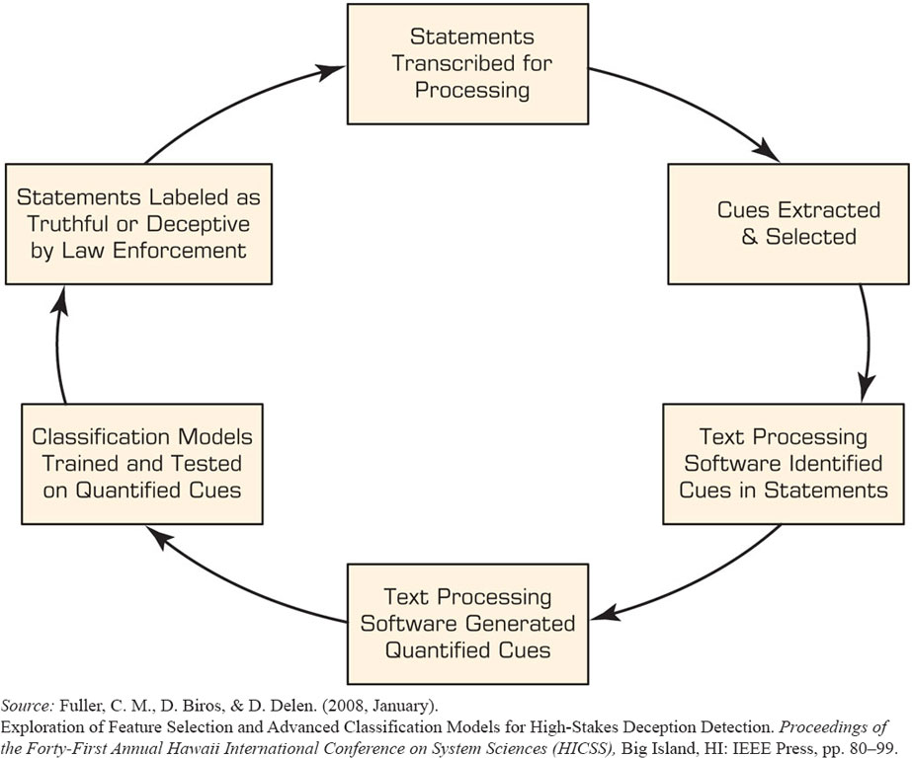
Application Case 7.3 (2 of 4)
Mining for Lies
Figure 7.3 Text-Based Deception-Detection Process.
Source: Fuller, C. M., D. Biros, & D. Delen. (2008, January). Exploration of Feature Selection and Advanced Classification Models for High-Stakes Deception Detection. Proceedings of the Forty-First Annual Hawaii International Conference on System Sciences (H I C S S), Big Island, H I: I E E E Press, pp. 80–99.

Slide 26
Application Case 7.3 (3 of 4)
Mining for Lies
Table 7.1 Categories and Examples of Linguistic Features Used in Deception Detection.
Number | Construct (Category) | Example Cues
1 | Quantity | Verb count, noun phrase count, etc.
2 | Complexity | Average number of clauses, average sentence length, etc.
3 | Uncertainty | Modifiers, modal verbs, etc.
4 | Nonimmediacy | Passive voice, objectification, etc.
5 | Expressivity | Emotiveness
6 | Diversity | Lexical diversity, redundancy, etc.
7 | Informality | Typographical error ratio
8 | Specificity | Spatiotemporal information, perceptual information, etc.
9 | Affect | Positive affect, negative affect, etc.

Slide 27
Application Case 7.3 (4 of 4)
Mining for Lies
371 usable statements are generated
31 features are used
Different feature selection methods used
10-fold cross validation is used
Results (overall % accuracy)
Logistic regression 67.28
Decision trees 71.60
Neural networks 73.46

Slide 28
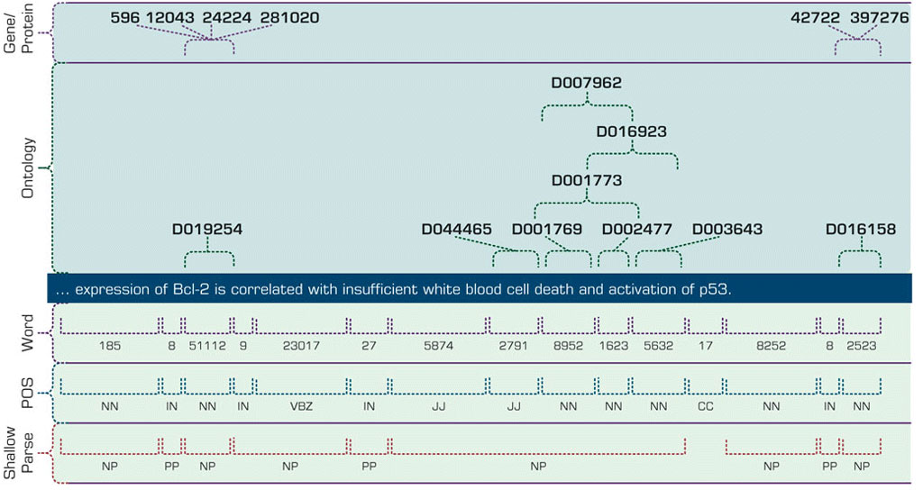
Text Mining Applications (2 of 2)
(Gene/Protein Interaction Identification)
Figure 7.4 Multilevel Analysis of Text for Gene/Protein Interaction Identification.
Source: Used with permission of Nakov, P., Schwartz, A., Wolf, B., & Hearst, M. A. (2005). Supporting annotation layers for natural language processing. Proceedings of the Association for Computational Linguistics (A C L), Interactive Poster and Demonstration Sessions, Ann Arbor, M I. Association for Computational Linguistics, 65–68.

Slide 29
Application Case 7.4
The Magic Behind the Magic: Instant Access to Information Helps the Orlando Magic Up their Game and the Fan’s Experience
Questions for Discussion:
According to the application case, what were the main challenges the Orlando Magic was facing?
How did analytics help the Orlando Magic to overcome some of its most significant challenges on and off the court?
Can you think of other uses of analytics in sports and especially in the case of the Orlando Magic? You can search the Web to find some answers to this question.

Slide 30
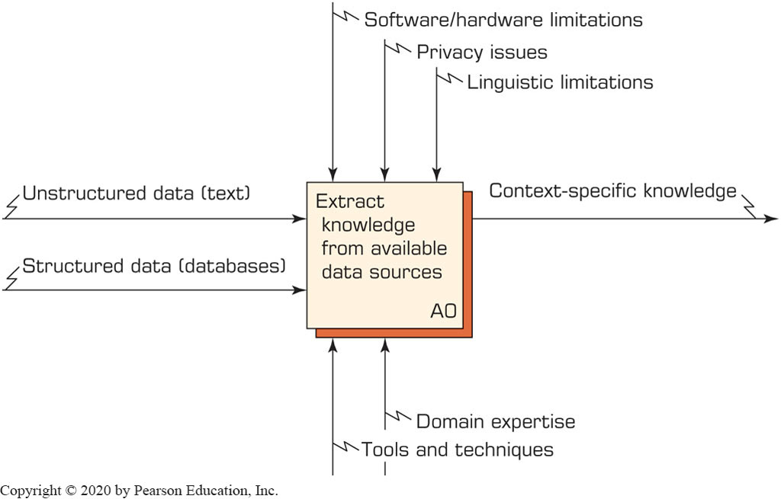
Text Mining Process (1 of 7)
A Context Diagram for Text Mining Process

Slide 31
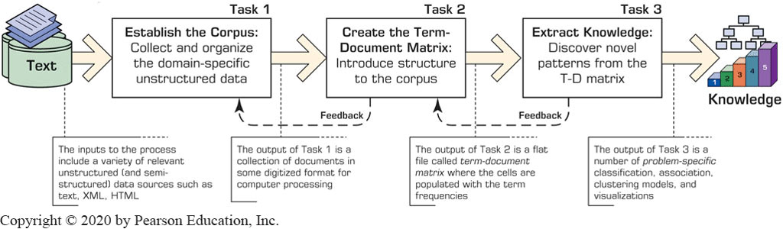
Text Mining Process (2 of 7)
Figure 7.6 The Three-Step/Task Text Mining Process.

Slide 32
Text Mining Process (3 of 7)
Step 1: Establish the corpus
Collect all relevant unstructured data (e.g., textual documents, X M L files, emails, Web pages, short notes, voice recordings…)
Digitize, standardize the collection (e.g., all in A S C I I text files)
Place the collection in a common place (e.g., in a flat file, or in a directory as separate files)

Slide 33
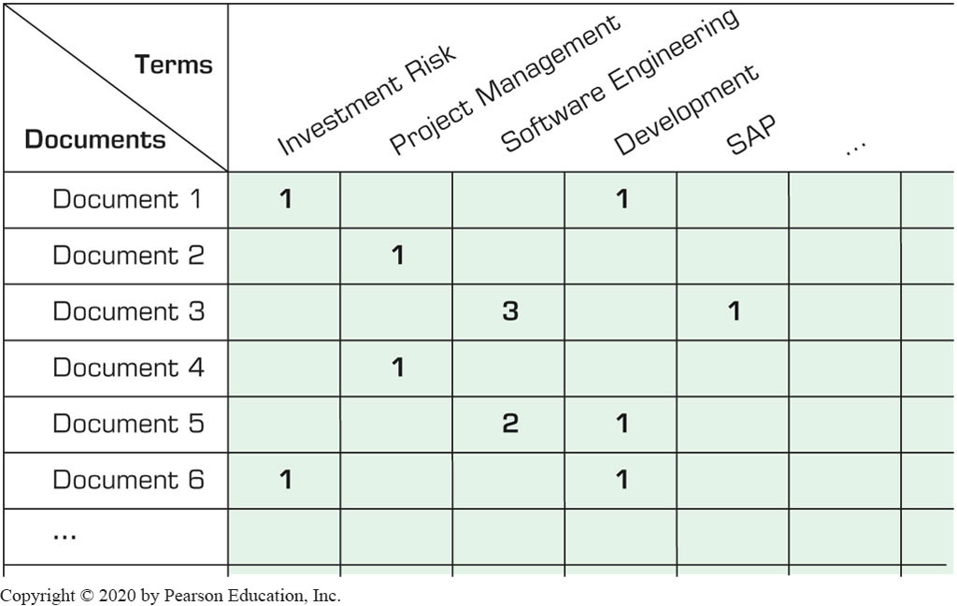
Text Mining Process (4 of 7)
Step 2: Create the Term–by–Document Matrix

Slide 34
Text Mining Process (5 of 7)
Step 2: Create the Term–by–Document Matrix (T D M) (Cont.)
Should all terms be included?
Stop words, include words
Synonyms, homonyms
Stemming
What is the best representation of the indices (values in cells)?
Row counts; binary frequencies; log frequencies;
Inverse document frequency

Slide 35
Text Mining Process (6 of 7)
Step 2: Create the Term–by–Document Matrix (T D M) (Cont.)
T D M is a sparse matrix. How can we reduce the dimensionality of the T D M?
Manual - a domain expert goes through it
Eliminate terms with very few occurrences in very few documents (?)
Transform the matrix using singular value decomposition (S V D)
S V D is similar to principle component analysis

Slide 36
Text Mining Process (7 of 7)
Step 3: Extract patterns/knowledge
Classification (text categorization)
Clustering (natural groupings of text)
Improve search recall
Improve search precision
Scatter/gather
Query-specific clustering
Association
Trend Analysis (…)

Slide 37
Application Case 7.5 (1 of 4)
Research Literature Survey with Text Mining
Mining the published I S literature
M I S Quarterly (M I S Q)
Journal of M I S (J M I S)
Information Systems Research (I S R)
Covers 12-year period (1994-2005)
901 papers are included in the study
Only the paper abstracts are used
9 clusters are generated for further analysis

Slide 38
Application Case 7.5 (2 of 4)
Research Literature Survey with Text Mining
Journal | Year | Author(s) | Title | Vol/No | Pages | Keywords | Abstract
M I S Q | 2005 | A. Malhotra, S. Gosain and O. A. El Sawy | Absorptive capacity configurations in supply chains: Gearing for partner-enabled market knowledge creation | 29/1 | 145-187 | Knowledge management supply chain absorptive capacity interorganizational information systems configuration approaches | The need for continual value innovation is driving supply chains to evolve from a pure transactional focus to leveraging interorganizational partner ships for sharing
I S R | 1999 | D. Robey and M. C. Boudreau | Accounting for the contradictory organizational consequences of information technology: Theoretical directions and methodological implications | 2-Oct | 167-185 | organizational transformation impacts of technology organization theory research methodology intraorganizational power electronic communication mis implementation culture systems | Although much contemporary thought considers advanced information technologies as either determinants or enablers of radical organizational change, empirical studies have revealed inconsistent findings to support the deterministic logic implicit in such arguments. This paper reviews the contradictory
J M I S | 2001 | R. Aron and E. K. Clemons | Achieving the optimal balance between investment in quality and investment in self-promotion for information products | 18/2 | 65-88 | information products internet advertising product positioning signaling signaling games | When producers of goods (or services) are confronted by a situation in which their offerings no longer perfectly match consumer preferences, they must determine the extent to which the advertised features of
… | … | … | … | … | … | … | …

Slide 39
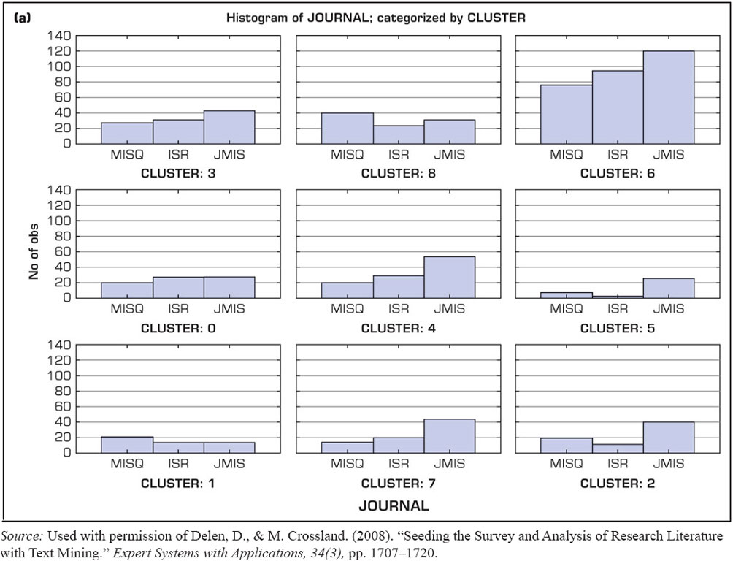
Application Case 7.5 (3 of 4)
Research Literature Survey with Text Mining
Figure 7.8 (a) Distribution of the Number of Articles for the Three Journals over the Nine Clusters.
Source: Used with permission of Delen, D., & M. Crossland. (2008). “Seeding the Survey and Analysis of Research Literature with Text Mining.” Expert Systems with Applications, 34(3), pp. 1707–1720.

Slide 40
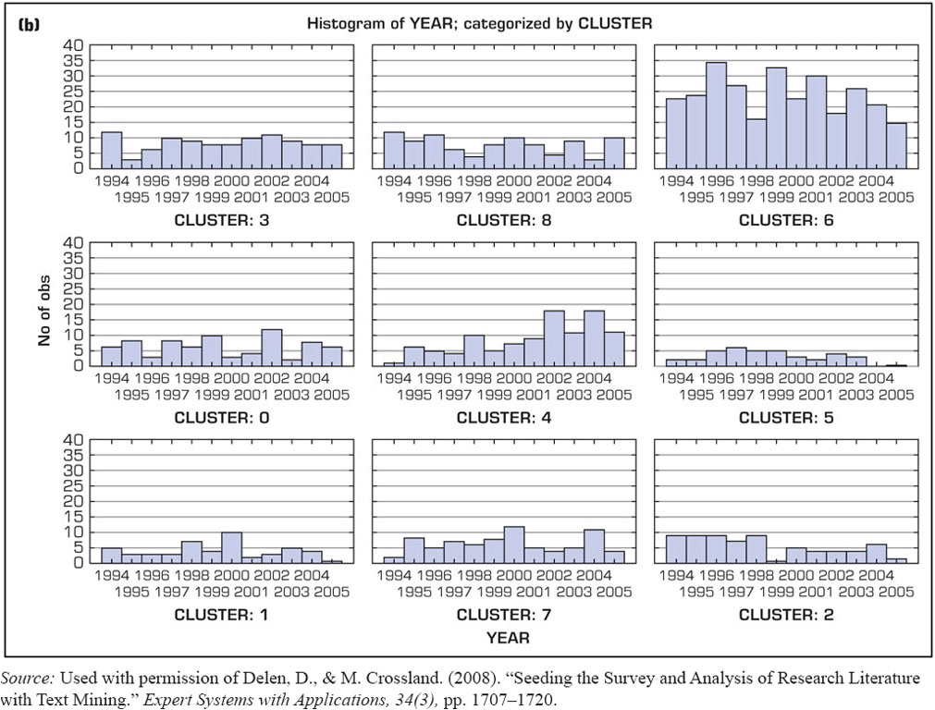
Application Case 7.5 (4 of 4)
Research Literature Survey with Text Mining
Figure 7.8 (b) Development of the Nine Clusters over the Years.
Source: Used with permission of Delen, D., & M. Crossland. (2008). “Seeding the Survey and Analysis of Research Literature with Text Mining.” Expert Systems with Applications, 34(3), pp. 1707–1720.

Slide 41
Sentiment Analysis
Sentiment → belief, view, opinion, and conviction
Sentiment analysis is trying to answer the question “What do people feel about a certain topic?”
By analyzing data related to opinions of many using a variety of automated tools
Used in variety of domains, but it application in C R M are especially noteworthy (which related to customers/consumers’ opinions)

Slide 42
Application Case 7.6
Creating a Unique Digital Experience to Capture Moments That Matter at Wimbledon
Questions for Discussion:
How did Wimbledon use analytics capabilities to enhance viewers’ experience?
What were the challenges, proposed solution, and obtained results?

Slide 43
Sentiment Analysis Applications
Voice of the customer (V O C)
Voice of the Market (V O M)
Voice of the Employee (V O E)
Brand Management
Financial Markets
Politics
Government Intelligence
… others

Slide 44
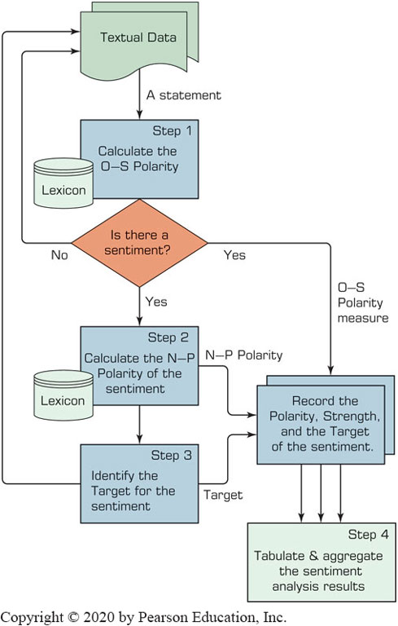
Sentiment Analysis Process (1 of 3)

Slide 45
Sentiment Analysis Process (2 of 3)
Step 1 – Sentiment Detection
Comes right after the he retrieval and preparation of the text documents
It is also called detection of objectivity
Fact [= objectivity] versus Opinion [= subjectivity]
Step 2 – N-P Polarity Classification
Given an opinionated piece of text, the goal is to classify the opinion as falling under one of two opposing sentiment polarities
N [= negative] versus P [= positive]

Slide 46
Sentiment Analysis Process (3 of 3)
Step 3 – Target Identification
The goal of this step is to accurately identify the target of the expressed sentiment (e.g., a person, a product, and event, etc.)
Level of difficulty → the application domain
Step 4 – Collection and Aggregation
Once the sentiments of all text data points in the document are identified and calculated, they are to be aggregated
Word → Statement → Paragraph → Document

Slide 47
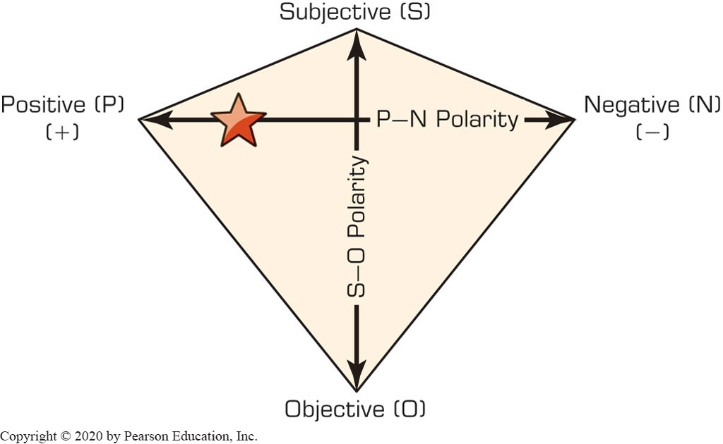
P-N Polarity and S-O Polarity

Slide 48
Web Mining Overview
Web is the largest repository of data
Data is in H T M L, X M L, text format
Challenges (of processing Web data)
The Web is too big for effective data mining
The Web is too complex
The Web is too dynamic
The Web is not specific to a domain
The Web has everything
Opportunities and challenges are great!

Slide 49
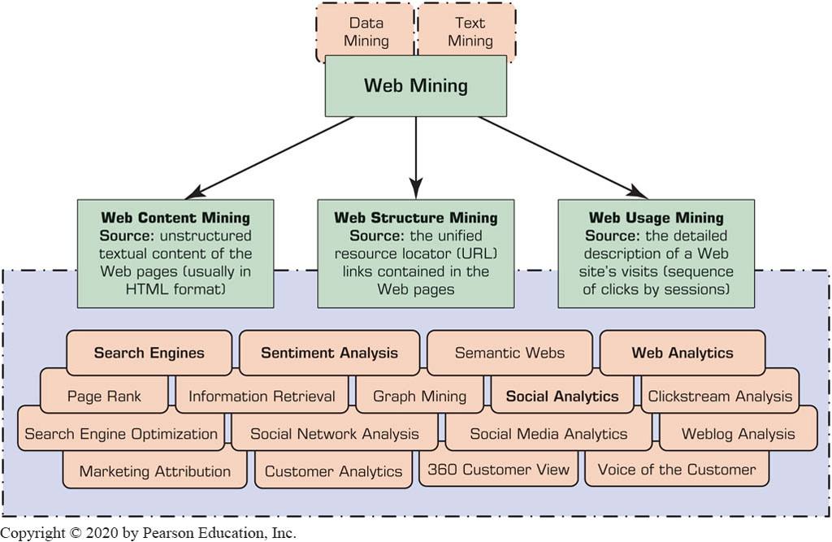
Web Mining
Web mining (or Web data mining) is the process of discovering intrinsic relationships from Web data (textual, linkage, or usage)

Slide 50
Web Content/Structure Mining
Mining the textual content on the Web
Data collection via Web crawlers
Web pages include hyperlinks
Authoritative pages
Hubs
hyperlink-induced topic search (H I T S) alg.

Slide 51
Web Usage Mining (1 of 2)
Extraction of information from data generated through Web page visits and transactions…
data stored in server access logs, referrer logs, agent logs, and client-side cookies
user characteristics and usage profiles
metadata, such as page attributes, content attributes, and usage data
Clickstream data
Clickstream analysis

Slide 52
Web Usage Mining (2 of 2)
Web usage mining applications
Determine the lifetime value of clients
Design cross-marketing strategies across products.
Evaluate promotional campaigns
Target electronic ads and coupons at user groups based on user access patterns
Predict user behavior based on previously learned rules and users’ profiles
Present dynamic information to users based on their interests and profiles
…

Slide 53
Search Engines
Google, Bing, Yahoo, …
For what reason do you use search engines?
Search engine is a software program that searches for documents (Internet sites or files) based on the keywords (individual words, multi-word terms, or a complete sentence) that users have provided that have to do with the subject of their inquiry
They are the workhorses of the Internet

Slide 54
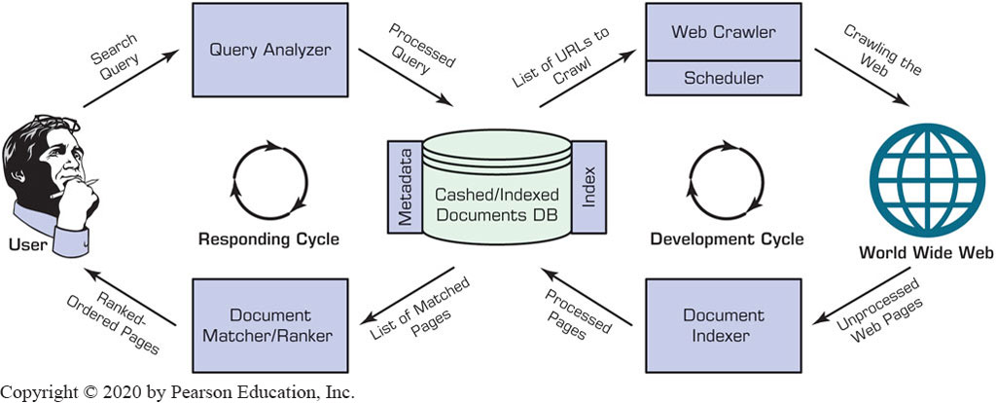
Structure of a Typical Internet Search Engine

Slide 55
Anatomy of a Search Engine
Development Cycle
Web Crawler
Document Indexer
Response Cycle
Query Analyzer
Document Matcher/Ranker

Slide 56
Search Engine Optimization
It is the intentional activity of affecting the visibility of an e-commerce site or a Web site in a search engine’s natural (unpaid or organic) search results
Part of an Internet marketing strategy
Based on knowing how a Search Engine works
Content, H T M L, keywords, external links, …
Indexing based on …
Webmaster submission of U R L
Proactively and continuously crawling the Web

Slide 57
Top 15 Most Popular Search Engines
(by eBizM B A, August 2016)
Rank | Name | Estimated Unique Monthly Visitors
1 | Google | 1,600,000,000
2 | Bing | 400,000,000
3 | Yahoo! Search | 300,000,000
4 | Ask | 245,000,000
5 | AOL Search | 125,000,000
6 | Wow | 100,000,000
7 | WebCrawler | 65,000,000
8 | MyWebSearch | 60,000,000
9 | Infospace | 24,000,000
10 | Info | 13,500,000
11 | DuckDuckGo | 11,000,000
12 | Contenko | 10,500,000
13 | Dogpile | 7,500,000
14 | Alhea | 4,000,000
15 | ixQuick | 1,000,000

Slide 58
Application Case 7.7
Delivering Individualized Content and Driving Digital Engagement: How Barbour Collected More Than 49,000 New Leads in One Month with Teradata Interactive
Questions for Discussion:
What does Barbour do? What was the challenge Barbour was facing?
What was the proposed analytics solution?
What were the results?

Slide 59
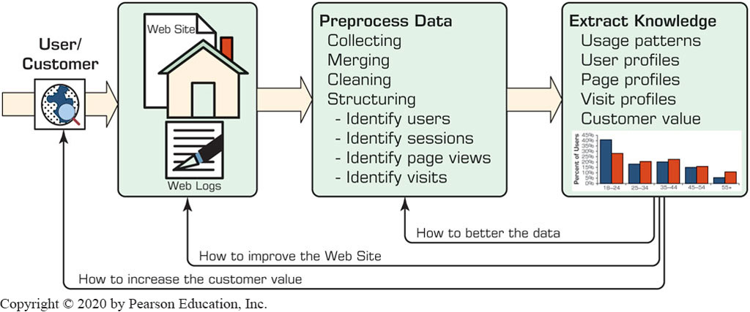
Web Usage Mining (Clickstream Analysis)

Slide 60
Web Analytics Metrics (1 of 3)
Web site usability
How were the visitors using my Web site?
Traffic sources
Where did they come from?
Visitor profiles
What do my visitors look like?
Conversion statistics
What does it all mean for the business?

Slide 61
Web Analytics Metrics (2 of 3)
Web Site Usability
Page views
Time on site
Downloads
Click map
Click paths
Traffic Source
Referral Web sites
Search engines
Direct
Offline campaigns
Online campaigns

Slide 62
Web Analytics Metrics (3 of 3)
Visitor Profiles
Keywords
Content groupings
Geography
Time of day
Landing page profiles
Conversion Statistics
New visitors
Returning visitors
Leads
Sales/conversions
Abandonment/exit rate

Slide 63
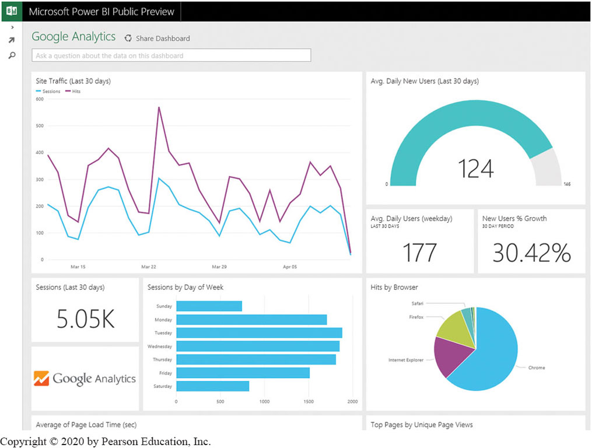
A Sample Web Analytics Dashboard

Slide 64
Social Analytics Social Network Analysis (1 of 2)
Social Network - social structure composed of individuals link to each other
Analysis of social dynamics
Interdisciplinary field
Social psychology
Sociology
Statistics
Graph theory

Slide 65
Social Analytics Social Network Analysis (2 of 2)
Social Networks help study relationships between individuals, groups, organizations, societies
Self organizing
Emergent
Complex
Typical social network types
Communication networks, community networks, criminal networks, innovation networks, …

Slide 66

Application Case 7.8
Tito’s Vodka Establishes Brand Loyalty with an Authentic Social Strategy
Discussion Questions:
How can social media analytics be used in the consumer products industry?
What do you think are the key challenges, potential solutions, and probable results in applying social media analytics in consumer products and services firms?

Slide 67
Social Analytics Social Network Analysis Metrics
Connections
Homophily
Multiplexity
Mutuality/reciprocity
Network closure
Propinquity
Segmentation
Cliques and social circles
Clustering coefficient
Cohesion
Distribution
Bridge
Centrality
Density
Distance
Structural holes

Slide 68
Social Media Definitions and Concepts
Enabling technologies of social interactions among people
Relies on enabling technologies of Web 2.0
Takes on many different forms
Internet forums, Web logs, social blogs, microblogging, wikis, social networks, podcasts, pictures, video, and product reviews
Different types of social media
Based on media research and social process

Slide 69
Social versus Industrial Media
Web-based social media are different from traditional/industrial media, such as newspapers, television, and film
Differentiating characteristics
Quality
Reach
Frequency
Accessibility
Usability
Immediacy
Updatability

Slide 70
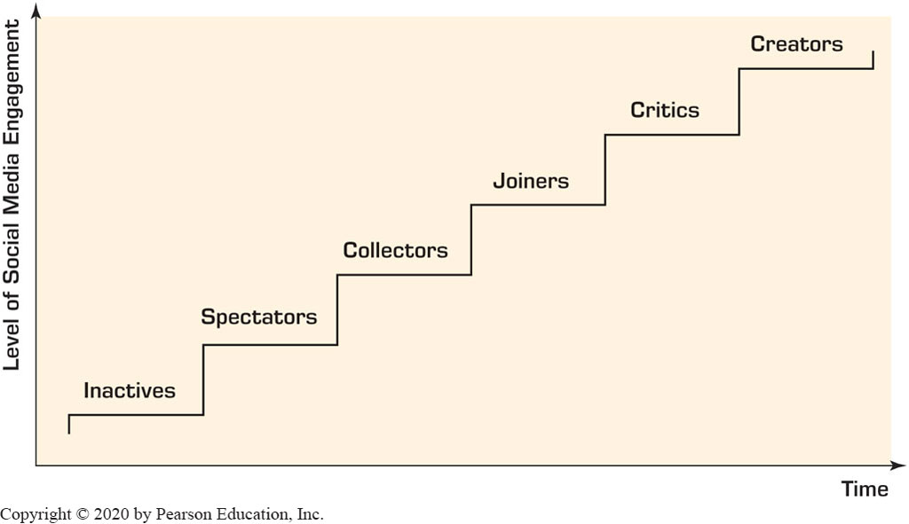
How Do People Use Social Media?
Different engagement levels

Slide 71
Social Media Analytics
It is the systematic and scientific ways to consume the vast amount of content created by Web-based social media outlets, tools, and techniques for the betterment of an organization’s competitiveness
Tools to measure social media impact:
Descriptive analytics
Social network analysis
Advanced analytics

Slide 72
Best Practices in Social Media Analytics
Think of measurement as a guidance system, not a rating system
Track the elusive sentiment
Continuously improve the accuracy of text analysis
Look at the ripple effect
Look beyond the brand
Identify your most powerful influencers
Look closely at the accuracy of your analytic tool
Incorporate social media intelligence into planning

Slide 73
End of Chapter 7
Questions / Comments

Slide 74

Copyright
This work is protected by United States copyright laws and is provided solely for the use of instructors in teaching their courses and assessing student learning. Dissemination or sale of any part of this work (including on the World Wide Web) will destroy the integrity of the work and is not permitted. The work and materials from it should never be made available to students except by instructors using the accompanying text in their classes. All recipients of this work are expected to abide by these restrictions and to honor the intended pedagogical purposes and the needs of other instructors who rely on these materials.

