Slide 1
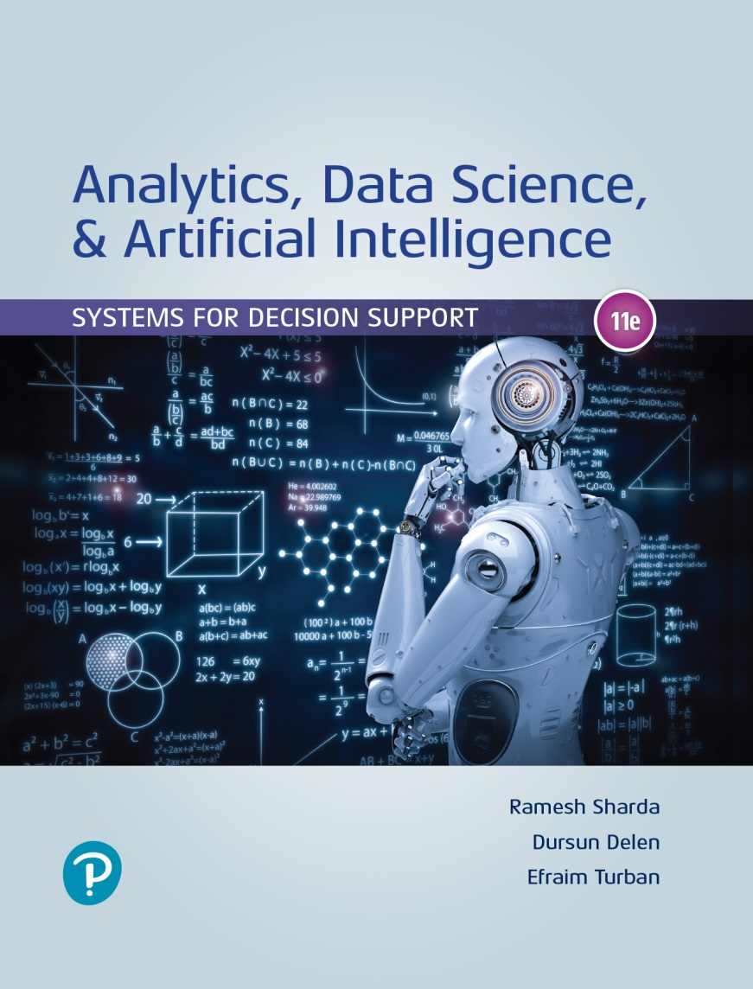
Analytics, Data Science and A I: Systems for Decision Support
Eleventh Edition
Chapter 8
Prescriptive Analytics: Optimization and Simulation
Slide in this Presentation Contain Hyperlinks. JAWS users should be able to get a list of links by using INSERT+F77
Copyright © 2020, 2015, 2011 Pearson Education, Inc. All Rights Reserved
Notes:
If this PowerPoint presentation contains mathematical equations, you may need to check that your computer has the following installed:
1) Math Type Plugin
2) Math Player (free versions available)
3) NVDA Reader (free versions available)

Slide 2
Learning Objectives (1 of 2)
8.1 Understand the applications of prescriptive analytics techniques in combination with reporting and predictive analytics
8.2 Understand the basic concepts of analytical decision modeling
8.3 Understand the concepts of analytical models for selected decision problems, including linear programming and simulation models for decision support
8.4 Describe how spreadsheets can be used for analytical modeling and solutions
Notes:
Slide 2 is list of textbook LO numbers and statements

Slide 3
Learning Objectives (2 of 2)
8.5 Explain the basic concepts of optimization and when to use them
8.6 Describe how to structure a linear programming model
8.7 Explain what is meant by sensitivity analysis, what-if analysis, and goal seeking
8.8 Understand the concepts and applications of different types of simulation
8.9 Understand potential applications of discrete event simulation
Notes:
Slide 2 is a list of textbook LO numbers and statements

Slide 4
Opening Vignette (1 of 2)
School District of Philadelphia Uses Prescriptive Analytics to Find Optimal Solution for Awarding Bus Route Contracts
Background and the problem
The solution…
The results…

Slide 5
Opening Vignette (2 of 2)
Questions for the Opening Vignette:
What decision was being made in this vignette?
What data (descriptive and or predictive) might one need to make the best allocations in this scenario?
What other costs or constraints might you have to consider in awarding contracts for such routes?
Which other situations might be appropriate for applications of such models?

Slide 6
Model Based Decision Making (1 of 2)
Use models/representations of real-world… to make decision on real-world situations
Plenty of examples exist in many domains
Its name changes but the purpose stays the same: support the decision making process
I N F O R M S publications has plenty of cutting edge, model-based decision making examples
Interfaces (new name-Journal of Applied Analytics), O R M S Today, and Analytics Magazine

Slide 7
Application Case 8.1
Canadian Football League Optimizes Game Schedule
Questions for Discussion:
List three ways in which Solver-based scheduling of games could result in more revenue as compared to the manual scheduling.
In what other ways can C F L leverage the Solver software to expand and enhance their other business operations?
What other considerations could be important in scheduling such games?

Slide 8
Model Based Decision Making (2 of 2)
Prescriptive analytics model examples
Mathematical models for decision recommendation
Indemnification of the problem
Environmental scanning and analysis
Variable identificaiton
Forecasting
As part of prescriptive analytics
What is likely to happen
Influencing the decision made for the future

Slide 9
Application Case 8.2
Ingram Micro Uses Business Intelligence Applications to Make Pricing Decisions
Questions for Discussion:
What were the main challenges faced by Ingram Micro in developing a B I C?
List all the business intelligence solutions developed by Ingram to optimize the prices of their products and to profile their customers.
What benefits did Ingram receive after using the newly developed B I applications?

Slide 10
Model Categories
Static versus dynamic models
Time dependent / time independent
Model management
Knowledge-based modeling
Current trends in modeling
Model libraries
Cloud-based modeling tools/platforms
Model transparency / multi-dimensional modeling
Influence diagrams for better modeling

Slide 11
Categories of Models
Table 8.1 Categories of Models.
Category | Process and Objective | Representative Techniques
Optimization of problems with few alternatives | Find the best solution from a small number of alternatives | Decision tables, decision trees, analytic hierarchy process
Optimization via algorithm | Find the best solution from a large number of alternatives, using a step-by-step improvement process | Linear and other mathematical programming models, network models
Optimization via an analytic formula | Find the best solution in one step, using a formula | Some inventory models
Simulation | Find a good enough solution or the best among the alternatives checked, using experimentation | Several types of simulation
Heuristics | Find a good enough solution, using rules | Heuristic programming, expert systems
Predictive models | Predict the future for a given scenario | Forecasting models, Markov analysis
Other models | Solve a what-if case, using a formula | Financial modeling, waiting lines

Slide 12
Structure of Mathematical Models for Decision Support (1 of 2)
Quantitative Models: Mathematically links decision variables, uncontrollable variables, and result variables
Non-quantitative models: qualitative models
Result (outcome variable)
Decision variables
Uncontrollable variable (or parameters)
Intermediate results

Slide 13
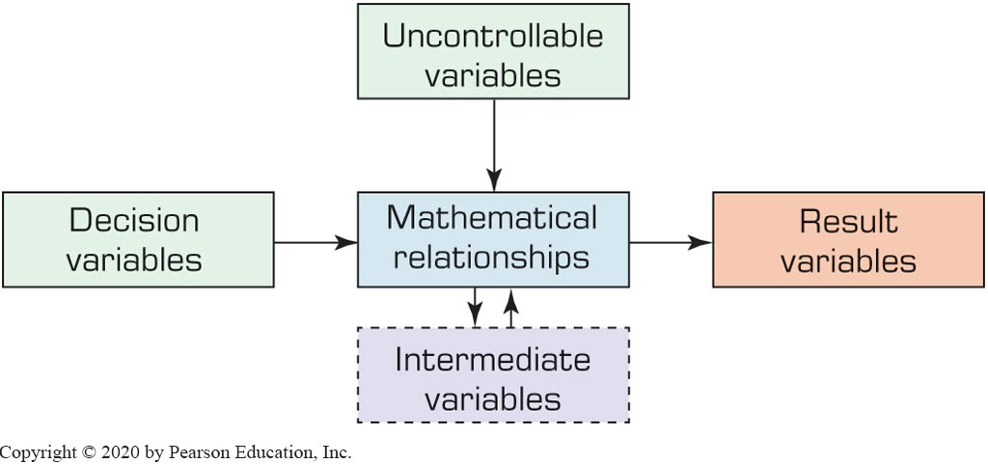
Structure of Mathematical Models for Decision Support (2 of 2)

Slide 14
Examples of Components of Models
Table 8.2 Examples of Components of Models.
Area | Decision Variables | Result Variables | Uncontrollable Variables and Parameters
Financial investment | Investment alternatives and amounts | Total profit, risk Rate of return on investment (R O I) Earnings per share Liquidity level | Inflation rate Prime rate Competition
Marketing | Advertising budget Where to advertise | Market share Customer satisfaction | Customer’s income Competitor’s actions
Manufacturing | What and how much to produce Inventory levels Compensation programs | Total cost Quality level Employee satisfaction | Machine capacity Technology Materials prices
Accounting | Use of computers Audit schedule | Data processing cost Error rate | Computer technology Tax rates Legal requirements
Transportation | Shipments schedule use of smart cards | Total transport cost Payment float time | Delivery distance Regulations
Services | Staffing levels | Customer satisfaction | Demand for services

Slide 15
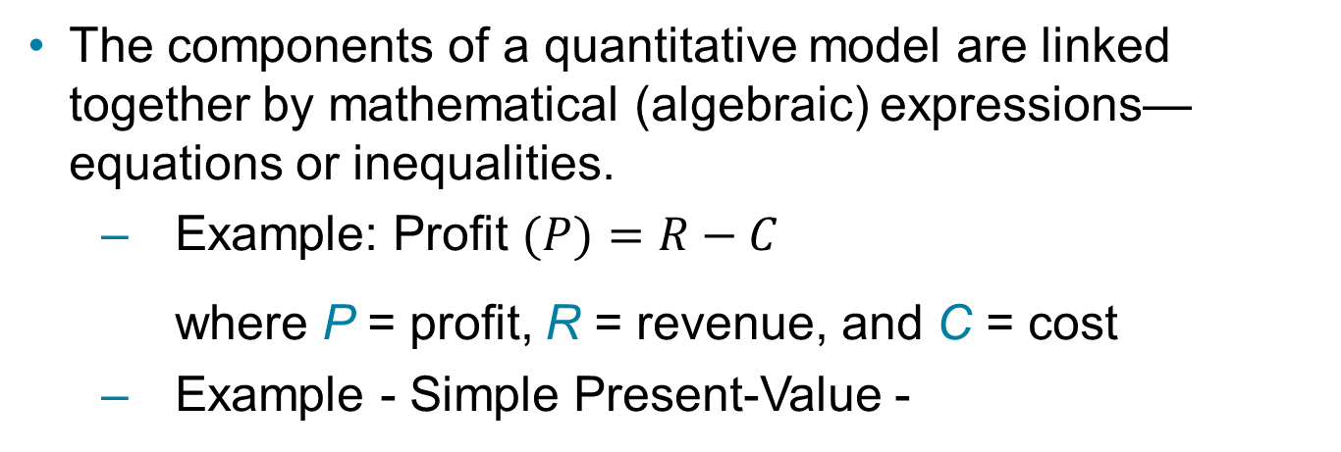
The Structure of a Mathematical Model
The components of a quantitative model are linked together by mathematical (algebraic) expressions—equations or inequalities.
Example: Profit $(P)=R−C$
where P = profit, R = revenue, and C = cost
Example - Simple Present-Value -
where P = present value, F = future cash-flow,
i = interest-rate, and n = number of period (years)

Slide 16
Modeling and Decision Making - Under Certainty, Uncertainty, and Risk (1 of 2)
Certainty
Assume complete knowledge
All potential outcomes are known
Uncertainty
Several outcomes for each decision
Probability of each outcome is unknown
Risk analysis (probabilistic decision making)
Probability of each outcomes is known
Level of uncertainty → Risk (expected value)

Slide 17
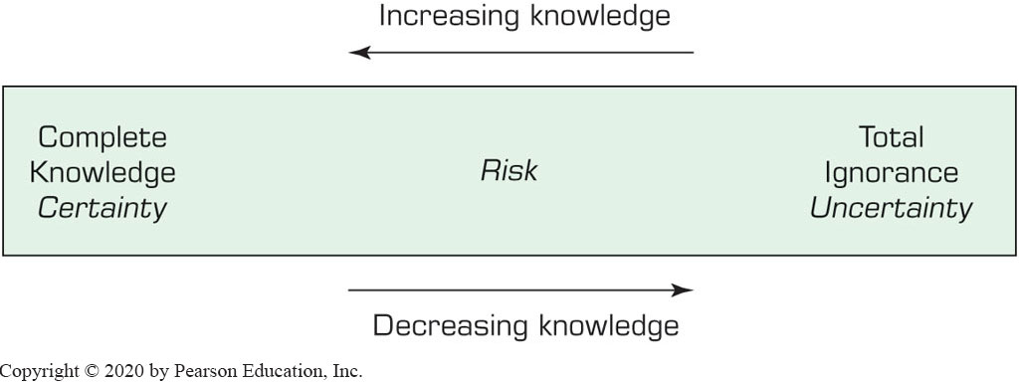
Modeling and Decision Making - Under Certainty, Uncertainty, and Risk (2 of 2)
The Zones of Decision Making

Slide 18
Application Case 8.3
American Airlines Uses Should-Cost Modeling to Assess the Uncertainty of Bids for Shipment Routes
Questions for Discussion:
Besides reducing the risk of overpaying or underpaying suppliers, what are some other benefits A A would derive from its “should-be” model?
Can you think of other domains besides air transportation where such a model could be used?
Discuss other possible methods with which A A could have solved its bid overpayment and underpayment problem.

Slide 19
Decision Modeling with Spreadsheets
Spreadsheet
Most popular end-user modeling tool
Flexible and easy to use
Powerful functions (add-in functions)
Programmability (via macros)
What-if analysis and goal seeking
Simple database management
Seamless integration of model and data
Incorporates both static and dynamic models
Examples: Microsoft Excel (with Solver add-in)

Slide 20
Application Case 8.4
Pennsylvania Adoption Exchange Uses Spreadsheet Model to Better Match Children with Families
Questions for Discussion:
What were the challenges faced by P A E while making adoption matching decisions?
What features of the new spreadsheet tool helped P A E solve their issues of matching a family with a child?

Slide 21
Application Case 8.5
Metro Meals on Wheels Treasure Valley Uses Excel to Find Optimal Delivery Routes
Questions for Discussion:
What were the challenges faced by Metro Meals on Wheels Treasure Valley related to meal delivery before adoption of the spreadsheet-based tool?
Explain the design of the spreadsheet-based model.
What are the intangible benefits of using the Excel-based model to Metro Meals on Wheels?

Slide 22
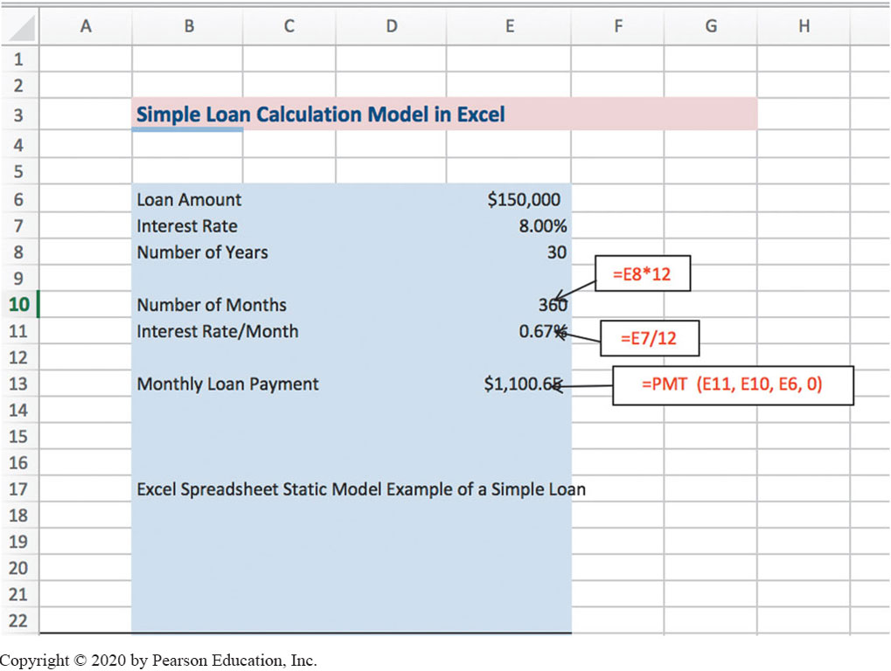
Excel Spreadsheet - Static Model Example
(Simple loan calculation of monthly payments)

Slide 23
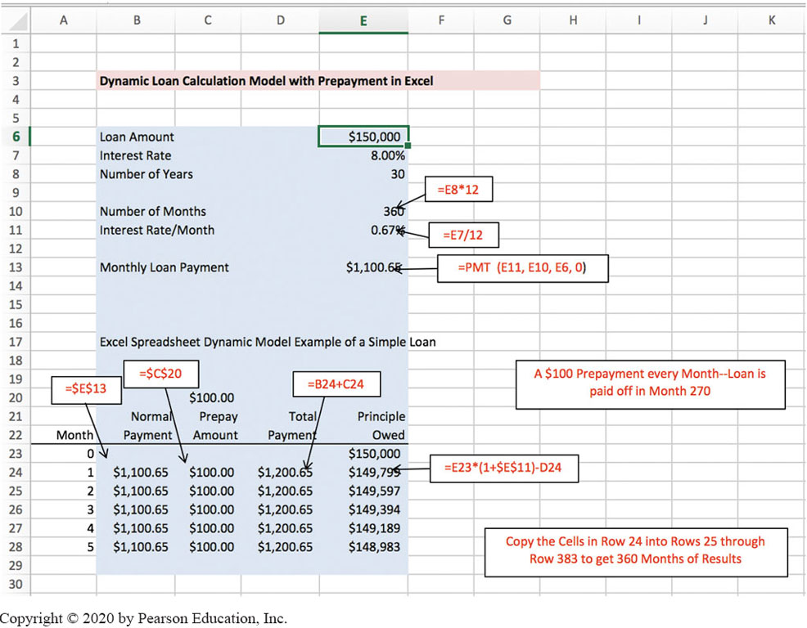
Excel Spreadsheet - Dynamic Model Example
(Simple loan calculation – effect of prepayment)

Slide 24
Mathematical Programming Optimization
Mathematical Programming
A family of tools designed to help solve managerial problems in which the decision maker must allocate scarce resources among competing activities to optimize a measurable goal
Optimal solution: The best possible solution to a modeled problem
Linear programming (L P): A mathematical model for the optimal solution of resource allocation problems. All the relationships are linear.

Slide 25
Application Case 8.6
Mixed-Integer Programming Model Helps the University of Tennessee Medical Center with Scheduling Physicians
Questions for Discussion:
What was the issue faced by the Regional Neonatal Associates group?
How did the H P S M model solve all of the physician’s requirements?

Slide 26
L P Problem Characteristics
Limited quantity of economic resources
Resources are used in the production of products or services
Two or more ways (solutions, programs) to use the resources
Each activity (product or service) yields a return in terms of the goal
Allocation is usually restricted by constraints

Slide 27
Linear Programming (L P) Steps
Identify the …
Decision variables
Objective function
Objective function coefficients
Constraints
Capacities / Demands / …
Represent the model
L I N D O: Write mathematical formulation
E X C E L: Input data into specific cells in Excel
Run the model and observe the results

Slide 28
L P Modeling – Example (1 of 3)
The Product-Mix Linear Programming Model
M B I Corporation
Decision variable: How many computers to build next month?
Two types of mainframe computers: C C-7 and C C-8
Constraints: Labor limits, Materials limit, Marketing lower limits
C C-7 C C-8 Rel Limit Labor (days) 300 500 <= 200,000 /mo Materials ($) 10,000 15,000 <= 8,000,000 /mo Units 1 >= 100 Units 1 >= 200 Profit ($) 8,000 12,000 Max
Objective: Maximize Total Profit / Month

Slide 29
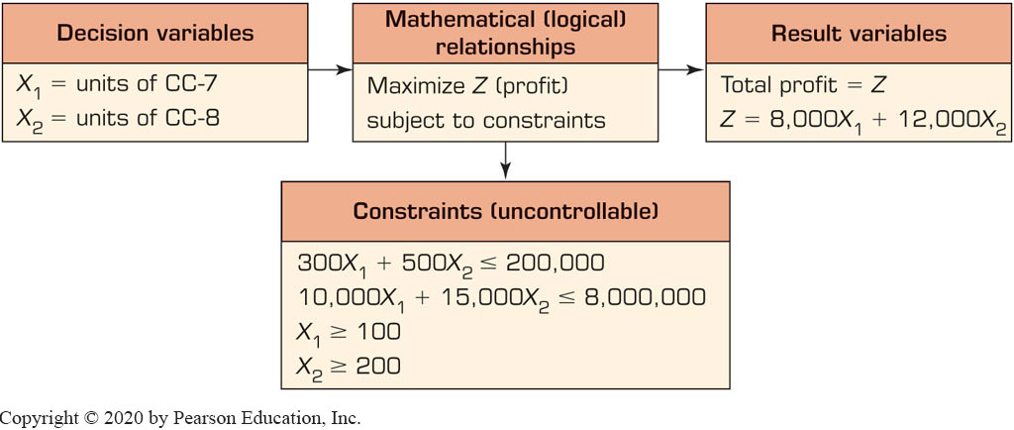
L P Modeling – Example (2 of 3)

Slide 30
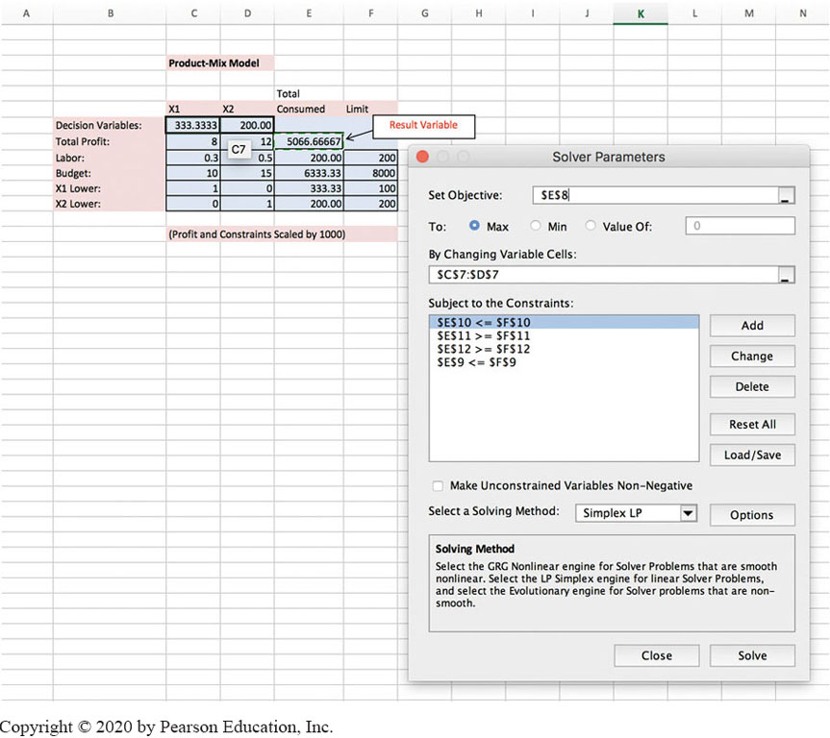
L P Modeling – Example (3 of 3)
Figure 8.6 Excel Solver Solution to the Product-Mix Example.

Slide 31
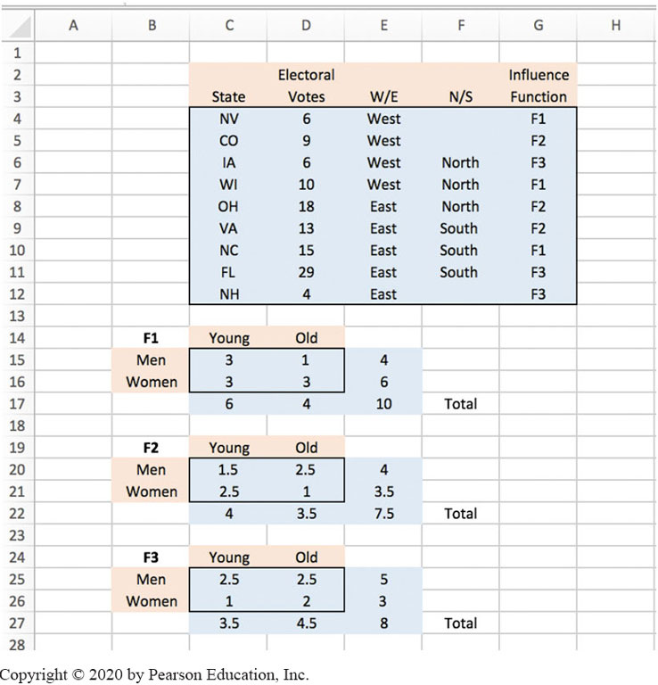
Illustrating the Power of Spreadsheet Modeling
Election Resource Allocation Problem
Analysis of “swing states” for the 2012 election…

Slide 32
Common Optimization Models
Assignment (best matching of objects)
Dynamic programming
Goal programming
Investment (maximizing rate of return)
Linear and integer programming
Network models for planning and scheduling
Nonlinear programming
Replacement (capital budgeting)
Simple inventory models (e.g., economic order quantity)
Transportation (minimize cost of shipments)

Slide 33
Multiple Goals, Sensitivity Analysis, What-If Analysis, and Goal Seeking (1 of 6)
Multiple Goals
Simple-goal vs. multiple goals
Vast majority of managerial problems has multiple goals (objectives) to achieve
Attaining simultaneous goals
Methods of handling multiple goals
Utility theory
Goal programming
Expression of goals as constraints, using L P
A points system

Slide 34
Multiple Goals, Sensitivity Analysis, What-If Analysis, and Goal Seeking (2 of 6)
Certain difficulties may arise when analyzing multiple goals
Difficult to obtain a single organizational goal
The importance of goals change over time
Goals and sub-goals are viewed differently
Goals change in response to other changes
Dynamics of groups of decision makers
Assessing the importance (priorities)
…

Slide 35
Multiple Goals, Sensitivity Analysis, What-If Analysis, and Goal Seeking (3 of 6)
Sensitivity analysis
It is the process of assessing the impact of change in inputs on outputs
Helps to …
eliminate (or reduce) variables
revise models to eliminate too-large sensitivities
adding details about sensitive variables or scenarios
obtain better estimates of sensitive variables
alter a real-world system to reduce sensitivities
…
Can be automatic or “trial and error”

Slide 36
Multiple Goals, Sensitivity Analysis, What-If Analysis, and Goal Seeking (4 of 6)
What-if analysis
Assesses solutions based on changes in variables or assumptions (scenario analysis)
What if we change our capacity at the milling station by 40% [what would be the impact]
Goal seeking
Backwards approach, starts with the goal and determines values of inputs needed
Example is break-even point determination
In-order to break even (profit = 0), how many products do we have to sell each month

Slide 37
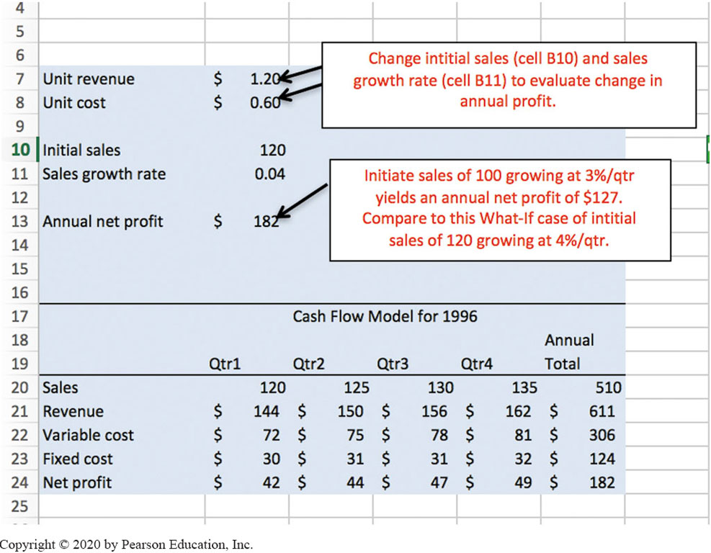
Multiple Goals, Sensitivity Analysis, What-If Analysis, and Goal Seeking (5 of 6)
Figure 8.10 Example of a What-If Analysis Done in an Excel Worksheet.

Slide 38
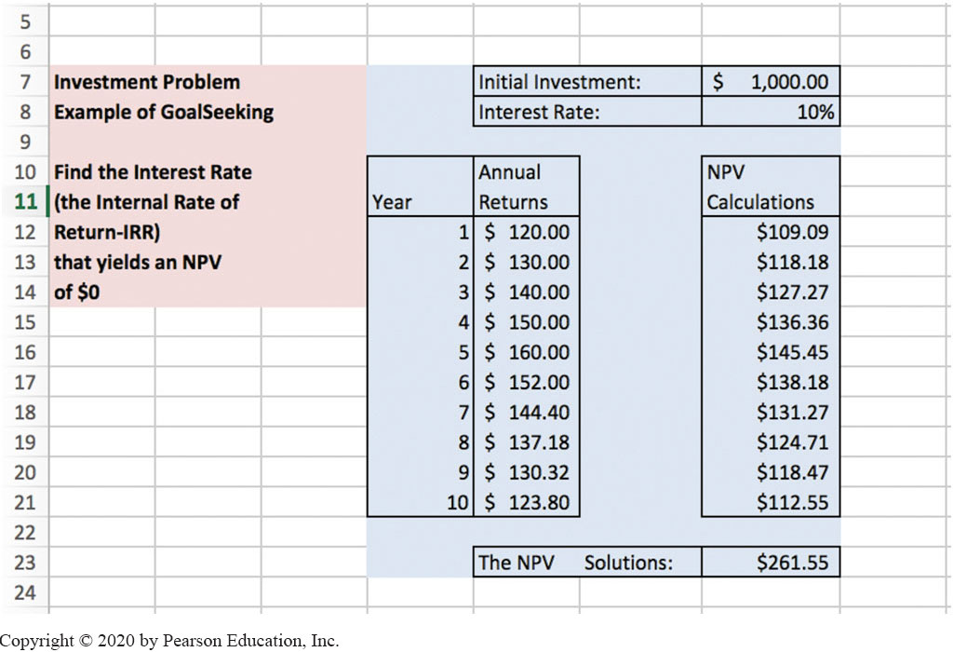
Multiple Goals, Sensitivity Analysis, What-If Analysis, and Goal Seeking (6 of 6)
Figure 8.11 Goal-Seeking Analysis.

Slide 39
Decision Analysis with Decision Tables and Decision Trees
Decision Tables – a tabular representation of the decision situation (alternatives)
Investment Example
Goal: maximize the yield after one year
Yield depends on the status of the economy (the state of nature)
Solid growth
Stagnation
Inflation

Slide 40
Decision Table: Investment Example (1 of 2)
If solid growth in the economy, bonds yield 12%; stocks 15%; time deposits 6.5%
If stagnation, bonds yield 6%; stocks 3%; time deposits 6.5%
If inflation, bonds yield 3%; stocks lose 2%; time deposits yield 6.5%

Slide 41
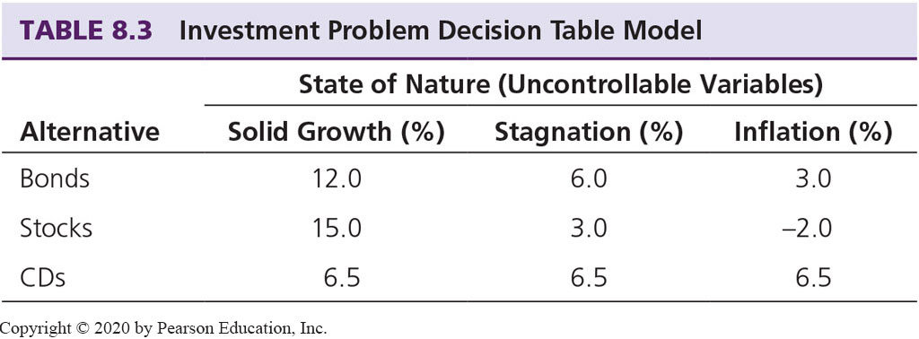
Decision Table: Investment Example (2 of 2)
Payoff decision variables (alternatives)
Uncontrollable variables (states of economy)
Result variables (projected yield)
Tabular representation:

Slide 42
Decision Table: Investment Example (Treating Uncertainty)
Optimistic approach
Pessimistic approach
Treating Risk/Uncertainty:
Use known probabilities
Expected values

Slide 43
Decision Table: Investment Example (Multiple Goals)
Multiple goals
Yield, safety, and liquidity
Alternative | Yield (%) | Safety | Liquidity
Bonds | 8.4 | High | High
Stocks | 8.0 | Low | High
CDs | 6.5 | Very high | High

Slide 44
Decision Trees
Graphical representation of relationships
Multiple criteria approach
Demonstrates complex relationships
Cumbersome, if many alternatives exists
Tools include
Mind Tools Ltd., mindtools.com
TreeAge Software Inc., treeage.com
Palisade Corp., palisade.com

Slide 45
Simulation
Simulation is the “appearance” of reality
It is often used to conduct what-if analysis on the model of the actual system
It is a popular D S S technique for conducting experiments with a computer on a comprehensive model of the system to assess its dynamic behavior
Often used when the system is too complex for other D S S techniques

Slide 46
Application Case 8.7
Steel Tubing Manufacturer Uses a Simulation-Based Production Scheduling System
Questions for Discussion:
Explain the advantages of using Simio’s simulation model over traditional methods.
In what ways has the predictive analysis approach helped management achieve the goals of analyzing the production schedules?
Besides the steel manufacturing industry, in what other industries could such a modeling approach help improve quality and service?

Slide 47
Major Characteristics of Simulation
Imitates reality and captures its richness both in shape and behavior
“Represent” versus “Imitate”
Technique for conducting experiments
Descriptive, not normative tool
Often to “solve” [i.e., analyze] very complex systems/problems
Simulation should be used only when a numerical optimization is not possible

Slide 48
Advantages of Simulation
The theory is fairly straightforward
Great deal of time compression
Experiment with different alternatives
The model reflects manager’s perspective
Can handle wide variety of problem types
Can include the real complexities of problems
Produces important performance measures
…

Slide 49
Disadvantages of Simulation
Cannot guarantee an optimal solution
Slow and costly construction process
Cannot transfer solutions and inferences to solve other problems (problem specific)
So easy to explain/sell to managers, may lead to overlooking analytical solutions
Software may require special skills

Slide 50
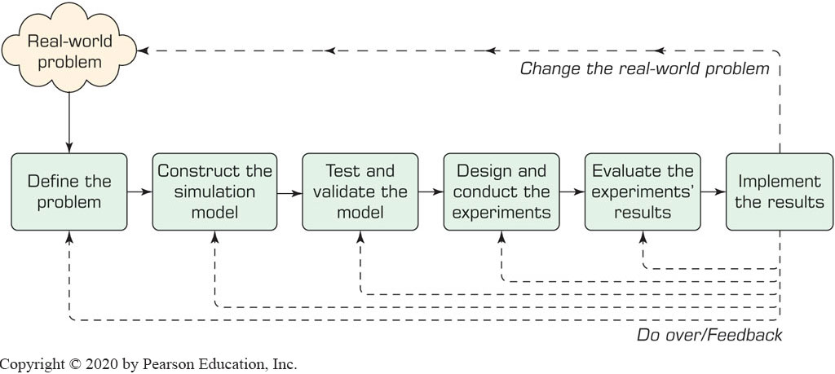
Simulation Methodology
Steps:
1. Define problem
2. Construct the model
3. Test and validate model
4. Design experiments
5. Conduct experiments
6. Evaluate results
7. Implement solution

Slide 51
Simulation Types
Probabilistic/Stochastic vs. Deterministic Simulation
Uses probability distributions
Time-dependent vs. Time-independent Simulation
Monte Carlo technique (X = A + B) [A, B, and X are all distributions]
Discrete Event vs. Continuous Simulation
Simulation Implementation
Visual Simulation and/or Object-Oriented Simulation

Slide 52
Application Case 8.8
Cosan Improves Its Renewable Energy Supply Chain Using Simulation
Questions for Discussion:
What type of supply chain disruptions might occur in moving the sugar cane from the field to the production plants to develop sugar and ethanol?
What types of advanced planning and prediction might be useful in mitigating such disruptions?

Slide 53
Visual Interactive Simulation (V I S)
Visual interactive modeling (V I M), also called Visual Interactive Simulation or Visual interactive problem solving
Uses computer graphics to present the impact of different management decisions
Often integrated with 3G and G I S
Users can perform sensitivity analysis
Static or dynamic (animation) systems
Virtual reality, immersive, …

Slide 54
Simulation Software
Stand-alone desktop simulation tools
Web-based simulation tools
See O R/M S Today for software reviews
Examples:
Simio
Arena
ExtendSim
S A S Simulation Studio
…

Slide 55
Application Case 8.9
Improving Job-Shop Scheduling Decisions through R F I D: A Simulation-Based Assessment
Questions for Discussion:
In situations such as what this case depicts, what other approaches can one take to analyze investment decisions?
How would one save time if an R F I D chip can tell the exact location of a product in process?
Research to learn about the applications of R F I D sensors in other settings. Which one do you find most interesting?

Slide 56
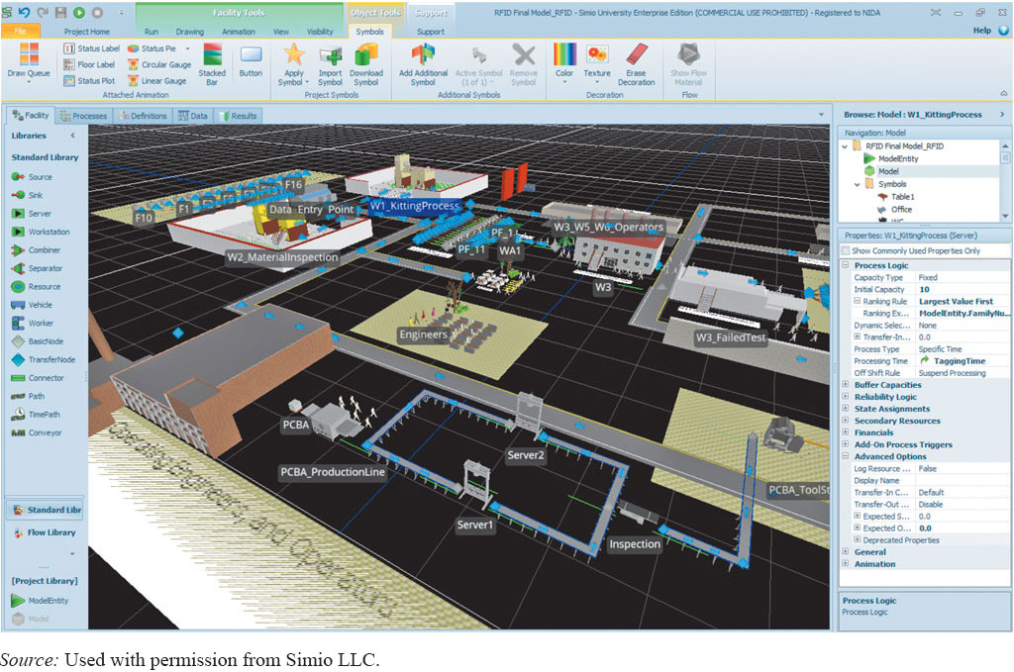
Application Case 8.9 – Simio Model (1 of 4)
Figure 8.13 Simio Interface View of the Simulation System.
Source: Used with permission from Simio L L C.

Slide 57
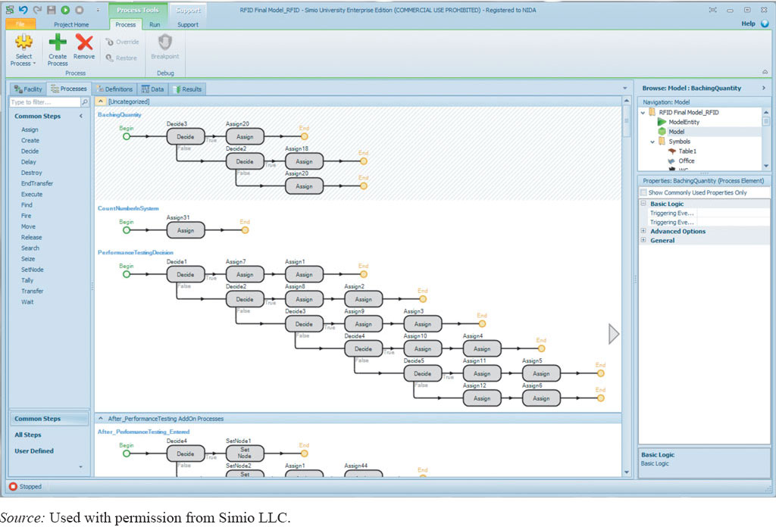
Application Case 8.9 – Simio Model (2 of 4)
Figure 8.14 Process View of the Simulation Model.
Back End - Process
Source: Used with permission from Simio L L C.

Slide 58
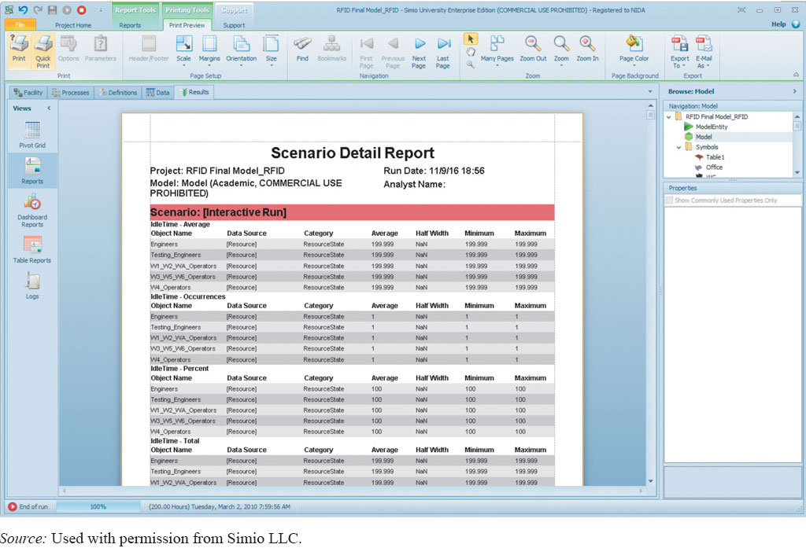
Application Case 8.9 – Simio Model (3 of 4)
Figure 8.15 Standard Report View.
Source: Used with permission from Simio L L C.

Slide 59
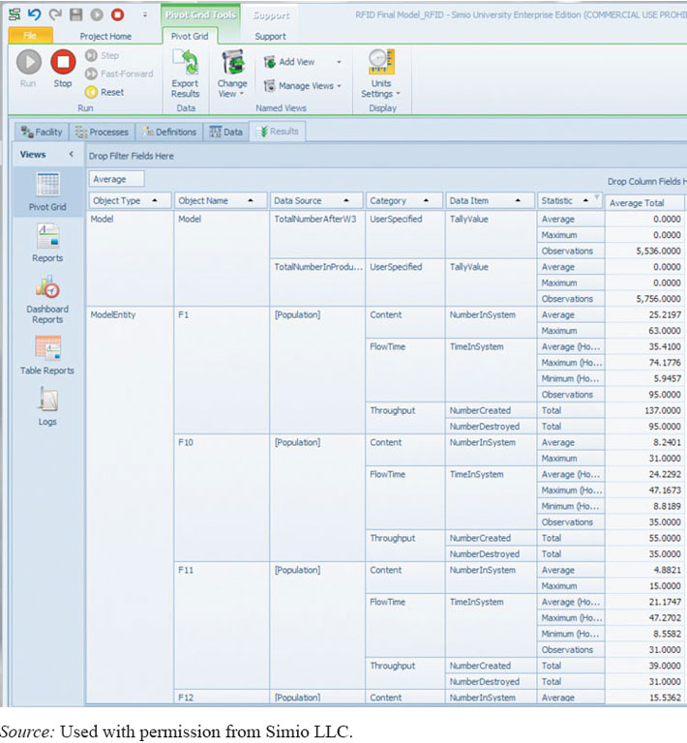
Application Case 8.9 – Simio Model (4 of 4)
Figure 8.16 Pivot Grid Report from a Simio Run.
OUTPUT
Source: Used with permission from Simio L L C.

Slide 60
End of Chapter 8
Questions & Comments

Slide 61

Copyright
This work is protected by United States copyright laws and is provided solely for the use of instructors in teaching their courses and assessing student learning. Dissemination or sale of any part of this work (including on the World Wide Web) will destroy the integrity of the work and is not permitted. The work and materials from it should never be made available to students except by instructors using the accompanying text in their classes. All recipients of this work are expected to abide by these restrictions and to honor the intended pedagogical purposes and the needs of other instructors who rely on these materials.

