Slide 1

Analytics, Data Science and A I: Systems for Decision Support
Eleventh Edition
Chapter 9
Big Data, Cloud Computing, and Location Analytics: Concepts and Tools
Slide in this Presentation Contain Hyperlinks. JAWS users should be able to get a list of links by using INSERT+F77
Copyright © 2020, 2015, 2011 Pearson Education, Inc. All Rights Reserved
Notes:
If this PowerPoint presentation contains mathematical equations, you may need to check that your computer has the following installed:
1) Math Type Plugin
2) Math Player (free versions available)
3) NVDA Reader (free versions available)

Slide 2
Learning Objectives (1 of 2)
9.1 Learn what Big Data is and how it is changing the world of analytics
9.2 Understand the motivation for and business drivers of Big Data analytics
9.3 Become familiar with the wide range of enabling technologies for Big Data analytics
9.4 Learn about Hadoop, MapReduce, and NoS Q L as they relate to Big Data analytics
9.5 Compare and contrast the complementary uses of data warehousing and Big Data technologies
Notes:
Slide 2 is a list of textbook LO numbers and statements.

Slide 3
Learning Objectives (2 of 2)
9.6 Become familiar with in-memory analytics and Spark applications
9.7 Become familiar with select Big Data platforms and services
9.8 Understand the need for and appreciate the capabilities of stream analytics
9.9 Learn about the applications of stream analytics
9.10 Describe the current and future use of cloud computing in business analytics
9.11 Describe how geospatial and location-based analytics are assisting organizations
Notes:
Slide 3 is a list of textbook LO numbers and statements.

Slide 4
Opening Vignette (1 of 4)
Analyzing Customer Churn in a Telecom Company Using Big Data Methods
Telecom – a highly competitive market segment
Customer churn rate is higher than most other markets
A good example of Big Data analytics
Challenges
Data from multiple sources
Data volume is higher than usual
Solution
Results

Slide 5
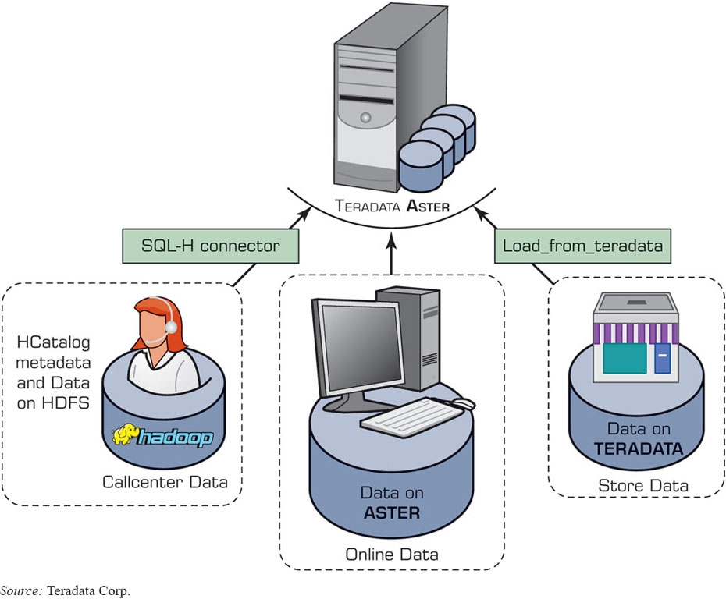
Opening Vignette (2 of 4)
Analyzing Customer Churn in a Telecom Company Using Big Data Methods
Figure 9.1 Multiple Data Sources Integrated into Teradata Vantage.
Source: Teradata Corp.

Slide 6
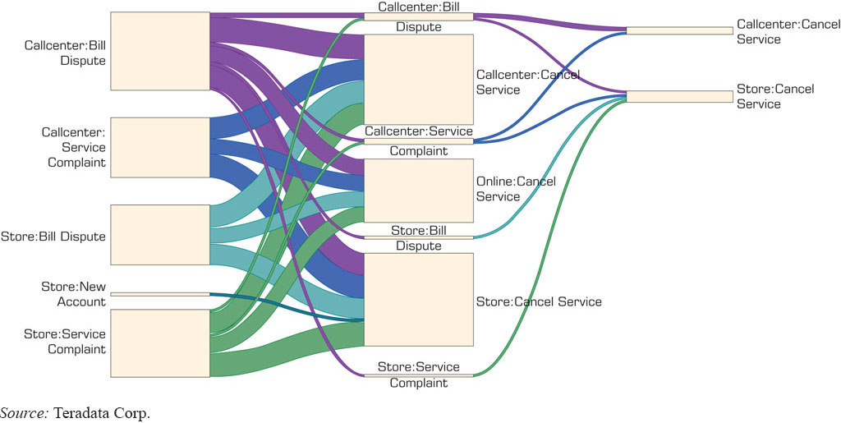
Opening Vignette (3 of 4)
Analyzing Customer Churn in a Telecom Company Using Big Data Methods
Figure 9.2 Top 20 Paths Visualization.
Source: Teradata Corp.

Slide 7
Opening Vignette (4 of 4)
Analyzing Customer Churn in a Telecom Company Using Big Data Methods
Questions for the Opening Vignette:
What problem did customer service cancellation pose to A T’s business survival?
Identify and explain the technical hurdles presented by the nature and characteristics of A T’s data.
What is sessionizing? Why was it necessary for A T to sessionize its data?
Research other studies where customer churn models have been employed. What types of variables were used in those studies? How is this vignette different?

Slide 8
Big Data - Definition and Concepts (1 of 2)
Big Data means different things to people with different backgrounds and interests
Traditionally, “Big Data” = massive volumes of data
E.g., volume of data at C E R N, N A S A, Google, …
Where does the Big Data come from?
Everywhere! Web logs, R F I D, G P S systems, sensor networks, social networks, Internet-based text documents, Internet search indexes, detail call records, astronomy, atmospheric science, biology, genomics, nuclear physics, biochemical experiments, medical records, scientific research, military surveillance, multimedia archives, …

Slide 9
Technology Insights 9.1
The Data Size Is Getting Bigger and Bigger
Hadron Collider - 1 P B/sec
Boeing jet - 20 T B/hr
Facebook - 500 T B/day
YouTube – 1 T B/4 min
The proposed Square Kilometer Array telescope (the world’s proposed biggest telescope) – 1 E B/day
Name | Symbol | Value
Kilobyte | k B | 10³
Megabyte | M B | 10⁶
Gigabyte | G B | 10⁹
Terabyte | T B | 10¹²
Petabyte | P B | 10¹⁵
Exabyte | E B | 10¹⁸
Zettabyte | Z B | 10²¹
Yottabyte | Y B | 10²⁴
Brontobyte* | B B | 10²⁷
Gegobyte* | G e B | 10³⁰
*Not an official S I (International System of Units) name/symbol, yet.

Slide 10
Big Data - Definition and Concepts (2 of 2)
Big Data is a misnomer!
Big Data is more than just “big”
The Vs that define Big Data
Volume
Variety
Velocity
Veracity
Variability
Value
…

Slide 11
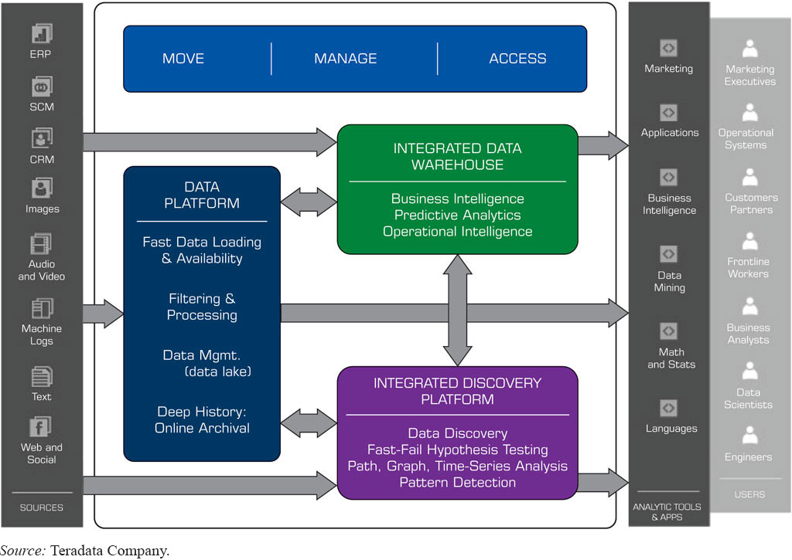
A High-Level Conceptual Architecture for Big Data Solutions (by AsterData / Teradata)
Figure 9.3 A High-Level Conceptual Architecture for Big Data Solutions.
Source: Teradata Company.

Slide 12
Application Case 9.1
Alternative Data for Market Analysis or Forecasts
Questions for Discussion:
What is a common thread in the examples discussed in this application case?
Can you think of other data streams that might help give an early indication of sales at a retailer?
Can you think of other applications along the lines presented in this application case?

Slide 13
Fundamentals of Big Data Analytics
Big Data by itself, regardless of the size, type, or speed, is worthless
Big Data + “big” analytics = value
With the value proposition, Big Data also brought about big challenges
Effectively and efficiently capturing, storing, and analyzing Big Data
New breed of technologies needed (developed or purchased or hired or outsourced …)

Slide 14
Big Data Considerations
You can’t process the amount of data that you want to because of the limitations of your current platform.
You can’t include new/contemporary data sources (e.g., social media, R F I D, Sensory, Web, G P S, textual data) because it does not comply with the data storage schema
You need to (or want to) integrate data as quickly as possible to be current on your analysis.
You want to work with a schema-on-demand data storage paradigm because the variety of data types involved.
The data is arriving so fast at your organization’s doorstep that your traditional analytics platform cannot handle it.
…

Slide 15
Critical Success Factors for Big Data Analytics (1 of 2)
A clear business need (alignment with the vision and the strategy)
Strong, committed sponsorship (executive champion)
Alignment between the business and I T strategy
A fact-based decision-making culture
A strong data infrastructure
The right analytics tools
Right people with right skills

Slide 16
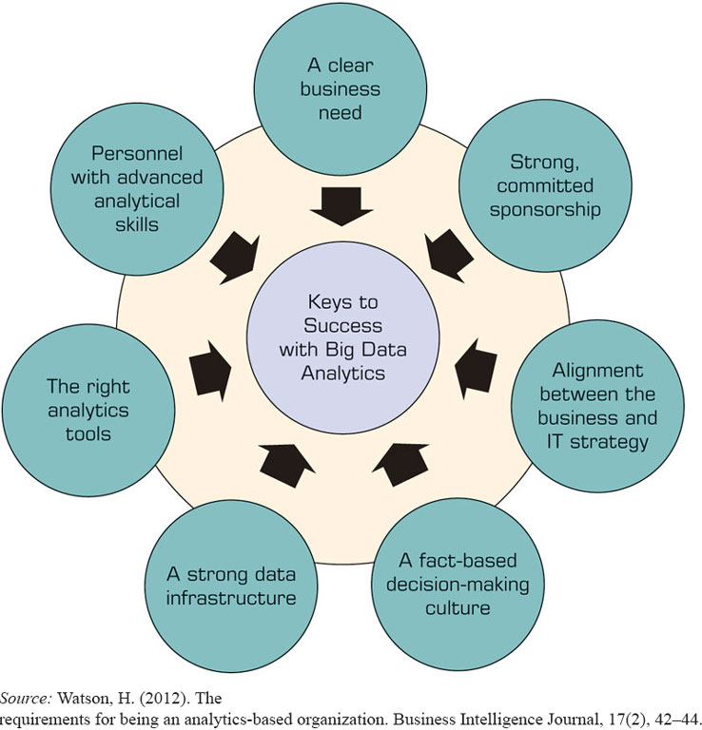
Critical Success Factors for Big Data Analytics (2 of 2)
Figure 9.4 Critical Success Factors for Big Data Analytics.
Source: Watson, H. (2012). The requirements for being an analytics-based organization. Business Intelligence Journal, 17(2), 42–44.

Slide 17
Enablers of Big Data Analytics
In-memory analytics
Storing and processing the complete data set in R A M
In-database analytics
Placing analytic procedures close to where data is stored
Grid computing & M P P
Use of many machines and processors in parallel (M P P - massively parallel processing)
Appliances
Combining hardware, software, and storage in a single unit for performance and scalability

Slide 18
Challenges of Big Data Analytics
Data volume
The ability to capture, store, and process the huge volume of data
Data integration
The ability to combine data quickly and at reasonable cost
Processing capabilities
The ability to process the data quickly, as it is captured (i.e., stream analytics)
Data governance (… security, privacy, access)
Skill availability (… data scientist)
Solution cost (R O I)

Slide 19
Business Problems Addressed by Big Data Analytics
Process efficiency and cost reduction
Brand management
Revenue maximization, cross-selling/up-selling
Enhanced customer experience
Churn identification, customer recruiting
Improved customer service
Identifying new products and market opportunities
Risk management
Regulatory compliance …

Slide 20
Application Case 9.2
Overstock.com Combines Multiple Datasets to Understand Customer Journeys
Questions for Discussion:
What are some of the different marketing campaigns a company might run to woo customers? What format might data about these campaigns take?
By visualizing the most common customer paths to sales, how would you use that information to make decisions on the future marketing campaigns?
What other applications of such path analysis techniques can you think of?

Slide 21

Big Data Technologies
MapReduce …
Hadoop …
Hive
Pig
Hbase
Flume
Oozie
Ambari
Avro
Mahout, Sqoop, Hcatalog, ….

Slide 22

Big Data Technologies MapReduce
MapReduce distributes the processing of very large multi-structured data files across a large cluster of ordinary machines/processors
Goal - achieving high performance with “simple” computers
Developed and popularized by Google
Good at processing and analyzing large volumes of multi-structured data in a timely manner
Example tasks: indexing the Web for search, graph analysis, text analysis, machine learning, …

Slide 23
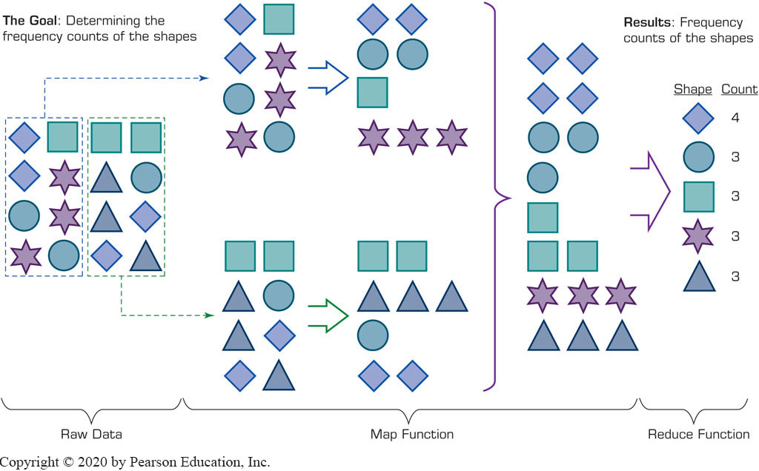
Big Data Technologies --MapReduce
How does MapReduce work?

Slide 24
Big Data Technologies --Hadoop (1 of 3)
Hadoop is an open source framework for storing and analyzing massive amounts of distributed, unstructured data
Originally created by Doug Cutting at Yahoo!
Hadoop clusters run on inexpensive commodity hardware so projects can scale-out inexpensively
Hadoop is now part of Apache Software Foundation
Open source - hundreds of contributors continuously improve the core technology

Slide 25
Big Data Technologies --Hadoop (2 of 3)
How Does Hadoop Work?
Access unstructured and semi-structured data (e.g., log files, social media feeds, other data sources)
Break the data up into “parts,” which are then loaded into a file system made up of multiple nodes running on commodity hardware using H D F S
Each “part” is replicated multiple times and loaded into the file system for replication and failsafe processing
A node acts as the Facilitator and another as Job Tracker
Jobs are distributed to the clients, and once completed the results are collected and aggregated using MapReduce

Slide 26
Big Data Technologies --Hadoop (3 of 3)
Hadoop Technical Components
Hadoop Distributed File System (H D F S)
Name Node (primary facilitator)
Secondary Node (backup to Name Node)
Job Tracker
Slave Nodes (the grunts of any Hadoop cluster)
Additionally, Hadoop ecosystem is made up of a number of complementary sub-projects: NoS Q L (Cassandra, Hbase), D W (Hive), …
NoS Q L = not only S Q L

Slide 27
Technology Insights 9.2
A Few Demystifying Facts about Hadoop
Hadoop consists of multiple products
Hadoop is open source but available from vendors, too
Hadoop is an ecosystem, not a single product
H D F S is a file system, not a D B M S
Hive resembles S Q L but is not standard S Q L
Hadoop and MapReduce are related but not the same
MapReduce provides control for analytics, not analytics
Hadoop is about data diversity, not just data volume
…

Slide 28
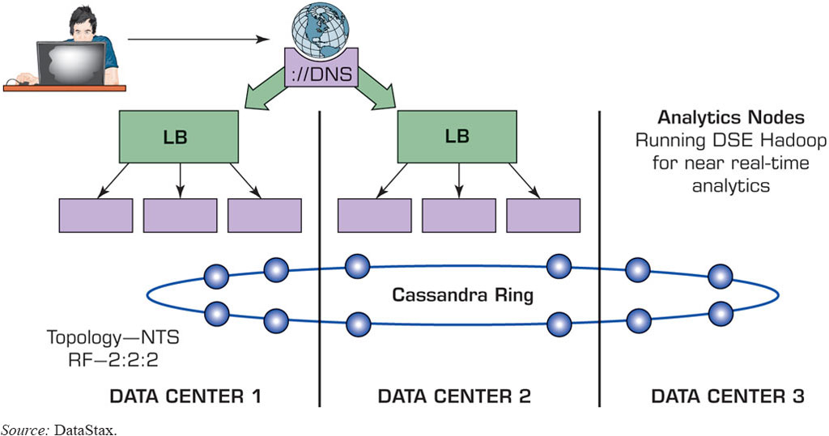
Application Case 9.3 - eBay’s Big Data Solution
Figure 9.6 eBay’s Multi–Data Center Deployment.
Source: DataStax.
Questions for Discussion:
Why did eBay need a Big Data solution?
What were the challenges, the proposed solution, and the obtained results?

Slide 29
Application Case 9.4
Understanding Quality and Reliability of Healthcare Support Information on Twitter
Questions for Discussion:
What was the data scientists’ main concern regarding health information that is disseminated on the Twitter platform?
How did the data scientists ensure that nonexpert information disseminated on social media could indeed contain valuable health information?
Does it make sense that influential users would share more objective information whereas less influential users could focus more on subjective information? Why?

Slide 30
Big Data and Data Warehousing
What is the impact of Big Data on D W?
Big Data and R D B M S do not go nicely together
Will Hadoop replace data warehousing/R D B M S?
Use Cases for Hadoop
Hadoop as the repository and refinery
Hadoop as the active archive
Use Cases for Data Warehousing
Data warehouse performance
Integrating data that provides business value
Interactive B I tools

Slide 31
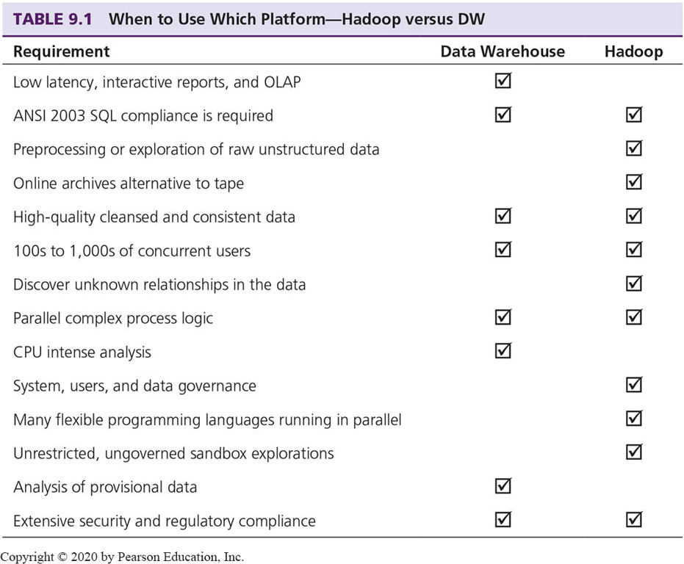
Hadoop versus Data Warehouse When to Use Which Platform

Slide 32
Coexistence of Hadoop and D W (1 of 2)
Use Hadoop for storing and archiving multi-structured data
Use Hadoop for filtering, transforming, and/or consolidating multi-structured data
Use Hadoop to analyze large volumes of multi-structured data and publish the analytical results
Use a relational D B M S that provides MapReduce capabilities as an investigative computing platform
Use a front-end query tool to access and analyze data

Slide 33
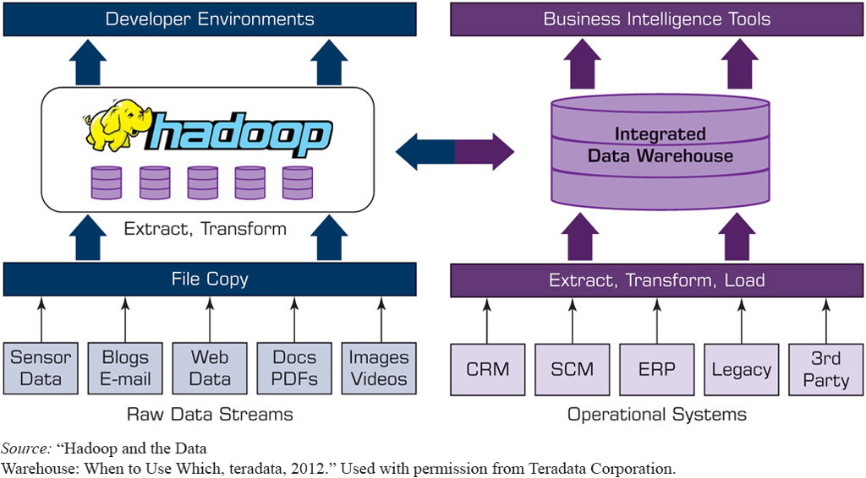
Coexistence of Hadoop and D W (2 of 2)
Figure 9.7 Coexistence of Hadoop and Data Warehouses.
Source:“Hadoop and the Data Warehouse: When to Use Which, teradata, 2012.” Used with permission from Teradata Corporation.

Slide 34
In-Memory Analytics and Spark
In-memory analytics = fast processing
In-memory processing with Apache Spark
Developed at University of California, Berkeley in 2009
Unified analytics engine for batch and streaming data
Apache Spark can be used to create
Machine learning
Fog computing
Graph
Streaming
Real-time analytics

Slide 35
Application Case 9.5
Using Natural Language Processing to analyze customer feedback in TripAdvisor reviews
Questions for Discussion:
How did the predictive modelling help TripAdvisor?
Why was Spark used?

Slide 36
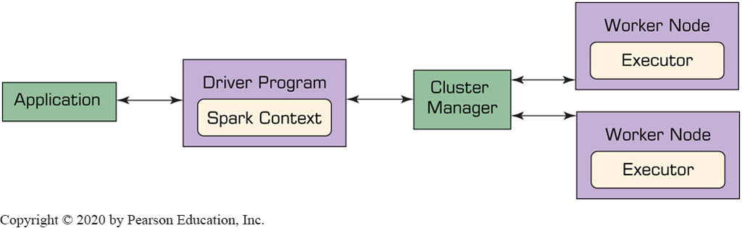
Architecture of Apache Spark
Works on a master-slave framework
Cluster manager manages worker nodes
Executors run in worker nodes

Slide 37
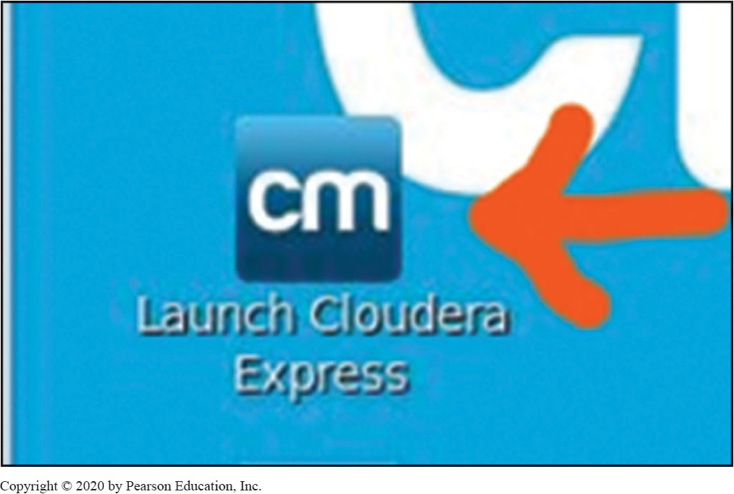
Getting Started with Apache Spark
Hardware and software requirements check
Follow the steps to get started with Spark on Cloudera Q S V M
A 15 steps process…

Slide 38
Big Data And Stream Analytics
Data-in-motion analytics and real-time data analytics
One of the Vs in Big Data = Velocity
Analytic process of extracting actionable information from continuously flowing data
Why Stream Analytics?
It may not be feasible to store the data, or lose its value
Stream Analytics Versus Perpetual Analytics
Critical Event Processing?

Slide 39
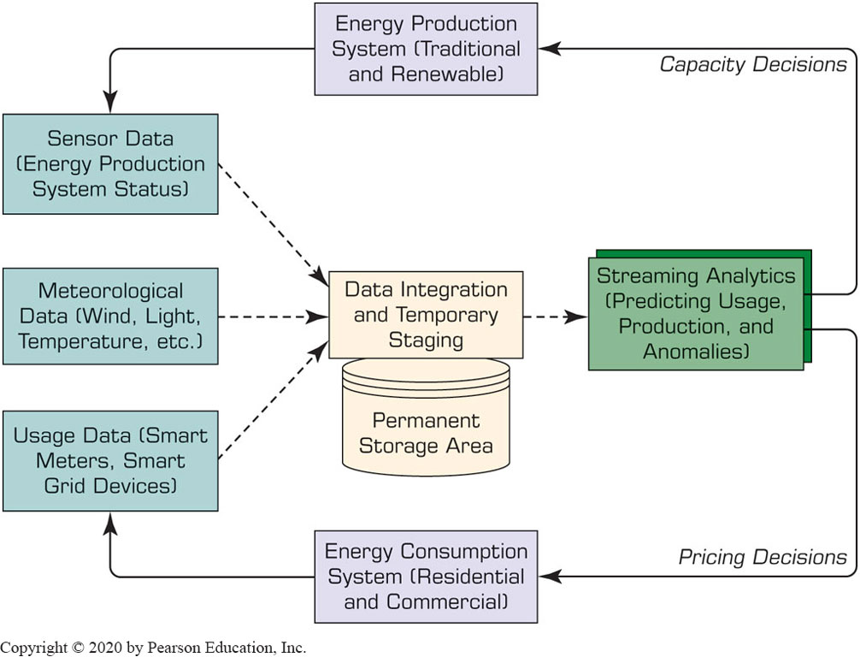
Stream Analytics
A Use Case in Energy Industry

Slide 40
Stream Analytics Applications
e-Commerce
Telecommunication
Law Enforcement and Cyber Security
Power Industry
Financial Services
Health Services
Government

Slide 41
Application Case 9.6
Salesforce Is Using Streaming Data to Enhance Customer Value
Questions for Discussion:
Are there areas in any industry where streaming data is irrelevant?
Besides customer retention, what are other benefits of using predictive analytics?

Slide 42
Big Data Vendors and Platforms
Big Data vendor landscape is developing rapidly
A representative list would include
Cloudera, MapR, Hortonworks, …
Also, I B M (Netezza, InfoSphere), Oracle (Exadata, Exalogic), Microsoft, Amazon, Google, …
Infrastructure service providers
Analytics solution providers
Business intelligence providers incorporating Big Data
Software, Hardware, Service, …

Slide 43
Application Case 9.7
Using Social Media for Nowcasting Flu Activity
Questions for Discussion:
Why would social media be able to serve as an early predictor of flu outbreaks?
What other variables might help in predicting such outbreaks?
Why would this problem be a good problem to solve using Big Data technologies mentioned in this chapter?

Slide 44
Technology Insights 9.3 (1 of 2)
An Illustrative Big Data Technology Platform: Teradata Vantage
Introduction
Analytic Engines and Functions
The NewS Q L engine
The Machine Learning engine
The Graph engine

Slide 45
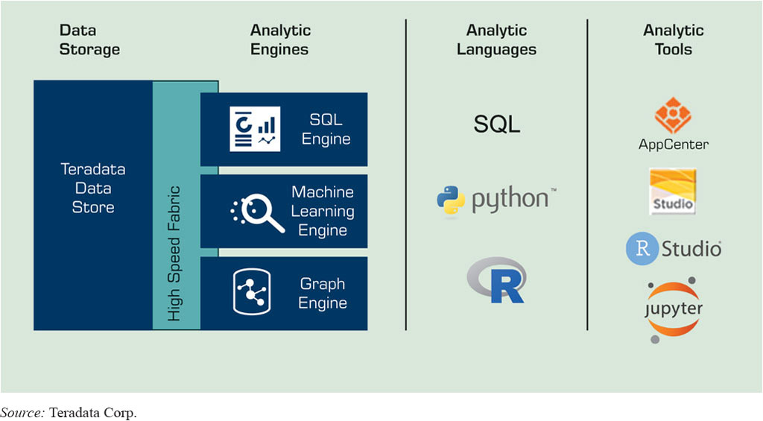
Technology Insights 9.3 (2 of 2)
An Illustrative Big Data Technology Platform: Teradata Vantage
Figure 9.10 Teradata Vantage Architecture.
Source: Teradata Corp.

Slide 46
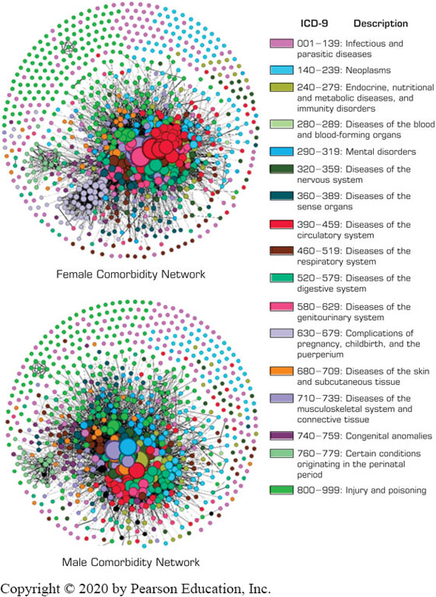
Application Case 9.8
Analyzing Disease Patterns from an Electronic Medical Records Data Warehouse
Questions for Discussion:
What could be the reasons behind the health disparities across gender?
What are the main components of a network?
What type of analytics was applied in this application?

Slide 47
Cloud Computing and Business Analytics (1 of 2)
Cloud computing – polling resources
“a model for enabling convenient, on-demand network access to a shared pool of configurable computing resources”
Amazon.com
Salesforce.com
I B M Cloud, Microsoft Azure, Google, Adobe, and many others

Slide 48
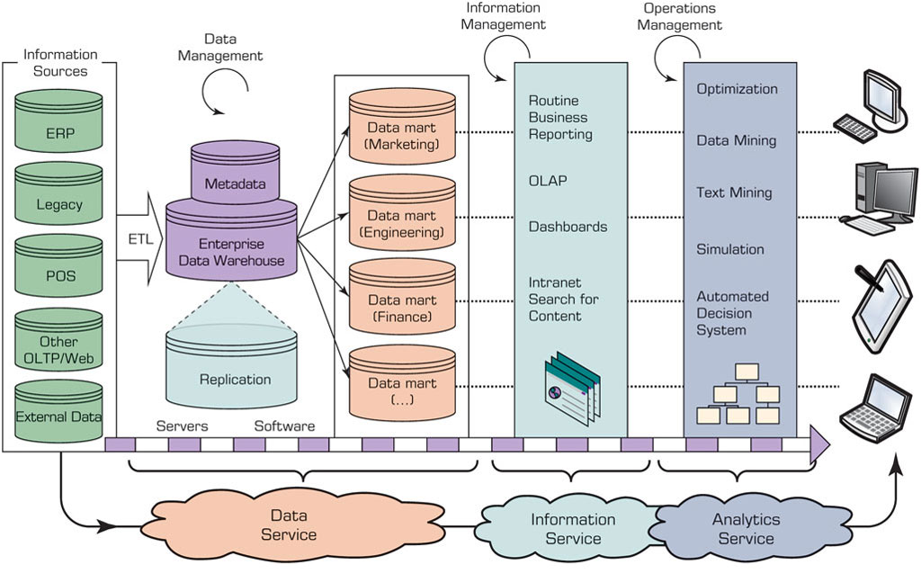
Cloud Based D W & D S S
Figure 9.12 Conceptual Architecture of a Cloud-Oriented Support System.
Source: Based on Demirkan, H., & Delen, D.(2013, April). Leveraging the capabilities of service-oriented decision support systems: Putting analytics and Big Data in cloud. Decision Support Systems, 55(1), 412–421.

Slide 49
Cloud Computing and Business Analytics (2 of 2)
Data as a Service (DaaS)
Software as a Service (SaaS)
Platform as a Service (PaaS)
Infrastructure as a Service (IaaS)
Analytics as a Service (AaaS)
Essential Technologies for Cloud Computing
Network, storage, server virtualization

Slide 50
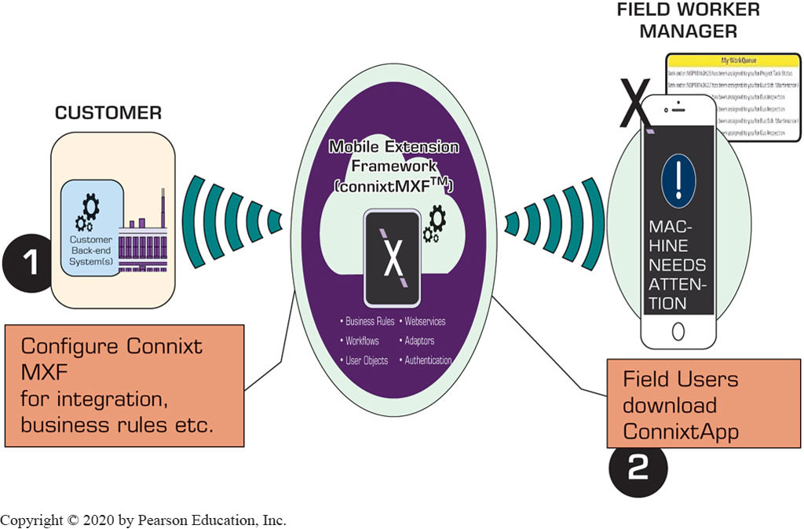
Application Case 9.9 (1 of 2)
Major West Coast Utility Uses Cloud-Mobile Technology to Provide Real-Time Incident Reporting

Slide 51
Application Case 9.9 (2 of 2)
Major West Coast Utility Uses Cloud-Mobile Technology to Provide Real-Time Incident Reporting
Questions for Discussion:
How does cloud technology impact enterprise software for small and mid-size businesses?
What are some of the areas where businesses can use mobile technology?
What types of businesses are likely to be the forerunners in adopting cloud-mobile technology?
What are the advantages of cloud-based enterprise software instead of the traditional on-premise model?
What are the likely risks of cloud versus traditional on-premise applications?

Slide 52
Cloud Computing and Analytics
Cloud deployment models
Private cloud
Public cloud
Hybrid cloud
Major Cloud Platform Providers in Analytics
Amazon Elastic Beanstalk
I B M Cloud
Microsoft Azure
Google App Engine
Openshift

Slide 53
Analytics Applications on the Cloud
Using Azure I O T, Stream Analytics, and Machine Learning to Improve Mobile Health Care Services
Gulf Air Uses Big Data to Get Deeper Customer Insight
Chime Enhances Customer Experience Using Snowflake
Analytics as a service providers
I B M Cloud, MineMyText, S A S Viya, Tableau, Snowflake …

Slide 54
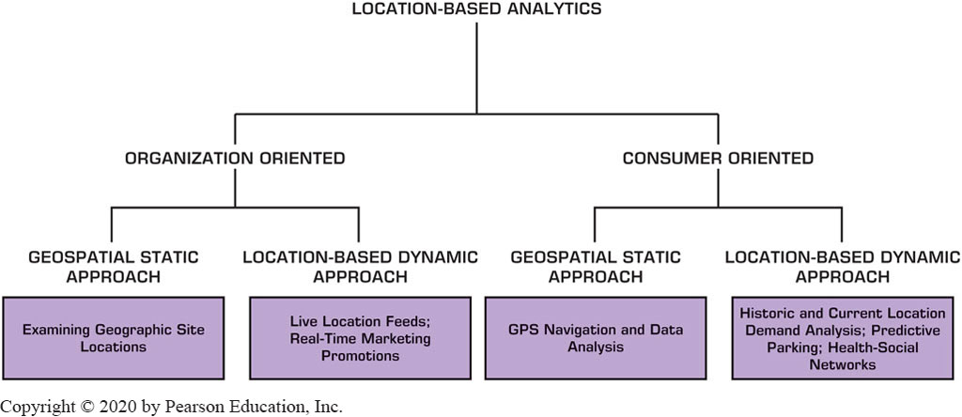
Location-Based Analytics (1 of 2)
Geospatial analytics / G I S
Agricultural, crime, disease spread applications

Slide 55
Application Case 9.10
Great Clips Employs Spatial Analytics to Shave Time in Location Decisions
Questions for Discussion:
How is geospatial analytics employed at Great Clips?
What criteria should a company consider in evaluating sites for future locations?
Can you think of other applications where such geospatial data might be useful?

Slide 56
Application Case 9.11
Starbucks Exploits G I S and Analytics to Grow Worldwide
Questions for Discussion:
What type of demographics and G I S information would be relevant for deciding on a store location?
It has been mentioned that Starbucks encourages its customers to use its mobile app. What type of information might the company gather from the app to help it better plan operations?
Will the availability of free W i-F i at Starbucks stores provide any information to Starbucks for better analytics?

Slide 57
Location-Based Analytics (2 of 2)
A Multimedia Exercise in Analytics Employing Geospatial Analytics
www.teradatauniversitynetwork.com/Library/Samples/BSI-The-Case-of-the-Dropped-Mobile-Calls
Real-Time Location Intelligence
Analytics Applications for Consumers
Waze
Yelp
ParkP G H
…

Slide 58
End of Chapter 9
Questions / Comments

Slide 59

Copyright
This work is protected by United States copyright laws and is provided solely for the use of instructors in teaching their courses and assessing student learning. Dissemination or sale of any part of this work (including on the World Wide Web) will destroy the integrity of the work and is not permitted. The work and materials from it should never be made available to students except by instructors using the accompanying text in their classes. All recipients of this work are expected to abide by these restrictions and to honor the intended pedagogical purposes and the needs of other instructors who rely on these materials.

