Slide 1
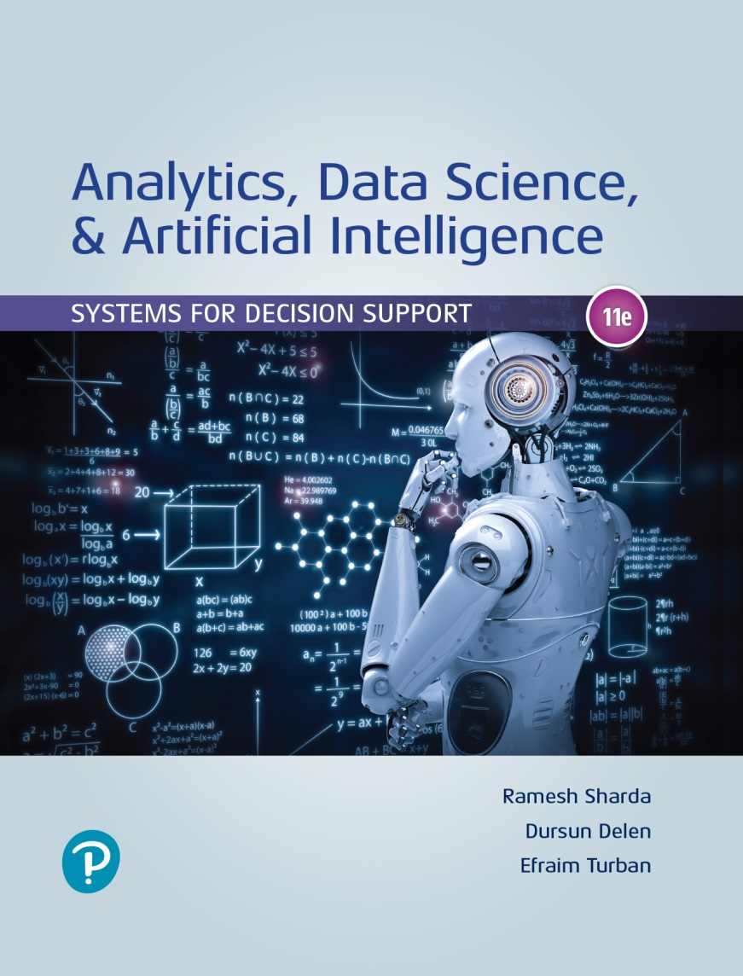
Analytics, Data Science and A I: Systems for Decision Support
Eleventh Edition
Chapter 10
Robotics: Industrial and Consumer Applications
Slide in this Presentation Contain Hyperlinks. JAWS users should be able to get a list of links by using INSERT+F77
Copyright © 2020, 2015, 2011 Pearson Education, Inc. All Rights Reserved
Notes:
If this PowerPoint presentation contains mathematical equations, you may need to check that your computer has the following installed:
1) Math Type Plugin
2) Math Player (free versions available)
3) NVDA Reader (free versions available)

Slide 2
Learning Objectives
10.1 Discuss the general history of automation and robots
10.2 Discuss the applications of robots in various industries
10.3 Differentiate between industrial and consumer applications of robots
10.4 Identify common components of robots
10.5 Discuss impacts of robots on future jobs
10.6 Identify legal issues related to robotics
Notes:
Slide 2 is list of textbook LO numbers and statements

Slide 3
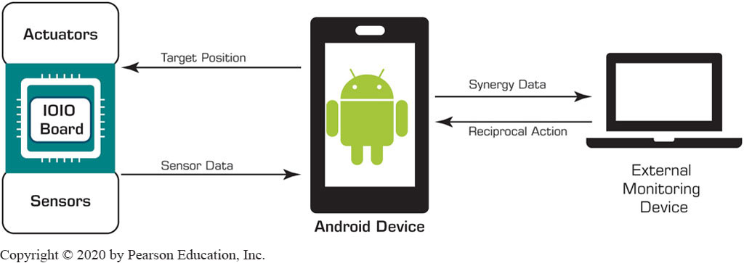
Opening Vignette (1 of 2)
Robots Provide Emotional Support to Patients and Children
Background
Robots in Industry and in Community
Latest trends in robot mediated emotional support
A General Schematic of a Huggable Robot

Slide 4
Opening Vignette (2 of 2)
Robots Provide Emotional Support to Patients and Children
Questions for the Opening Vignette:
What characteristics would you expect to have in a robot that provides emotional support to patients?
Can you think of other applications where robots such as the Huggable can play a helpful role?
Visit the website https://www.universal-robots.com/case-stories/aurolab/ to learn about collaborative robots. How could such robots be useful in other settings?

Slide 5
Overview of Robots (1 of 2)
Everybody has a different definition of a robot
Robot is a machine or a physical device or software that with the cooperation of A I can accomplish a responsibility autonomously
Sense and effect the environment
Applications of robotics in our day-to-day lives have been increasing
Fourth Industrial Revolution
Applications of robotics in manufacturing, health, and I T

Slide 6
Overview of Robots (2 of 2)
Robots are moving from automation (performing repetitive tasks) to autonomy (self initiated executed tasks)
Imaginative robots: R2D2 and C3-P O (Star Wars)
Factories are using robots to automate routine tasks for the last several decades
Consumer focused robots – Roomba
Self driving car! (robots that we have to trust)

Slide 7
History of Robots (1 of 4)
Humans have been fascinated with the idea of machines serving us for a long time
First idea of robotics was conceptualized in 320 B C when Aristotle, a Greek philosopher, stated
“If every tool, when ordered, or even of its own accord, could do the work that befits it, then there would be no need either of apprentices for the master workers or of slaves for the lords.”
In 1495, Leonardo Da Vinci drafted strategies and images for a robot that looked like a human

Slide 8
History of Robots (2 of 4)
Between 1700 and 1900, various automatons were created
Throughout the industrial revolution, robotics was triggered by the advances in steam power and electricity
As the demand increased so did the efforts for more automation
In 1893, “Steam Man,” a prototype for a humanoid robot was proposed by George Moore
Composed of steel and powered by steam engine, and could walk autonomously at 9 miles/hr

Slide 9
History of Robots (3 of 4)
In 1913, the world’s first moving conveyor belt assembly line was started by Henry Ford
1920, the term robot was coined by Karel Capek in his play Rossum’s Universal Robots.
Then a toy robot, Lilliput, was manufactured in Japan.
1950s, the first commercial robot arm, Planetbot, was developed, and used by General Motors
In 1960s, Ralph Mosher and his team created two remotely operated robotic arms, Handyman and Man-mate developed
Used hydraulic and mimicked human spine

Slide 10
History of Robots (4 of 4)
New mobile robots came into the picture
The first one built in 1963, named Shakey
Could move freely, avoid obstacles in his path
Had a radio antenna, vision center, and C P U …
The space race started with Russia’s Sputnic
In 1976, N A S A sent Viking lander to Mars
In 1986, the first L E G O produces released by Honda
In 1994, C M U developed Dante I I, eight-legged robot
In the near future, 2.6M significant robots are expected to make it to the real-world

Slide 11
Illustrative Applications of Robotics (1 of 10)
Changing Precision Technology
A mobile production company in China
Using robotic arms to produce parts for mobile phones
Reduced number of workers from 650 to 60 (~90%)
Productivity: up by 250%; defects down from 25% to 5%
Adidas
Automate factories: Speedfactory in Germany and the U S
Raw material → products reduced from months to days
Agile/fast manufacturing to catch or create trends
Additive manufacturing, robotic arms, and computerized knitting, …

Slide 12
Illustrative Applications of Robotics (2 of 10)
B M W
Employs collaborative robots (cobot)
Combining humans and robots for complex tasks
Efficient production, modernized work environment
60 work side by side with humans in B M W’s S C plant
Tega
A social bot supporting preschoolers
Storytelling, offering help with vocabulary, …
Uses feedback from students via reinforcement learning
Watch the video youtube.com/watch?v=16in922JTsw

Slide 13
Illustrative Applications of Robotics (3 of 10)
San Francisco Burger Eatery
Flipping burgers: from human to machine
The burger-making machine
Not a traditional moving robot
Complete, end-to-end, burger prep device
Two machines makes 20 burgers per hour.
Has 350 sensors, 20 computers, and nearly 7,000 parts
Spyce
Budget-friendly, mostly robot enabled restaurant
Founded by M I T engineering graduates
End-to-end, form order taking to preparation and service

Slide 14
Illustrative Applications of Robotics (4 of 10)
Mahindra & Mahindra Ltd.
Indian multinational firm working with Virginia Tech
To improve the process of harvesting tabletop grapes
Robots in the Defense Industry
M A A R S (Modular Advanced Armed Robotic System)
An upgraded version of special weapons observation reconnaissance detection system (S W O R D S) robots that were used by the U.S. military during the Iraq war
S A F F I R (Shipboard Autonomous Firefighting Robot)
A humanoid robotic structure that get into confined spaces, more through narrow isles and can climb ladders

Slide 15
Illustrative Applications of Robotics (5 of 10)
Pepper
A semihumanoid robot
Manufactured by SoftBank Robotics
Is about 4 feet tall, has three directional wheels attached, enabling it to move all around the place
Can understand human emotions
Can walk autonomously, recognize individuals, and can lift their mood through conversation, avoids collusions
Supports commends in Japanese, English, and Chinese
Can be used in service industries as well as homes
Has its cons too (incompetence or security issues)

Slide 16
Illustrative Applications of Robotics (6 of 10)
Use of Pepper
Nestlé Japan, a leading coffee manufacturer, has employed Pepper to sell Nescafé machines to enhance customer experience
Courtyard by Marriott and Mandarin Oriental are employing Pepper to increase customer satisfaction and efficiency
Central Electric Cooperative (C E C), an electric distribution cooperative located in Stillwater, Oklahoma, has installed Pepper to monitor outages
Fabio, a Pepper robot, was installed as a retail assistant at an upmarket food and wine store in England and Scotland, …

Slide 17
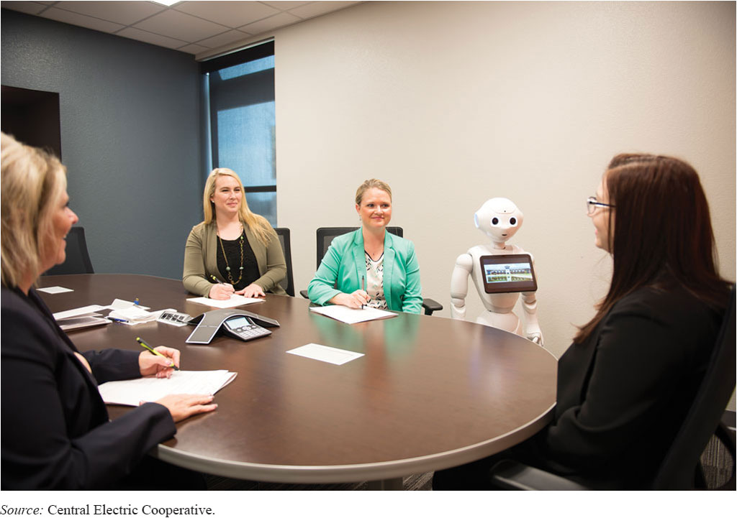
Illustrative Applications of Robotics (7 of 10)
Pepper Robot as a Participant in a Group Meeting

Slide 18
Illustrative Applications of Robotics (8 of 10)
Da Vinci Surgical System
Use of robotics in surgeries is gaining popularity
Da Vinci system has performed thousands of surgeries
It is the most ubiquitous robot used in more units than any other robot
It is designed to perform nominally invasive operations, can perform simple as well as complex/delicate surgeries
Its critical components: surgeon console, patient side cart, endowrist instruments, and vision system
Has either three or four arms attached that the surgeon controls using master controls
Patients who have surgery that used the Da Vinci system heal faster than those performed by traditional methods…

Slide 19
Illustrative Applications of Robotics (9 of 10)
Snoo
A Wi-Fi-enabled robotic Crib
Developed by Yves Behar, pediatrician, Dr. Harvey Karp, and M I T–trained engineers
Puts babies to sleep automatically (no more wakeups!)
“Safest bed ever made with a built-in swaddling strap!”
M E Di
Machine and Engineering Designing Intelligence
Available at six hospitals in Canada and one in the U S
M E Di helps reduce stress in children from painful surgeries, tests, and injections

Slide 20
Illustrative Applications of Robotics (10 of 10)
Care-E Robot
Airports are growing in size and the number of people who go to them – excellent target for A I and robots
K L M (Royal Dutch Airlines) using Care-E Robot
Reads the boarding pass and takes the passenger to the his/her gate, avoiding missed flights, and also carrying his/her luggage
A G R O B O T
Developed in Spain
Delicately pics strawberries when they are at their full maturity (a difficult task compared to other fruits)

Slide 21
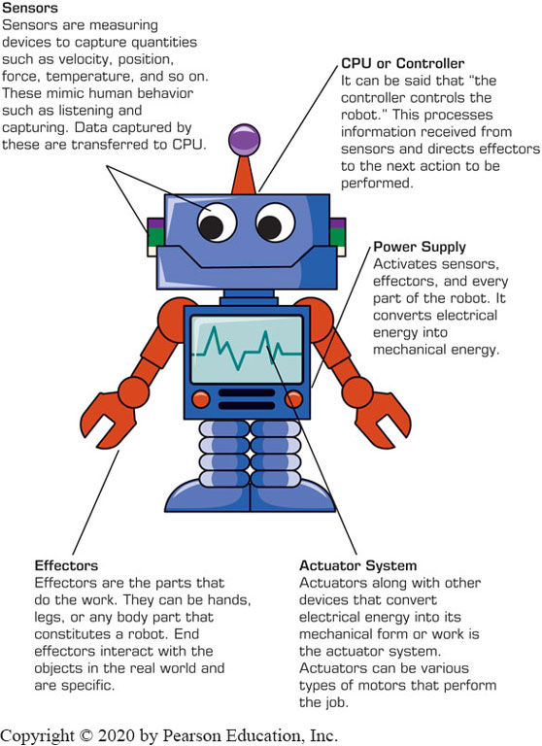
Components of Robots (1 of 2)
Depending on their purpose, robots are made of different components
However, all robots have some common components
… and others are tweaked according to a robot’s purpose

Slide 22
Components of Robots (2 of 2)
Power Controller
Driving force of a robot
Sensors
Used to direct a robot in its surrounding
Force sensors, ultrasound sensors, distance sensors, laser scanners, vision sensors / cameras, etc.
Effectors or Rover or Manipulator
Body and related physical parts of a robot
Navigation of Actuator System
Controller or C P U

Slide 23
Categories of Robots
Preset Robots
Preprogrammed to perform the same task
Collaborative Robots or CoBots
Collaborate with assists to humans
Stand-Alone Robots
Autonomously modifies behavior, learns, and acts
Remote-Controlled Robots
Human controlled robots to perform dangerous tasks
Supplementary Robots
Enhance the existing capabilities or replace capabilities that a human has lost or does not have

Slide 24
Autonomous Cars: Robots in Motion
Self-driving cars (hype or reality?)
Technical, behavioral, and regulatory challenges
The future reality: self-driving cars everywhere
Early version of self-driving-cars
Researchers at Carnegie Mellon used neural networks to control an autonomous vehicle, enabled by the radio antenna developed in 1925
Newer Enablers – mobile phone technologies, wireless internet, computer centers in cars, navigation maps, A I and deep learning

Slide 25
Autonomous Vehicle Development
The heart of an autonomous vehicle system is a laser rangefinder (or light detection and ranging – lidar device)
Sits on the vehicle’s roof; generated 3D image of the car’s surroundings, and combines it with high-resolution world maps
The process is called: mapping and localization
Sensors, such as the four radar devises on the front and back bumpers to see far distances to make decisions
A detailed and current map of the road
Mcity – a city built for testing of autonomous cars
Google’s Waymo – one of the early pioneers. Uber, Tesla, and all other car manufacturer are in this race.
D O T, N H T S A, and State level laws and rulings…

Slide 26
Issues with Self-Driving Cars
Challenges with technology
Environmental challenges
Regulatory challenges
Public trust issues
Self-driving trucks
Massive impact on logistics
Autonomous drones and air vehicles
For commercial and governmental businesses

Slide 27
Impact of Robots on Current and Future Jobs (1 of 2)
By 2025, up to 25 percent of current jobs will be replaced by robots (an optimistic estimate!)
Group activity:
Watch: www.youtube.com/watch?v=GHc63Xgc0-8 and www.youtube.com/watch?v=ggN8wCWSIx4
Answer the following:
What are your takeaways from these videos?
What is the most likely scenario in your view?
How can you prepare for the day when indeed humans may not need to apply for many jobs?

Slide 28
Impact of Robots on Current and Future Jobs (2 of 2)
The seven jobs likely to increase in popularity:
A I development
Customer–robot interactions
Robot managers
Data labelers
Robot pilots and artists
Test drivers and quality inspectors
A I lab scientists

Slide 29
Legal Implications of Robots and Artificial Intelligence
Tort Liability
Patents
Property
Taxation
Practice of Law
Constitutional Law
Professional Certification
Law Enforcement

Slide 30
End of Chapter 10
Questions / Comments

Slide 31

Copyright
This work is protected by United States copyright laws and is provided solely for the use of instructors in teaching their courses and assessing student learning. Dissemination or sale of any part of this work (including on the World Wide Web) will destroy the integrity of the work and is not permitted. The work and materials from it should never be made available to students except by instructors using the accompanying text in their classes. All recipients of this work are expected to abide by these restrictions and to honor the intended pedagogical purposes and the needs of other instructors who rely on these materials.

