Slide 1

Analytics, Data Science and A I: Systems for Decision Support
Eleventh Edition
Chapter 11
Group Decision Making, Collaborative Systems, and A I Support
Slide in this Presentation Contain Hyperlinks. JAWS users should be able to get a list of links by using INSERT+F77
Copyright © 2020, 2015, 2011 Pearson Education, Inc. All Rights Reserved
Notes:
If this PowerPoint presentation contains mathematical equations, you may need to check that your computer has the following installed:
1) Math Type Plugin
2) Math Player (free versions available)
3) NVDA Reader (free versions available)

Slide 2
Learning Objectives (1 of 2)
11.1 Understand the basic concepts and processes of group work, communication, and collaboration
11.2 Describe how computer systems facilitate team communication and collaboration in an enterprise
11.3 Explain the concepts and importance of the time/place framework
11.4 Explain the underlying principles and capabilities of groupware, such as group support systems (G S S)
11.5 Understand how the Web enables collaborative computing and group support of virtual meetings
Notes:
Slide 2 is a list of textbook LO numbers and statements.

Slide 3
Learning Objectives (2 of 2)
11.6 Describe collective intelligence and its role in decision making
11.7 Define crowdsourcing and explain how it supports decision making and problem solving
11.8 Describe the role of A I in supporting collaboration, group work, and decision making
11.9 Describe human–machine collaboration
11.10 Explain how teams of robots work
Notes:
Slide 3 is a list of textbook LO numbers and statements.

Slide 4
Opening Vignette (1 of 3)
Hendrick Motorsports Excels with Collaborative Teams
The Operations
The Problems During the Racing Season
Off-Season Problems
The Solution
The Results

Slide 5
Opening Vignette (2 of 3)
Hendrick Motorsports Excels with Collaborative Teams
Discussion Questions
What were the major drivers for the use of Microsoft’s Teams?
List some discussions held during the racing season, and how they were supported by the technology.
List decisions held during the off-season, and how they were supported by the technology.
Discuss why Microsoft Teams was selected, and explain how it supports teamwork group decision making.

Slide 6
Opening Vignette (3 of 3)
Hendrick Motorsports Excels with Collaborative Teams
Discussion Questions
Trace communication and collaboration within and between groups.
Specify the function of Microsoft Teams workspace.
Watch the video at youtube.com/watch?time_continue=108&v=xnFdM9IOaTE and summarize its content.

Slide 7
Making Decisions in Groups: Characteristics, Process, Benefits, And Dysfunctions
Groupwork: the work done by two or more people together
A group performs a task
Members may be located in different places
Group members may work at different times
Group members may work for the same organization or for different organizations
A group can be permanent or temporary
A group can be at one managerial level or span several levels …

Slide 8
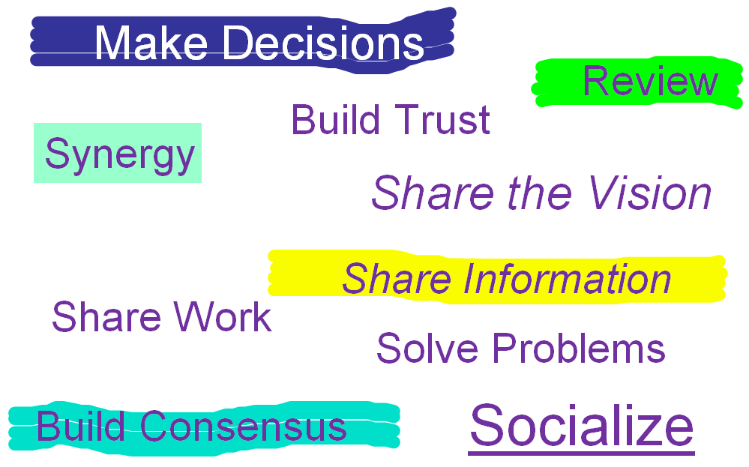
Why Groupwork / Collaborate?

Slide 9
Characteristics of Group Work
Group member located in different places/organizations
Work at different times
Group work can be permanent or temporary
Group members can be from different managerial levels
Group can create synergy (or not!)
Process gains versus process losses
Group work may lead to (or required to be completed in a very short time (more people = less time to finish?)
Physical meetings may be cost prohibitive, …. more

Slide 10
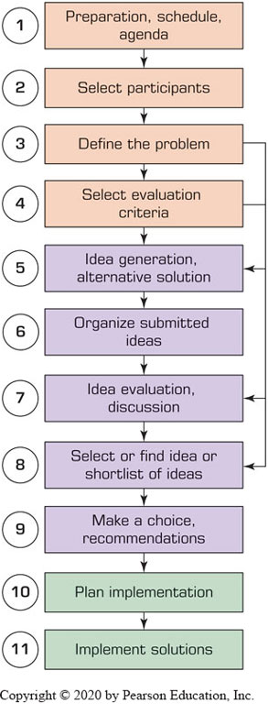
Group Decision-Making Process
Types of Decisions Made by Groups
Groups are usually involved in two major types of decision making:
Making a decision together.
Supporting activities or tasks related to the decision-making process. For example, the group may select criteria for evaluating alternative solutions, …

Slide 11
Benefits and Dysfunctions of Groupwork
Benefits of Working in Groups (Process Gains) | Dysfunctions of Face-to-Face Group Process (Process Losses)
It provides learning. Groups are better than individuals at understanding problems. They can teach each other. People readily take ownership of problems and their solutions. Group members have their egos embedded in the final decision, so they are committed it. Groups are better than individuals at catching errors. A group has more information and knowledge than any one member does. Members can combine their knowledge to create new knowledge. More and more creative alternatives for problem solving can be generated, and better solutions can be derived (e.g., through brainstorming). A group may produce synergy during problem solving, therefore the effectiveness and/or quality of group work can be greater than the sum of what individual members produce. Working in a group may stimulate the creativity of the participants and the process. Working together could allow a group to have better and more precise communication. Risk propensity is balanced. Groups moderate high-risk takers and encourage conservatives. | Social pressures of conformity may result in groupthink (i.e., people begin to think alike and not tolerate new ideas; they yield to conformance pressure). It is a time-consuming, slow process. Some relevant information could be missing. A meeting can lack coordination, have a poor agenda, or be poorly planned. A meeting may be dominated by time, topic, opinion of one or a few individuals, or fear of contributing because of the possibility of conflicts. Some group members can tend to influence the agenda while some try to rely on others to do most of the work (free riding). The group may ignore good solutions, have poorly defined goals, or be composed of the wrong participants. Some members may be afraid to speak up. The group may be unable to reach consensus. The group may lack focus. There can be a tendency to produce poor-quality compromises. There is often nonproductive time (e.g., socializing, preparing, waiting for latecomers). There can be a tendency to repeat what has already been said (because of failure to remember or process). Meeting costs can be high (e.g., travel, participation time spent). There can be incomplete or inappropriate use of information. There can be too much information (i.e., information overload). There can be incomplete or incorrect task analysis. There can be inappropriate or incomplete representation in the group. There can be attention or concentration blockage.

Slide 12
Supporting Groupwork
Goal: to support groupwork
Increase benefits / decrease losses
Traditional methods
Nominal Group Technique
“Individuals work alone to generate ideas which are pooled under guidance of a trained facilitator”
Delphi Method
“A structured process for collecting and distilling knowledge from a group of experts by means of questionnaires”
Electronic Meeting System (E M S)

Slide 13
Overview of Group Support Systems
Technology that helps groups to collaborate effectively
These technologies are called G S S (Group Support Systems)
G S S enablers: Internet and its derivatives (intranets, internet of things [IoT], and extranets)
The Web is the common infrastructure for G S S
Recently communication and collaboration tools have received more attention due to
Their increased capabilities
Save time and money
Expedite decision making

Slide 14
Time/Place Framework (1 of 2)
Same time / same place. Participants meet face-to-face, as in a traditional meeting, or decisions are made in a specially equipped decision room.
Same time / different place. Participants are in different places, but they communicate at the same time (e.g., with videoconferencing or I M).
Different time / same place. People work in shifts. One shift leaves information for the next shift.
Different time / different place. Participants are in different places, and they send and receive information at different times.

Slide 15
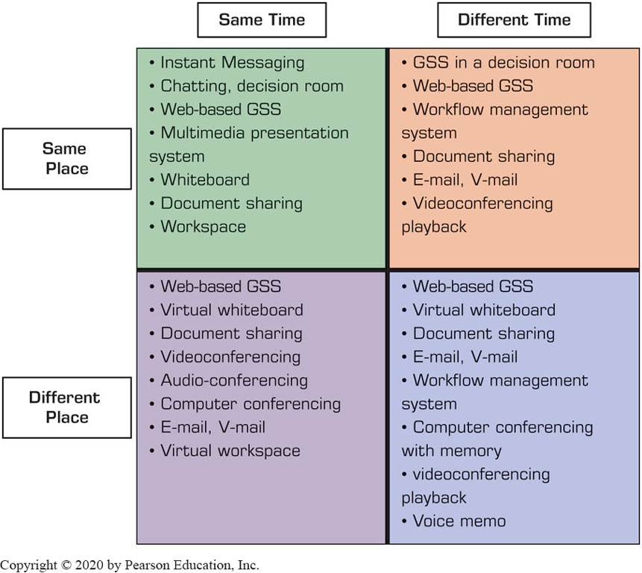
Time/Place Framework (2 of 2)

Slide 16
Group Collaboration for Decision Support
Groups can help to
identify problems,
assist in choosing criteria for selecting solutions, generating solutions (e.g., brainstorming),
Evaluating alternatives, and
assisting in the selection of the best solution and implementing it
Computerized tools and platforms
Support communication and collaboration
Support of decision making

Slide 17
Electronic Support for Group Communication and Collaboration
Groupware products provide a way for groups to share resources and opinions
Synchronous or Asynchronous
Examples
dropbox.com
drive.google.com
office.microsoft.com
…
See Table 11.1 for a list of examples

Slide 18
Groupware
Virtual Meeting Systems
Webex.com, GoTomeeting.com, Skype.com, …
GroupSystems (Groupsystems.com)
Collaborative Workflow
Web 2.0
Search, links, authoring, tags, extensions, signals
Collaborative Networks
Synchronous versus asynchronous systems

Slide 19
Groupware Products Synchronous versus Asynchronous (1 of 3)
Table 11.1 Groupware Products and Features.
General (Can Be Either Synchronous or Asynchronous)
Built-in e-mail, messaging system Browser interface Joint Web page creation Active hyperlink sharing File sharing (graphics, video, audio, or other) Built-in search functions (by topic or keyword) Workflow tools Corporate portals for communication, collaboration, and search Shared screens Electronic decision rooms Peer-to-peer networks

Slide 20
Groupware Products Synchronous versus Asynchronous (2 of 3)
Table 11.1 Groupware Products and Features.
Synchronous (Same Time)
I M Videoconferences, multimedia conferences Audioconferences Shared whiteboard, smart whiteboard Instant videos Brainstorming Polling (voting) and other decision support (activities such as consensus building, scheduling) Chats with people Chats with bots

Slide 21
Groupware Products Synchronous versus Asynchronous (3 of 3)
Table 11.1 Groupware Products and Features.
Asynchronous (Different Times)
Virtual workspaces Tweets Ability to receive/send e-mail, SMS Ability to receive notification alerts via e-mail or SMS Ability to collapse/expand discussion threads Message sorting (by date, author, or read/unread) Auto responders Chat session logs Electronic bulletin boards, discussion groups Blogs and wikis Collaborative planning and/or design tools

Slide 22
Collaborative Workflow (1 of 2)
Software products that address project-oriented and collaborative business processes
Administered centrally, and accessed/used by participants at different locations (and times)
Goal: empower knowledge workers through communication, negotiation, and collaboration within an integrated environment
Collaborative workplace: moved from a conference room to a virtual place for teams to work together
Virtual collaborative workplace – support by digital enablers and computerized tools

Slide 23
Collaborative Workflow (2 of 2)
Major Vendors of Virtual Workspace
Google Cloud Platform (deployed on the “cloud,” so it is offered as a platform-as-a-service (PaaS)
Citrix Workspace Cloud (deployed on the “cloud” and Citrix is known for its GoToMeeting collaboration tool)
Microsoft Workspace (a part of Office 365)
Cisco’s Webex (a popular collaboration package including Meeting).
Slack workspace (a very popular workspace)
A digital space where teammates share, communicate, and collaborate on work [supported with many components]

Slide 24
Collaborative Networks and Hubs
Traditionally, supply-chain member close to each other (supplier and manufacturer; distributor and retailer) communicate to share information on product flow
Vertically integrated supply-chain
Nowadays, the whole supply chain can communicate and collaborate on collaborative planning, forecasting, and replenishment
Multi-node, network-based integration of supply-chain
Collaborative hub: a center point for group collaboration
Example: Surface Hub for Business by Microsoft

Slide 25
Social Collaboration
Collaboration conducted within and between socially oriented groups
Group interactions and information/knowledge sharing to attain common goals
Done on social media sites, and it is enabled by the Internet, IoT, and social collaboration software
Collaboration in Social Networks
Facebook – Facebook workspace
LinkedIn – LinkedIn Lookup
Social collaboration software for teams
Wrike, Ryver, Azendoo, Zimbra social platform, Samepage, Zoho, Asana, Jive, Chatter, and Social Tables

Slide 26
Popular Collaboration Software
Communication tools: Yammer (social collaboration), Slack, Skype, Google Hangouts, GoToMeeting
Design tools: InVision, Mural, Red Pen, Logo Maker
Documentation tools: Office Online, Google Docs, Zoho
File-sharing tools: Google Drive, Dropbox, Box
Project management tools: Asana, Podio, Trello, WorkflowMax, Kanban Tool,
Software tools: GitHub, Usersnap,Workflow tools: Integrity, B P Logix

Slide 27
Other Tools that Support Collaboraiton and/or Communication
Notejoy (makes collaborative notes for team)
Kahootz (brings stakeholders together to form communities of interest)
Nowbridge (offers team connectivity, ability to see participants)
Walkabout Workplace (is a 3D virtual office for remote teams).
RealtimeBoard (is a enterprise visual collaboration).
Quora (is a popular place for posting questions to the crowd).
Pinterest (allows collection of text and images on selected topics).
I B M connection closed (offers a comprehensive communication and collaboration tool set).
Skedda (schedules space for coworking)
Zinc (is a social collaboration tool)
Scribblar (is an online collaboration room for virtual brainstorming)
Collokia (is a machine learning platform for workflow)

Slide 28
Direct Computerized Support for Group Decision Making
Decisions are frequently made at meetings
Some are one-time critical/strategic decision
Often complex and controversial decisions
Process dysfunctions can significant affect the decision outcomes
Computerized support has often been suggested to mitigate these controversies
These systems are usually called group decision support systems (G D S S), group support systems (G S S), electronic meeting systems (E M S)

Slide 29
Group Decision Support Systems (G D S S)
It is an interactive computer-based system that facilitates the solution of semistructured or unstructured problems by a group of decision makers
Goal – support group decision making
A specially designed I S to enhance collaborative decision processes
It encourages generation of ideas, freedom of expression, and resolution of conflicts
First generation G D S S: face-to-face in the same room
Decision room
Today’s G D S S: virtual, over the Web

Slide 30
G D S S – Gains and Losses
Gains:
Parallelism
Anonymity
Triggering
Synergy
Structure
Record keeping
Loses:
Free-riding
Flaming

Slide 31
Decision Rooms (1 of 3)
Expensive, customized, purposeful facilities
12 to 30 networked computers
Usually recessed into the desktop
Server and special software
Large-screen projection system
Breakout rooms
Need a trained facilitator for success

Slide 32
Supporting the Entire Decision-Making Process - Stormboard (1 of 2)
Provides support for different brainstorming and group decision-making configurations
Sequence of activities
Define the problem and the users’ objectives
Brainstorm ideas
Organize the ideas in groups of similar flavor, look for patterns, and select only viable ideas
Collaborate, refine concepts, and evaluate (using criteria) the meeting’s objectives…

Slide 33
Supporting the Entire Decision-Making Process - Stormboard (2 of 2)
Sequence of activities (cont.)
The software enables users to prioritize proposed ideas by focusing on the selection criteria. It lets all participants express their thinking and directs the team to be cohesive.
It presents a short list of superior ideas
The software suggests the best idea and recommends implementation
It plans the project implementation.
It manages the project.
It periodically reviews progress.

Slide 34
Comprehensive Groupware Tools
MeetingRoom - one of the first comprehensive, same time/same place electronic meeting packages
GroupSystems Online - offered similar capabilities
ThinkTank (GroupSystems latest product)
A suite of tools that facilitate various group decision-making activities
It shortens cycle time for brainstorming
Improved collaboration of face-to-face or virtual teams through customizable goal-specific processes
Examples: ThinkTank use (thinktank.net/case-study)

Slide 35
Brainstorming for Idea Generation and Problem Solving
Brainstorming is the process for generating creative ideas
Involves freewheeling group discussions and spontaneous contribution of ideas for solving problems and making strategy and resource allocation
Contributors’ ideas are discussed by the members
Goal - generate as many ideas as possible, no matter how bizarre they look
Ideas are discussed and evaluated by the group
To mitigate the potential dysfunctions, computer supportis frequently recommended

Slide 36
Computer Supported Brainstorming
Creation of a large number of ideas
Large group participation
Real-time updates
Information color coding
Collaborative editing.
Design of brainstorming sessions
Idea sharing
Idea mapping (e.g., create mind maps)
Text, video, documents, etc. posting
Remote brainstorming
Creation of an electronic archive
Reduction of social loafing

Slide 37
Online Brainstorming Service and Tool Providing Companies
eZ Talks Meetings. Cloud-based tool for brainstorming and idea sharing.
Bubbl.us. Visual thinking machine that provides a graphical representation of ideas and concepts, helps in idea generation, and shows where ideas and thoughts overlap.
Mindomo. Tool for real-time collaboration that offers integrated chat capability.
Mural. Tool that enables collecting and sorting of ideas in rich media files. It is designed as a Pinboard that invites participants.
iMindQ. Cloud-based service that enables creating mind maps and basic diagrams.

Slide 38
Group Support Systems (G S S)
Includes all forms of communication and collaborative activities including collaborative computing
It used to be a specialize software, now it is embedded into standard I T productivity tools
Microsoft Office 365 includes Microsoft Teams (opening vignette)
How G S S improves group work
Improve productivity and effectiveness
Streamline and speed-up the process
Improving the quality of the outcomes
Increase process gains and reduce process losses
Helps in working simultaneously and with anonymity

Slide 39
G S S Support Activities
Support parallel processing and idea generation.
Enables participation of larger groups with more complete information, knowledge, and skills.
Permits the group to use structured or unstructured techniques and methods.
Offers rapid, easy access to external information.
Allows parallel computer discussions.
Helps participants frame the big picture.
Provides anonymity, which allows objective contribution
Provides measures to prevent individuals from controlling a meeting; ways to participate in instant anonymous voting.
Provides structure for the planning process.
Automatically records all information presented.

Slide 40
Collective Intelligence and Collaborative Intelligence (1 of 4)
Collective intelligence (C I) refers to the total intelligence of a group.
It is also refers to as the wisdom of the crowd
M I T center for collective intelligence (cci.mit.edu)
Benefits of C I, see 50Minutes.com
Types of Collective Intelligence
Cognition
Cooperation, and
Coordination
Computerized support to collective intelligence

Slide 41
Collective Intelligence and Collaborative Intelligence (2 of 4)
Example 1: The Carnegie University Foundation Supports Network Collaboration
Content is stored and shared in one place (the “cloud”)
Asynchronous conversations using discussion boards
Facilitating social collaboration and problem solving
Example 2: How Governments Tap IoT for Collective Intelligence
Governments are using IoT to support decision making and policy creation
The IoT collect ideas and aspirations of the citizens
How Collective Intelligence May Change Work and Life

Slide 42
Application Case 11.1
Collaborative Modeling for Optimal Water Management: The Oregon State University Project
Questions for Discussion:
Crowdsourcing is used to find information from a crowd. Why is it needed in this case?
How does WRESTORE act as a C I tool?
Debate centralized control versus participative collaboration. Cite the pros and cons of each.
Why it is difficult to manage water resources?
How can an optimization/simulation/A I model support group work in this case?

Slide 43
Collective Intelligence and Collaborative Intelligence (3 of 4)
Having people to collaborate is difficult
Collaborative intelligence requires:
(1) willingness to share, (2) knowing how to share, (3) being willing to collaborate, (4) knowing what to share, (5) knowing how to build trust, (6) understanding team dynamics, (7) using correct hubs for networking, (8) mentoring and coaching properly, (9) being open to new ideas, and (10) using computerized tools and technology.
For another list of success factors, see thebalancecareers.com/collaboration-skills-with-examples-2059686

Slide 44
Collective Intelligence and Collaborative Intelligence (4 of 4)
How to Create Business Value from Collaboration: The I B M Study
Groups and team members provide ideas and insights. The study presents three major points:
Enhances organizational outcomes by correctly tapping the knowledge and experience of working groups (e.g., customers, partners, and employees).
It is crucial to target and motivate the appropriate participants.
Needs to address the issue of participants’ resistance to change.

Slide 45
Crowdsourcing as a Method for Decision Support
Crowdsourcing - outsourcing tasks to a large group of people (crowd).
Goal – to leverage the wisdom of a crowd
Viewed as a method of collective intelligence
Essentials of crowdsourcing…
Tutorial on crowdsourcing and examples, watch the video youtube.com/watch?v=lXhydxS S N O Y
Examples
2005, Doritos Inc. has run a “Crash the Super Bowl”
See other examples on page 633 in the book

Slide 46
Major Types of Crowdsourcing (1 of 2)
Collective intelligence (or wisdom). People in crowds are solving problems and providing new insights.
Crowd creation. People are creating various types of content and sharing it with others (for pay or free).
Crowd voting. People are giving their opinions and ratings on ideas, products, or services, as well as evaluating and filtering information presented to them.
Crowd support and funding. People are contributing and supporting endeavors for social or business causes, such as offering donations, and micro-financing new ventures.

Slide 47
Major Types of Crowdsourcing (2 of 2)
Logo design—Design Bill
Problem solving—InnoCentive, NineSigma, …
Business innovation—Chardix
Brand names—Name This
Product and manufacturing design—Pronto E R P
Data cleansing—Amazon Mechanical Turk
Software testing—uTest
Trend watching—TrendWatching
Images—Flickr Creative Commons

Slide 48
The Process of Crowdsourcing (1 of 2)
Identify the problem and the task(s) to be outsourced.
Select the target crowd (if not an open call).
Broadcast the task to the crowd.
Engage the crowd in accomplishing the task (e.g., idea generation, problem solving).
Collect user-generated content.
Have the quality of submitted material evaluated by the management, by experts, or by a crowd.
Select the best solution (or a short list).
Compensate the crowd (e.g., the winning proposal).
Implement the solution.

Slide 49
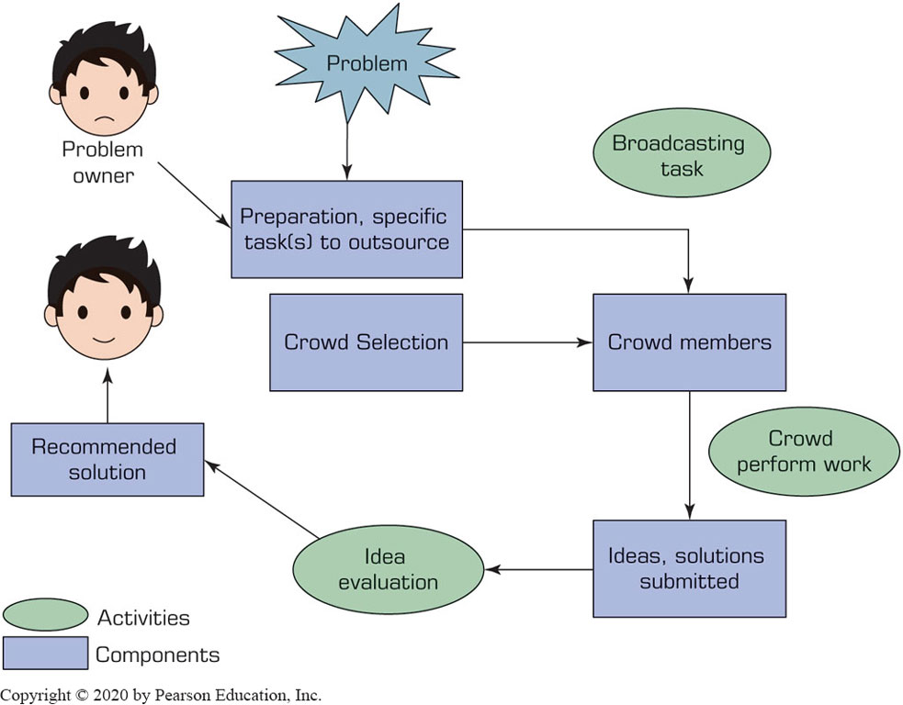
The Process of Crowdsourcing (2 of 2)

Slide 50
Application Case 11.2
How InnoCentive Helped G S K Solve a Difficult Problem
Questions for Discussion:
Why did G S K decide to crowdsource?
Why did the company use InnoCentive?
Comment on the global nature of the case.
What lessons did you learn from this case?
Why do you think a small $5000 reward is sufficient?

Slide 51
A I Support of Group Decision Making
A major objective of A I is to automate decision making and/or to support its process
A I can help in the following steps in the process:
Meeting preparation
Problem identification
Idea generation
Idea organization
Group interaction and collaboration
Predictions
Multilingual group communications
…

Slide 52
A I Supports Team Collaboration
Findings of the Cisco Systems sponsored a global survey, A I Meets Collaboration
Virtual assistants increase employees’ productivity, creativity, and job satisfaction. Bots also enable employees to focus on high-value tasks.
Bots are accepted as part of workers’ teams.
Bots improve conference calls. They also can take meetings notes and schedule meetings.
A I can use facial recognition to sign in eligible people to meetings.
Personal characteristics are likely to influence how people feel about A I in the workplace…

Slide 53
Swarm Intelligence and Swarm A I (1 of 2)
Swarm intelligence refers to the collective behavior of decentralized, self organized systems, natural or artificial
Such systems consist of things (e.g., ants, people) interacting with each other and their environment
A swarm’s actions are not centrally controlled, but they lead to intelligent behavior
In contrast with animals and other species whose interactions among group members are natural, people need technology to exhibit swarm intelligence
Example - Oxford university study on english premier league
Swarm A I technology
Algorithms for creating the human swarm

Slide 54
Application Case 11.3
X P R I Z E Optimizes Visioneering
Questions for Discussion:
Why is the group discussion in this case complex?
Why is getting a consensus when top experts are involved more difficult than when non-experts are involved?
What was the contribution of swarm A I?
Compare simple voting to swarm A I voting.

Slide 55
Swarm Intelligence and Swarm A I (2 of 2)
Swarm A I Predictions - Swarm A I was used by Unanimous A I for making predictions in difficult-to-assess situations. Examples include:
Predicting Super Bowl #52 number of points scored
Predicting winners in the regular N F L season.
Predicting the top four finishers of the 2017 Kentucky Derby.
Predicting the top recipients of the Oscars in 2018.

Slide 56
Human-Machine Collaboration and Teams of Robots (1 of 4)
Human–Machine Collaboration in Cognitive Jobs
Top Management Jobs
Robots as coworkers – Challenges
Designing a human–machine team that capitalizes on the strength of each partner.
Exchanging information between humans and robots.
Preparing company employees for the collaboration
Changing business processes to accommodate human–robot collaboration
Ensuring the safety of robots and employees that work together.

Slide 57
Human-Machine Collaboration and Teams of Robots (2 of 4)
Technologies that support robots as coworkers
Virtual reality can be used as a powerful training tool
A robot is working with an ad agency in Japan to generate ideas.
A robot can be your boss.
Robots are coworkers in providing parts out of bins in assembly lines and can check quality together with humans.
A I tools measure blood flow and volume of the cardiac muscles in seconds (insteadof minutes when done completely by a radiologist). This information facilitates the decisions made by radiologists.

Slide 58
Human-Machine Collaboration and Teams of Robots (3 of 4)
Blending humans and ai to best serve customers
“Artificial Intelligence with the Human Touch”
Watch it at youtube.com/watch?v=NP2qqwGTNPk
Collaborative robots (Co-Bots)
Team of collaborative robots
Example: Teams of Robots to Explore Mars
Example: Alibaba.com is using teams of robots in its smart warehouses. Watch it at youtube.com/watch?v=FBl4Y55V2Z4

Slide 59
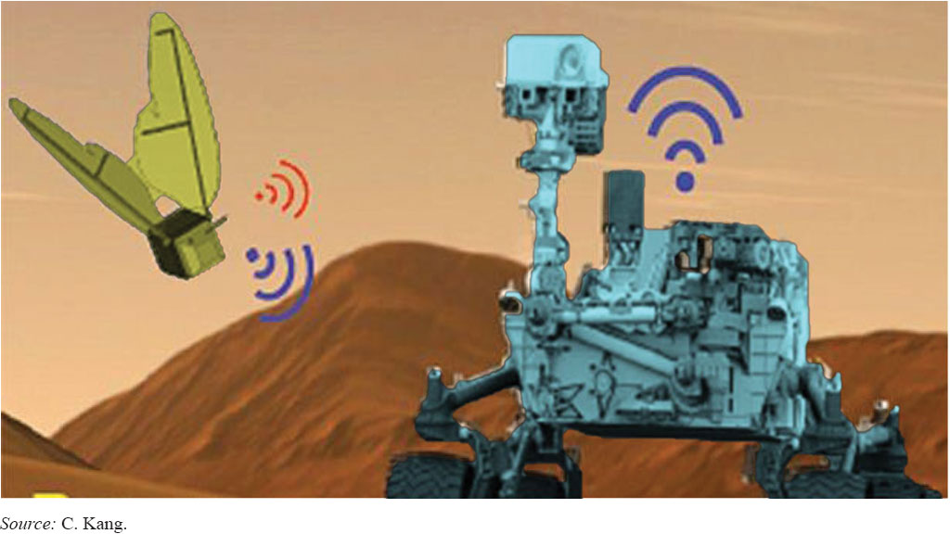
Human-Machine Collaboration and Teams of Robots (4 of 4)
Team of Robots Prepares to Go to Mars
Figure 11.4 Team of Robots Prepares to Go to Mars.
Source: C.Kang.

Slide 60
End of Chapter 11
Questions / Comments

Slide 61

Copyright
This work is protected by United States copyright laws and is provided solely for the use of instructors in teaching their courses and assessing student learning. Dissemination or sale of any part of this work (including on the World Wide Web) will destroy the integrity of the work and is not permitted. The work and materials from it should never be made available to students except by instructors using the accompanying text in their classes. All recipients of this work are expected to abide by these restrictions and to honor the intended pedagogical purposes and the needs of other instructors who rely on these materials.

