Slide 1
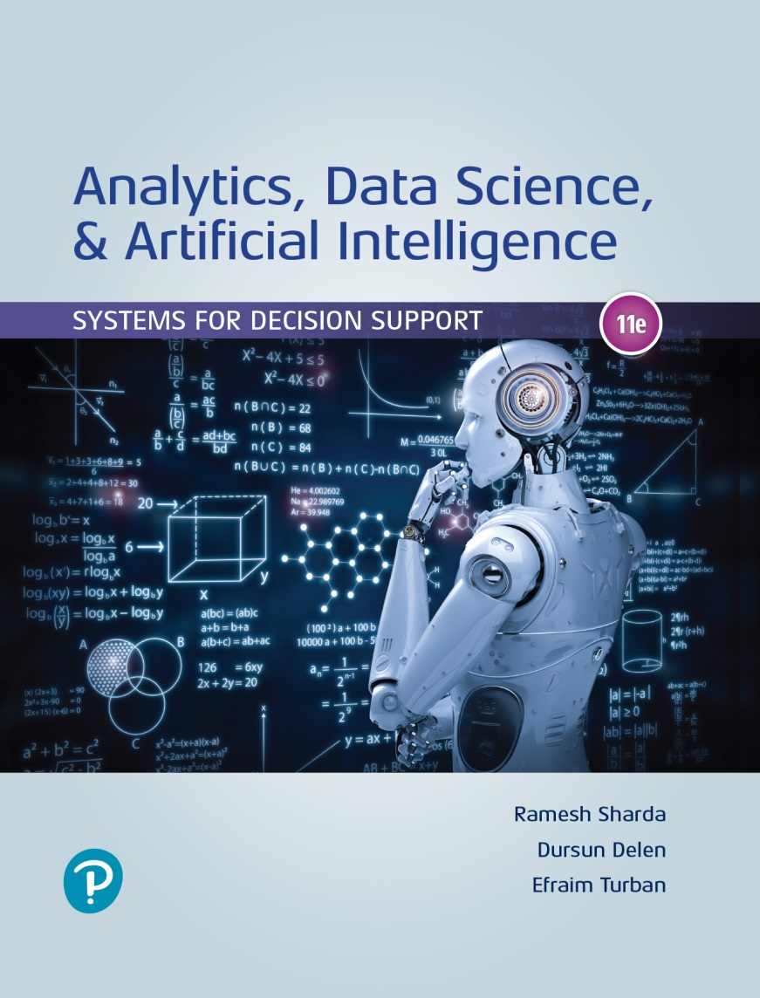
Analytics, Data Science and A I: Systems for Decision Support
Eleventh Edition
Chapter 12
Knowledge Systems: Expert Systems, Recommenders, Chatbots, Virtual Personal Assistants, and Robo Advisors
Copyright © 2020, 2015, 2011 Pearson Education, Inc. All Rights Reserved
Notes:
If this PowerPoint presentation contains mathematical equations, you may need to check that your computer has the following installed:
1) Math Type Plugin
2) Math Player (free versions available)
3) NVDA Reader (free versions available)

Slide 2
Learning Objectives (1 of 2)
12.1 Describe recommendation systems
12.2 Describe expert systems
12.3 Describe chatbots
12.4 Understand the drivers and capabilities of chatbots and their use
12.5 Describe virtual personal assistants and their benefits
Notes:
Slide 2 is a list of textbook LO numbers and statements.

Slide 3
Learning Objectives (2 of 2)
12.6 Describe the use of chatbots as advisors
12.7 Discuss the major issues related to the implementation of chatbots
Notes:
Slide 3 is a list of textbook LO numbers and statements.

Slide 4
Opening Vignette (1 of 2)
Sephora Excels with Chatbots
The Problem
The Solution
The Results

Slide 5
Opening Vignette (2 of 2)
Sephora Excels with Chatbots
Discussion Questions:
List and discuss the benefits of bots to the company.
List and discuss the benefits of bots to customers.
Why were the bots deployed via Messenger and Kik?
What would happen to Sephora if competitors use a similar approach?

Slide 6
Concepts of Expert Systems (E S) (1 of 6)
E S is a computer-based information system
Emulates the decision making and/or problem solving abilities of human experts in complex areas
One of the earliest success application areas of A I
Expert systems use started in research institutions in 1960s
Goal – help nonexperts to make decisions and solve problems that usually require expertise
Works well in narrowly defined domains

Slide 7
Concepts of Expert Systems (E S) (2 of 6)
Expert - A person who has the special knowledge, judgment, experience, and skills to provide sound advice and solve complex problems in a narrowly defined area.
To be called an expert, one must be able to solve a problem and achieve a performance level that is significantly better than an average person
An expert at one time or in one region may not be an expert in another time or region.
E.g., a legal expert in New York is not a expert in Beijing
Experts have expertise that can help solve problems and explain certain obscure phenomena only within a specific domain

Slide 8
Concepts of Expert Systems (E S) (3 of 6)
Typically, human experts are capable of doing the following:
Recognizing and formulating a problem
Solving a problem quickly and correctly
Explaining a solution
Learning from experience
Restructuring knowledge
Breaking rules and norms, if necessary
Determining relevance and associations
Can E S do these? Can a machine help a nonexpert perform like an expert?
Real experts are rare and hard to find

Slide 9
Concepts of Expert Systems (E S) (4 of 6)
Expertise - The extensive, task-specific knowledge that experts possess.
The level of expertise determines the success of a decision made by an expert.
Expertise is often acquired through training, learning, and experience in practice.
Expertise includes explicit knowledge, such as theories learned from a textbook or a classroom and implicit knowledge gained from experience.

Slide 10
Concepts of Expert Systems (E S) (5 of 6)
Knowledge types (expertise) used in E S applications
Theories about the problem domain
Rules and procedures regarding the general problem domain
Heuristics about what to do in a given problem situation
Global strategies for solving of problems amenable to expert systems
Meta knowledge (i.e., knowledge about knowledge)
Facts about the problem area
These types of knowledge enable experts to make better and faster decisions than nonexperts.

Slide 11
Concepts of Expert Systems (E S) (6 of 6)
Expertise often includes the following characteristics:
It is usually associated with a high degree of intelligence, but it is not always associated with the smartest person
It is usually associated with a vast quantity of knowledge
It is based on learning from past successes and mistakes
It is based on knowledge that is well stored, organized, and quickly retrievable from an expert who has excellent recall of patterns from previous experiences.

Slide 12
Characteristics and Benefits of E S
E S were use explicitly by hundreds of companies during the period of 1980 to 2010
Since 2011, the explicit use cases for E S experienced a rapid decline
Reason - the emergence of better knowledge systems, three types of which are described in this chapter
The major objective of E S is the transfer of expertise to a machine.
Then, the expertise will be used by nonexperts.
A typical example of E S use is diagnosis.
Self-diagnosis of computer problems
Diagnosis in medicine – See the example on “Are You Crazy?”

Slide 13
Benefits of E S
Perform routine tasks (e.g., diagnosis, candidate screening, credit analysis) that require expertise much faster than humans.
Reduce the cost of operations.
Improve consistency and quality of work, reduce human errors.
Speed up decision making and make consistent decisions.
May motivate employees to increase productivity.
Preserve scarce expertise of retiring employees.
Help transfer and reuse knowledge.
Reduce employee training cost by using self-training.
Solve complex problems without experts and solve them faster.
See things that even experts sometimes miss.
Combine expertise of several experts.
Centralize decision making (e.g., by using the “cloud”).
Facilitate knowledge sharing.

Slide 14
Structure and Process of E S
Consultation Environment (use of E S via G U I)
Development Environment
Component of an E S
Knowledge acquisition (from humans and others)
Knowledge representation (if-then-else rules)
Knowledge base (knowledge repository)
Inference engine (control/search structure)
User interface
Justifier/explanation module
Knowledge refinement system

Slide 15
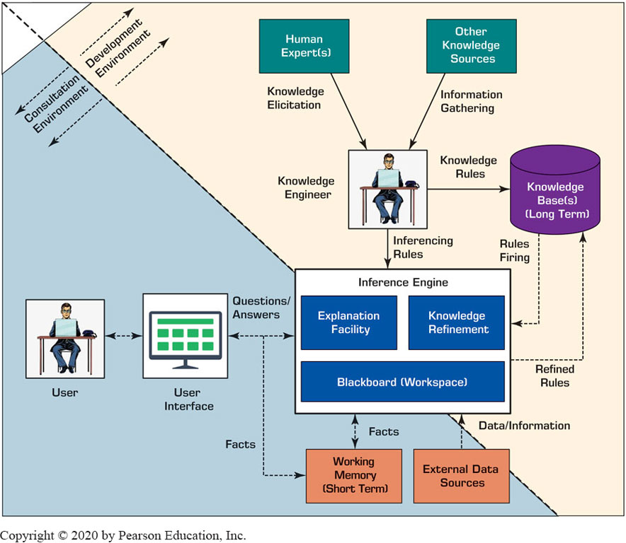
General Architecture of an E S

Slide 16
Application Case 12.1
E S Aid in Identification of Chemical, Biological, and Radiological Agents
Questions for Discussion:
How can the C B R Advisor assist in making quick decisions?
What characteristics of the C B R Advisor make it an expert system?
What could be other situations in which similar expert systems can be employed?

Slide 17
Why the Classical E S are Disappearing
The use of classical E S are rapidly decreasing for the following reasons:
Issued with acquisition of knowledge from experts
Shortage of real experts and knowledge engineers
Need to frequently update acquired knowledge
Lack of efficiency and robustness in the rule-based foundation
Need to supplement the rule-based user-interface (e.g., by voice communication, image maps).
The reasoning capability of rule-based technology is limited compared to use of newer mechanisms such as those used in machine learning.

Slide 18
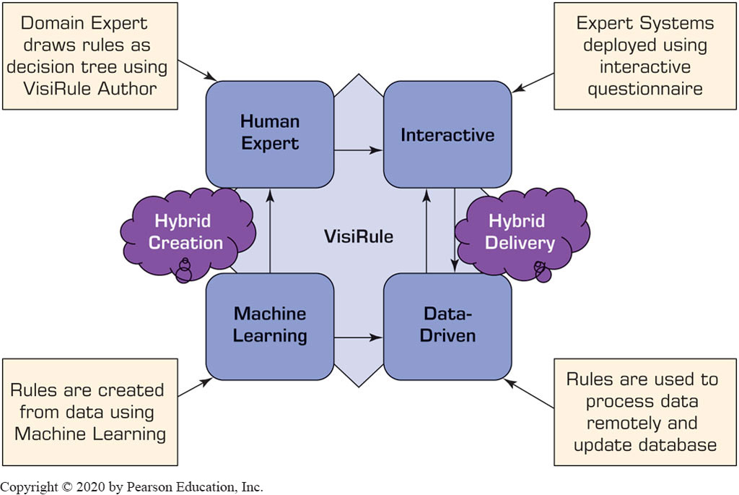
Application Case 12.2 (1 of 2)
VisiRule
Figure 12.2 The Process of VisiRule Recommendation Systems.

Slide 19
Application Case 12.2 (2 of 2)
ViviRule
Questions for Discussion:
Which of the limitations of early E S have been solved by the VisiRule system?
Compare Figures 12.2 and 12.1. What are the differences between the creation (Fig. 12.2) and the development (Fig. 12.1) subsystems?
Compare Figures 12.2 and 12.1. What are the differences between the delivery (Fig. 12.2) and the consultation (Fig. 12.1) subsystems?
Identify all A I technologies and list their contribution to the VisiRule system.
List some benefits of this E S to users.

Slide 20
Recommendation Systems
Recommendation system, also known as recommender system or recommendation engine
Recommending/suggesting one-to-one targeted products or services
Predict the importance (rating or preference) that a user will attach to a product or service
Based on the prediction, specific products and services are recommended to the user
Top applications include movies, music, and books. However, there are also systems for travel, restaurants, insurance, and online dating.

Slide 21
Benefits of Recommendation Systems
Benefits to customer:
Personalization
Discovery
Customer satisfaction
Reports
Increased dialog with seller
Benefits to seller:
Higher conversion rate
Increased cross-sell
Increased customer loyalty
Enabling mass customization

Slide 22
Methods for Recommendation Systems
Collaborative filtering
Building a model that summarizes the past behavior of shoppers in a multi-dimensional manner
Makes recommendations on the new customers based on the similarity to previous shoppers
Uses A I/machine learning to predict the preferences
Content-based filtering
Allows vendors to identify customer preferences by the attributes of the product(s) that customers have bought
Recommend new products with similar attributes
Several other filtering methods also exists

Slide 23
Application Case 12.3
Netflix Recommender: A Critical Success Factor
Questions for Discussion:
Why is the recommender system useful? (Relate it to one-to-one targeted marketing.)
Explain how recommendations are generated.
Amazon disclosed its recommendation algorithms to the public but Netflix did not. Why?
Research the research activities that attempt to “mimic the human brain.”
Explain the changes due to the globalization of the company.

Slide 24
Chatbots (1 of 2)
Chatbots (chat robots) emerged in the last decade
A computerized service that enables easy conversations between humans and humanlike computerized robots or image characters
Some chatbots are equipped with N L P abilities for better understanding, and some with A I/machine learning for learning and improving
Chatbot services are often available messaging services such as Facebook Messenger or WeChat, and on Twitter

Slide 25
Types of Bots
Regular bots. These are essentially conversational intelligent agents (Chapter 2).
They can do simple, usually repetitive, tasks for their owners, such as showing their bank’s debits, helping them to purchase goods online, and to sell or buy stocks online.
Chatbots. In this category, we include more capable bots, for example, those that can stimulate conversations with people.
Intelligent bots. These have a knowledge base that is improving with experience.
That is, these bots can learn, for example, a customer’s preferences (e.g., like Alexa and some robo advisors).

Slide 26
Chatbots (2 of 2)
Drivers
Powerful tools to build chatbots
The quality of conversations is improving
Demand for chatbots are increasing (allowing rapid growth without the need to hire many service personnel)
Helps in appealing to younger customers
Components
A person (client)
A computer, avatar, or robot (the A I machine)
A knowledge base (often stored at the cloud)
A human-computer interface (enabler of the dialog)
N L P that enables machine to “understand” the user

Slide 27
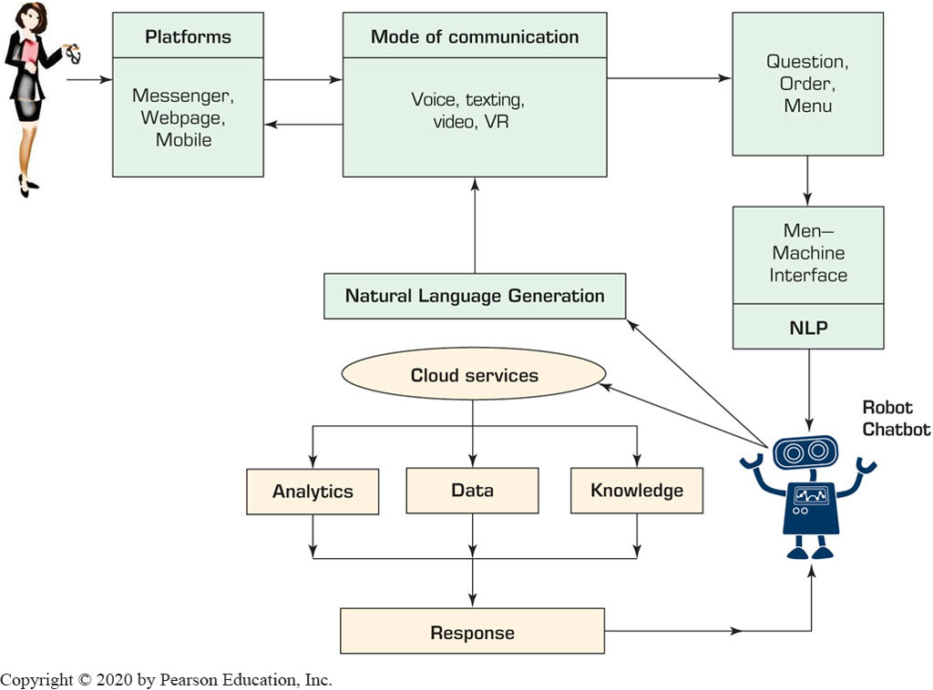
Process of Chatting with a Chatbots

Slide 28
Chatbots Drivers and Benefits
The need to cut costs.
The increasing capabilities of A I, especially N L P and voice technologies.
The ability of conversing in different languages (via machine translation).
The increased quality and capability of captured knowledge.
The push of devices by vendors (e.g., virtual personal assistants such as Alexa from Amazon and Google Assistant from Alphabet).
Its use for providing superb and economic customer service and conducting market research.
Its use for text and image recognition.
Its use to facilitate shopping and support of decision making.

Slide 29
Chatbots
Representative Chatbots from Around the World
RoboCoke, Kip, Walnut, Taxi Bot, ShopiiBot, B O.T, Hazie, Green Card, Zoom, Akita, …
For more, please see chatbots.org/ and botlist.co/bots/
Major Categories of Chatbots’ Applications
Chatbots for enterprise activities, including communication, collaboration, customer service, and sales (such as in the opening vignette)
Chatbots that act as personal assistants
Chatbots that act as advisors, mostly on finance-related topics
These are explained in the following sections

Slide 30
Enterprise Chatbots (1 of 3)
Chatbots can fundamentally change the way that business is done. The interest of enterprises in chatbots
Less expensive and more consistent
Mobile friendly (the new trend for new generation)
Chatbots for marketing and customer experience
Improving the customer experience
Examples
LinkedIn
Mastercard
Coca-Cola
Messaging services and Facebook’s chatbots

Slide 31
Application Case 12.4
WeChat’s Super Chatbot
Questions for Discussion:
Find some recent activities that WeChat does.
What makes this chatbot so unique?
Compare the bot of WeChat to bots offered by Facebook.

Slide 32
Application Case 12.5
How Vera Gold Mark Uses Chatbots to Increase Sales
Questions for Discussion:
List the benefits to V G M.
List the benefits to buyers.
What is the role of Kenyt Technologies?

Slide 33
Enterprise Chatbots (2 of 3)
Enterprise Chatbots: Financial Services
Banking - Chatbots can use predictive analytics and cognitive messaging to perform tasks such as making payments, inquiring account details, etc.
Example: P O S B of Singapore has an A I-driven bot on Facebook Messenger
Enterprise Chatbots: Service Industry
Healthcare – robot receptionist, chatty companions, …
Education – tutors, translators, …
Government – dialog tool for use by the public
Travel and hospitality – tour guides, customer service

Slide 34
Application Case 12.6
Transavia Airlines Uses Bots for Communication and Customer Care Delivery
Questions for Discussion:
What drives consumer preference for mobile devices and chat?
Why was the bot placed on Facebook Messenger?
What were the benefits of using Cognizant?
What is the advantage of buying a ticket from a bot rather than from an online store?

Slide 35
Enterprise Chatbots (3 of 3)
Representative examples of chatbot tasks:
Help with project management.
Handle data entry.
Conduct scheduling.
Streamline payments with partners.
Advise on authorization of funds.
Monitor work and workers.
Analyze internal Big Data.
Find discounted and less expensive products.
Simplify interactions.
Facilitate data-driven strategy.
Use machine learning.
Facilitate and manage personal finance.

Slide 36
Technology Insights 12.1
Chatbots’ Platform Providers
Popular vendors:
ChettyPeople
Kudi
Twyla
The most popular platforms:
I B M Watson
Microsoft’s Bot Framework

Slide 37
Virtual Personal Assistants (1 of 2)
Assistant for Information Search
If You Were Mark Zuckerberg, Facebook C E O
While Siri and Alexa were in development he develop his own personal assistant to help him run his home and his work
Amazon’s Alexa and Echo
Alexa can do many things…
Alexa can be taught/customized for individualized skills
Amazon Echo, Echo Dot, and Echo Tap
Alexa for Enterprise …

Slide 38
Virtual Personal Assistants (2 of 2)
Apple Siri
Siri: Speech Interpretation and Recognition Interface
V I V: developed in 2016, by Dag Kittlaus, the creator of Siri, as “an intelligent Interface for everything”
Goggle Assistant
Other personal assistants
Microsoft Cortana (Cortana with Bing)
Samsung Bixby
Competition Among Large Tech Companies
Knowledge for Virtual Personal Assistants

Slide 39
Chatbots and Professional Advisors (Robo Advisors) (1 of 2)
A special category of virtual personal assistants
Designed to provide personalized professional advice in specific domains, especially in investment and portfolio management
Evolution of Financial Robo Advisors
Robo Advisors 2.0: Adding the Human Touch
Quality of advice provided by robo advisors?
It depends on their knowledge embedded within
Managing Mutual Funds Using A I

Slide 40
Application Case 12.7
Betterment, the Pioneer of Financial Robo Advisors
Questions for Discussion:
What are Betterment’s benefits to investors?
Compare Betterment to its major competitors (see Eule, 2017).
What are the benefits of adding the human touch (i.e., compared to pure automation and only human service)?
Find some new information about Betterment. Write a report.

Slide 41
Chatbots and Professional Advisors (Robo Advisors) (2 of 2)
Other Professional Advisors
Computer operations
Self-guides to solve encountered problems
Travel
planning future national and international trips
Medical and health advisors
Shopping advisors (shopbots)
Example: Smart Assistant Shopping Bots
I B M Watson-based robo advisors

Slide 42
Chatbots Implementation Issues
Technology issues
Disadvantages and limitations of bots
Inferior performance
Virtual assistants under attack
Quality of Chatbots
Quality of robo advisors
Microsoft’s Tay (Twitter based chatbot)
Constructing Bots
Using Microsoft’s Azure bot service

Slide 43
End of Chapter 12
Questions / Comments

Slide 44

Copyright
This work is protected by United States copyright laws and is provided solely for the use of instructors in teaching their courses and assessing student learning. Dissemination or sale of any part of this work (including on the World Wide Web) will destroy the integrity of the work and is not permitted. The work and materials from it should never be made available to students except by instructors using the accompanying text in their classes. All recipients of this work are expected to abide by these restrictions and to honor the intended pedagogical purposes and the needs of other instructors who rely on these materials.

