Slide 1
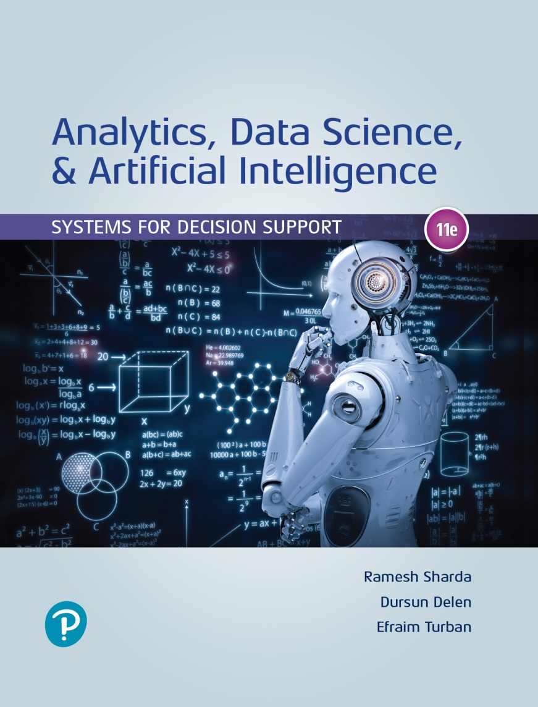
Analytics, Data Science and A I: Systems for Decision Support
Eleventh Edition
Chapter 13
The Internet of Things as a Platform for Intelligent Applications
Slide in this Presentation Contain Hyperlinks. JAWS users should be able to get a list of links by using INSERT+F7
Copyright © 2020, 2015, 2011 Pearson Education, Inc. All Rights Reserved
Notes:
If this PowerPoint presentation contains mathematical equations, you may need to check that your computer has the following installed:
1) Math Type Plugin
2) Math Player (free versions available)
3) NVDA Reader (free versions available)

Slide 2
Learning Objectives (1 of 2)
13.1 Describe the IoT and its characteristics
13.2 Discuss the benefits and drivers of IoT
13.3 Understand how IoT works
13.4 Describe sensors and explain their role in IoT applications
13.5 Describe typical IoT applications in a diversity of fields
Notes:
Slide 2 is a list of textbook LO numbers and statements.

Slide 3
Learning Objectives (2 of 2)
13.6 Describe smart appliances and homes
13.7 Understand the concept of smart cities, their content, and their benefits
13.8 Describe the landscape of autonomous vehicles
13.9 Discuss the major issues of IoT implementation
Notes:
Slide 3 is a list of textbook LO numbers and statements.

Slide 4
Opening Vignette (1 of 3)
C N H Industrial Uses the IoT to Excel
The Problem
The Solution
The Results

Slide 5
Opening Vignette (2 of 3)
C N H Industrial Uses the IoT to Excel
Questions for the Opening Vignette:
Why is the IoT the only viable solution to C N H’s problems?
List and discuss the major benefits of IoT.
How can C N H’s product development benefit from the collected data about usage?
It is said that the IoT enables telematics and connected vehicles. Explain.
Why is IoT considered the “core of the future business strategy”?

Slide 6
Opening Vignette (3 of 3)
C N H Industrial Uses the IoT to Excel
Discussion Questions (cont.)
It is said that the IoT will enable new services for C N H (e.g., for sales and collaboration with partners). Elaborate.
View Figure 13.1 (The process of IoT) and relate it to the use of IoT at C N H.
Identify decision support possibilities.
Which decisions made by the company and its customers are supported by IoT?

Slide 7
Essentials of Internet of Things (IoT) (1 of 2)
IoT refers to a computerized network that connects many objects (people, animals, devices, sensors, buildings, items) each with embedded microprocessor
Connections are made wirelessly via Internet
IoT allows communication and exchange of data among the object and their environment
Connections are made anytime, anyplace
IoT uses ubiquitous computing

Slide 8
Essentials of Internet of Things (IoT) (2 of 2)
Analysts predicts that by 2025, more than 50 Billion objects (devices) will be connected to the Internet, creating the backbone of IoT applications
It is a disruptive technology
Changing the business models
Join the conversations at iotcommunity.com
Allows extensive communication and collaboration between users and items
Devices can connect each other directly
Increasing productivity and automation
Unlimited use cases…

Slide 9
Definitions and Characteristics of IoT (1 of 3)
“The Internet of Things means sensors connected to the Internet and behaving in an Internet-like way by making open, ad hoc connections, sharing data freely, and allowing unexpected applications, so computers can understand the world around them and become humanity’s nervous system.”
Kevin Ashton, Creator of the term Internet of Things
“The IoT is a network of connected computing devices including different types of objects (e.g., digital machines). Each object in the network has a unique identifier (U I D), and it is capable of collecting and transferring data automatically across the network.”
Our working definition

Slide 10
Definitions and Characteristics of IoT (2 of 3)
IoT allows people and things to interact and communicate at any time, any place, regarding any business topic or service.
IoT Characteristics (Miller, 2015)
Large numbers of objects (things) can be connected.
Each thing has a unique definition/I D (I P address).
Each thing has the ability to receive, send, and store data automatically.
Each thing is delivered mostly over the wireless Internet.
Each thing is built upon machine-to-machine (M2M) communication.
Internet connects people to each other using computing technology, while IoT connects “things” (physical devices and people) to each other and to sensors that collect data

Slide 11
Definitions and Characteristics of IoT (3 of 3)
Simple Examples
Autonomous vehicles (more on this later)
Smartbin (“smart” trash containers)
Refrigerator automatically ordering food items
Clorox introduced a new Brita filter that automatically orders water filter when needed
IoT is Changing Everything (in production/logistics)
Real-time tracking of everything
Real-time route tracking, logistics optimization
Real-time condition assessment of critical objects
Real-time monitoring of the perishable items

Slide 12
IoT Ecosystem (1 of 2)
The IoT ecosystem refers to all components that enable users to create IoT applications
E.g., gateways, analytics, A I algorithms, servers, data storage, security, and connectivity devices
Platforms
Software, hardware, connectivity, …
Building blocks
Interfaces, platforms, 3D, …
Applications
Personal, home, vehicle, industrial, enterprise
See Figure 13.1 for a full picture of the IoT ecosystem

Slide 13
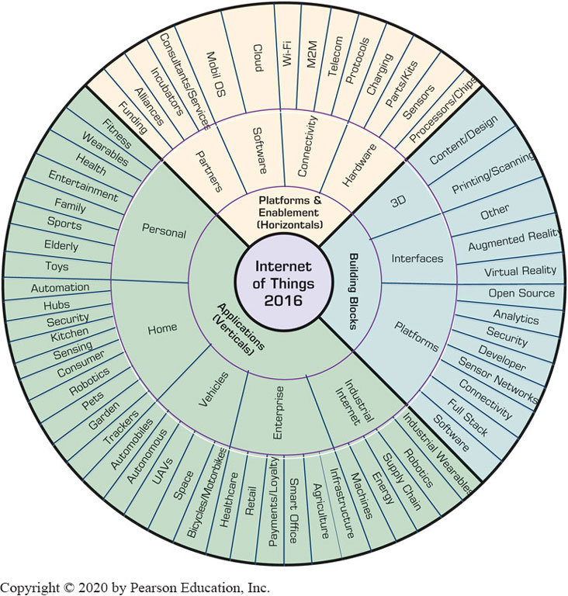
IoT Ecosystem (2 of 2)
Figure 13.1 The IoT 2016 (Ecosystem).

Slide 14
Structure of IoT Systems (1 of 2)
IoT Technology Infrastructure (four major blocks)
Hardware
physical devices, sensors, and actuators where data are produced and recorded
Connectivity
Via hubs, gateways and Internet/Cloud)
Software backend
The logic/process implementation that manages data, often in the cloud)
Applications
The use of the generates data → information for some specific of purposes

Slide 15
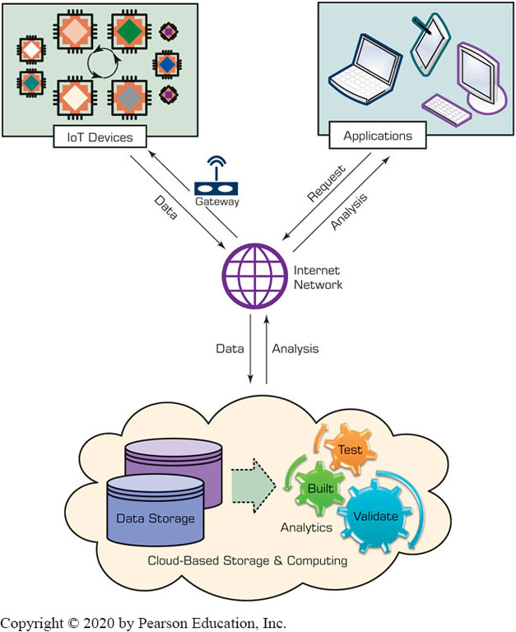
Structure of IoT Systems (2 of 2)
Figure 13.2 The Building Blocks of IoT.
Implementations often utilize IoT Platforms
Amazon A W S IoT,
Microsoft Azure IoT suite,
Predix IoT Platform by General Electric (G E),
I B M Watson IoT platform
Teradata
Unified Data Architecture has

Slide 16
Major Benefits and Drivers of IoT (1 of 3)
Major Benefits of IoT
Reduces cost by automating processes.
Improves workers’ productivity.
Creates new revenue streams.
Optimizes asset utilization (e.g., see the opening vignette).
Improves sustainability.
Changes and improves everything.
May anticipate our needs (predictions).
Enables insights into broad environments.
Enables smarter decisions/purchases.
Provides increased accuracy of predictions.
Identifies problems quickly (even before they occur).
Provides instant information generation and dissemination.
Offers quick and inexpensive tracking of activities.
See more benefits of IoT in the book.

Slide 17
Major Benefits and Drivers of IoT (2 of 3)
Major Drivers of IoT
Very large number of “things” will be connected to the Internet
Connected autonomous “things”/systems (e.g., robots, cars) create new IoT applications.
Broadband Internet is more widely available, increasing with time.
The cost of devices and sensors is continuously declining.
The cost of connecting the devices is decreasing.
Additional devices are created (via innovations) and are interconnected easily
More sensors are built into devices.
Smartphones’ penetration is skyrocketing.
The availability of wearable devices is increasing.
The speed of moving data is increasing to 60H T z.
See more benefits of IoT in the book.

Slide 18
Major Benefits and Drivers of IoT (3 of 3)
Opportunities…
Drivers and benefits of IoT paints a good picture for many opportunities in many industries and settings
How big can an IoT network be?
As large as it needs to be
Not all 50B objects will be connected to each other
Example: World’s Largest IoT Is Being Built in India (2017)
Constructed by Tata Communications of India and H P Enterprises (H P E) of the United States, over the H P E Universal IoT Platform.

Slide 19
How IoT Works (1 of 2)
IoT is not an application.
It is an infrastructure, platform, or framework that is used to support applications.
A simple view to hot IoT works:
The Internet ecosystem includes a large number of things
Sensors and other devices collect information from the ecosystem
The collected information can be displayed, stored, and processed analytically (e.g., by data mining)
This analysis converts the information into knowledge and/or intelligence
Expert systems or machine learning may help in turning the knowledge into decision support (made by people and/or machines), which is evidenced by improved actions and results… leading to new applications and use cases.

Slide 20
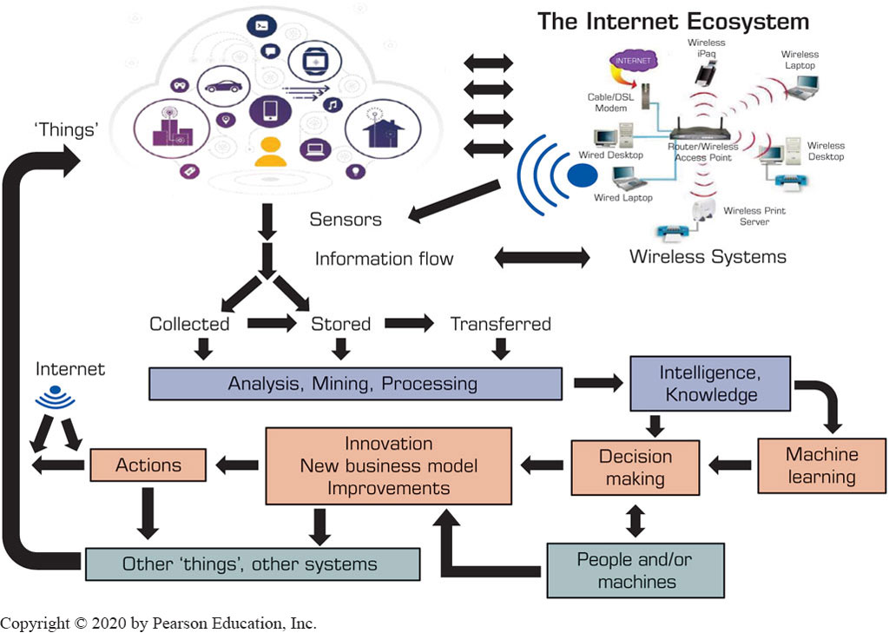
How IoT Works (2 of 2)
Figure 13.3 The Process of IoT.

Slide 21
Sensors and Their Role in IoT (1 of 2)
A sensor is an electronic device that automatically collects data about events in its environment
Sensors are a critical part of IoT systems
There are several types of sensors and several methods for collecting data from sensors
Sensors are also essential components in robotics and autonomous vehicles
Sensors have distance and precision limits
Sensors of a very short range are known as proximity sensors, which are more reliable than longer ranges

Slide 22
Application Case 13.1
Using Sensors, IoT, and A I for Environmental Control at the Athens, Greece, International Airport
Questions for Discussion:
What is the role of IoT in the project?
What is the role of sensors?
What are the benefits of the project?

Slide 23
Sensors and Their Role in IoT (2 of 2)
How Sensors Work with IoT
In large-scale applications, sensors collect data that are transferred to processing in the “cloud”
Sensor Applications and Radio-Frequency Identification (R F I D) Sensors
Sensors can measure many things: humidity, temperature, etc.
A well-known type of sensor that plays an important role in IoT is radio-frequency identification
R F I D in conjunction with other sensors play a major role in IoT applications

Slide 24
Technology Insight 13.1
R F I D Sensors
R F I D - a generic technology that uses of radio-frequency waves to identify objects
Part of a family of automatic identification technologies that also includes ubiquitous barcodes and magnetic strips
R F I S stores richer identification data
Use of R F I D spread by retailers’ supply-chains
R F I D works with tags and readers
Active vs passive tags (long/short range)

Slide 25
Application Case 13.2
Rockwell Automation Monitors Expensive Oil and Gas Exploration Assets to Predict Failures
Questions for Discussion:
What type of information would likely be collected by an oil and gas drilling platform?
Does this application fit the three V’s (volume, variety, velocity) of Big Data? Why or why not?
Which other industries (list five) could use similar operational measurements and dashboards?

Slide 26
Use of R F I D and Smart Sensors in IoT
Basic R F I D tags, active or passive, are not sensors
Purpose: determine the location of the object, couple it with the time of detection
R F I D sensors – tags enhanced with on-board sensors
Purpose: determine the location, time, and measurements of the environmental conditions
Smart Sensor - Senses the environment and processes the input it collects by using its built-in computing capabilities

Slide 27
Selected IoT Applications (1 of 2)
French National Railway System’s Use of IoT
Manage 15,000 trains and 30,000 kilometers
Provide quality, availability, and safety for its nearly 14 million passengers
Uses I B M Watson in the background
Other Applications
Hilton hotels – smartphone check-in/smart-key
Ford, Tesla – voice orders, smart maintenance, …
Johnnie Walker – connecting bottles to the Internet
Apple – Streamline shopping with Apple Pay
Starbucks Clover Net in the Cloud – system wide…

Slide 28
Selected IoT Applications (2 of 2)
How IoT is Driving Marketing
Disruptive data collection – IoT can collect more data about customers from more data sources
Realtime personalization – sensing and acting the perceived needs of the customers in real-time
Environmental attribution – IoT can monitor environments regarding ad delivery for specific places, customers, methods, and campaigns
Complete conversation path - consumer purchasing paths, conversations between customers and vendors

Slide 29
Smart Homes and Appliances (1 of 5)
A smart home is a home with automated components that are interconnected such as lights, appliances, security, and entertainment that are able to communicate each other
Designed to provide their dwellers with comfort, security, low energy cost, and convenience
Most existing home are not smart, but the can inexpensively be equipped with partial smartness
See techterms.com\definition\smart_home
Protocols: X I O, U P B, Z-Wave, EnOcean, …
These products offer scalability, so more devices can be connected

Slide 30
Smart Homes and Appliances (2 of 5)
Typical Components of Smart Homes
Lighting and T V
Energy management (e.g., Nest)
Water control (watercop.com)
Smart speaker and chatbots (e.g., Alexa)
Home entertainment
Alarm clock
Vacuum cleaner
Camera
Refrigerator (and other appliances)
Home security and safety
…

Slide 31
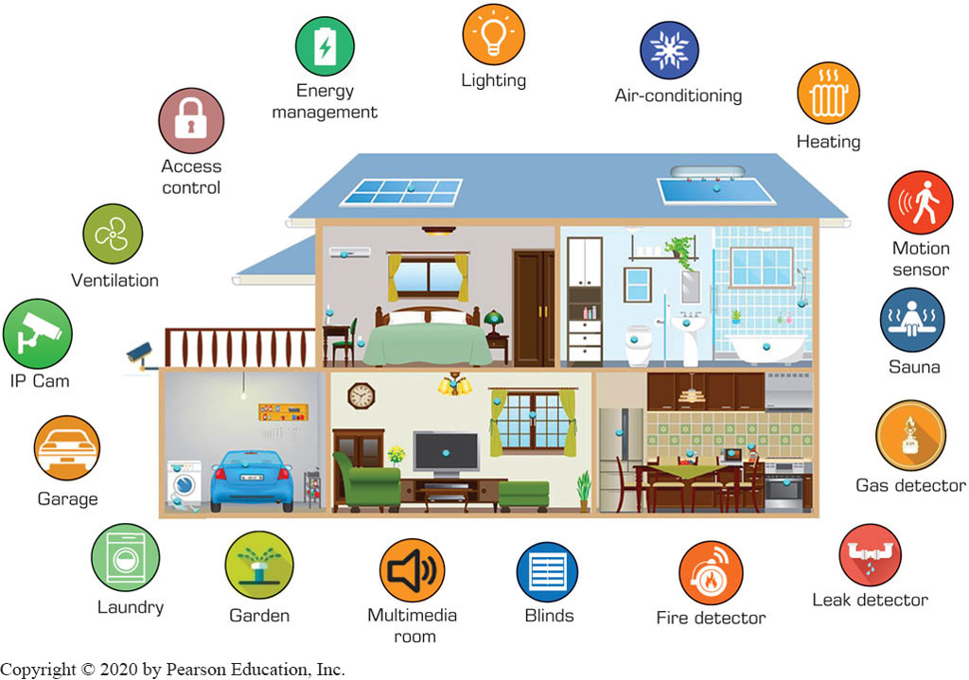
The Components of a Smart Home

Slide 32
Smart Homes and Appliances (3 of 5)
Example: iHealthHome
Provides real-time information to caregivers and physicians (and loved ones)
Reminds seniors of daily appointments and when to take their medicine
Smart appliances are appliances enhanced with sensor and communication technologies
They comminute with other devises and people through the home network and Internet
Google Nest, and other Nest products (nest.com)
Popular kits for smart homes include Amazon Eco, Google Home

Slide 33
Smart Homes and Appliances (4 of 5)
Home Appliances in Consumer Electronic Show (C E S) 2016–2018
Samsung Smart fridge
Gourmet robotic cooker
10 in 1 device for the kitchen (kitchen “robot”)
L G H U M-B O T Turbo+
Haier R3D2 Refrigerator
Instaview Refrigerator from L G
Whirlpool’s smart top load washer
L G L D T8786S T dishwasher
Trends include T V, connected entertainment systems, smart security systems, smart utility managers, …

Slide 34
Smart Homes and Appliances (5 of 5)
A Smart Home Is Where the Bot Is
A I based both in smart homes with predictive abilities
Barriers to Smart Home Adoption
Compatibility. Too many vendors and products; connecting them all is a challenge
Communication. Different consumers have different ideas on what the smart home should be
Concentration. Brands need to concentrate on population segments that are most interested in smart homes (e.g., Gen Y)
Also - cost justification, invasion of privacy, security, and ease of use, ...

Slide 35
Smart Cities and Factories
Smart cities use digital technologies (mostly mobile based) to facilitate better public services for citizens, better utilization of resources, and less negative environmental impact.
Smart Buildings: From Automated to Cognitive Buildings
I B M’s Cognitive Building learns the behavior of a building’s system in order to optimize it
Doing so autonomously by integrating with the IoT devices and sensors
Uses IoT and sensors to monitor, analytics to learn, robots to act …

Slide 36
Application Case 13.3
Amsterdam on the Road to Become a Smart City
Questions for Discussion:
Watch the video at youtube.com/watch?v=FinLi65Xtik/ and comment on the technologies used.
Get a copy of the M I T case study at sloanreview.mit.edu/case-study/data-driven-city-management/. List the steps in the process and the applications that were likely used in IoT.
Identify the smart components used in this project.

Slide 37
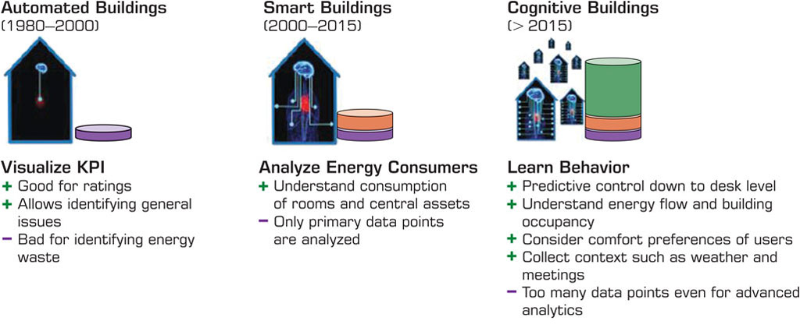
Smart Building - Example
Figure 13.5 I B M’s Cognitive Building Maturity Framework.
Hong Kong has a project called a smart mobility for the improvement of road safety. A consortium of private and public organizations has introduced Intelligent Transport
Source: I B M. “Embracing the Internet of Things in the new era of cognitive buildings.” I B M Global Business Services, White Paper, 2016. Courtesy of International Business Machines Corporation, © International Business Machines Corporation.Used with permission.

Slide 38
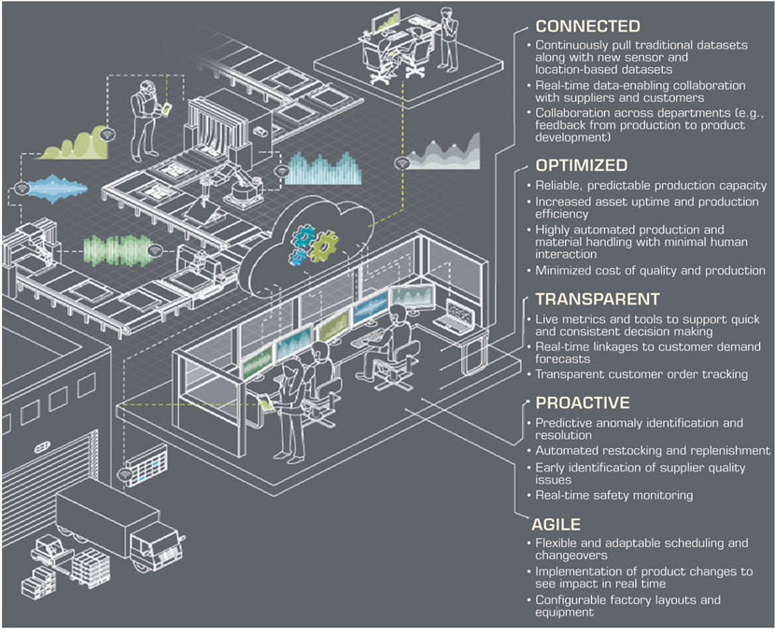
Smart Factories
Figure 13.6 Five Key Characteristics of a Smart Factory (Deloitte).
Source: Burke, Hartigan, Laaper, Martin, Mussomeli, Sniderman, “The smart factory: Responsive, adaptive, connected manufacturing,” Deloitte Insights (2017), https://www.deloitte.com/insights/us/en/focus/industry-4-0/smart-factory-connected-manufacturing.html. Used with permission.

Slide 39
Application Case 13.4
How I B M Is Making Cities Smarter Worldwide
Questions for Discussion:
List the various services that are improved by IoT in a smart city.
How do the technologies support decision making?
Comment on the global nature of the examples.

Slide 40
Smart Cities (1 of 3)
Improving Transportation in the Smart City
A major problem in many cities is the increased number of vehicles and the inability to accommodate all of them effectively
Solutions include building more roads, public transportation, smart traffic via IoT+Sensors+Analytics
Example 1
Smart studs transmits information of what they sense
Smart studs + autonomous vehicle = feature of traffic
Example 2
Hong Kong parking, collision warning, and alerts for speeders and lane changing violators

Slide 41
Smart Cities (2 of 3)
Example: The S A S Analytics Model for Smart Cities
Sense
Understand the signals in the data
Act
Bill Gates’ Futuristic Smart City
In November 2017, Bill Gates purchased 60,000 acres of land west of Phoenix, Arizona, where he plans to construct a futuristic city from scratch
Technology Support for Smart Cities
Technology support by Bosch Corp., and Others

Slide 42
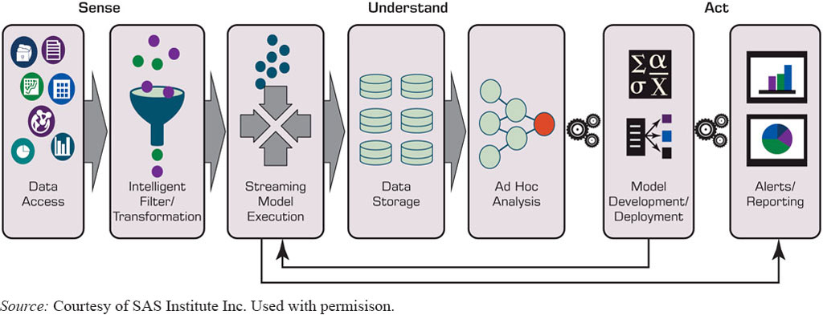
Smart Cities (3 of 3)
Figure 13.7 S A S Supports the Full IoT Analytics Life Cycle for Smart Cities (S A S).
Source: Courtesy of S A S Institute Inc. Used with permisison.

Slide 43
Autonomous Self-Driving Vehicles (1 of 2)
Autonomous vehicles (driverless cars, robot-driven cars, self-driving cars, and autonomous cars) are already on the roads in several places
The Developments of Smart Vehicles
Google in the 1990s – Waymo
TECHNOLOGY INSIGHTS 13.2 Toyota and Nvidia Corp. Plan to Bring Autonomous Driving to the Masses
See blogs.nvidia.com/blog/2016/09/28/Xavier/.
Flying Cars?

Slide 44
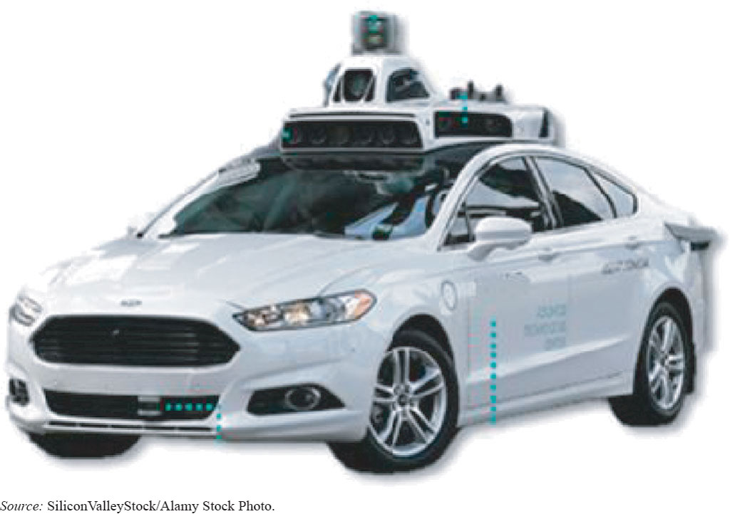
Application Case 13.5 (1 of 2)
Waymo and Autonomous Vehicles
Figure 13.8 Waymo (Google) Self-Driving Car.
Source: SiliconValleyStock/Alamy Stock Photo.

Slide 45
Application Case 13.5 (2 of 2)
Waymo and Autonomous Vehicles
Questions for Discussion:
Why did Waymo first use simulation?
Why was legislation needed?
What is the Early Rider Program?
Why will it take years before regular car owners will be able to enjoy a ride in the back seat of their self-driving cars?
Why are Lyft, Uber, and Avis interested in selfdriving cars?

Slide 46
Autonomous Self-Driving Vehicles (2 of 2)
Implementation Issues in Autonomous Vehicles
3D map technologies – need to reduce the price and increase the quality/precision
A I software capabilities need to be increased
Proper education, management of expectations
More research and improvement of facilitators needed (sensors, roads, infrastructure, …)
Data transmission and communication needs improvements

Slide 47
Implementing IoT and Managerial Considerations (1 of 2)
Major Implementation Issues
Organizational alignment
Interoperability challenges
Security
Additionally …
Privacy
Connection of the silos of data
Preparation of existing I T architectures
Management
Connected customers

Slide 48
Implementing IoT and Managerial Considerations (2 of 2)
Strategy for Turning Industrial IoT into Competitive Advantage
Specify the business goals
Express an analytic strategy
Evaluate the needs for edge analytics
Select appropriate analytics solutions
Continues improvement closes the loop
Future of IoT
Larger, more connected/networked, smarter, …
A I enhancement of IoT

Slide 49
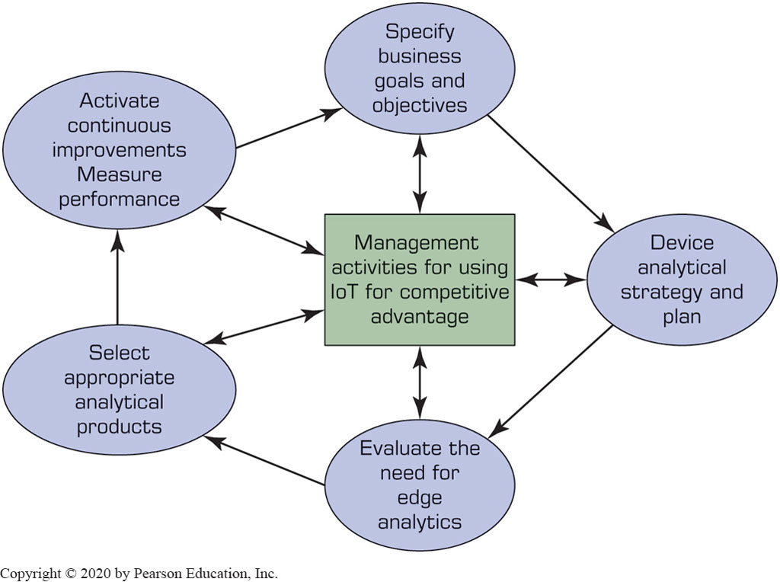
The IoT Strategy

Slide 50
End of Chapter 13
Questions / Comments

Slide 51

Copyright
This work is protected by United States copyright laws and is provided solely for the use of instructors in teaching their courses and assessing student learning. Dissemination or sale of any part of this work (including on the World Wide Web) will destroy the integrity of the work and is not permitted. The work and materials from it should never be made available to students except by instructors using the accompanying text in their classes. All recipients of this work are expected to abide by these restrictions and to honor the intended pedagogical purposes and the needs of other instructors who rely on these materials.

