Slide 1
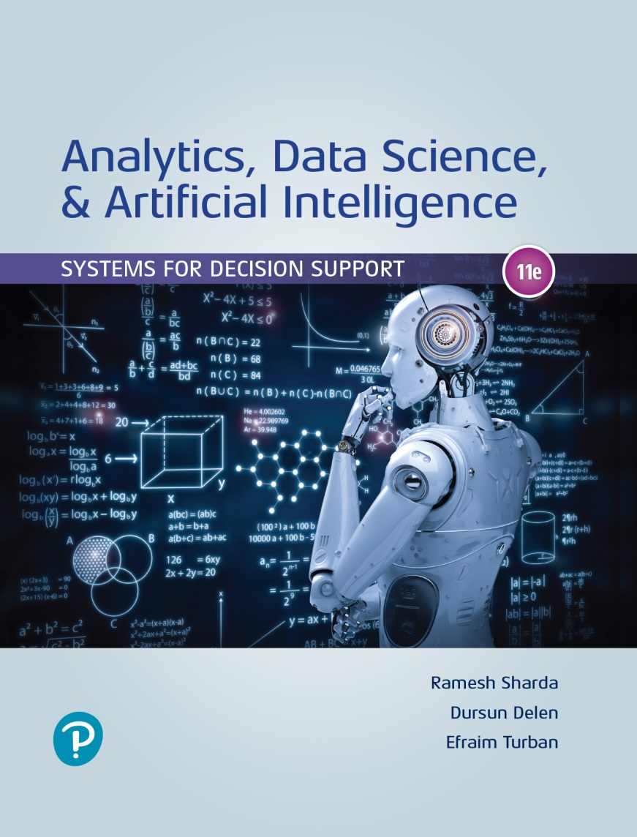
Analytics, Data Science and A I: Systems for Decision Support
Eleventh Edition
Chapter 14
Implementation Issues: From Ethics and Privacy to Organizational and Societal Impacts
Slide in this Presentation Contain Hyperlinks. JAWS users should be able to get a list of links by using INSERT+F77
Copyright © 2020, 2015, 2011 Pearson Education, Inc. All Rights Reserved
Notes:
If this PowerPoint presentation contains mathematical equations, you may need to check that your computer has the following installed:
1) Math Type Plugin
2) Math Player (free versions available)
3) NVDA Reader (free versions available)

Slide 2
Learning Objectives (1 of 2)
14.1 Describe the major implementation issues of intelligent technologies
14.2 Discuss legal, privacy and ethical issues
14.3 Understand the deployment issues of intelligent systems
14.4 Describe the major impacts on organizations and society
14.5 Discuss and debate the impacts on jobs and work
Notes:
Slide 2 is list of textbook LO numbers and statements

Slide 3
Learning Objectives (2 of 2)
14.6 Discuss the arguments of utopia and dystopia in a debate of the future of robots and artificial intelligence (A I)
14.7 Discuss the potential danger of mathematical models in analytics
14.8 Describe the major influencing technology trends
14.9 Describe the highlights of the future of intelligent systems
Notes:
Slide 2 is list of textbook LO numbers and statements

Slide 4
Opening Vignette (1 of 2)
Why Did Uber Pay $245 Million to Waymo
Background
Self driving cars for Uber…
The legal dispute…
Why did they settle?
Conclusion

Slide 5
Opening Vignette (2 of 2)
Why Did Uber Pay $245 Million to Waymo
Questions for the Opening Vignette:
Identify the legal issues involved in this case.
Why do you think Waymo agreed to take Uber’s shares instead of money?
What is the meaning of intellectual property in this case?
The presiding federal judge said at the end: “This case is now ancient history.” What did he mean to say?
Summarize the potential damages to the two parties if they had continued with the legal dispute.
Summarize the benefits of the settlement to both sides.

Slide 6
Implementing Intelligent Systems
What can you do with the output of analytics?
Implement them!
Some results are “good to know” and done
Most require perpetual use (as a D S S) in the organizaiton
Implementing A I/analytic solution is not easy...
In addition to common issues related to any computer based system implementation, A I/analytics implementation has specific issues to deal with
Before talking about the issues, let us first look at the process…

Slide 7
The Intelligent Systems Implementation Process
Five major steps of implementation
Step 1. Need assessment (business case)
Step 2. Preparation (readiness)
Step 3. System acquisition (in-house/outsource)
Step 4. System development
Step 5. Impact assessment

Slide 8
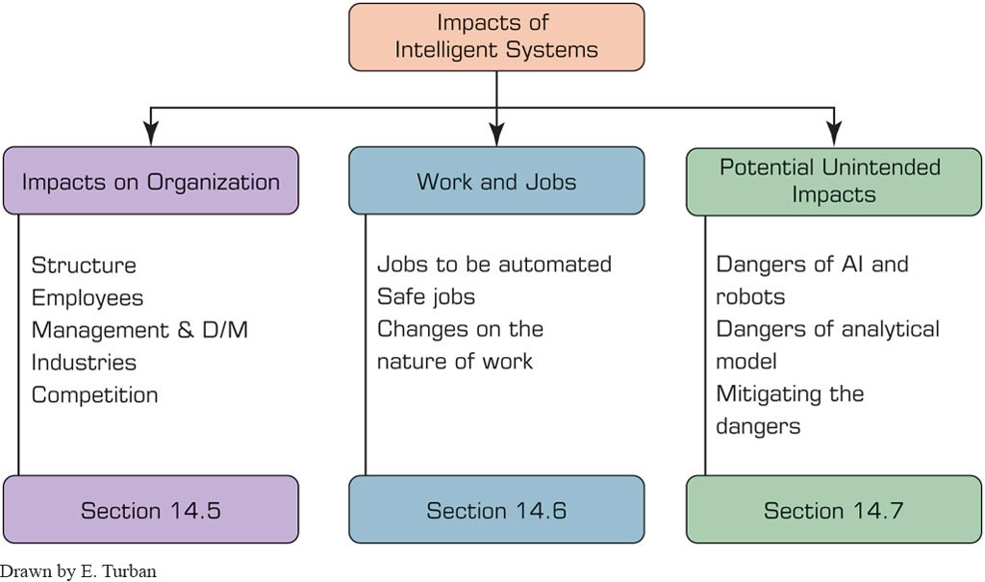
The impact of Intelligent Systems
Figure 14.2 Impact Landscape.
Drawn by E. Turban

Slide 9
Legal, Privacy and Ethical Issues (1 of 12)
As data science, analytics, cognitive computing, and A I grow in reach and pervasiveness, everyone may be affected by these applications
Just because something is doable through technology does not make it appropriate, legal, or ethical
Data science and A I professionals/manager must be aware of these concerns
Legality versus Privacy versus Ethics
Something legal may not be ethical…

Slide 10
Legal, Privacy and Ethical Issues (2 of 12)
Legal Issues
What is the value of an expert opinion in court?
Who is liable for wrong advice (or information) provided by an intelligent application?
What happens if a manager enters an incorrect judgment value into an intelligent application and the result is damage or a disaster?
Who owns the knowledge in a knowledge base (e.g., the knowledge of a chatbot)?
Can management force experts to contribute their expertise to an intelligent system? …
See the example on “Intellectual Property Protection”

Slide 11
Legal, Privacy and Ethical Issues (3 of 12)
A I and Law
A I applications to the legal profession/problems
Analyzing legal-related data (e.g., regulatory conflicts) to detect pattern
Providing legal advice to consumers (e.g., see DoNotPay.com).
Document review
Analyzing contracts
Supporting legal research
Predicting results (e.g., likelihood to win)
A I impact on the legal profession.

Slide 12
Legal, Privacy and Ethical Issues (4 of 12)
Privacy Issues
Privacy: the right to be left alone and the right to be free from unreasonable personal intrusions
Related to legal, ethical, and social issues in many countries. It recognized today by federal government and by every state in the U S either by statute or by common law
Two rules that applies to interpretation of privacy
The right of privacy is not absolute (needs to be balanced against the needs of the society)
The public’s right to know is superior to the individual’s right to privacy
It is difficult to determine/enforce privacy regulations

Slide 13
Legal, Privacy and Ethical Issues (5 of 12)
Privacy Issues
Collecting information about individuals
Target marketing…
Internet is the enabler of new face of data collection
Virtual personal assistants
Amazon Echo/Alexa… listening all the time
Mobile user privacy
Tracking through the smartphones – not just the cell-phone providers but potentially many apps on your phone
Privacy in IoT networks
Recent technology issues in privacy and analytics
“What They Know” (WallStreetJournal.com, 2016).
See Rapleaf, Qualia (qualia.com), reputation.com, …

Slide 14
Legal, Privacy and Ethical Issues (6 of 12)
Privacy
Example: Using Sensors and IoT to Observe Bankers at Barclays Bank
Using heat and motion sensors, Barclays tracks how long its bankers are at their desks
Other issues of potential privacy violation
Delaware police are using A I dashcams to look for fugitives in passing cars
Facebook’s face recognition systems create concerns regarding privacy protection
Epicenter offers its employees a microchip implant. It acts like a swipe card, …

Slide 15
Legal, Privacy and Ethical Issues (7 of 12)
Privacy
Who own our private data?
You or the technology creators?
A new car with sensors to collect data and connected to the Internet to disseminate it …
New battle between car manufacturer and Apple, Google, … as to who can access this data
Apps collect data abut the users
Google’s Waze
Yelp…
Spotify…
…

Slide 16
Legal, Privacy and Ethical Issues (8 of 12)
Ethical Issues
Not necessarily illegal, matter of personal values
Example: Facebook’s experiment to present different News Feeds to the users and monitor their emotional reactions as measured by replies, likes, sentiment analysis, and so on. …
Running this experiment without the users’ informed consent was viewed as unethical
Transparency on what A I does for both vendors and customers is needed in order to stay ethical
This way people can stay honest and adhere to the goals of A I, so it can play a significant role in our life and work.

Slide 17
Legal, Privacy and Ethical Issues (9 of 12)
Ethical Issues of Intelligent Systems
What are their impact on jobs?
How do machines affect our behavior and interactions?
How can wealth created by intelligent machines be distributed?
How can intelligent applications mistakes be guarded against?
Can intelligent systems be fair and unbiased? How can bias in creation and operation of A I systems be eliminated?
How can intelligent applications be keep safe from adversaries?
How can systems be protected against unintended consequences (e.g., accidents in robot operations)? …

Slide 18
Legal, Privacy and Ethical Issues (10 of 12)
Additional Ethical Issues of Intelligent Systems
Electronic surveillance.
Ethics in business intelligence (B I) and A I systems design.
Software piracy.
Invasion of individuals’ privacy.
Use of proprietary databases and knowledge bases.
Use of personal intellectual property, and benefits.
Accuracy of data, information, and knowledge.
Protection of the rights of users.
Accessibility to information by A I users.
The amount of decision making to delegate to intelligent machines (how A I can fail due to inappropriate ethics).

Slide 19
Legal, Privacy and Ethical Issues (11 of 12)
Other Topics in Intelligent Systems Ethics
Machine ethics is a part of the ethics of A I that is concerned with the moral behavior of artificially intelligent beings.
Robotics is concerned with the moral behavior of designers, builders, and users of robots.
Microsoft’s Tay chatbot was closed due to its inability to understand many irrelevant and offending comments.
Some are afraid that algorithm-based technologies, including A I, may become racists.
Self-driving cars may one day face a decision of whom to save and whom to kill.
Voice technologies enable the identification of callers to A I machines. Good, but also creates privacy concerns. …

Slide 20
Legal, Privacy and Ethical Issues (12 of 12)
The 10 commandments of computer ethics:
Thou shalt not use a computer to harm other people.
Thou shalt not interfere with other people’s computer work.
Thou shalt not snoop around in other people’s files.
Thou shalt not use a computer to steal.
Thou shalt not use a computer to bear false witness.
Thou shalt not use/copy software for which you have not paid.
Thou shalt not use other people’s computer resources.
Thou shalt not appropriate other people’s intellectual output.
Thou shalt not program without thinking about the social consequences of the program you write.
Thou shalt not use a computer in ways that does not show consideration and respect.

Slide 21
Deployment of Intelligent Systems (1 of 4)
Topics related to deployment strategy :
When to start intelligent projects and how to prioritize them.
How to decide whether to do it yourself or outsource.
How to justify investments in intelligent projects.
How to overcome resistance (e.g., fear of job loss).
How to arrange appropriate people-robot teams.
How to determine which decisions to fully automate by A I.
How to protect intelligent systems security and privacy.
How to handle possible loss of jobs and retraining.
How to determine whether you have the needed technology.
How to decide what support top management should provide.
How to integrate the system with business processes.
…

Slide 22
Deployment of Intelligent Systems (2 of 4)
Top Management and Implementation
Senior executives need to understand the tactical as well as the strategic opportunities (of A I)
Redesign their organization
Commit to helping shape the future of work
Integrate intelligent systems into their workplace.
K P M G’s holistic approach towards implementation:
Establishing priority areas for technological innovation.
Developing a strategy and a plan for the employees.
Identify providers and partners for plans’ execution.
Establishing a strategy and plans to realize benefits from the digital labor initiatives.

Slide 23
Deployment of Intelligent Systems (3 of 4)
System Development Implementation Issues
Since A I and business analytics are broad terms, describing several technologies whose maturity levels vary, implementation issues may vary considerably.
Major problems (Shchutskaya, 2017):
Development Approach
Customized approach centered around data
Learning from data
Learning accurately from clean/relevant data
No clear view is available of how insights are generated
Data need to be converted into actionable insight

Slide 24
Deployment of Intelligent Systems (4 of 4)
Connectivity and Integration
A I and analytic applications need to be connected to the existing I T systems
Example: The Australian government commissioned Microsoft in August 2017 for integration of all systems
Security Protection
Many applications are on the cloud connected via Internet
Leveraging Intelligent Systems in Business
Customize customer experience
Increase customer engagement
Intelligently detect problems and anomalies

Slide 25
Impact of Intelligent Systems on Organizations
Knowledge revolution (faster and impactful)
New organizational units and their management
Transforming businesses and increasing competitive advantage
Using intelligent systems to gain competitive advantage
Using robots Amazon.com enabled the company to reduce cost and control online commerce
Autonomous vehicles will impact the competition in the automotive industry
See the case “1-800-Flowers.com is using analytics”

Slide 26
Application Case 14.1
How 1-800-Flowers.com Uses Intelligent Systems for Competitive Advantage
Questions for Discussion:
Why it is necessary to provide better customer experience today?
Why do data need sophisticated analytical tools?
Read the “Key benefit of S A S Marketing Automation.” Which benefits do you think are used by 1-800-Flowers.com and why?

Slide 27
Impact of Intelligent Systems on Organizations (1 of 3)
Redesign of an Organization Through the Use of Analytics
Data science for studying organizational dynamics, personnel behavior, and redesigning the organization to better achieve its goals → People Analytics
H R for better/faster hiring, and employee management
Creating data (G P S and sensor)-driven, better-functioning project teams and environments
Humanyze claims “… successful leaders indeed have larger networks with which they interact, spend more time interacting with others, and are also physically active”

Slide 28
Impact of Intelligent Systems on Organizations (2 of 3)
Intelligent Systems’ Impact on Managers’ Activities, Performance, and Job Satisfaction
Less experience is required for making many decisions
Faster decisions based on information and the automation
Less reliance on experts and analysts
Power is being redistributed among managers
Support for complex decisions → faster/better solutions
Information needed for high-level decision making is expedited or even self-generated
Automation of routine decisions or phases in the decision-making process may eliminate some managers.

Slide 29
Technology Insight 14.1
S A S Decision Manager
Questions for Discussion:
What does S A S R T D M do?
Why is S A S R T D M important?
For whom is S A S® R T D M designed?
Key features real-time decision manager (R T D M)
Real-time analytics.
Rapid decision process construction.
Enterprise data throughout.
Campaign testing.
Automated self-learning analytical process.
Connectivity.

Slide 30
Impact of Intelligent Systems on Organizations (3 of 3)
Impact on Decision Making
Intelligent technologies improve or automate decision making (potentially impacting managers’ job).
Industrial Restructuring
A new Industrial Revolution?
Different and far reaching than before: enabling many cognitive tasks to be done by machines
Speed of change is so radical… societal impacts!
The examples are not just in games like Jeopardy! or G O, but also in real life, speech recognition image processing…

Slide 31
Impact on Jobs and Work (1 of 9)
Generally agreed upon that
Intelligent systems will create many new jobs as automation always has.
There will be a need to retrain many people.
The nature of work will be changed.
Polarization of the labor market (in the future)
Most jobs lost will be in the middle—middle skills
Are intelligent systems going to take jobs—my job?
Example: Pilots at FedEx
Three pilot operating 1000 airplanes by 2020

Slide 32
Impact on Jobs and Work (2 of 9)
Intelligent systems may create massive job losses
They are moving very fast.
They may take a large variety of jobs, including many white-collar and nonphysical jobs.
Their comparative advantage over manual labor is very large and growing rapidly
They are already taking some professional jobs
Financial advisors, paralegals, medical specialists...
The capabilities of A I are growing rapidly.
In Russia, robots are already teaching mathematics in schools

Slide 33
Application Case 14.2
White-Collar Jobs That Robots Have Already Taken
Questions for Discussion:
Watch the 4:22 min. video about an interview with Palmer, at linkedin.com/pulse/5-jobsrobots-take-first-shelly-palmer/. Discuss some of the assertions made regarding doctors.
Discuss the possibility of your checkup by a robot-diagnostician. How would you feel?
With the bombardment of fake news and their biased creators, it may be wise to replace all of them by intelligent machines. Discuss such a possibility.
You are a defendant in a crime you did not commit. Would you prefer a traditional lawyer or one equipped with an A I e-discovery machine? Why?

Slide 34
Impact on Jobs and Work (3 of 9)
Which Jobs Are Most in Danger? Which Ones Are Safe?
Table 14.1 Ten Top Safe and at Risk Occupations.
Probability of Job Loss
Low-Risk Jobs
0.0036 First-Line supervisors of firefighting and prevention workers 0.0036 Oral and maxillofacial surgeons 0.0035 Healthcare social workers 0.0035 Orthotists and prosthetists 0.0033 Audiologists 0.0031 Mental health and substance abuse social workers 0.0030 Emergency management directors 0.0030 First-Line supervisors of mechanics, installers, and repairers 0.0028 Recreational therapists

Slide 35
Impact on Jobs and Work (4 of 9)
Which Jobs Are Most in Danger? Which Ones Are Safe?
Table 14.1 Ten Top Safe and at Risk Occupations.
Probability of Job Loss
High-Risk Jobs
0.99 Telemarketers 0.99 Title examiners, abstractors, and searchers 0.99 Sewers, hand 0.99 Mathematical technicians 0.99 Insurance underwriters 0.99 Watch repairer 0.99 Cargo and freight agents 0.99 Tax preparers 0.99 Photographic process workers and processing machine operators 0.99 New account clerks
Source: Based on Straus (2014) Straus, R.R. “Will You Be Replaced by a Robot? We Reveal the 100 Occupations Judged Most and Least at Risk of Automation.” ThisisMoney.com, May 31, 2014. thisismoney.co.uk/money/news/article-2642880/Table-700-jobs-reveals-professions-likely-replaced-robots.html

Slide 36
Impact on Jobs and Work (5 of 9)
Intelligent systems may actually add jobs
P w C – robots will create 7 million new jobs in U K
I B M new deep learning service saves I T jobs
Automation will fill unfilled 50K truck driver jobs
Gartner Inc. predicts that by 2020, A I will create more jobs than it eliminates
New categories of human jobs that have been created by A I
Some believe that there will be a total of increase in jobs due to A I-induced innovations…

Slide 37
Impact on Jobs and Work (6 of 9)
Jobs and the Nature of Work Will Change
While you may not lose your job, intelligent applications may change it.
Moving low-skilled to high skilled jobs for humans
Example: Skills of Data Scientists Will Change
Shortage of 250,000 data scientists by 2024
Need to keep-up with the advancements…
Executives think..
85% - intelligent technologies will impact their workforce within five years
79% - the current skill sets to be restructured

Slide 38
Impact on Jobs and Work (7 of 9)
A McKinsey study of 3,000 executives
Digital capabilities need to come before A I.
Machine learning is powerful, but it is not the solution to all problems.
Do not put technology teams solely in charge of intelligent technologies.
Adding a business partner may help with A I-based projects.
Prioritize a portfolio approach to A I initiatives.
The biggest challenges will be people and business processes.
…

Slide 39
Impact on Jobs and Work (8 of 9)
Dealing with the changes - suggestions
Use learning and education to facilitate the change.
Involve the private sector in enhancing retraining.
Have governments provide incentives to the private sector to improve human capital.
Encourage private and public sectors to create appropriate digital infrastructure.
Innovative income and wage schemes need to be developed.
Carefully plan the transition to the new work. Deal properly with displaced employees.
.…

Slide 40
Impact on Jobs and Work (9 of 9)
Conclusion: Let’s Be Optimistic!..
Replacing many human jobs and reducing wages are [hopefully] exaggerated
Yes, there will be some jobs replaced, but also new jobs and job types will be created
…
Instead, intelligent technologies will clearly contribute to shorter work time for humans.
Today, most people work long hours just for survival.
…

Slide 41
Potential Dangers f Robots, A I, and Analytical Modeling (1 of 3)
Position of A I Dystopia
Elon Musk: “We need to be super careful with A I. Potentially more dangerous than nukes.”
See video at youtube.com/watch?v=SYqCbJ0AqR4
Bill Gates: “I am in the camp that is concerned about super intelligence. Musk and some others are on this and I don’t understand why some people are not concerned.”
Stephen Hawking: The late scientist stated, “The development of full artificial intelligence could spell the end of the human race.”
Watch the T E D: youtube.com/watch?v=MnT1xgZgkpk
What do you think?

Slide 42
Potential Dangers f Robots, A I, and Analytical Modeling (2 of 3)
The A I Utopia’s Position
Watch the 26 min. documentary video on the future of A I at youtube.com/watch?v=UzT3Tkwx17A
Crime fighting in Santa Cruz, California
Prediction of the probability that a song will be a hit
Finding the perfect match for dating in a population of 30,000
Idea: A I will partner and support humans to innovate
Some issues related to utopia
People will have a problem of what to do with their free time
The road to A I Utopia could be rocky (impact on jobs)
Everything will be different - one day we will not drive anymore and there may not be human financial advisors

Slide 43
Potential Dangers f Robots, A I, and Analytical Modeling (3 of 3)
The Open A I Project and the Friendly A I
Open A I, a non-profit organization
Created by Elon Mask and others to prepare against the unintended action of robotics and A I
Safe artificial general intelligence (A G I)
See Open A I.com
The friendly A I
A I benefiting humans rather than harming them
Watch youtube.com/watch?v=EUjc1WuyPT8
The O’Neil Claim of Potential Analytics’ Dangers
Book: “Weapons of Math Destruction: How Big Data Increases Inequality and Threatens Democracy”
See author’s blog site at mathbabe.org

Slide 44
Relevant Technology Trends (1 of 4)
Gartner’s Top Strategic Technology Trends for 2018 and 2019
A I Foundation and Development
Intelligent Apps and Analytics
Intelligent and Autonomous Things
Digital Twin (real-world objects and systems)
Empowered Cloud (Cloud to the Edge)
Conversational Human-Machine Platforms
Immersive Experience
Blockchain
Augmented Analytics …

Slide 45
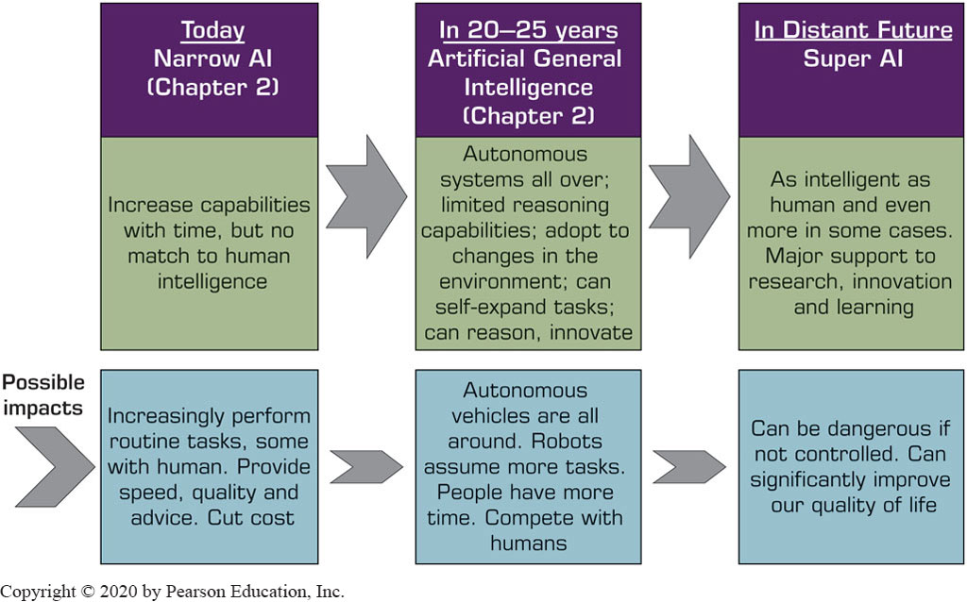
Relevant Technology Trends (2 of 4)
Figure 14.3 Predict the future of A I.

Slide 46
Relevant Technology Trends (3 of 4)
Ambient Computing (Intelligence)
Electronic environments (e.g., network devices such as sensors) that are sensitive and responsive to people and their environments
Potential benefits of ambient computing
Recognize individuals and other “things” and their context at any given time and place.
Integrate into the environment and existing systems.
Anticipate people’s desires and needs without asking.
Deliver targeted services based on people’s needs.
Be flexible (i.e., can change their actions in response to people’s needs or activities).
Be invisible.

Slide 47
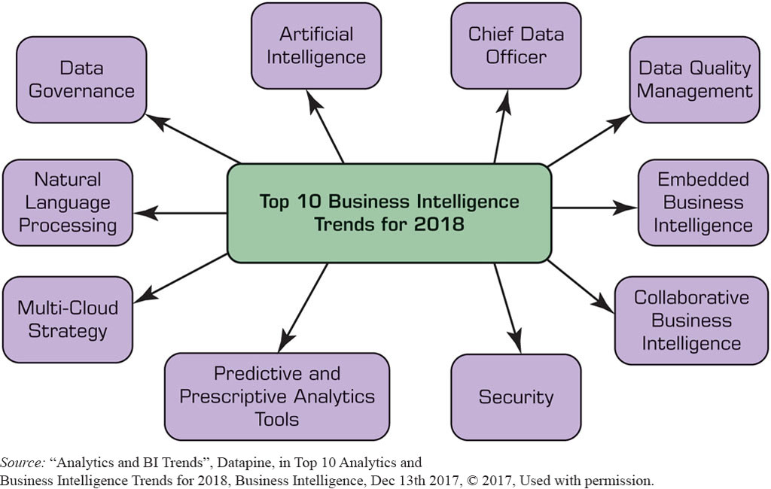
Relevant Technology Trends (4 of 4)
Figure 14.4 Future of Analytics.
Source: “Analytics and B I Trends”, Datapine, in Top 10 Analytics and Business Intelligence Trends for 2018, Business Intelligence, Dec 13th 2017, © 2017, Used with permission.

Slide 48
Future of Intelligent Systems (1 of 2)
What Are the Major U.S. High-Tech Companies Doing in the Intelligent Technologies Field?
Google (Alphabet) …
Apple …
Facebook …
Microsoft …
I B M …
A I Research Activities in China
TENCENT
BAIDU
ALIBABA

Slide 49
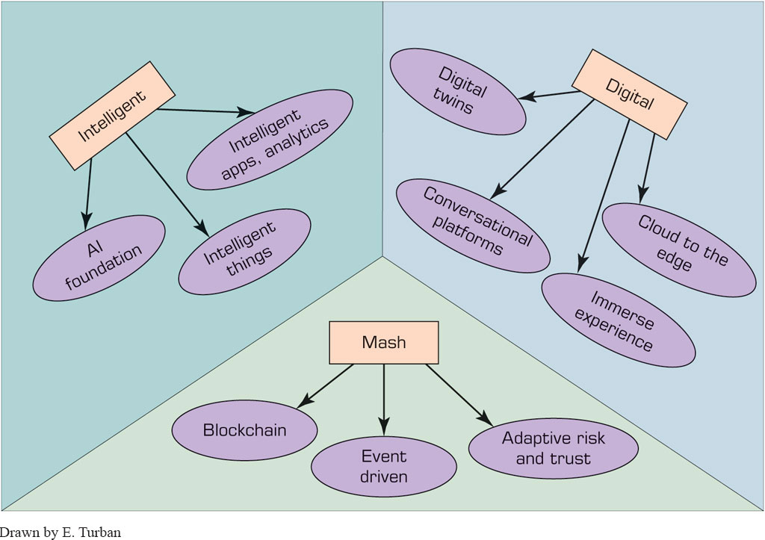
Application Case 14.3 (1 of 3)
How Alibaba.com Is Conducting A I
Figure 14.5 Gartner Prediction.
Drawn by E. Turban

Slide 50
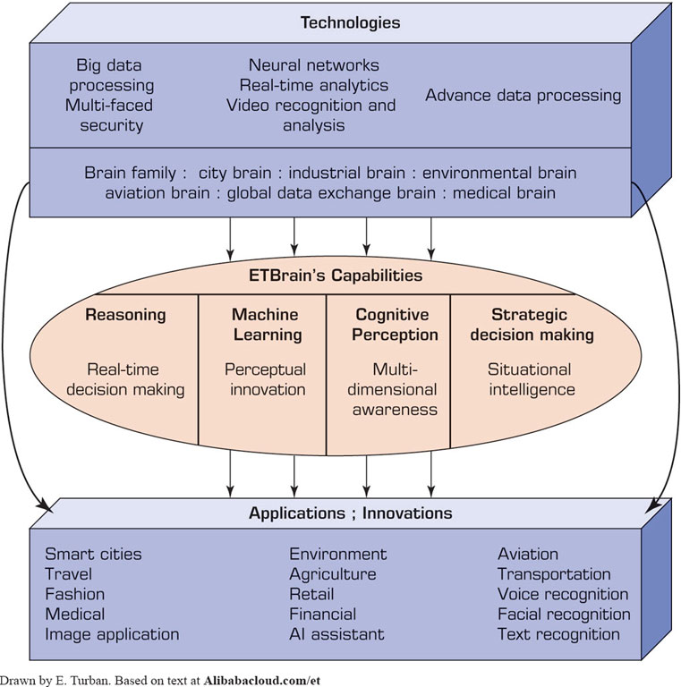
Application Case 14.3 (2 of 3)
How Alibaba.com Is Conducting A I
Figure 14.6 Alibaba’s E T Brain Model.
Drawn by E. Turban. Based on text at Alibabacloud.com/et

Slide 51
Application Case 14.3 (3 of 3)
How Alibaba.com Is Conducting A I
Questions for Discussion:
Relate cloud computing to A I at Alibaba.
Explain the logic of the E T Brain model.
Search the Web to find recent Alibaba activities in the A I field.
Read Lashinsky (2018). Why is Alibaba in such strong competition with Tencent?

Slide 52
Future of Intelligent Systems (2 of 2)
The U.S. – China Competition
Who will control A I?
At the moment, U.S. companies are ahead of Chinese companies, but the future is anybody’s guess
The Largest Opportunity in Business
Tech companies has been the beneficiary of A I
Despite their rivalry, Facebook, Amazon, Google, I B M, and Microsoft partner to advance practices in A I
Impact on Business
Impact on Quality of Life

Slide 53
End of Chapter 14
Questions / Comments

Slide 54

Copyright
This work is protected by United States copyright laws and is provided solely for the use of instructors in teaching their courses and assessing student learning. Dissemination or sale of any part of this work (including on the World Wide Web) will destroy the integrity of the work and is not permitted. The work and materials from it should never be made available to students except by instructors using the accompanying text in their classes. All recipients of this work are expected to abide by these restrictions and to honor the intended pedagogical purposes and the needs of other instructors who rely on these materials.

