Slide 1
Distribution
Sarah Ewing

Slide 2
Why?
The distribution of your variables will affect how accurate your results are.

Slide 3
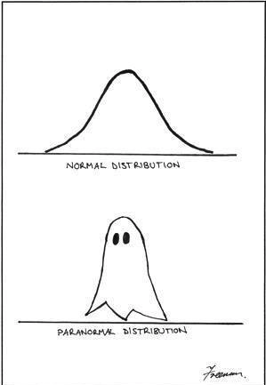
Overview
Distributions
Frequency
Probability
Assumptions
Transformations
Test Case

Slide 4
Distribution
Frequency Distribution
a mathematical function showing the number of instances in which a variable takes each of its possible values.
Probability Distribution
a function of a discrete variable whose integral over any interval is the probability that the random variable specified by it will lie within that interval.

Slide 5
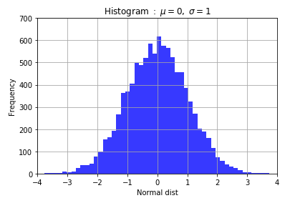
Frequency Distribution
Its just a fancy way to say:
The Y axis is frequency

Slide 6
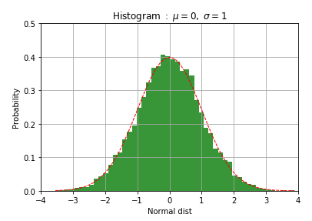
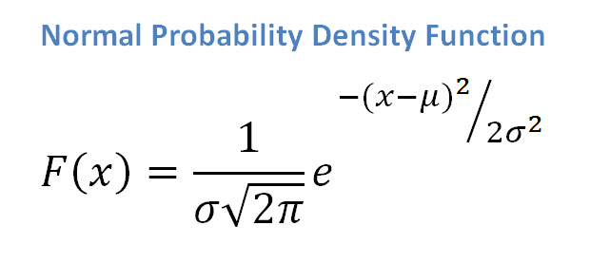
Probability Distribution
Its just a fancy way to say:
The Y axis is probability

Slide 7
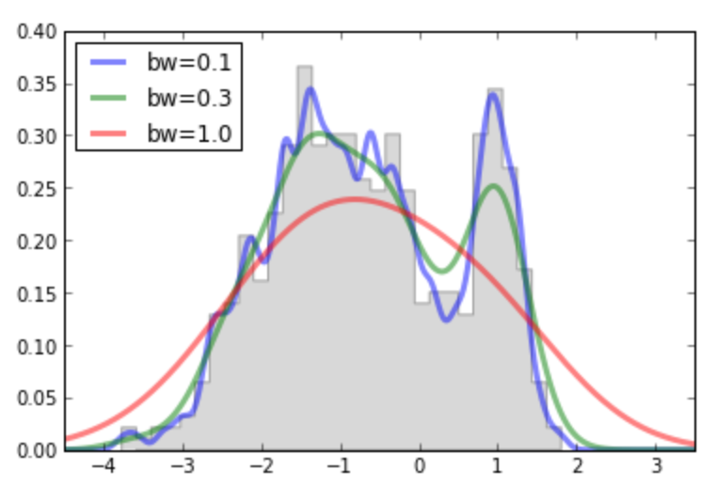
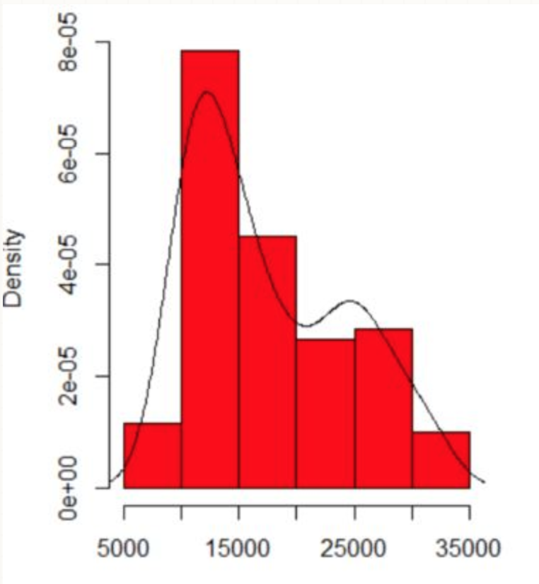
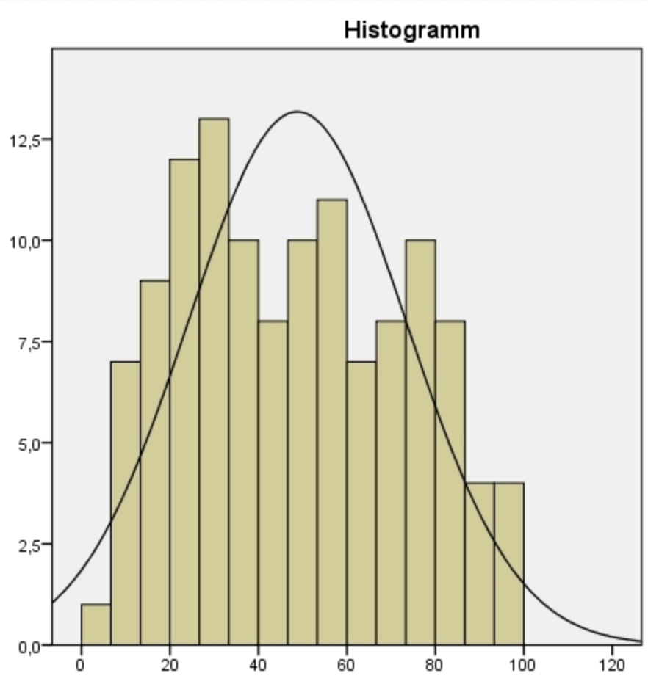
Distributions
Real Data is messy:

Slide 8
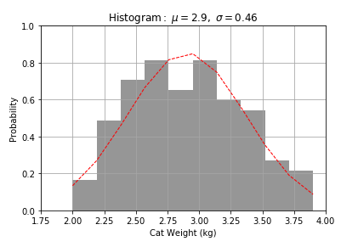
Normal Distribution
EX of a normal distribution:
Human Height
Test scores
Bills
Or…
Cat weight
(python code)

Slide 9
Distributions
There are a lot of ways to solve for the theoretical distribution (red line):
Maximum Likelihood Estimate (MLE),
Method of Moments (MoM),
Expectation Maximation (EM)… and many more
Overview of normal (5 min):
https://www.youtube.com/watch?v=iYiOVISWXS4

Slide 10
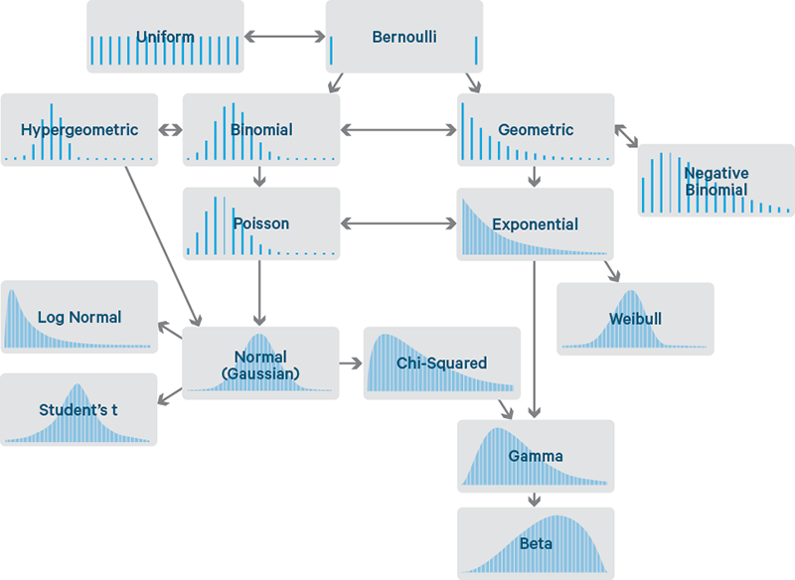
Distributions
Simplified distribution & their relationship:
Discrete:
i.e. 1, 2, 3, 4, …
Continuous:
i.e. 4.2, π, e, 6 …

Slide 11
Distributions
Detailed relationship of univariate distributions can be seen here:
http://www.math.wm.edu/~leemis/chart/UDR/UDR.html

Slide 12
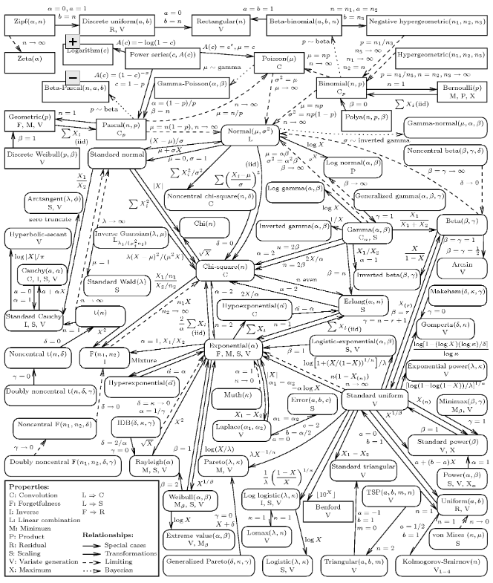

Slide 13
Assumptions
Tests / Methods have assumptions:
Almost everything assumes a normal distribution “Parametric”:
ANOVA
Linear Regression
Sometimes the methods don’t care about the distribution “Non-Parametric”:
Mann-Whitney test
Kruskle Wallis Test
Lower power (BAD)

Slide 14
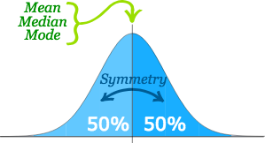
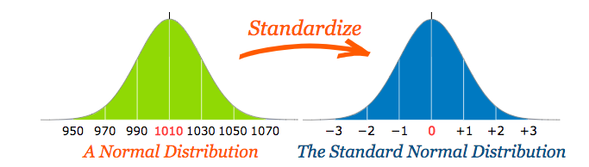
Assumptions
Why do they assume normal?
Really cool properties.
https://www.mathsisfun.com/data/standard-normal-distribution.html

Slide 15
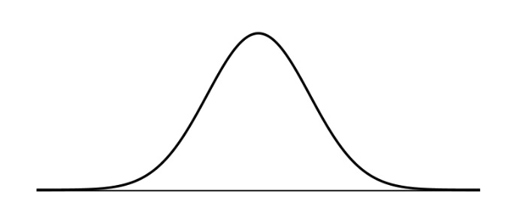
Assumptions
Quick note, these all are kind of the same:
Gaussian
Normal
T-distribution
Z-distribution
F-distribution
There are some nuances, but theoretically, they are all trying to be a bell shaped curve

Slide 16
Transformation
Linear transformations:
+, −, ×, ÷
Non-linear transformations:
√, log(), ln(), squaring, raising to another power
Why do we care?
Non-linear transformations can change a non-normal distribution into a normal distribution

Slide 17
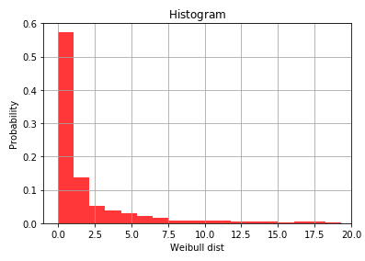
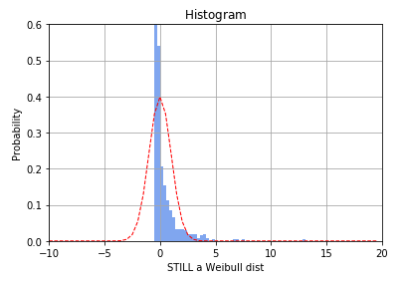
Transformation
Linear:
(data – mean) / SD ~~ [a.k.a. z-test]

Slide 18
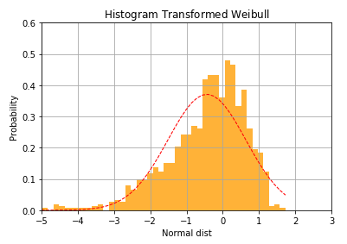
Transformation
Non-linear: Log

Slide 19
Example
Data from a memory retention experiment in which 13 subjects were asked to memorize a list of disconnected items. The subjects were then asked to recall the items at various times up to a week later. The proportion of items (y = prop) correctly recalled at various times (x = time, in minutes) since the list was memorized were recorded and plotted.

Slide 20
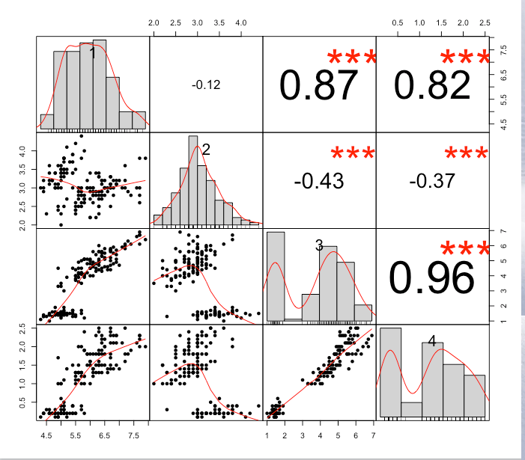
Favorite Graph
This is the iris data.

