Slide 1


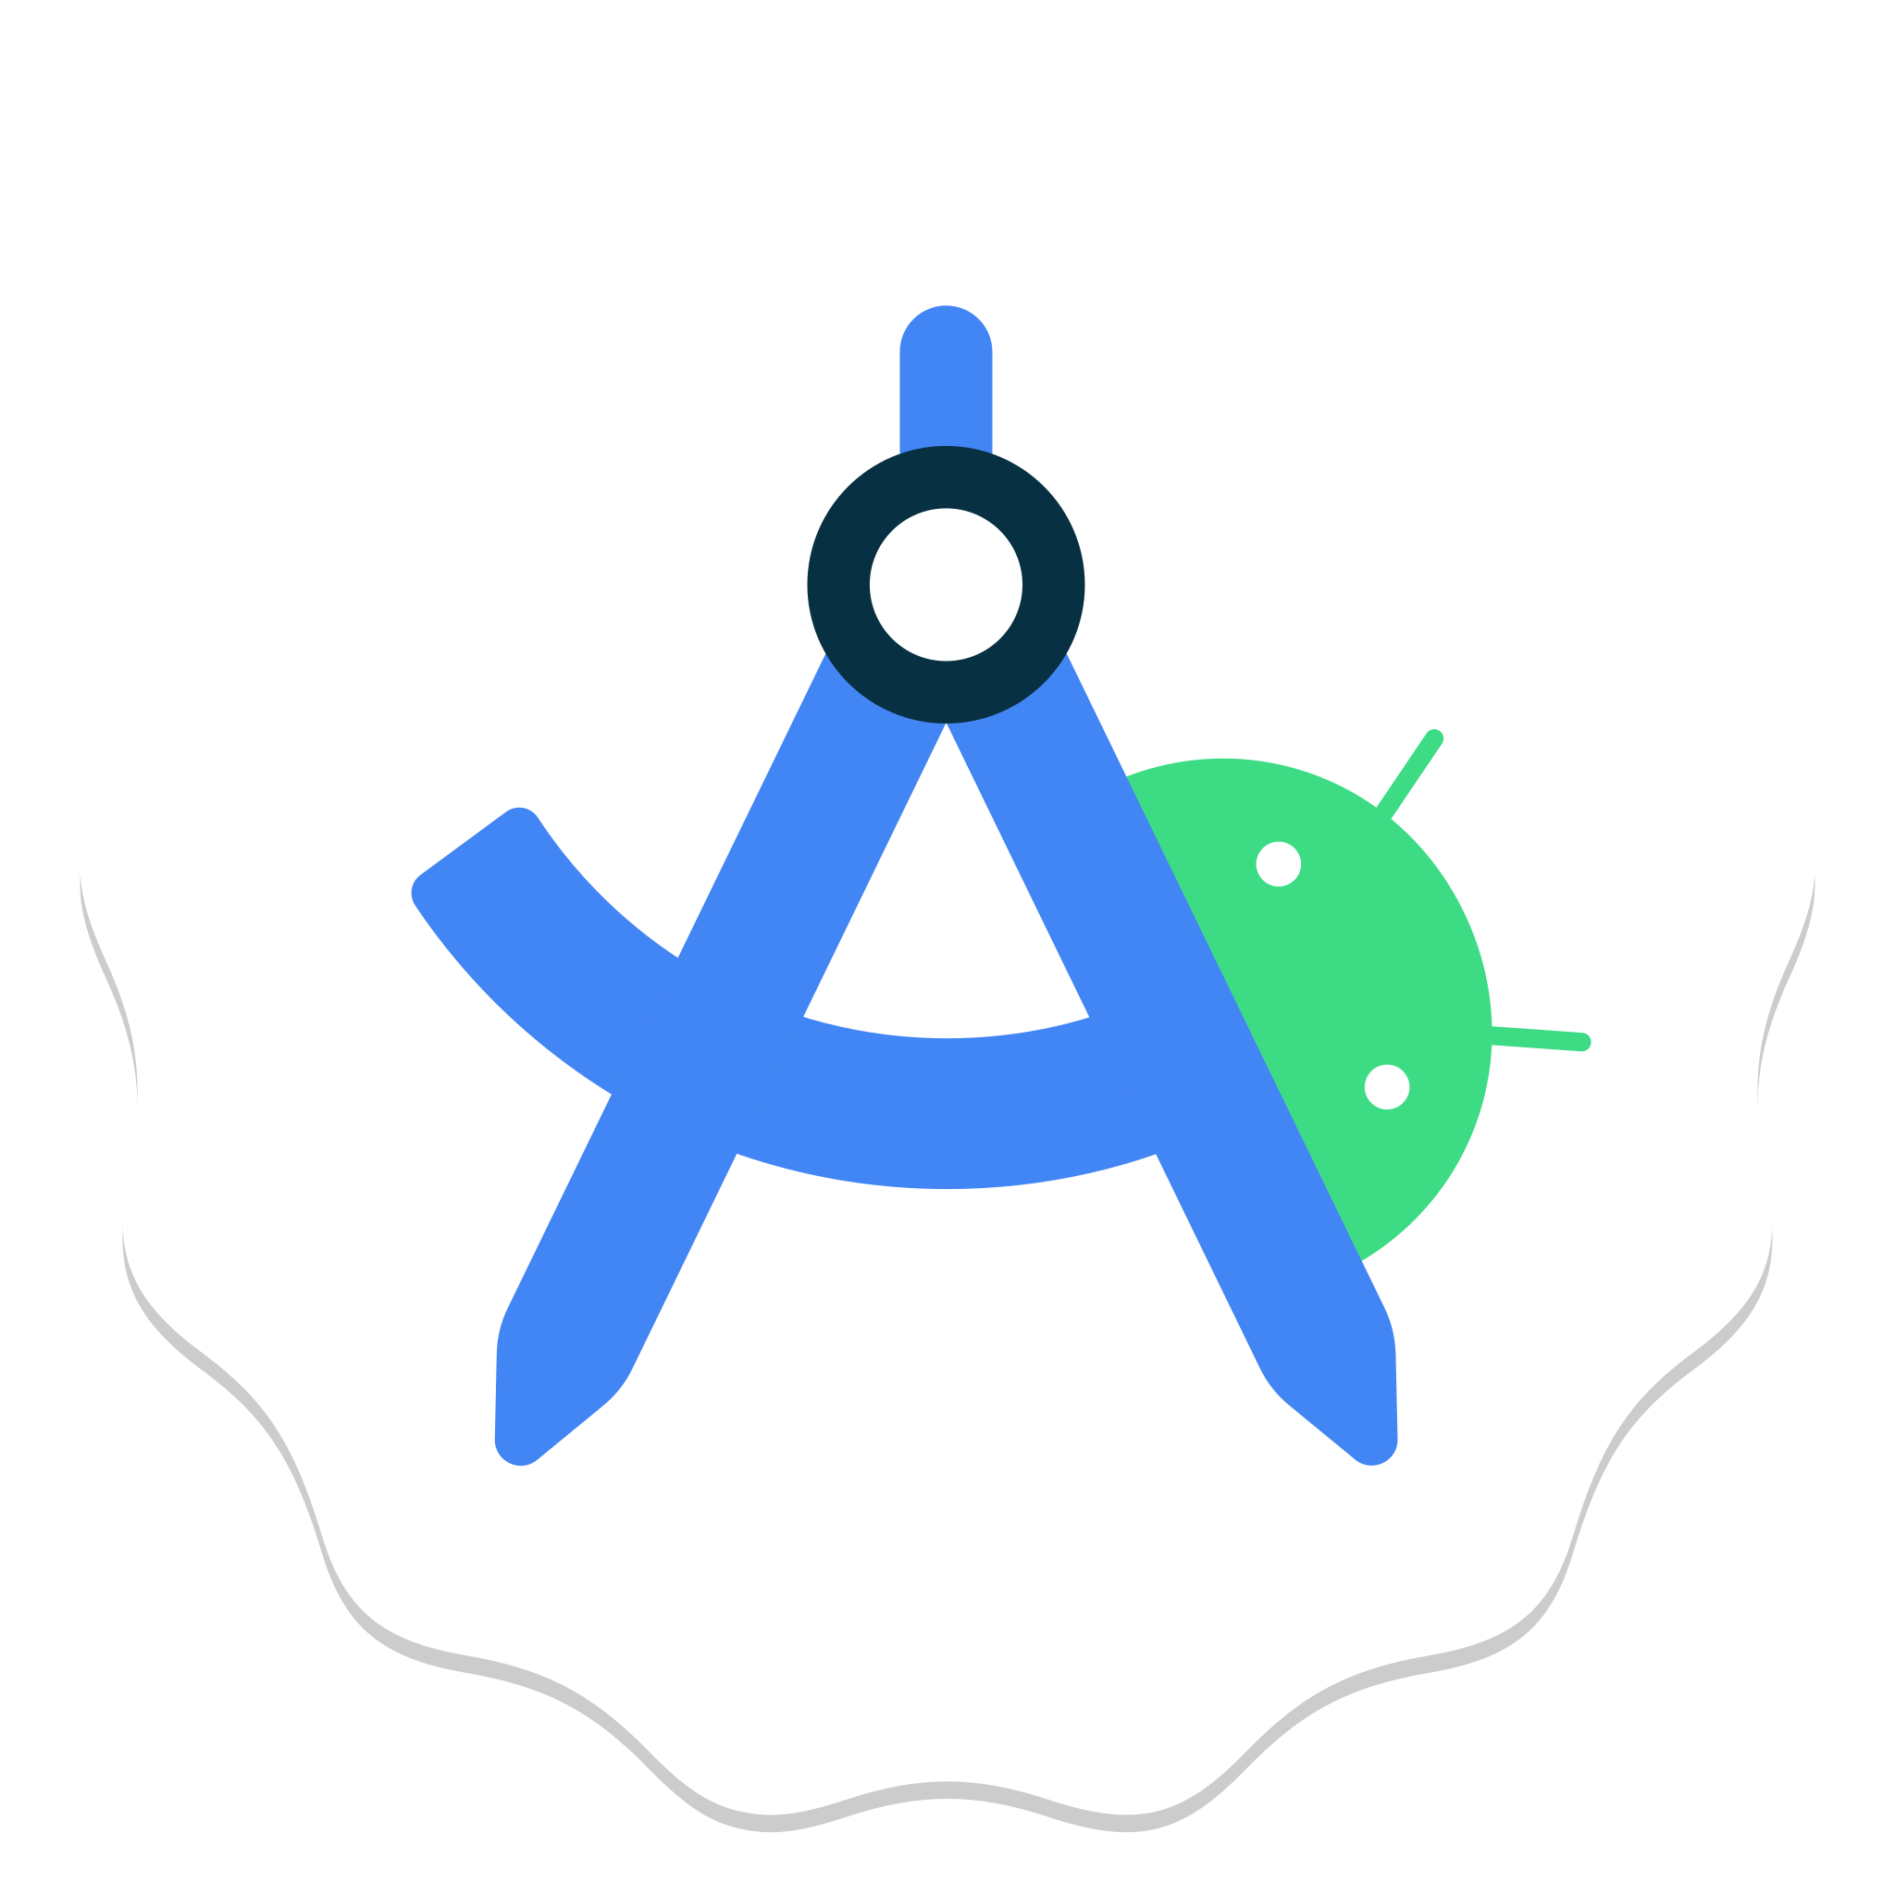
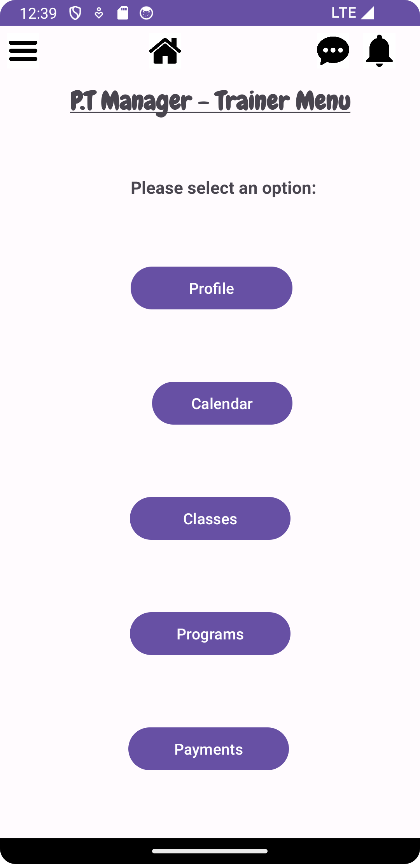

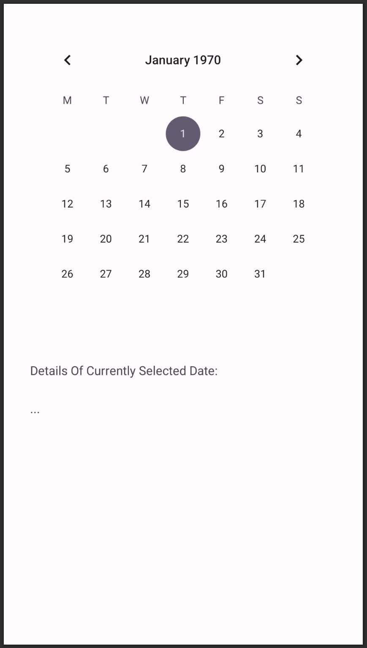




PT-Manager
A personal trainer app for clients and trainers for booking sessions and managing class schedules
Booking System
Trainers can book slots on available days to hold classes that clients can sign up for. Slots are added to the database and updated through the server for any changes the trainer makes.
Messaging System
Program List
Clients and trainers can communicate using the in-app chat system, for changes in class times or updates. Combining WebSocket and Node.js server the aim is to handle HTTP requests and responses in real-time
PT-Manager shows the details for ongoing workout programs available to the client. The client can filter the programs to find the class they want.
Billy Spiers, Hisham Javed, Kevin Hills, Daniel Nkurunziza
Supervised by David Castro Perez
Notes:
Things that are work in progress, Ideas of extending it.
It would be better to see a general picture of what the app will do when its finished.
Discuss any of the technical details of the app, technical challenges, performance issues,
Anything we would want to talk about. “Implementing this was a challenge because of…”

