Slide 1


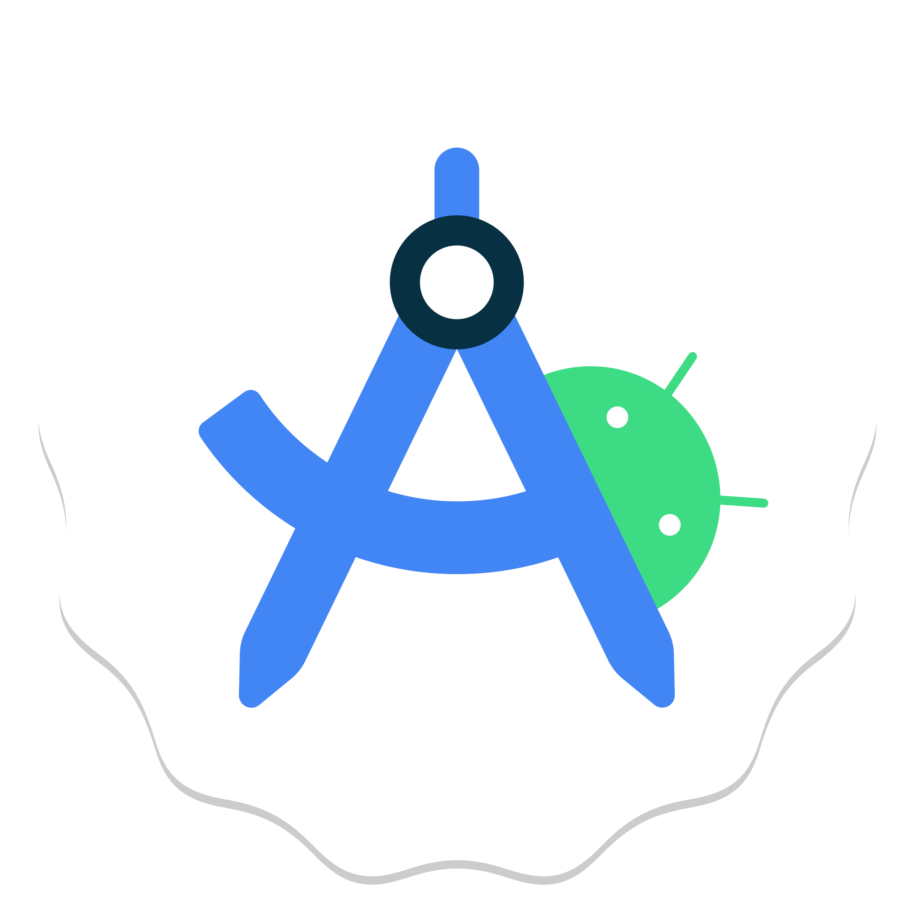
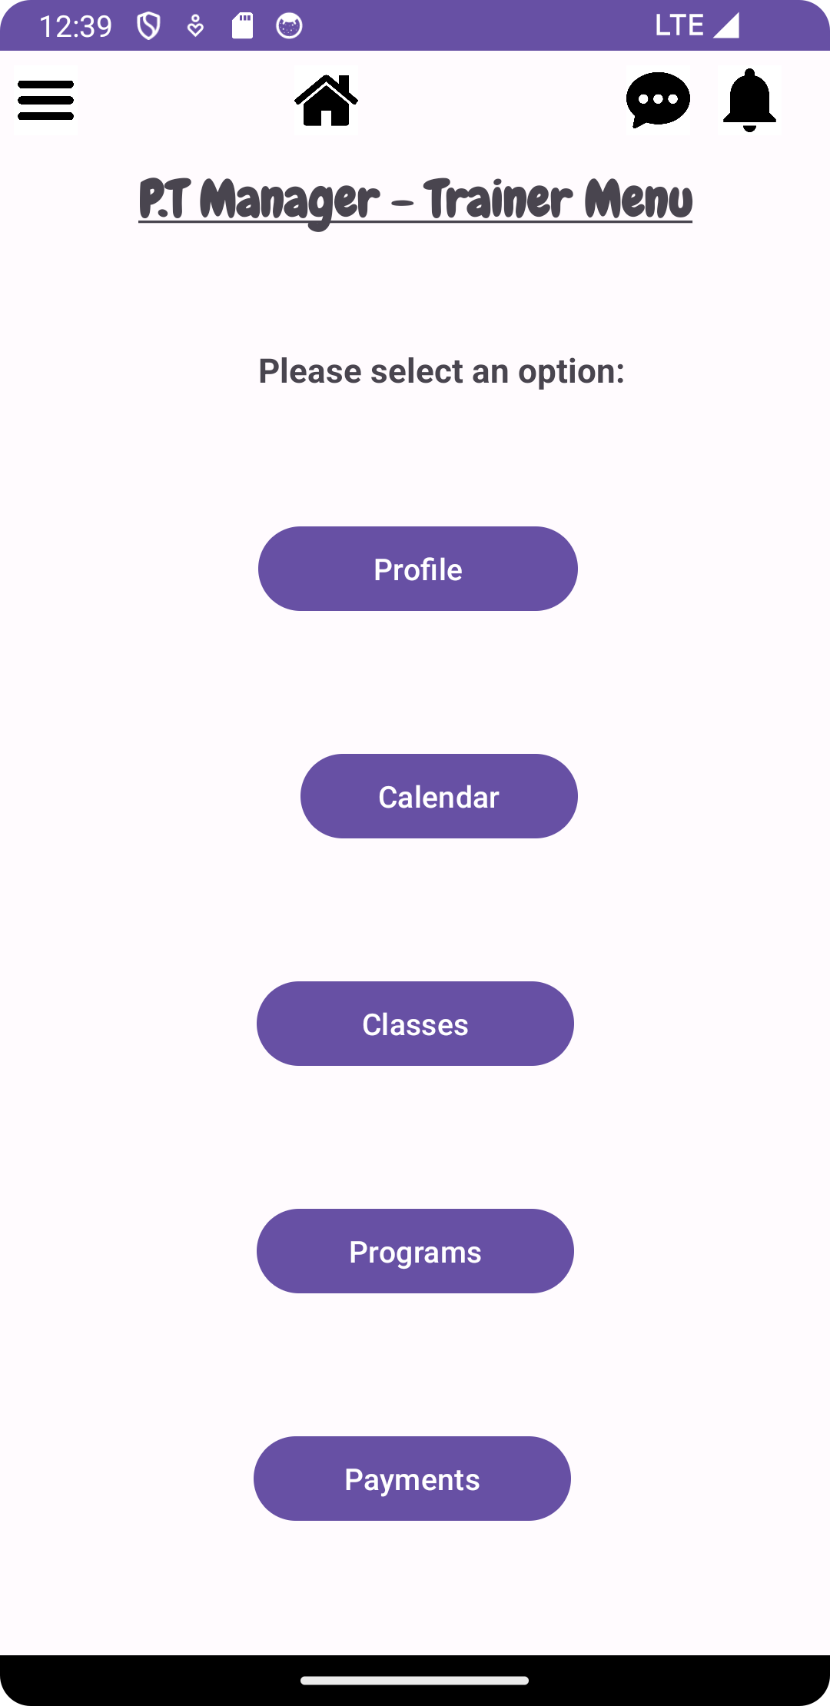

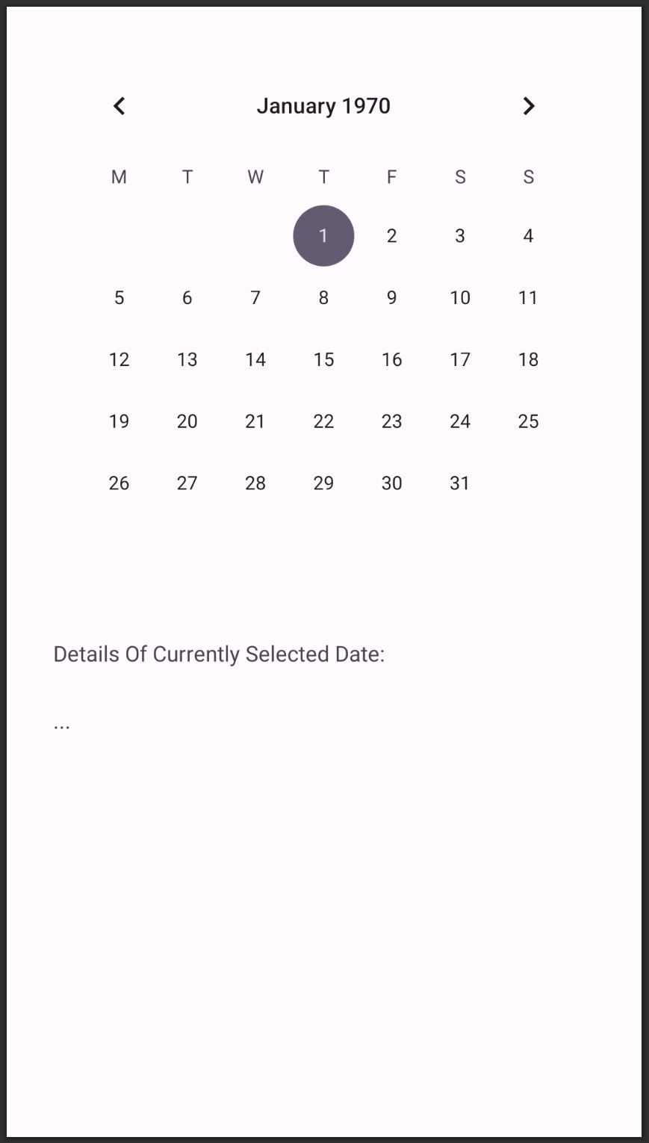



PT-Manager
A personal trainer app for clients and trainers for booking sessions and managing class schedules
Booking System
Trainers can book slots on available days to hold classes that clients can sign up for. If a trainer is unable to make their appointment they can reschedule
Messaging System
Program List
Clients and trainers can communicate using the in-app chat system, for changes in class times or updates.
PT-Manager shows the details for all the classes available to the client. The client can filter the programs to find the class they want.
Billy Spiers, Hisham Javed, Kevin Hills, Daniel Nkurunziza
Supervised by David Castro Perez

