Slide 1
Laptop Sales Forecast: Q1 2019
Prepared by Ryan Do
For John Doe, VP Laptops

Slide 2
The Question
Are we going to achieve our sales budget for the first quarter of 2019?
How much are we going to exceed/miss it by?

Slide 3
The Approach
We can use time series based methods:
Based on the principle that historic data can reasonably estimate future outcomes.

Slide 4
Enter SARIMA
Seasonal AutoRegressive Integrated Moving Average
In a nutshell:
SARIMA makes predictions based on past seasonal patterns as well as by projecting trends on a big picture scale.
Potential drawbacks:
Still may not be complex enough a model to capture all the nuances of sales patterns. Recurrent neural networks (machine learning) may be able to do this better with enough data.

Slide 5
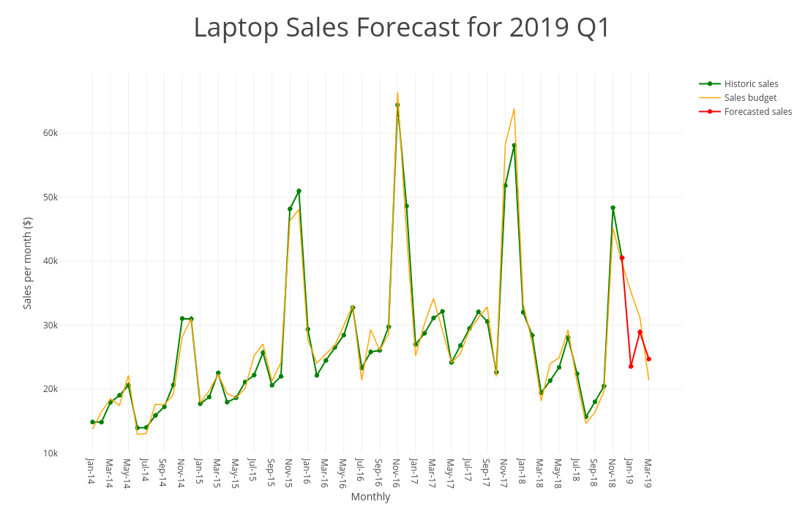

Slide 6
Past patterns inform the future
Every holiday season we see a huge spike in sales followed by a sharp drop in the new year with a bounce back in Feb.
Our SARIMA model forecasted a similar trend for Q1 2019.
Let’s take a more detailed look in the following slides.

Slide 7
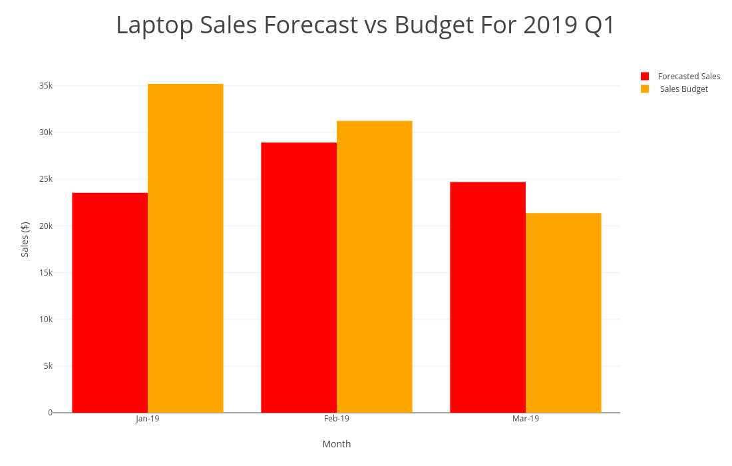

Slide 8
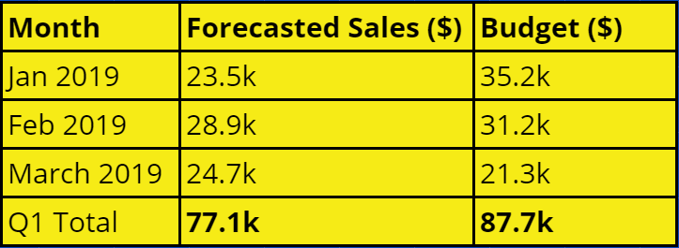
How will we perform?
For Q1 2019, we have forecasted via SARIMA that our sales target will be missed by $10.6k.

