Slide 1
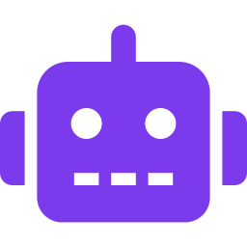
INTERNAL DEMO
Multi-Agent QA
Orchestration
with Polarion
From Requirements to Automated Test Runs
— Already Running in Our Team
"Turning repetitive QA work into minutes instead of hours"
QA Engineering Team
2025
Your Name · Internal Demo – March 2026 · VS Code Agents + polarion-cli
Notes:
Good morning / afternoon everyone. Today I'm showing something I've built that's already saving me time on QA: a multi-agent system that reads Polarion requirements, generates test cases and risks, runs our automated tests, and closes the loop by updating test runs — all with one command in VS Code. Let's see how it works and how it can help all of us. [~20–30 seconds]

Slide 2

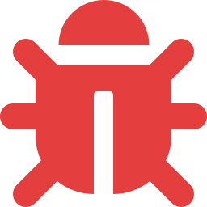
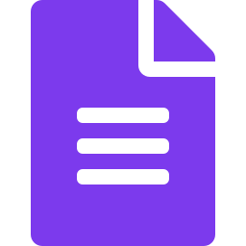

The QA Pain We All Know
Manual & Time-Consuming
Inconsistent Risk ID
Test case creation:
hours per requirement
Risks missed when
team is under pressure
Traceability Gaps
Manual Test Run Updates
Reqs, tests & results
often drift apart
Someone still updates
Polarion after each run
Notes:
We've all felt this. Turning a requirement into solid test cases takes hours. Risks get missed when we're busy. And after tests run, someone still has to create or update the test run in Polarion. This process is exactly what I wanted to automate — while keeping everything traceable and secure inside our tools. [~45–60 seconds]

Slide 3
Where We Are in AI-Assisted Development
BEFORE
AFTER
Code completion only
Chat-based generation
Single agent tasks
Repetitive manual loop
QA as bottleneck
Polarion updated last
Coordinated multi-agent teams
Agents handle the repetitive loop
We focus on judgment & edge cases
Full traceability by default
Already running in our team
No new vendor needed
→
Notes:
We've seen AI evolve quickly — from autocomplete, to chat, to single agents. I'm not waiting for the future — I'm already using multi-agent orchestration in VS Code with our polarion-cli to handle the full QA cycle. The goal is simple: agents handle the repetitive loop so we can focus on judgment, edge cases, and business logic — the work only we can do. [~40–50 seconds]

Slide 4
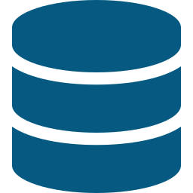
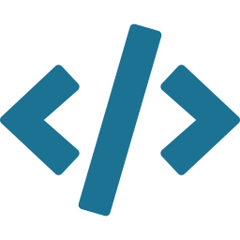
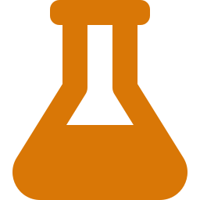
Tools We're Already Using
Polarion ALM
polarion-cli
VS Code Agents
Test Suite
Requirements,
test cases, test runs
full traceability
→
Python CLI — secure
bridge to Polarion
no exposed credentials
→
Where agents live
and collaborate
(Copilot / custom)
→
pytest / your framework
automated tests
marked with IDs
1
2
3
4
Notes:
Everything stays inside our environment. Nothing new to procure. Polarion is the source of truth for requirements, test cases and results. The CLI handles authentication and permissions safely — agents call the CLI to read and write in Polarion without ever exposing credentials directly. VS Code is where the agents live. And our existing pytest suite does the actual test execution — nothing changed there. [~50–60 seconds]

Slide 5


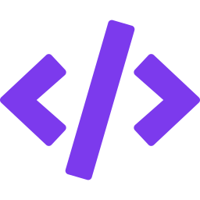




The Team — Humans + Agents (Streamlined)
3 humans · 3 required agents · 2 optional agents (on request)
👤 HUMAN ROLES
H1
H2
H3
Provides POLARION_ID
Implements & Reviews
Closes the QA Loop
“analyse requirement
0169-12345”
Kicks off the loop
Uses risks + TCs as guide
High-level TDD
Code review by team
Creates TAR in Polarion
Links evidence
Completes traceability
🤖 AGENT ROLES
Required · always run
Optional · on request
A1
A2
A3
A4 · OPTIONAL
Code Reviewer
Requirement
Analyst
Polarion
Writer
Test
Engineer
AI-assisted implementation review
Opus
Creates WIs
Sets FMEA ratings
Saves
tc_wi_mapping.csv
Writes pytest funcs
Runs tests
Creates Polarion test
run + evidence
Readiness gate
Codebase grounding
Existing risks + TCs
Produces review doc
A5 · OPTIONAL
Feature Coder
AI-assisted implementation
Notes:
This slide shows the full team — both humans and agents. Three humans are in the loop at key decision points: The Human Analyst creates the requirement in Polarion — that's the starting point for everything. The QA Engineer is the first review gate — they read the agent-generated test cases and risks, approve them, and add them to the Polarion TPS. The Developer reads the requirement plus the approved test cases and risks, then implements the feature using TDD — writing unit and integration tests with Polarion test case IDs embedded so they wire up automatically. Five agents then handle all the mechanical work: Orchestrator plans. Test Designer generates. Risk Analyst identifies gaps. Test Executor runs the suite. Polarion Updater publishes results with evidence. Humans own the judgment. Agents own the repetition. [~1.5–2 minutes]

Slide 6
End-to-End Flow — Streamlined Loop
From POLARION_ID to closed TAR — humans drive judgment, agents handle the loop
HUMAN
OPTIONAL · ON REQUEST
Provides POLARION_ID
“analyse requirement 0169-12345”
AI-assisted help around
the human implementation step
A1 · AGENT
Requirement Analyst (Opus)
Readiness gate · codebase grounding · existing risks + TCs → review doc
A4
Code Reviewer
⏸ HUMAN GATE 1
AI-assisted implementation review
Approve / Reject / Partial
QA Engineer reviews the review doc before any Polarion writes
A5
A2 · AGENT
Feature Coder
Polarion Writer
Creates WIs · sets FMEA ratings · saves tc_wi_mapping.csv
AI-assisted implementation
HUMAN
Implement feature + code review
↩ Plug in around the human
“Implement + review” step
Risks + TCs as guide (high-level TDD) · team performs code review
A3 · AGENT
Test Engineer
Writes pytest funcs · runs tests · creates Polarion test run with evidence
HUMAN
Creates TAR — closes the QA loop
Test Action Report finalised in Polarion · full traceability achieved
Notes:
This is the complete flow — let me walk through it. Phase 1 is automated. The Orchestrator reads the requirement and creates a plan. The Test Designer and Risk Analyst write test case and risk work items directly into Polarion. Then the pipeline pauses for Human Gate 1: the QA Engineer opens those Polarion work items, reads through the generated test cases and risks, and makes a judgment call. They approve — or send back for revision. Only approved items move forward. Human Gate 2: the Developer reads the requirement plus the approved test cases and risks, and uses them as a TDD guide to implement the feature or bugfix. They write unit and integration tests referencing the Polarion test case IDs — this is what makes automated execution traceable back to Polarion later. Phase 2 resumes automatically: the Test Executor runs the test suite, and the Polarion Updater publishes the Test Run with PASS/FAIL/SKIP results and attached evidence — screenshots, logs, whatever is available. [~75 seconds]

Slide 7
DEMO 01 / 02
In Action — VS Code Side
[ VS Code Screenshot ]
$ polarion-cli run --req POL-1234
→ Connecting to Polarion...
→ Fetched: POL-1234 (Login Flow)
→ Generating 8 test cases...
→ Review & confirm? [y/N]
What you'll see:
① Trigger orchestration in VS Code
② Agents read req via polarion-cli
③ Test cases & risks generated
④ Automated tests run
⑤ Polarion Test Run updated
Notes:
[DEMO START — approx 2 minutes] I'm in VS Code on a [feature name or anonymized] branch. I type one command… Watch the Orchestrator kick off — it connects to Polarion and pulls the requirement. Here the Test Designer is pulling the requirement text and generating structured test cases with preconditions. Risk Analyst identifies edge cases the Test Designer flagged. Test Executor is now running the suite — you can watch the results stream in. Keep the demo tight — focus on the magic of the handoffs between agents. [~2 minutes — live or recorded demo]

Slide 8
DEMO 02 / 02
Demo – Results in Polarion
Live results:
[ Polarion Screenshot ]
Fresh Test Run created
Test cases linked to POL-XXXX
PASS / FAIL / SKIP applied
Logs & evidence attached
6
PASSED
1
FAILED
1
SKIPPED
✓ Evidence attached per test case
Notes:
[DEMO continues — approx 2 more minutes] Now let me quickly switch over to show the actual Test Run in Polarion. Here's the fresh Test Run — created moments ago, linked directly to our requirement. You can see the test cases are linked, PASS/FAIL/SKIP statuses are already applied, and the logs are attached as evidence — all done automatically by the Polarion Updater. Nothing was touched manually. The traceability chain is complete: requirement → test cases → test run → results → evidence. All in Polarion. [~2 minutes — demo ends here]

Slide 9
What We're Seeing So Far
Hours
100%
Minutes
Saved per feature
vs. manual process
Traceability in
Polarion, automatically
End-to-end loop
per requirement
More Consistent
Higher-Value Work
No New Vendor
Test coverage & risk ID
no longer author-dependent
Engineers focus on
review, logic & complex cases
Built entirely on
tools we already own
Notes:
Early runs show clear wins in speed and consistency. Hours saved per feature — the exact number depends on complexity, but the difference is significant and immediate. 100% traceability in Polarion without anyone touching it manually. And the loop runs in minutes. Most importantly: this frees us up for higher-value work. Engineers review the output, catch the business logic the agent missed, and focus on the complex cases that genuinely need human judgment. And we built it entirely on tools we already own — no new vendor, no new procurement. [~60–75 seconds]

Slide 10
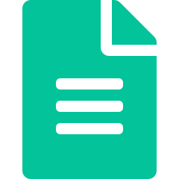



NEXT STEPS
Let's Make This Useful for Everyone
Resources
I can share templates + CLI examples
[ QR Code ]
or link to
Confluence / wiki
Agent prompts, setup guide, walkthrough doc
Feedback wanted
Which requirement types should we test next?
Ideas for extensions?
Self-healing tests, req updates, CI integration
Questions?
Happy to do a deeper session with your team
Thank you!
Notes:
This is a starting point — built on tools we already own. I'd love to share the agent prompt templates, polarion-cli examples, and setup guide with anyone who wants to try it. Everything is documented and ready. Most importantly: I want your feedback. Which requirement types should we throw at the agents next? What broke, what surprised you, what did the agents get wrong? There are also some obvious extensions to explore — self-healing tests, automatic requirement updates, CI/CD integration. Happy to work on those together. Thank you — happy to take any questions now, or set up a deeper session with your team. [~60–90 seconds + Q&A]

