Slide 1
Virtual Electrochemist
From Carla & Ieva
To Wolfgang

Slide 2
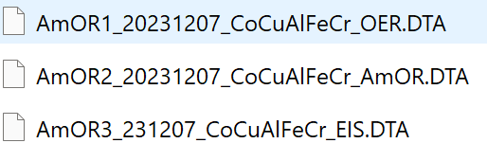
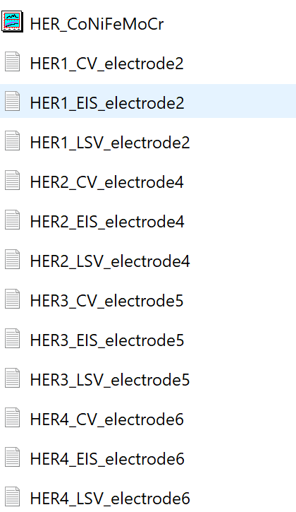
Electrochemistry data
Data plots and the experimental details will be presented in the following slides.
Data files were sent in zip format and can be visualized by origin, excel, matlab, etc.
Ammonia Oxidation Reaction (AmOR)
AmOR1: raw LSV data purging Ar
AmOR2: raw LSV data purging NH3
AmOR3: EIS for IR correction
b) Hydrogen Evolution Reaction (HER)
Extract from the origin file:
HER1: LSV, CV and EIS_ using electrode 2
HER2: LSV, CV and EIS _ using electrode 4
HER3: LSV, CV and EIS _ using electrode 5
HER4: LSV, CV and EIS _ using electrode 6
(CV for conditing the electrode, EIS for IR correction)
Experimental details
i) Catalyst composition: (elemental concentrations in overall cell in contact) ii) Electrode material: (e.g. sputtered on something on Ni, C, glassy carbon) iii) Catalyst morphology: iv) Electrolyte: composition: (e.g. 1M KOH; +pH value;+purging condition(e.g. Ar, O, air)) v) Environment of experiment: (room atmosphere, room temperature, any chamber, fumehood) vi) Reference electrode: (e.g.: the one used in the experiment, Ag|AgCl|3M KCl) vii) Scan rate: (e.g.: 1 V/s) viii) potential range: (vs. using the real reference, like Ag|AgCl|3M KCl) ix) IR correction/compensation: (yes/no and how, there is the EIS in the SI?) x) Normalization procedure area: (current density, is described at the paper which is the Area?) xi) publication reference: (doi) xii) Any other additional information: (any details you may think it is important)

Slide 3
a) AmOR
Details
i) Aimed composition: Al₂₀Cr₂₀Fe₂₀Co₂₀Cu₂₀, ICP-MS confirmed: Al₂₁Cr₁₃Fe₂₂Co₂₁Cu₂₃
ii) Ni foam substrate, AlCoCrCuFe layer deposited by spray coating according to PVP/metal precursor spraying synthesis (https://doi.org/10.1002/anie.202218493) iii) Catalyst morphology: SEM, TEM, XRD, ICP-MS (https://doi.org/10.1002/anie.202404348) iv) Electrolyte: composition: 1M KOH; pH 13.9, GDE condition (scheme in the next slide). Gas purged as shown in the figure, in case of only Ar – OER (black line), Ar+NH₃ – OER in competition with AmOR (red line) v) Environment of experiment: room atmosphere, room temperature, fumehood vi) Reference electrode: Ag|AgCl|3M KCl vii) Scan rate: 10 mV/s viii) potential range: from 0 V to 0.8 V vs. Ag|AgCl|3M KCl ix) IR correction/compensation: yes (file added) x) Normalization procedure area: geometric area (0.95 cm²) is used xi) publication reference: this LSV was not included in the publication, but the catalyst was published due to its selectivity (https://doi.org/10.1002/anie.202404348) xii) Any other additional information: LSVs obtained using Ni foam-based electrodes usually demonstrate mediocre reproducibility, due to the difference in real surface area, which cannot be so easily determined. However, general behaviour usually remains the same – if we see significantly increased currents in AmOR conditions, this would not change. Only the exact current values might vary (+-10 mA cm⁻²). Before LSV measurements, conditioning cycles from 0 V to 0.45 V vs. Ag|AgCl|KCl (3 M), 100 mV·s-1 for 8 cycles was performed in the absence of NH₃ gas.
Ni_{f}_AlCoCrCuFe

Slide 4
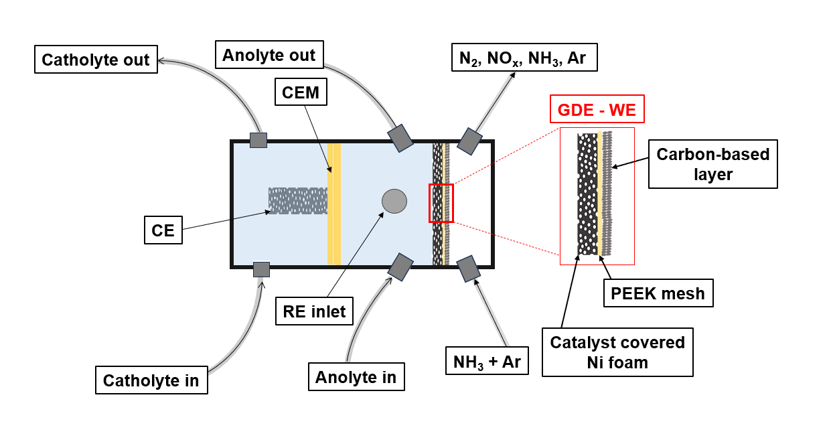
a) AmOR
GDE arrangement in the flow-through cell

Slide 5
b) HER
Details
i) Aimed composition: Co₂₀Ni₂₀Fe₂₀Mo₂₀Cr₂₀, ICP-MS confirmed: Co₂₃Ni₁₈Fe₂₆Mo₁₉Cr₁₄
ii) Ni foam substrate, CoNiFeMoCr layer deposited by spray coating according to PVP/metal precursor spraying synthesis (https://doi.org/10.1002/anie.202218493) iii) Catalyst morphology: SEM, TEM, XRD, ICP-MS (https://doi.org/10.1002/anie.202218493) iv) Electrolyte: composition: 1M KOH; pH 13.9 v) Environment of experiment: room atmosphere, room temperature, rotation rate 1600 rpm (RDE). vi) Reference electrode: Ag|AgCl|3M KCl vii) Scan rate: 10 mV/s viii) potential range: from -0.7 V to -1.6 V vs. Ag|AgCl|3M KCl ix) IR correction/compensation: yes (file added) x) Normalization procedure area: geometric area (0.1134 cm²) is used xi) publication reference: Figure S24 (https://doi.org/10.1002/anie.202218493) xii) Any other additional information: Before LSV, conditioning procedure from -0.70 V to -1.60 V vs. Ag|AgCl|KCl (3 M) at 50 mV∙s -1 for 8 cycles, 1600 rpm was performed. To obtain reproducibility measurement repeated 4 times and average value was used.
CoNiFeMoCr

