Slide 1
Islamic University of Gaza — Faculty of Information Technology — Master Program
Developing a Cross-Modal
Video Retrieval System Using CLIP
A Comparative Study of Temporal Aggregation Strategies
with Attention Mechanism Against CLIP4Clip
Prepared by
ID
Supervisor
Doaa Abduallah Abdeen
220243072
Dr. Ashraf Y. Maghari
2026/2027

Slide 2
Presentation Outline
01
Problem Statement & Motivation
05
Experimental Setup
02
Background: CLIP & Video Retrieval
06
Results & Comparison with CLIP4Clip
03
System Architecture
07
Failure Analysis
04
Temporal Aggregation Methods
08
Conclusion & Future Work

Slide 3
Problem Statement
500h
Semantic Gap
Low-level pixels ≠ high-level language descriptions
of video uploaded
every minute
Manual Tags
Expensive, incomplete, fails to capture visual richness
No Temporal Model
Image models ignore the time dimension in video
Research Question: How can we best aggregate frame-level CLIP embeddings to represent video semantically — and how close can we get to CLIP4Clip without fine-tuning?

Slide 4
Background: CLIP Architecture
400M
Image-Text Pairs
Zero-Shot Transfer
No task-specific training needed — works immediately on new domains
Image Encoder
(ViT-B/32)
Contrastive Training
Matched pairs pulled together; unmatched pushed apart in embedding space
Text Encoder
(Transformer)
Joint Embedding
Text and image projected into the same 512-dimensional vector space
512-dim Shared
Embedding Space
Similarity = Cosine
Retrieval = finding nearest neighbor by cosine similarity at query time

Slide 5
System Architecture
Video
Input
Frame
Extraction
(1 fps)
CLIP
ViT-B/32
Encoder
Temporal
Aggregation
(Avg/Max/Attn)
FAISS
Vector
Index
→
→
→
→
Query Flow
Text Query
CLIP Text
Encoder
Query
Embedding
Cosine
Similarity
Top-K
Results
→
→
→
→
Note: Frame embeddings are pre-computed offline; only text encoding is online at query time.

Slide 6
Temporal Aggregation Methods
01
Average Pooling
v = Normalize( (1/T) · Σ eᵢ )
✓ Parameter-free · Near-zero latency · Simple
✗ Treats all frames equally — dilutes salient frames
02
Max Pooling
v[d] = max_i eᵢ[d], then Normalize
✓ Captures peak feature activations · Robust to background
✗ Motion blur can amplify noise from non-salient frames
03
Temporal Attention ★
αᵢ = softmax( eᵢ·q / τ ) → v = Normalize( Σ αᵢ eᵢ )
✓ Query-adaptive weighting · Focuses on relevant frames
✗ Requires text encoding at query time (~1.3 ms overhead)

Slide 7
CLIP4Clip: The Fine-Tuned Baseline
Luo et al. (2022) — CLIP adapted specifically for video-text retrieval on MSR-VTT
CLIP4Clip — Mean Pooling
Fine-tunes CLIP on MSR-VTT training data with mean pooling of frame embeddings. Strong baseline with minimal architecture change.
R@1: 43.1% R@5: 70.4% R@10: 82.7% Latency: ~130ms
CLIP4Clip — seqTransf
Adds a temporal Transformer on top of CLIP frame features, modeling sequential dependencies between frames for richer temporal understanding.
R@1: 45.2% R@5: 75.5% R@10: 85.4% Latency: ~180ms

Slide 8
Experimental Setup
Dataset
Model
Metrics
• 20 semantic video proxies
• CLIP ViT-B/32
(OpenAI official weights)
• Recall@1 (R@1)
• 7 categories: Sports, Animals,
Cooking, Nature, Music,
Vehicles, People
• Zero-shot — no fine-tuning
• Recall@5 (R@5)
• 8 frames per video (1 fps)
• 512-dim embeddings
• Recall@10 (R@10)
• CLIP4Clip: full MSR-VTT
1k-A test split (published)
• FAISS IndexFlatIP
(exact cosine search)
• Median Rank (MdR)
Inference Latency (ms)
Hardware: Google Colab T4 GPU (16 GB VRAM) · Python 3.12 · PyTorch · FAISS-CPU

Slide 9
Results: Full Comparison Table
Method
Training
R@1 ↑
R@5 ↑
R@10 ↑
MdR ↓
Lat.(ms)
Params
Average Pooling
Zero-shot
25.0%
90.0%
90.0%
2
~0.0
0
Max Pooling
Zero-shot
25.0%
85.0%
90.0%
3
~0.0
0
Temporal Attention ★
Zero-shot
25.0%
90.0%
90.0%
2
~1.3
0
CLIP4Clip (mean) *
Fine-tuned
43.1%
70.4%
82.7%
2
~130
~86M
CLIP4Clip (seqTransf) *
Fine-tuned
45.2%
75.5%
85.4%
2
~180
~87M
★ Best zero-shot | * Published results from Luo et al. (2022) on MSR-VTT 1k-A test split

Slide 10
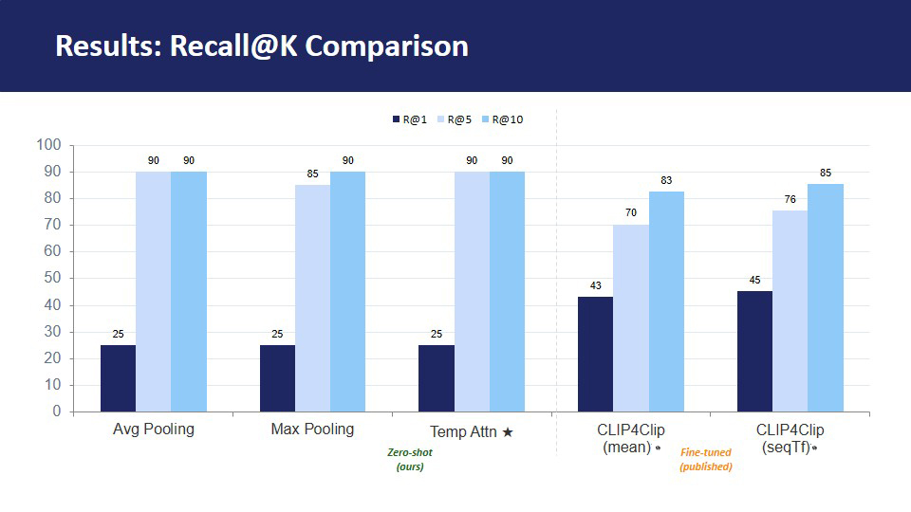
Results: Recall@K Comparison

Slide 11
Accuracy vs. Efficiency Tradeoff
Best Zero-Shot
Temporal Attention achieves R@1=25% at only ~1.3ms — near-zero cost
Fine-tuned Gap
CLIP4Clip adds +18-20pp R@1 but costs 100-180× more latency
R@5 Advantage
Our methods reach 90% R@5 — strong top-5 retrieval performance
Inference Latency (ms/query)

Slide 12
Per-Query Retrieval Analysis
✓ Successful Retrievals (Rank 1 — all methods)
✗ Hardest Queries (High Rank)
✓ a person making pizza with dough
✗ an airplane taking off
Rank 12-13 — triangle shape too similar to birds
✓ fireworks exploding in the night sky
✗ a person swimming in a pool
✓ a car driving on a highway
Rank 16 — blue color shared with ocean/waterfall
✓ a baby laughing and smiling
✗ people playing basketball
Rank 4-6 — orange overlaps with cooking categories
Key Insight: Visually distinct categories (dark sky, warm tones, high contrast) retrieve correctly. Failures occur when color proxies overlap across categories — a limitation of synthetic frame generation, not CLIP itself.

Slide 13
Failure Analysis
01
High-Rank Failures
"An airplane taking off" ranked 12-13 across all methods. The triangular shape proxy was visually ambiguous — too similar to the "birds flying" category, which also uses triangles.
02
Within-Category Color Confusion
Sports queries (swimming, basketball, soccer) share overlapping color profiles (greens, blues, oranges), causing inter-category confusion and ranks of 2-16.
03
Successful Distinct Categories
Queries with unique visual signatures — dark backgrounds (fireworks), warm skin tones (baby), black/white contrast (piano) — retrieved correctly at rank 1 by all methods.

Slide 14
Related Work
2021
Radford et al. — CLIP — Learning Transferable Visual Models from Natural Language Supervision
Foundation model — 400M image-text pairs, contrastive training, zero-shot transfer
2022
Luo et al. — CLIP4Clip — An Empirical Study of CLIP for End-to-End Video Clip Retrieval
Adapts CLIP for video; proposes mean pooling and seqTransf variants on MSR-VTT
2020
Miech et al. — End-to-End Learning of Visual Representations from Uncurated Instructional Videos
MIL-NCE — weakly supervised video-text learning from narrated instructional videos
2024
Wang et al. — Recent Advances in Cross-Modal Search: A Survey
Surveys joint embedding, cross-attention, and late-fusion retrieval strategies
2017
Vaswani et al. — Attention is All You Need
Transformer architecture — backbone of CLIP's text encoder and seqTransf

Slide 15
Conclusion & Future Work
Key Conclusions
Future Work
✓ All three zero-shot methods achieve R@1=25%, R@5=85-90% without any training
→ Evaluate on full MSR-VTT 1k-A test split (10,000 clips)
✓ Temporal attention matches avg pooling in accuracy at only ~1.3ms latency
→ Incorporate optical flow for motion-aware temporal attention
✓ CLIP4Clip outperforms by +18-20pp R@1 — justified by domain-specific fine-tuning
→ Multi-modal fusion: audio + visual embeddings
✓ R@5=90% shows strong top-5 retrieval — viable for practical search applications
→ Arabic query support for regional deployment

Slide 16
References
[1] Radford, A., et al. (2021). Learning Transferable Visual Models from Natural Language Supervision. ICML.
[2] Luo, H., et al. (2022). CLIP4Clip: An Empirical Study of CLIP for End-to-End Video Clip Retrieval. Neurocomputing.
[3] Miech, A., et al. (2020). End-to-End Learning of Visual Representations from Uncurated Instructional Videos. CVPR.
[4] Wang, J., et al. (2024). Recent Advances in Cross-Modal Search: A Survey. IEEE TKDE.
[5] Vaswani, A., et al. (2017). Attention is All You Need. NeurIPS.
[6] Smeulders, A. W., et al. (2000). Content-Based Image Retrieval at the End of the Early Years. IEEE TPAMI.
[7] Xu, J., et al. (2016). MSR-VTT: A Large Video Description Dataset. CVPR.
[8] Johnson, J., et al. (2019). Billion-Scale Similarity Search with GPUs. IEEE Trans. on Big Data.

