Slide 1
K-means とは
Doan Quang Van
Center for Computational Sicences, University of Tsukuba

Slide 2
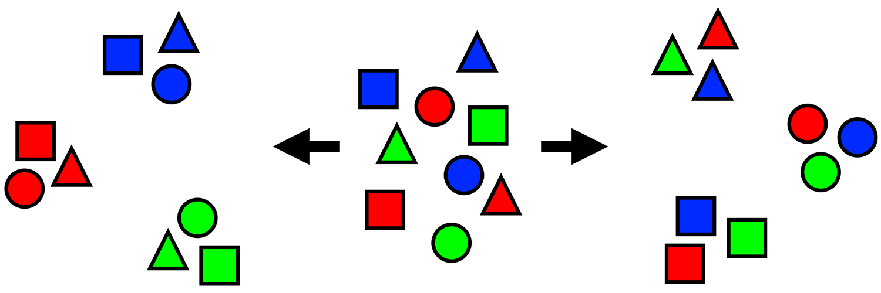
“Humans need to classify things to make sense of this crazy and chaotic world.”

Slide 3
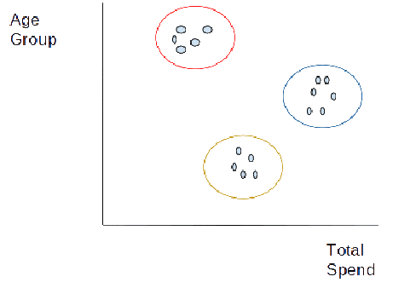
https://neptune.ai/blog/k-means-clustering

Slide 4
“K-means clustering is a method of vector quantization, originally from signal processing, that aims to partition n observations into k clusters in which each observation belongs to the cluster with the nearest mean, serving as a prototype of the cluster.”

Slide 5
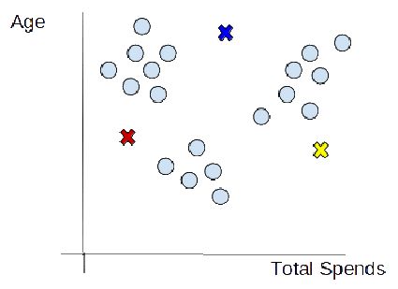
Choosing the number of clusters
Initializing centroids

Slide 6
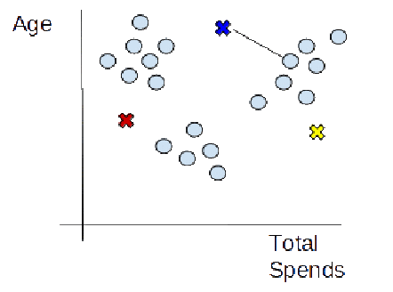
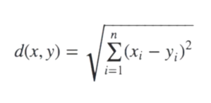
Assign data points to the nearest cluster

Slide 7
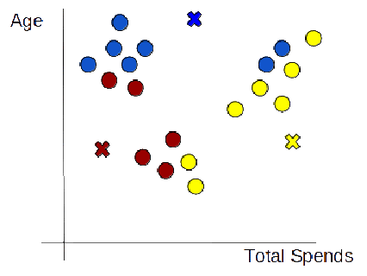

Slide 8
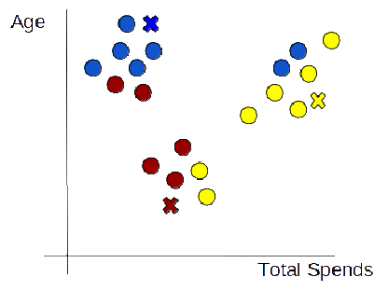

Re-initialize centroids

Slide 9
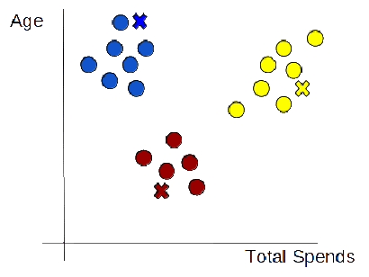
Repeat steps 3 and 4

Slide 10
