Slide 1

Clustering climate data
使用データ：https://github.com/doan-van/GIS_class/tree/main
Quang-Van DOAN
Center for Computational Sciences
University of Tsukuba
https://medium.com/

Slide 2
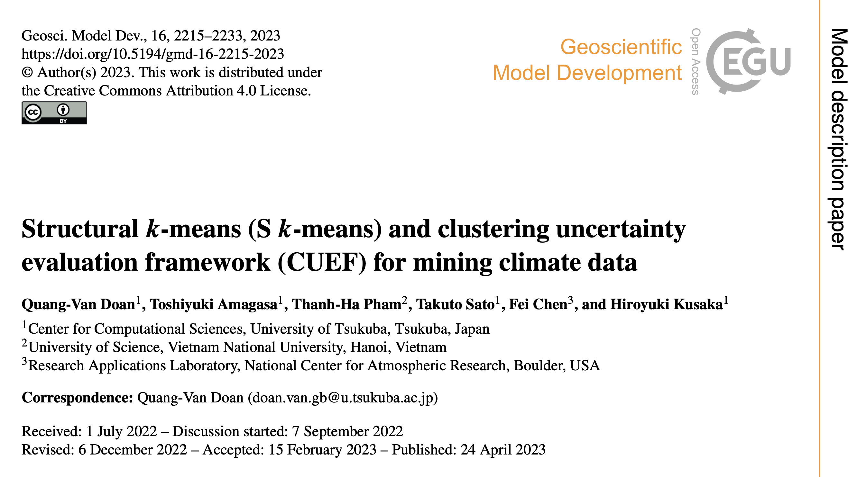
https://gmd.copernicus.org/articles/16/2215/2023/
ソースコード：
https://github.com/doan-van/S-k-means

Slide 3
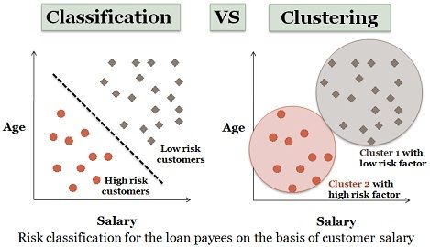
https://techdifferences.com/difference-between-classification-and-clustering.html

Slide 4
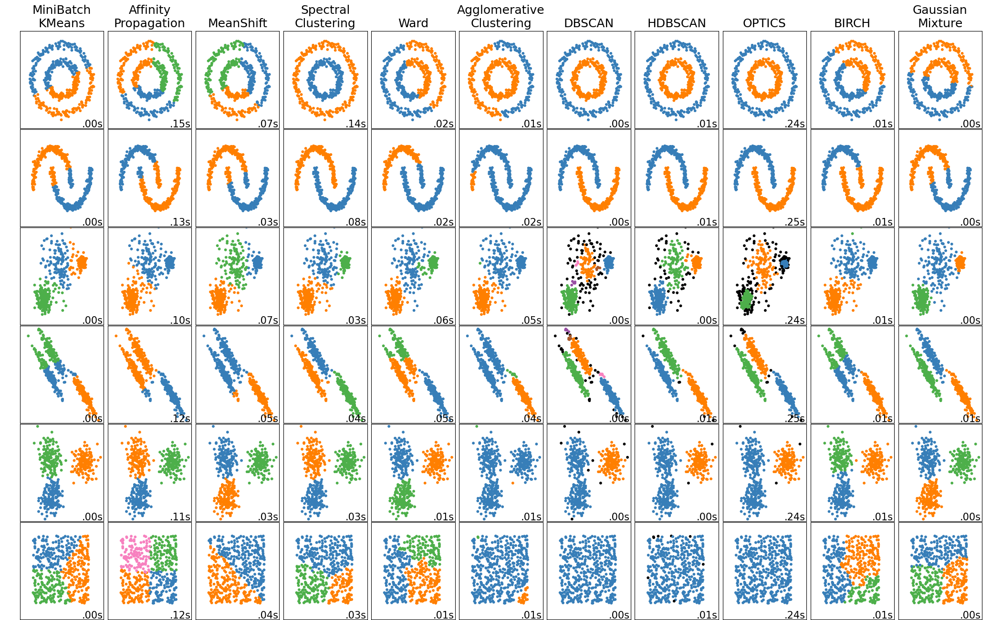
From Scikit-learn

Slide 5
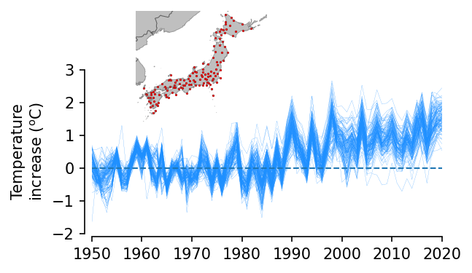
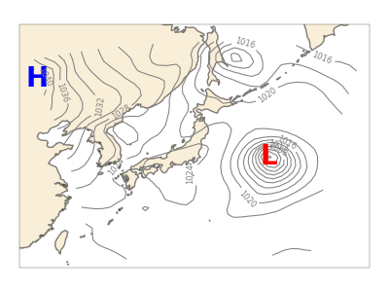
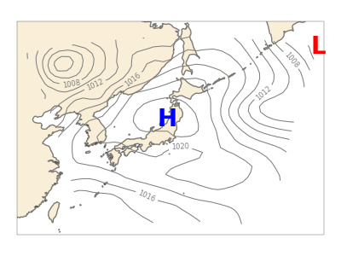
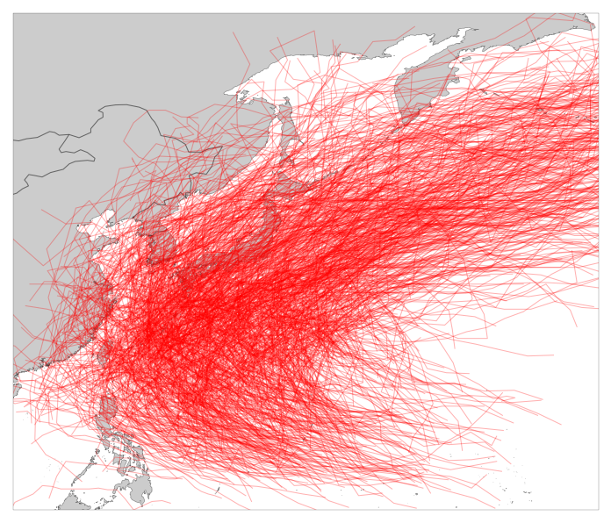
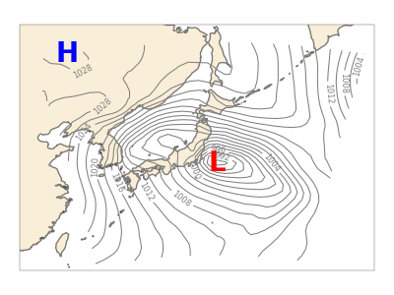
Time series
Eurasian continent
Pacific Ocean
Weather pattern
Typhoon tracking

Slide 6
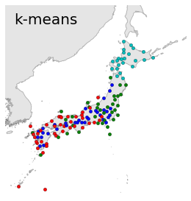
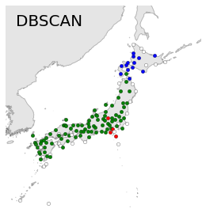
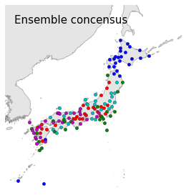
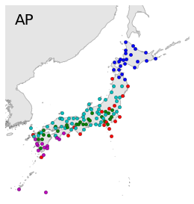
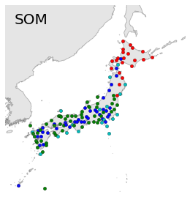
Cluster-based Similarity Partitioning Algorithm
(A. Strehl and J. Ghosh, 2002)

