Slide 1



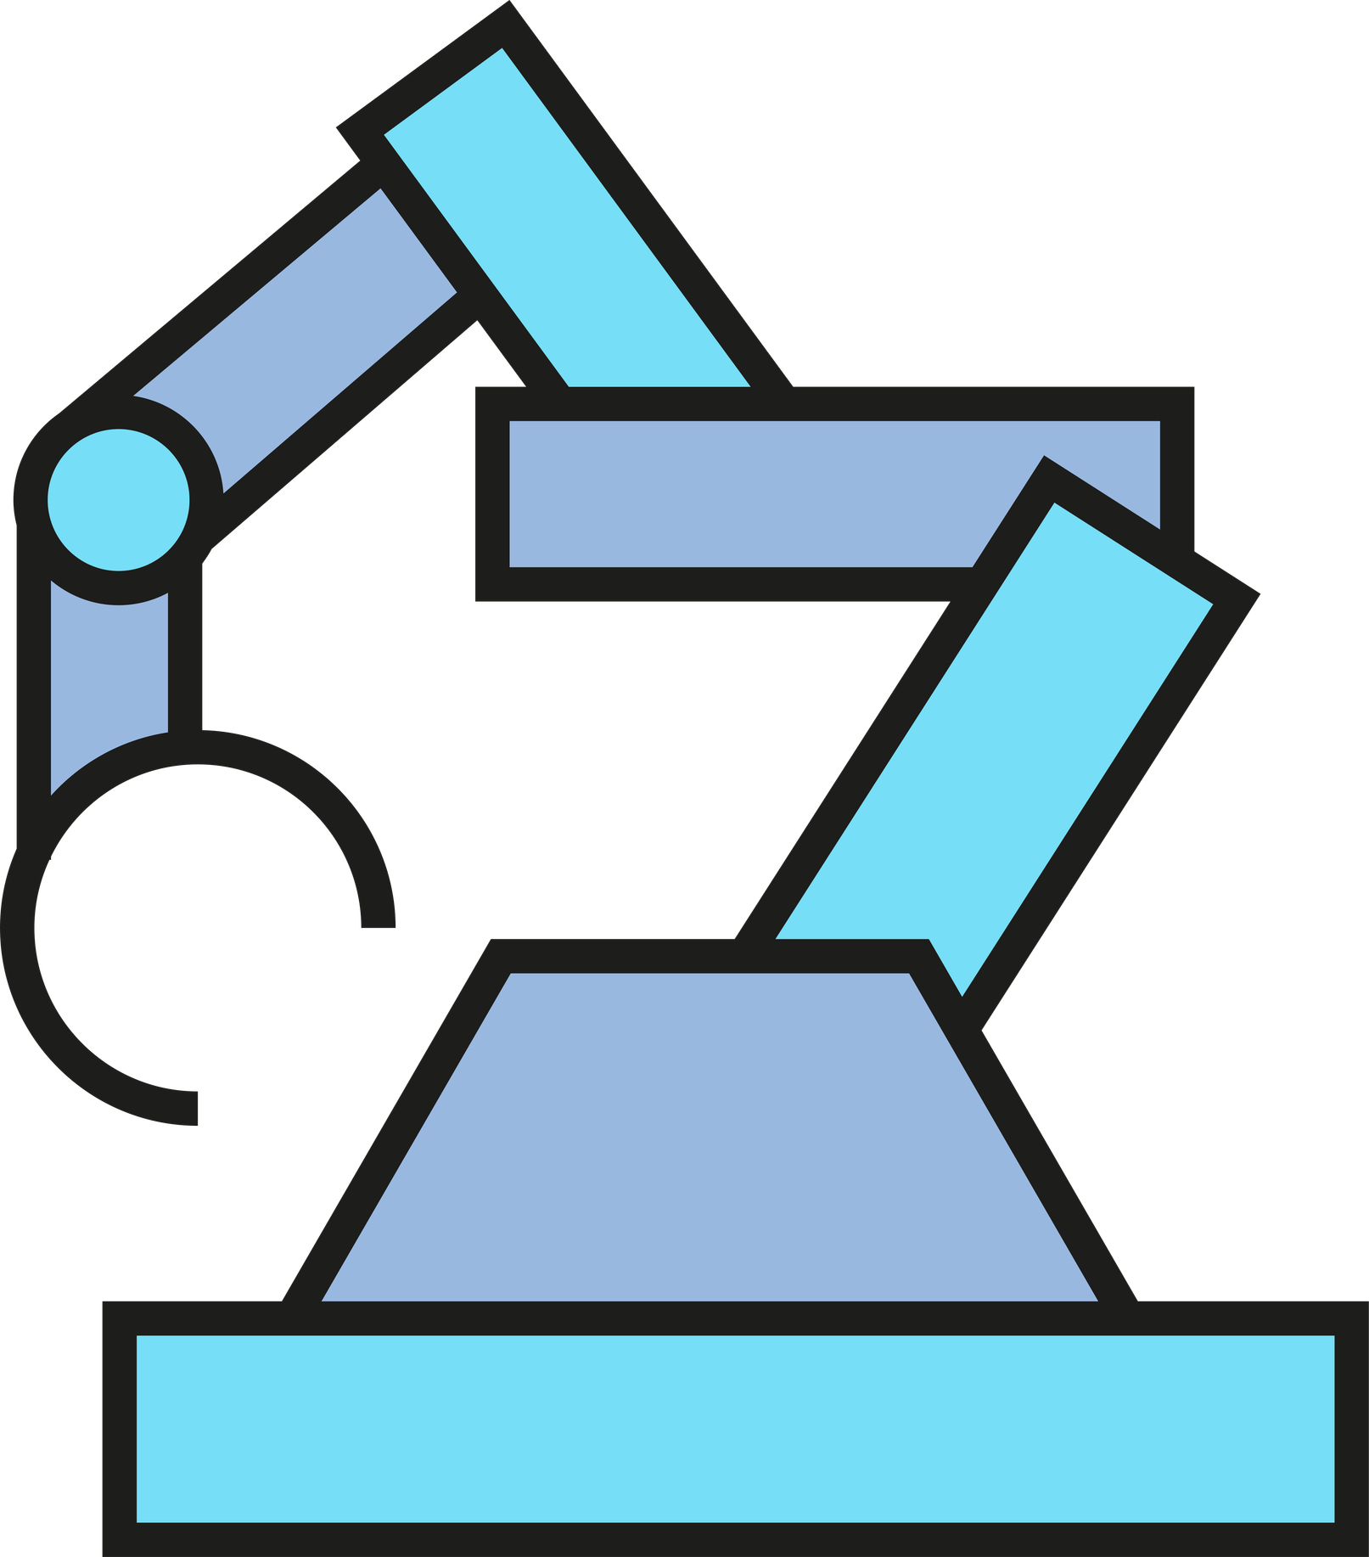
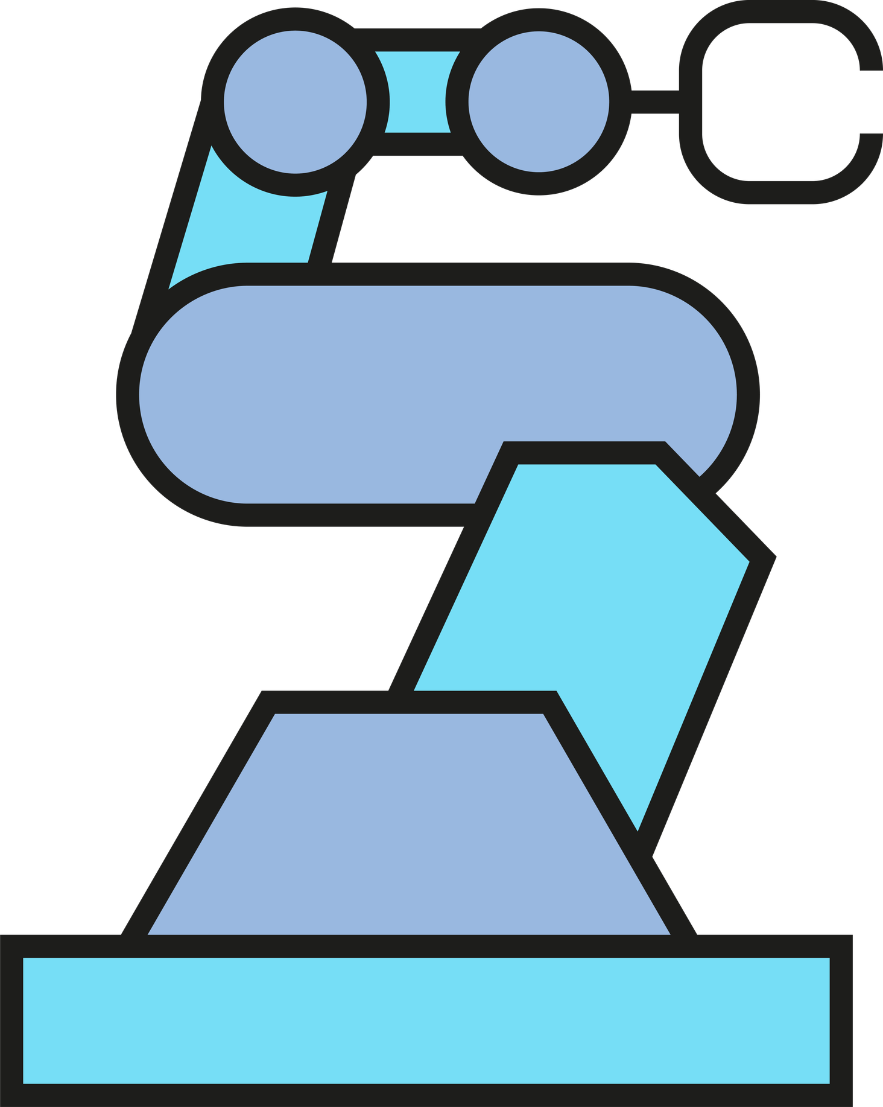
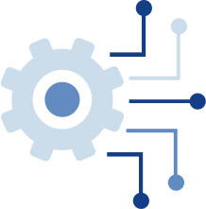
Cable-driven Soft Finger Simulation
Nguyen Dang Doanh 202418423

Slide 2

Table of contents
PROJECT OVERVIEW
PHYSICAL MODEL & FOUNDATION
DESIGN & IMPLEMENTATION
RESULTS & EVALUATION
CONCLUSION

Slide 3
Project Overview
Simulation Objective: Simulate a soft finger controlled by cable actuation. Observation: Observe the deformation of the elastic material under pulling forces.
Analysis: Analyze the effect of material stiffness on the bending amplitude of the finger.
Simulation Platform: SOFA (Simulation Open Framework Architecture) combined with the SoftRobots plugin.
Core Method: Finite Element Method (FEM) for highly accurate physical simulations.
Versions Used: Python 3.12.1 and SOFA v26.06.

Slide 4
Source code structure
Mesh directory: Stores 3D geometric file formats for finite element calculation (.vtk) and graphic visualization (.stl).
FingerwithSTLIB.py: Main file for Scene Setup and integrated Controller.
Setup Function: Contains the createScene(rootNode) function to build the SOFA Scene Graph.

Slide 5
Physical model and foundation
Dynamics Model: Initializes the soft-finger dynamics using FEM with elastic material.
Boundary Conditions: BoxROI fixed boundary.
Total Mass: 0.05 kg.
Poisson’s Ratio: 0.45 (silicone/rubbery material).
Young’s Modulus: 400 kPa (default stiffness).
Gravity: 0.0, -9810.0, 0.0 mm/s² along the -Y-axis.

Slide 6
Design and implementation
Cable Actuator: Sets up the pulling cable actuator using CableConstraint
Coordinate Mapping: Uses BarycentricMapping
Controller Integration: Integrates a custom class inheriting from Sofa.Core.Controller
Event Listening: Listens to simulation time step events (onAnimateBeginEvent)
Calculation: Automatically calculates and updates the cable contraction value using a smooth Cosine wave function
Maximum Displacement: The actuator has a maximum cable pull displacement of 40.0 mm

Slide 7
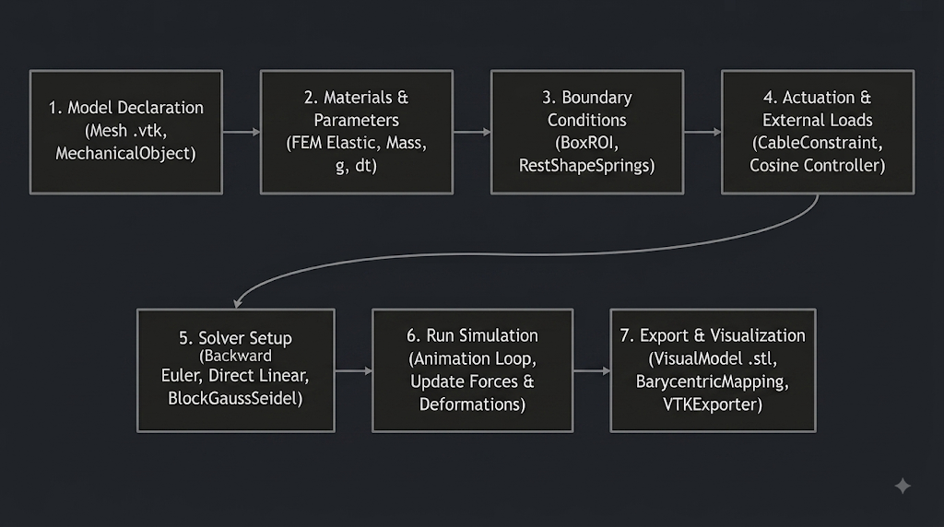
Simulation flowchart

Slide 8
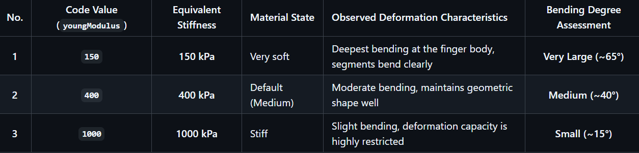
Results and evaluation
Study Objective: Investigating the effect of Material Stiffness (youngModulus) while keeping the maximum cable pull stroke constant at 40 mm

Slide 9
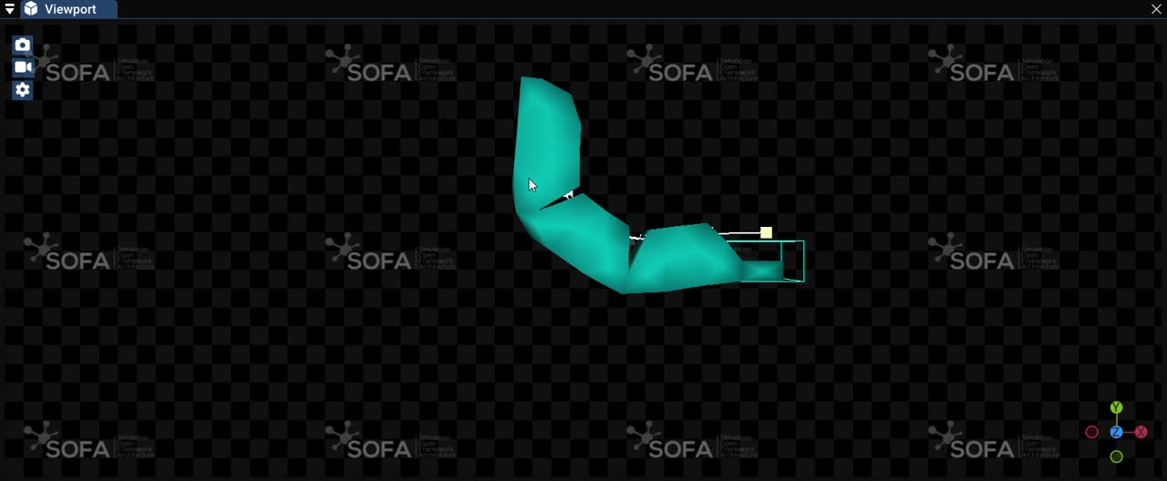
Results and evaluation

Slide 10
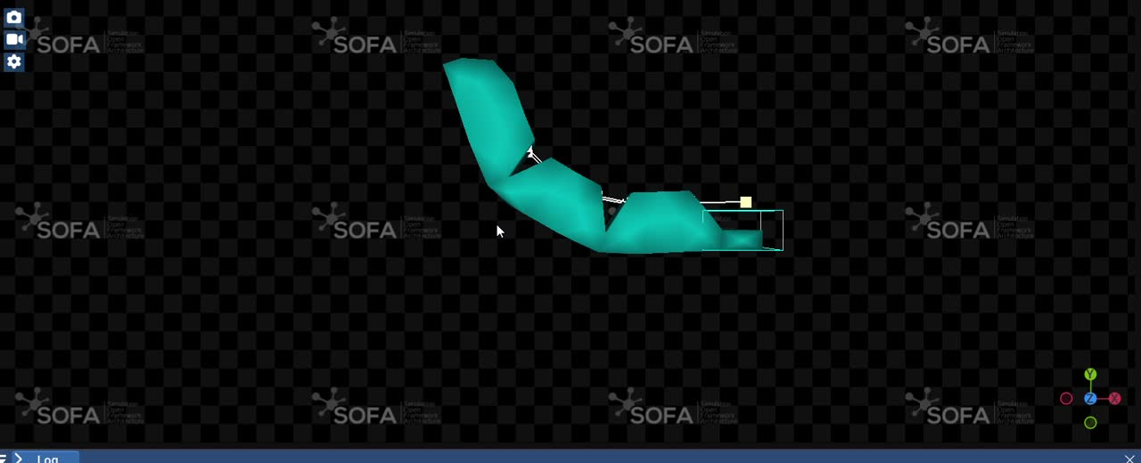
Results and evaluation

Slide 11
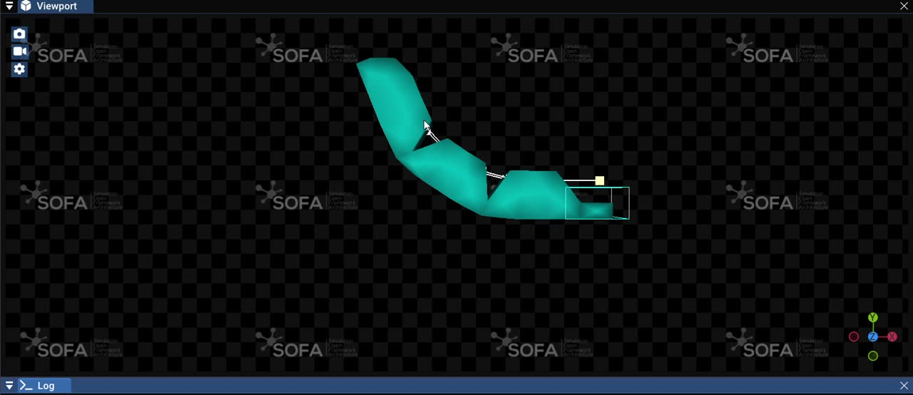
Results and evaluation

Slide 12
Conclusions and limitations
No Physical Interaction (Collision): The current model does not prevent self-collision if the finger is bent excessively.
Cable Simplification: The cable is simulated ideally, ignoring friction between the cable and the internal cavities of the finger wall.
Design Constraints: The finger is a solid block, lacking the bellows structure commonly seen in reality to optimize the bending angle.
Ideal Actuation Assumptions: The simulation assumes an idealized cable pull with instantaneous response and infinite force. It does not account for the electromechanical constraints of a real actuator system, such as motor torque limits, inertia, or signal delays within the physical control loop.

Slide 13
Future developments
Physical Prototyping: Transition from simulation to physical manufacturing using 3D printed molds to cast silicone, allowing for a direct comparison between the FEM simulation and real-world kinematic behavior.
Controller Upgrade: Implement a closed-loop control system to replace the current open-loop cosine function, enabling more precise trajectory tracking.

Slide 14
Thank You

