Slide 1
FinNews Tracker
Collecting and preparing Vietnamese financial news for company-level sentiment analysis
Group members:
Bùi Doãn Khang – 20235950
Ngô Đức Huy – 2023
Đặng Hoàng Sơn - 2023
Lê Kế Đức - 2023
Nguyễn Hoàng Trung Kiên - 2023
Supervisor: Thân Quang Khoát

Slide 2
Project introduction
1 · Introduction
FinNews Tracker: follow what the news says about each listed company, day by day
Why this project
What it shows
Benefits
Hundreds of company news articles appear every day across many sites — too many to read.
One article can be good for one company and bad for another: “VNM tăng trưởng mạnh mẽ trong khi đó MSN cho thấy sự sụt giảm mạnh trên sàn chứng khoán”.
Goal: label every news article per (article, company) as positive / negative / neutral.
Pick a ticker + date range + news source → number of positive / negative / neutral articles.
News sentiment over time (chart) and the article list with links to the original.
Home page: tickers with the most positive news in the last 7 / 30 / 90 days.
Updated automatically every day.
Investors: see the news picture of a company in seconds instead of reading every article.
Research: a clean, company-linked Vietnamese financial news dataset from 2010.
Not investment advice — a reference tool alongside prices and fundamentals.
Tools
Data collection
Python
requests
lxml
Data processing
pandas
PyArrow / Parquet
rule-based company linker (regex)
Modelling
PhoBERT
PyTorch
Hugging Face Transformers
scikit-learn
Underthesea
Product (planned)
PostgreSQL
FastAPI
HTML / CSS / JS + Chart.js
Docker
cron

Slide 3
Project workflow
2 · Overview
FOCUS OF THIS REPORT
NEXT STEPS
①
②
③
④
⑤
⑥
Collection
→
Cleaning
→
Company linking
→
Sentiment
→
Database
→
Web app
Crawl 5 sites, 2010 → now
Normalise, merge duplicates
Tickers, names, former names; equity filter
PhoBERT per (article, company)
Articles, companies, labels
Ticker + date + source
↻
⑦ Daily automated run: crawl new articles → clean and merge duplicates → link companies → score sentiment → write to DB → web updated the same day.

Slide 4
Crawling
3 · Data collection
5 news sites, company and stock news from each site's first article to today, with full article text
News site | Period | Progress
vietstock.vn | 07/2007 → now | Done, 164.872 records with full content (from 2010; 2007–2009 next)
diendandoanhnghiep.vn | Start date to confirm (site blocks our crawler) | No crawler yet
baodautu.vn | 10/2019 → 01/2026 (section discontinued) | Done, 4,660 records with full content
stockbiz.vn | 09/2021 → now (site launched) | No crawler yet
dantri.com.vn | 01/2005 → now | No crawler yet
One schema for all sites: every crawler outputs the same columns (next slide).
Broad sections (stockbiz, dantri, diendandoanhnghiep) mix in non-company news → must go through the equity news filter.
Cross-site duplicates: several sites often cover the same event → grouped into one event, not deleted (slide 8).

Slide 5
Metadata
3 · Data collection
Every crawled article is stored with 12 columns
Column | Meaning | Example
link | Article URL — unique key, used to skip duplicates | vietstock.vn/2010/01/vna-giai-toa-co-phieu-…-739-272831.htm
article_id | Article ID taken from the URL | 272831
domain | News site (source filter on the web app) | vietstock.vn
channel_id · category | Section the article was listed in | 739 · Giao dịch nội bộ (insider trading)
title | Headline | VNA: Giải tỏa cổ phiếu cho cổ đông sáng lập và cổ đông đặc biệt
description | Lead paragraph (sapo) | first 1–2 sentences summarising the article
content | Full body text, one paragraph per line | main input for company linking and sentiment
author · source | Byline and cited source printed on the article | reporter name · original publisher
publication_date · year | Publish time (to the second) and year, used for date filters | 2010-01-06 13:54:00 · 2010

Slide 6
Dataset preview (vietstock.vn)
3 · Data collection
164,872 articles listed for 01/2010 → 10/2026
Article phase (full text of each page): ~1 request per article, split across several machines with --shard. 2007–2009 still to list.

Slide 7
Daily incremental crawl
3 · Data collection
After the history is collected, the crawler only fetches new articles each day
List new articles
Skip known links
Download pages
Save
Hand over
→
→
→
→
current month, all channels
dedupe by link
new articles only
raw_articles
cleaning → linking
Resumable
No duplicates
Polite crawling
Each finished (channel, month) is recorded and skipped next time; the current month is always re-listed to catch new articles.
Deduplicated by link; articles already downloaded are not fetched again; permanent errors (404) are logged and skipped.
Minimum delay between requests, automatic retry on network errors, a log for every run.

Slide 8
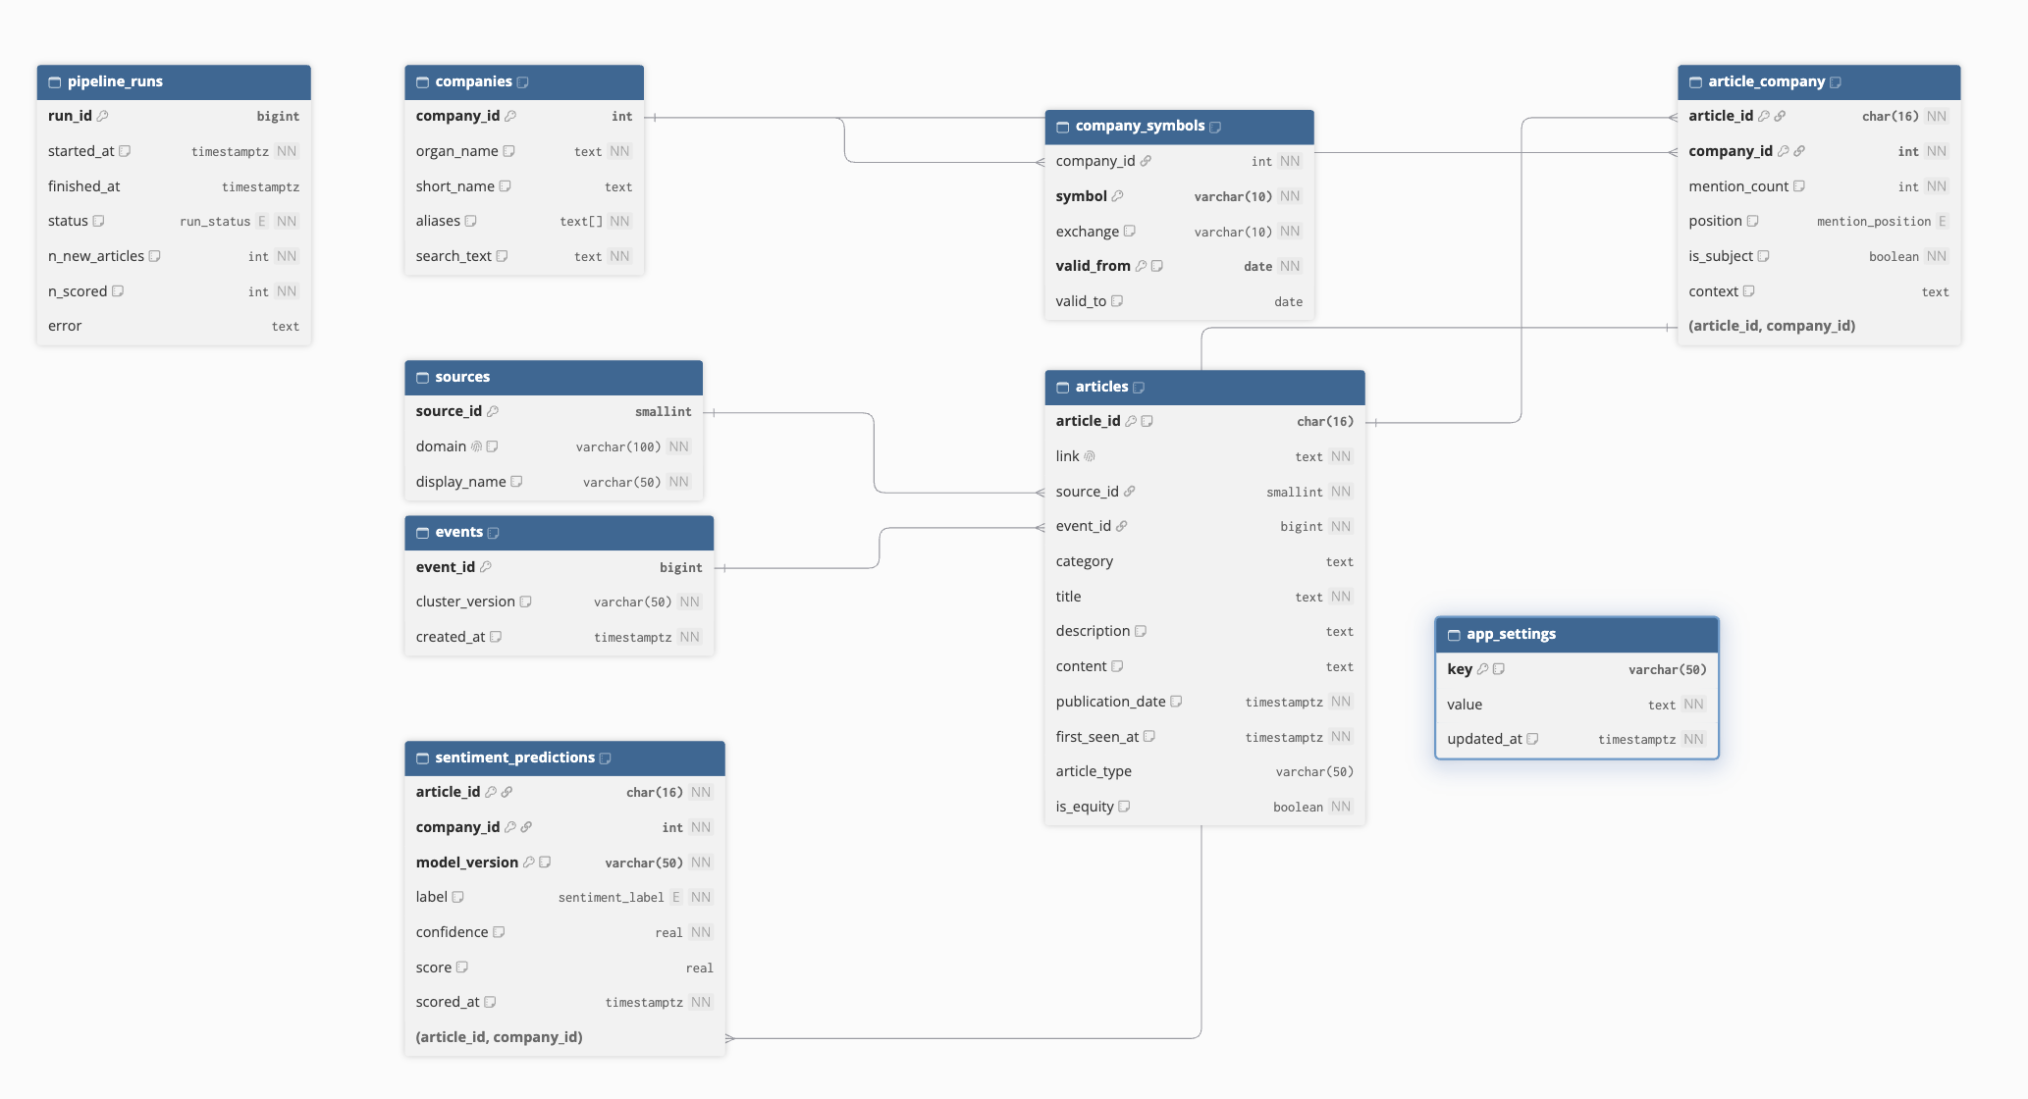
Planned database schema
5 · Plan
PostgreSQL: 9 tables + 1 materialized view; the web reads one view

Slide 9
Output data & next phases
5 · Plan
Output data (main tables)
Next phases
Table | Main columns
articles | Link, source_id, event_id, category, title, description, content, publication_date, is_equity
companies + company_symbols | company_id, names, aliases; ticker history with valid_from / valid_to
article_company | article_id, company_id, mention_count, position, is_subject, context
1
Data collection
Finish crawlers for diendandoanhnghiep, stockbiz, dantri
2
Data preparation
Combine cleaning steps into one pipeline
Finish the rules for firm extraction
Link companies on the new data; measure precision / recall on ~300 articles
3
Labelling & model
Label 1,500–2,000 (article, company) pairs
Prepare the sentiment model

