Slide 1
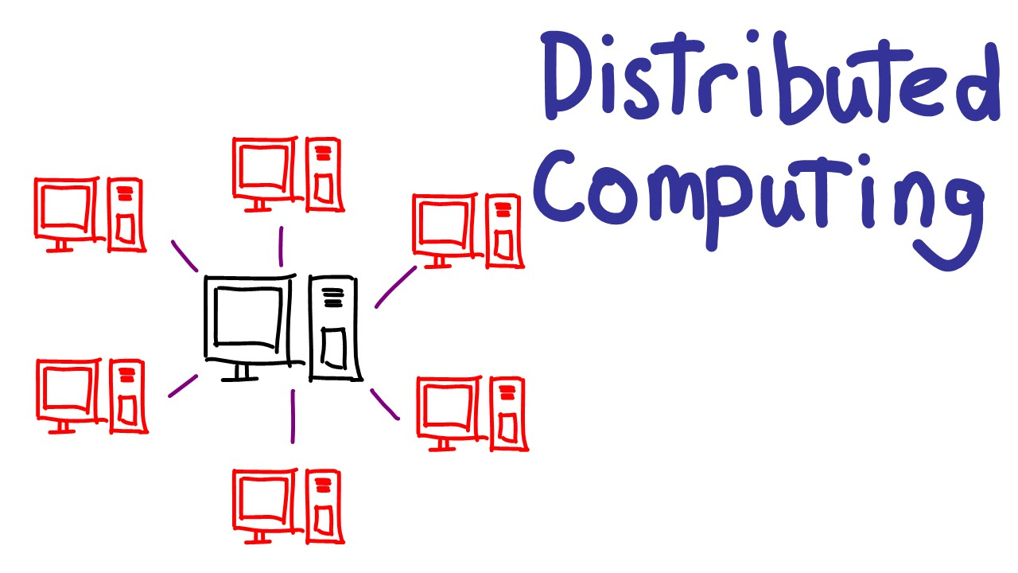
is a collection of computational and storage devices connected through a communications network. Components are distributed
Two important issues:
Topology: the way components connected
Mode: the method they communicate with each other
Many models available
Each has pros and cons

Slide 2
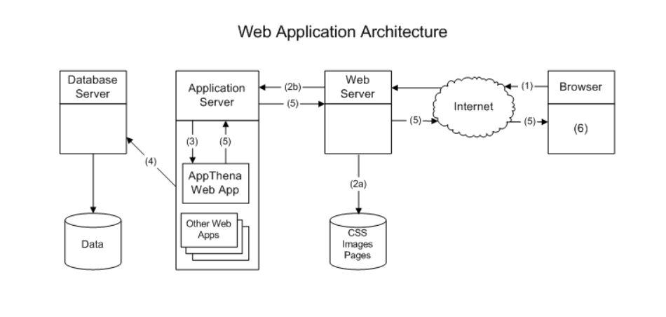

Slide 3
01 Microservice Architecture

Slide 4
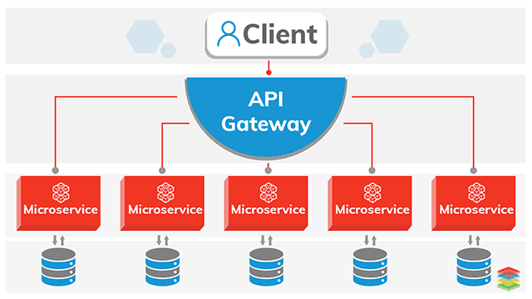
Microservices is an architectural style application
that is an aggregate of many small and independent services that can run separately, develop and deploy independently.
In this Architecture, each service is close and performs a single function

Slide 5
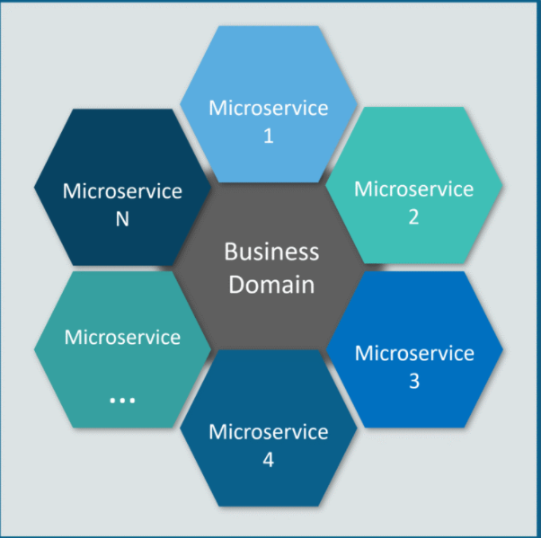

Slide 6
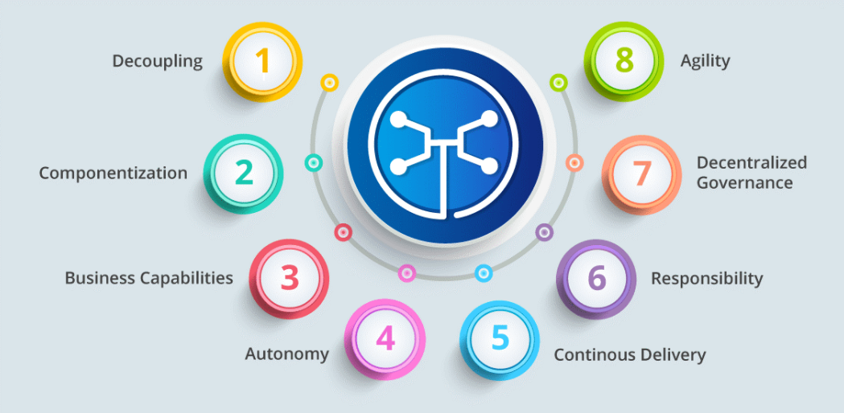
Features of Microservices

Slide 7
Decoupling: Services in a system are largely decoupled. So the whole application can be easily built, change and minified.
Componentization: Microservices are considered as independent components that can be easily replace and upgraded.
Business Capabilities: Microservices are very simple and focus on a single capability
Continuous Delivery: Enables regular software releases, through systematic automation of software creation, testing and approval

Slide 8
Autonomy: Developers and teams can work independently of each other, thus increasing speed.
Responsibility: Microservices are not focused on applications like projects. Instead, they treat apps as product for which they are responsible.
Decentralized Governance: The focus is on using the right tools for the right job.
Agility: Microservices support agile development. Any new features can be quickly developed and remove again.

Slide 9
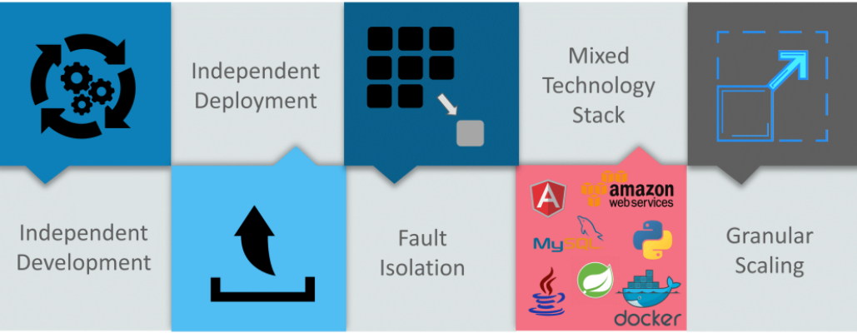
ADVANTAGES of microservices

Slide 10
ADVANTAGES
Independent Development: All microservices can be easily developed base on its own functionality.
Independent Deployment: Based on discrete functions, they can be deployed individually in any application.
Fault Isolation: Even if an application’s service is down, the system continues to work.
Mixed Technology Stack: Different languages and technologies can be used to build different services of the same application.
Granular Scaling: Individual components can scale as needed, no need to scale all components together.

Slide 11
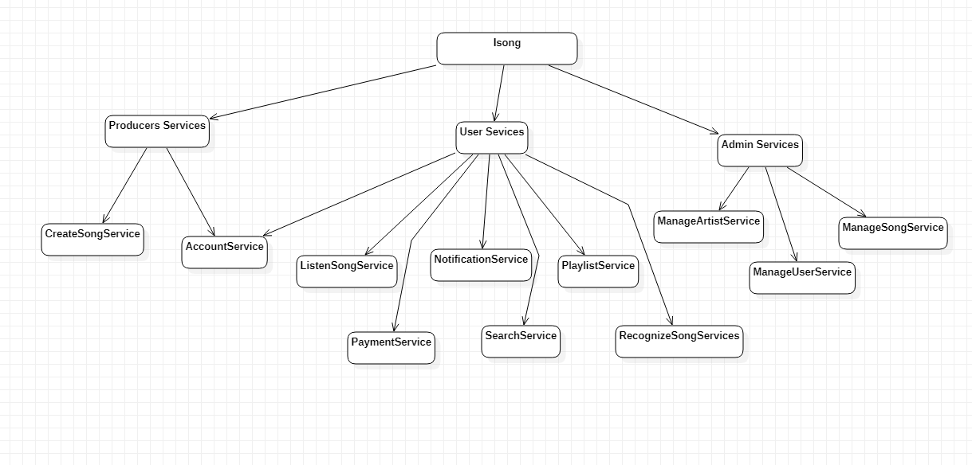

Slide 12
02 Service-Oriented Architecture (SOA)

Slide 13
A Service Oriented Architecture (SOA) starts with a businesses process.
In this context, a service is a business functionality that is well-defined, self-contained, independent from other services, and published and available to be used via a standard programming interface.
Software manages business processes through a SOA with well-defined and standard interfaces that can build, enhance, and expand their existing infrastructure more flexible.
SOA services can be extensively reused within a given domain or product line, and even among legacy systems.
Loose coupling of service–orientation provide great flexibility for enterprises to make use of all available service recourses regardless of platform and technology restrictions.
The connections between services are conducted by common and universal message oriented protocols such as the SOAP Web service protocol, which can deliver requests and responses between services loosely.
A connection can be established statically or dynamically.

Slide 14
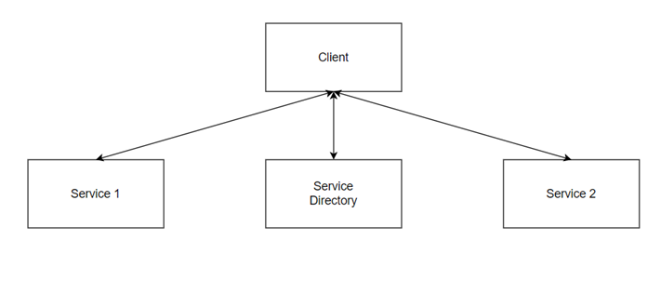

Slide 15
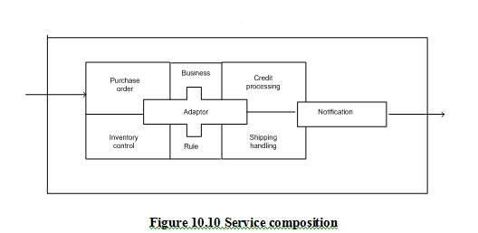

Slide 16
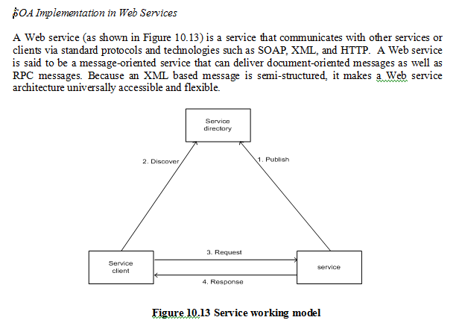
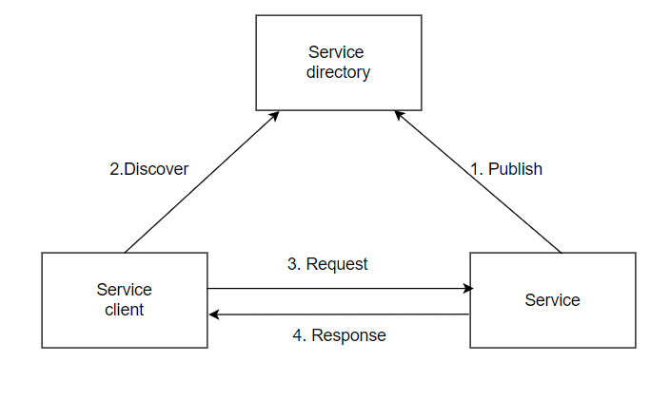
SOAP vs WSDL

Slide 17
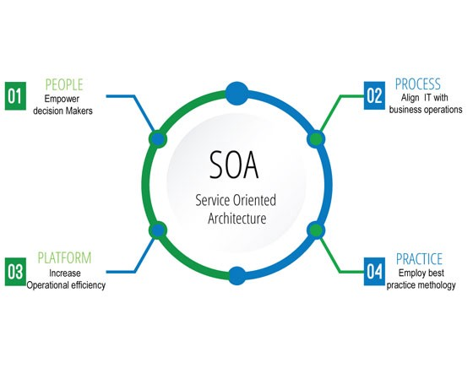
ADVANTAGES of SOA

Slide 18
ADVANTAGES
Loosely-coupled connection: Loose-coupling is the key attribute of SOA.
Each service component is independent from other services due to the stateless service feature.
The implementation of a service will not affect the application of the service as long as the exposed interface is not changed.
It makes SOA software much easier to evolve and update.
Interoperability: Technically any client or any service can access other services regardless of their platform, technology, vendors, or language implementations.

Slide 19
Reusability: Any service can be reused by any other service,. Because clients of a service only need to know its public interfaces, service composition and integration become much easier.
SOA based business application development comes much more efficient in term of time and cost.
Scalability: Loosely coupled services make themselves easy to scale.
The coarse-grained, document-oriented, and asynchronous service features enhance the scalability attribute.

Slide 20
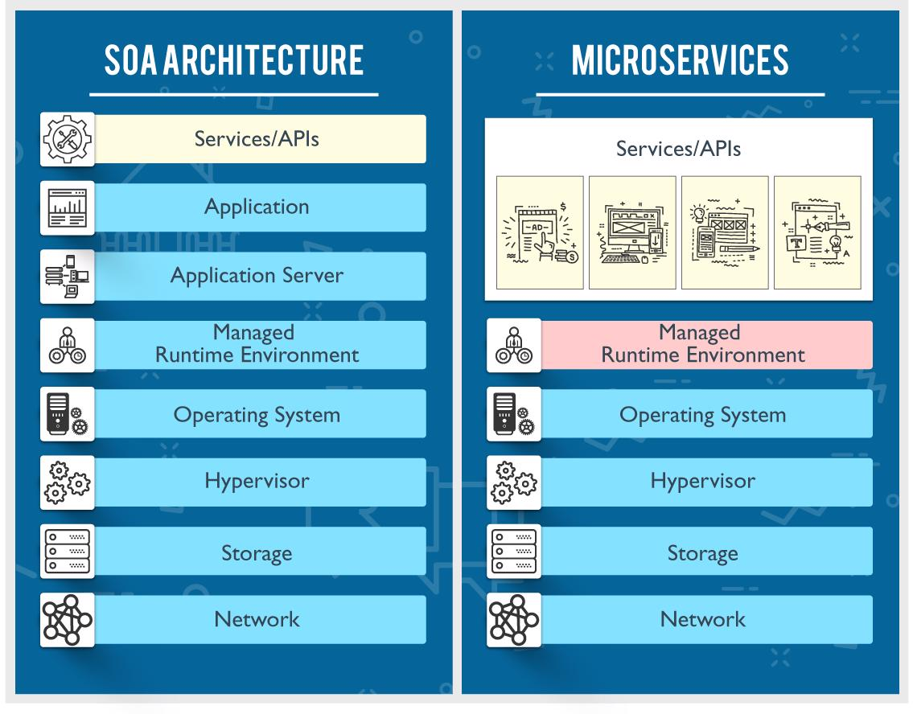

Slide 21
THANK YOU

Slide 22


