Slide 1

HOTEL MANAGEMENT
GROUP 1 – AP146
Doan Thanh Nhan
Nguyen Thanh Kien ( C )
Ngo Thien An

Slide 2

1
Practical basis
2
Introduce
3
Feature of Application
Content
4
Plan & Task Assignment
5
Application UI
6
Advantages And Disadvantages
7
Development

Slide 3
1. PRACTICAL BASIS:
Need
Supply
Pioneers
Team
Derived from the need to use management software of hotels at local

Slide 4
2. INTRODUCE
Convenience for customers and employees.
Increase efficiency and ensure data accuracy
Easy to use
Manage rooms, services, employees, customers,….
Bills or invoices

Slide 5
3. FEATURES OF APPLICATION
1
Creating database automatically
2
Login
3
Hotel management
4
Dynamic role assignment
5
Using QR code for some functions
6
Bills/Invoices reports
9
8
7
Booking, check in, check out
Dynamic UI (such as display rooms…)
User logs and block spamming MAC address

Slide 6
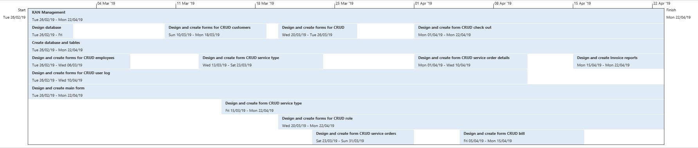
4. PLAN AND TASK ASSIGNMENT
Plan timeline

Slide 7
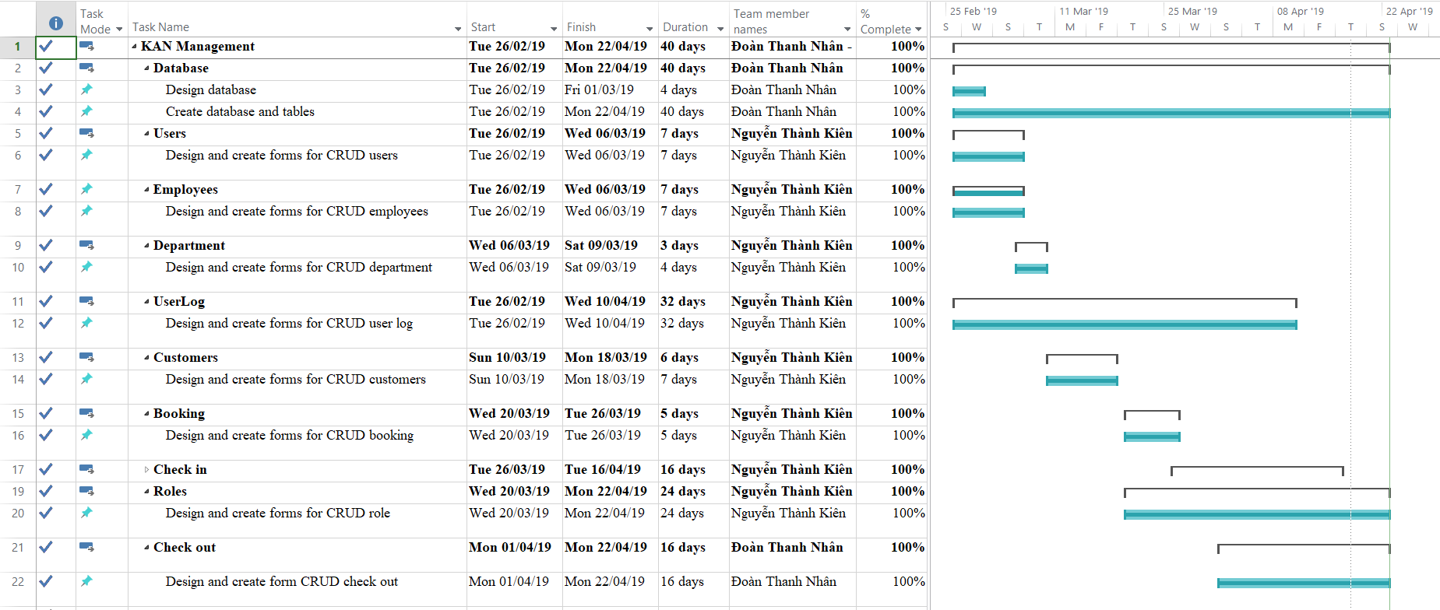
4. PLAN AND TASK ASSIGNMENT
Task assignment 01

Slide 8
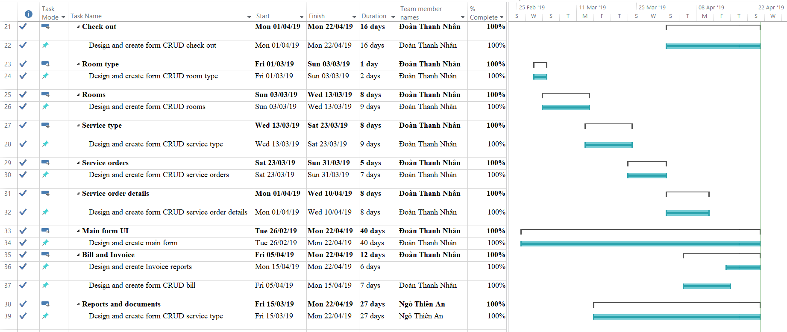
4. PLAN AND TASK ASSIGNMENT
Task assignment 02

Slide 9
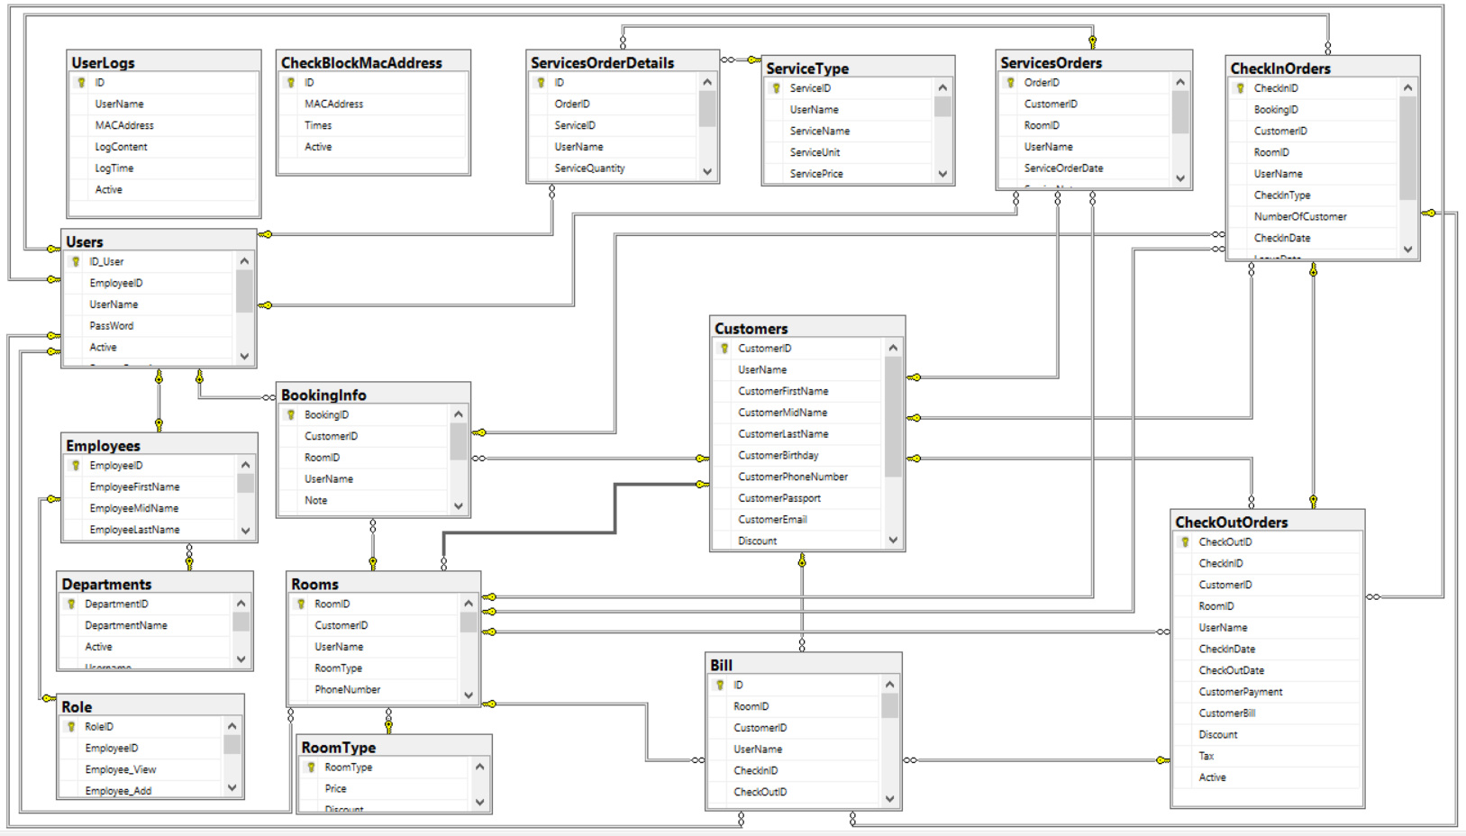
4. PLAN AND TASK ASSIGNMENT
Entity Relationship Diagram

Slide 10
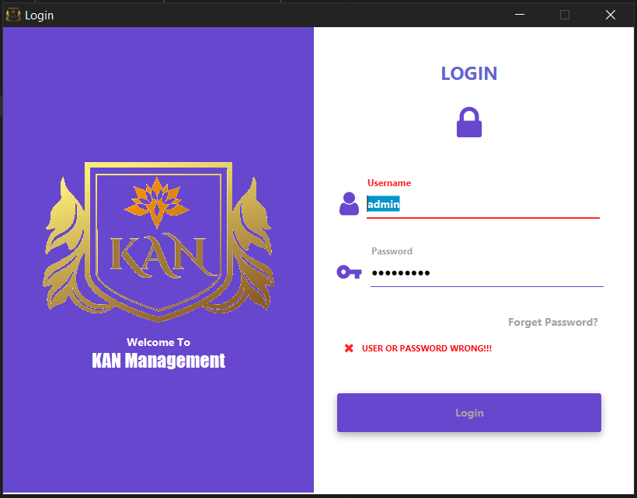
5. APPLICATION USER INTERFACE (UI)
Login form

Slide 11
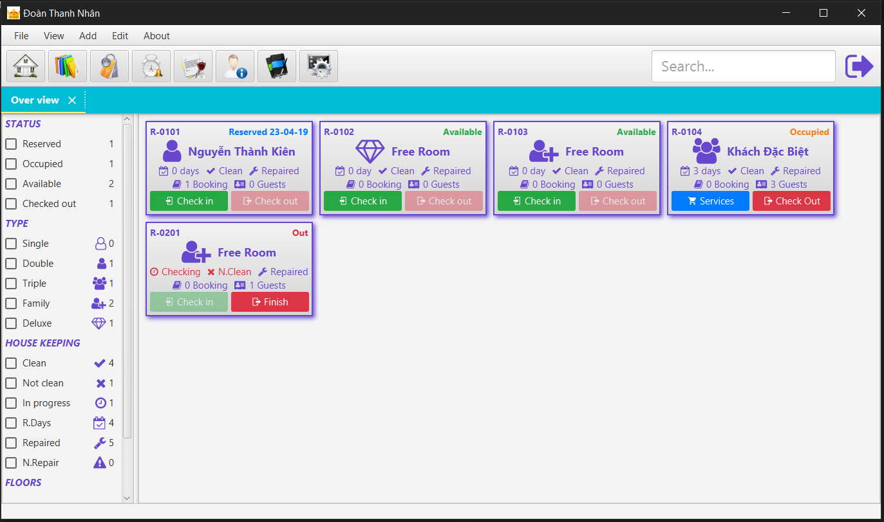
5. APPLICATION USER INTERFACE (UI)
Main form

Slide 12
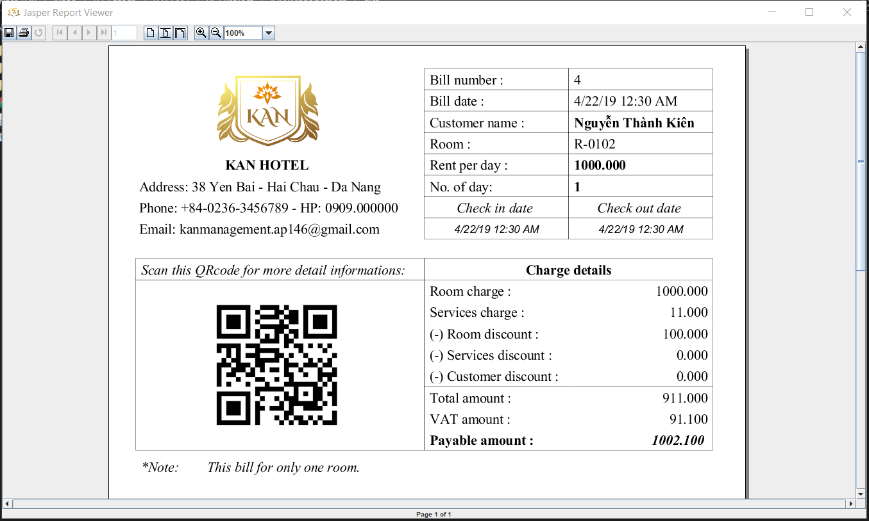
5. APPLICATION USER INTERFACE (UI)
Bill report

Slide 13
6. ADVANCETAGES
A
D
A
V
A
T
A
G
E
S
Provide many information (such as employees, customers, rooms, services…)
Dynamic UI
Can create database dynamically
User can use many functions up to their roles
Application is friendly and easy to use
Can create and reading QR codes
Can report and print bills/invoices.
Use Microsoft SQL Server On-Premises
Use Microsoft Azure (Remote Server)
Use GIT for team work.

Slide 14
6. DISADVANCETAGES
D
I
S
A
V
A
N
T
A
G
E
S
Due to limited time and knowledge, the current application only perform only one kind of report: Bills/Invoices
Due to limited knowledge about hotel operations, so there are some cases that may not be true to reality
Working with JavaFX in 1st time.
Multi language has not yet been applied to the program

Slide 15
7. DEVELOPMENT
In the future, we can add some functions such as:
+ Salary management
+ Making reports up to category
+ Integrated restaurant management

Slide 16


