Slide 1
HOW TO LEARN PYTHON
Hybrid Technologies Vietnam
DAD - 2021

Slide 2
Contents
Python Fundamentals
Object-Oriented Programming in Python
Data Structures and Algorithms in Python
Advanced Concepts in Python

Slide 3
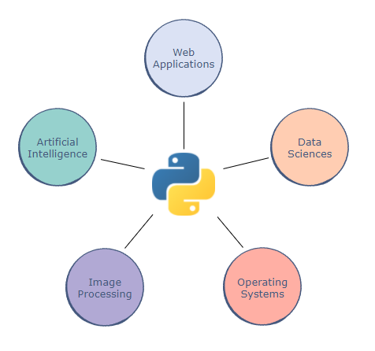
What is Python?
A high-level language
Readability
Applications
Version History + Python 2.7 + Python 3.9.2

Slide 4
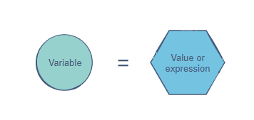
Data types and Variables
Data types
Variables
Numbers
Strings
Booleans

Slide 5
Operators
Arithmetic operators: +,-,*,/,%,**,//
Comparison operators: >,<,>=,<=,==,!=, is, is not
Assignment operators: =, +=, -=, *=, /=, //=, **=, %=, |=, &=, ^=, >>=, <<=
Logical operators: and, or, not
Bitwise operators: &, |, ^, ~, <<, >>

Slide 6
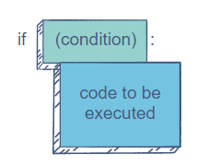
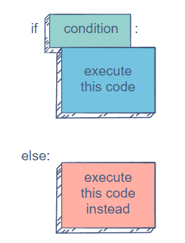
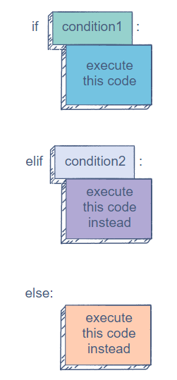
Conditional Statements
if
if-else
if-elif-else

Slide 7
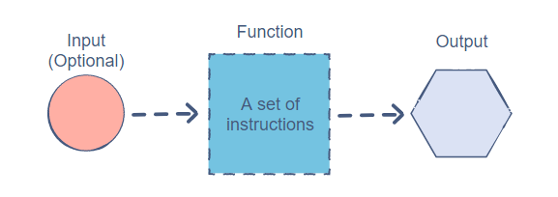
Functions
Reusability
Simplicity

Slide 8
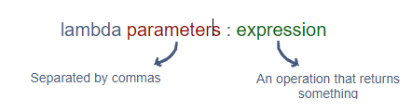

Lambda
A lambda is an anonymous function that returns some form of data.

Slide 9
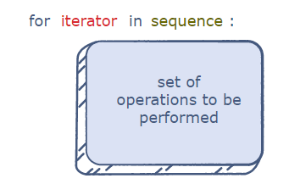
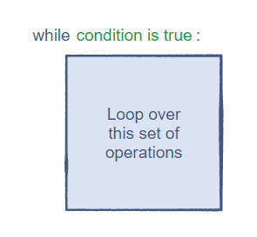
Loops
The for Loop
The while Loop

Slide 10
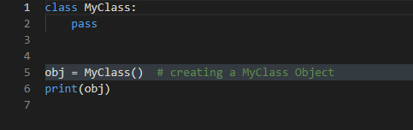
Declaring a Class in Python

Slide 11
Slide Title
Make Effective Presentations
Using Awesome Backgrounds
Engage your Audience
Capture Audience Attention

Slide 12
Slide Title
Make Effective Presentations
Using Awesome Backgrounds
Engage your Audience
Capture Audience Attention

Slide 13
Slide Title
Product A
Product B
Feature 1
Feature 2
Feature 3
Feature 1
Feature 2
Feature 3

Slide 14
Slide Title
Product A
Product B
Feature 1
Feature 2
Feature 3
Feature 1
Feature 2
Feature 3

Slide 15


