Slide 1
HOW TO LEARN PYTHON
Hybrid Technologies Vietnam
DAD - 2021

Slide 2
Contents
Python Fundamentals
Object-Oriented Programming in Python
Data Structures and Algorithms in Python
Advanced Concepts in Python

Slide 3
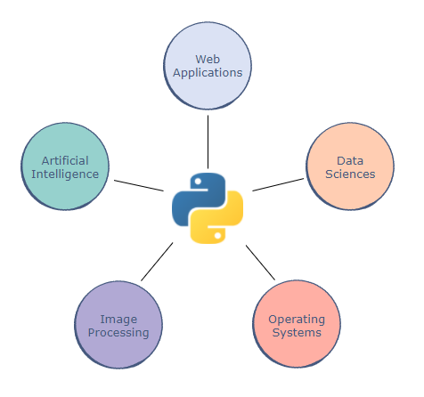
What is Python?
A high-level language
Readability
Applications
Version History + Python 2.7 + Python 3.9.2

Slide 4
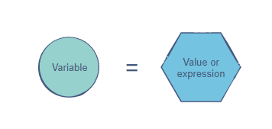
Data types and Variables
Data types
Variables
Numbers
Strings
Booleans

Slide 5
Operators
Arithmetic operators: +,-,*,/,%,**,//
Comparison operators: >,<,>=,<=,==,!=, is, is not
Assignment operators: =, +=, -=, *=, /=, //=, **=, %=, |=, &=, ^=, >>=, <<=
Logical operators: and, or, not
Bitwise operators: &, |, ^, ~, <<, >>

Slide 6
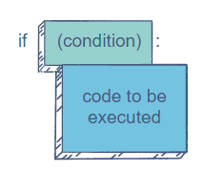
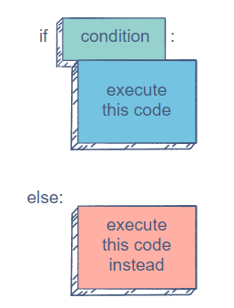
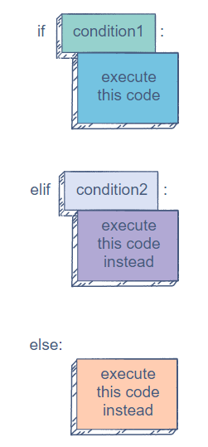
Conditional Statements
if
if-else
if-elif-else

Slide 7
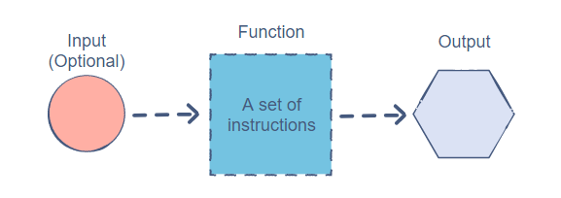
Functions
Reusability
Simplicity

Slide 8
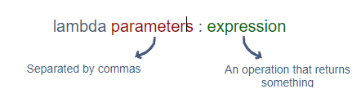

Lambda
A lambda is an anonymous function that returns some form of data.

Slide 9
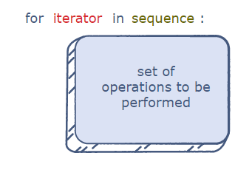
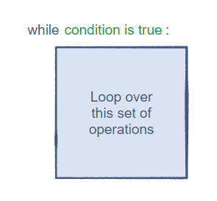
Loops
The for Loop
The while Loop

Slide 10
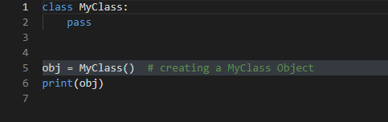
Declaring a Class in Python

Slide 11
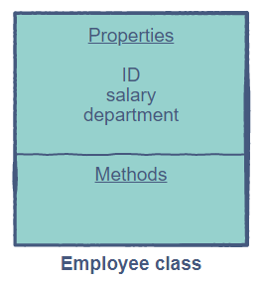
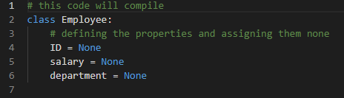
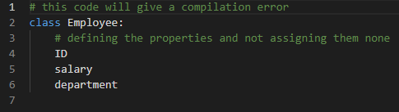
Implement Properties in a class

Slide 12
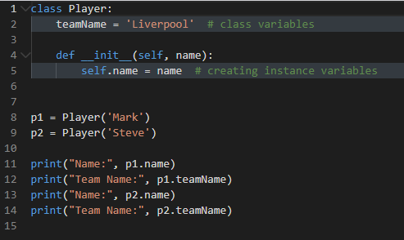
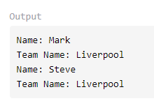
Class and Instance Variables

Slide 13
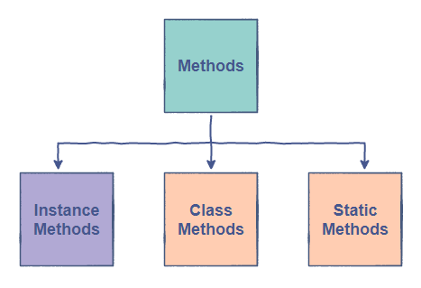
Method in a Python Class

Slide 14
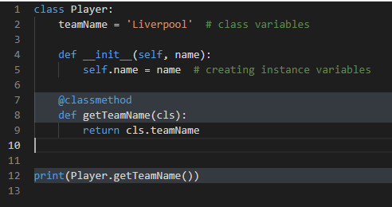

Class methods

Slide 15
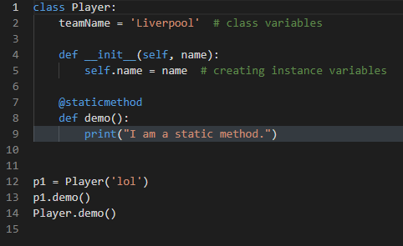
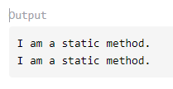
Static methods

Slide 16
Inheritance
Single
Multi-level
Hierarchical
Multiple
Hybrid

Slide 17
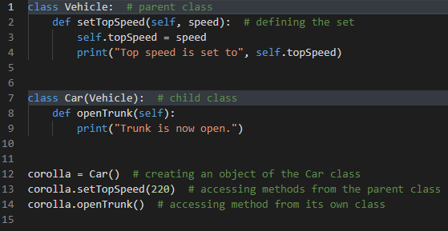
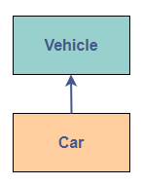
Single Inheritance

Slide 18
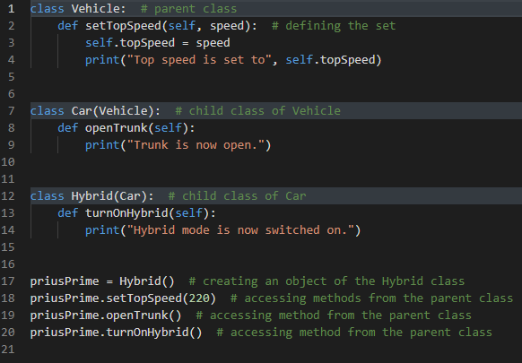
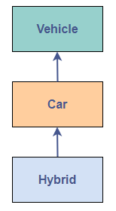
Multi-level Inheritance

Slide 19
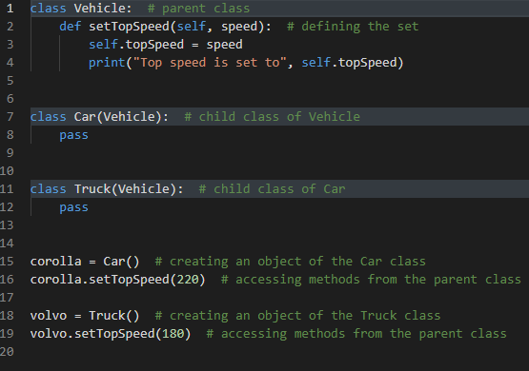
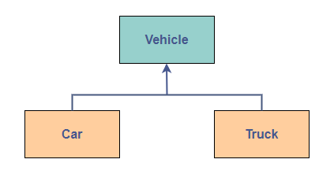
Hierarchical Inheritance

Slide 20
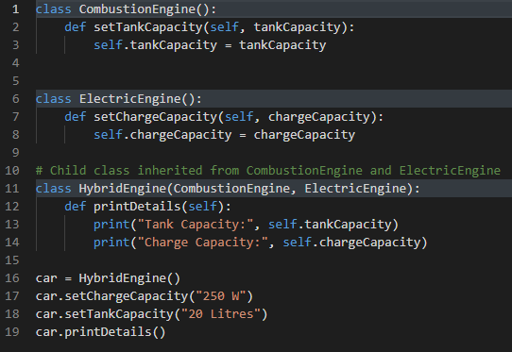
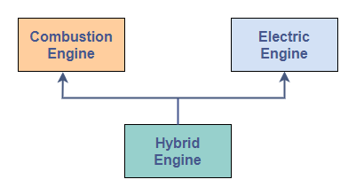
Multiple Inheritance

Slide 21
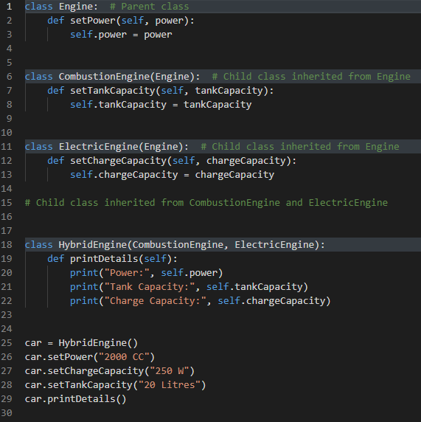
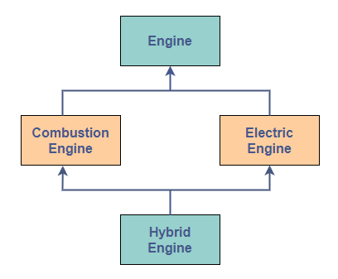
Hybrid Inheritance

