Slide 1
Federated Learning Implementation (20240120)
January 2024

Slide 2
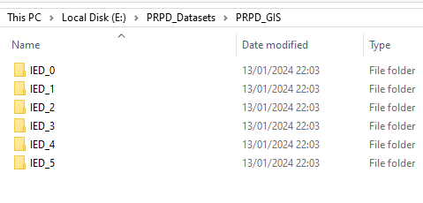
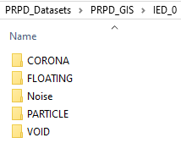
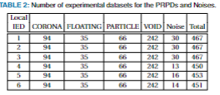
PRPD Data
Each IED contains 5 kinds of fault
=> These IEDs are considered as local environment and can not be shared to each others.

Slide 3
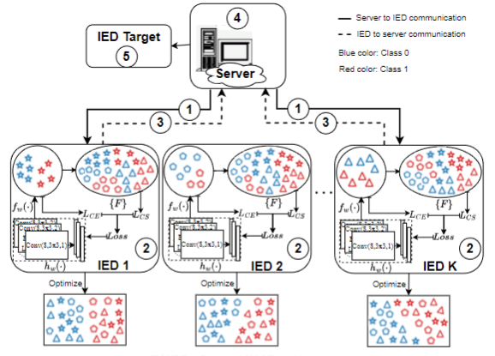
Federated Learning algorithm

Slide 4
Implementation in python
Abstract
Run server.py with specifying the number of IEDs participated for training model (default = 2)
Choose any 2 local IED for training (ex: local_IED_0 and local_IED_1)
Run local_IED_0.py
Run local_IED_1.py
The local IEDs are connected to the server through same Ports and got an id
After each round, each side executes their tasks until finish the training model

Slide 5
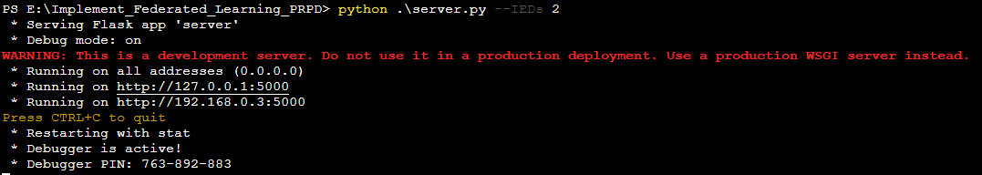
Implementation in python
Demo: run server.py, local_IED_0.py, local_IED_1.py at the same time in different terminals
Server side: (terminal 1)
Note: If run all IEDs (--IEDs 5)
Then run 5 more terminals for local training
Or:
Port to connect locals

Slide 6
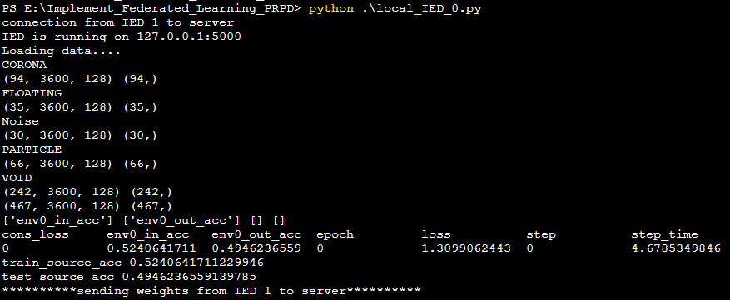
Implementation in python
Demo: run server.py, local_IED_0.py, local_IED_1.py at the same time in different terminals
Local side: (terminal 2)
Got ID

Slide 7
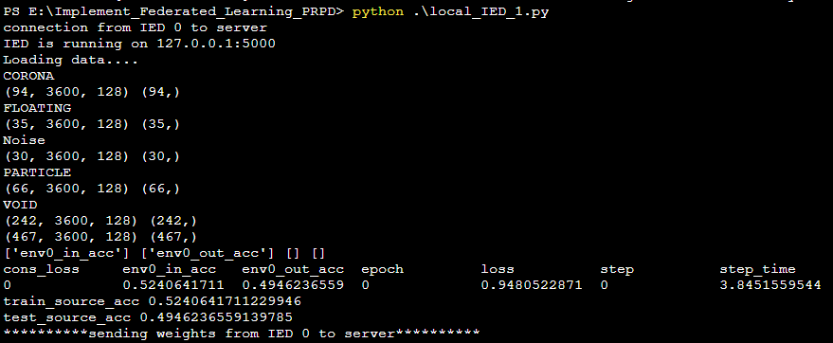
Implementation in python
Demo: run server.py, local_IED_0.py, local_IED_1.py at the same time in different terminals
Local side: (terminal 3)
Got ID

Slide 8
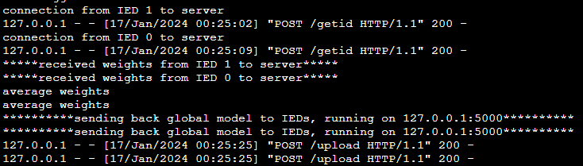
Implementation in python
Demo: run server.py, local_IED_0.py, local_IED_1.py at the same time in different terminals
When local IEDs are connected to server => training model
EPOCH 0
Server side: (terminal 1)
Local side: (terminal 2)
Local side: (terminal 3)

Slide 9
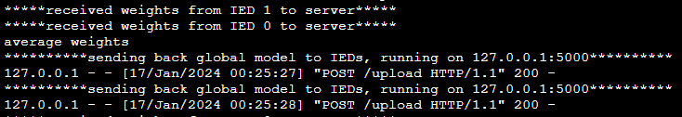
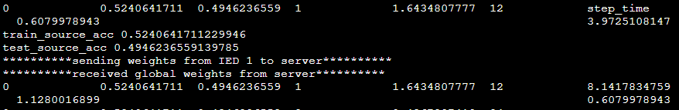
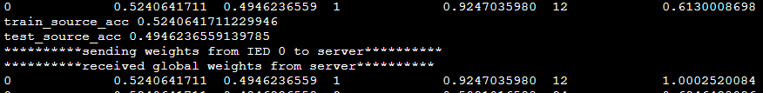
Implementation in python
Demo: run server.py, local_IED_0.py, local_IED_1.py at the same time in different terminals
When local IEDs are connected to server => training model
EPOCH 1
Server side: (terminal 1)
Local side: (terminal 2)
Local side: (terminal 3)

Slide 10
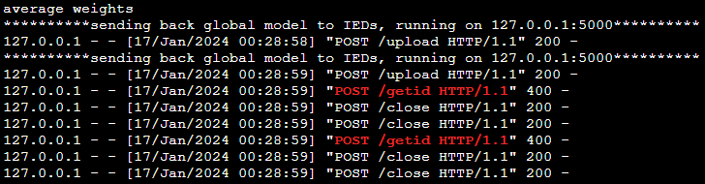
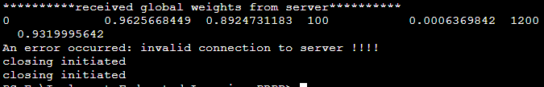
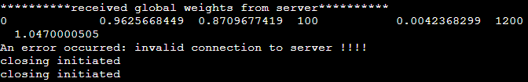
Implementation in python
Demo: run server.py, local_IED_0.py, local_IED_1.py at the same time in different terminals
When local IEDs are connected to server => training model
---------------TRAINING UNTIL 100 EPOCH ---------------
Server side: (terminal 1)
Local side: (terminal 2)
Local side: (terminal 3)

Slide 11
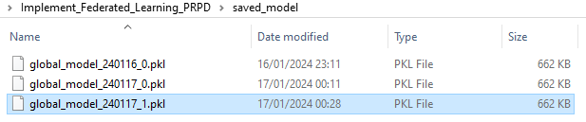
Implementation in python
Demo: run server.py, local_IED_0.py, local_IED_1.py at the same time in different terminal
Final global model is saved
=> We can use this model for testing other samples (.csv file)

Slide 12
Thanks for your attention!

