Slide 1
FINANCIAL SYSTEMS
SWIFT, GLOBAL PAYMENTS
& THE STRATEGIC RETURN OF GOLD
How financial messaging, settlement infrastructure,
sanctions and reserve diversification intersect
TEAM BRIEFING | NOVEMBER 2026
A practical guide to the plumbing and geopolitics of cross-border finance
01 / 16

Slide 2
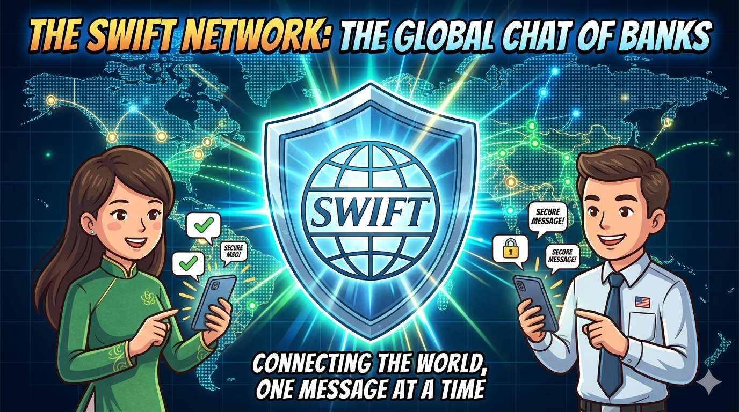

Slide 3
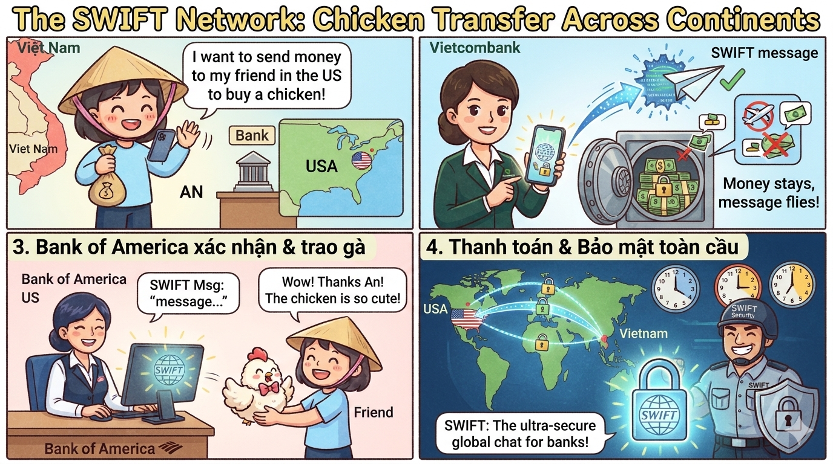
Notes:
Câu chuyện "Chuyển gà xuyên lục địa"
Bạn đang ở Việt Nam và muốn gửi cho người bạn thân ở Mỹ một số tiền để mua một con gà. Bạn ra ngân hàng Vietcombank (VCB), còn bạn của bạn dùng ngân hàng Bank of America (BoA).
Sai lầm phổ biến: Bạn nghĩ VCB sẽ đóng gói tiền vào vali, lên máy bay bay sang Mỹ và giao cho BoA? Không hề!
Thực tế diễn ra: VCB chỉ cần mở "ứng dụng chat" SWIFT lên và nhắn cho BoA một cái tin: "Ê BoA, tao vừa nhận của thằng A ở Việt Nam tiền mua gà. Mày tự trích quỹ của mày ở bên đó đưa cho con B bạn nó hộ tao nhé. Ghi nợ vào sổ giữa hai đứa mình, hôm sau tính toán bù trừ sau!".
Thế là xong! Con gà đã được mua mà không có tờ tiền mặt nào phải bay qua đại dương cả. SWIFT chính là cái "ứng dụng chat" giúp gửi đi những dòng tin nhắn (gọi là Điện SWIFT) như vậy.

Slide 4
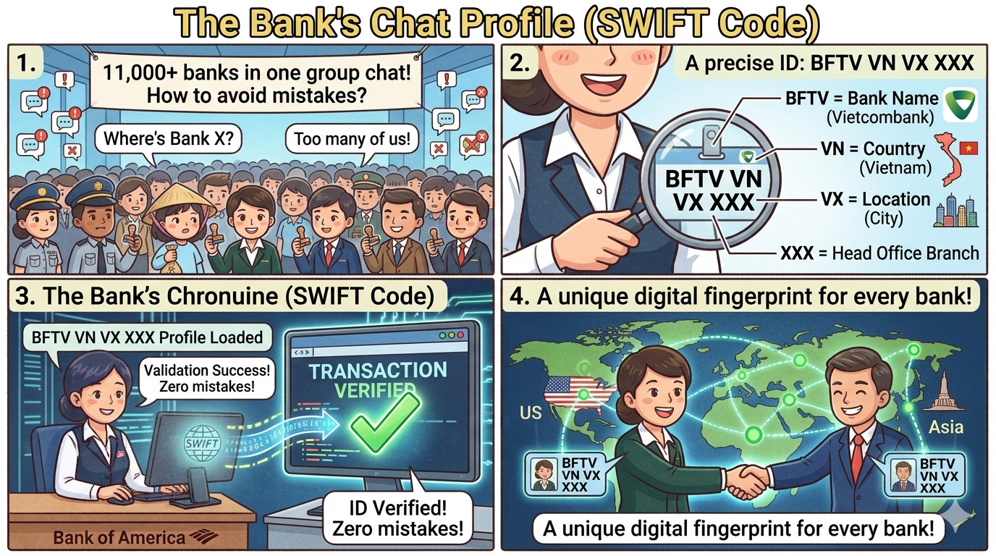
Notes:
"Nick chat" của các ngân hàng (SWIFT Code / BIC)
Để không nhắn nhầm cho ngân hàng khác trong một "Group Chat" có hơn 11.000 thành viên, mỗi ngân hàng sẽ được cấp một cái "ID tài khoản" (gọi là SWIFT Code hoặc BIC) gồm 8 đến 11 ký tự.
Cái mã này trông thì loằng ngoằng nhưng đọc cấu trúc thì rất dễ thương:
4 ký tự đầu: Tên viết tắt của ngân hàng (Ví dụ: BFTV là Vietcombank, VBAA là Agribank).
2 ký tự tiếp theo: Mã quốc gia (VN nghĩa là Việt Nam).
2 ký tự tiếp: Mã địa phương/thành phố.
3 ký tự cuối (nếu có): Mã chi nhánh (nếu là trụ sở chính thì thường viết là XXX).

Slide 5
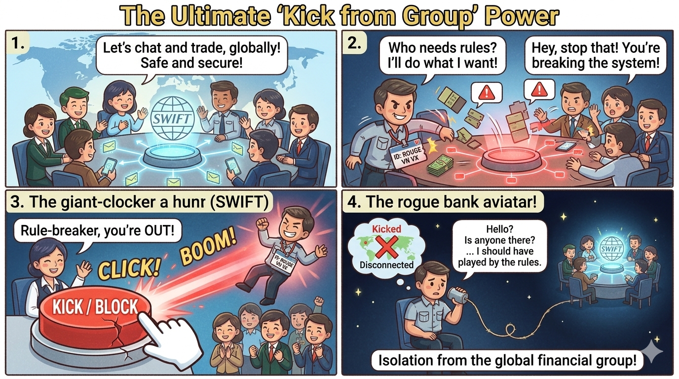
Notes:
Sức mạnh "Kích (Kick) ra khỏi nhóm"
Vì SWIFT là hệ thống kết nối gần như toàn bộ mạch máu tài chính toàn cầu, nên nếu một quốc gia hay ngân hàng nào đó "gây gổ" hoặc vi phạm luật chơi chung, các nước lớn sẽ đồng lòng "Kích (Kick) block tài khoản" của ngân hàng đó ra khỏi nhóm chat SWIFT (như trường hợp của một số ngân hàng Nga hay Iran trước đây).
Khi bị văng khỏi nhóm chat, ngân hàng đó sẽ giống như người tối cổ: Không thể nhắn tin đòi tiền, cũng không thể nhận tin nhắn chuyển tiền từ các ngân hàng quốc tế khác. Họ phải tự đi tìm hoặc tự xây các "ứng dụng chat" nội bộ khác vất vả hơn rất nhiều.

Slide 6
The big picture
Three connected systems — but they are not the same thing.
01 MESSAGING
02 SETTLEMENT
03 GEOPOLITICS
SWIFT securely carries standardized financial instructions between institutions. It does not hold customer deposits or move settlement balances.
Banks and central-bank / clearing infrastructures update account balances to complete payment. This is where money is actually settled.
Sanctions can restrict access to SWIFT and/or prohibit transactions. Reserve freezes and gold accumulation are related but distinct policy tools.
CORE THESIS
SWIFT is a critical communications layer in global finance — powerful because so much of the system depends on it, but not the system that creates or settles money.
The Russia–Ukraine war made this distinction visible: messaging access, transaction bans and immobilised reserves were deployed as separate measures.
SOURCE SWIFT — What is SWIFT?; EU Council — sanctions explained
02

Slide 7
What SWIFT is — and is not
Think of SWIFT as the secure, shared language and network used by financial institutions.
11,500+
SWIFT DOES
SWIFT DOES NOT
Transmit secure, standardized messages (e.g. payment instructions, confirmations and trade-related messages).
Hold deposits, issue currency, decide whether a payment is lawful, or itself debit/credit the banks’ settlement accounts.
members
Banks
Financial institutions
Market infrastructures
Corporates
BANK A
BANK B
A
SWIFT MESSAGE
B
Cooperative owned by members
A trusted communications rail — not a pool of money.
SOURCE SWIFT — What is SWIFT?; SWIFT oversight
03

Slide 8
The crucial distinction: message ≠ money
A SWIFT instruction coordinates payment; separate account systems perform the settlement.
COMMUNICATION
Payer bank
SWIFT
Payee bank
Creates payment instruction
Routes authenticated message
Receives / processes instruction
SETTLEMENT
Debit
Clear / settle
Credit
Payer’s bank balance
Correspondent or payment system
Payee’s bank balance
The message tells institutions what to do; ledger entries and settlement balances make the payment final.
SOURCE Richmond Fed — What Is SWIFT?; BIS Annual Economic Report 2025
04

Slide 9
How a cross-border USD payment works
Illustrative correspondent-banking route: USD 100 from a customer in Country A to a beneficiary in Country B.
1
2
3
4
5
PAYER
BANK A
US CORRESPONDENT
CLEARING
BANK B
Customer A
Debits payer
Nostro / vostro
CHIPS / Fedwire
Credits beneficiary
SWIFT messages coordinate the instructions, references, routing and confirmations between banks.
USD settlement occurs through account balances — ultimately in central-bank money for final settlement.
No truck, wire or token of USD needs to cross the border. Intermediaries update accounts in sequence.
SOURCE BIS Annual Economic Report 2025; Richmond Fed
05

Slide 10
What “clearing” and “settlement” actually mean
A simplified mental model for the financial plumbing behind a payment.
CLEARING
SETTLEMENT
CORRESPONDENT BANKING
Validate, match, route and calculate obligations. A clearing system may offset many payments so participants settle only their net positions.
The final discharge of obligations by transferring balances between accounts — often commercial-bank reserves at a central bank.
A bank holds an account with another bank in a currency / market where it does not have direct access. These are often called nostro / vostro accounts.
ANALOGY
SWIFT is the secure instruction and tracking channel. Clearing is the reconciliation of who owes what. Settlement is the final account update that discharges the debt.
For USD: CHIPS clears and nets eligible payments; Fedwire is used for final settlement of net positions in Federal Reserve balances.
SOURCE BIS Annual Economic Report 2025; Federal Reserve / Richmond Fed
06

Slide 11
SWIFT’s infrastructure: resilient, distributed, regulated
Three Operating Centres across two messaging zones — not one central server in one country.
EUROPEAN MESSAGING ZONE
TRANS-ATLANTIC MESSAGING ZONE
NETHERLANDS
SWITZERLAND
UNITED STATES
Operating Centre
Operating Centre
Operating Centre
EEA / UK / Switzerland customers are assigned here by default; intra-zone messages stay in this zone.
US customers are assigned here by default; inter-zone messages are processed in both zones.
Important nuance: Switzerland participates in both zones. Cross-zone message data may be stored across all three centres. Redundancy supports continuity; it does not make SWIFT legally “American” or “Dutch”.
SOURCE SWIFT FAQ — Operating Centres and Distributed Architecture
07

Slide 12
Why Belgium and EU law matter
SWIFT is a Belgian cooperative — and the EU can legally prohibit it from providing services to designated institutions.
SWIFT
EU COUNCIL / LEGISLATOR
Headquarters:
La Hulpe, Belgium
SANCTIONS REGULATION
Belgian cooperative law
+ applicable EU law
SWIFT must stop providing the prohibited messaging service
Oversight is separate: the National Bank of Belgium is lead overseer, working with G10 central banks on resilience, security and systemic risk.
SOURCE SWIFT oversight; SWIFT governance; EU Council
08

Slide 13
Russia–Ukraine: how SWIFT became a sanctions instrument
The invasion did not “switch off Russia”; the EU targeted named banks and expanded restrictions over time.
24 FEB 2022
2 MAR 2022
12 MAR 2022
2024–2025
Full-scale invasion
of Ukraine
EU announces first
SWIFT exclusions
Initial exclusion
enters into force
Further restrictions;
transaction bans expand
Initial EU list (2022): Otkritie, Novikombank, Promsvyazbank, Rossiya Bank, Sovcombank, VEB and VTB.
Sanctions were targeted, legally defined and coordinated with partners — not a universal ban on every Russian bank or every Russian payment.
SOURCE EU Council, 2 Mar 2022; EU sanctions Q&A
09

Slide 14
Three sanctions levers — do not conflate them
SWIFT exclusion, transaction prohibitions and immobilised reserves have different legal and operational effects.
1 SWIFT EXCLUSION
2 TRANSACTION BAN
3 RESERVE IMMOBILISATION
A bank loses access to SWIFT messaging services. It becomes harder, slower and costlier to communicate payment instructions globally.
It does not automatically erase balances or make all alternative channels impossible.
A legal prohibition on dealing with listed entities. Even if a bank can send messages through another channel, counterparties may still be legally barred from transacting.
Assets of the Central Bank of Russia held under EU / partner jurisdiction were immobilized. This restricts access to assets; it is not a SWIFT network outage.
Key lesson: SWIFT access is one chokepoint. Legal restrictions on counterparties and control over reserve assets can be more consequential than messaging access alone.
SOURCE European Commission, 2 Mar 2022; EU Council sanctions Q&A
10

Slide 15
Can a country operate without SWIFT?
Yes — but alternative messaging does not automatically recreate trust, reach, liquidity or legal access.
SPFS — RUSSIA
CIPS — CHINA
BILATERAL / PROPRIETARY
Domestic financial messaging system developed by the Bank of Russia; designed to reduce reliance on SWIFT.
Cross-border interbank payment system for RMB clearing and settlement; can support RMB internationalisation.
Direct bank links, regional arrangements and other messaging rails can route some flows — subject to counterparties and compliance.
A substitute must solve more than messaging: network coverage, currency convertibility, correspondent relationships, liquidity, compliance acceptance and confidence in final settlement.
The EU has also restricted EU entities’ connections to Russia’s SPFS since June 2024.
SOURCE EU Council — sanctions against Russia, updated Q&A
11

Slide 16
Central banks and gold: the post-2022 pattern
Official-sector net buying accelerated after 2022 — but the trend began in 2010, before the invasion.
1,136 t
1,037 t
1,045 t
2022
2023
2024
Record annual net buying
Turkey +148t; China +62t reported
Second consecutive year above 1,000t
China +225t; Poland +130t
Third consecutive year above 1,000t
Poland +90t; China +44t
Context: central banks have been net buyers every year since 2010. Geopolitical risk and inflation are among the factors cited by the World Gold Council.
Gold is not a payment network; it is a reserve asset that can be held domestically and carries no foreign issuer’s credit risk.
SOURCE World Gold Council — Full-year reports 2022, 2023, 2024
12

Slide 17
Who bought — and who sold? Selected country signals
Annual reported net changes in official gold holdings; tonnes. Positive = buyer, negative = seller.
Turkey
+148
China
+62
Egypt
+47
Qatar
+35
India
+33
Kazakhstan
-51
Country activity is not uniform: some central banks buy to build strategic buffers, while others sell domestically mined gold or adjust reserves tactically.
SOURCE World Gold Council — Full-year 2022 report
13

Slide 18
2025 update: buying remained resilient, but moderated
2025 LEAD BUYER
863 t
Latest full-year data available in this briefing (published 29 January 2026).
Poland +102t
CENTRAL BANK NET GOLD DEMAND (TONNES)
1,136 t
Kazakhstan +57t
Brazil +43t
1,037 t
1,045 t
2022
2023
2024
2025
Notable sellers: Singapore −15t; Russia −6t. WGC estimates that unreported buying represented 57% of the 2025 annual total — country-level disclosures are incomplete.
SOURCE World Gold Council — Q4 & Full-year 2025, 29 Jan 2026
14

Slide 19
Why gold? The link to sanctions is indirect — but meaningful
Gold can reduce some forms of external exposure; it does not replace the global payments system.
GEOPOLITICAL
RISK
RESERVE
DIVERSIFICATION
DOMESTICALLY
HELD GOLD
LOWER ISSUER /
CUSTODY RISK
STRATEGIC
OPTIONALITY
IMF finding: sanctions have historically induced a modest shift away from at-risk currencies toward gold that can be warehoused domestically.
But gold is not frictionless: it has storage, transport, liquidity, valuation and operational constraints — and does not itself settle ordinary invoices.
Correlation is not proof: the post-2022 gold surge has multiple drivers, including inflation concerns, portfolio diversification and geopolitical uncertainty.
SOURCE IMF — Dollar Dominance update, 11 Jun 2024; WGC
15

Slide 20
Takeaways & references
Five points to carry into the discussion.
• SWIFT is a secure financial messaging network — not a bank, currency or settlement system.
• Cross-border money movement is mainly a chain of account updates across correspondent banks and payment systems.
• Belgian incorporation and EU law give EU sanctions a direct legal path to restrict SWIFT services.
• Russia-related sanctions combined SWIFT exclusions with transaction prohibitions and immobilised reserves.
• Central-bank gold buying signals diversification and risk management — not a one-to-one proxy for de-dollarisation or SWIFT avoidance.
KEY REFERENCES
↗ SWIFT — What is SWIFT?
↗ SWIFT — Oversight
↗ SWIFT — Operating Centres FAQ
↗ EU Council — Russia sanctions Q&A
↗ EU Council — 2 Mar 2022 SWIFT ban
↗ BIS — Annual Economic Report 2025
↗ Richmond Fed — What Is SWIFT?
↗ IMF — Dollar dominance update
↗ WGC — Gold trends 2022–2025
16

