Slide 1
DIPLOMA PROJECT
STAR WARS API APPLICATION (VARIANT 8)
Student: Denis Ziulikov
Cloud&DevOps Internship
Stream 24
2022

Slide 2
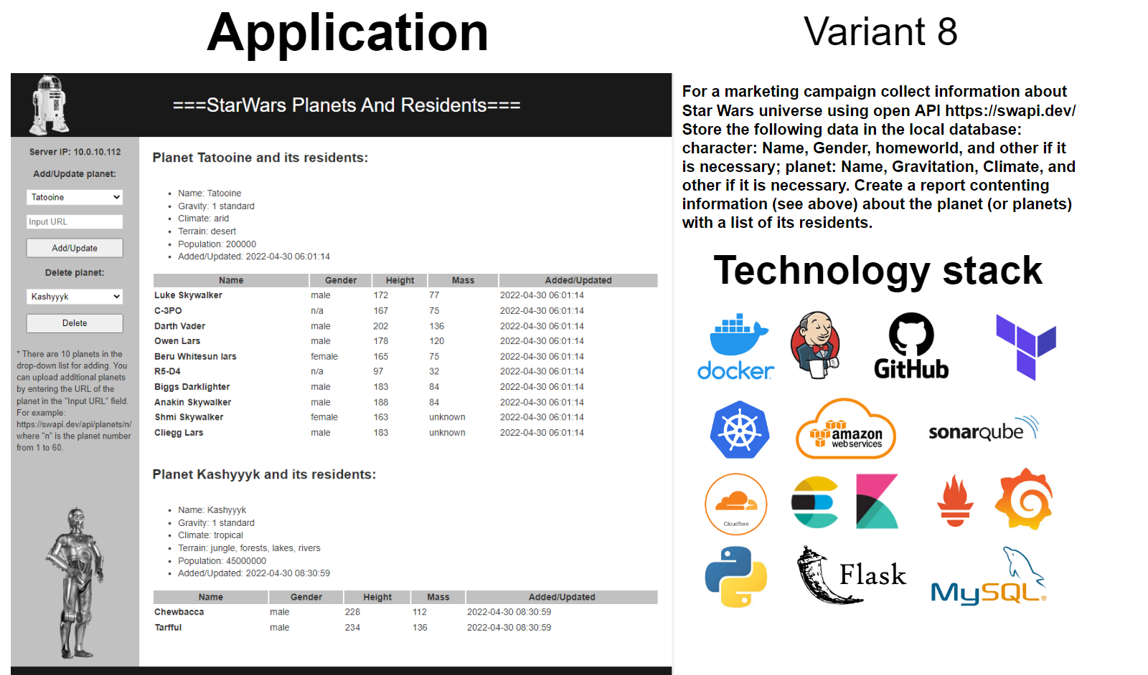

Slide 3
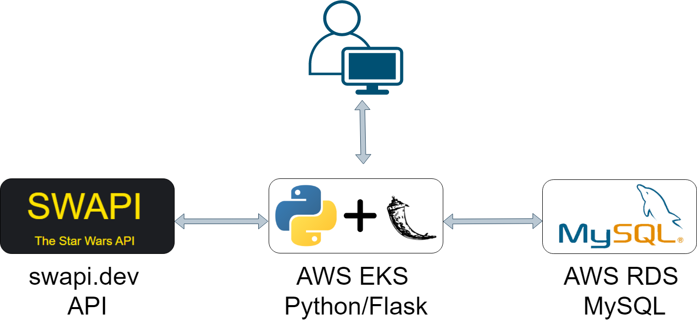
App architecture

Slide 4
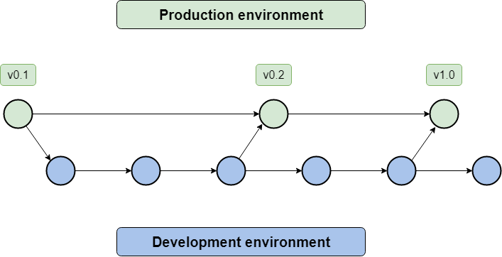
Branching strategy
https://github.com/dobarden/epam24-diploma

Slide 5
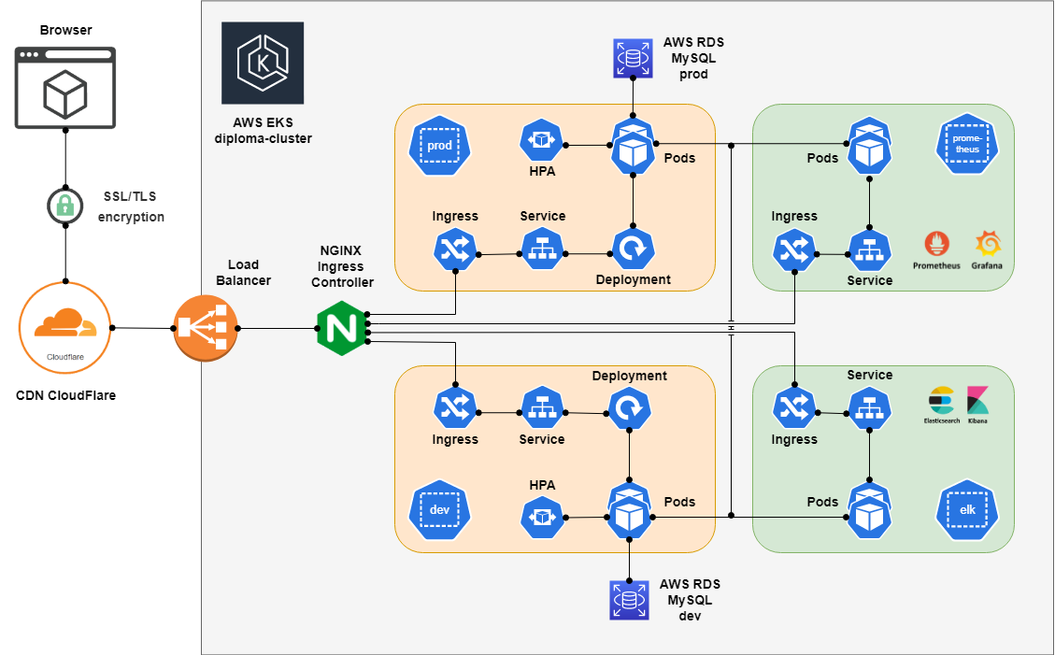
Infrastructure diagram

Slide 6
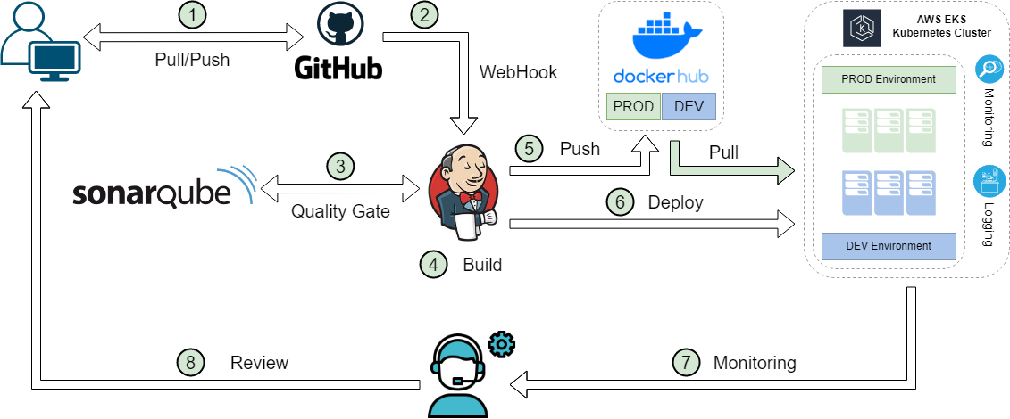
CI/CD diagram

Slide 7
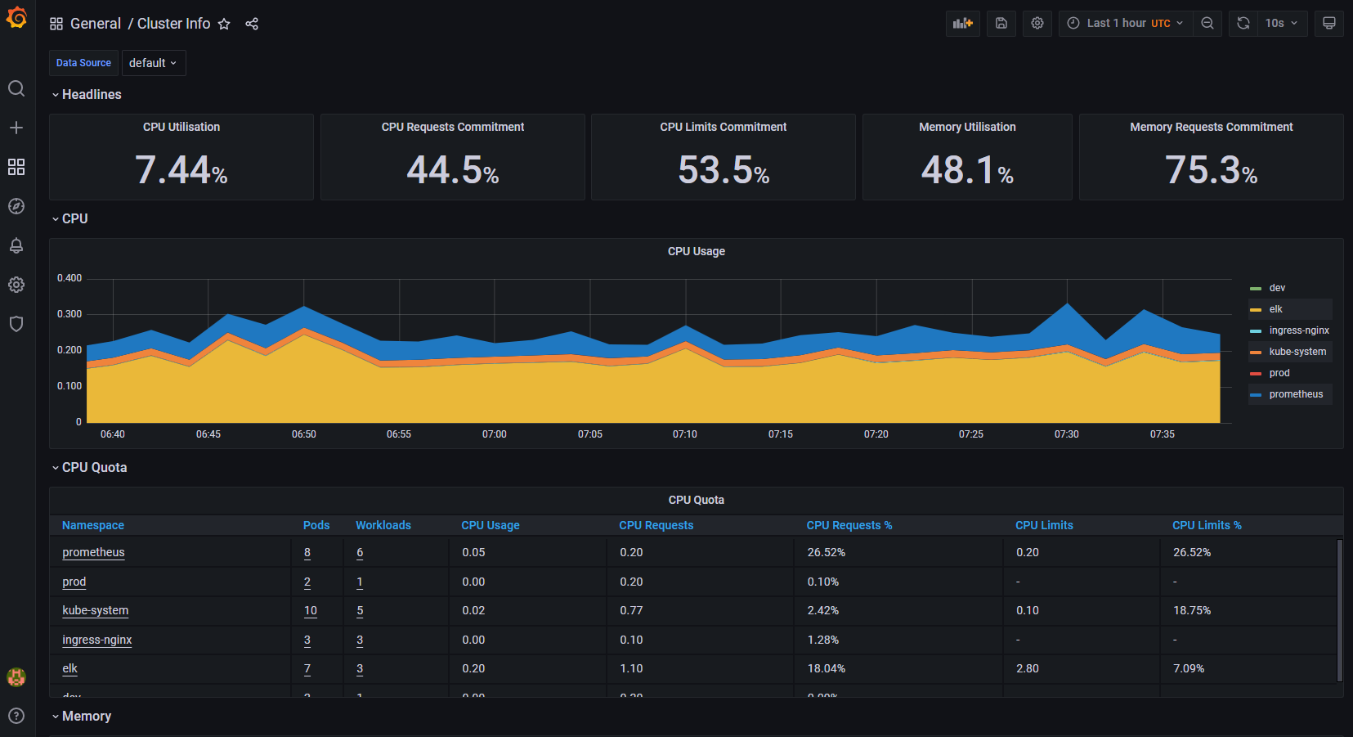
Monitoring

Slide 8
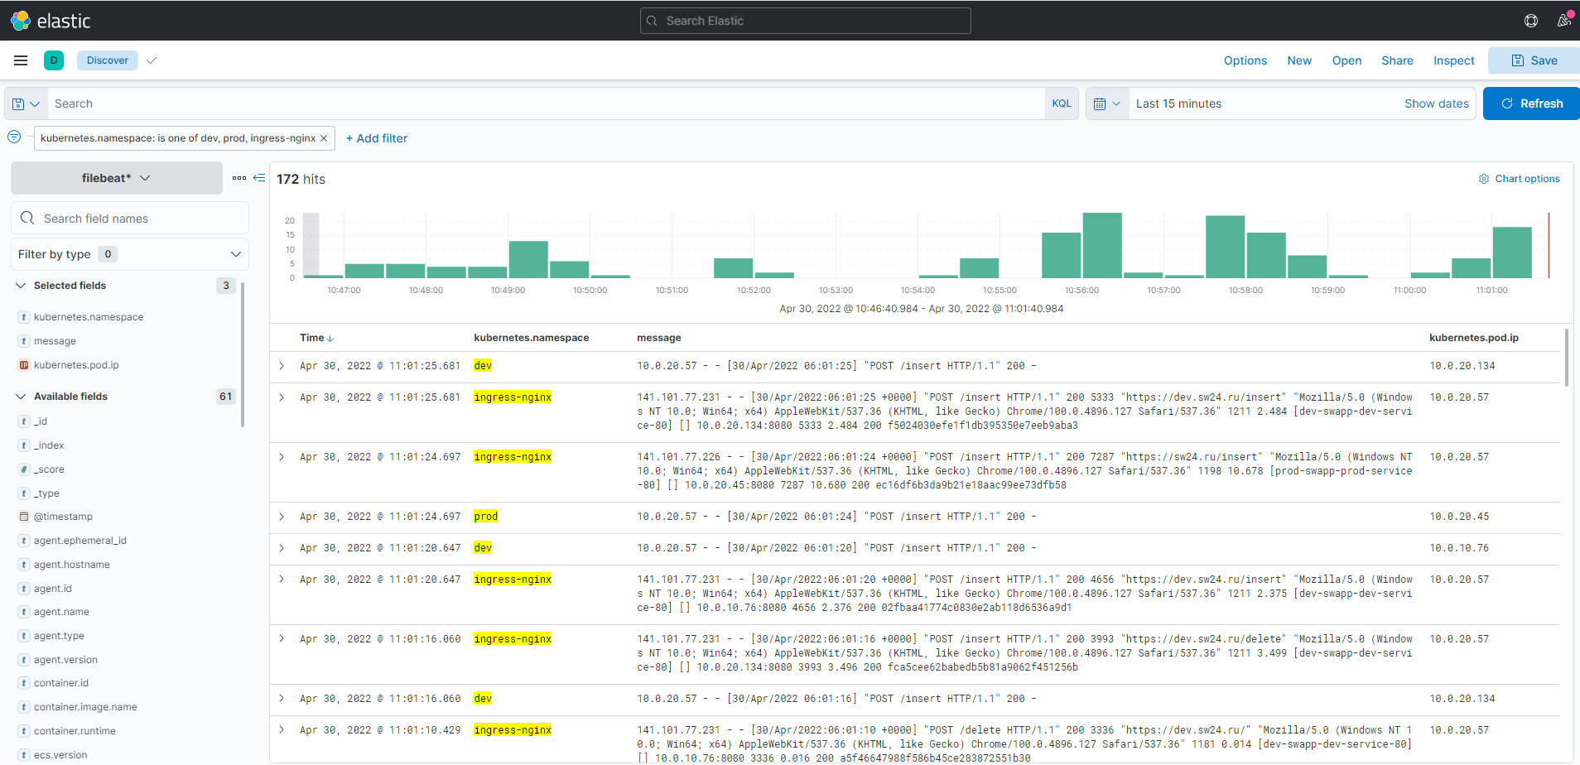
Logging

Slide 9
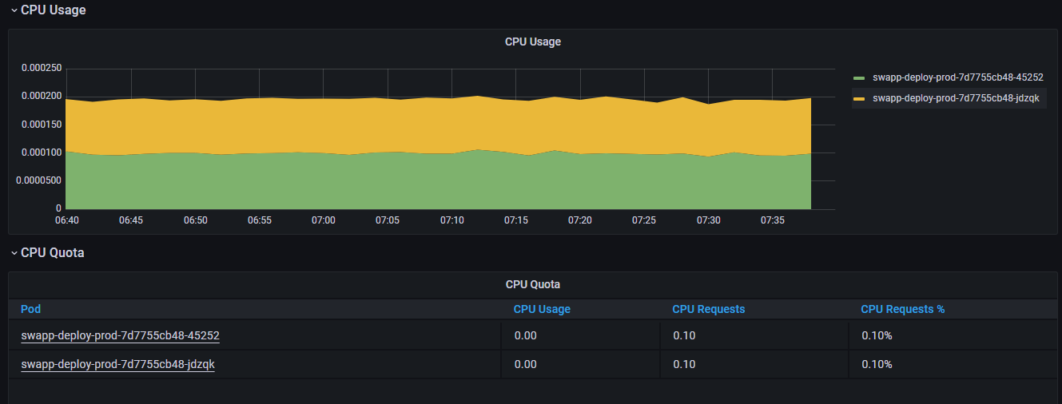
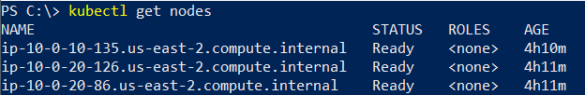
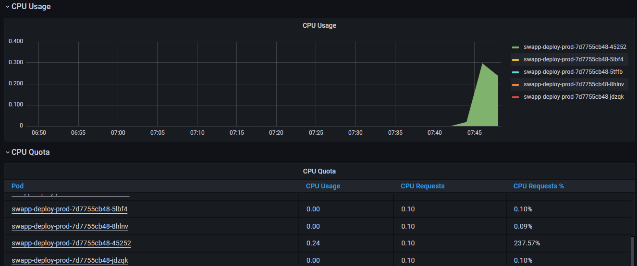
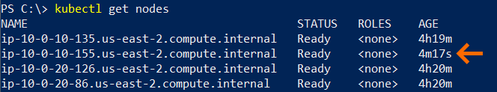
Scalability
Load OFF
Load ON

Slide 10
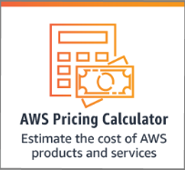
Cloud and Cost efficiency
Service | Count | Monthly cost | Total 12 months cost | Region | Currency
Amazon EKS | 1 | 73 | 876 | US East (Ohio) | USD
EC2 instances (t3.medium) | 4 | 79,4 | 952,8 | US East (Ohio) | USD
Network Load Balancer | 1 | 16,43 | 197,16 | US East (Ohio) | USD
Amazon RDS for MySQL (db.t2.micro) | 2 | 63,44 | 761,28 | US East (Ohio) | USD
Elastic File System (EFS 1 GB) | 1 | 0,3 | 3,6 | US East (Ohio) | USD
 |  | 232,57 | 2790,84 | US East (Ohio) | USD
https://calculator.aws/

Slide 11
Q&A
Student: Denis Ziulikov
Cloud&DevOps Internship
Stream 24
2022

