Slide 1
CTA Simulation
Dhruv Dobariya
Daniel Kwan
CSC 521

Slide 2
Agenda
Introduction
Primary Goals
Overview
Code Description
Distributions
Summary
Citations

Slide 3
Introduction
Most of us who are based in Chicago have taken CTA Train either to work or class. There has been steep decrease in frequency of CTA trains after Covid. We are creating a simulation to calculate the number of trains needed based on various parameters.

Slide 4
Primary Goals
Simulation train capacity based on average ridership in order to determine how many trains to run

Slide 5
Overview
Domain knowledge, as in every Monte Carlo simulator, plays a key role in this project.
The Chicago Transit Authority (CTA) handles public transportation in Chicago.
The CTA runs daily trains; only the Red and Blue line operate for the full 24 hours.
There are several other routes such as Brown, Pink, Green, Yellow, Purple and Orange.
We are simulating the Blue Line which runs from O'Hare Airport to Forest Park. It has 33 stations in total which includes stations in Downtown Chicago.
The Blue Line has 200 trains run each direction each day.
A single Blue Line train has 8 coaches in total with a peak coach capacity of 80, for a total of 640 possible passengers per train.
The CTA publishes daily ridership data going back to 2001. We used this data to inform our ridership distributions.

Slide 6
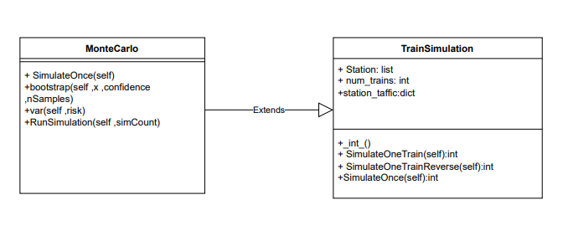
Code description and UML Diagram
Based on a given number of trains and a monthly ridership, our simulation tells us the number of passengers on each train at each station.
The subclass TrainSimulation represents a simulation of Blue Line of Chicago. The constructor of class takes 2 arguments which are Stations and num_trains. The stations variable is a tuple with 3 values: Station name, Average ridership and Standard deviation of daily riders.
The SimulateOneTrain method in TrainSimulation simulates ridership of one train by generating riders based on parameters like destination which are based on mean and standard deviation of daily riders. This method simulates from O'Hare to Forest Park. It uses num_trains to distribute number of riders at each station for 1 train. It also updates the ridership at each station and returns the number of riders who were unable to get on a train.
Notes:
Here is an overview of how our code works. You can read it in depth, but essentially we start by generating passengers in each station based on our distribution data. Then we iterate through the stations and have these riders board the train, allocating passenger destinations based on the remaining stations in the line. We also check if the train is full and return excess passengers to the platform.

Slide 7
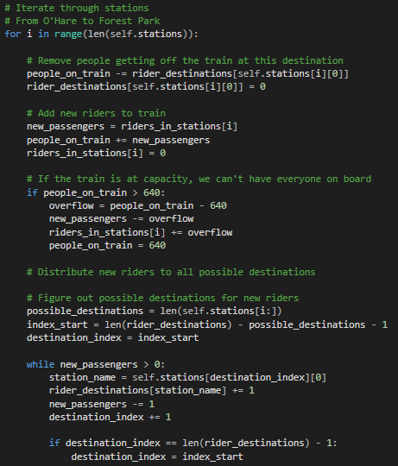
The SimulateOneTrainReverse method does the same task as SimulateOneTrain but it does from Forest Park to O'Hare.
The SimulateOnce method calls both SimulateOneTrain and SimulateOneTrainReverse, and returns the number of riders unable to board the train. It is implemented by the TrainSimulation class which is extension of the MonteCarlo class.
The RunSimulation method runs the simulation for a specific number of times, and it stores the result in an array. It also returns mean and confidence interval.
The daily ridership for each station which uses normal distribution with mean and standard deviation given in the stations array.
Notes:
We have one function for each direction of the Blue Line, and both return the total number of passengers unable to board the train. SimulateOnce calls each direction and combines the total. RunSimulation then calculates that average, since we've extended it all from the Monte Carlo class.

Slide 8
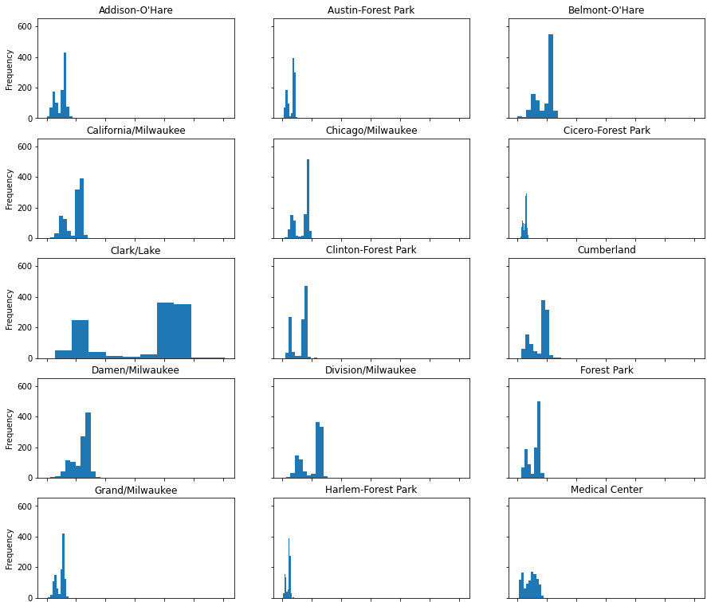
Distributions
Sample distributions from
Blue Line stations
Notes:
For our distributions, we created histograms for each station in the Blue Line. You can see from the overall view the typical bimodal peak. These peaks represent weekday commutes versus weekend general travel.

Slide 9
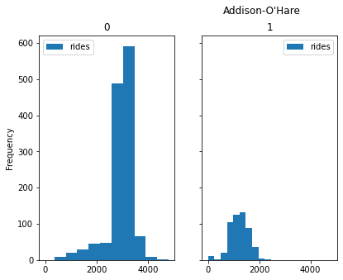
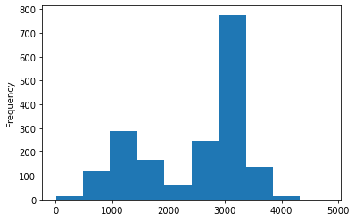
Distributions
Addison Station
Notes:
You can see this discrepancy in individual station histograms. On the left is the overall histogram; while on the right are two histograms broken out by weekday versus weekend.

Slide 10
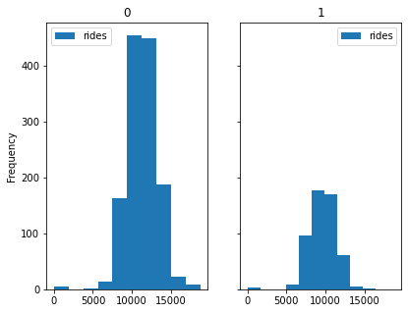
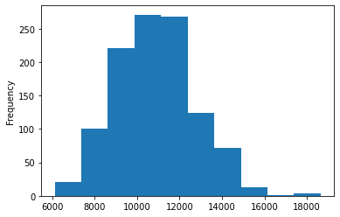
Distributions
O'Hare Airport
Notes:
Every station has this two-peak distribution except for one: O'Hare airport, which is much more of a normal distribution.

Slide 11
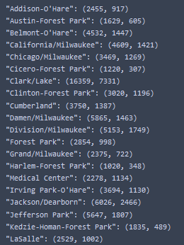
DISTRIBUTIONS
Initial simulation only uses means and standard deviations and does not account for two peaks.
Notes:
However, our initial simulation uses means and standard deviations calculated from the aggregated weekday and weekend data.

Slide 12
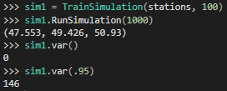





Results
100 Trains
150 Trains
200 Trains (Actual Schedule)
125 Trains
110 Trains
115 Trains
Notes:
In our simulation results, we discovered that the true number of trains is significantly higher than necessary to ensure every passenger can board when they want to. Even cutting service by 25% did not leave any passengers behind in 95% of all cases. After we determined that 200 trains was sufficient, we found that the breakeven point is between 110 and 115 trains per day. Of course fewer trains also means higher levels of passenger discomfort, since at these levels of service each train is likely to be quite full.

Slide 13
Next Steps
We will create additional parameters like Weather and Big Events to see how they might affect the number of trains required.
We can also calculate approximate commuter traffic by looking at the difference between weekend and weekday distributions. Then we can re-run the simulation to determine the number of trains required during heavy commuting hours.
Notes:
As we move toward the final report, our next steps are to include additional parameters that might affect passenger levels, such as weather and large local events like sports games. We also hope to use our simulation to help predict peak demand. We can do this by adjusting the distributions we input into the simulator from full-day averages to commuter hour numbers—determined by subtracting weekend traffic from weekday traffic. This is a level of forecasting beyond the original data.

Slide 14
THANK YOU

Slide 15
Citations
https://www.transitchicago.com/assets/1/6/Monthly_Ridership_2022-10(Final).pdf
https://data.cityofchicago.org/Transportation/CTA-Ridership-L-Station-Entries-Daily-Totals/5neh-572f
https://en.wikipedia.org/wiki/Chicago_Transit_Authority
https://en.wikipedia.org/wiki/Blue_Line_(CTA)
https://www.transitchicago.com/
https://numpy.org/

