Slide 1
Exploiting and Defense
Dobin Rutishauser
2016, 2017, 2018

Slide 2
Intro
Notes:
Who knew about this module?

Slide 3
About Me
Dobin Rutishauser
Working as Security Analyst @ Compass Security
Penetration Tests
Webapp Checks
Architecture Reviews
& lots more
Interested in Hacking Security since a young age (1998+)

Slide 4
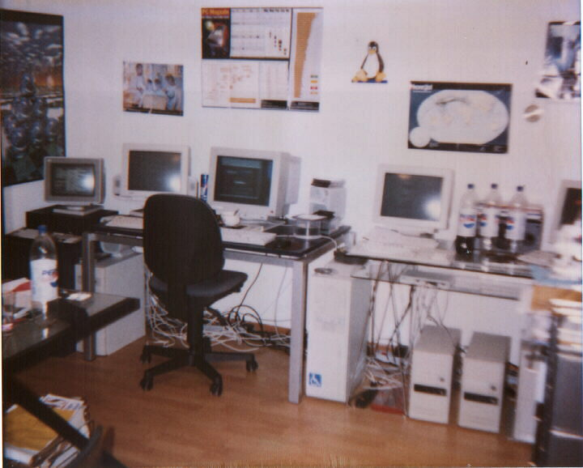
I got a bit overboard when I was little

Slide 5
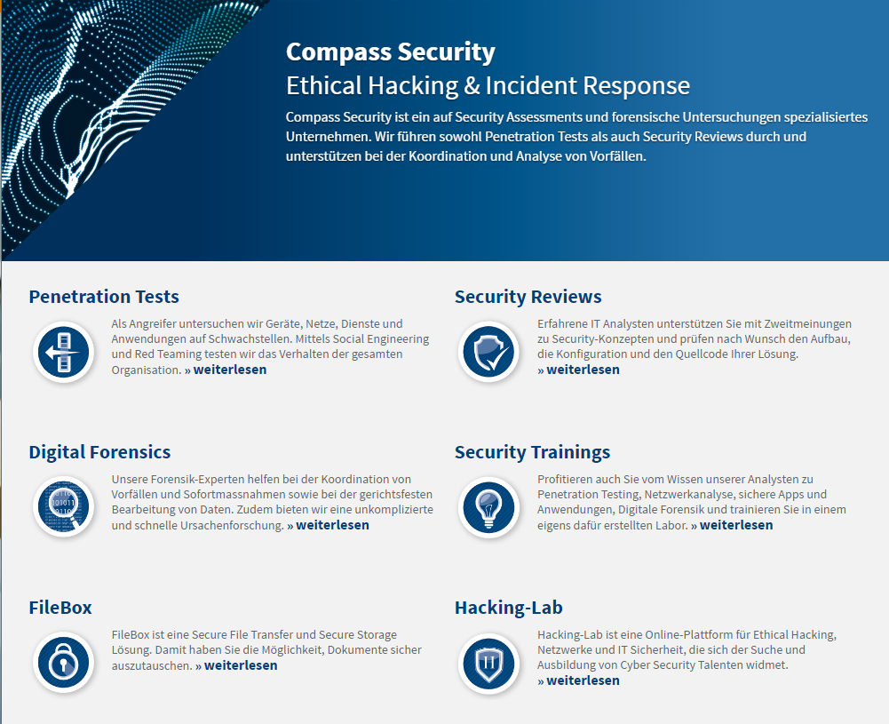
Compass

Slide 6
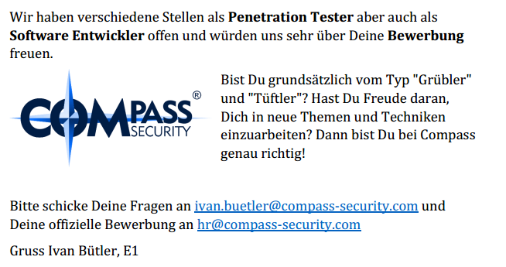
Compass is hiring (always)

Slide 7
Content

Slide 8
Content
Exploit & Defense
We will write exploits to exploit buffer-overflows
We will analyze what defenses exist to make writing exploits harder

Slide 9
Lecture

Slide 10
Lecture
Website:
https://exploit.courses
Online exploit development website
Access to your own Linux via JavaScript terminal
Uses Hacking-Lab accounts
Solve challenges online
Write exploits
Debug stuff
https://www.hacking-lab.com
Half-online challenges website
Uses HLCD (Kali-based Linux Distribution)
VPN-Based
Use this if you don’t like exploit.courses

Slide 11
Lecture
Slack (optional)
Chat++
https://bfhed2017.slack.com/shared_invite/MTQzNzkxODMyOTE2LTE0ODc1ODEyMzMtYTJmNDUzZmNmNQ
Und Quizlet (optional):
Quizes
https://quizlet.com/join/AnKsUcWHC

Slide 12

Lecture
Siiiiii abr ähhhhh
EBP isch doch 32 bit?
Notes:
Fragen erwünscht
Aufstrecken / schnippen / Reinreden
Interkation (wie kurs)

Slide 13
Motivation
Motivation for Exploiting & Defense

Slide 14
Motivation
For the hacker:
Develop exploits
Debugging of C/C++ code
Disassembly & reversing of assembler code
Being 31337
For the Sysadmin
Judge security level of operating systems, and applications
Harden and protect servers, clients
For the CISO:
Assess CVSS scores
Assess (new) security mitigations
Better risk analysis
Notes:
Ask people what they want

Slide 15
Motivation
For everyone:
How do functions work?
How does the memory allocator work?
What’s the difference between userspace and kernelspace?
How does computer work?!
Notes:
Ask people what they want

Slide 16

Content
Looking behind the curtain

Slide 17
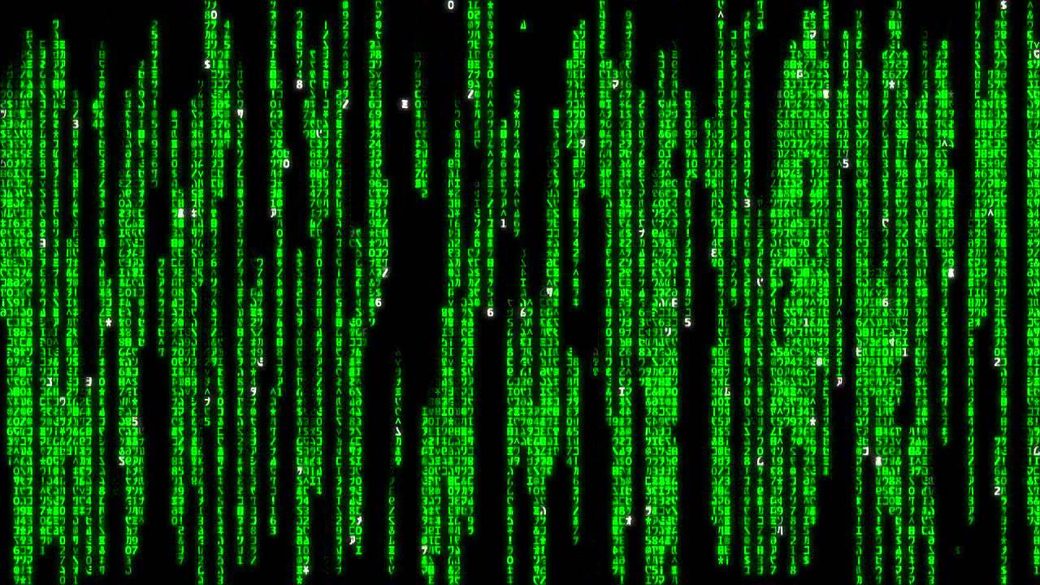
Motivation

Slide 18
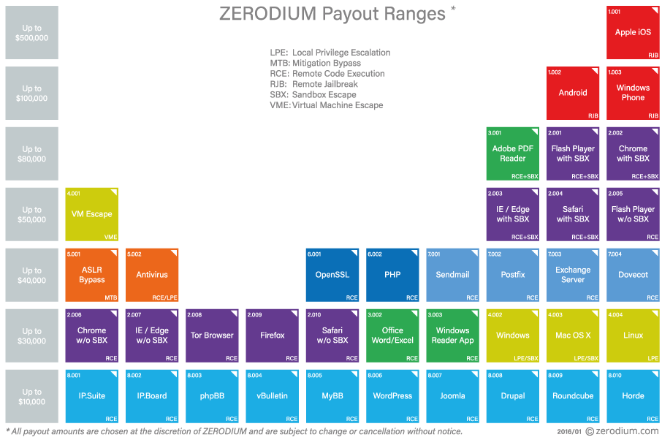
Motivation

Slide 19
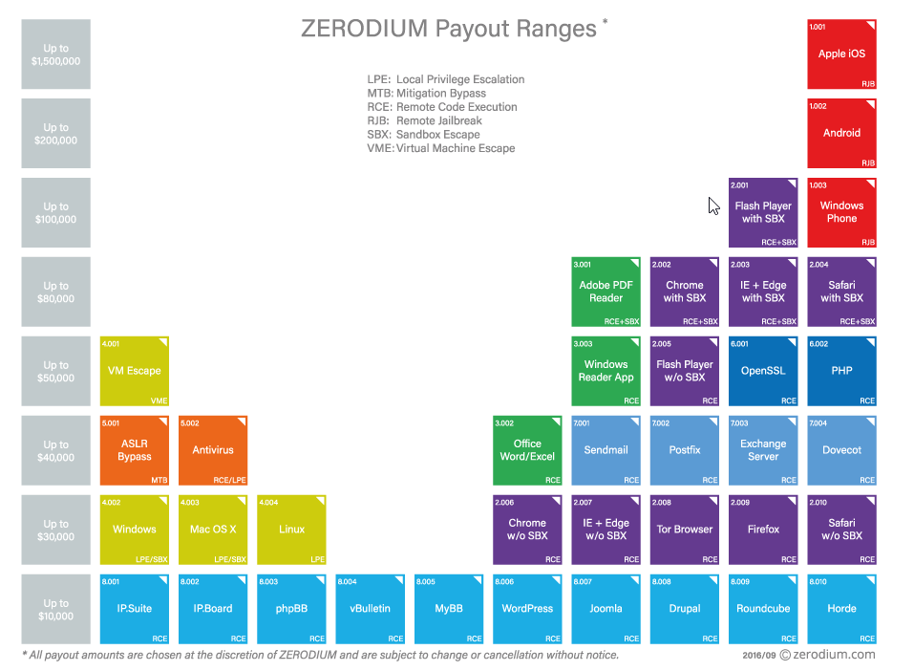
Motivation

Slide 20
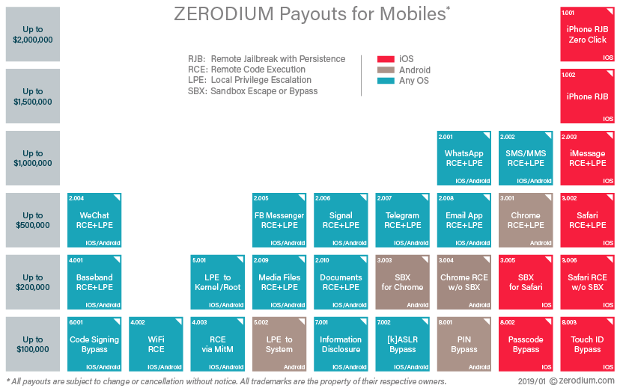

Slide 21
Content of the next 8 Friday afternoons

Slide 22
Content
You want to learn:
What memory corruptions are
What buffer overflows are
What exploits are
How exploits are being created
To exploit a local application
To exploit a remote application
Learn about anti-exploiting technologies
To circumvent all common anti-exploiting technologies for Linux
See how Windows does it
Use Use-After-Free
Hack browsers
Hack facebook “for a friend”

Slide 23
Content
You will actually learn:
Intel x86
Architecture
CPU
Registers
Linux
Userspace memory layout, stacks, heap
Syscalls
Sockets
Networking
Programming Languages
Assembler
C
Python
Bash

Slide 24
Plan

Slide 25
Plan
29.03.2019
Theory:
0x01 Intro (this)
0x02 Intro Technical
0x10 Intel Architecture
0x11 Memory Layout
Challenges:
0: Introduction to memory layout - basic
1: Introduction to memory layout - advanced

Slide 26
Plan
05.04.2019
Theory:
0x12 C Array and Data Structures
0x30 Assembler Intro
0x31 Shellcode
0x32 Function Call Convention
0x33 Debugging
Challenges:
2: C buffer analysis - simple
3: Introduction to shellcode development
7: Function Call Convention in x86 (32bit)
8: C buffer analysis - with debugging
9: Simple Buffer overflow - variable overwrite

Slide 27
Plan
12.04.2019
Theory:
0x41 Buffer Overflow
0x42 Exploit
0x44 Remote Exploit
Challenges:
11: Development of a buffer overflow exploit - 32 bit
12: Development of a buffer overflow exploit - 64 bit
13: Development of a remote buffer overflow exploit - 64 bit

Slide 28
Plan
26.04.2019
Theory:
0x51 Exploit Mitigation
0x52 Defeat Exploit Mitigation
0x53 Exploit Mitigation – PIE
0x54 Defeat Exploit Mitigation ROP
Challenges:
14: Stack canary brute force
15: Simple remote buffer overflow exploit - ASLR/DEP/64bit
16: Remote buffer overflow with ROP - DEP/64bit
17: Remote buffer overflow with ROP - DEP/ASLR/64bit

Slide 29
Plan
03.05.2019
Theory:
0x55: Defeat Exploit Mitigation – Heap Intro
0x56: Defeat Exploit Mitigation – Heap Attacks
Challenges:
31: Heap use-after-free analysis

Slide 30
Plan
10.05.2019
Theory:
0x60: Windows Exploiting
0x70: Secure Coding
0x71: Fuzzing
Challenges:
60: Linux Hardening

Slide 31
Plan
17.05.2017
Theory:
0x72: Linux Hardening
0x73: Kernel Exploitation
0x74: Hardware Hacking

Slide 32
Plan
24.05.2017
Theory:
Puffer
Case Studies
Questions

Slide 33
Content
Intel Architecture
Buffer Overflow
Memory Layout
C Arrays
BoF Exploit
Assembler
Remote Exploit
Shellcode
Exploit Mitigations
Function Calls
Defeat Exploit Mitigations
Debugging

Slide 34
ASCII Armor
Arbitrary Write
Overflow Local Vars
Stack Canary
Heap Overflows
Brute Force
Exploit
Mitigations
Partial RIP Overwrite
ASLR
NOP Slide
PIE
Info Disclosure
DEP
Ret 2 PLT
ROP

Slide 35
And:
Windows Exploiting
Secure Coding
Fuzzing
Linux Hardening
Browser Security
Case Studies
Kernel Exploits

Slide 36
Exam Oral
What is (mainly) relevant for the oral exam?
How does memory corruption work?
How does an exploit work?
What exploit mitigations exist?
How can these exploit mitigations be circumvented?
More theoretical, not so much the nitty gritty details
Typical question:
Explain me how a buffer overflow exploit works
Now we introduce ASLR. What do you need to change?

Slide 37
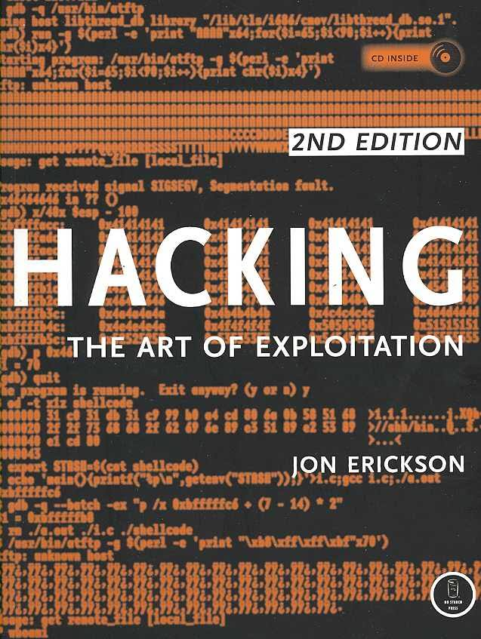
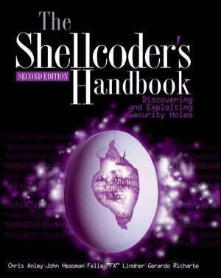
Books

Slide 38
Legal Issue

Slide 39
Legal CH
Don’t hack other people’s systems
«Damit der Tatbestand des strafbaren Hackens erfüllt ist, müssen folgende Voraussetzungen kumulativ erfüllt sein:
Eindringen in das Datenverarbeitungssystem;
fremdes Datenverarbeitungssystem;
Eindringen auf dem Weg der von Datenübertragungseinrichtungen;
besondere Sicherung gegen Zugriff.
https://www.lexwiki.ch/hacken/

Slide 40

Legal International
Wassenaar
Arms Control Treaty
Anti-proliferation of Nukes and stuff
Includes now (?):
Intrusion malware
Intrusion exploits
IP surveillance
-> Exploits are now weapons…
Not allowed to transport over the border
Exception: If they are open source
(stop selling 0-days to Chinese gov!)
http://blog.erratasec.com/2015/05/some-notes-about-wassenaar.html

