Slide 1
Yookiterm – http://exploit.courses

Slide 2
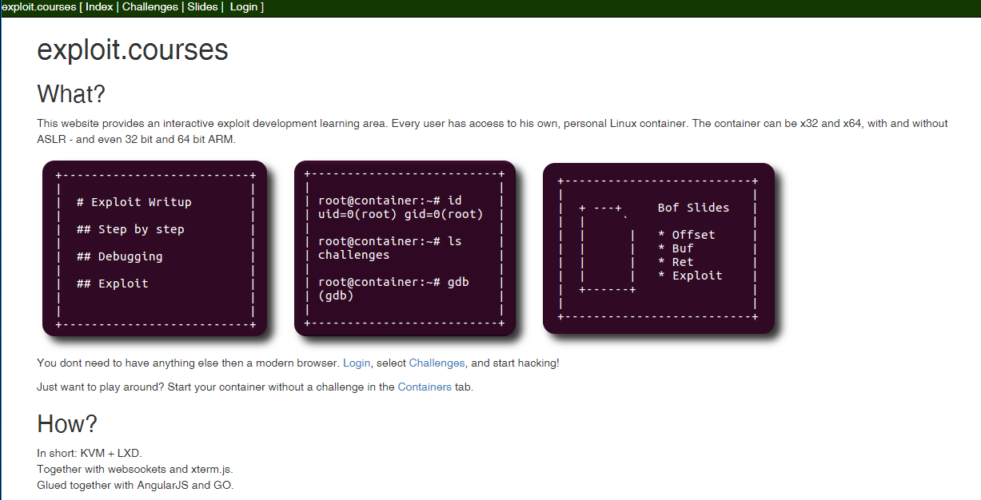
Yookiterm: Exploit.courses

Slide 3
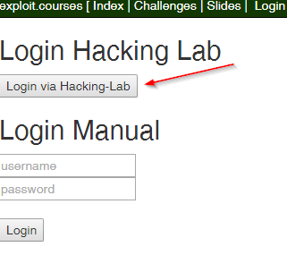
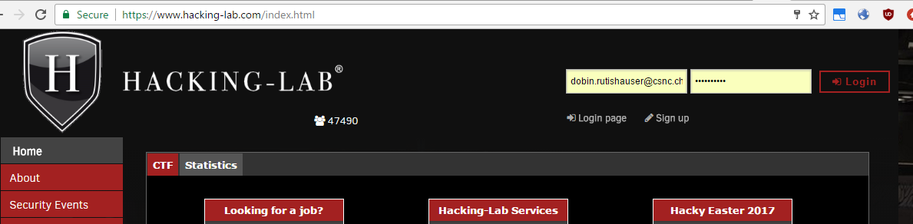
Yookiterm: Exploit.courses

Slide 4
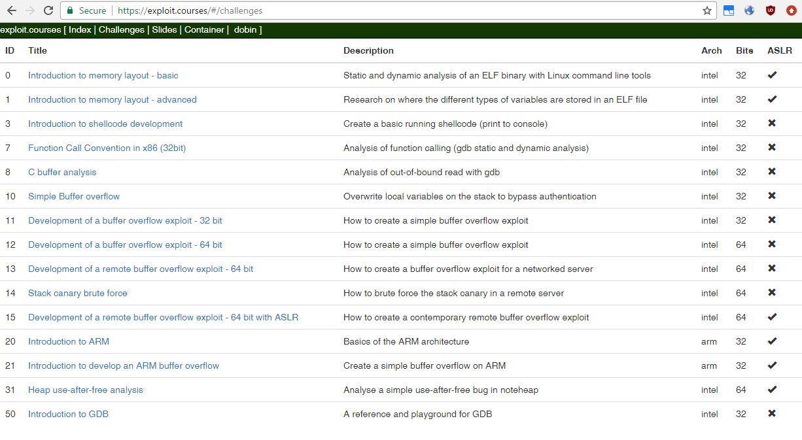
exploit.courses: Challenges

Slide 5
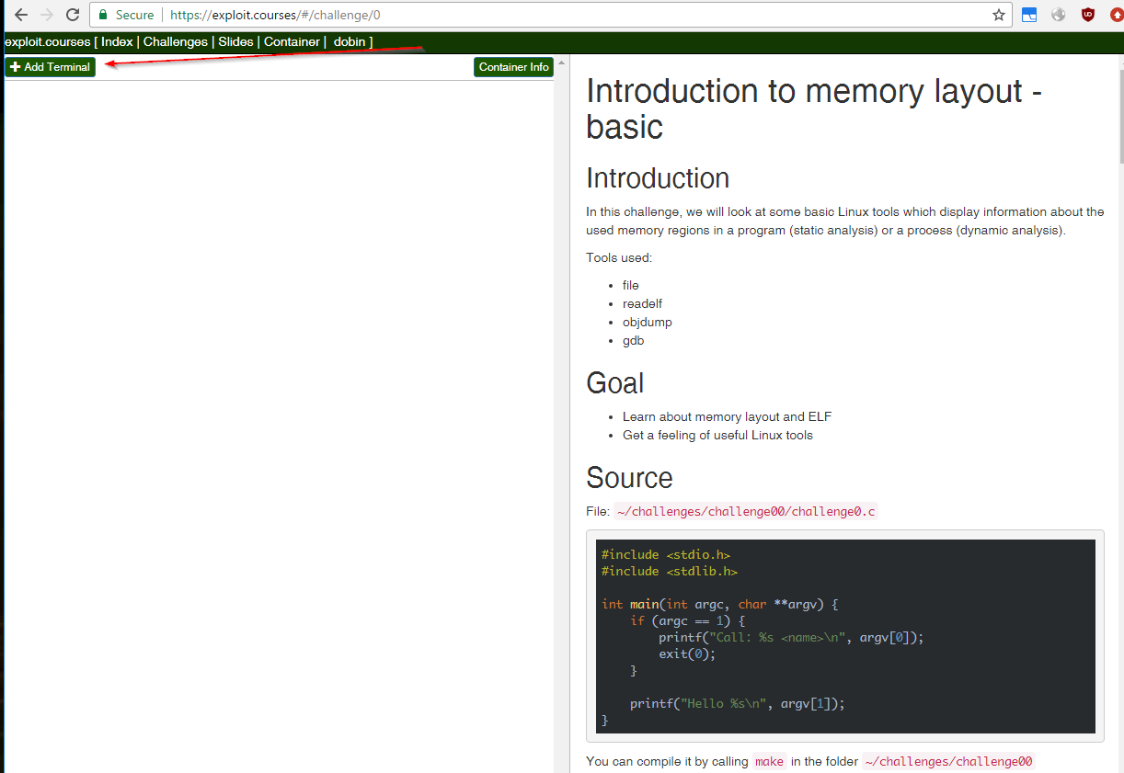
exploit.courses: Challenges

Slide 6
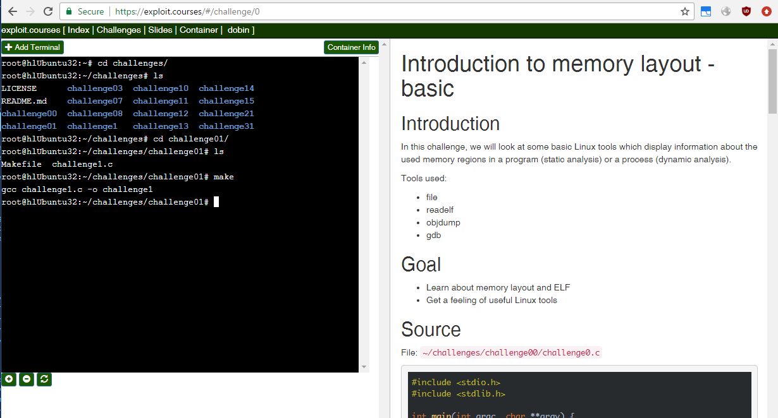
exploit.courses: Challenges

Slide 7
exploit.courses: Container
There are three different container you can access:
ASLR (32, 64 bit)
NO ASLR (32, 64 bit)
ARM (32, 64 bit)
32 and 64 bit hosts are usually shared, including data

Slide 8
exploit.courses: Container
Container lifetime: 6 days
Container max lifetime: 12 days
Copy your files with SCP

Slide 9
exploit.courses: Container
The challenge files (vulnerable programs, exploits):
https://github.com/dobin/yookiterm-challenges-files
The challenge writeups:
https://github.com/dobin/yookiterm-challenges

