Slide 1
Crypto Diversification and Correlation Analysis
By the developers of:
CRYVESTO_API

Slide 2
Where does crypto belong in a portfolio?
Does crypto diversification exist?
In 2018, the National Bureau of Economic Research concluded that the risk-return dynamics of cryptocurrencies (Bitcoin, Ripple, and Ethereum) were distinct from those of stocks, currencies, and precious metals. Essentially, they found that the change in the value of an asset like stocks didn’t mirror the changes of value of cryptocurrencies and vice versa.
“Cryptocurrencies,” the authors added, “have no exposure to most common stock market and macroeconomic factors.” During this time, with cryptocurrencies not being correlated to stocks and other assets, they served as a way to buffer stock market losses or for the stock market to buffer cryptocurrency losses.
However, much has changed in the fast-moving world of cryptocurrencies, including their correlation with the stock market.
OUR HYPOTHESIS
The correlation between stocks and cryptocurrency has been increasing since 2020; now both crypto and US equities appear to be moving in tandem. We hypothesize that crypto prices are currently an indicator for the tech-heavy, growth-heavy Nasdaq 100, and to a lesser extent, are likewise correlated with value stocks.

Slide 3
Investigation
STEP 1:
Using Yahoo Finance API, make calls to get historical data for largest market cap coins
STEP 2:
Analyzing Cryptos together to compare returns, volatility, and risk/return profile
STEP 3:
Analyzing Cryptos relationship against Nasdaq 100 and S&P 500 for two time periods, 2016-2019 & 2020-Present
STEP 4:
Create two Monte Carlo Simulations for a hypothetical portfolio. One portfolio with BTC/ETH/S&P, another portfolio with BTC/LUNA/S&P, and both portfolios weighted [5%, 5%, 90%] accordingly.

Slide 4
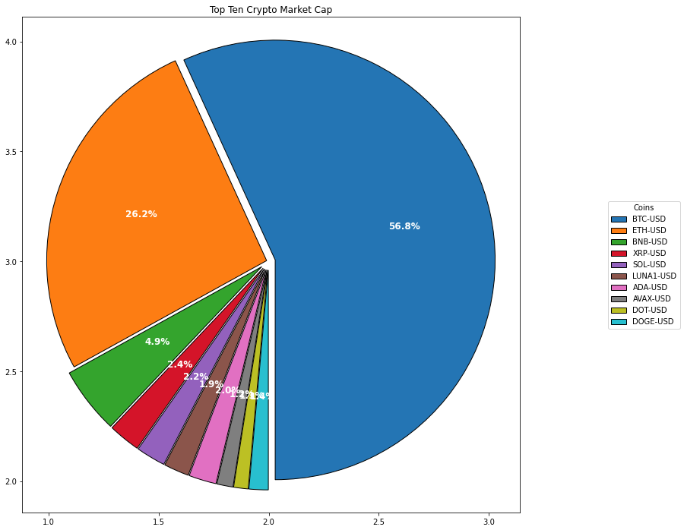
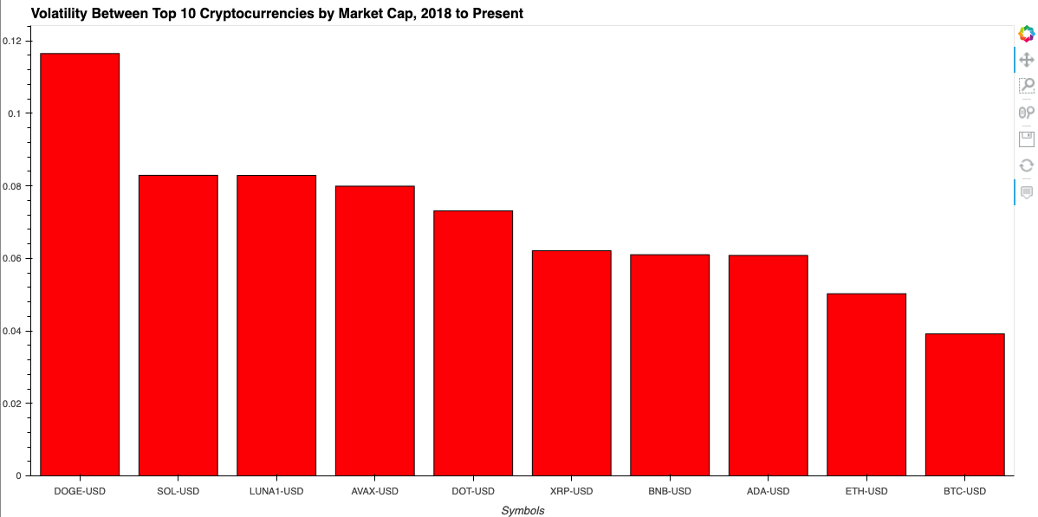
Step 1
Largest Crypto Coins by Market Cap

Slide 5
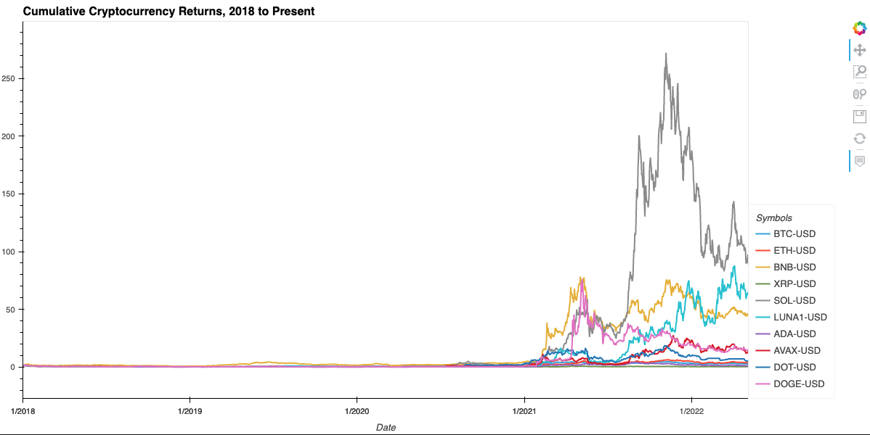
Step 2.1
Cumulative Returns 2018-Present

Slide 6
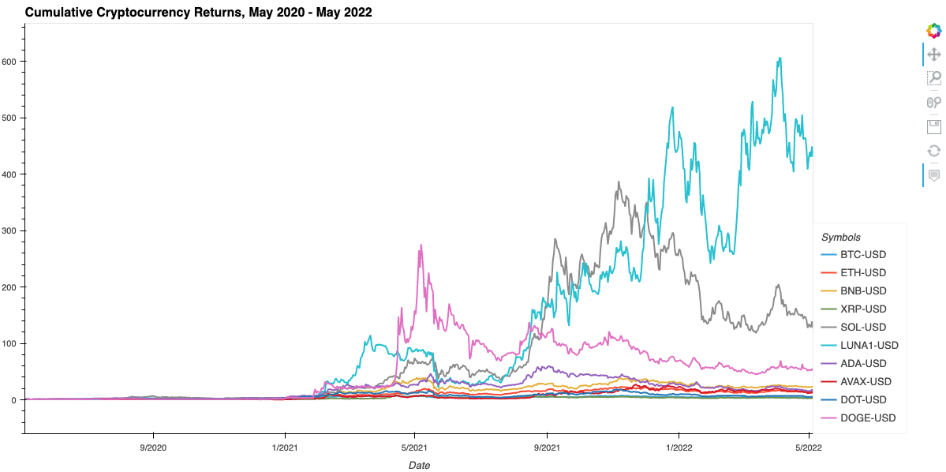
Step 2.2
Cumulative Returns 24 Months

Slide 7
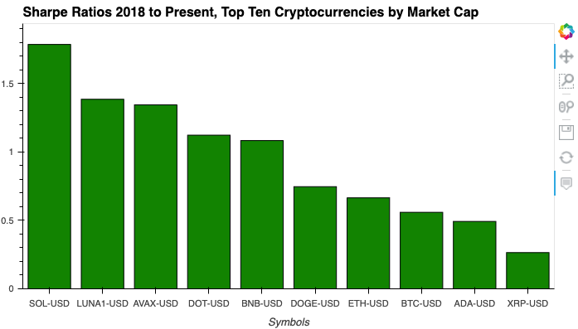
Step 2.3
Sharpe Ratios

Slide 8
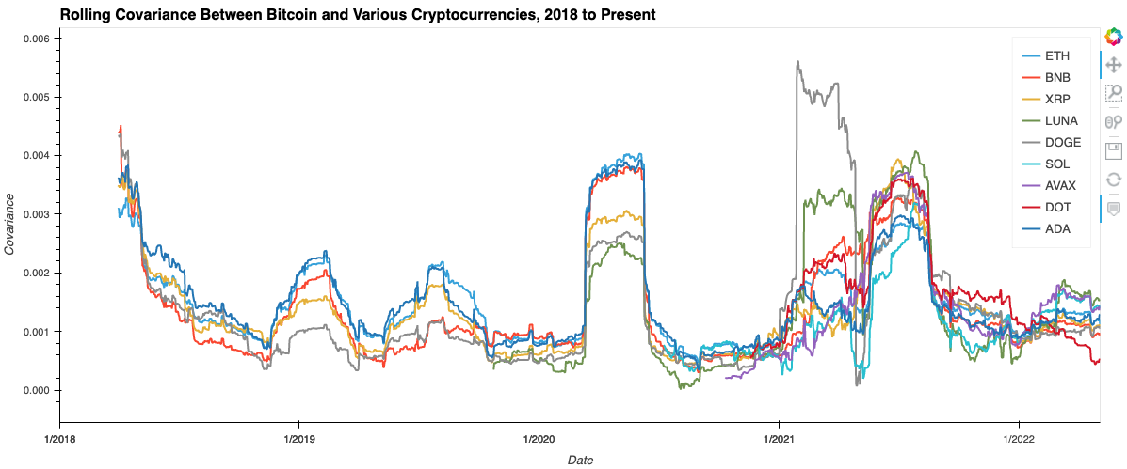
Step 2.4
Rolling Covariance Between Bitcoin and Various Crypto, 2018 - Present

Slide 9
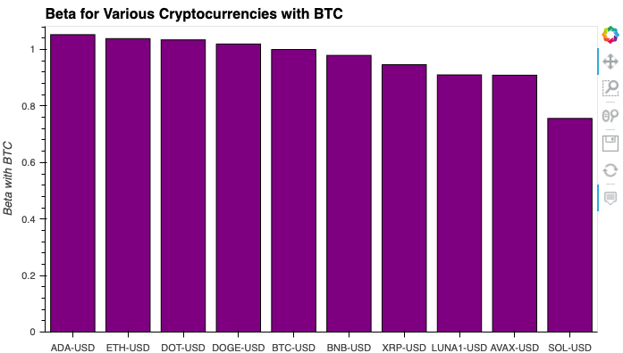
Step 2.5
Beta: Top 10 Crypto Against Bitcoin 2018 - Present

Slide 10
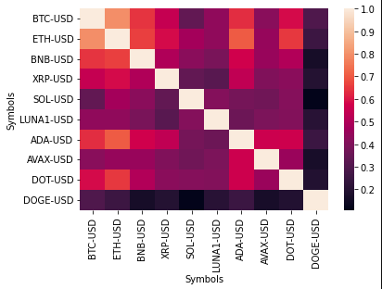
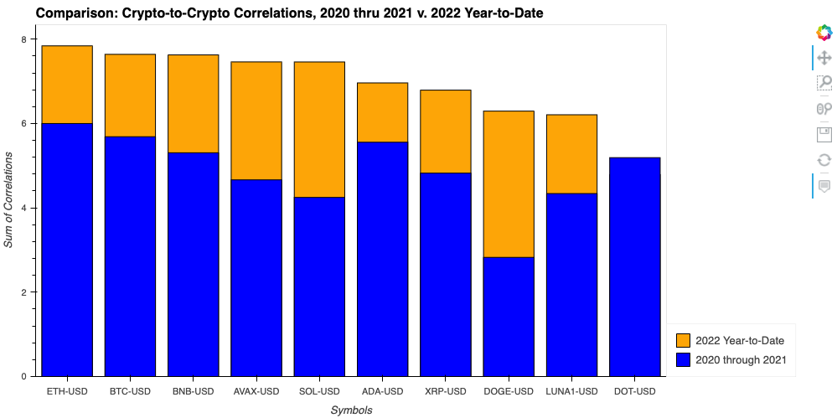
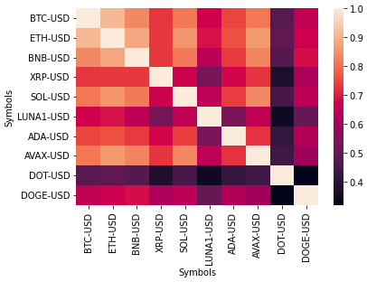
Step 2.6
Analyzing Cryptos Together To Compare Returns, Volatility, & Risk/Return Profile
2020-2021
2022-YTD
Correlation Comparison

Slide 11
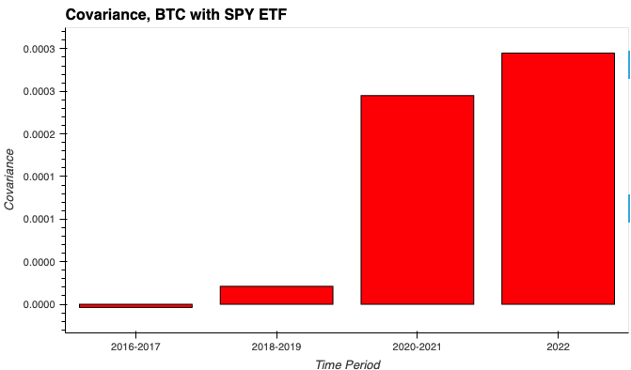
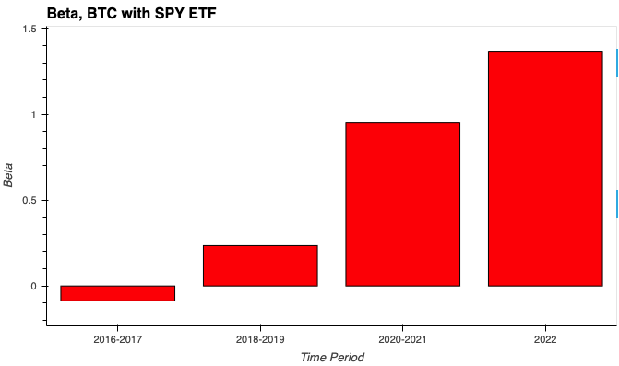
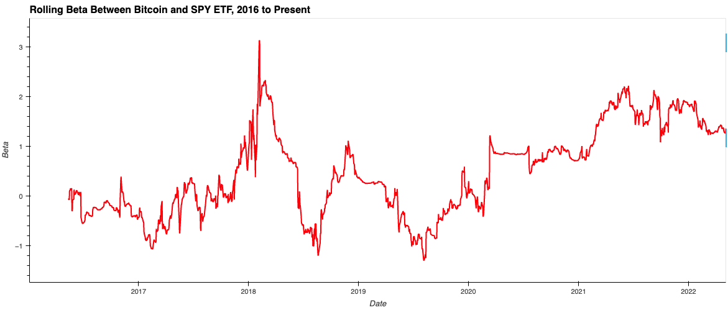
Step 3.1
Covariance, Beta, & Rolling Beta, BTC with SPY ETF 2016 - Present

Slide 12
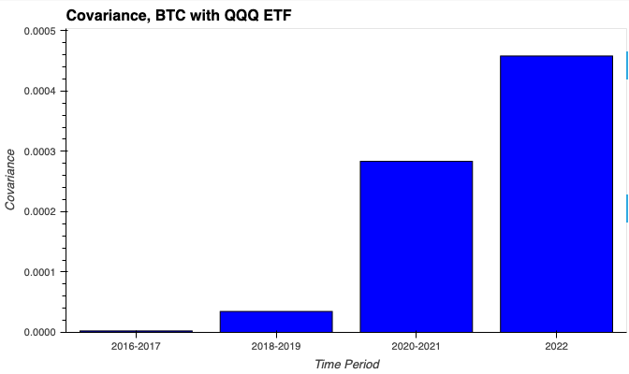
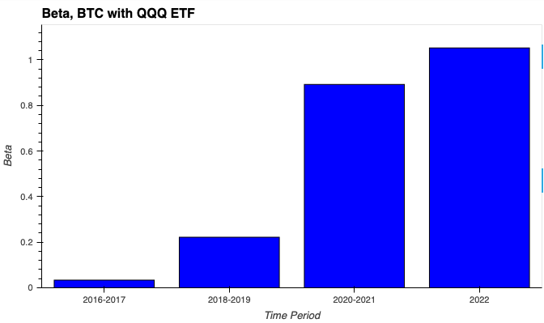
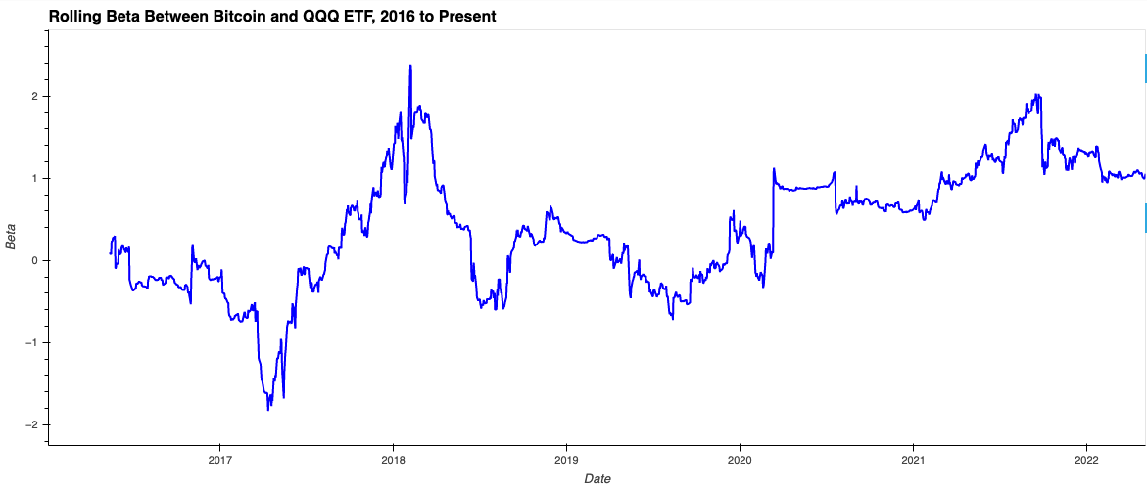
Step 3.2
Covariance, Beta, & Rolling Beta, BTC with QQQ ETF 2016 - Present

Slide 13
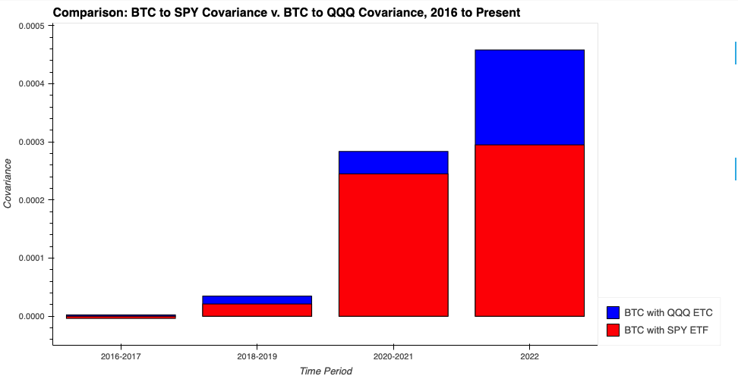
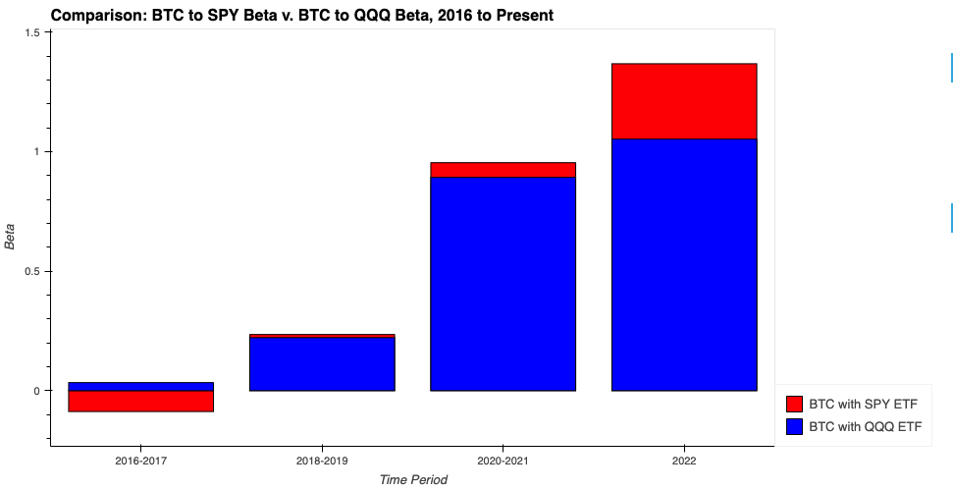
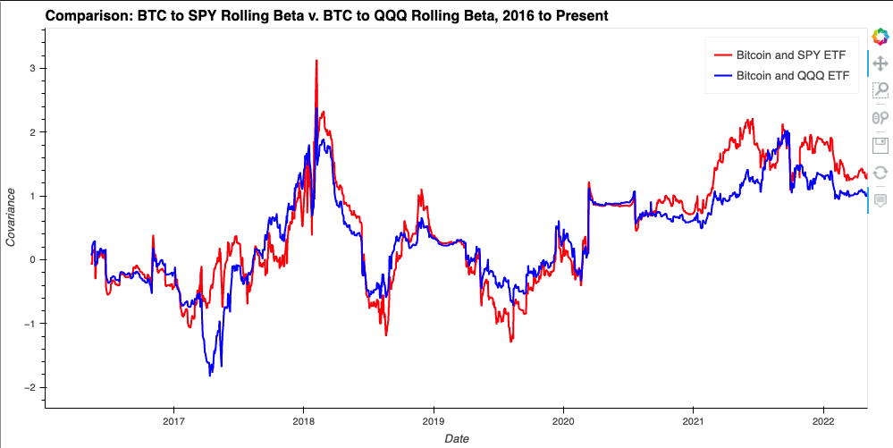
Step 3.2
Covariance, Beta, & Rolling Beta, BTC with QQQ ETF 2016 - Present & BTC with SPY ETF 2016 - Present

Slide 14
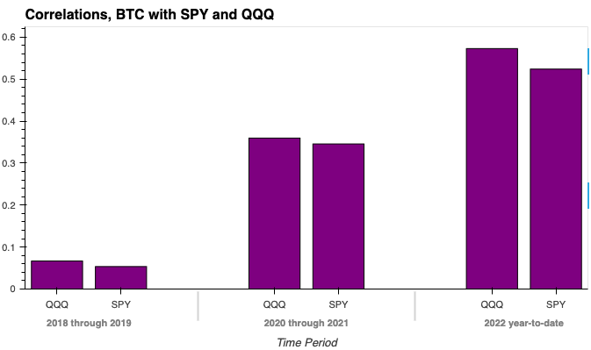
Step 3.3
Correlations, BTC with SPY & QQQ
2018-2019, 2020-2021, 2022 YTD

