Slide 1



'CryVesto for your Portfolio'
A FinTech project to analyze Cryptocurrencies with portfolio assets using Monte Carlo Simulations

Slide 2

'CryVesto for your Portfolio'
This program application is for a fintech startup serving as a crypto consulting and research firm.
It is part of a larger program following the Fama-French Regression Analysis and before the user interface app to help clients make informed investment decisions.

Slide 3
'CryVesto for your Portfolio'
It utilizes a Monte Carlo Simulation app projecting returns based on analysis of major equity and fixed income asset classes with and without cryptocurrency for comparison purposes, as a viable alternate class of investment.
Traditionally the 3 major classes of equities(stocks), fixed income(bonds), and cash are used to comprise security portfolios.

Slide 4
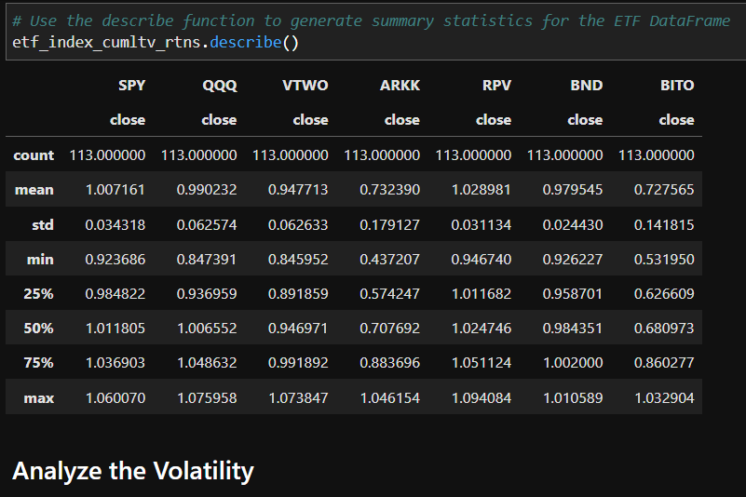
'CryVesto for your Portfolio'
The major equities markets are the S&P 500, NASADQ 100, Russell 2000, and S&P 500 Value indices represented by the following ETFs: SPY, QQQ, VTWO, RPV respectively. The traditional asset of fixed income is represented by the Total Bond Market ETF(BND). Special consideration is given to ARK Innovation ETF (ARKK) as a popular aggressive growth ETF composed mostly of high-risk start-ups with innovative technology.

Slide 5
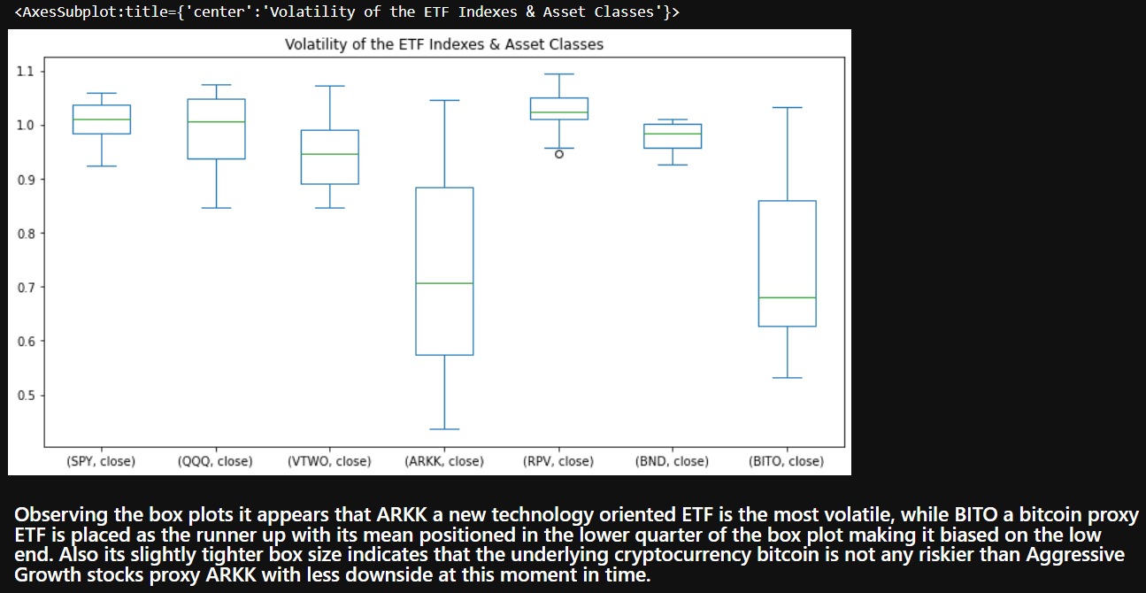
'CryVesto for your Portfolio'

Slide 6
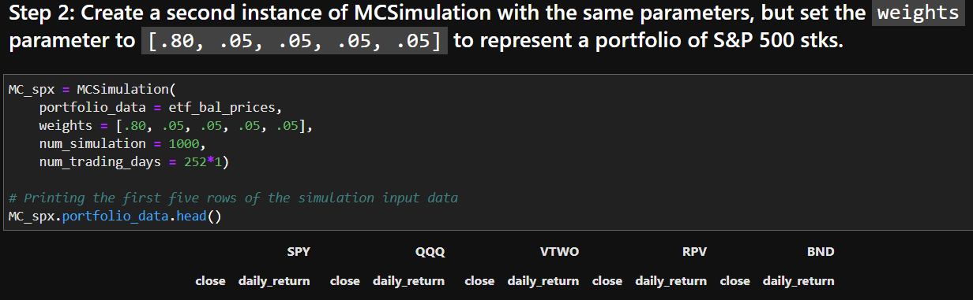
'CryVesto for your Portfolio'

Slide 7
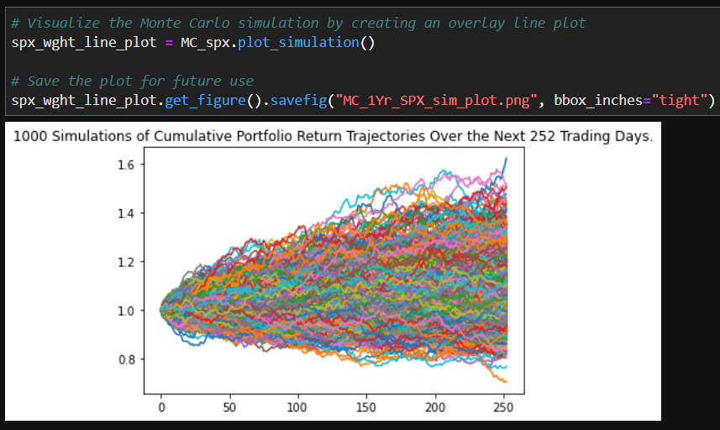
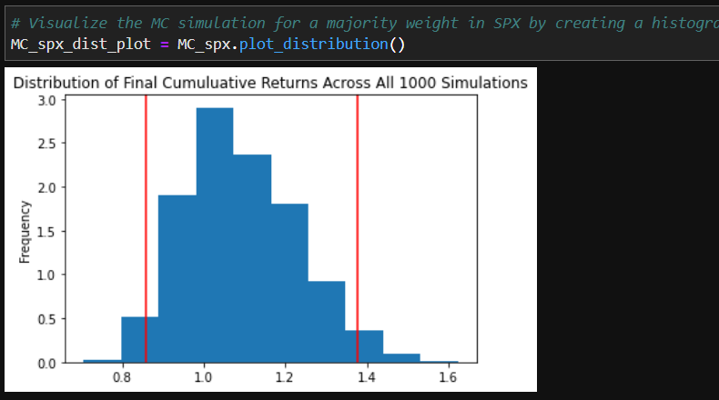
'CryVesto for your Portfolio'

Slide 8
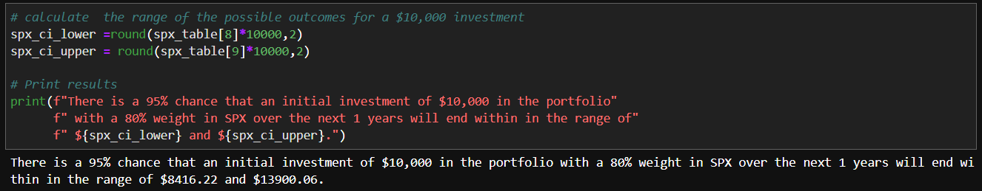
'CryVesto for your Portfolio'

Slide 9
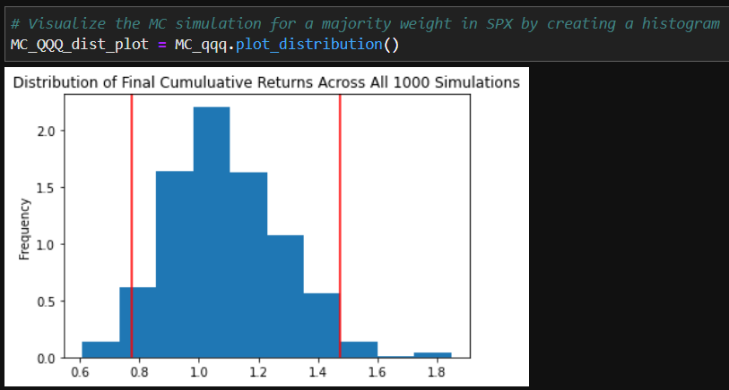
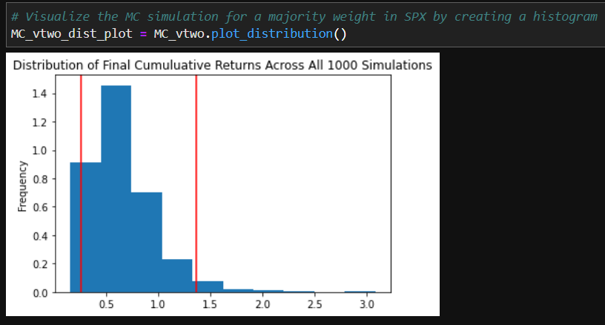
'CryVesto for your Portfolio'

Slide 10
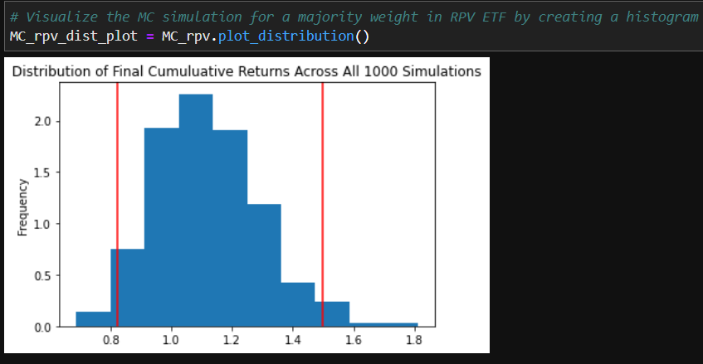
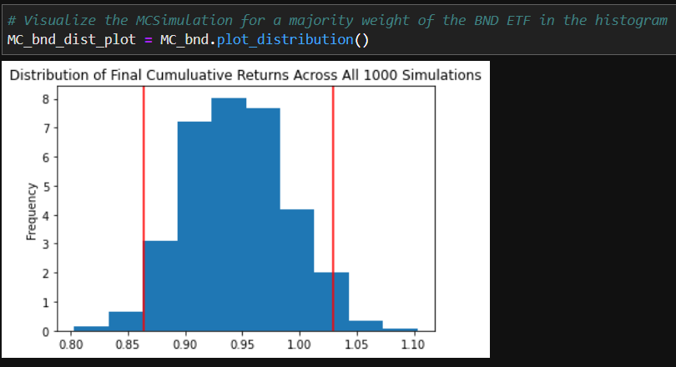
'CryVesto for your Portfolio'

Slide 11
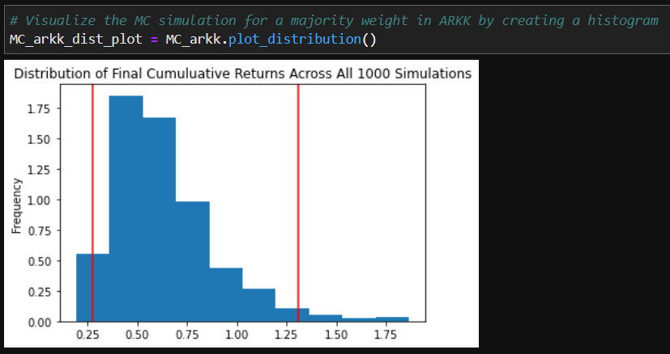
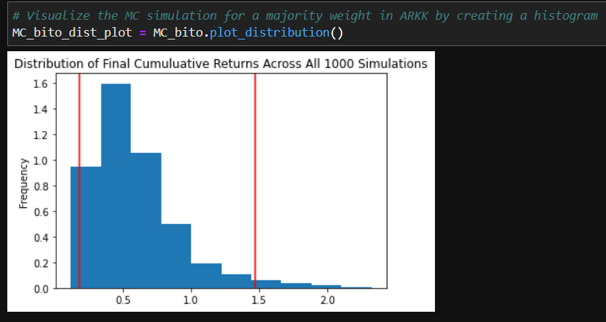
'CryVesto for your Portfolio'

Slide 12
'CryVesto for your Portfolio'
Synopsis:
It is apparent that ARKK and BITO have separated from the other asset classes in performance of cumulative returns and show a measure of coorelation in this metric.
The metrics for std dev compared to SPX@ 0.0334; that ARKK@ 0.1804 and BITO@ 0.1386 have also separated themselves from the other asset classes as being the riskiest.
Observing the box plots it appears that ARKK ETF is the most volatile, while BITO a bitcoin proxy ETF is placed as the runner up are both heavily coorelated away from the other asset classes with much longer boxes. BITO's slightly tighter box size indicates that the underlying cryptocurrency bitcoin is not any riskier than Aggressive Growth Tech stocks proxy ARKK.
The MCSimulator histograms shows that the index ETFs showed assymetry or near the bell curve, while BITO and ARKK showed assymetry with skewed long positive tails. This increasingly confirms coorelation between BITO and ARKK with their skewed long positive tails with the mean centered to left means that there are few large gains and frequent smaller losses.
Observing the MCforcasting confirms this as the SPY and QQQ weight balance portfolio posted 10000 investment returns from 8347-13772 and 7858-14676 respectively for the major broad indexes. While heavy weighted ARKK and BITO ETFs showed 10000 investment returns ranging from 2881-12128 and 1774-14212 respectively.
It is increasingly evident from the metrics that BITO has aligned itself with metrics of aggressive growth asset class equities and has displayed similar investment returns when forcasting on a 10000 investment.

