Slide 1

Cryvesto 2.0
Presenter Dana Hayes
Notes:
Hello Class, My name is Dana Hayes, Chief Product Officer, and would like to introduce Cryvesto 2.0.

Slide 2




Agenda
Intro: Executive Summary & Project Goals
Approach to Achieve Goals
Research & Data Preparation
The Selected Model
Results & conclusion or Application
Future Next Steps

Slide 3




Intro & Proposal
Team Cryvesto 2.0 attempts to construct a Machine Learning Sentiment Trade Bot (ML-STB) that identifies ‘Bullish’ or ‘Bearish’ market sentiment from news and social media sources.
We believe that positive and negative sentiment sets market trends.
Utilizing the aggregated data metrics, we aim to generate trade signals in response to ‘fear’ and ‘greed’ expressions.
Notes:
For Project 2, team Cryvesto 2.0 seeks to construct a Machine Learning(ML) Sentiment Trade Bot(STB) that utilizes market sentiment from news and social media sources that responds to ‘Bullish’ or ‘Bearish’ signals. The Bullish or Bearish signals trigger an entry or exit point to trade targeted securities or assets. We will then compare the ML_STB with traditional technical indicators using SMAs for DMAC signals that trigger entry and exit points, as well as different algorithm classification models.
We believe that our evaluation comparison highlights the importance of ‘fear’ and ‘greed’ that influences market forces, which could be leading indicators for trade points. When utilized from the aggregated database metrics, signals are generated in response to ‘fear’ and ‘greed’ to place trades.

Slide 4


Executive Summary
We believe that our analysis of sentiment identifies the influential market forces of ‘fear’ and ‘greed’ and can be leading indicators for trade points.
Our hypothesis:
In a time period, when 'Bullish' sentiment is high asset prices will likely rise; and when 'Bearish' sentiment is high the opposite will occur with asset prices declining.
Notes:
As an example, there are certain popular trading industry phrases, such as the "The trend is your friend." or "Buy on the rumor, sell on the news." that can't be ignored as these phrases among other expressions are now encapsulated and contained on the internet within popular social media sites like "Twitter” and, "Reddit". Today there are other newer sites focused on block chain and cryptocurrency, such as ‘Bitcointalks’, ‘Mamby’, ‘Discord’(crypto channel), and e-mag’s ‘Medium’(considered the best source for crypto investor education according to CriticalHit.net).
With the proliferation of high frequency trading(HFT) rising to 80% of market trading today, it gives cause to seek a different approach for automated ML algorithm modeling based on traditional technical indicator inputs that trigger entry and exit points, as well as different algorithm classification models.. Capturing investor sentiment to get a competitive advantage earlier than traditional technical analysis signals. We specifically program our system on Sentiment from different media sources like business news, and internet social media sites to adapt and utilize newly sourced data. We're planning to improve traditional algorithmic trading systems by adding 'Sentiment' as leading indicators to get a competitive advantage in the market. We identify existing buy, sell or hold trading signals with key words and phrases that express 'Bullish' or 'Bearish' sentiment emanating from 'fear and 'greed' language. We then enhance these logic encoded signals into a sentiment indicator in order to identify with machine learning algorithms that can adapt this new data.

Slide 5




Team Cryvesto
Anna Joltaya
Ashok Pandey
Scott Marler
Rensley Ramos
Chief R & D Officer
Chief Computer Scientist
Chief Technology Officer
Chief Marketing & Sales Executive

Slide 6
Data Analysis
Sources of Data
API’s Considered
Twitter
Reddit
Wall Street Journal
News Api
TextBlob
NLTK(used)
Augmento (used)
Twitter
NewsAPI(used)

Slide 7
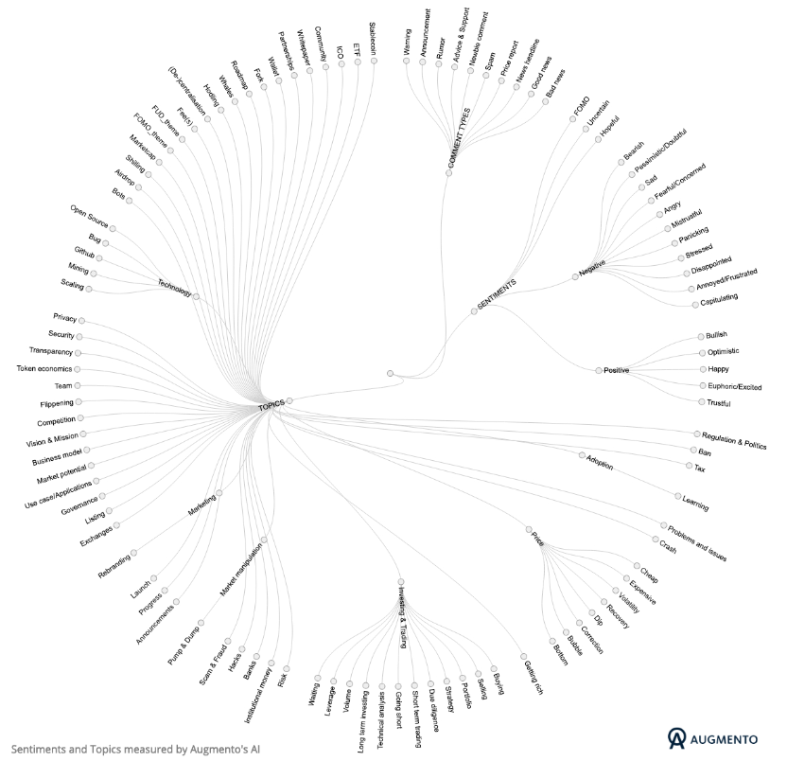

Augmentos “Sentiment Polarity Indicator” for Crytocurrencies
More than 100 sentiments relating to topics of discussion about cryptocurrencies on social media from Twitter, Bitcointalk & Reddit.
Notes:
As illustrated, augment’s ai quantifies more than 100 sentiment relating to topics of discussion with key words and phrases about crypto currencies on social media- Twitter, Bitcointalk, and Reddit. In observation some sentiments are visualized as opposites.

Slide 8
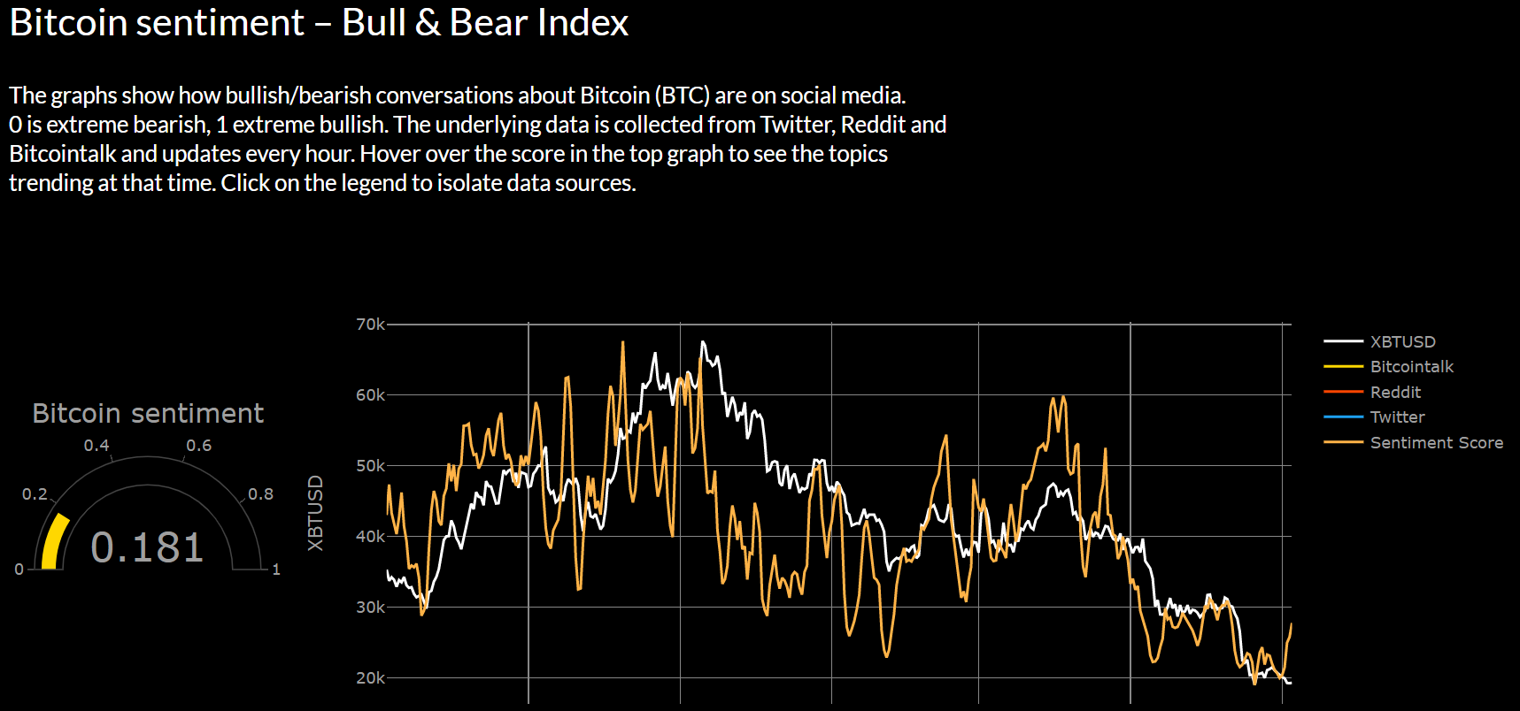
Bitcoin Sentiment Gauge & Chart

Slide 9
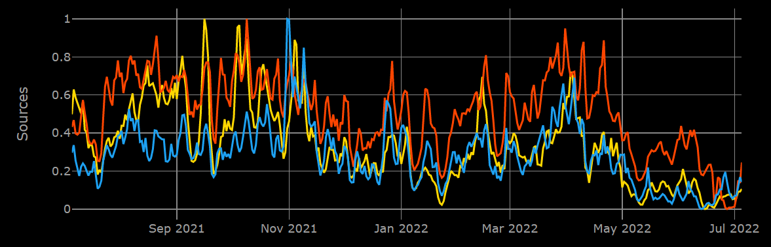
Social Media Data Metrics Chart
 | Category 1 | Category 2 | Category 3 | Category 4
Item 1 | 4.5 | 2.3 | 1.7 | 5
Item 2 | 3.2 | 5.1 | 4.4 | 3
Item 3 | 2.1 | 1.7 | 2.5 | 2.8
Item 4 | 4.5 | 2.2 | 1.7 | 7

Slide 10
The Models
Models Analyzed
Signal Strategy
SVC
Logistic Regression
AdaBoost (Recommended for consistent predictability for both signals)
Random Forrest
Neural Networks
Simple Strategy – (KISS works)
Strategy combines different levels of sentiment polarity to determine signals
SMA Short/Long – SMA of Sentiments instead of daily returns

Slide 11
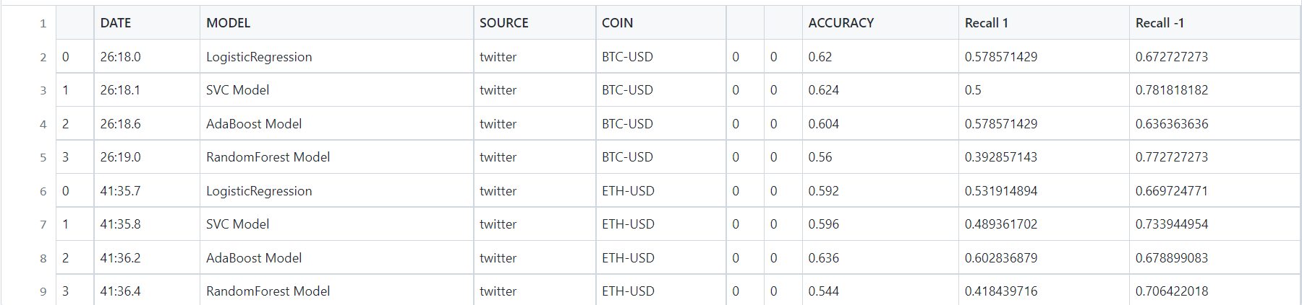
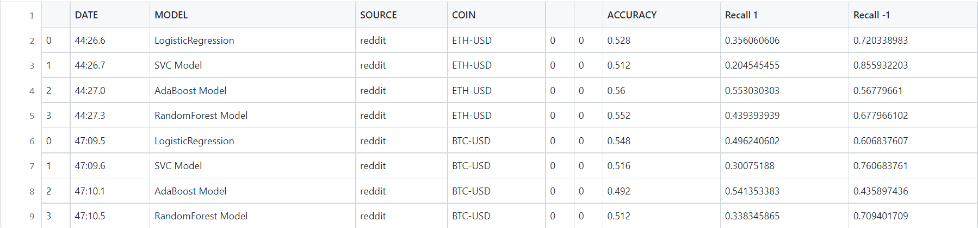
Algo Model Classification Reports
Twitter Classification Report
Reddit Classification Report

Slide 12
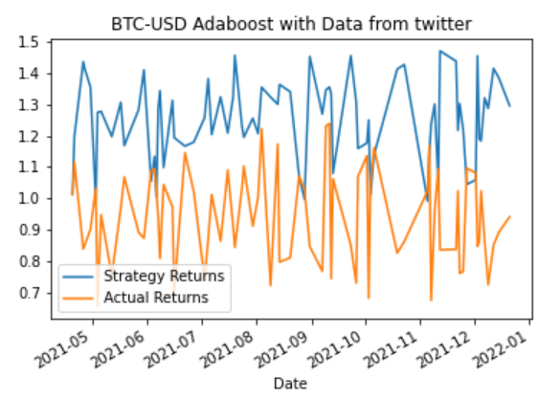
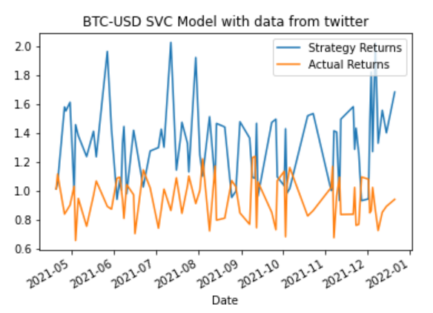
Actual Returns vs Strategy Returns Charts
Twitter Sentiments BTC with Adaboost
Twitter Sentiments BTC with SVC

Slide 13
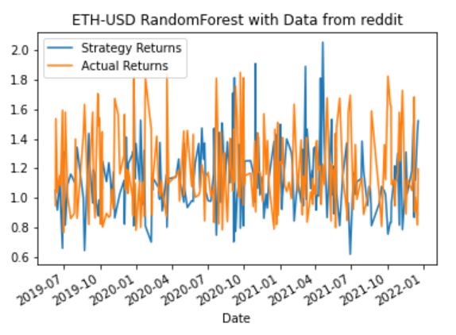
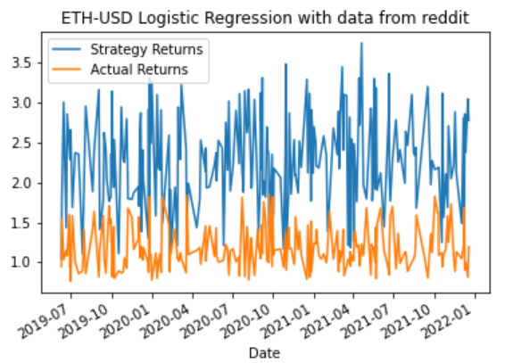
Actual Returns vs Strategy Returns Charts
Reddit Sentiment Ethereum Random Forest
Reddit Sentiment Ethereum Logistic Regression

Slide 14
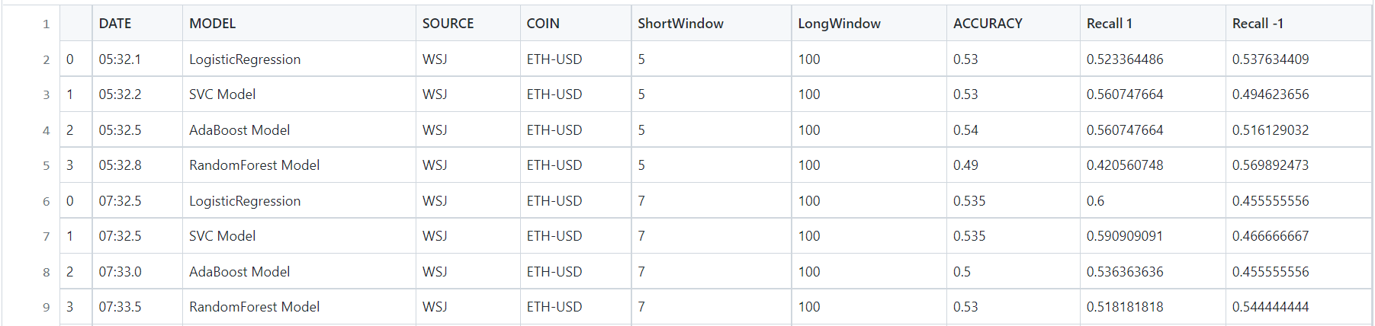
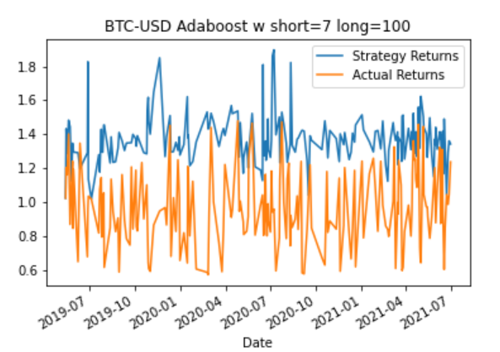
Wall Street Journal Headlines Sentiment Results

Slide 15
The CryVesto Approach to Achieve Project Goals
Backtested the models and compared Classification reports with Cumulative Returns
Problems anticipated- to tame the model
Placed strategic modifications in the signal coding
Backtested many trial runs with different configurations
Analyzed several Neural Network performance runs
Converted Classification Reports & Charts to pandas for efficiency and avoid the tedious backtesting process of changing parameters and recording.

Slide 16
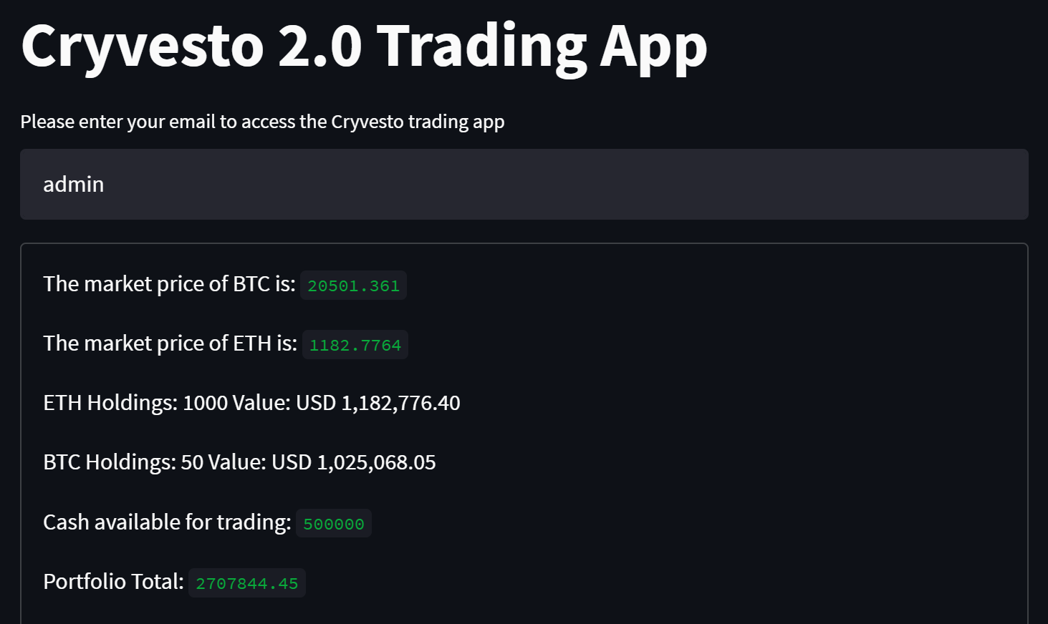
The Cryvesto Trading GUI

Slide 17
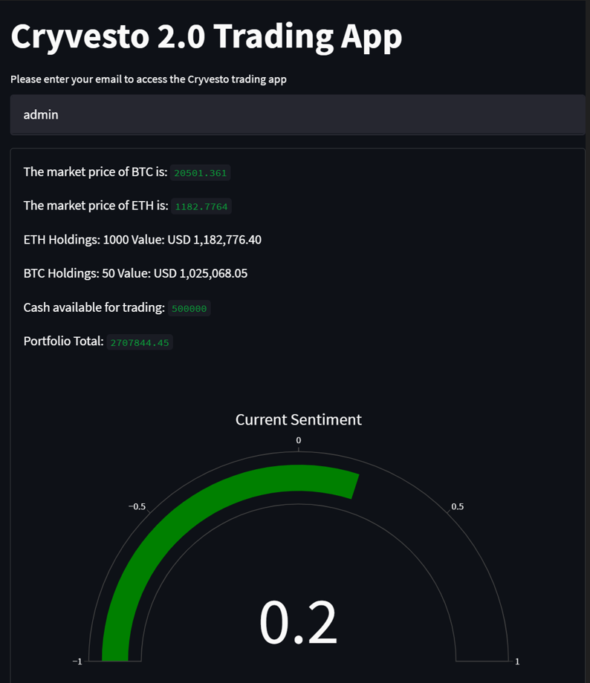

The Cryvesto Sentiment Meter
The ML-STB program signals a bull market

Slide 18


Slide 19

Summary
With PowerPoint, you can create presentations and share your work with others, wherever they are. Type the text you want here to get started. You can also add images, art, and videos on this template. Save to OneDrive and access your presentations from your computer, tablet, or phone.

Slide 20


Thank You
Team Cryvesto 2.O
Email address
Website address

