Slide 1
Cryvesto 2.0

Slide 2
REQUIREMENTS
Each project group will prepare a formal 10-minute presentation that includes the following:
An executive summary of the project and project goals. (5 points)
Explain how this project relates to fintech and machine learning.
The selected model. (5 points)
Describe the machine learning model that your group selected and why.
The data preparation and model training process. (3 points)
Describe the source of your data and why you chose it for your project.
Describe the collection, cleanup, and preparation process.
Describe the training process.
The approach that your group took to achieve the project goals. (5 points)
Include any relevant code or demonstrations of the machine learning model.
Describe the techniques that you used to evaluate the performance of the model.
Discuss any unanticipated insights or problems that arose and how you resolved them.
The results andconclusions from the machine learning model or application. (5 points)
Include relevant images or examples to support your work.
If the project goal wasn’t achieved, share the issues and what the group tried for resolving them.
Next steps. (2 points)
Take a moment to discuss the potential next steps for the project.
Discuss any additional questions that you’d explore if you had more time. Specifically, if you had additional weeks to work on your project, what would you research next?

Slide 3
Executive Summary
Explain how this project relates to fintech and machine learning.

Slide 4
The Model
Describe the machine learning model that your group selected and why.

Slide 5
The data preparation and model training process. (3 points)
Describe the source of your data and why you chose it for your project.
Describe the collection, cleanup, and preparation process.
Describe the training process.

Slide 6
The approach that your group took to achieve the project goals. (5 points)
Include any relevant code or demonstrations of the machine learning model.
Describe the techniques that you used to evaluate the performance of the model.
Discuss any unanticipated insights or problems that arose and how you resolved them

Slide 7
The results and conclusions from the machine learning model or application. (5 points)
Include relevant images or examples to support your work.
If the project goal wasn’t achieved, share the issues and what the group tried for resolving them.

Slide 8
Next steps. (2 points)
Take a moment to discuss the potential next steps for the project.
Discuss any additional questions that you’d explore if you had more time. Specifically, if you had additional weeks to work on your project, what would you research next?

Slide 10
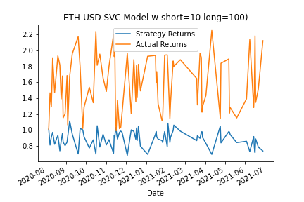
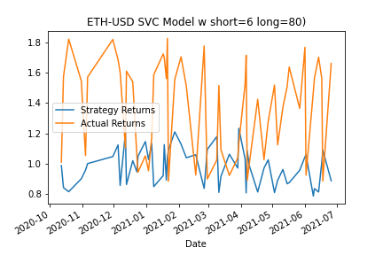
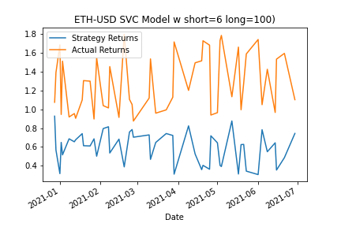
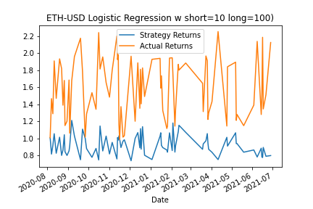
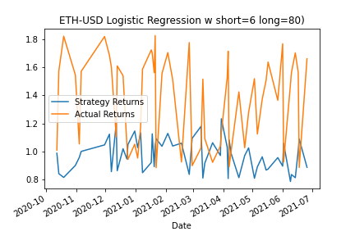
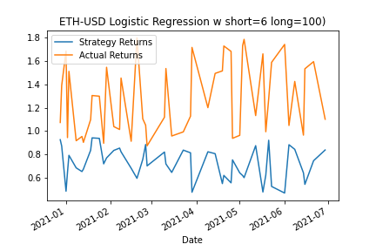

Slide 11
