Slide 1
Lesson - 3
HTML 5. Base Elements.
Part 2
SkillUp by Dobrea Vladislav

Slide 2
Lesson Plan
Tables
Forms
Homework

Slide 3
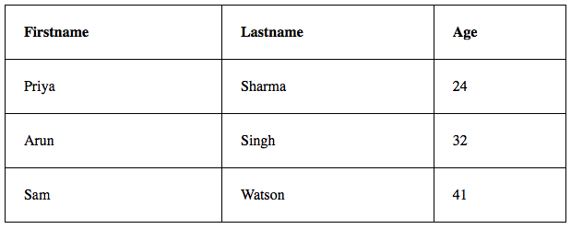
Table
A table is an arrangement of data in rows and columns, or possibly in a more complex structure. Tables are widely used in communication, research, and data analysis.
Tables are useful for various tasks such as presenting text information and numerical data.
Tables can be used to compare two or more items in tabular form layout.
Tables are used to create databases.

Slide 4
Table elements
<th>
<tr>
<td>

Slide 5
Table elements
<tr> - defines each table row
<td> - A table data/cell is defined
<th> - table header is defined with
<caption> - adds caption at the top of table
Main attributes of <td> and <th> :
- colspan: Specifies the number of columns a header cell should span
- rowspan: Specifies the number of rows a header cell should span

Slide 6
Tables
When to use?
- HTML tables should be used for tabular data
When not?
Don’t use tables for creating layouts of the page
Reason?
Layout tables reduce accessibility for visually impaired users
Tables produce tag soup
Tables are not automatically responsive

Slide 7
Let’s practice

Slide 8
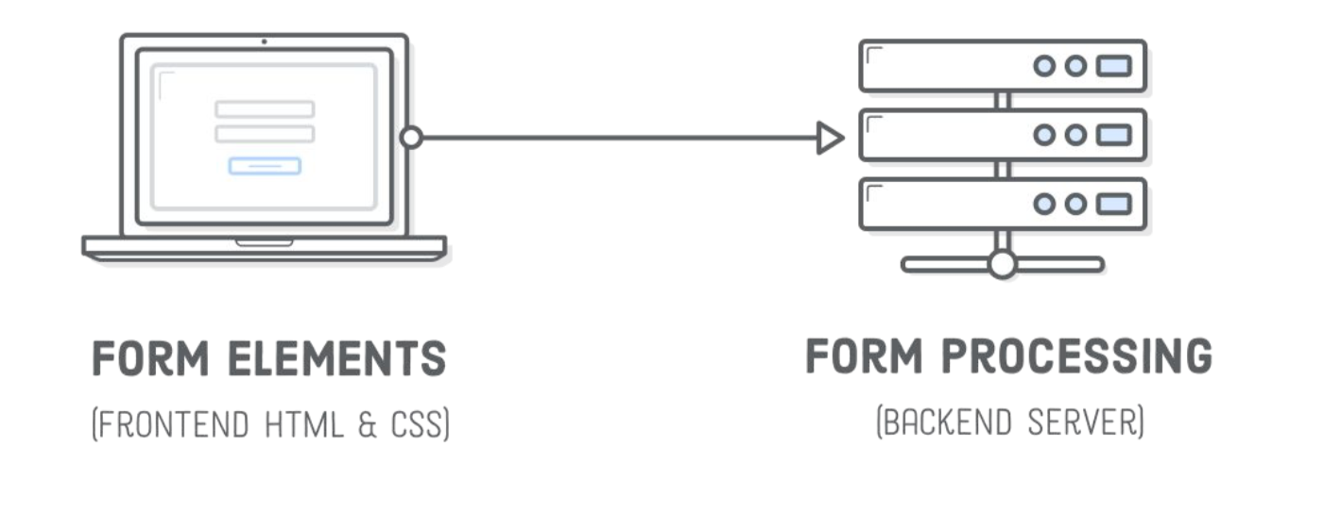
Forms
Forms are one of the main points of interaction between a user and a web site or application. They allow user to input some data and pass it to server

Slide 9
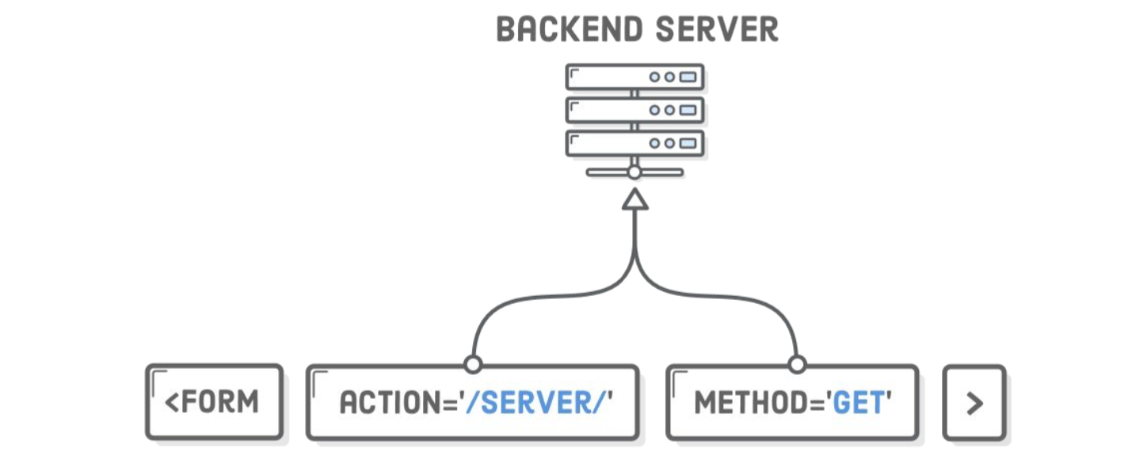
How forms work ?
To add a form to website just use <form> tag

Slide 10
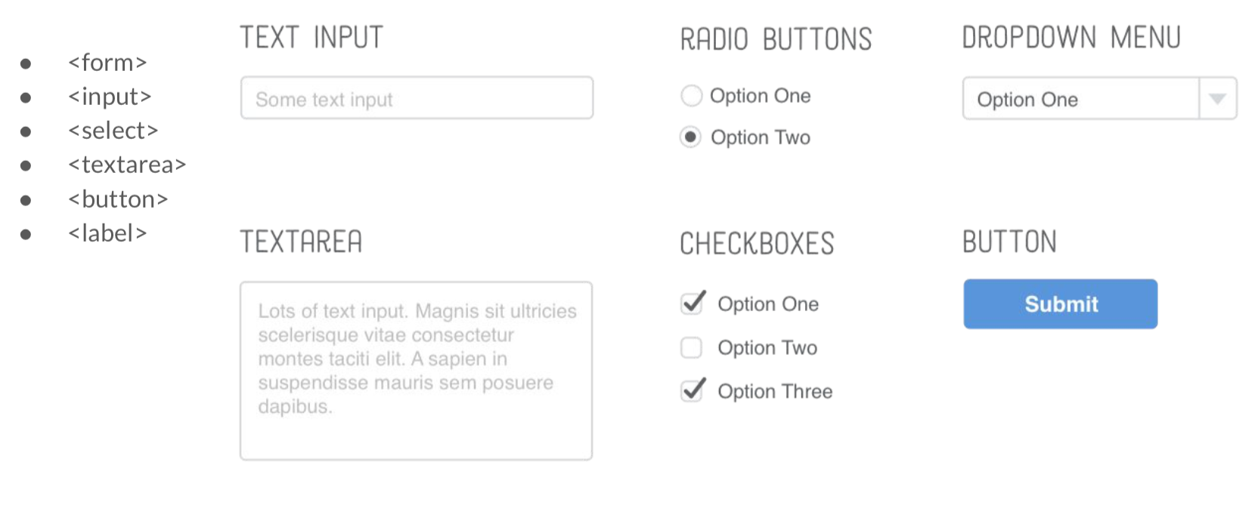
Forms elements

Slide 11
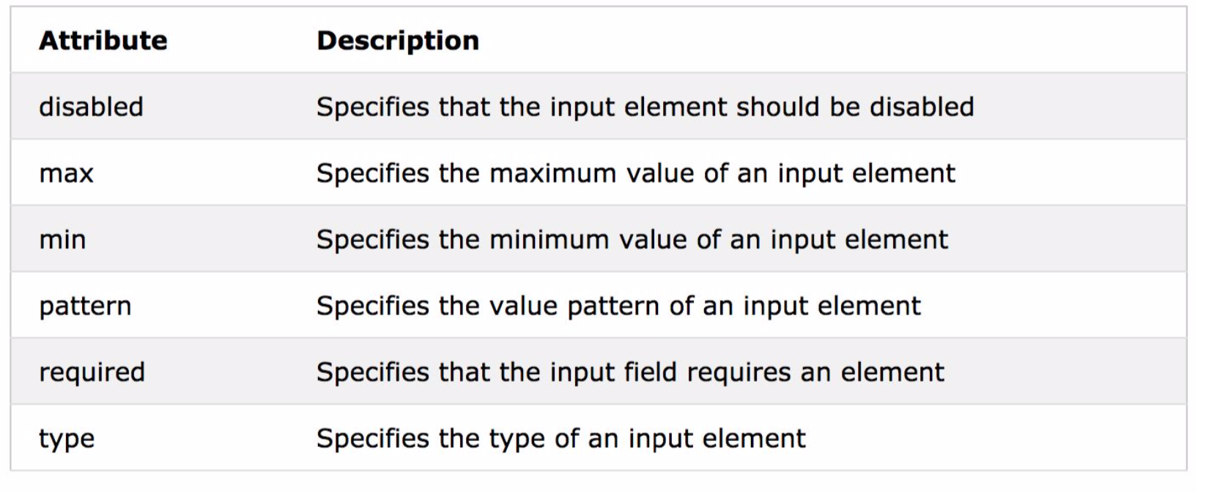
Automatic HTML form validation

Slide 12
Let’s practice

Slide 13
References
HTML Tables
https://developer.mozilla.org/en-US/docs/Learn/HTML/Tables
https://developer.mozilla.org/en-US/docs/Learn/HTML/Tables/Basics
HTML form:
https://internetingishard.com/html-and-css/forms/
https://developer.mozilla.org/en-US/docs/Learn/Forms/Your_first_form
https://www.w3schools.com/html/html_forms.asp
Form elements: https://www.w3schools.com/html/html_form_elements.asp
Form input types: https://www.w3schools.com/html/html_form_input_types.asp
Form attributes: https://www.w3schools.com/html/html_form_attributes.asp
Automatic HTML Form Validation:
https://www.w3schools.com/js/js_validation.asp
https://www.w3schools.com/tags/att_form_novalidate.asp

Slide 14
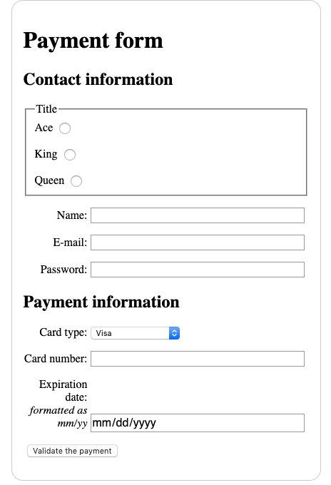
Homework
Re-create in HTML following image of form
In <select> element you can use any values

