Slide 1
Lesson - 6
CSS. Introduction
Part - 2
SkillUp by Dobrea Vladislav

Slide 2
Lesson Plan
Recap + HW
CSS Reset
Semantic Layouts
Layout Types
Flexbox

Slide 3
Homework Review
Key Points
Resetting CSS
Semantic Layout Elements
Positioning of elements
Meaningful names of classes
Don’t repeat yourself (DRY)
Don’t use Absolute for layout

Slide 4
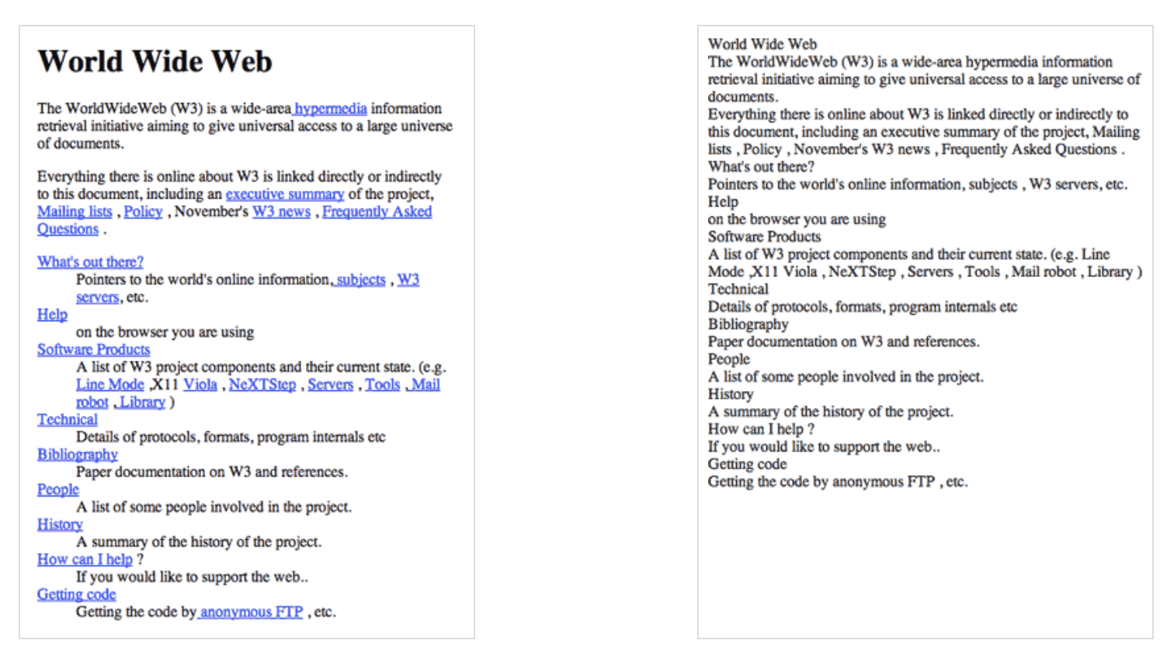
What is CSS reset?
A CSS Reset (or “Reset CSS”) is a short, often compressed (minified) set of CSS rules that resets the styling of all HTML elements to a consistent baseline.
See the difference?

Slide 5
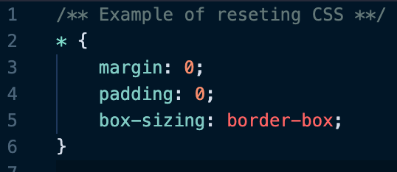
How can we reset?
To reset CSS we can use some very simple rules or either choose some min libraries that can help us with it
Basic reset
More Complex solutions:
Normalize CSS
Reset CSS

Slide 6
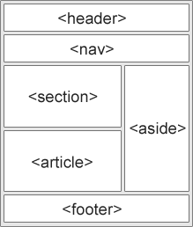
Semantic Layout
List of new semantic elements
The semantic elements added in HTML5 are:
<article>
<aside>
<details>
<figcaption>
<figure>
<footer>
<header>
<main>
<mark>
<nav>
<section>
<summary>
<time>

Slide 7
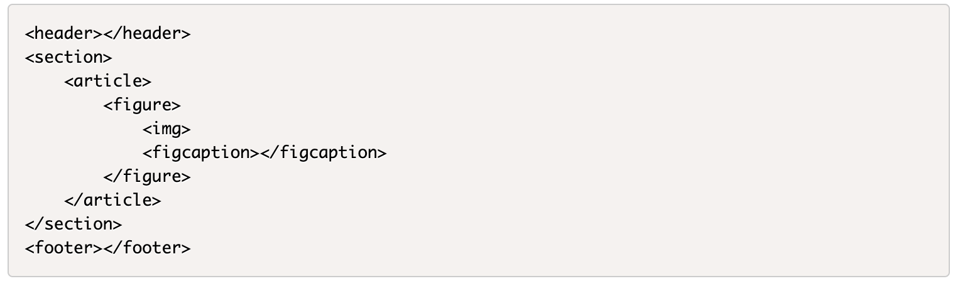
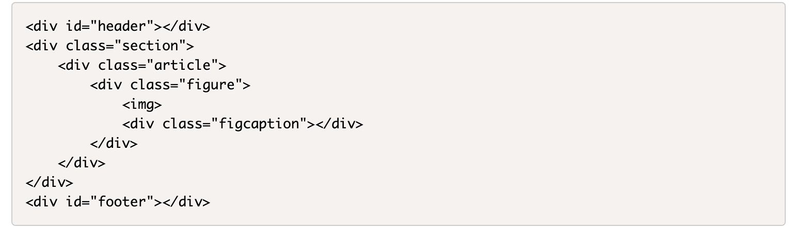
More readable code
VS

Slide 8
Other benefits
Overall, semantic elements also lead to more consistent code
It has greater accessibility and useful for search engine

Slide 9
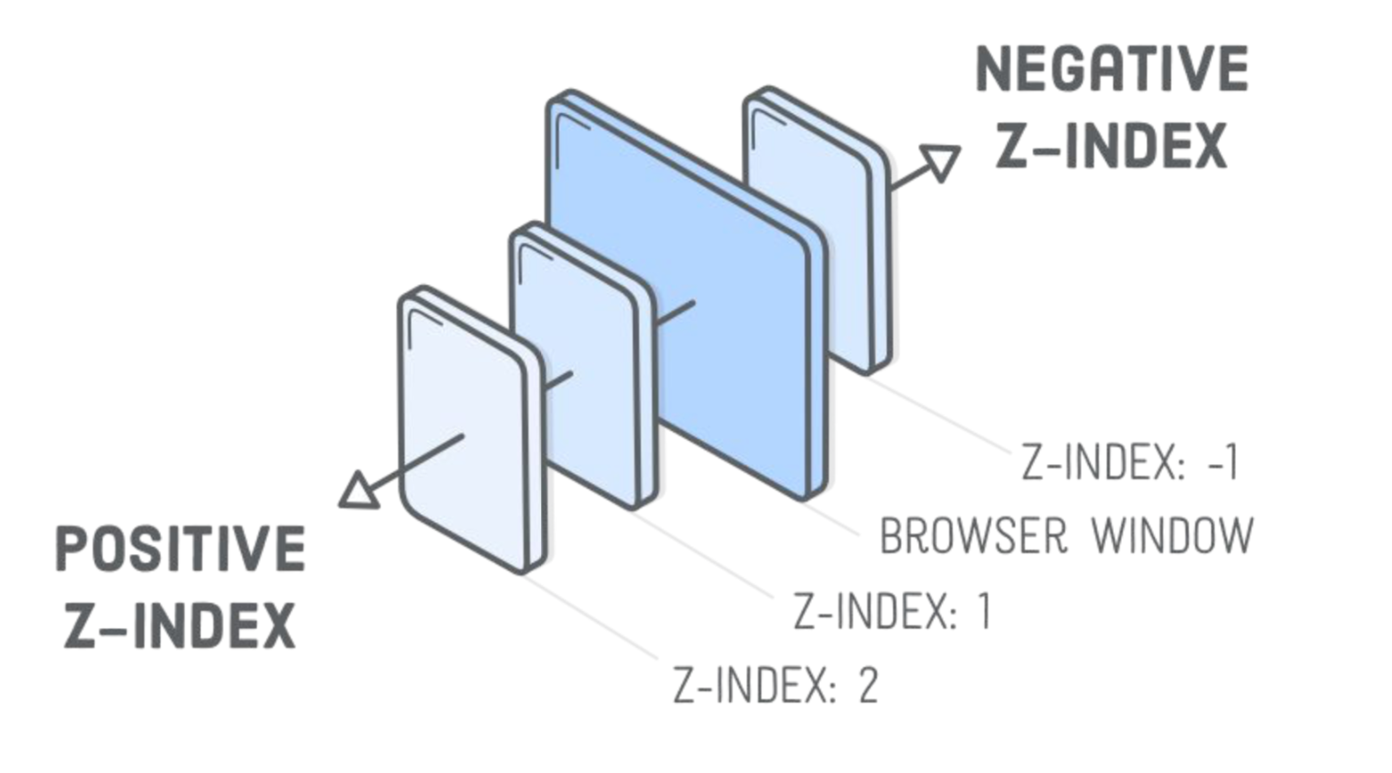
Positioning and Z-Index

Slide 10
The Whitespace problem
Here's the deal: a series of inline-block elements formatted like you normally format HTML will have spaces in between them.
This isn't a "bug" (I don't think). It's just the way setting elements on a line works. You want spaces between words that you type to be spaces right? The spaces between these blocks are just like spaces between words. That's not to say the spec couldn't be updated to say that spaces between inline-block elements should be nothing, but I'm fairly certain that is a huge can of worms that is unlikely to ever happen.

Slide 11
How to solve it?
1. Remove the spaces
2. Negative margin
3. Skip the closing tag
4. Set the font size to zero
5. Use other approach for layout (flex)
Check this article

Slide 12
Let’s practice

Slide 13
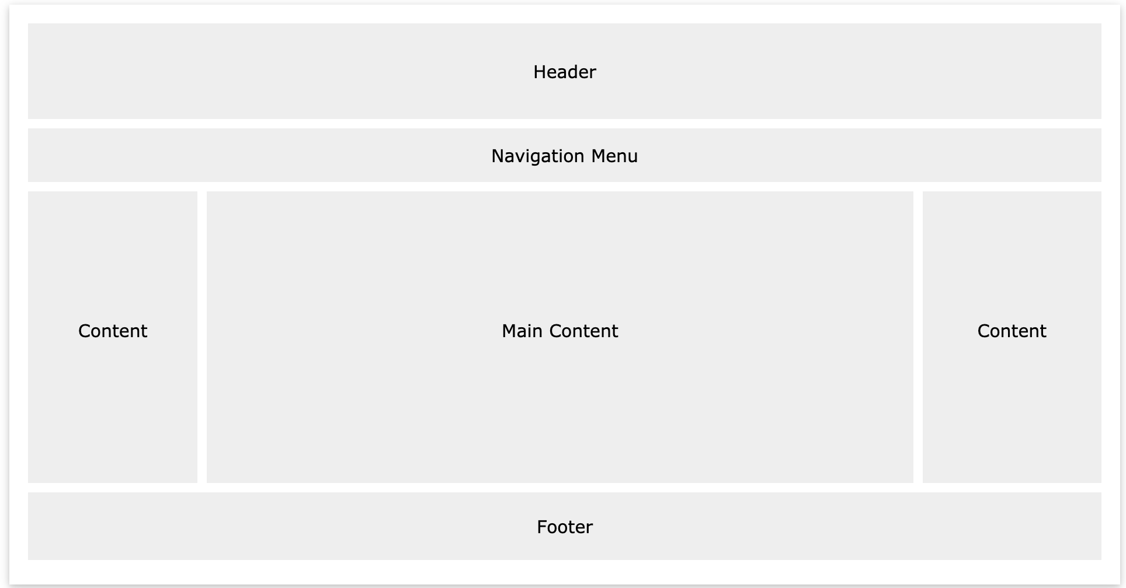
Layouts
Header
Navigation Bar
Content
Columns
Footer

Slide 14
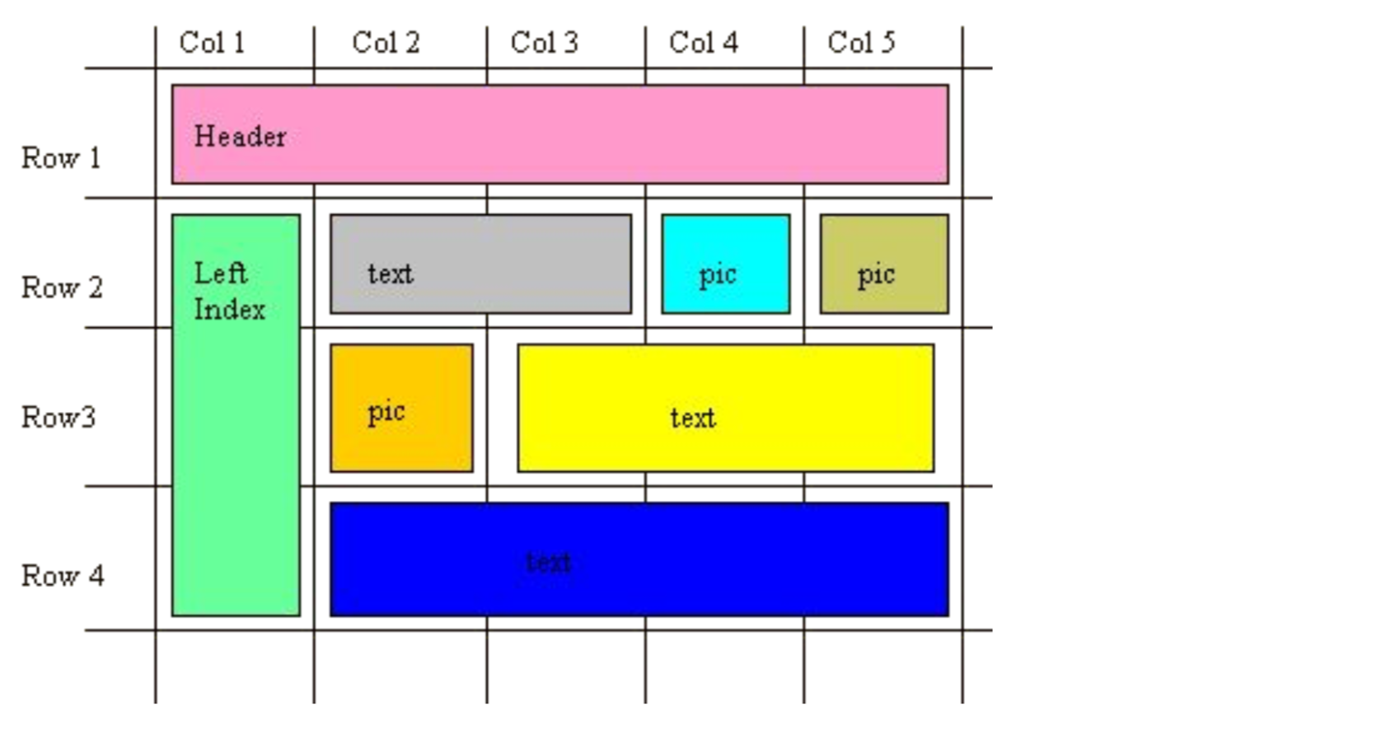
Table Layout

Slide 15
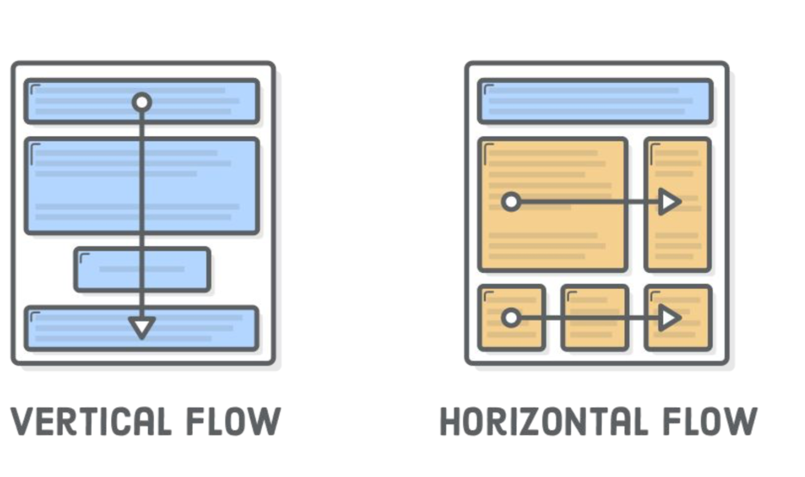
Float - the ugly one

Slide 16
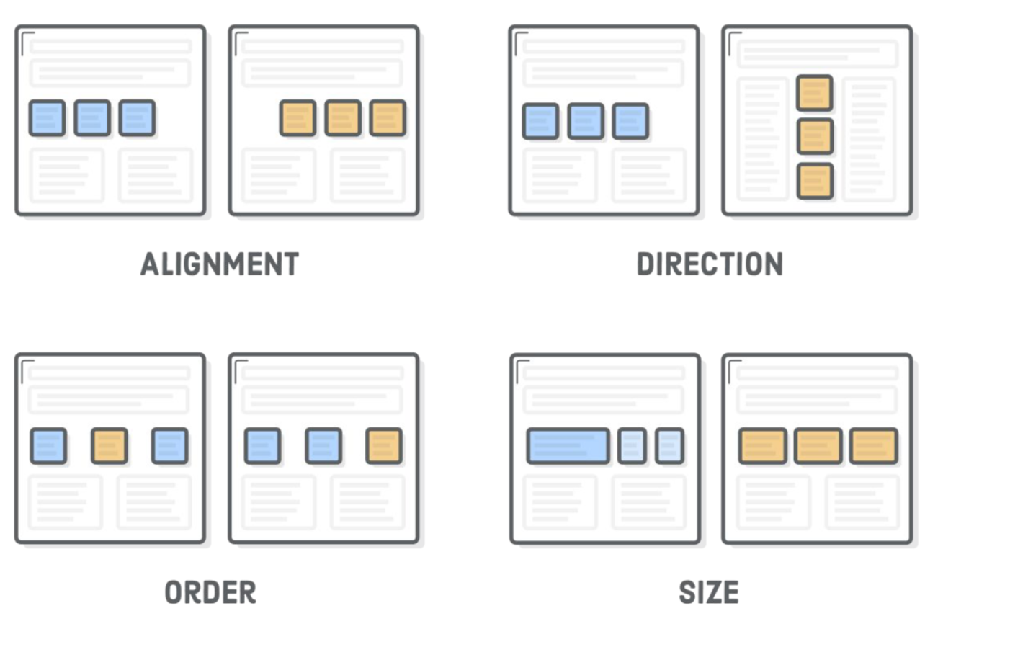
Flexbox
The “Flexible Box” or “Flexbox” layout mode offers an alternative to Floats for defining the overall appearance of a web page. Whereas floats only let us horizontally position our boxes, flexbox gives us complete control over the alignment, direction, order, and size of our boxes.

Slide 17
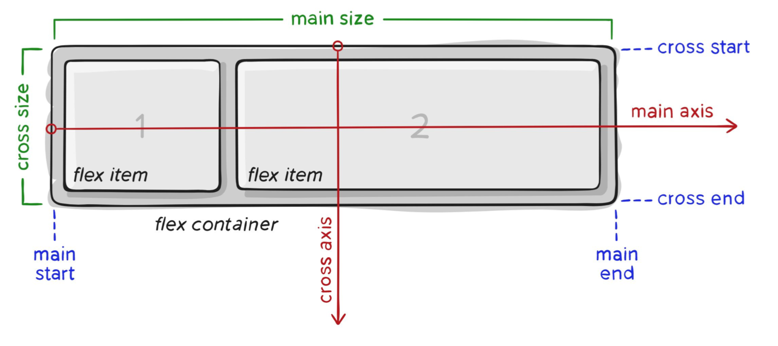
Terminology
The first step in using flexbox is to turn one of our HTML elements into a flex container. We do this with the display property, which should be familiar from the CSS Box Model chapter. By giving it a value of flex, we’re telling the browser that everything in the box should be rendered with flexbox instead of the default box model.

Slide 18
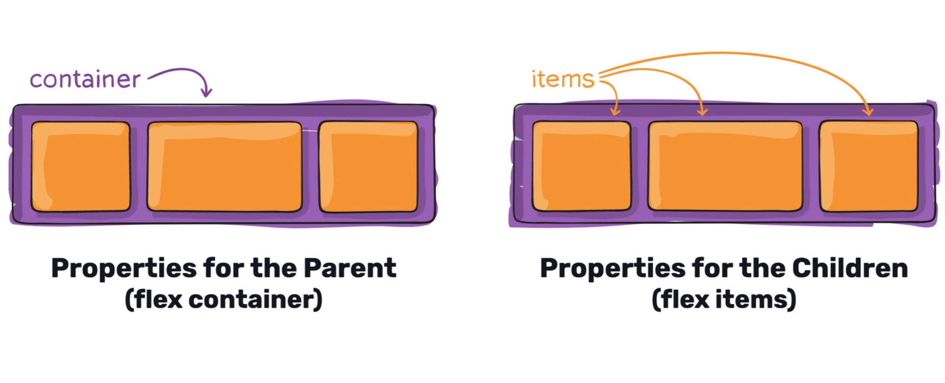
Container VS item
- Display
- Direction
- Wrapping
- Order
- Align
- Flex

Slide 19
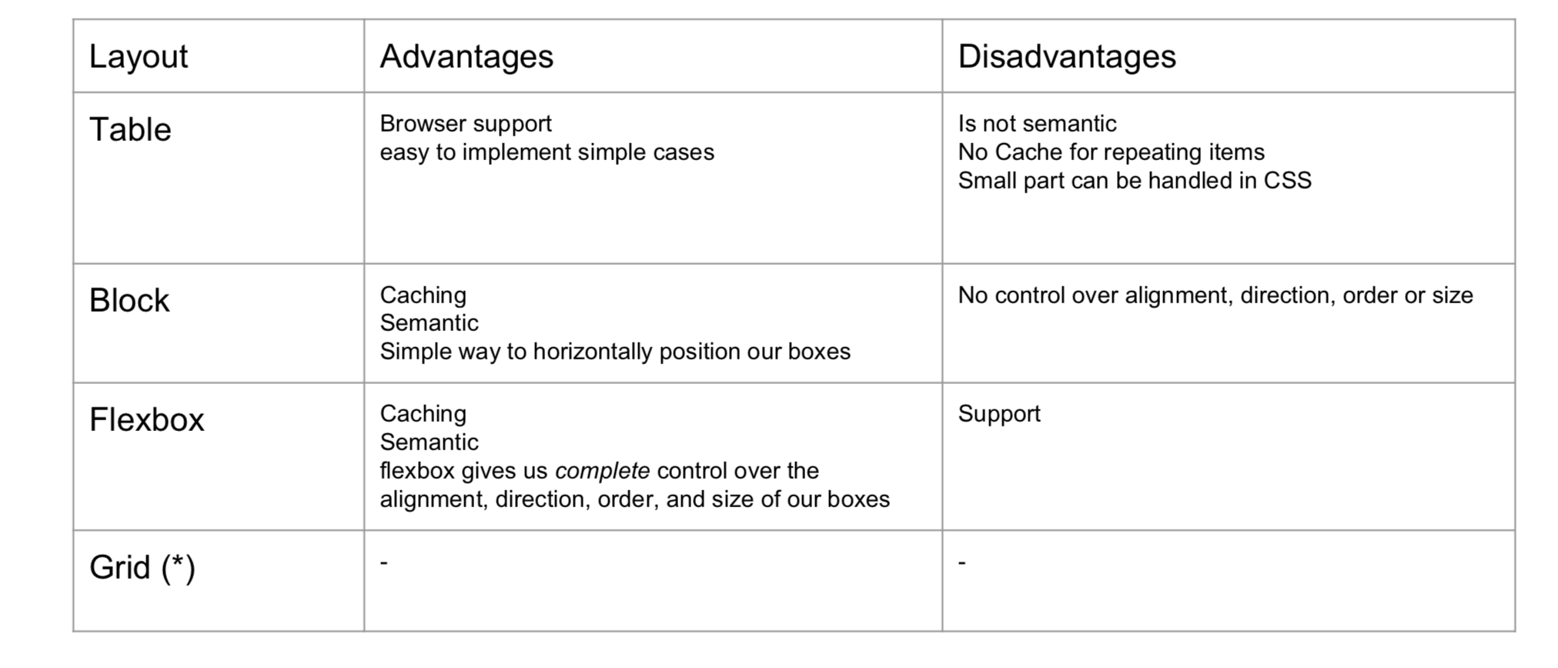
What to choose?

Slide 20
References
Reset CSS
Reset - https://meyerweb.com/eric/tools/css/reset/
Normalize - http://nicolasgallagher.com/about-normalize-css/
Semantic Layout
https://www.w3schools.com/html/html5_semantic_elements.asp
https://guide.freecodecamp.org/html/html5-semantic-elements/
About Float
https://css-tricks.com/all-about-floats/
CSS Flex
https://css-tricks.com/snippets/css/a-guide-to-flexbox/
Flex Games
https://flexboxfroggy.com/#ru
http://www.flexboxdefense.com/

