Slide 1

Lesson - 7
Introduction to GIT
And Command Line
SkillUp by Dobrea Vladislav

Slide 2
Lesson Plan
Basic Command Line
GIT
Github

Slide 3
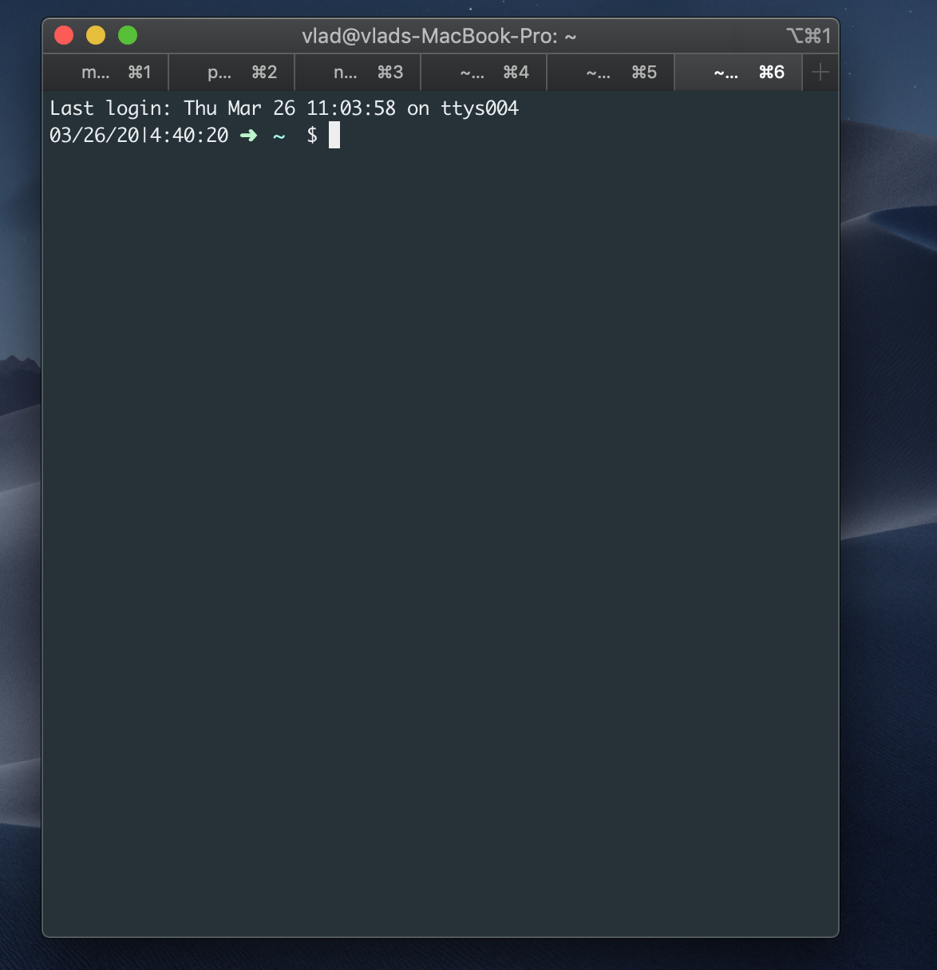
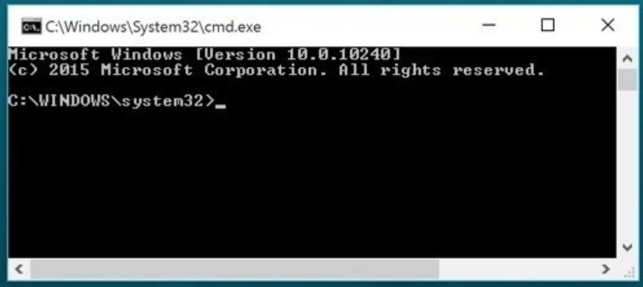
What is the command line?
The window, which is usually called the command line or command-line interface, is a text-based application for viewing, handling, and manipulating files on your computer. It's much like Windows Explorer or Finder on the Mac, but without the graphical interface. Other names for the command line are: cmd, CLI, prompt, console or terminal.

Slide 4
How to use it?
Depending on your version of Windows and your keyboard, one of the following should open a command window (you may have to experiment a bit, but you don't have to try all of these suggestions):
Go to the Start menu or screen, and enter "Command Prompt" in the search field.
Hold the Windows key and press the "R" key to get a "Run" window. Type "cmd" in the box, and click the OK key.

Slide 5
What we can do with it ?
Some basic commands:
Current directory
List files and directories
Change current directory
Create directory
Clean up
… use it with GIT

Slide 6
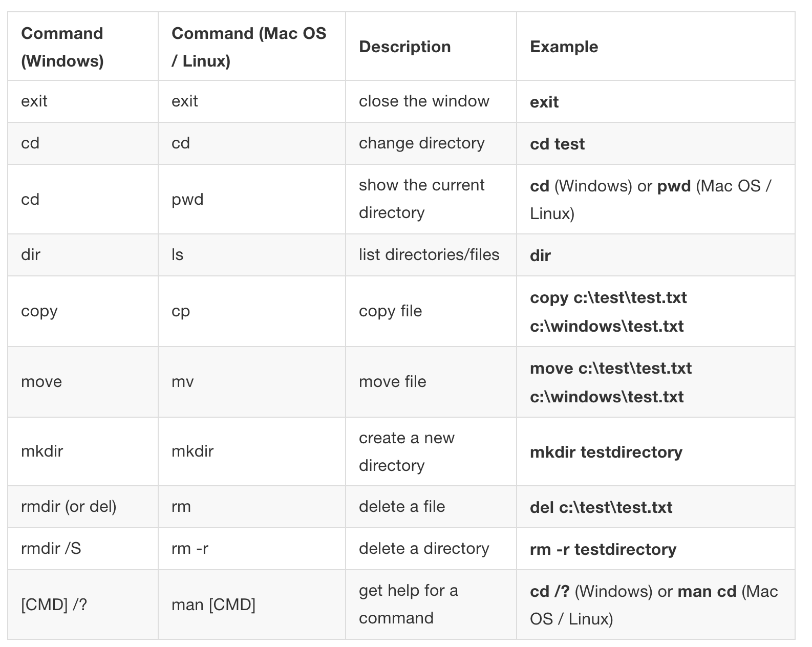
Summary of commands

Slide 7
Let’s practice

Slide 8
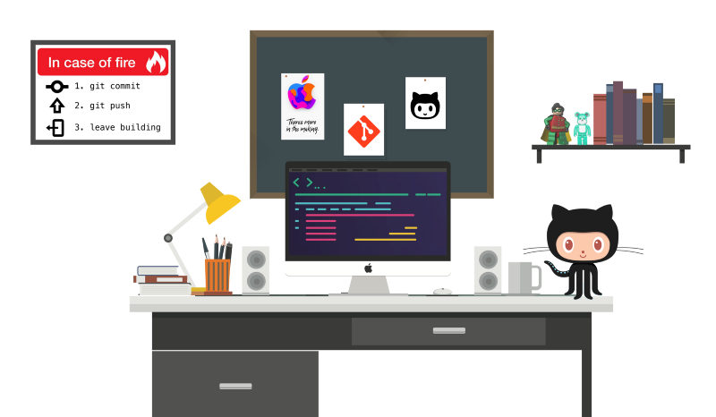
GIT Introduction

Slide 9

What is version control?
Version control is a system that records changes to a file or set of files over time so that you can recall specific versions later. So ideally, we can place any file in the computer on version control.

Slide 10
Why we need this?
A Version Control System (VCS) allows you to revert files back to a previous state, revert the entire project back to a previous state, review changes made over time, see who last modified something that might be causing a problem, who introduced an issue and when, and more. Using a VCS also means that if you screw things up or lose files, you can generally recover easily. And sometimes you just want to know “who wrote this crap”, and having access to that information is worthwhile ?.

Slide 11
What is GIT?
Git is a version-control system for tracking changes in computer files and coordinating work on those files among multiple people. Git is a Distributed Version Control System. So Git does not necessarily rely on a central server to store all the versions of a project’s files. Instead, every user “clones” a copy of a repository (a collection of files) and has the full history of the project on their own hard drive. This clone has all of the metadata of the original while the original itself is stored on a self-hosted server or a third party hosting service like GitHub.

Slide 12
How it helps?
Git helps you keep track of the changes you make to your code.
If at any point while coding you hit a fatal error and don’t know what’s causing it you can always revert back to the stable state.
Or you can simply see what changes you made to your code over time.

Slide 13
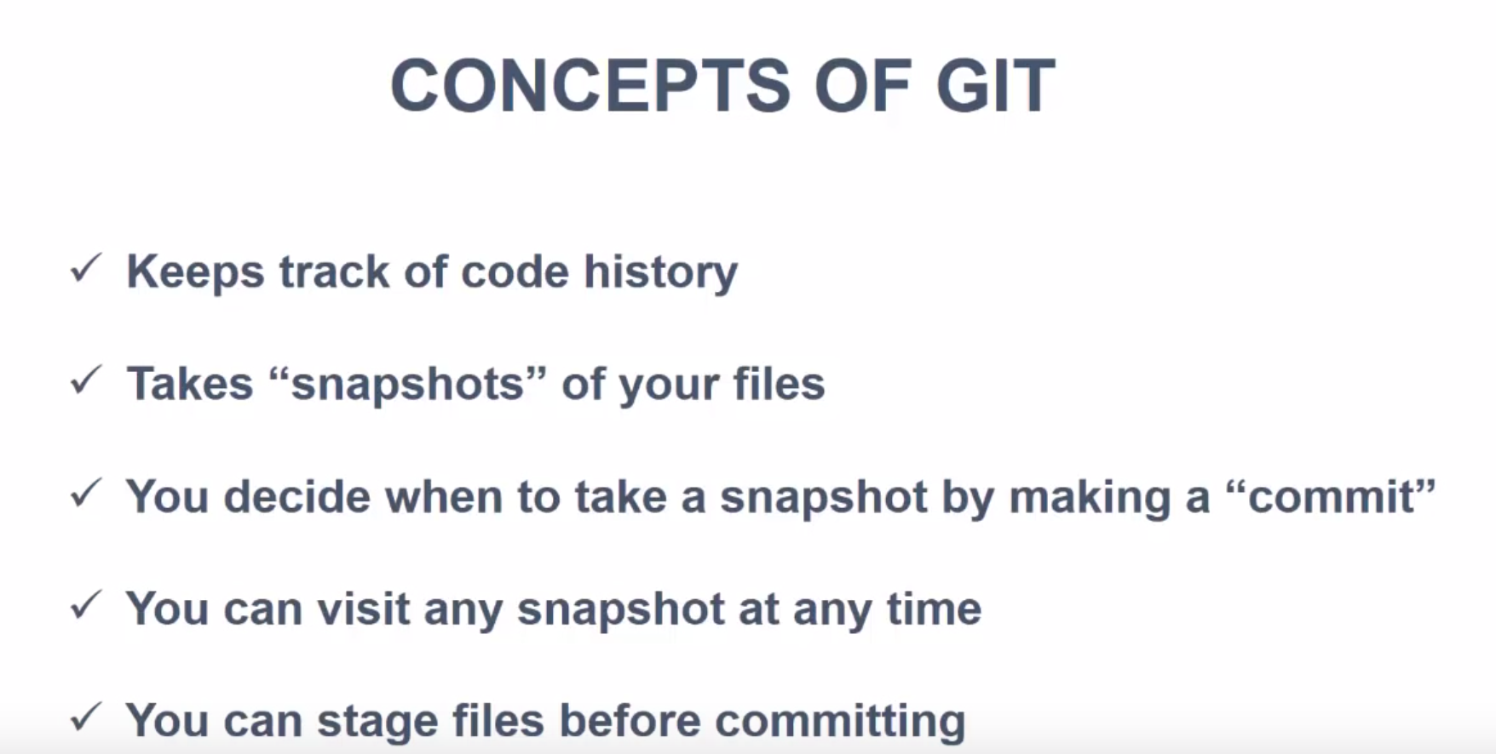

Slide 14
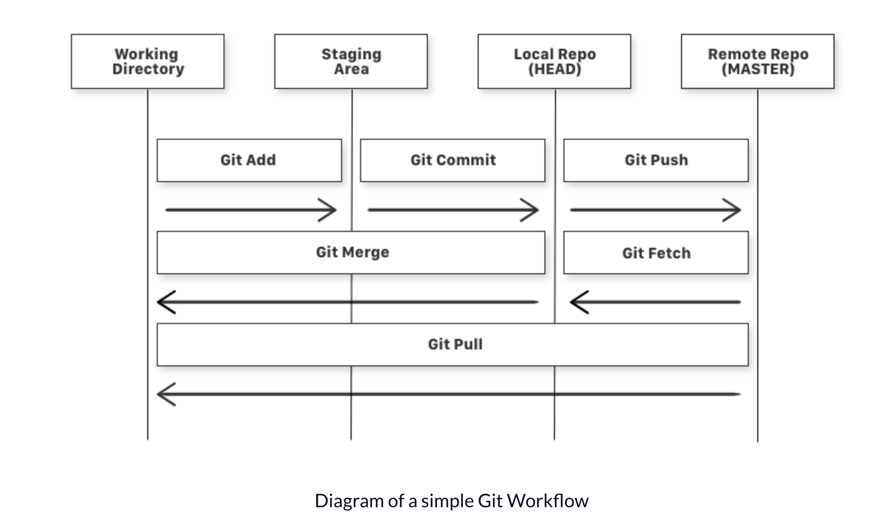
GIT Workflow
There are four fundamental elements in the Git Workflow.
Working Directory, Staging Area, Local Repository and Remote Repository.

Slide 15
Basic Commands
git init
git add <file>
git status
git commit
git push
git pull
git clone
// Initialize local Git Repository
// Add File(s) to Index
// Check status of working tree
// Commit changes to index
// Push to remote repository
// Pull latest from repository
// Clone Repository into a new directory

Slide 16
How to install?
1. Go here: https://git-scm.com/downloads or https://gitforwindows.org/
Download and run it, it’s a simple install wizard

Slide 17
Let’s practice

Slide 18
Learning Resources
GIT Introduction
Intro to GIT (video) must watch! https://www.youtube.com/watch?v=SWYqp7iY_Tc
https://www.freecodecamp.org/news/learn-the-basics-of-git-in-under-10-minutes-da548267cc91/
GIT Cheatsheet https://github.github.com/training-kit/downloads/ru/github-git-cheat-sheet/
Learn git as a GAME https://learngitbranching.js.org/
Another Documentation https://guides.github.com/introduction/git-handbook/
Command Line Introduction
https://tutorial.djangogirls.org/en/intro_to_command_line/

Slide 19
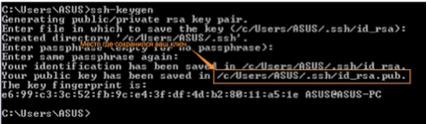
Home Work Setup
Установить GIT: https://gist.github.com/derhuerst/1b15ff4652a867391f03
Создать репозиторий из WEB interface c именем lesson-6: https://guides.github.com/activities/hello-world/
Сгенерировать SSH Public Key (Linux, OSx, Windows):
https://confluence.atlassian.com/bitbucketserver/creating-ssh-keys-776639788.html
Добавить сгенерированный SSH Public Key в GIT repository (для копирования ключа на Windows смотрите следующий пункт: https://help.github.com/articles/adding-a-new-ssh-key-to-your-github-account/
Для того чтобы скопировать сгенерированный ключ на Windows:
Переходим в папке где лежит ключ используя cd и dir команды
Открываем файл в notepad: start notepad "myfile.txt"
Копируем содержимое файла

Slide 20
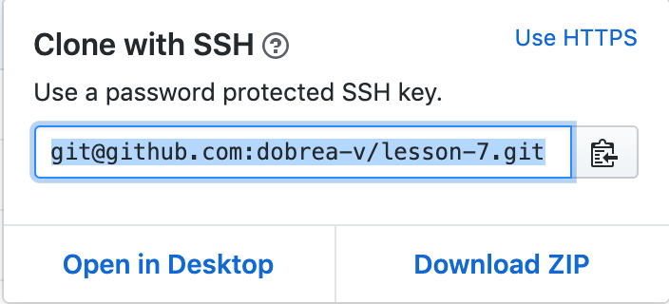
Home Work
Скачиваем репозиторий в нужную папку (url может скопировать в папку, Clone with SSH): git clone git@github.com:<your_git_account>/<repo>
Переходим в папку с только что скачанный репозиторием: cd <repo>
Добавляем файлы из домашнего (lesson 6, то что с макетом) задания: git add .
Выполняем сохранение наших изменений в локальный репозиторий: git commit -m "Add initial version of home work"
Заливаем изменения в удаленный репозиторий: git push origin master

