Slide 1
Lesson - 9
Responsive Web Design
SkillUp by Dobrea Vladislav

Slide 2
Lesson Plan
Review HW ( merging branches GitHub)
What is RWD?
Grid View
Media Queries
Meta tag viewport
Responsive Images
Working with Figma

Slide 3
What is Responsive Web Design?
Responsive web design (RWD) is an approach to web design that makes web pages render well on a variety of devices and window or screen sizes. Recent work also considers the viewer proximity as part of the viewing context as an extension for RWD.^{[1]} Content, design and performance are necessary across all devices to ensure usability and satisfaction.
Responsive web design makes your web page look good on all devices.
Responsive web design uses only HTML and CSS.
Responsive web design is not a program or a JavaScript.

Slide 4
RWD key points
A site designed with RWD adapts the layout to the viewing environment by using fluid, proportion-based grids, flexible images, and CSS3 media queries, an extension of the @media rule, in the following ways:
The fluid grid concept calls for page element sizing to be in relative units like percentages, rather than absolute units like pixels or points.
Flexible images are also sized in relative units, so as to prevent them from displaying outside their containing element.
Media queries allow the page to use different CSS style rules based on characteristics of the device the site is being displayed on, e.g. width of the rendering surface (browser window width or a physical display size).
Responsive layouts automatically adjust and adapt to any device screen size, whether it is a desktop, a laptop, a tablet, or a mobile phone.

Slide 5
RWD and SEO?
Responsive web design in SEO allows visitors to navigate your website easily. No matter whatever the device is. It provides a better user experience to your website because they could get the information anywhere and anytime. If your website does not have responsive web design Google will penalize for providing a bad user experience.
Important Note: Though you have a well-designed website, If your page is not responsive and mobile-friendly on smartphones you cannot rank higher on SERP

Slide 6
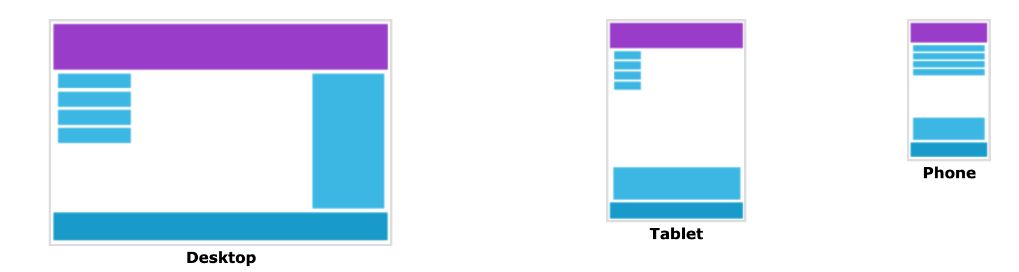
Designing For The Best Experience For All Users
Web pages can be viewed using many different devices: desktops, tablets, and phones. Your web page should look good, and be easy to use, regardless of the device.
Web pages should not leave out information to fit smaller devices, but rather adapt its content to fit any device:

Slide 7
Responsive Web Design - The Viewport
What is The Viewport?
The viewport is the user's visible area of a web page.
The viewport varies with the device, and will be smaller on a mobile phone than on a computer screen.
Before tablets and mobile phones, web pages were designed only for computer screens, and it was common for web pages to have a static design and a fixed size.
Then, when we started surfing the internet using tablets and mobile phones, fixed size web pages were too large to fit the viewport. To fix this, browsers on those devices scaled down the entire web page to fit the screen.
This was not perfect!! But a quick fix.

Slide 8
Setting The Viewport
HTML5 introduced a method to let web designers take control over the viewport, through the <meta> tag.
You should include the following <meta> viewport element in all your web pages:
A <meta> viewport element gives the browser instructions on how to control the page's dimensions and scaling.
The width=device-width part sets the width of the page to follow the screen-width of the device (which will vary depending on the device).
The initial-scale=1.0 part sets the initial zoom level when the page is first loaded by the browser.

Slide 9
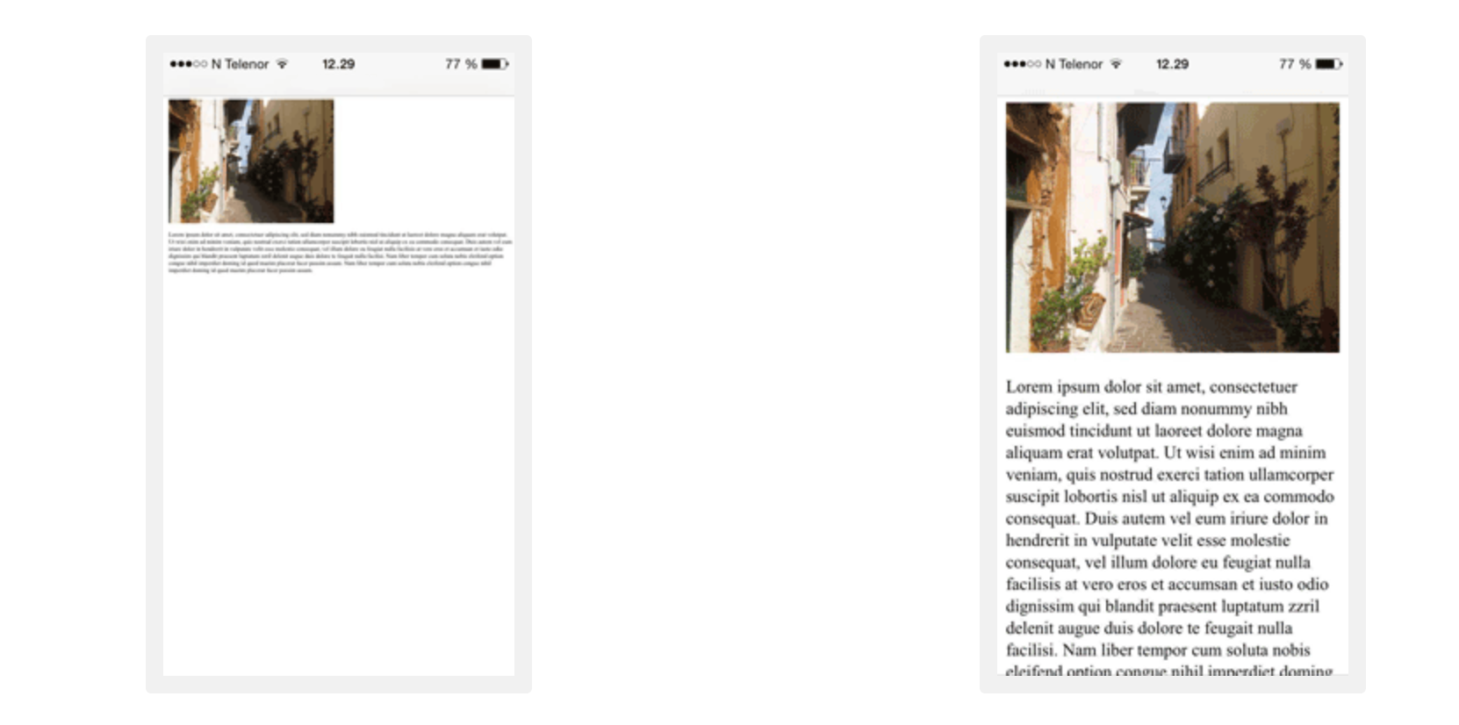
Viewport Difference
Without the viewport meta tag
With the viewport meta tag

Slide 10
Size Content to The Viewport
Users are used to scroll websites vertically on both desktop and mobile devices - but not horizontally!
So, if the user is forced to scroll horizontally, or zoom out, to see the whole web page it results in a poor user experience.
Some additional rules to follow:
1. Do NOT use large fixed width elements - For example, if an image is displayed at a width wider than the viewport it can cause the viewport to scroll horizontally. Remember to adjust this content to fit within the width of the viewport.
2. Do NOT let the content rely on a particular viewport width to render well - Since screen dimensions and width in CSS pixels vary widely between devices, content should not rely on a particular viewport width to render well.
3. Use CSS media queries to apply different styling for small and large screens - Setting large absolute CSS widths for page elements will cause the element to be too wide for the viewport on a smaller device. Instead, consider using relative width values, such as width: 100%. Also, be careful of using large absolute positioning values. It may cause the element to fall outside the viewport on small devices.

Slide 11
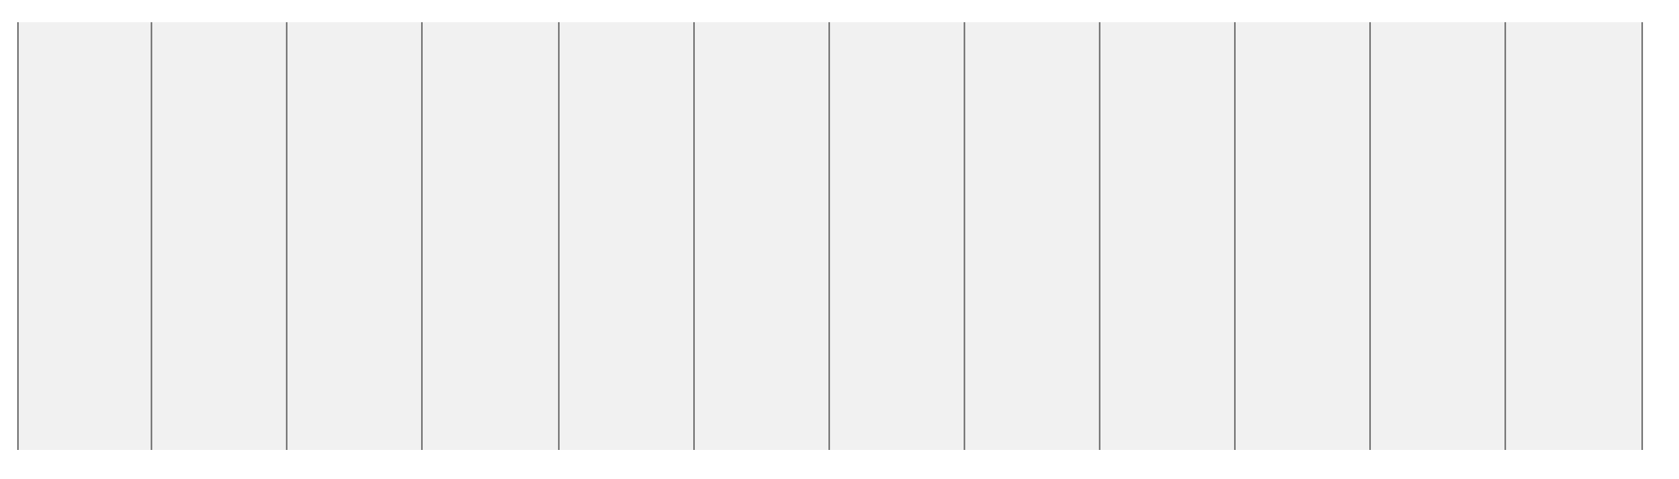
What is a Grid-View?
Many web pages are based on a grid-view, which means that the page is divided into columns:

Slide 12
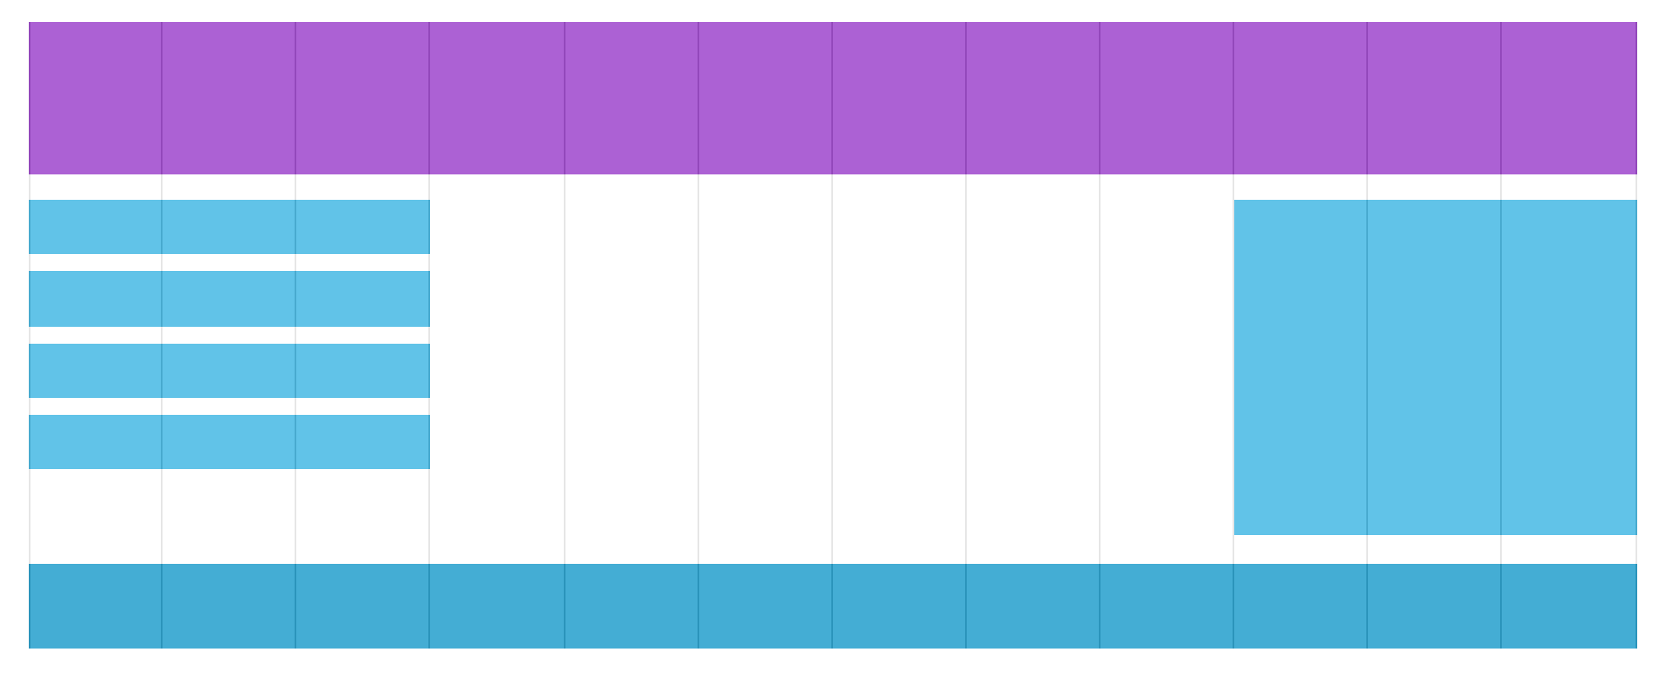
Helps in placing items on the page
Using a grid-view is very helpful when designing web pages. It makes it easier to place elements on the page.

Slide 13
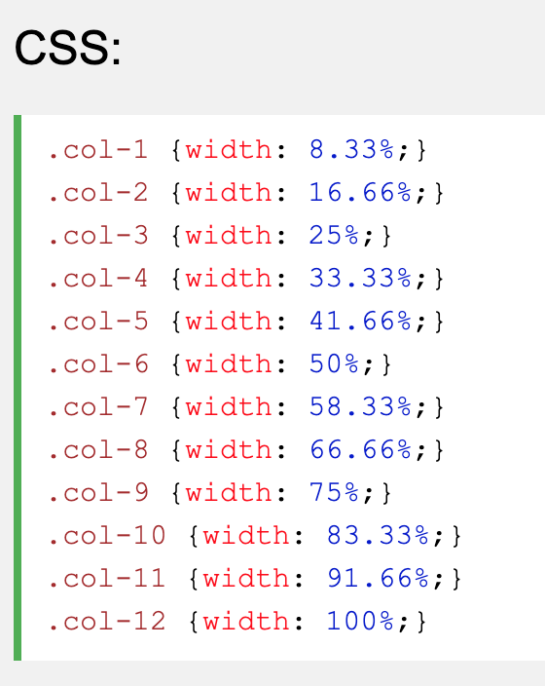
Very Basic Implementation

Slide 14
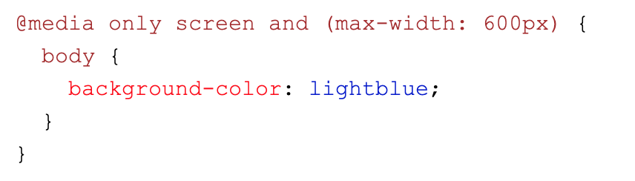
What is a Media Query?
Media query is a CSS technique introduced in CSS3.
It uses the @media rule to include a block of CSS properties only if a certain condition is true.
This is also called adding a breakpoint
If the browser window is 600px or smaller, the background color will be lightblue:

Slide 15
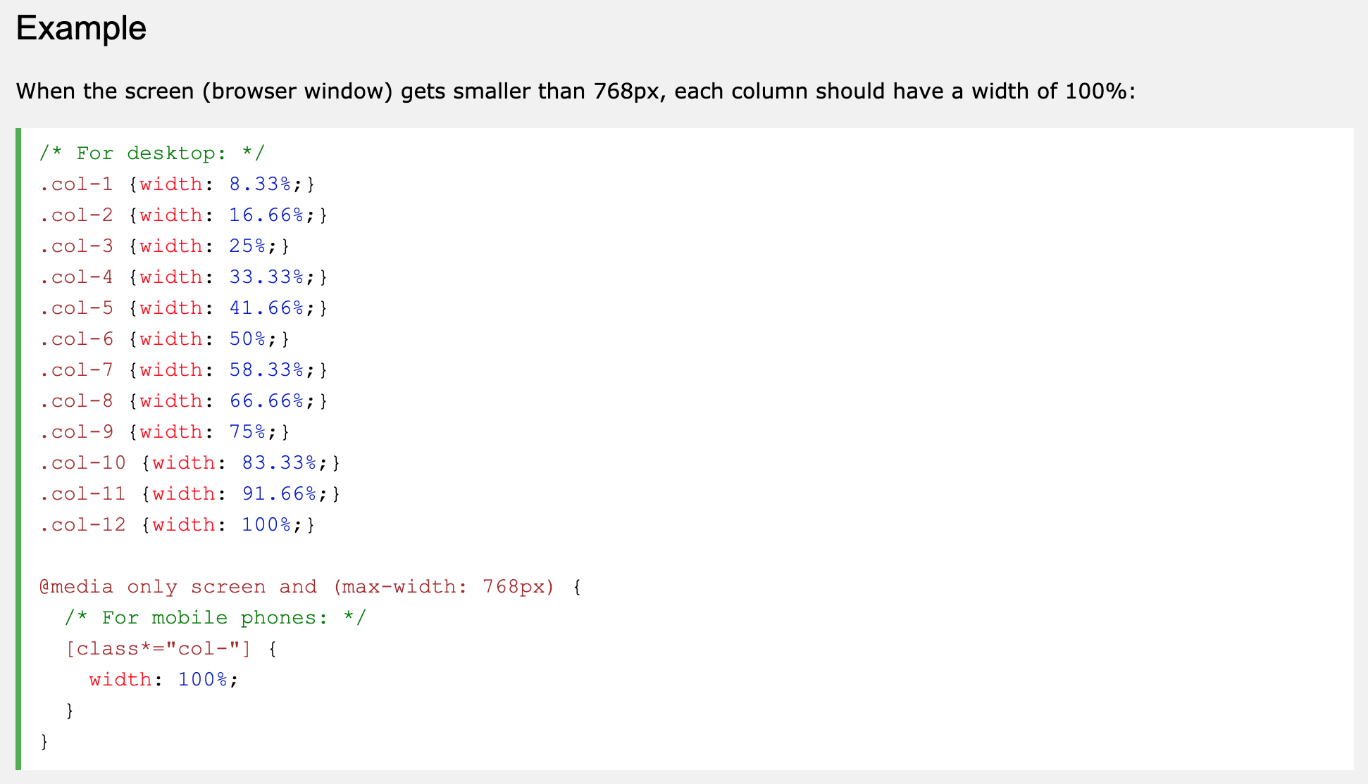
Example

Slide 16
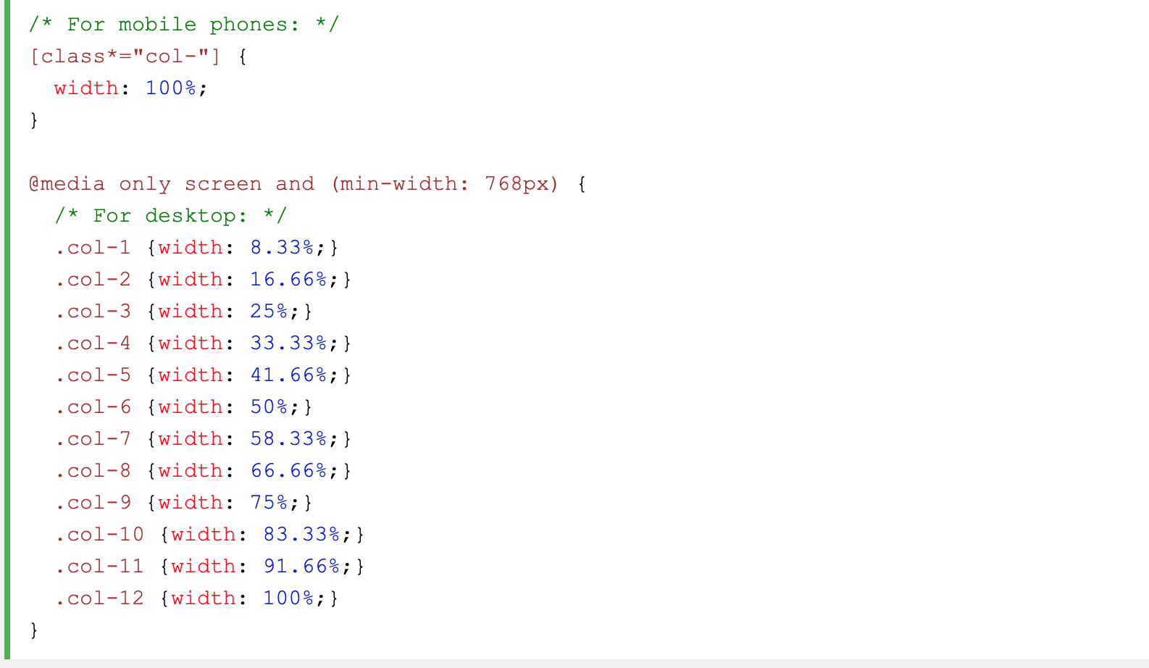
Always Design for Mobile First
Mobile First means designing for mobile before designing for desktop or any other device (This will make the page display faster on smaller devices).
This means that we must make some changes in our CSS.

Slide 17
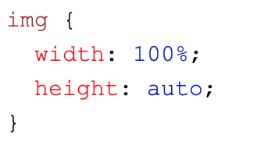
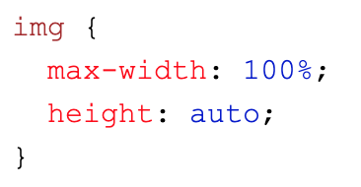
Responsive Images
If the width property is set to a percentage and the height is set to "auto", the image will be responsive and scale up and down:
Notice that in the example above, the image can be scaled up to be larger than its original size. A better solution, in many cases, will be to use the max-width property instead.

Slide 18
Let’s practice

Slide 19
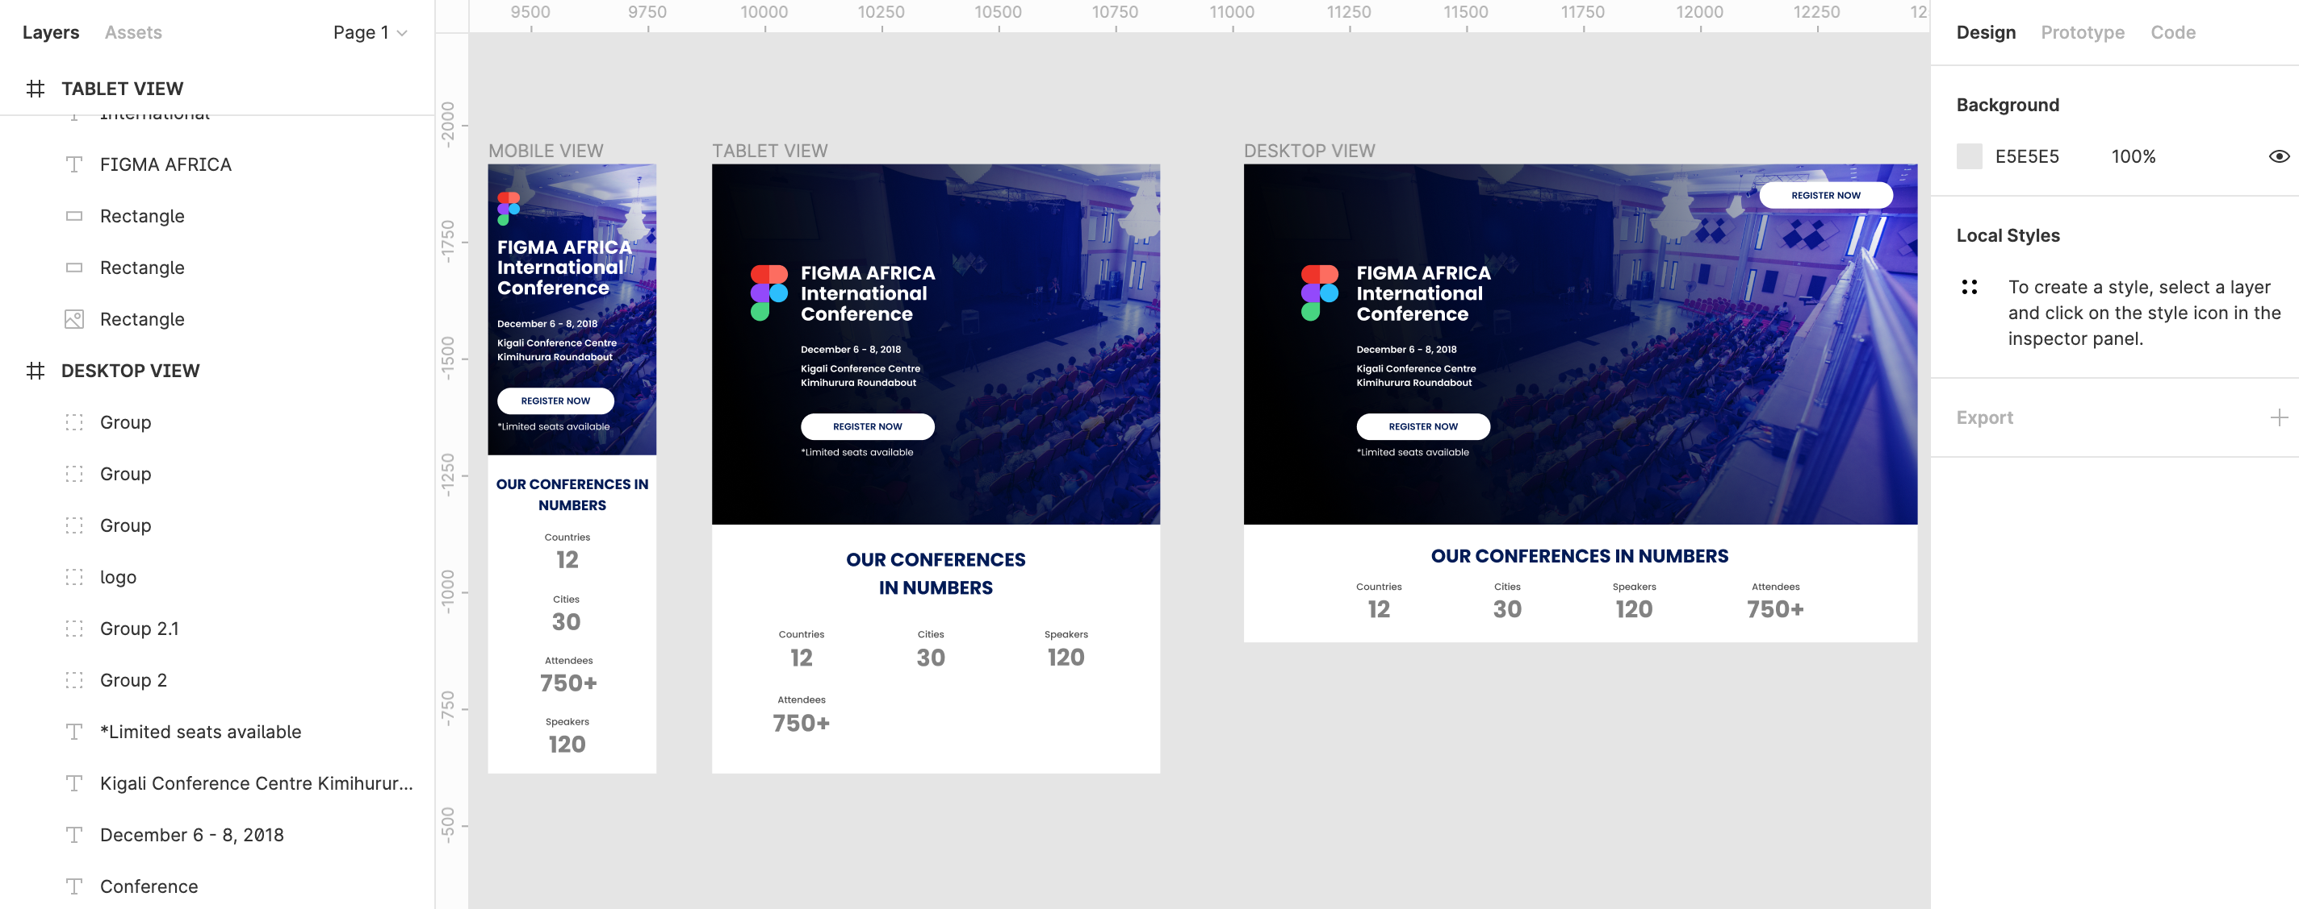
Figma Project
Go to
https://www.figma.com/file/NFChPUQyWb2NZpqTgeelLn/Event-Landing-Page-(Copy)?node-id=0%3A1

Slide 20
Learning Resources
Responsive Web Design
https://www.smashingmagazine.com/2011/01/guidelines-for-responsive-web-design/
https://www.w3schools.com/css/css_rwd_intro.asp
https://www.freecodecamp.org/news/learn-responsive-web-design-in-5-minutes/
https://www.youtube.com/watch?v=srvUrASNj0s
Media Queries
https://developer.mozilla.org/en-US/docs/Web/CSS/Media_Queries/Using_media_queries
https://medium.com/@pbojinov/media-queries-explained-9bf20a85731f
Figma
https://blog.prototypr.io/getting-started-with-figma-fc0db85c852c

Slide 21
Home Work Instructions
Open figma project https://www.figma.com/file/NFChPUQyWb2NZpqTgeelLn/Event-Landing-Page-(Copy)?node-id=0%3A1
Create a new folder and start git project
Implement it using HTML/CSS and using RWD techniques.
Push it to GitHub. Name it Lesson-9-HW

