Slide 1
Lesson - 1
Introduction. HTML 5
SkillUp by Dobrea Vladislav

Slide 2
Lesson Plan
Introduction
Communication
IDE’s and working environment
HTML5 Theory
Creating first Page
HomeWork

Slide 3

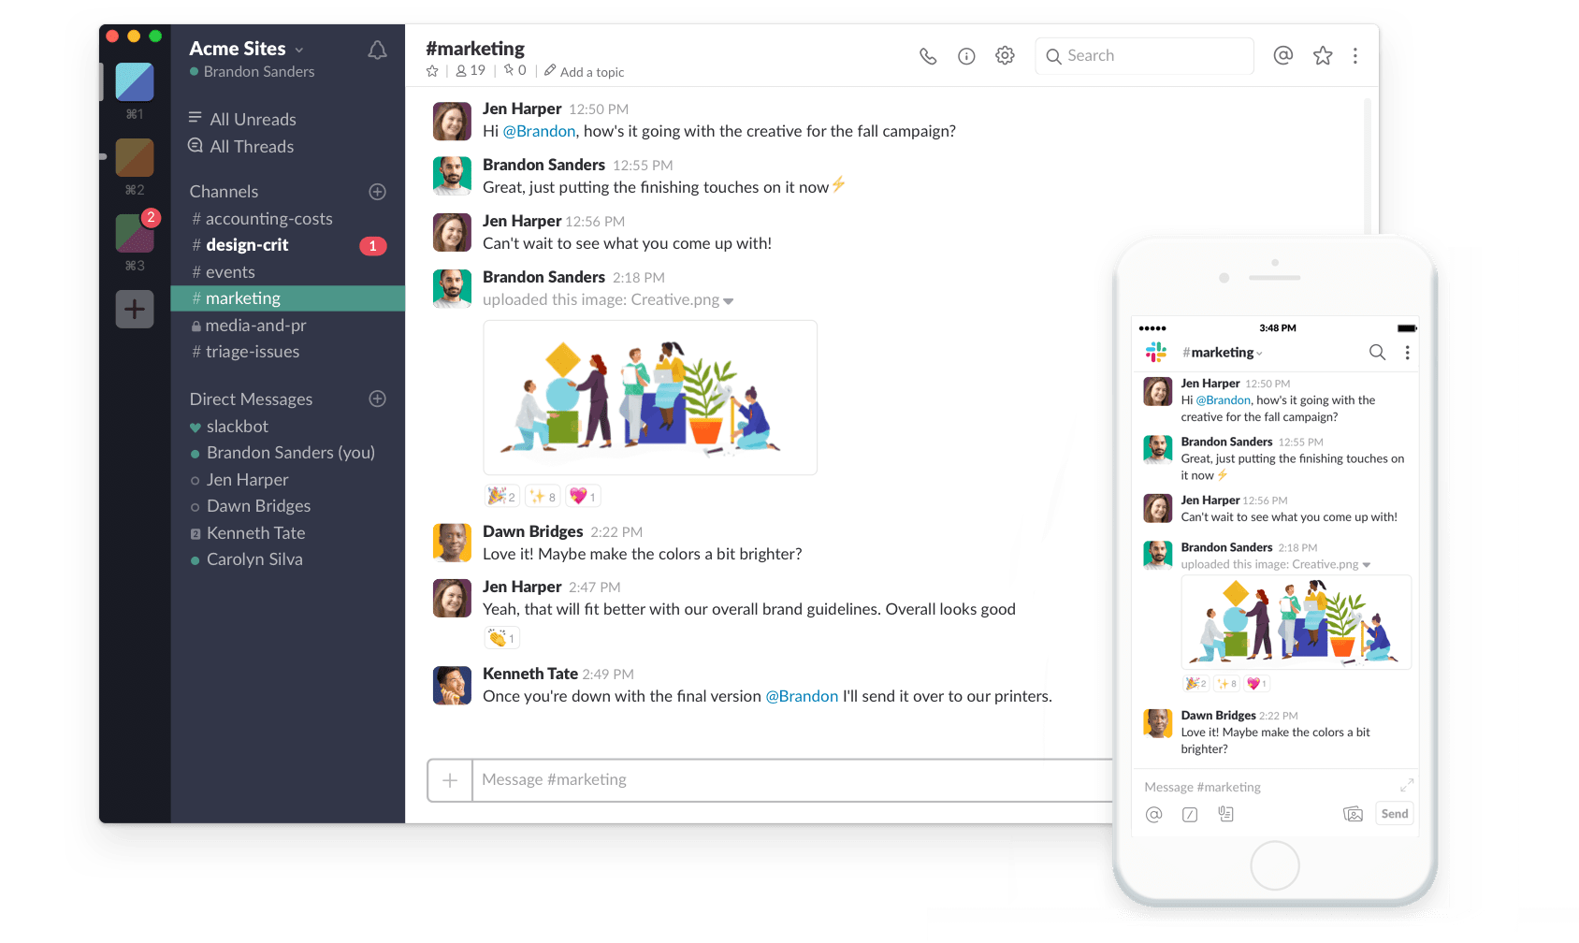
Slack for daily communication
Go to Slack website
Register and download app
Join our slack workspace

Slide 4

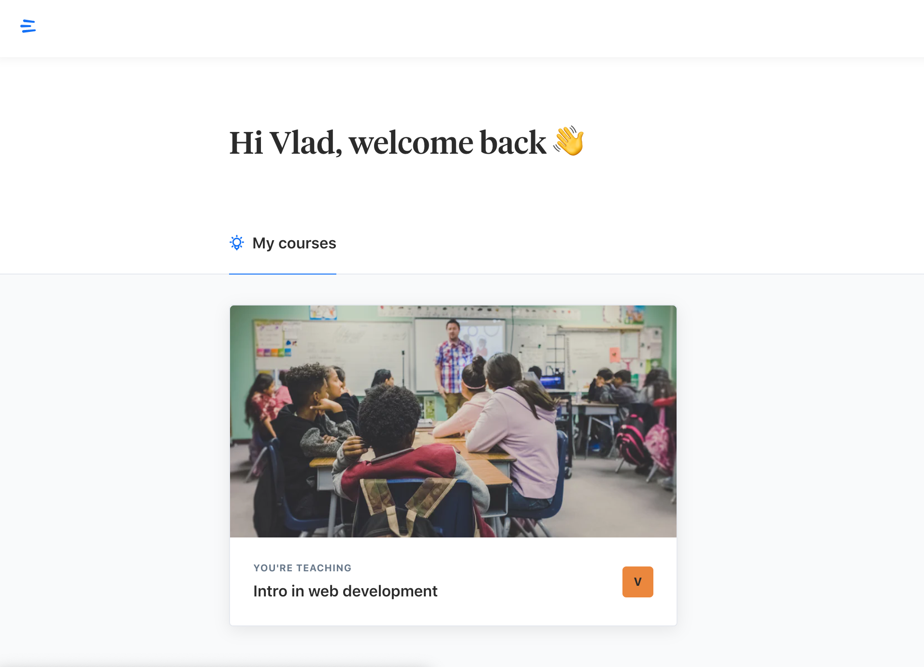
EduFlow for progress tracking
What for ?
Courses material
Assignment tracking
How to?
I will send invite link to your email
Addresses

Slide 5

Github
What is Github?
How to ?
Code hosting platform
Version Control
Collaboration
Go to GitHub official page
Register
Send me your profile
More action later in this course

Slide 6

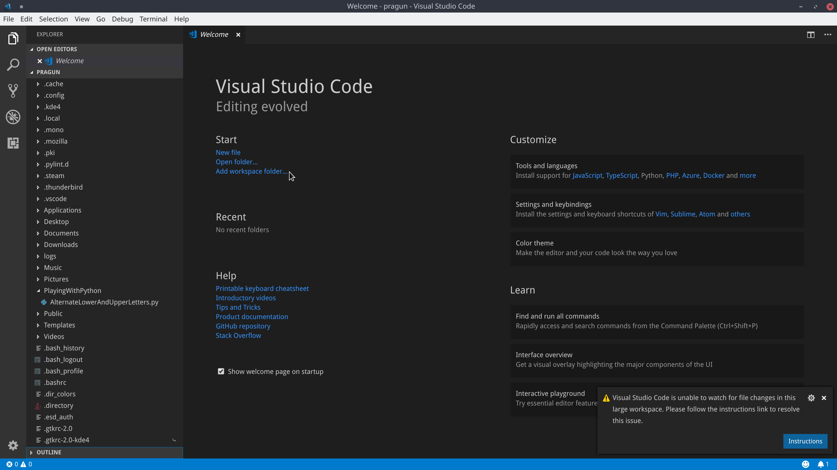
Tools to get started
Visual Studio Code
Go to this link and download

Slide 7
More tools…
CodePen - http://codepen.io
CodeSandbox - https://codesandbox.io/

Slide 8

What is HTML?
HTML is a language for describing WEB pages
HTML stands for Hyper Text Markup Language
HTML is not a programming languages, it is markup language
A markup language is a set of markup tags
HTML uses markup tags to describe WEB pages, the tags indicate where headings, images, lists, links, line breaks and other components should go

Slide 9




HTML Extension
When your computer opens a *.html files, it knows to open it in Browser (Chrome, Firefox, Safari and etc.)
The browser can read this file and know how to display it on the screen.
Screen readers and other assistive devices can also utilize the HTML tags to present the information in special ways

Slide 10

Web standards organizations
W3C (World Wide Web Consortium) - https://validator.w3.org/
IETF (Internet Engineering Task Force)
WAI (Web Accessibility Initiative)

Slide 11
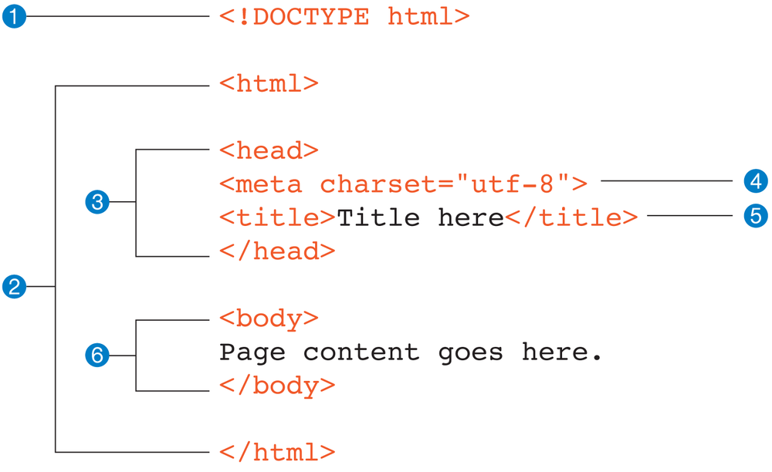
HTML Structure

Slide 12
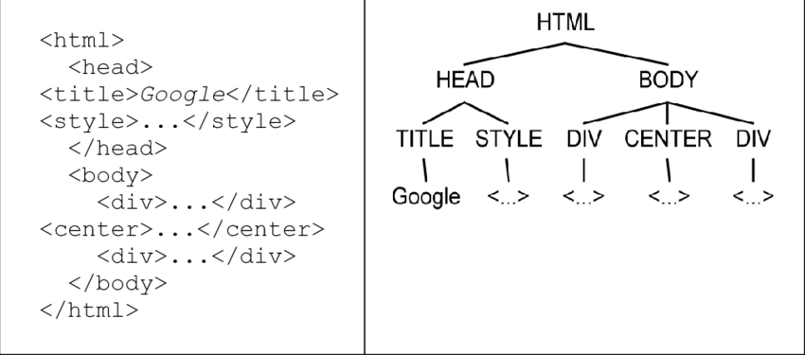
What is DOM?

Slide 13
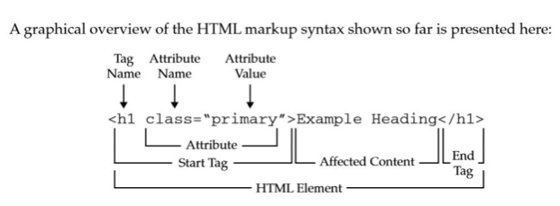
HTML Tag structure

Slide 14

Learning HTML
Semantics
Is there a tag that better conveys the meaning I am trying to get across?
If someone is searching my page can they find what they need and access it easily?
Is it responsive?
Does it provide valid accessibility?
Syntax
What tags are there?
Does it look valid?
Did I remember to "end" my tag?

Slide 15
References
Progressive Enhancement или всё-таки Graceful Degradation: https://habr.com/post/157115/
Usability, UX vs UI:
https://www.cornerstonedm.co.uk/blog/frontend-usability/
https://habr.com/post/321312/
Ресурсы, которые могут помочь при выполнении домашнего задания:
Doctype: https://www.w3schools.com/tags/tag_doctype.asp
Ссылки в HTML: https://www.w3schools.com/tags/tag_a.asp
Изображения в HTML: https://www.w3schools.com/tags/tag_img.asp
Списки: https://www.w3schools.com/html/html_lists.asp
Надстрочный текст: https://www.w3schools.com/tags/tag_sup.asp
Подстрочный текст: https://www.w3schools.com/tags/tag_sub.asp
Комментарии: https://www.w3schools.com/tags/tag_comment.asp
Разрыв строки: https://www.w3schools.com/tags/tag_br.asp
Форматирофание текста: https://www.w3schools.com/html/html_formatting.asp
Хорошие сервисы, которые советую вам использовать перед отправкой домашнего задания:
Проверка разметки HTML - HTML W3C HTML Validator: https://validator.w3.org
Проверка семантики - HTML Semantics: https://gsnedders.html5.org/outliner/
А также статья о том, что проверяется перед тем как отдать готовую страницу клиенту: https://habr.com/post/114256/
Visual Studio Code: https://code.visualstudio.com/docs/getstarted/introvideos

Slide 16
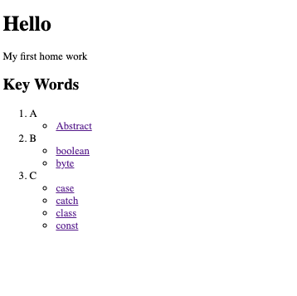
Homework
Create and send me your Github account.
Create CodePen account.
Re create image bellow into a HTML page in CodePen and send link
NOTE: create actual link that will point to a google search result
ex: abstract: href = https://www.google.com/search?q=abstract

