Slide 1
Lesson - 2
HTML 5. Base Elements.
Part 1
SkillUp by Dobrea Vladislav

Slide 2
Lesson Plan
Review Homework
Lists
Hyperlinks
Working with images
Text formating
Homework

Slide 3
Homework review
Required Elements:
Headings
Lists
Hyperlinks

Slide 4
Headings
Why Headings Are Important ?
- Search engines use the headings to index the structure and content of your web pages.
- Users often skim a page by its headings. It is important to use headings to show the document structure.
- <h1> headings should be used for main headings, followed by <h2> headings, then the less important <h3>, and so on.
Heading 1
Heading 2
Heading 3
Heading 4
Heading 5
Heading 6

Slide 5
Lists
Lists types:
1. Ordered: <ol> - Ordered lists are lists in which the order of the items does matter
2. Unordered: <ul> - Unordered lists are used to mark up lists of items for which the order of the items doesn't matter

Slide 6
List nesting?
It is perfectly ok to nest one list inside another one. You might want to have some sub-bullets sitting below a top level bullet.

Slide 7
Hyperlinks
What is a hyperlink?
One of the most important feature of WEB
They allow us to link our documents to any other document
Just about any web content can be converted to a link, so that when clicked
<p>I'm creating a link to
<a href="https://www.mozilla.org/en-US/">the Mozilla homepage</a>.
</p>

Slide 8
Links
Additional attribute:
-title: this is intended to contain supplementary useful information about the link, such as what kind of information the page contains, or things to be aware of.
<p>I'm creating a link to
<a href="https://www.mozilla.org/en-US/"
title="The best place to find more information about Mozilla's
mission and how to contribute">the Mozilla homepage</a>.
</p>

Slide 9
Document fragments
It is possible to link to a specific part of an HTML document (known as a document fragment), rather than just to the top of the document. To do this you first have to assign an id attribute to the element you want to link to. It normally makes sense to link to a specific heading, so this would look something like the following:
<h2 id="Mailing_address">Mailing address</h2>
Then to link to that specific id, you'd include it at the end of the URL, preceded by a hash/pound symbol, for example:
<p>Want to write us a letter? Use our <a href="contacts.html#Mailing_address">mailing address</a>.</p>

Slide 10
Absolute vs Relative
absolute URL: Points to a location defined by its absolute location on the web, including protocol and domain name. So for example, if an index.html page is uploaded to a directory called projects that sits inside the root of a web server, and the web site's domain is http://www.example.com, the page would be available at http://www.example.com/projects/index.html
<p>A link to my <a href="http://www.example.com/pdfs/project-brief.pdf">project brief</a>.</p>
relative URL: Points to a location that is relative to the file you are linking from
<p>A link to my <a href="../pdfs/project-brief.pdf">project brief</a>.</p>

Slide 11
Images on the web
In order to put a simple image on a webpage, we use the <img> element. This is an empty element (meaning that it has no text content or closing tag) that requires a minimum of one attribute to be useful — src (sometimes spoken as its full title, source).
The src attribute contains a path pointing to the image you want to embed in the page, which can be a relative or absolute URL, in the same way as href attribute values in <a> elements.
!Important: Don’t forget to add alt attribute

Slide 12
Text formating
Emphasis and Importance:
<em> - in HTML we use it to emphasis text
<strong> - We use it to make text bold
Additional formatting elements:
1. <dl>, <dt>, <dd> - Definition Lists
2. <q>, <blockquote> - Block level or Inline Quotations

Slide 13
References
Text Formatting Fundamentals - https://developer.mozilla.org/en-US/docs/Learn/HTML/Introduction_to_HTML/HTML_text_fundamentals
Advanced text formatting - https://developer.mozilla.org/en-US/docs/Learn/HTML/Introduction_to_HTML/Advanced_text_formatting
Hyperlinks - https://developer.mozilla.org/en-US/docs/Learn/HTML/Introduction_to_HTML/Advanced_text_formatting
Images - https://developer.mozilla.org/en-US/docs/Learn/HTML/Multimedia_and_embedding/Images_in_HTML
Recommended online resources
https://www.geeksforgeeks.org/html-introduction/
https://www.w3schools.com/html/html_intro.asp
https://developer.mozilla.org/en-US/docs/Learn/HTML/Introduction_to_HTML

Slide 14
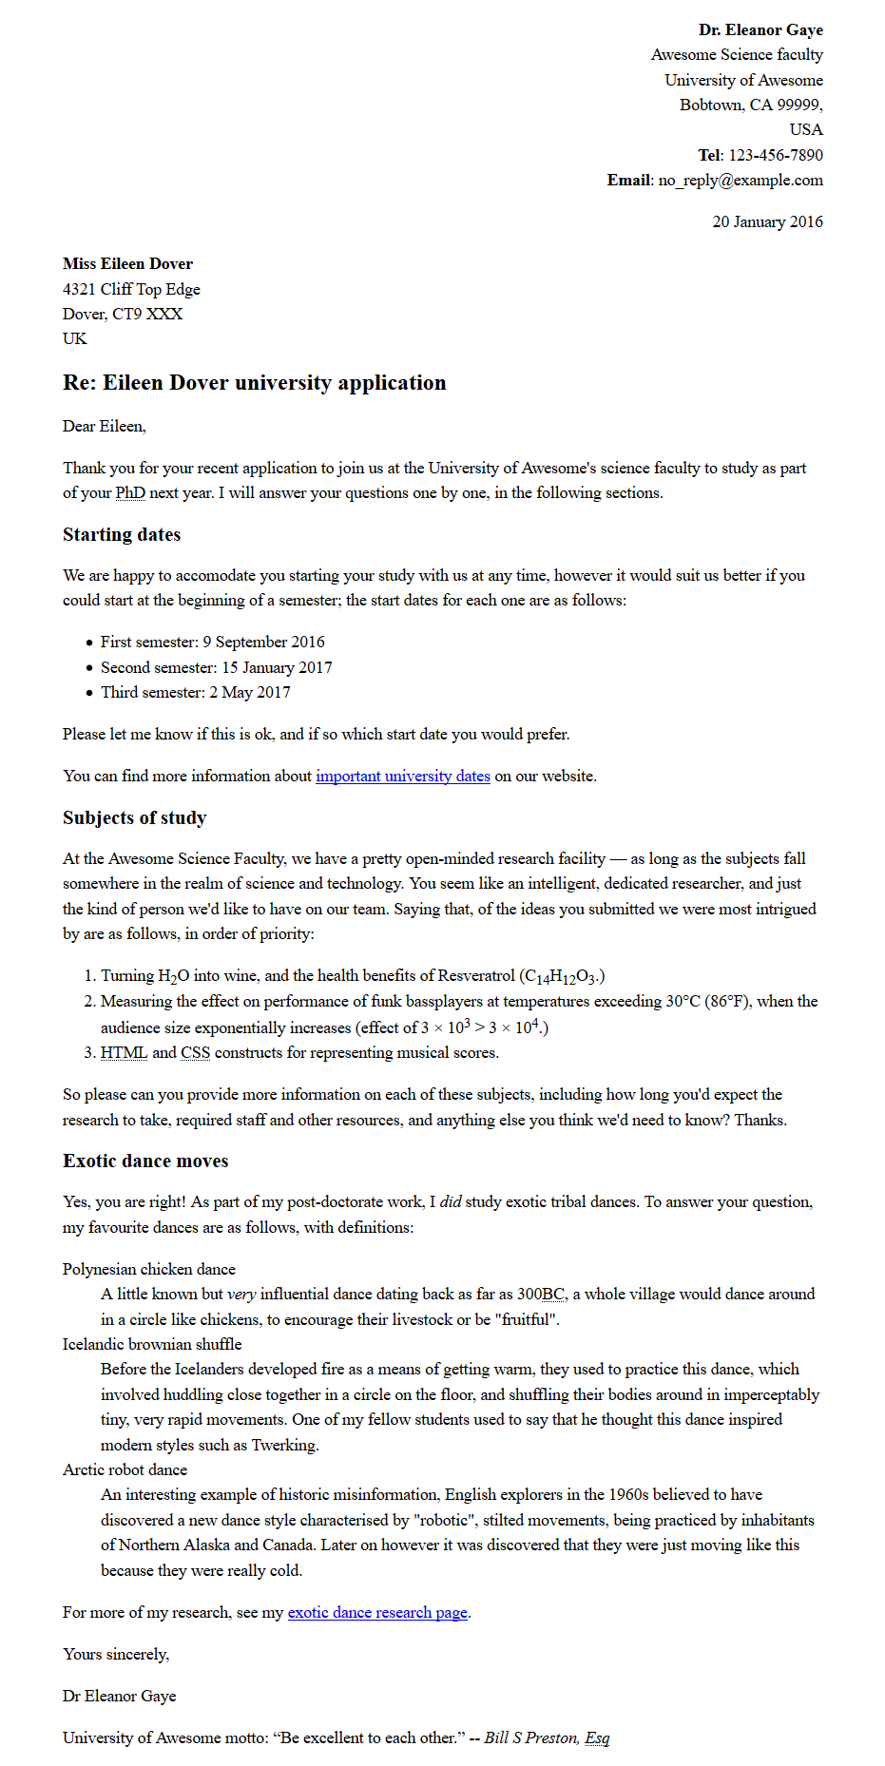
Homework
Follow this link to get text of letter
Create index.html file with basic template
Add the following css from this link
Add required markup to match image, if you can’t open it from presentation, open with this link
It should be downloadable and resizable

Slide 15
Step by step guide
Markup from source the source file, a letter, that should match following image
Block/structural semantics:
You should structure the overall document with an appropriate structure including doctype, and <html>, <head> and <body> elements.
The letter in general should be marked up with a structure of paragraphs and headings, with the exception of the below points. There is one top level heading (the "Re:" line) and three second level headings.
The semester start dates, study subjects and exotic dances should be marked up using an appropriate list type.
The two addresses should be put inside <address> elements. Each line of the address should sit on a new line, but not be in a new paragraph.
Inline semantics:
The names of the sender and receiver (and "Tel" and "Email") should be marked up with strong importance.
The four dates in the document should be given appropriate elements containing machine-readable dates.
The first address and first date in the letter should be given a class attribute value of "sender-column"; the CSS you'll add later will then cause these to be right aligned, as should be the case in a classic letter layout.
The five acronyms/abbreviations in the main text of the letter should be marked up to provide expansions of each acronym/abbreviation.
The six sub/superscripts should be marked up appropriately — in the chemical formulae, and the numbers 103 and 104 (they should be 10 to the power or 3 and 4, respectively).
Try to mark up at least two appropriate words in the text with strong importance/emphasis.
There are two places where a hyperlink should be added; add appropriate links with titles. For the location that the links point to, just use http://example.com.
The university motto quote and citation should be marked up with appropriate elements

