Slide 1
Lesson - 5
CSS. Introduction
Part - 2
SkillUp by Dobrea Vladislav

Slide 2
Lesson Plan
Recap + HW
Box types
Display
Unit measurements
CSS Shorthands
CSS Positioning

Slide 3


Box Types
In CSS we broadly have two types of boxes — block boxes and inline boxes. These characteristics refer to how the box behaves in terms of page flow, and in relation to other boxes on the page
Block VS Inline

Slide 4
Inline Elements
Inline elements rules:
Take only as much space as they need
Displayed side by side
Don’t accept width or height properties, and top-bottom margin
Can be a parent of other inline elements
Examples: <span>, <button>, <input> ..etc

Slide 5
Block Elements
Block-level elements rules
Take full-width (100% width) by default
Each gets displayed in a new line
Width & height properties can be set
Can contain other block or inline elements
Examples: <p>, <div>, <table>, <form> ..etc

Slide 6
Let’s see the code

Slide 7

Display property
The display property is one of the most commonly used features of CSS development. Our web page treats every HTML element as a box, and with the display property, we determine how these boxes will be shown, or whether to show or hide them.
The display property specifies the display behavior (the type of rendering box) of an element. — W3

Slide 8
Types of display properties
There are various values of the display property. We will be covering the following parts in this lesson:
display: none vs. visibility: hidden
display: block
display: inline
display: inline-block

Slide 9



Display none vs hidden
We can hide elements by declaring a display: none value. Another way is to declare visibility: hidden instead of display: none, but there is a difference between them.
visibility: hidden;
Initial
display: none;

Slide 10
Let’s practice

Slide 11
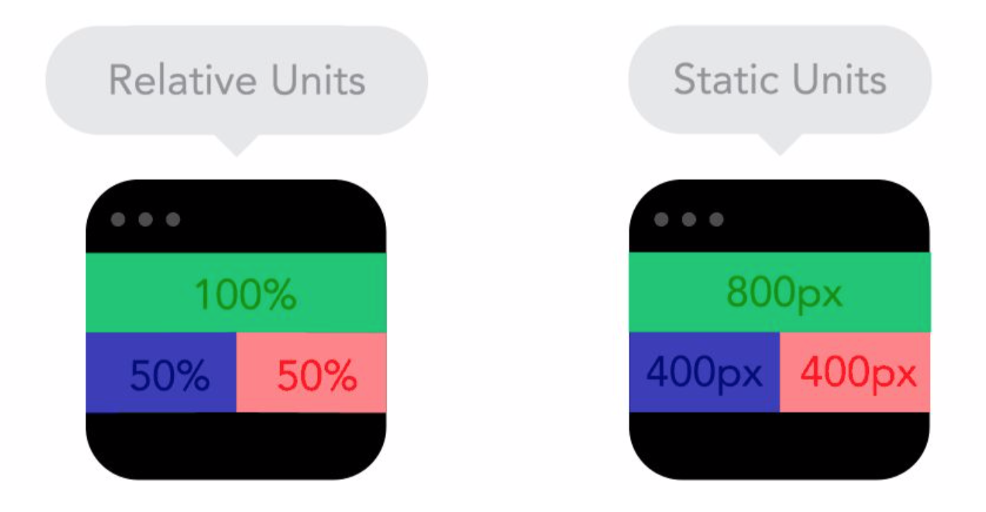
Unit measurements

Slide 12
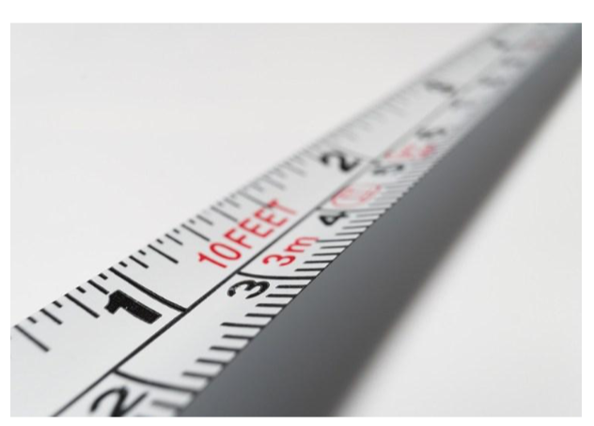
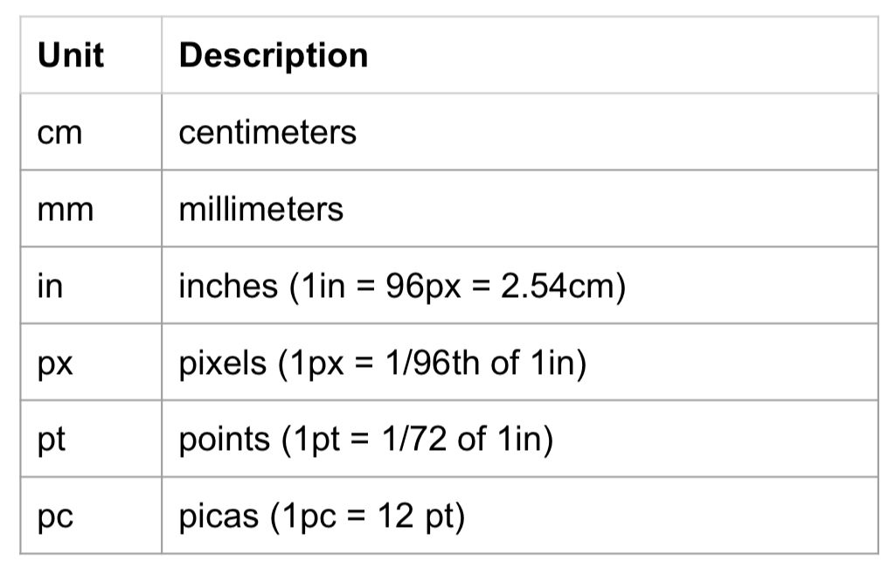
Absolute Units

Slide 13

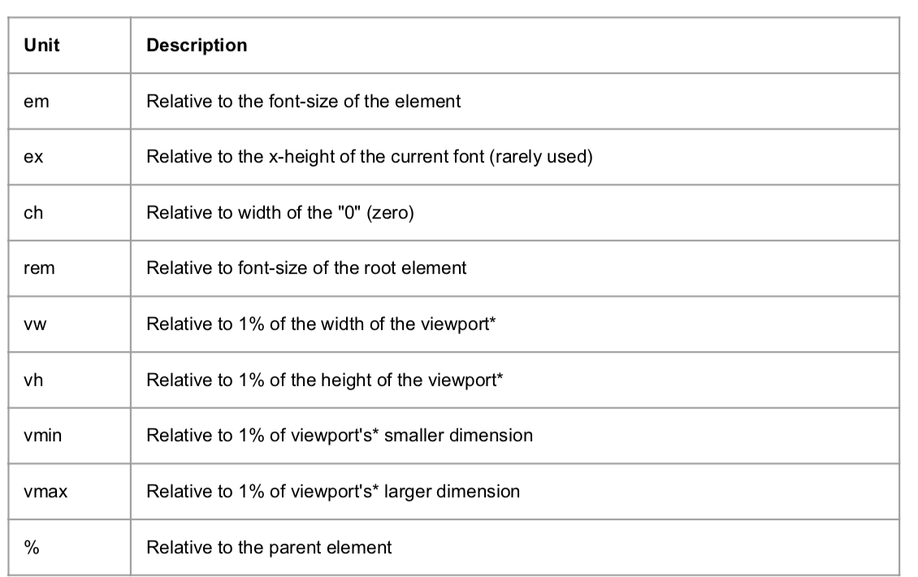
Relative Units

Slide 14
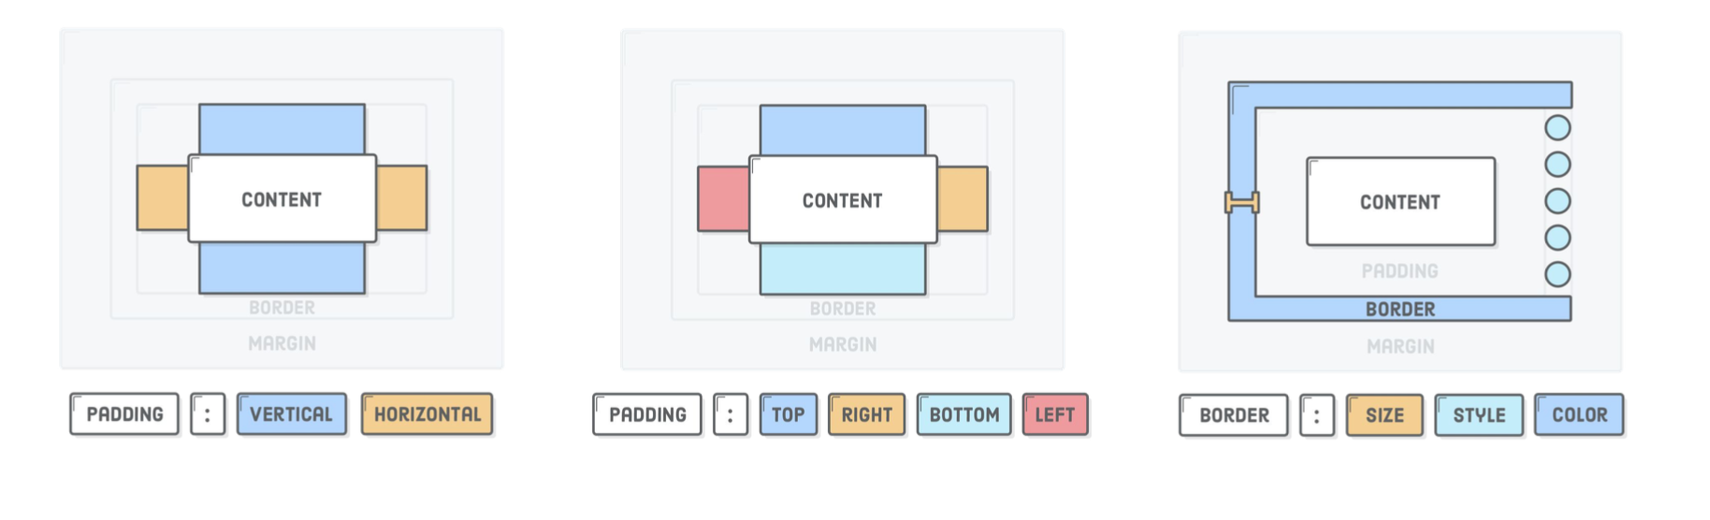
CSS Shorthand commands
Other existing shorthands: font, background

Slide 15
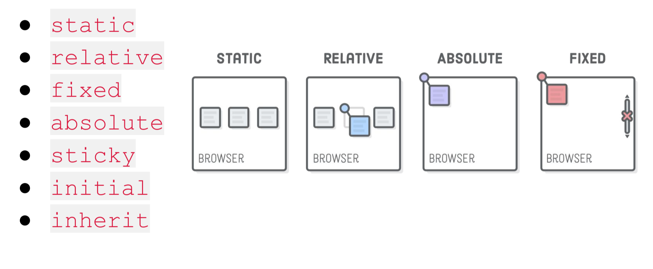
CSS Positioning

Slide 16
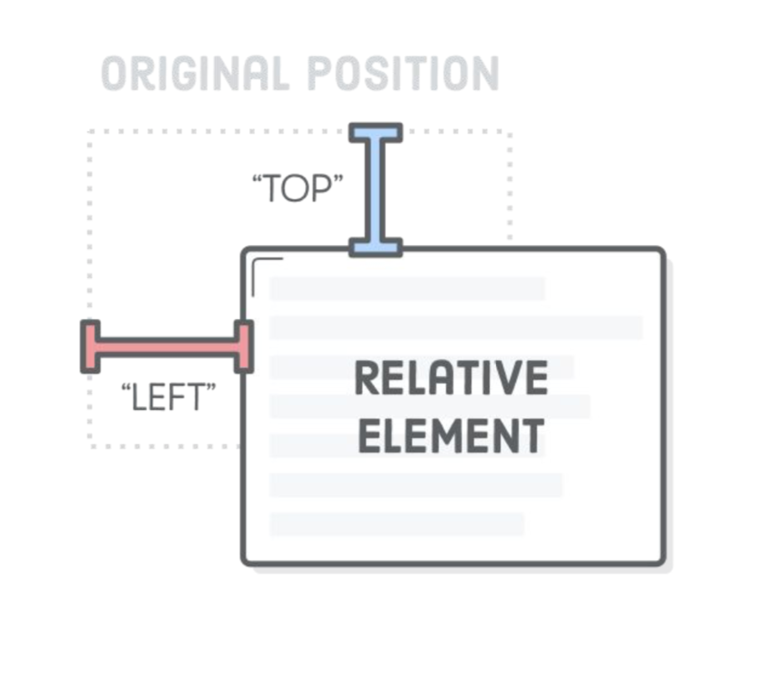
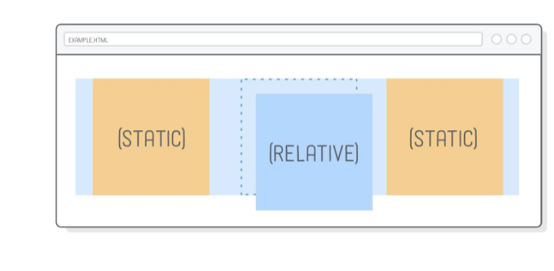
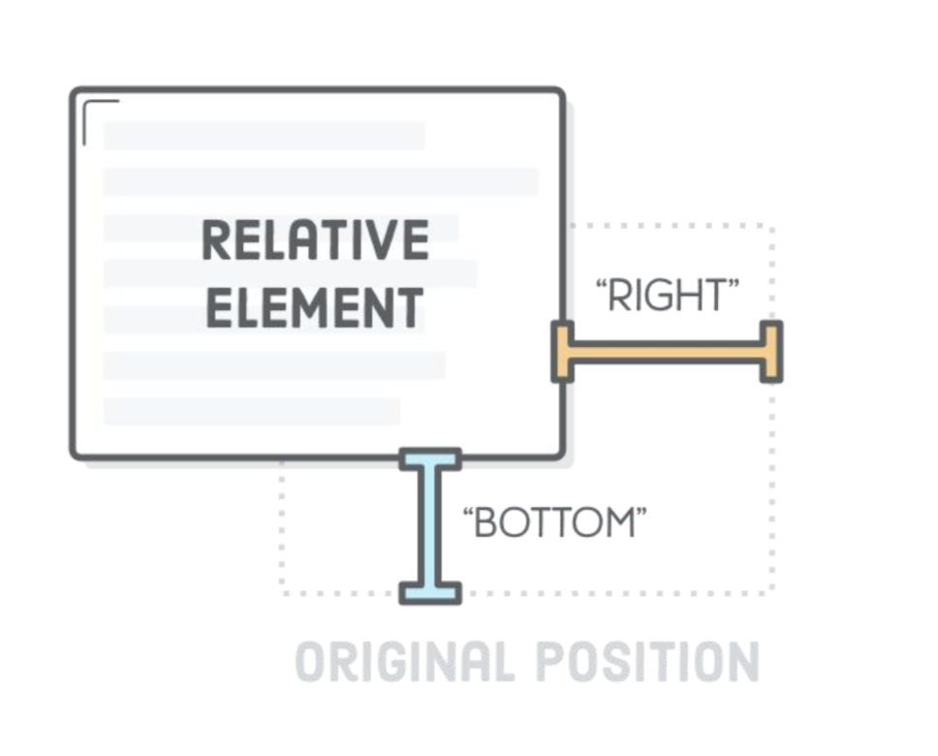
Relative Positioning

Slide 17
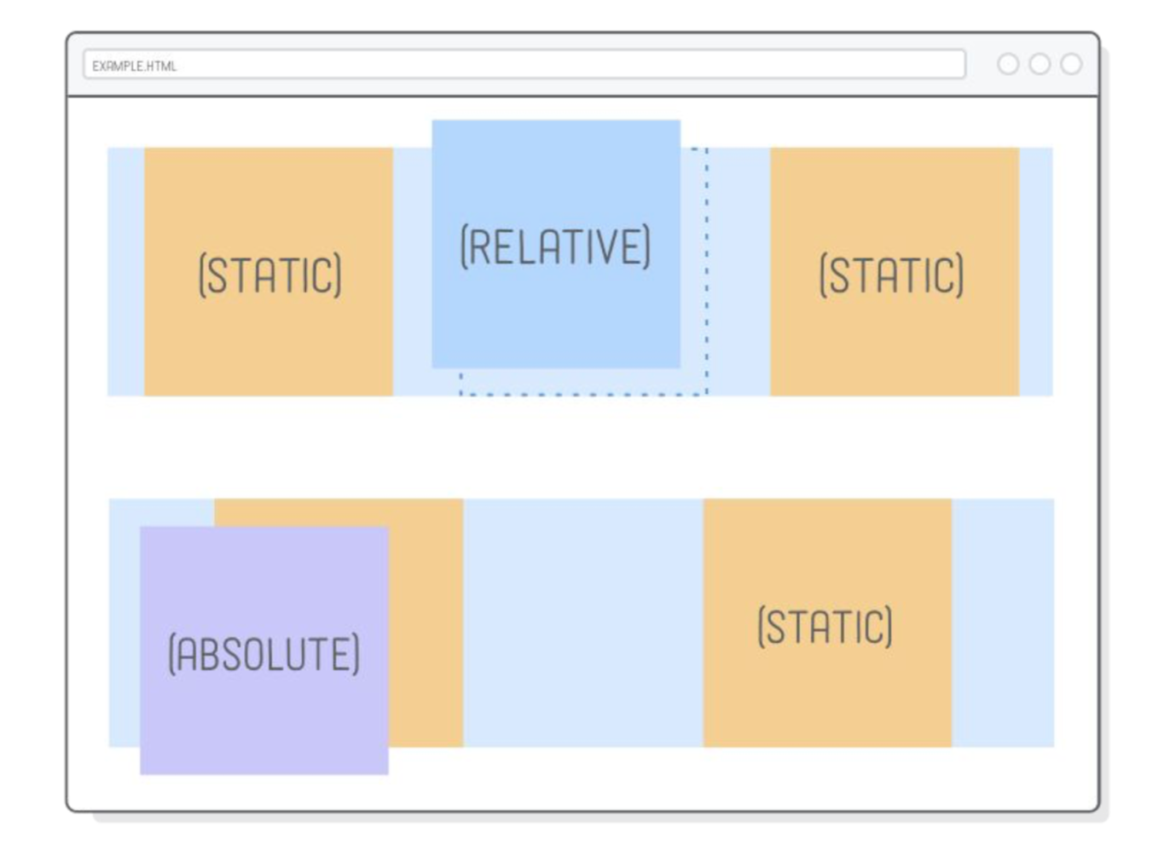
Absolute Positioning

Slide 18
Let’s practice

Slide 19
References
Measurement units:
https://developer.mozilla.org/en-US/docs/Learn/CSS/Building_blocks/Values_and_units
https://www.tutorialspoint.com/css/css_measurement_units.htm
Display:
https://css-tricks.com/almanac/properties/d/display/
https://developer.mozilla.org/en-US/docs/Learn/CSS/CSS_layout/Normal_Flow
Position:
https://internetingishard.com/html-and-css/advanced-positioning/
https://www.w3schools.com/css/css_positioning.asp
https://css-tricks.com/almanac/properties/p/position/

