Slide 1
Lesson - 4
CSS. Introduction
SkillUp by Dobrea Vladislav

Slide 2
Lesson Plan
Introduction
CSS Syntax
Ways to apply CSS
Box Model
Selectors

Slide 3
CSS Introduction
What is CSS?
CSS stands for Cascading Style Sheets
CSS describes how HTML elements are to be displayed on screen, paper, or in other media
CSS saves a lot of work. It can control the layout of multiple web pages all at once
External stylesheets are stored in CSS files

Slide 4
CSS Solves a Big Problem
HTML was NEVER intended to contain tags for formatting a web page!
HTML was created to describe the content of a web page, like:
<h1>This is a heading</h1>
When tags like <font>, and color attributes were added to the HTML 3.2 specification, it started a nightmare for web developers. Development of large websites, where fonts and color information were added to every single page, became a long and expensive process.
To solve this problem, the World Wide Web Consortium (W3C) created CSS.
CSS removed the style formatting from the HTML page!

Slide 5
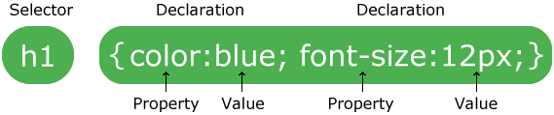
CSS Syntax
Simple Rules:
The selector points to the HTML element you want to style.
The declaration block contains one or more declarations separated by semicolons.
Each declaration includes a CSS property name and a value, separated by a colon.
A CSS declaration always ends with a semicolon, and declaration blocks are surrounded by curly braces.

Slide 6
Let’s practice

Slide 7
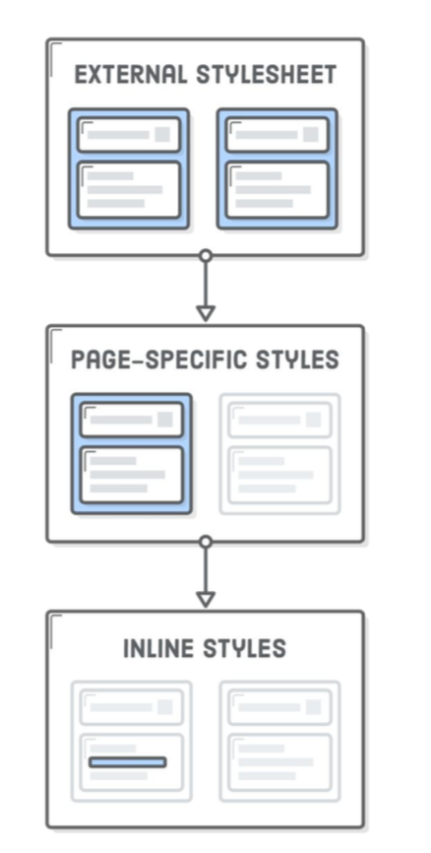
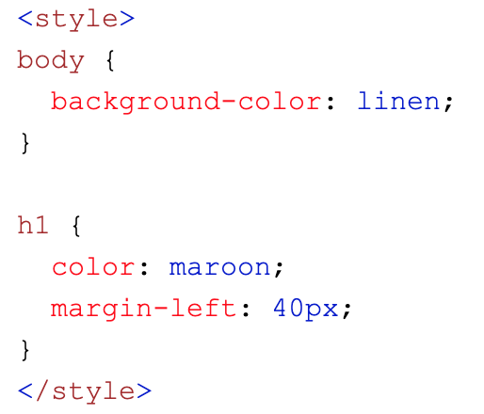
Three ways of adding CSS
External CSS
Internal CSS
Inline CSS

Slide 8
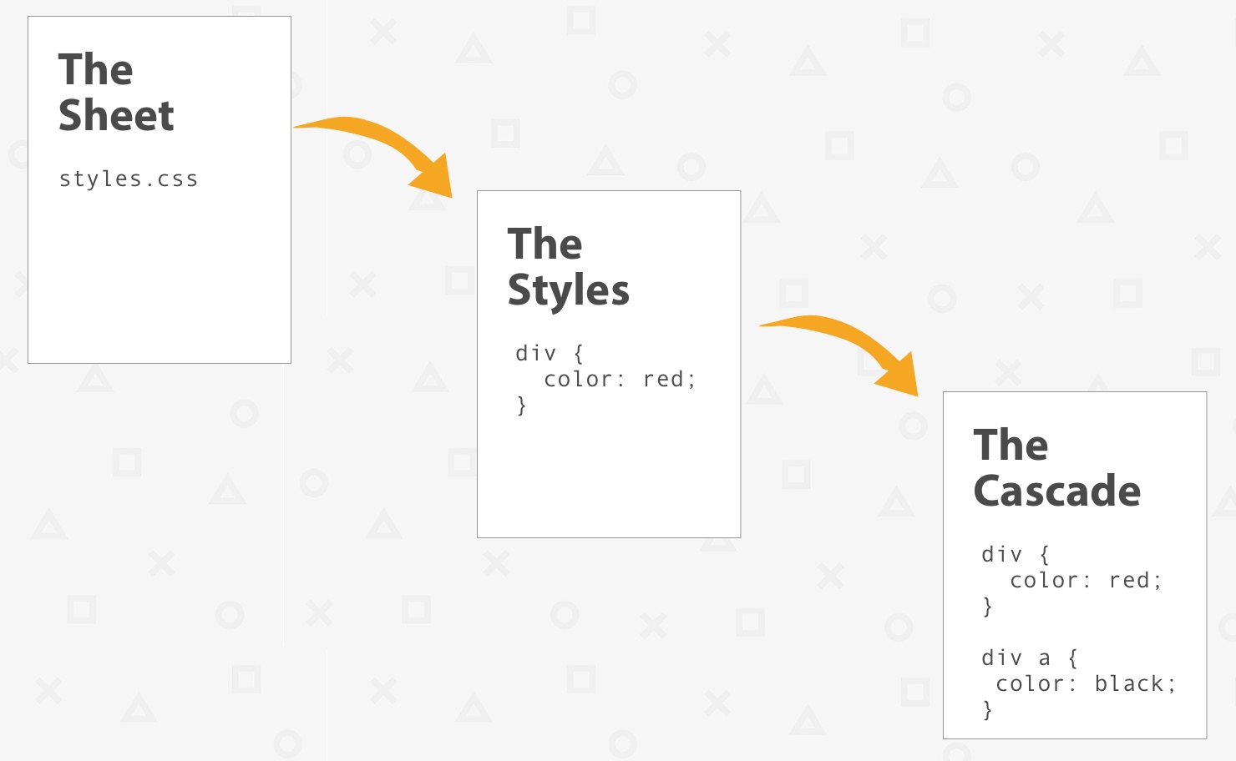
Multiple styles?
What style will be used when there is more than one style specified for an HTML element?
All the styles in a page will "cascade" into a new "virtual" style sheet by the following rules, where number one has the highest priority:
Inline style (inside an HTML element)
External and internal style sheets (in the head section)
Browser default
So, an inline style has the highest priority, and will override external and internal styles and browser defaults.

Slide 9
Let’s practice

Slide 10

Box Model
All HTML elements can be considered as boxes. In CSS, the term "box model" is used when talking about design and layout.
Explanation of the box model parts:
Content - The content of the box, where text and images appear
Padding - Clears an area around the content. The padding is transparent
Border - A border that goes around the padding and content
Margin - Clears an area outside the border. The margin is transparent

Slide 11
Let’s practice

Slide 12
CSS Selectors
CSS selectors are used to "find" (or select) the HTML elements you want to style.
We can divide CSS selectors into five categories:
Simple selectors (select elements based on name, id, class)
Combinator selectors (select elements based on a specific relationship between them)
Pseudo-class selectors (select elements based on a certain state)
Pseudo-elements selectors (select and style a part of an element)
Attribute selectors (select elements based on an attribute or attribute value)

Slide 13
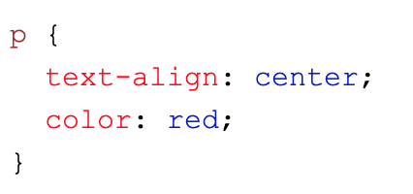
Simple Selectors
The CSS element Selector
The element selector selects HTML elements based on the element name.
This will target all <p> elements

Slide 14
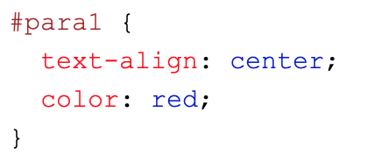
Simple Selectors
The CSS id Selector
The id selector uses the id attribute of an HTML element to select a specific element.
The id of an element is unique within a page, so the id selector is used to select one unique element!
To select an element with a specific id, write a hash (#) character, followed by the id of the element.
This will target element with id=“para1”

Slide 15
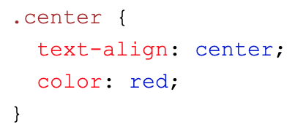
Simple Selectors
The CSS class Selector
The class selector selects HTML elements with a specific class attribute.
To select elements with a specific class, write a period (.) character, followed by the class name.
In this example all HTML elements with class="center" will be red and center-aligned

Slide 16
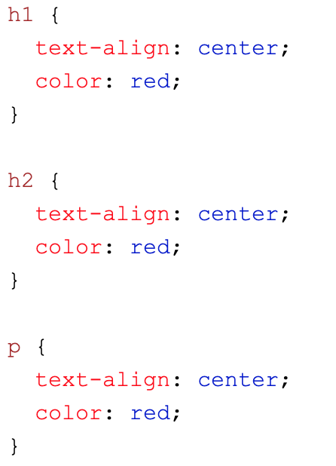
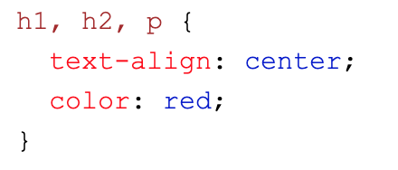
Simple Selectors
The CSS Grouping Selector
The grouping selector selects all the HTML elements with the same style definitions.

Slide 17
References
CSS Intro:
https://www.w3schools.com/css/css_intro.asp
https://internetingishard.com/html-and-css/hello-css/
How to add CSS to HTML: https://www.w3schools.com/html/html_css.asp
CSS Syntax: https://www.w3schools.com/css/css_syntax.asp
CSS Selectors:
https://www.w3schools.com/cssref/css_selectors.asp
https://internetingishard.com/html-and-css/css-selectors/
CSS Specificity: https://www.w3schools.com/css/css_specificity.asp
Box model:
https://internetingishard.com/html-and-css/css-box-model/
https://css-tricks.com/box-sizing/
https://www.w3schools.com/css/css_boxmodel.asp
CSS Display visibility:
https://css-tricks.com/almanac/properties/d/display/
http://ptgmedia.pearsoncmg.com/images/9780321888938/samplepages/0321888936.pdf

