Slide 1
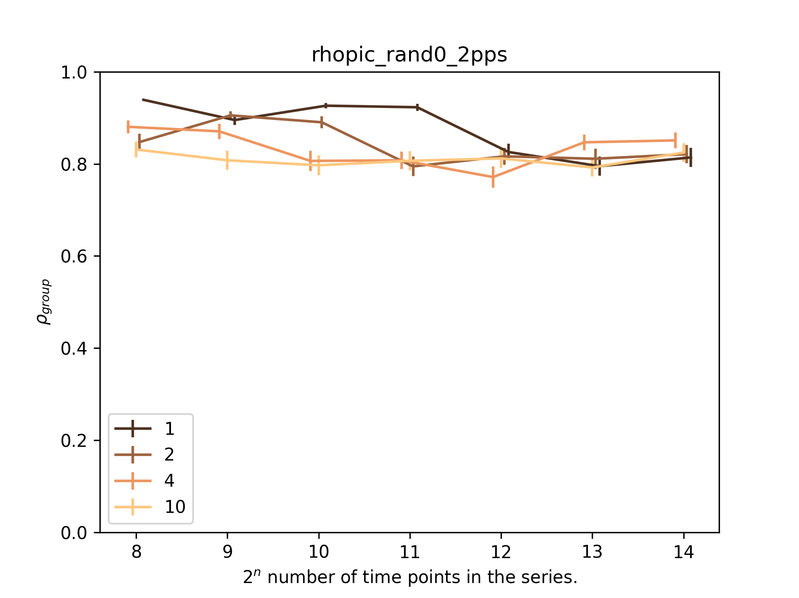
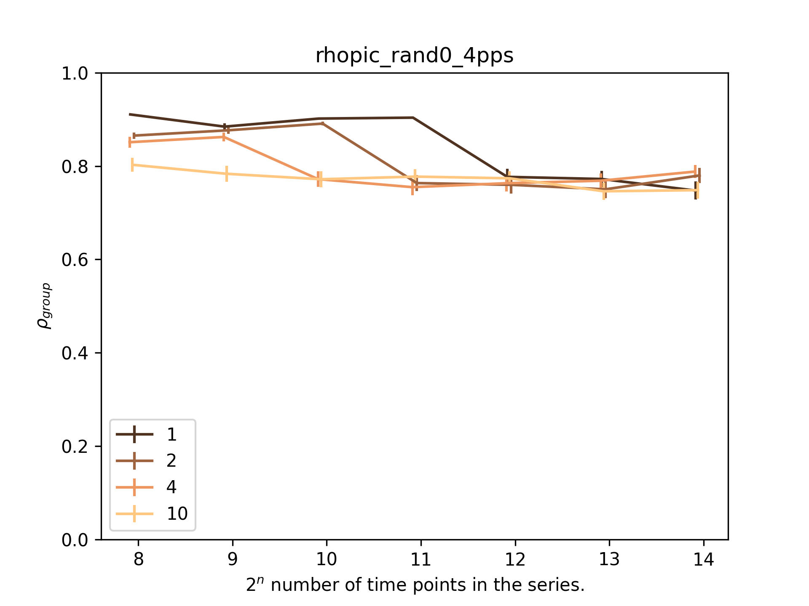
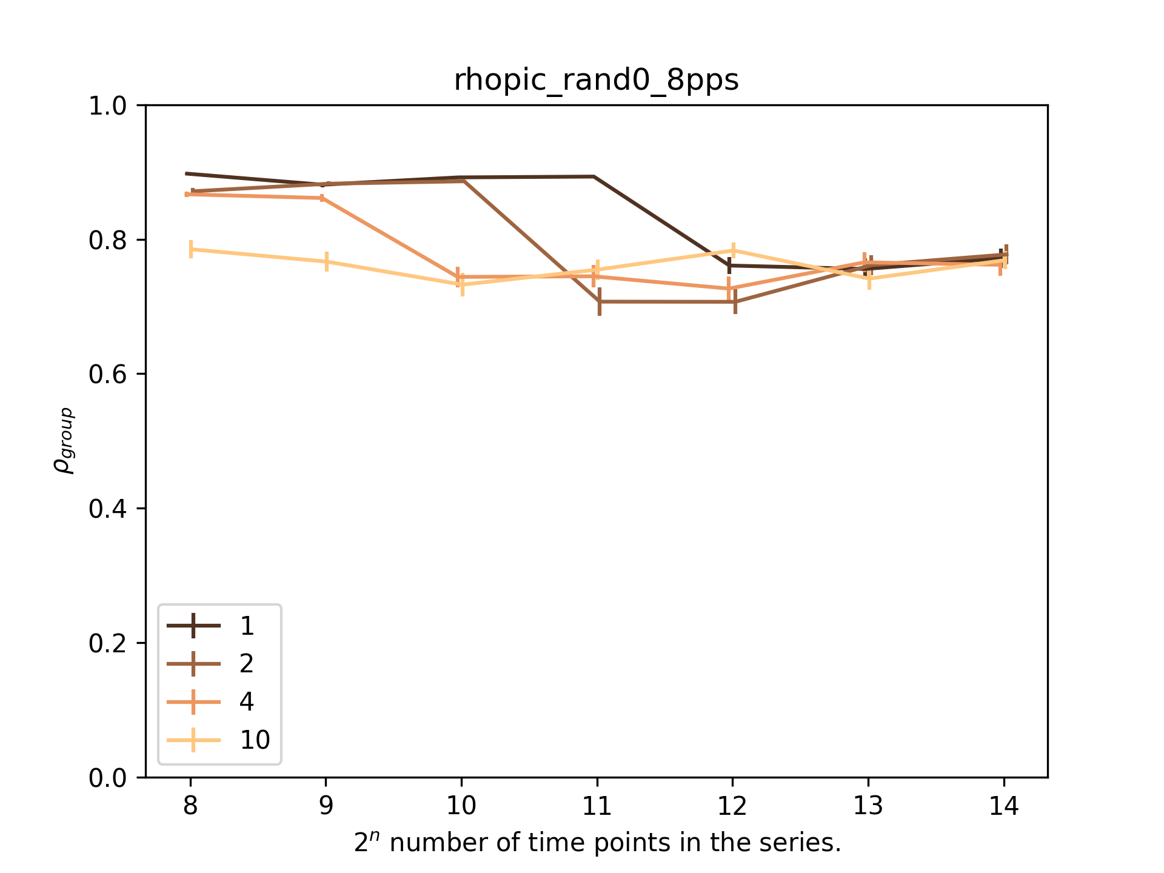
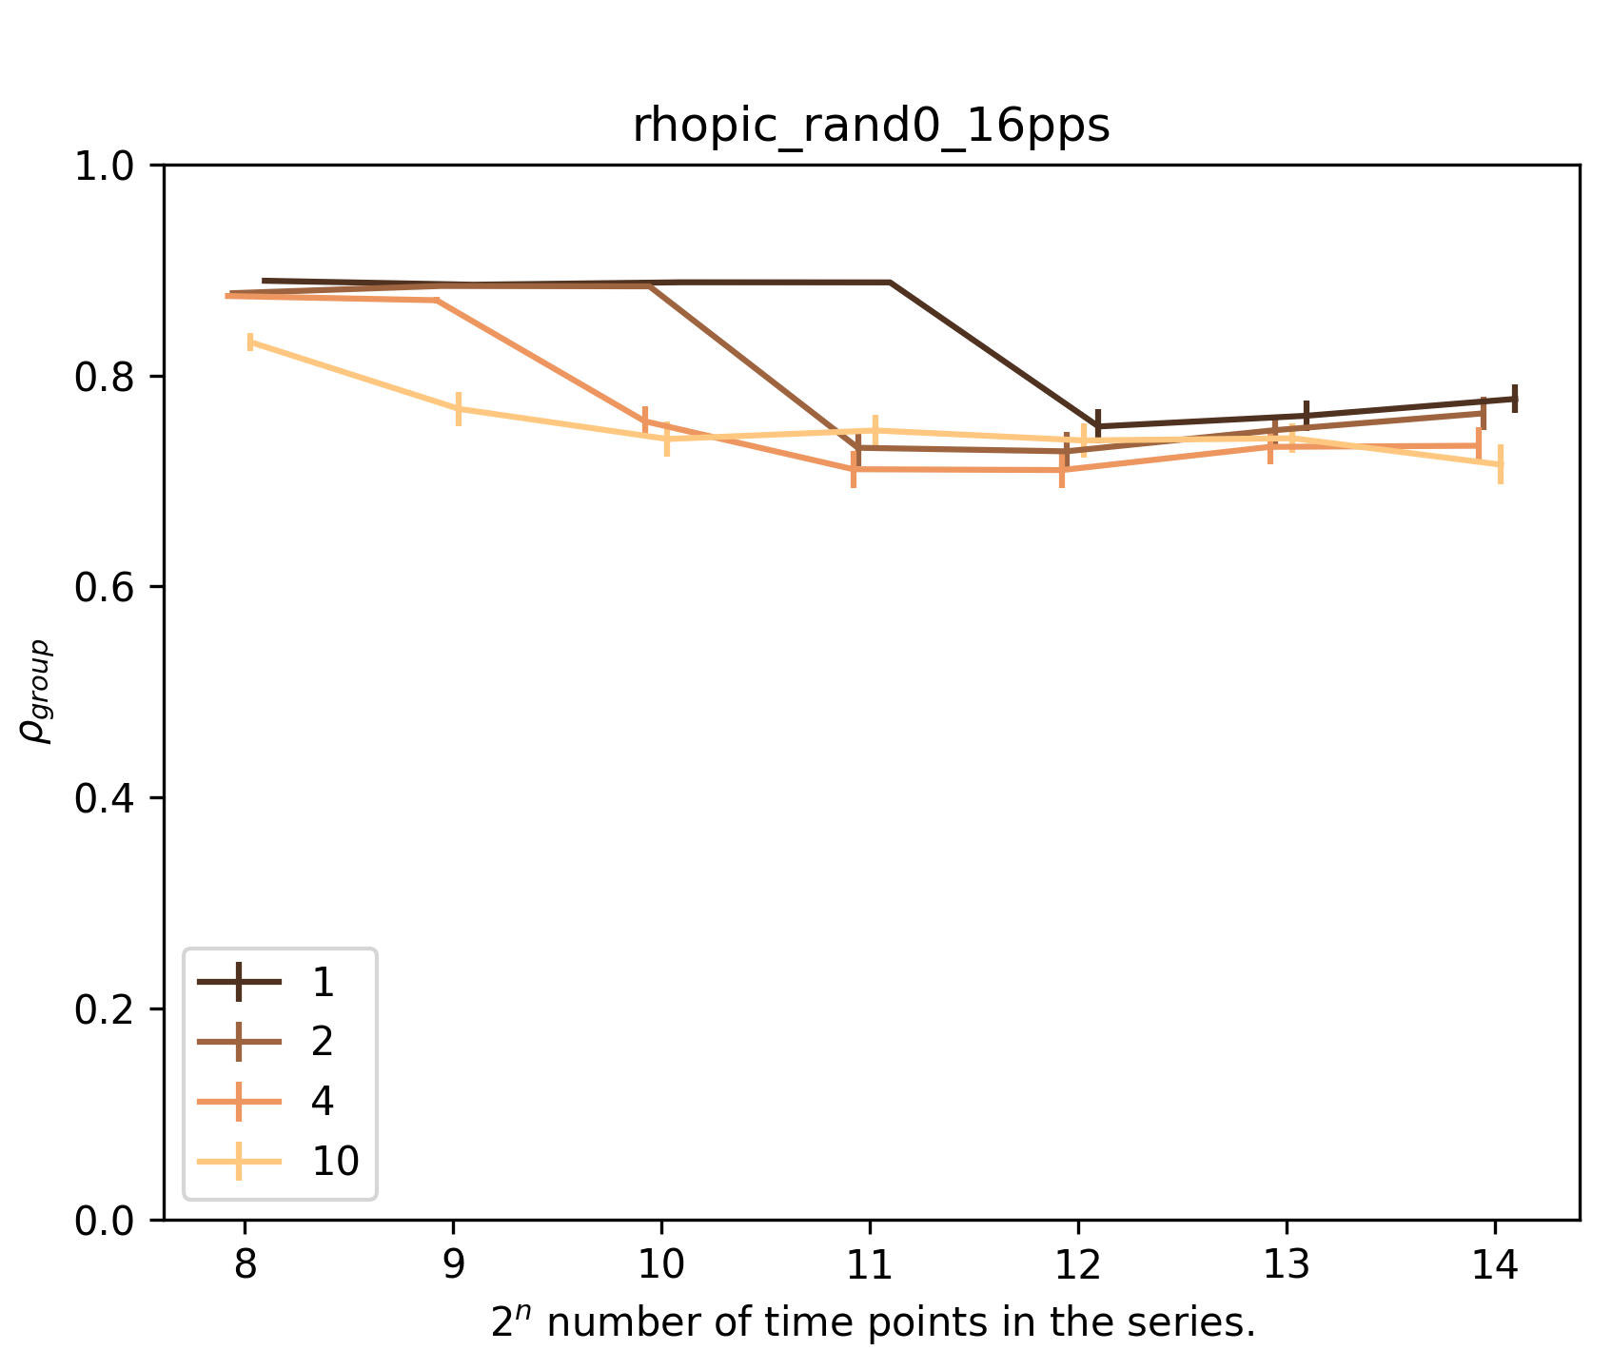
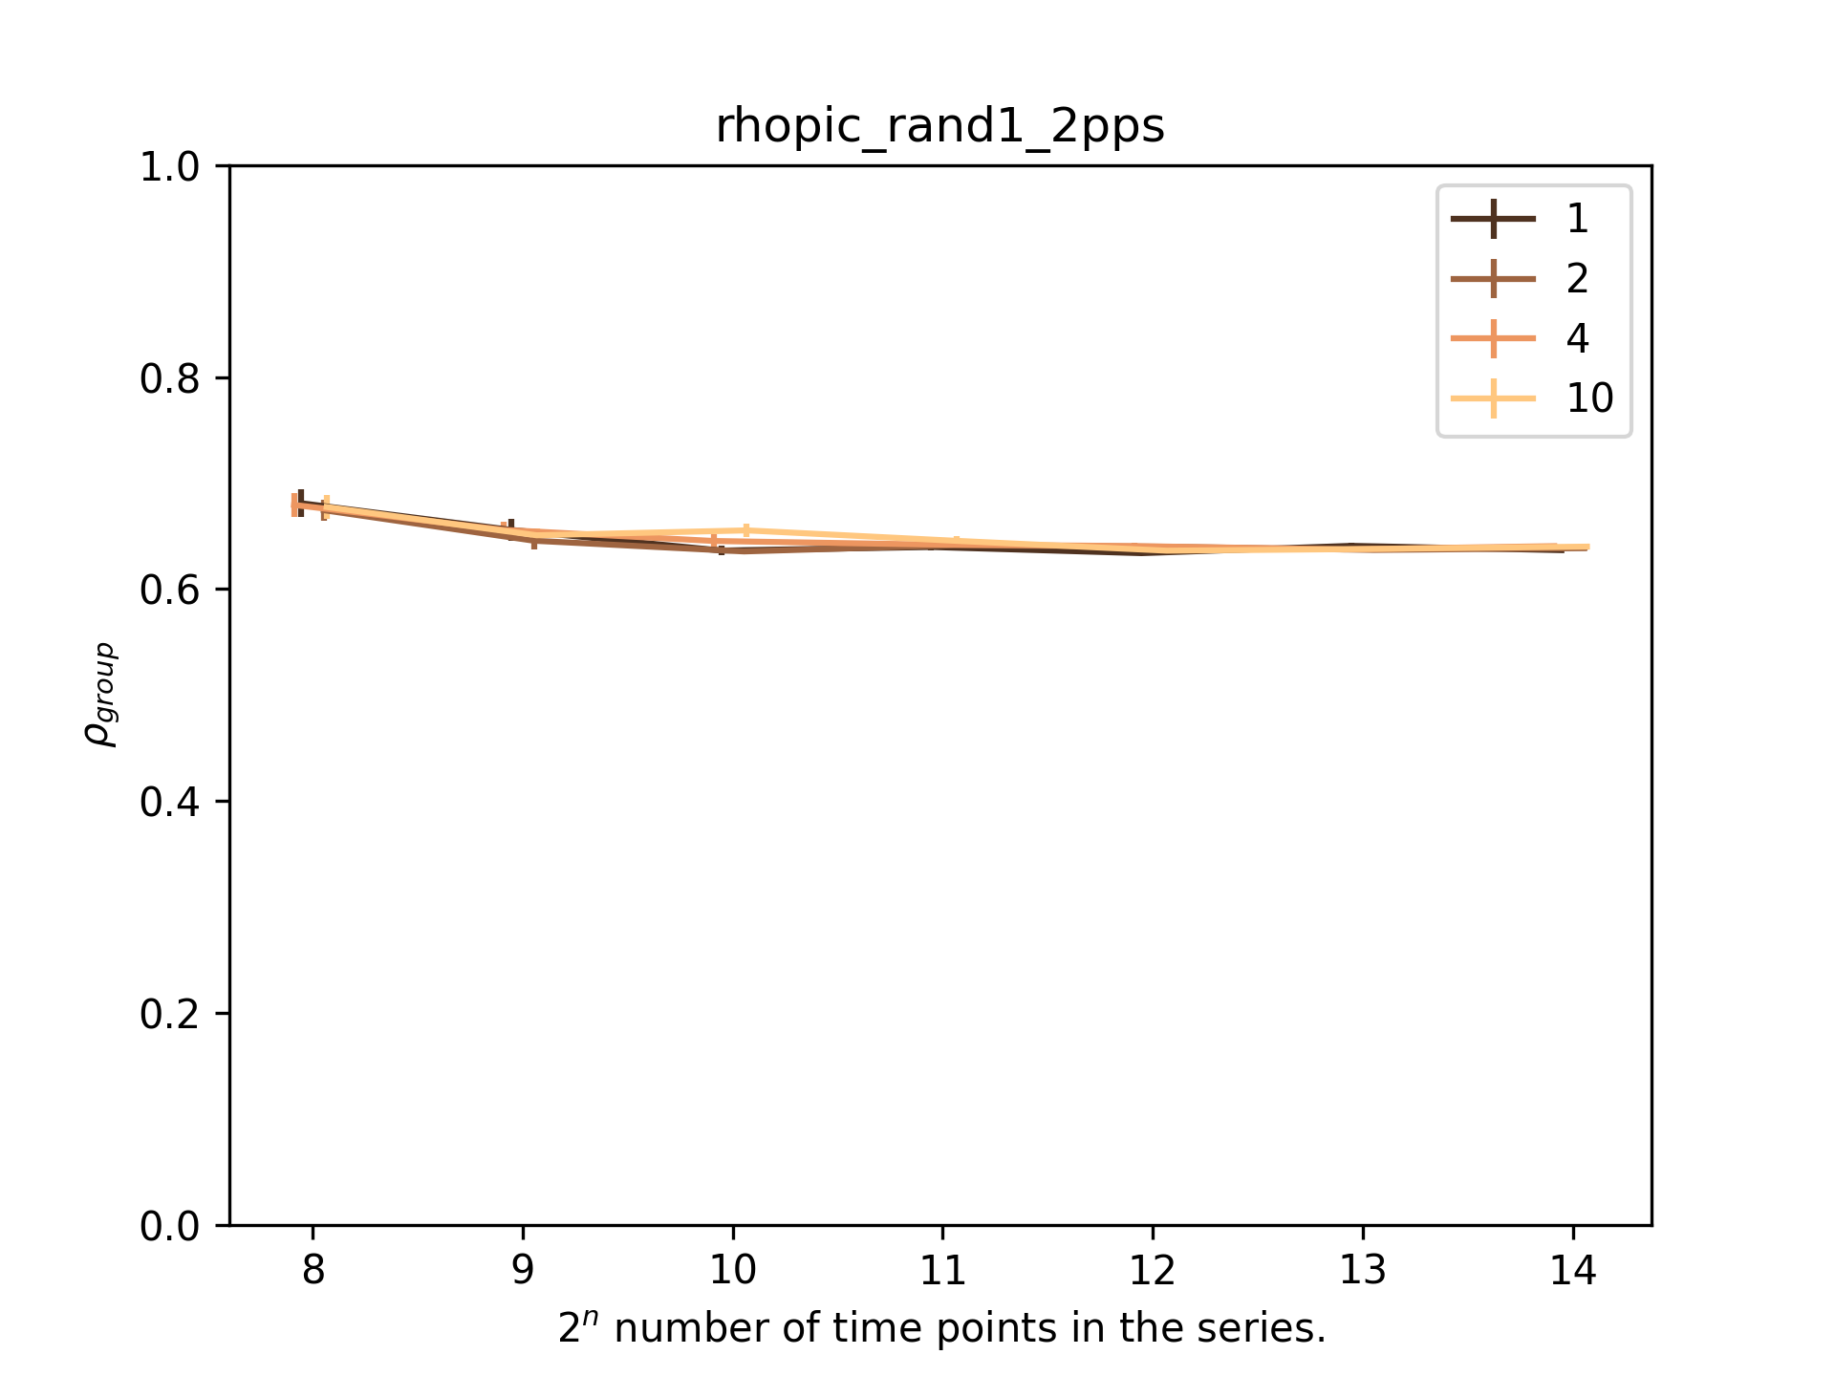
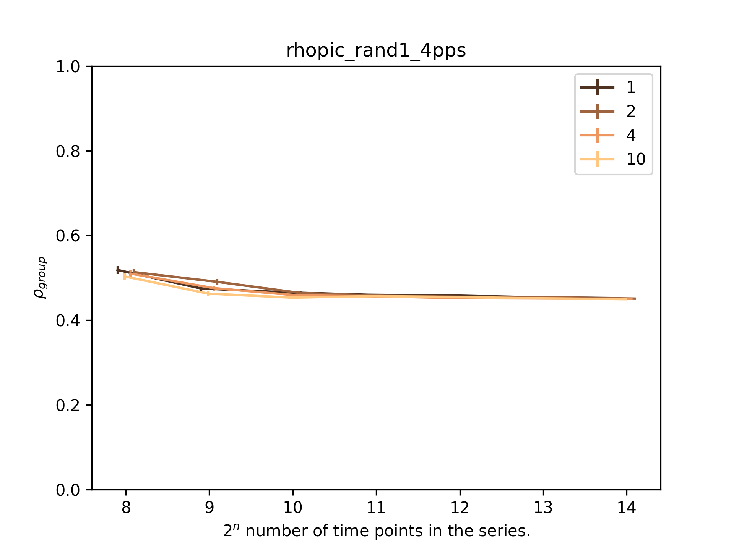
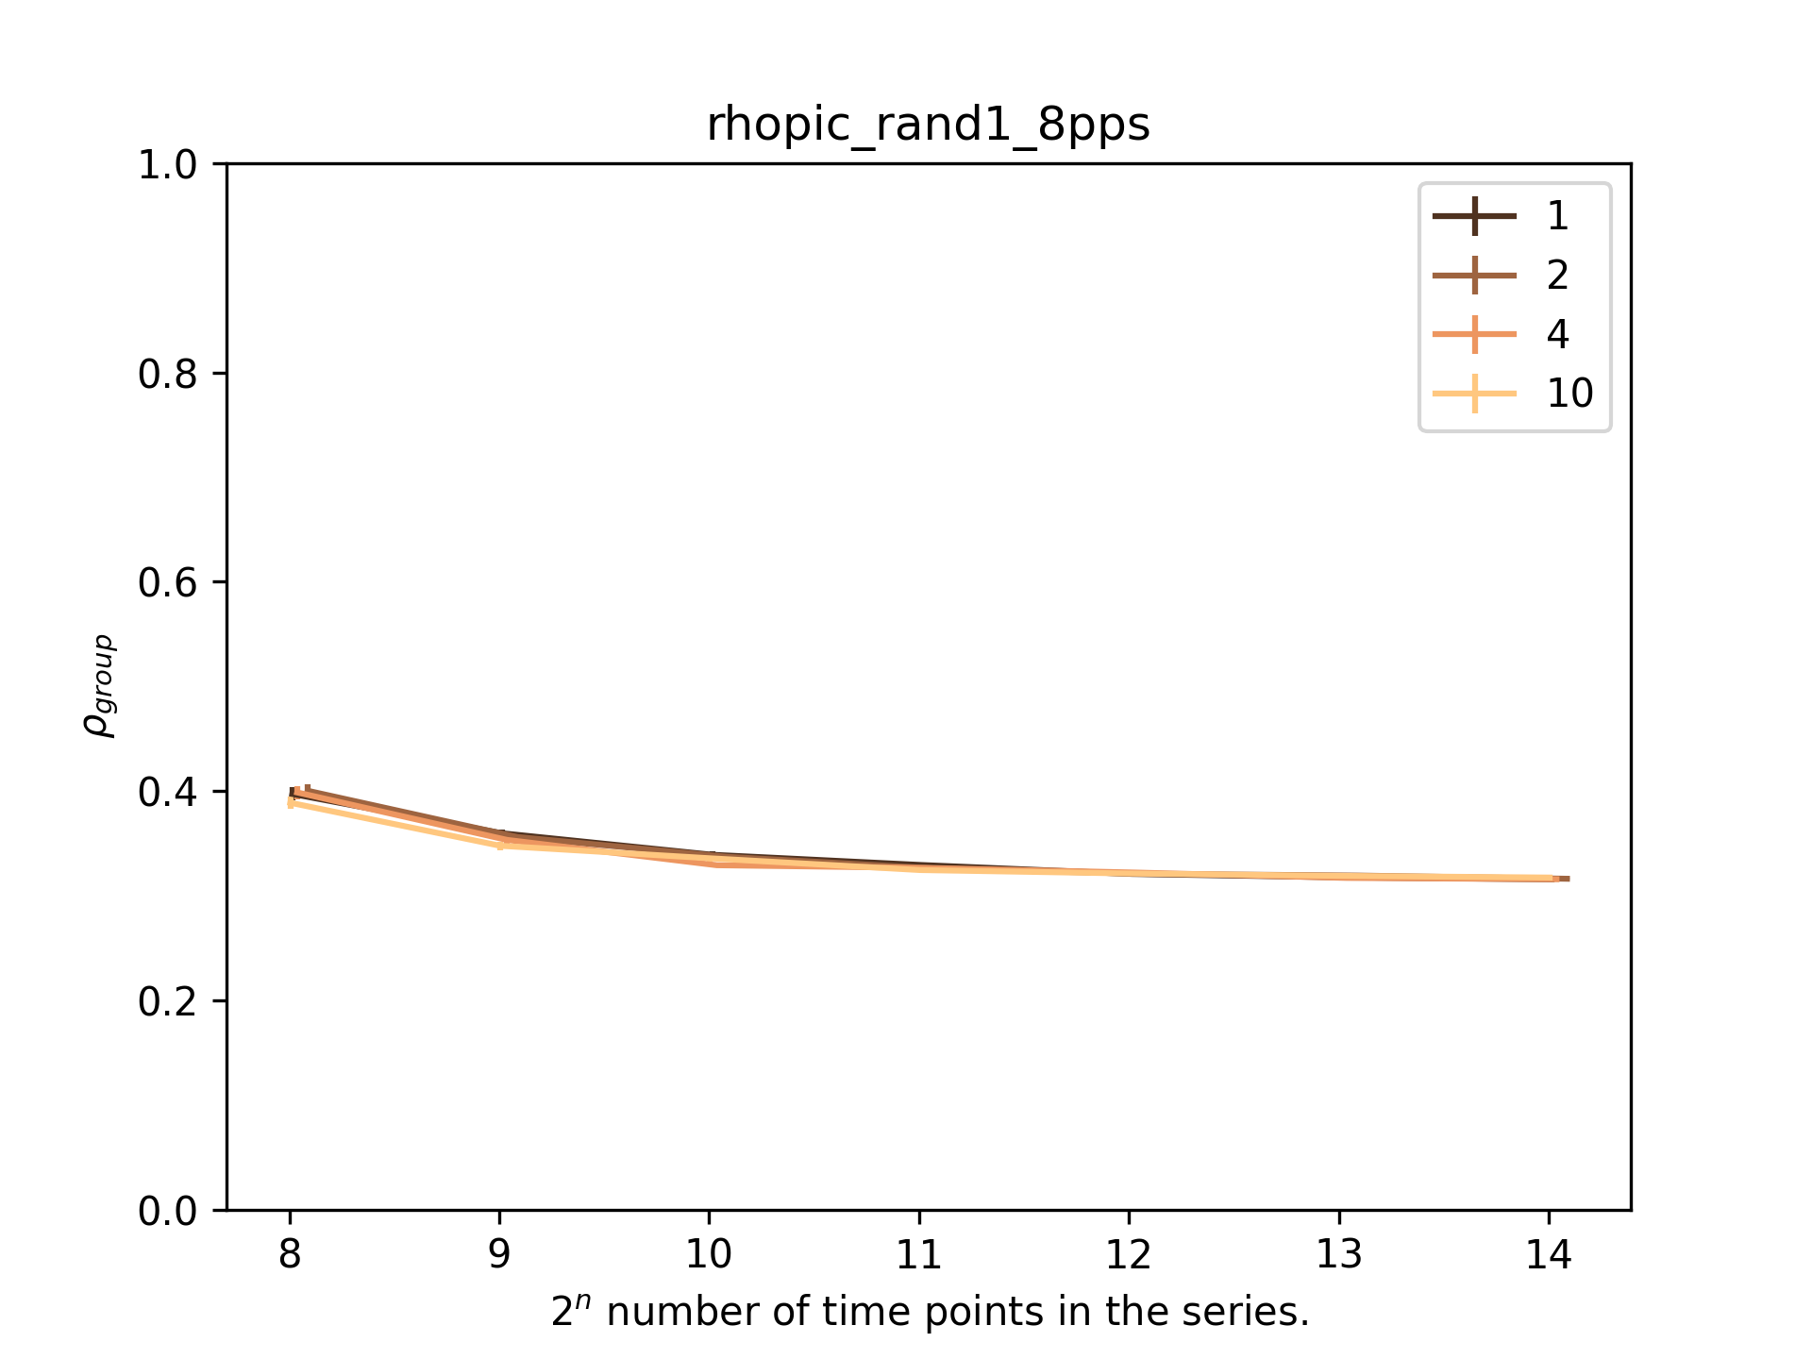
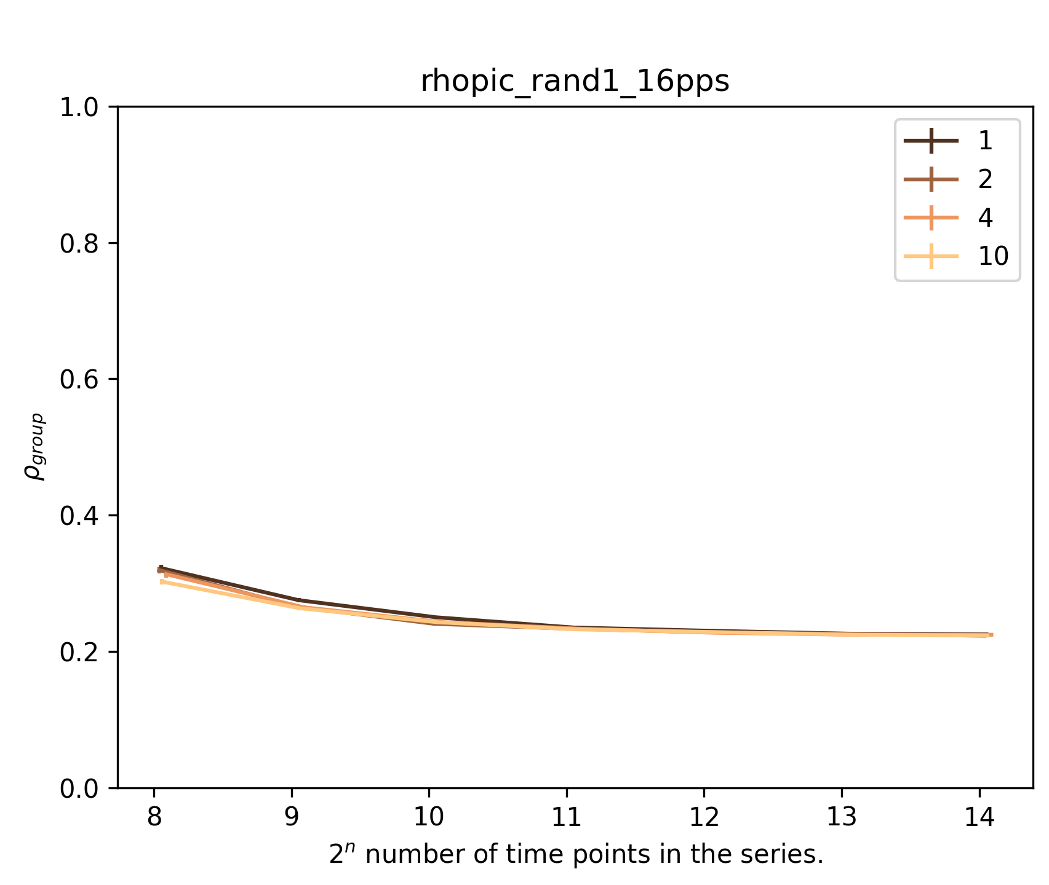
Phase-synchronized oscillations with small additive variability
Non-synchronous oscillations (mismatch of frequency and phase)
#participants: 2 4 8 16
1. Dependence on length of time series.
2. Dependence on average frequency of the oscillations.
Average frequency, Hz
#participants: 2 4 8 16
Average frequency, Hz
3. Dependence on number of participants.
4. Difference from real baseline

