Slide 1
Paper Presentation STAT 9911: Principles of AI
Ryan Chan
02-25-2025

Slide 2
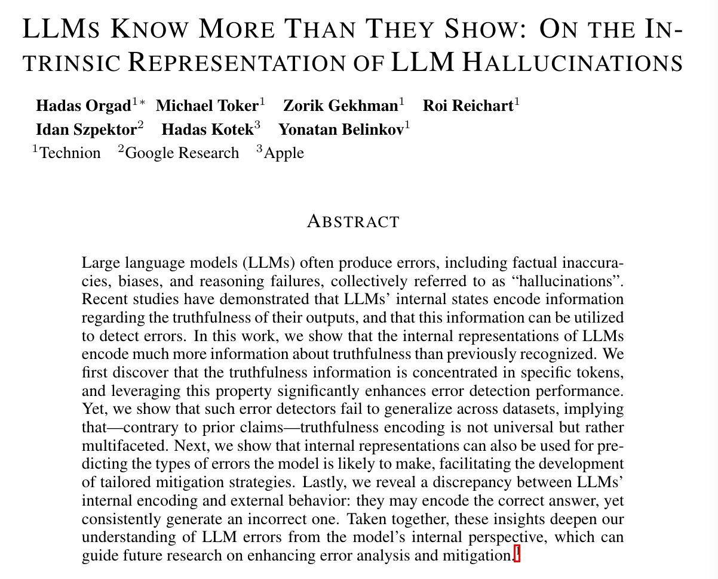
Today’s Paper

Slide 3
Introduction

Slide 4
Hallucinations
There are many different definitions, or even names, for hallucinations
E.g. “Confabulations”, “Fabrications”
In this work:
“Our framework adopts a broad interpretation, considering hallucinations to encompass all errors produced by an LLM, including factual inaccuracies, biases, common-sense reasoning failures, and other real-world errors.”

Slide 5
Key Questions
Where are truthfulness signals encoded in the LLMs?
Can we predict whether the outputs of LLMs are truthful?
Can we categorize and predict the types of errors LLMs make?
Do the internal representations and outputs of the model align?
Notes:
1. Which token can tell me what the LLM outputs is true or not
2. Previous works claim that there are some universal truthness encoding. This work shows that does not exist
In fact they encode multiple distinct notions of truth

Slide 6
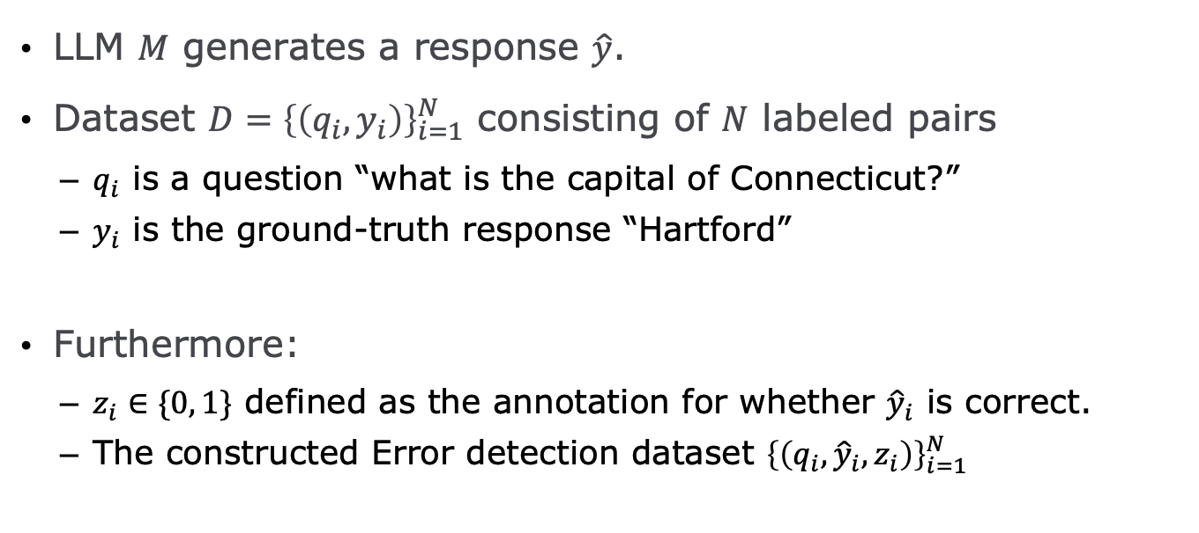
Setting up the Notation
LLM $M$ generates a response $\hat{y}$.
Dataset $D={\left\{\left(q_{i},y_{i}\right)\right\}}_{i=1}^{N}$ consisting of $N$ labeled pairs
$q_{i}$ is a question “what is the capital of Connecticut?”
$y_{i}$ is the ground-truth response “Hartford”
Furthermore:
$z_{i}∈\{0, 1\}$ defined as the annotation for whether ${\hat{y}}_{i}$ is correct.
The constructed Error detection dataset ${\left\{\left(q_{i},{\hat{y}}_{i}, z_{i}\right)\right\}}_{i=1}^{N}$

Slide 7
Experiment Setup
LLMs: Mistral-7b (Jiang et al., 2023), Mistral-7b-instruct-v0.2 (denoted Mistral-7b-instruct), Llama3-8b (Touvron et al., 2023), and Llama3-8b-instruct.
Datasets: TriviaQA (Joshi et al., 2017), HotpotQA with/without context (Yang et al., 2018), Natural Questions (Kwiatkowski et al., 2019), Winobias (Zhao et al., 2018), Winogrande (Sakaguchi et al., 2021), MNLI (Williams et al., 2018), Math (Sun et al., 2024), IMDB review sentiment analysis (Maas et al., 2011), and a dataset of movie roles (movies) that we curate.

Slide 8

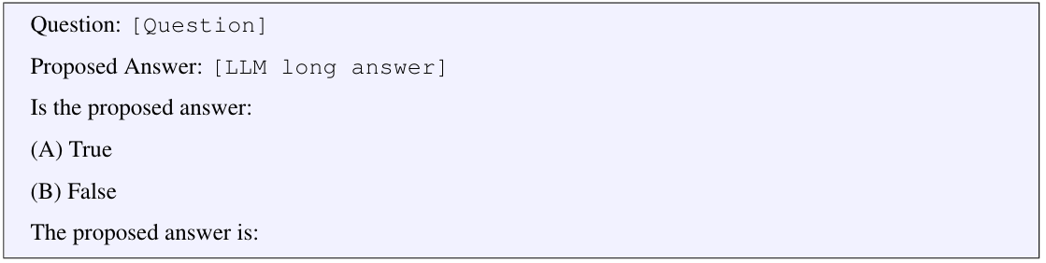
Error Detection Methods
Majority: predicts most frequent label in the training set
Aggregated probabilities/logits: averages logits of the output token probabilities
P(True): asks LLM to evaluate the correctness
Probing Classifiers: trains a small classifier on the intermediate activations (e.g. last token, second last token)

Slide 9
Results

Slide 10
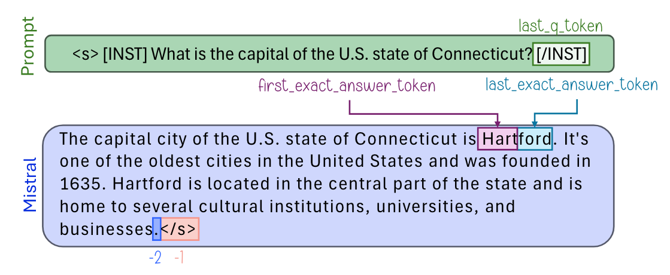
1. Where are truthfulness signals encoded in the LLMs?
Selecting which token to use is often overlooked
Proposed Method: Use an external LLM to tell us where the answer tokens are, and train a probing classifier on that token.
Four extra tokens to try: the one immediately preceding the first exact answer token, the first exact answer token itself, the last exact answer token, and the one immediately following it

Slide 11
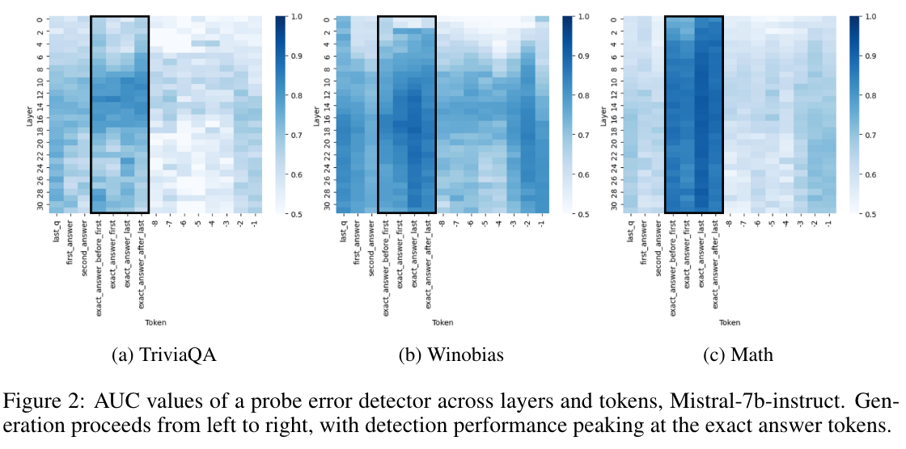
1. Where are truthfulness signals encoded in the LLMs?

Slide 12
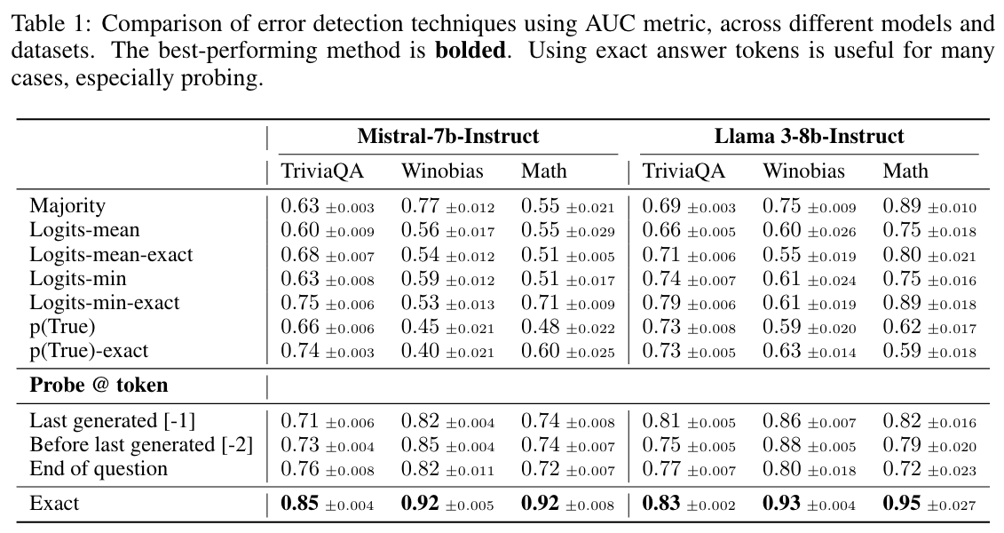
1. Where are truthfulness signals encoded in the LLMs?

Slide 13
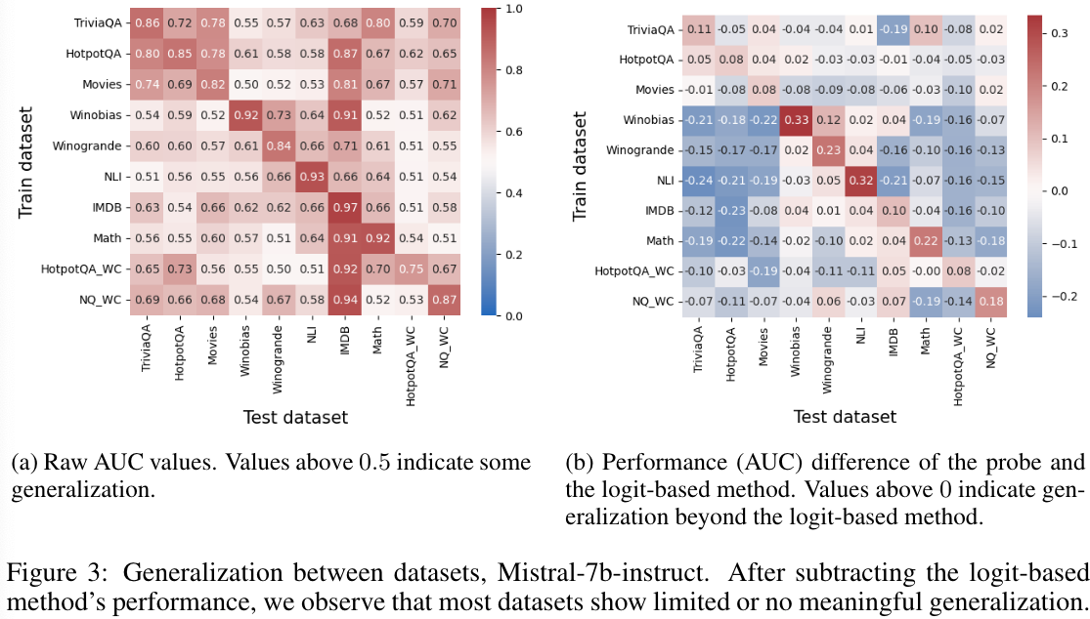
2. Can we predict whether the outputs of LLMs are truthful?

Slide 14
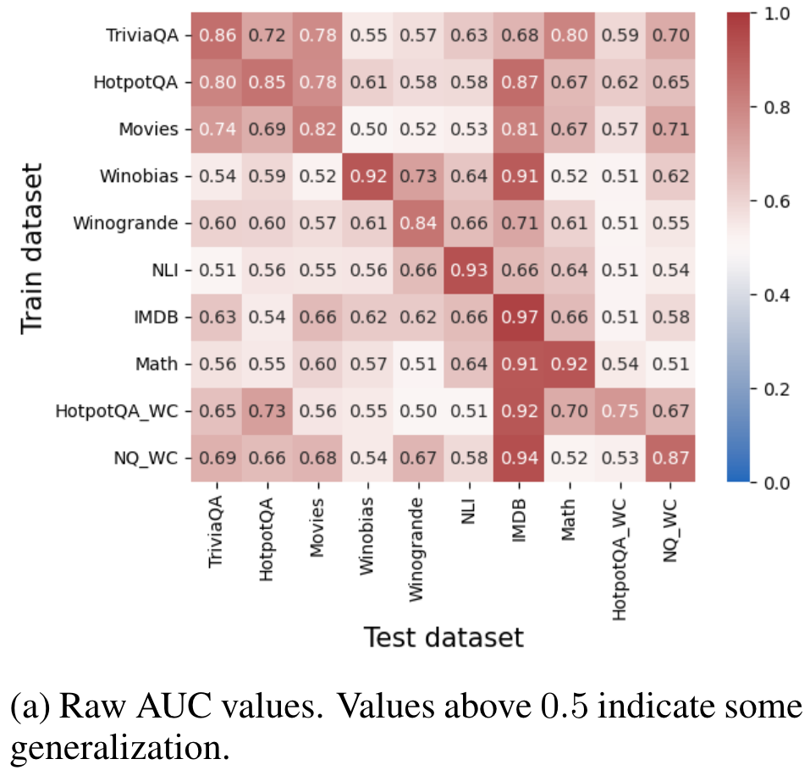
2. Can we predict whether the outputs of LLMs are truthful?
In other words, can we train probing classifiers on the answer token to predict whether the response will be truthful?

Slide 15
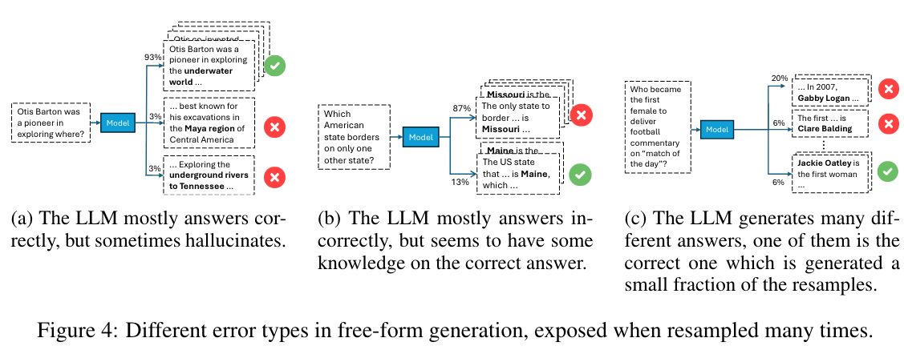
3. Can we categorize and predict the types of errors LLMs make?
Paper claims that most errors can be categorized into these three types

Slide 16
3. Can we categorize and predict the types of errors LLMs make?
Then, the response can be categorized into the following five types:
(A) Refuses to answer: The model responds that it cannot answer the question in at least half the cases.
(B) Consistently correct: Answers correctly in at least half of the cases. This category is divided into: (B1) always correct; and (B2) mostly correct with occasional errors.
(C) Consistently incorrect: Consistently generates the same incorrect response in at least half of the cases. Similarly to type B, we subdivide this type into (C1) correct answer is never produced; and (C2) correct answer appears at least once.
(D) Two competing: Generates both correct and incorrect responses at similar rates difference in rates is 5 or less, and each response is generated at least 5 times.
(E) Many answers: Generates over 10 distinct answers. Like types C and D, Subtypes include (E1) correct answer is never generated; and (E2) correct answer is generated at least once.

Slide 17
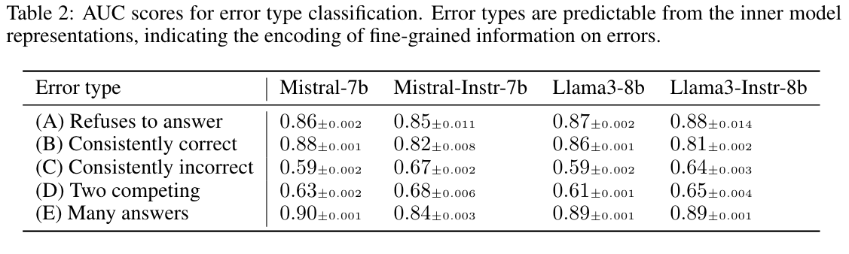
3. Can we categorize and predict the types of errors LLMs make?
Each question is answered 30 times.

Slide 18
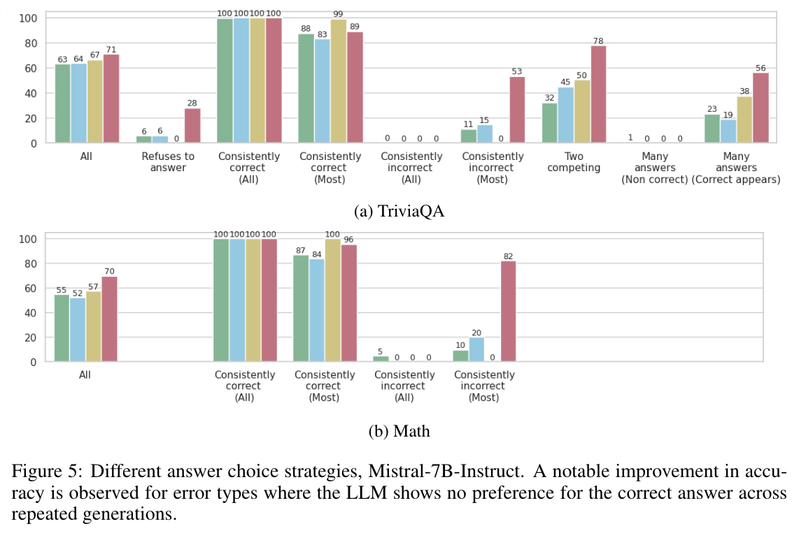
4. Do the internal representations and outputs of the model align?
Finally, can we leverage the probing classifiers to inform us about whether the response is correct?

Slide 19
Discussion and Thoughts

Slide 20
Discussion
Probing is an extremely effective way to tell whether the model is hallucinating or not
Potential Extensions:
Can we manipulate the internal representation to turn an incorrect response into a truthful response?
Can we somehow ask the model to curate more information when we know the response is hallucinated?

Slide 21
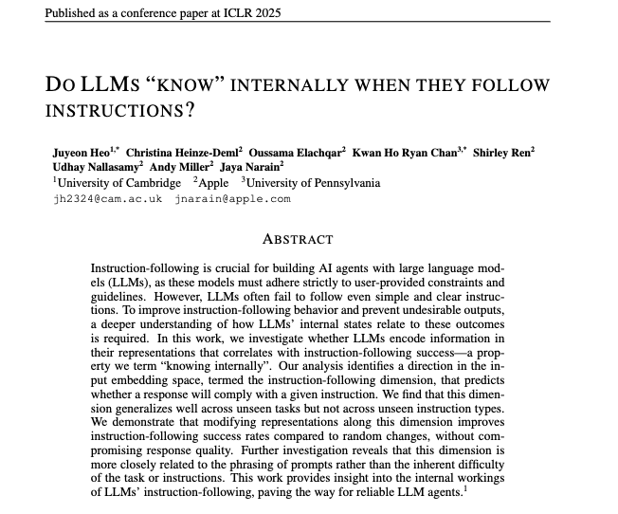
Shameless Plug
Performs a similar study on whether we can use internal activations to know whether LLM will follow instructions
One takeaway: Linear probes can predict task generalization but not instruction generalization.

Slide 22
Thank you

