Slide 1
Diagnosis of Alzheimer’s disease and other biomedical applications using vision transformers and large language models
STAT 9911
Thomas Yu
PhD Student, Biostatistics
Notes:
Biomedical applications, multimodal data

Slide 2
Alzheimer’s disease
Neurodegenerative disorder characterized by the decline of cognitive function and the progressive loss of memory and independence
~32 million people worldwide have AD dementia (2023)
No cure yet, but there are treatments that can slow disease progression
Early detection very important, allows for early intervention
Scheltens et al., 2021

Slide 3
Neuroimaging and multimodal data
Neuroimaging (e.g., MRI, PET scans) play a key role in the diagnosis of Alzheimer’s
Either raw images are used directly or images are processed through a pipeline to extract features (e.g., regional brain volume, cortical thickness measurements of different areas of the brain)
Non-imaging data can also provide important information
Examples: patient demographics (age!), genetic markers (APOE allele), biomarkers, etc.
Important to develop multimodal models that use both imaging and tabular data to achieve high diagnostic accuracy

Slide 4
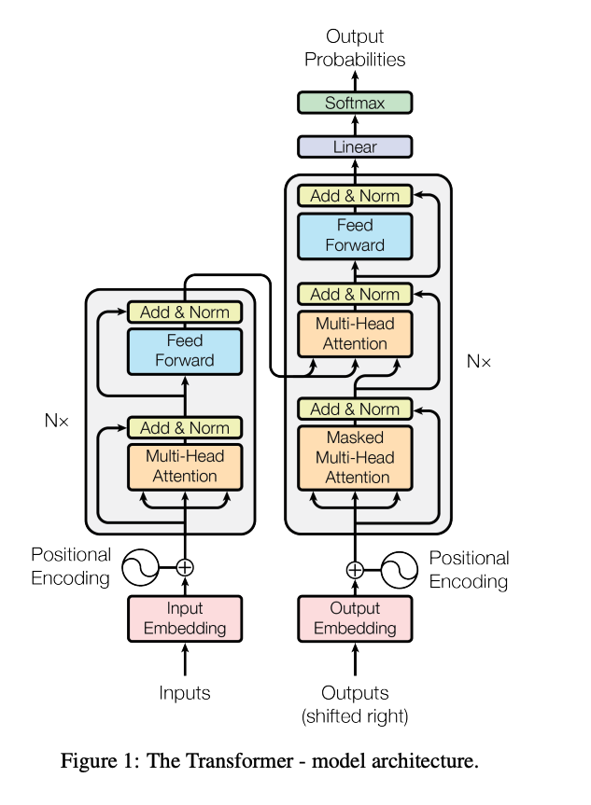
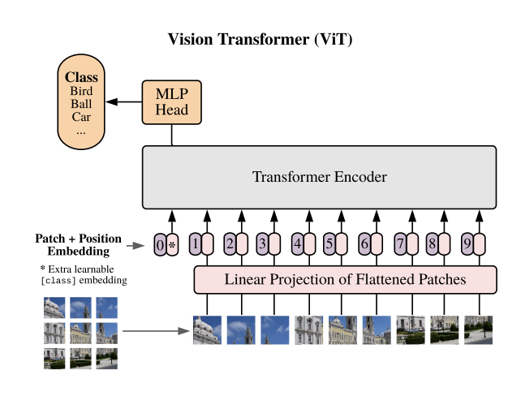
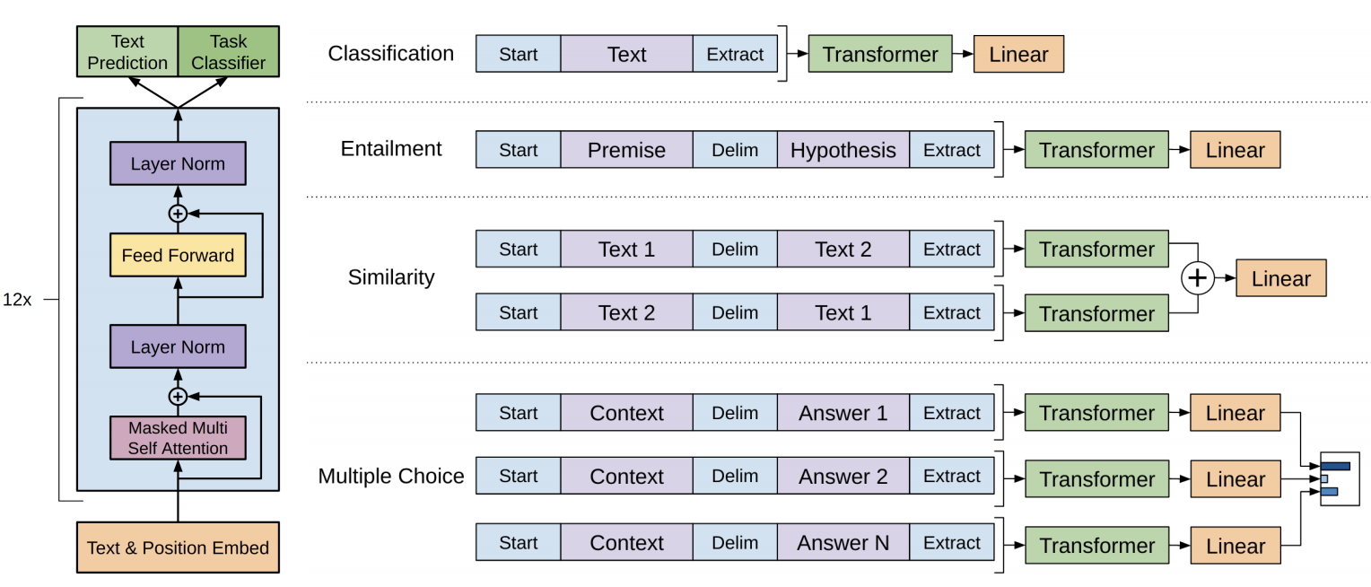

Transformers: ViTs and LLMs
Transformer
Vision Transformer
Input: images
Splits images into patches and adds positional encodings to capture spatial info
Uses: classification, object detection, medical diagnosis
Large Language Model
Input: text
Tokenizes text and adds positional encodings
Uses: text response, classification, medical diagnosis
Vaswani et al., 2017

Slide 5
Efficiently Training Vision Transformers on Structural MRI Scans for Alzheimer’s Disease Detection
Dhinagar et al., 2023

Slide 6
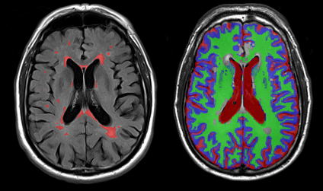
Vision Transformers for AD
Self-attention mechanism captures long-range spatial dependencies better than CNNs
Anatomical context important in medical imaging
Dhinagar et al., 2023

Slide 7
Training ViT
Often requires large datasets
Solution: pretrain using synthetic data from a generative model
Pretraining: 38,710 scans from UK Biobank and 100,000 synthetic scans from a latent diffusion model trained on UKBB data
Training: 4698 scans from ADNI (Alzheimer’s Disease Neuroimaging Initiative) and OASIS3 (Open Access Series of Imaging Studies phase 3)
Dhinagar et al., 2023

Slide 8
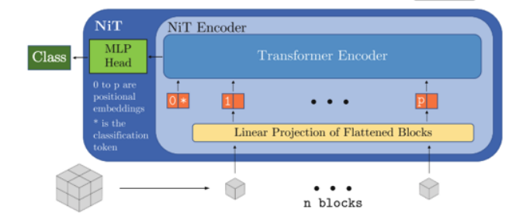
NiT (neuroimage transformer) architecture
Patch size: 8
Hidden dimension size: 256
Transformer encoder layers: 6
Self-attention heads: 12
Dropout: 0.3
Parameters: 5M
Dhinagar et al., 2023

Slide 9
Optimizing hyperparameters
Literature review to define bounds of hyperparameters typically used for vision transformers
Grid search
Learning rate: from uniform distribution between 0.00001 to 0.001
Weight decay: from uniform distribution between 0.00001 to 0.001
Warm-up epochs: 1, 5, 10, 15
Number of attention heads: 2, 4, 8, 12
Number of encoder layers: 3, 4, 6
Final: warm up epoch of 1, learning rate of 0.0000581, ADAM optimizer with weight decay of 0.5889, 12 attention heads and 6 encoder layers.
Dhinagar et al., 2023
Notes:
Learning rate: how fast model updates weights, weight decay: regularization penalty to large weight values, warm-up epochs: learning rate starts smaller to stabilize early training, attention heads: each head focuses on different parts of input, encoder layers: depth of transformer

Slide 10
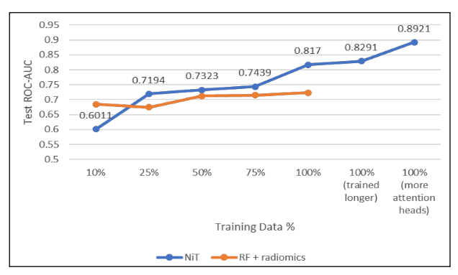
Results
Best performance: ROC-AUC of 0.8921 for distinguishing AD vs healthy patients
Dhinagar et al., 2023

Slide 11
Large language models improve Alzheimer’s disease diagnosis using multi-modality data
Feng et al., 2023

Slide 12
Large language models for AD
Non-imaging data is difficult to integrate in traditional AD models
Concatenating tabular features show limited improvement
Text-based data, such as examination notes, are especially challenging
Solution: LLMs
Adept at natural language processing
Large amount of training data and model parameters
ChatGPT passed part of the US medical licensing exams
Feng et al., 2023

Slide 13

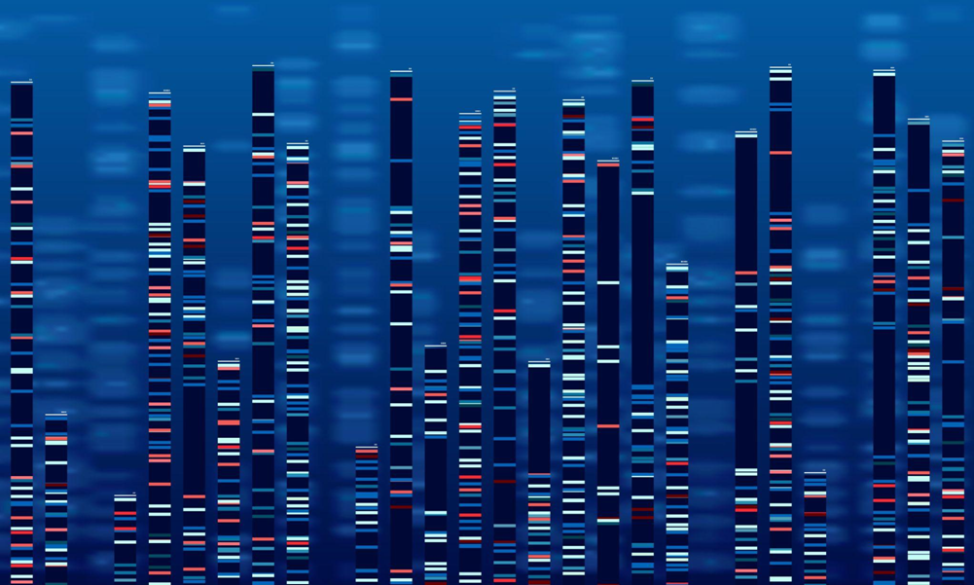
Non-imaging data
Examples of non-imaging data: demographic information (age, gender, family medical history), neuropsychological data (test results), biomarker data, genomics data
Traditional methods require data processing, feature selection, and other operations that may require doctor input
LLMs can use their existing knowledge to process non-imaging data without outside help
Feature tokens from GPT outperformed representation learning, graph neural networks, random forest, etc.
Feng et al., 2023

Slide 14
Model architecture
MRI and PET images are processed by two separate ConvNeXt vision encoders and combined using cross-attention
Non-imaging data is turned into a prompt and submitted to GPT4, which generates features tokens
Feature tokens and imaging features are integrated into a classifier for final AD prediction
Feng et al., 2023

Slide 15
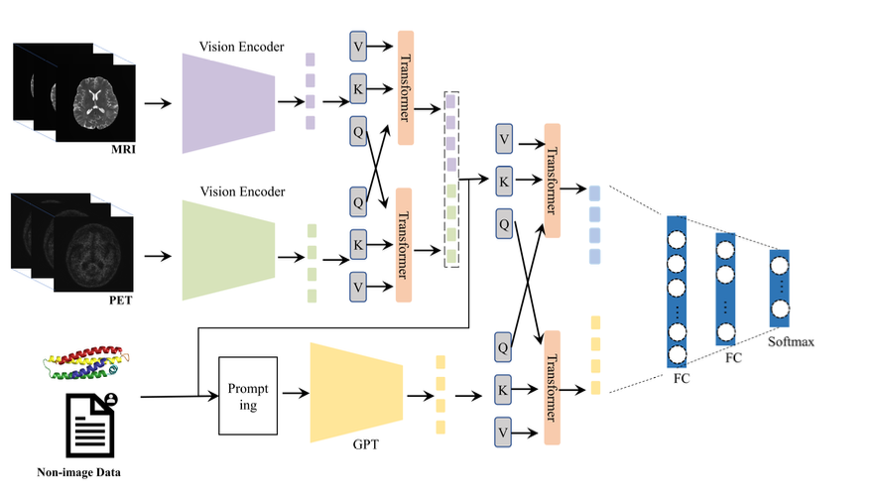
Model architecture
Feng et al., 2023

Slide 16
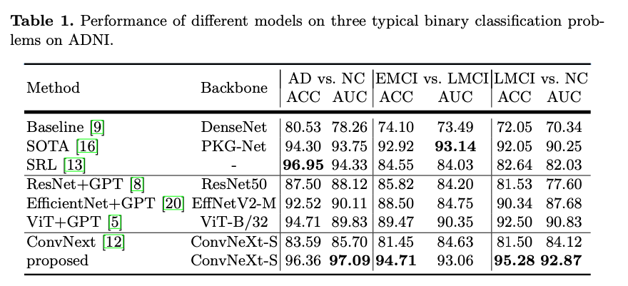
Results
Evaluate model using Alzheimer’s Disease Neuroimaging Initiative (ADNI) dataset
New model improves upon current SOTA model and previous paper on multiple tasks
AD (Alzheimer’s disease) vs NC (normal control)
EMCI (Early Mild Cognitive Impairment) vs LMCI (Late Mild Cognitive Impairment)
LMCI vs NC
Feng et al., 2023
Notes:
EMCI: Early Mild Cognitive Impairment, LMCI: Late Mild Cognitive Impairment

Slide 17
Utility of ChatGPT in Clinical Practice
Liu et al., 2023

Slide 18

ChatGPT in hospitals?
Prompt: What is the diagnosis given these symptoms: Hallucinations, Agitation and physical struggles, Cyanosis (turning blue), Rapid heart rate (tachycardia), Severe thirst, Abdominal pain and rectal bleeding, Outbursts of rage
ChatGPT: Lead poisoning
Prompt: Differential diagnosis?
ChatGPT: 1. Lead Poisoning, 2. Diabetic Ketoacidosis (DKA), 3. Carbon Monoxide Poisoning, 4. Methanol or Ethylene Glycol Poisoning, 5. Severe Acute Pancreatitis, 6. Pheochromocytoma (Adrenal Tumor)
Liu et al., 2023

Slide 19
ChatGPT in clinical decision support
Differential-diagnosis lists: Given 30 clinical case studies, ChatGPT-3 and physicians were asked to generate 5 possible diagnoses, ranked.
Correct diagnosis in top 5 list: ChatGPT (83.3%), Physicians (98.3%)
Correct top diagnosis: ChatGPT (53.3%), Physicians (93.3%)
Clinical decision-making: Given 36 clinical cases, ChatGPT-3.5 made a final diagnosis with an accuracy of 76.9%
Given more clinical information (diagnostic testing), accuracy improved.
Liu et al., 2023

Slide 20
ChatGPT in clinical decision support
Breast cancer screening: ChatGPT-3.5 achieved a score of 1.83 out of 2, in comparison with the American College of Radiology appropriateness criteria.
Often recommends imaging even when unnecessary
May hallucinate reasoning
Shows promise for helping physicians with radiologic decision-making for standardized cases
Optimizing CDS: ChatGPT-3.5 and physicians generated 36 and 29 suggestions, respectively, for CDS alerts (e.g., drug interactions, preventative care). Out of top 20, 9 were ChatGPT
Direct acceptability was lower, but overall useful and relevant
Could serve as complementary tool for physicians
Liu et al., 2023

Slide 21
ChatGPT in answering medical questions
Can ChatGPT provide information about diseases?
Benefits: help doctors and patients, triage, screening, training healthcare workers
Retinal diseases: how accurate was ChatGPT?
100 responses: 45 very good, 26 minor inaccuracies, 17 misinterpreted inaccuracies, 12 potentially harmful errors
Obstetrics and gynecology: ChatGPT showed useful preliminary information
Training data not easily updatable
Hepatic disease: ChatGPT answered ~75-80% of questions correctly, but only ~40-50% of answers were comprehensive
Better for basic knowledge and treatment than diagnosis and prevention
Liu et al., 2023

Slide 22
ChatGPT in writing medical documents
Writing medical documents is a time-consuming and error-prone process
ChatGPT can assist by providing templates or proofreading
Patient letters: ChatGPT scored 7/10 on correctness and 7/10 on “humanness”
Could reduce workload by having clinicians fix generated letters as opposed to writing from scratch
Radiology reports: ChatGPT asked to simplify existing radiology reports
75% of reports were rated as accurate
Patients already put their reports into ChatGPT
Suggestion: ChatGPT simplifies report, clinician reviews, then sent to patient
Liu et al., 2023

Slide 23
ChatGPT in writing medical documents
Medical notes: ChatGPT was asked to generate medical notes from ICU data (treatment history, lab results, etc.)
Strengths: organized notes accurately, understood abbreviations, revise notes after feedback
Weaknesses: issues with causal reasoning, lack of contextual understanding
Liu et al., 2023

Slide 24
Future of ChatGPT in clinical settings
Real time monitoring: continuously interpret patient data (vital signs, lab results)
Allows for risk assessment and predictive analytics that aid in prevention and timely intervention
Precision medicine: analyze patient-specific data to predict individual response to therapies
Develop models that integrate large amounts of genomic and clinical data
Telemedicine: facilitate virtual appointments by providing virtual assistance and remote guidance
Integration: add ChatGPT to existing clinical workflow, not just in research settings
Liu et al., 2023

Slide 25
Potential issues with ChatGPT in clinical practice
Hallucinations could be disastrous
Biases in training data could be reproduced by ChatGPT
Human review process is critical
Security measures to protect patient data
Encryption, access control, privacy regulations
Lacks ability to comprehend complex relationships
Training data may be outdated and not reflect the latest standards of care
Liu et al., 2023

Slide 26
References
Scheltens, P., De Strooper, B., Kivipelto, M., Holstege, H., Chételat, G., Teunissen, C. E., Cummings, J., & van der Flier, W. M. (2021). Alzheimer’s disease. Lancet (London, England), 397(10284), 1577–1590. https://doi.org/10.1016/S0140-6736(20)32205-4
Dhinagar NJ, Thomopoulos SI, Laltoo E, Thompson PM. Efficiently training vision transformers on structural MRI scans for Alzheimer’s disease detection. Annu Int Conf IEEE Eng Med Biol Soc. 2023:1–6. doi: 10.1109/EMBC40787.2023.10341190
Mubonanyikuzo V, Yan H, Komolafe TE, Zhou L, Wu T, Wang N. Detection of Alzheimer Disease in Neuroimages Using Vision Transformers: Systematic Review and Meta-Analysis. J Med Internet Res. 2025;27:e62647. doi: 10.2196/62647
Feng Y, Wang J, Gu X, Xu X, Zhang M. Large language models improve Alzheimer’s disease diagnosis using multi-modality data. arXiv preprint. arXiv:2305.19280. https://arxiv.org/abs/2305.19280
Liu J, Wang C, Liu S. Utility of ChatGPT in Clinical Practice. J Med Internet Res. 2023;25:e48568. doi: 10.2196/48568
Vaswani A, Shazeer N, Parmar N, et al. Attention is all you need. Advances in Neural Information Processing Systems (NeurIPS). 2017. doi: 10.48550/arXiv.1706.03762

